Slide 1
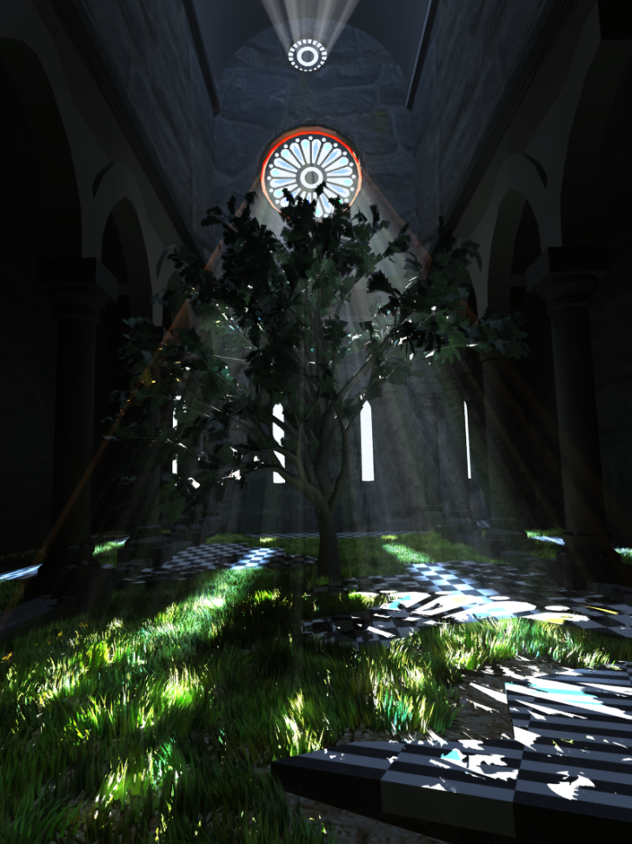
Efficient Real-Time Shadows
Elmar Eisemann (TU Delft)
Ulf Assarsson (Chalmers University)
Nickolay Kasyan (Crytek)
Michael Schwarz
Michael Wimmer (TU Wien)

Slide 2
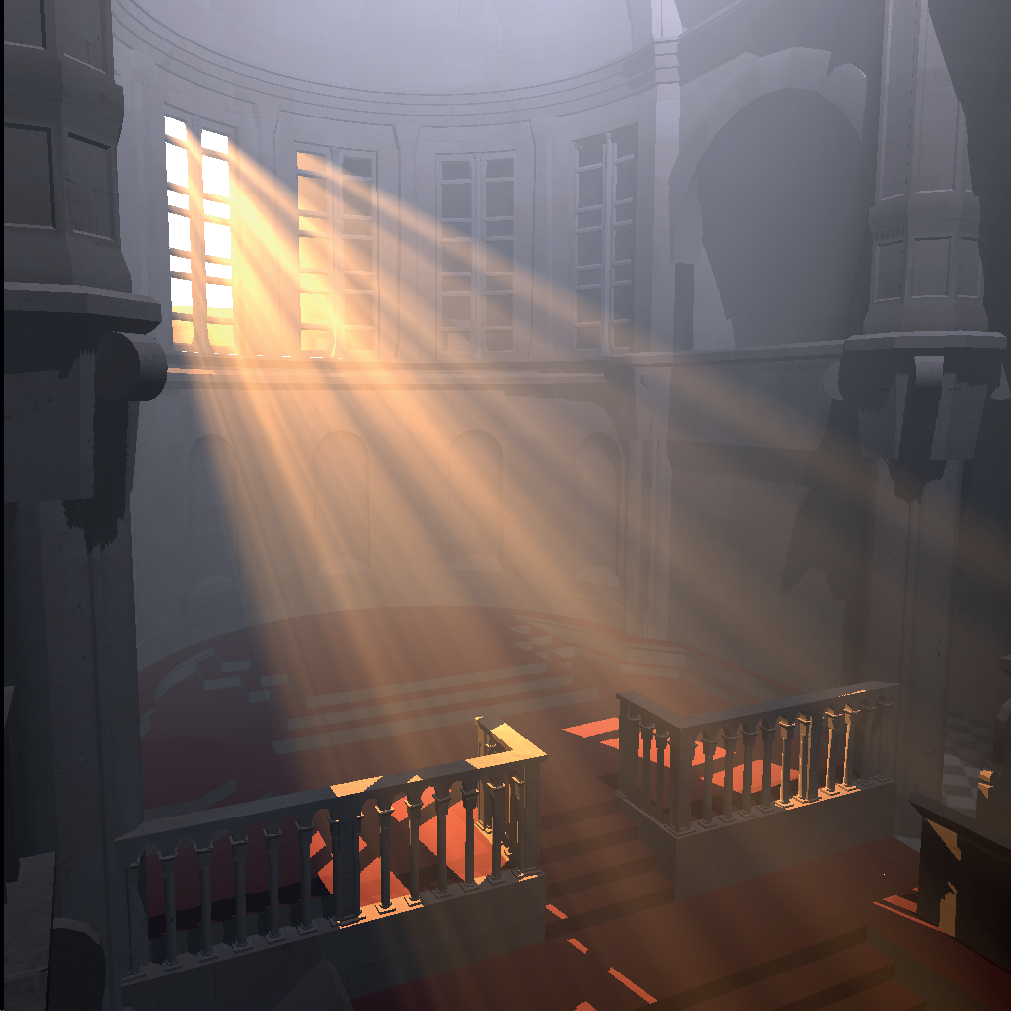
Volumetric Shadows
Ulf Assarsson
(20 minutes)

Slide 3
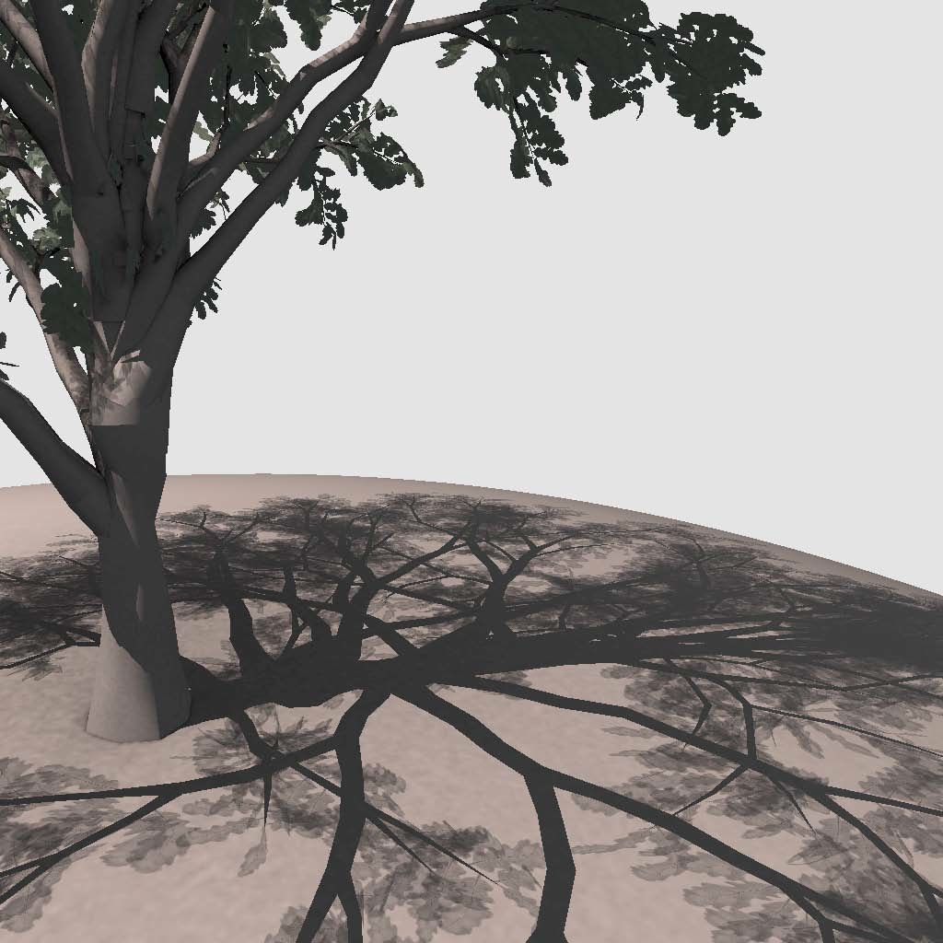
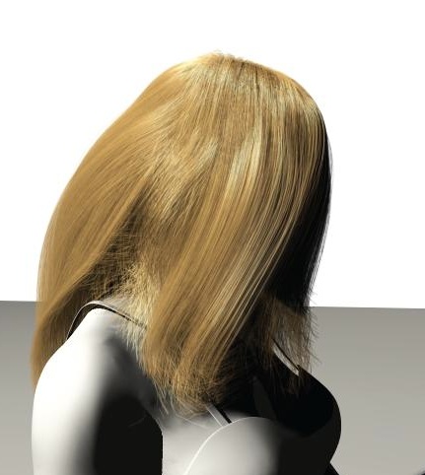
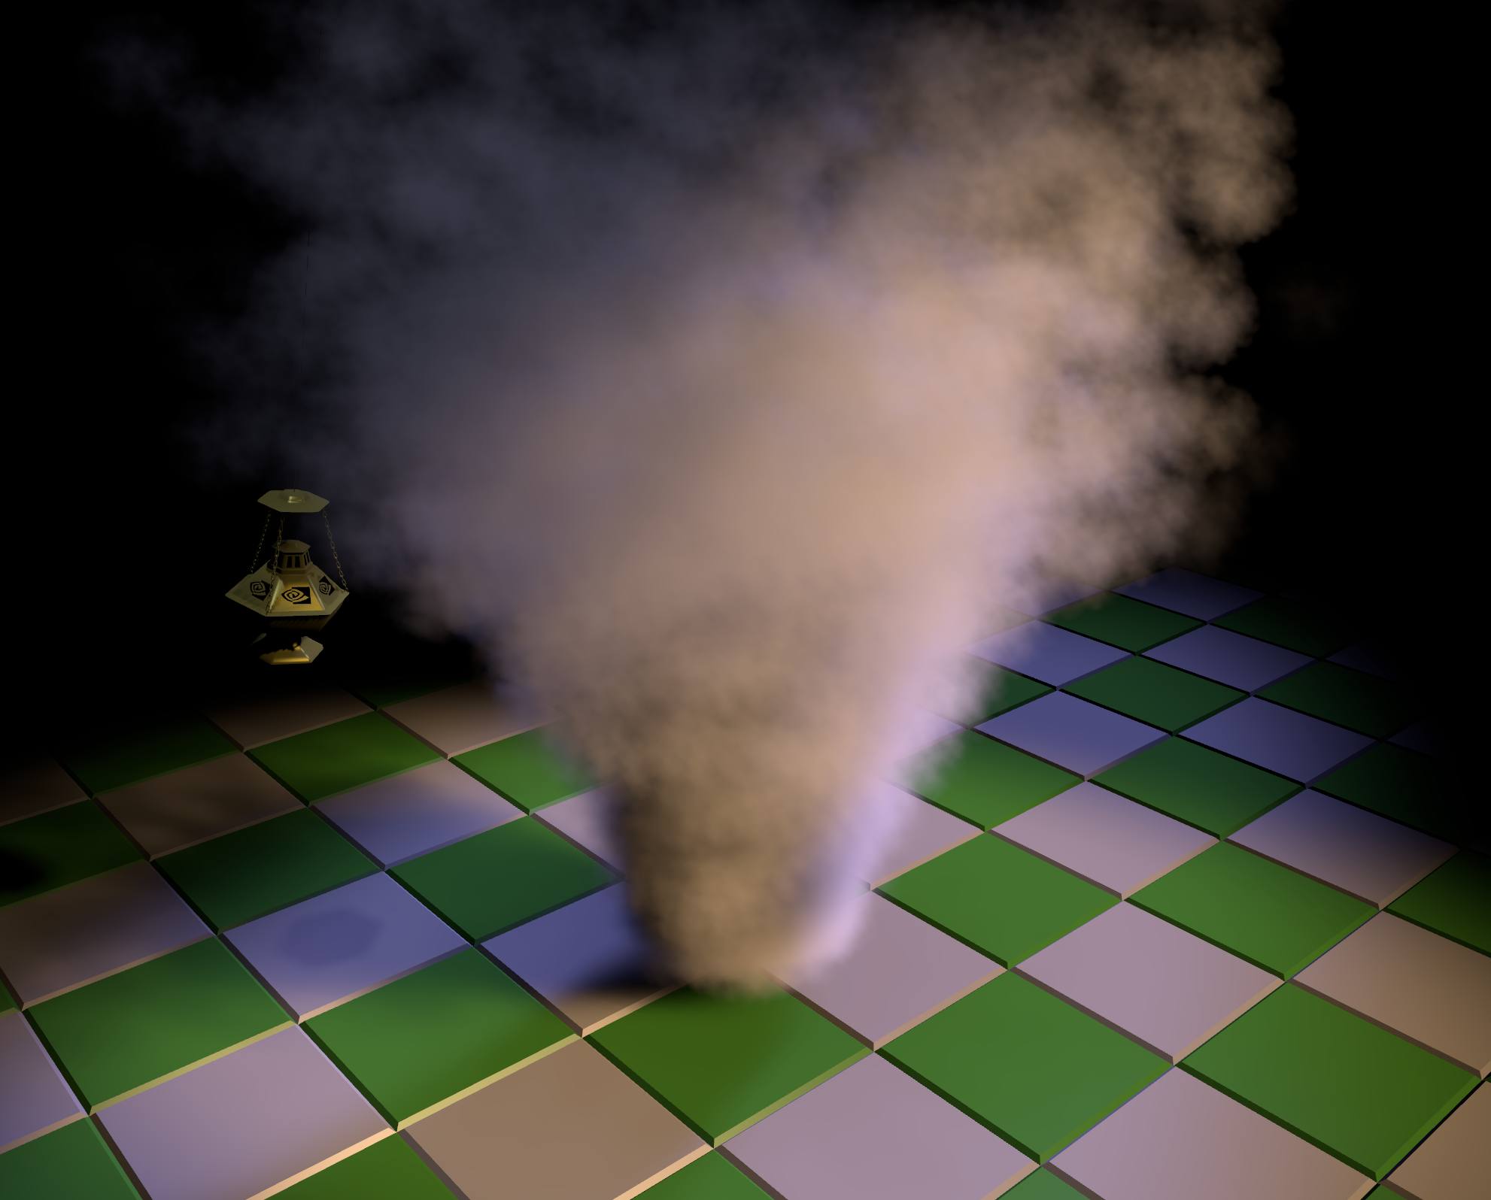
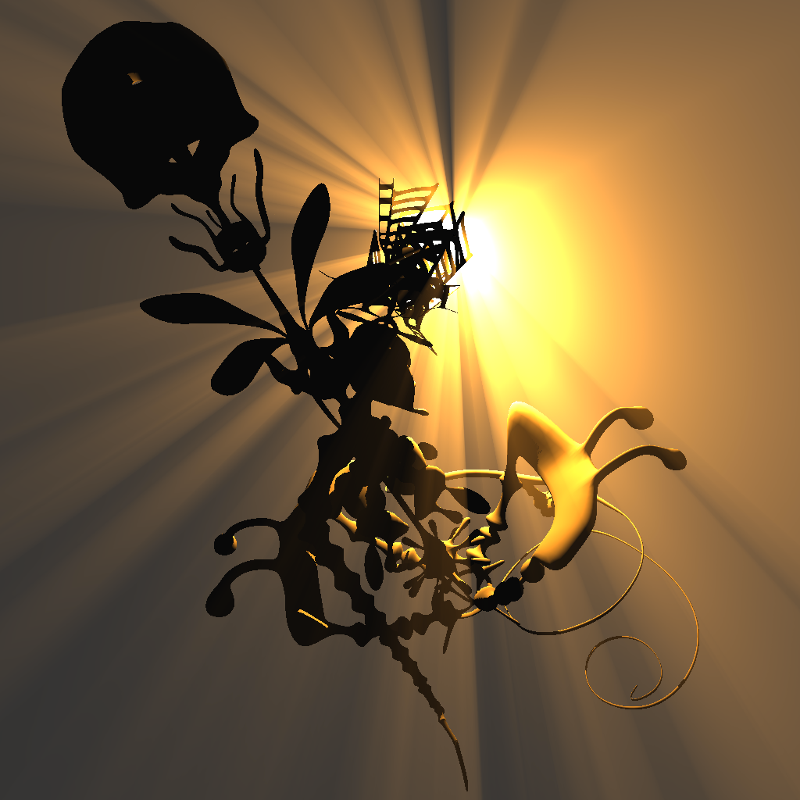
Transparent Media
Transparent solid objects:
  Shadow Volumes:
  constant transparency per object [Kim and Turk ‘08]
  Textured transparency: Per-triangle shadow volumes [Sintorn et al. ‘11]
  Shadow Maps
  Layered Shadow Maps
Hair and Smoke:
  Deep Shadow Maps [Lokovic and Veach 2000]
  Opacity Shadow Maps [Kim and Neumann ‘01]
  Occupancy Maps [Sintorn and Assarsson, ‘09]
  Slice Maps [Dong ‘04, Eisemann ‘06,’08]
  Adaptive Volumetric Shadow Maps [Salvi ’10]
  Fourier Opacity Mapping [Jansen and Bavoil ‘10]
Shadows from scattering in Participating Media
  Real-Time Single Scattering in Homogeneous Participating Media
  Ray-Marching based approaches
  Shadow-Volume based approaches
  Real-Time Multiple Scattering in Homogeneous Participating Media
(“Volumetric Shadows”):
Notes:
Volumetric shadows is a sub-category of shadows in combination with transparent media.
If we have transparent solid objects and want to use shadow volumes, then that works fine if the solid objects have a constant transparency per object.
If we have transparent textured shadow casters, essentially the only option is to use “per-triangle shadow volumes” which currently requires CUDA, OpenCL or compute shaders. I have already described per-Triangle Shadow Volumes in the first part of this course.
For shadow maps, you can simply use alpha-components in the shadow maps and use layered shadow maps.
If we have other types of transparent objects, such as hair, fur, steam, gas, and smoke, then the state-of-the-art algorithms somehow originate from Deep shadow maps.
I will explain those and focus on Adaptive Volumetric Shadow Maps and Fourier Opacity Maps.
If you have a participating media, which not just blocks but also scatters light, then those situations have special solutions, which we will look into in about 5 minutes. Shadows for participating media is what normally is referred to as Volumetric Shadows.

Slide 4
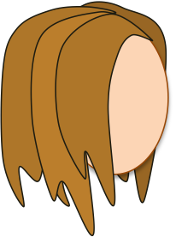
Transparent Media
Deep Shadow Maps [Lokovic and Veach 2000]
Transparent solid objects:
  Shadow Volumes:
  Per object transparency [Kim and Turk ‘08]
  Per-triangle shadow volumes [Sintorn et al. ‘11]
  Shadow Maps
  Layered Shadow Maps
Hair and Smoke:
  Deep Shadow Maps [Lokovic and Veach 2000]
  Opacity Shadow Maps [Kim and Neumann ‘01]
  Occupancy Maps [Sintorn and Assarsson, ‘09]
  Slice Maps [Dong ‘04, Eisemann ‘06,’08]
  Adaptive Volumetric Shadow Maps [Salvi ’10]
  Fourier Opacity Shadow Maps [Jansen and Bavoil ‘10]
Shadows in Participating Media:
  Real-Time Single Scattering in Homogeneous Participating Media
  Ray-Marching based approaches
  Shadow-Volume based approaches
  Real-Time Multiple Scattering in Homogeneous Participating Media
Draw all hair strands from lights viewpoint
Compute and store a visibility function per shadow map pixel.
The visibility function represents how much the shadow increases with distance from light
…and is compressed to a piecewise linear function of depth
visibility
depth
Notes:
Deep Shadow Maps stores a shadow function per texel. In other words, a curve representing how the amount of shadow increases with depth.
Here is an explanation.
This is the light source. This is hair for which we want shadows. This is the deep shadow map.
First, we draw all hair strands from the light’s viewpoint onto the shadow map, in order to compute and store a visibility function per shadow map pixel.
This function represents how much the shadow increases with the distance from the light, and in practice it is compressed to a piecewise linear function of the depth.
… The major problem is how to represent this visibility function per pixel in a fixed amount of points and how to compress it, because a varying number of elements per pixel is complicated or slow to store in render targets and texture buffers.
We will look at two different approaches – Adaptive volumetric shadow maps, and Fourier Opacity Mapping. Adaptive volumetric shadow maps elegantly solves how to compress the curve in real-time, that is, keep the number of elements per pixel limited while still maintaining a good representative function.
Fourier Opacity Mapping, on the other hand, elegantly avoids the need for any order dependency or depth sorting while creating or using the shadow map.

Slide 5
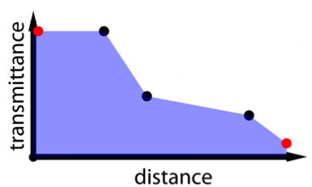
Shadows from semi-transparent objects
Adaptive Volumetric Shadow Maps
Algorithm:
Create the AVSM:
Render blockers in light space into per pixel linked lists of [depth/transmittance]
  Each pixel stores a transmittance function
The first and last control points are always kept
Notes:
Now, the trick of Adaptive Volumetric Shadow Maps is to keep the number of control points in the function at a fixed maximum.
To create the adaptive volumetric shadow map, we render the shadow casters onto the shadow map, just like for deep shadow maps, but into linked lists of control points storing the fragment’s [depth and transmittance].
Each pixel has room for a fixed number of control points.
Here is the visibility function per shadow map pixel:
The first and last control point are always kept.
The function is assumed to be linear between the control points.

Slide 6
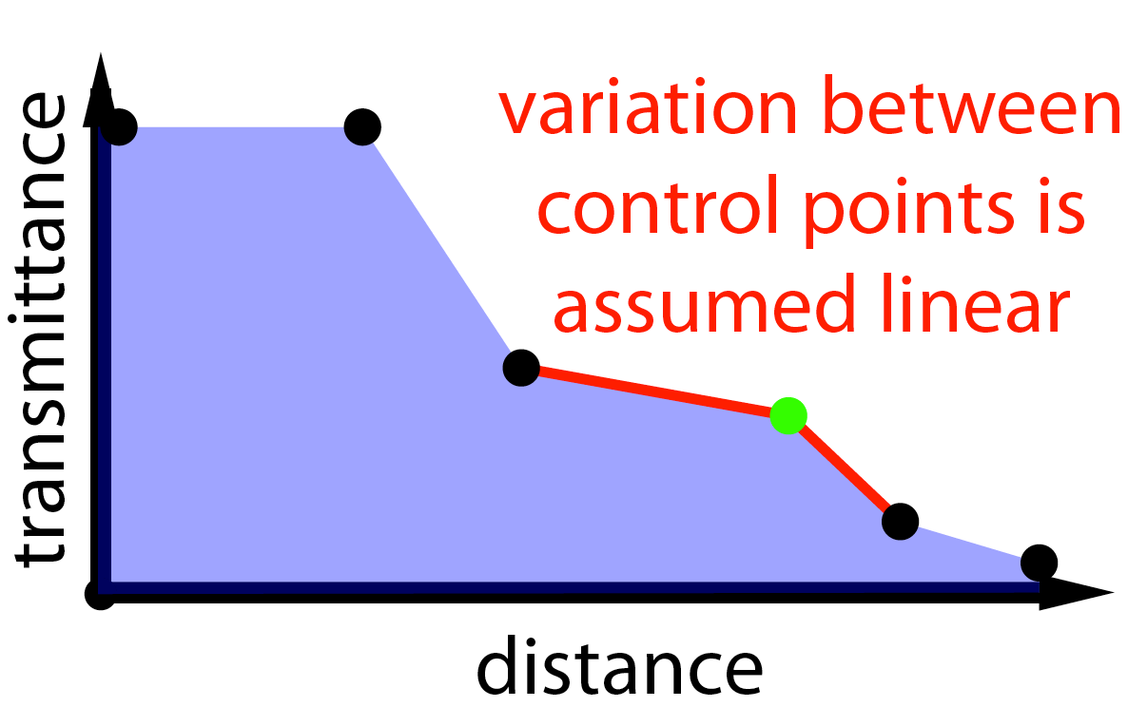
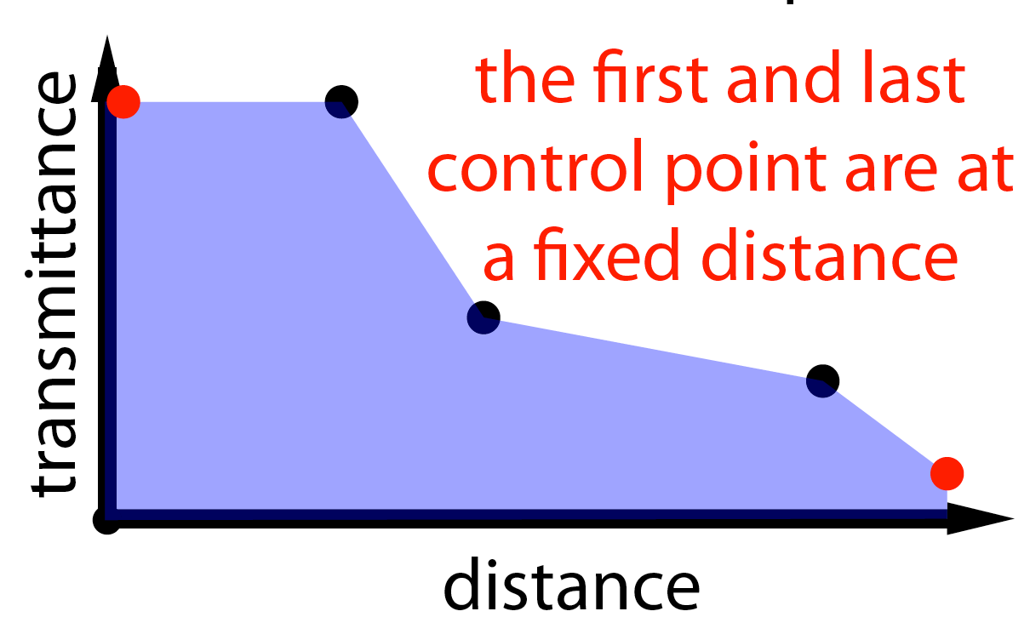
Shadows from semi-transparent objects
Adaptive Volumetric Shadow Maps
Algorithm:
Create the AVSM:
Render blockers in light space into per pixel linked lists of [depth/transmittance]
  Each pixel stores a transmittance function
Notes:
When we get one control point too much, we remove the point whose triangle has the minimum area.

Slide 7
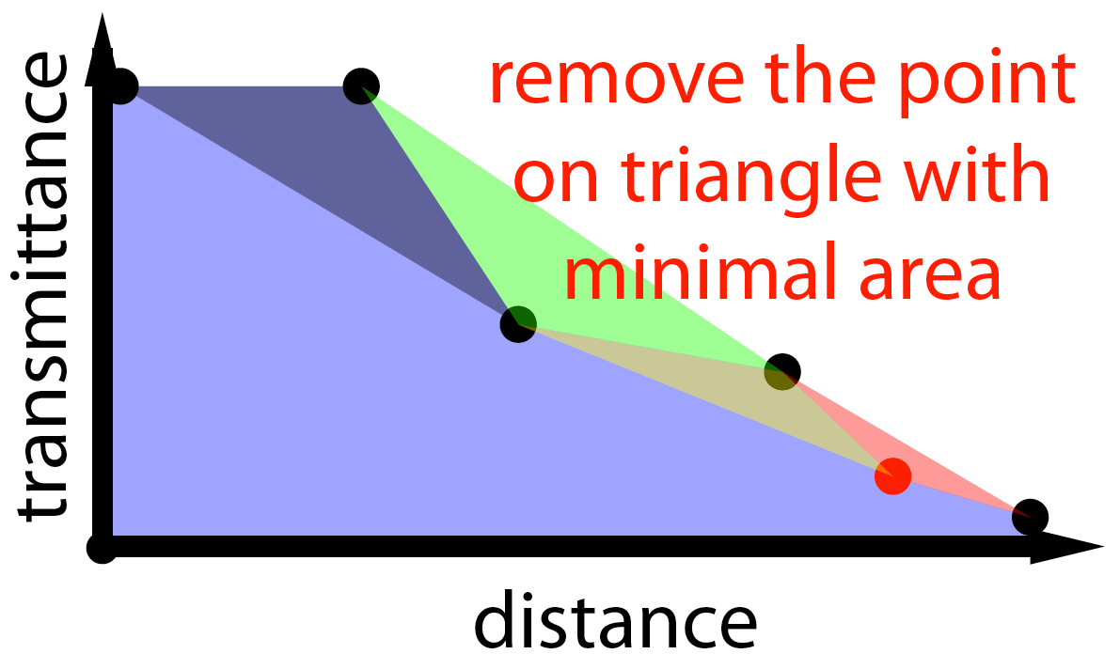
Shadows from semi-transparent objects
Adaptive Volumetric Shadow Maps
Algorithm:
Create the AVSM:
Render blockers in light space into per
pixel linked lists of [depth/transmittance]
  Each pixel stores a transmittance function
  Trick – reduce to store max n values per pixel
Using the AVSM
  Render shadow receiving objects.
    For each pixel,
      lookup shadow value from the AVSM.
Notes:
The function is assumed to be linear between the control points.
When we get one control point too much, we remove the point whose triangle has the minimum area.
Thus, the control point affecting the curve least, is discarded.
In other words, we form triangles between each three control points, and remove the control point who is the middle vertex of the smallest triangle.
All this is just a heuristic to nicely keep a fixed number of control points while maintaining a reasonably good visibility function.
Then, during rendering of shadow receiving objects, we do as usual… for each potentially shadow receiving pixel, we just lookup the shadow value from the Adaptive Volumetric Shadow Map.

Slide 8
Shadows from semi-transparent objects
Fourier Opacity Mapping
Transmittance function represented as linear combination of basis function coefficients (sine/cosine of Fourier transforms).
Recall Fourier series
Projection of function onto the basis functions:
Reconstruction of the function:
Creation of FOM:
For each shadow casting primitive
  For each rasterized fragment, the shader writes
  (using multiple textures):
visibility
depth
where:
z is depth,
k is coefficient [0,1,...n]
α is opacity
Notes:
Here, the transmittance function is represented as a linear combination of basis function coefficients from fourier transforms.
Let’s recall Fourier series. We can project any function, such as the visibility function onto the cosine and sine basis functions of the Fourier Transform.
Then, we can reconstruct our original visibility function f(t) from all the a and b coefficients.
For creation of the Fourier Opacity Map, we do as follows.
For each shadow casting primitive, and for each rasterized fragment, the shader writes out, using multiple render targets, the coefficients, a_k and b_k, where z is the fragment’s depth value, alpha is the opacity and k is the coefficient, where we usually use something like 7-15 coefficients.
These vectors a and b are the coefficients of how this shadow casting fragment affects the visibility function.

Slide 9
Shadows from semi-transparent objects
Fourier Opacity Mapping
Transmittance function represented as linear combination of basis function coefficients (sine/cosine of Fourier transforms).
Recall Fourier series
Projection of function onto the basis functions:
Reconstruction of the function:
Creation of FOM:
For each shadow casting primitive
  For each rasterized fragment, the shader writes
  (using multiple textures):
visibility
depth
where:
z is depth,
k is #used_coefficients
α is opacity
Notes:
Lets take a look at the usage of the Fourier Opacity Map.
When it comes to using the Fourier Opacity Map, for each fragment of shadow receiving primitives, the visibility is looked up by reconstructing the visibility function for the pixel, using the coefficient vectors a, and b, which are stored in the pixel. Then, we just compute the value for the fragment’s depth, z.
Now, why on earth would you like to go to Fourier Series to represent your visibility functions?
The key feature is that these sums are order independent. We need no depth sorting at creation (nor usage). So, we don’t need to care which previous created coefficients comes from fragments closer than our z-value or not. We can just create our Opacity Map by rendering shadow casting fragments in any order.
Remember that for for instance Adaptive Volumetric Shadow Maps, we need to insert points in the right place in the visibility function and we need to remove points when we get too many. For Fourier Opacity Maps, we have none of those time consuming issues. We can just add on the contribution from as many fragments as we like, into our maybe 15 representative coefficients.
A disadvantage is that ringing artifacts can be seen if too few coefficients are used, (7-15 coefficients).

Slide 10
Shadows from semi-transparent objects
Fourier Opacity Mapping
Creation of FOM:
For each shadow casting primitive
  For each rasterized fragment, the shader writes
  (using multiple textures):
Usage of FOM:
For each shadow receiving primitive and fragment:
  Visibility is looked up by:
Key feature:
  Sum is order independent, no depth sorting, no limit of #representative fragments in the FOM.
Ringing artifacts if using too few coefficients
where:
z is depth,
k is #used_coefficients
α is opacity
visibility
vis(z)
z
depth
Notes:
Lets take a look at the usage of the Fourier Opacity Map.
When it comes to using the Fourier Opacity Map, for each fragment of shadow receiving primitives, the visibility is looked up by reconstructing the visibility function (click) for the pixel, using the coefficient vectors a, and b, which are stored in the pixel. Then, we just compute the value for the fragment’s depth, z.
Now, why on earth would you like to go to Fourier Series to represent your visibility functions?
(click) The key feature is that these sums are order independent. We need no depth sorting at creation (nor usage). So, we don’t need to care which previous created coefficients comes from fragments closer than our z-value or not. We can just create our Opacity Map by rendering shadow casting fragments in any order.
Remember that for for instance Adaptive Volumetric Shadow Maps, we need to insert points in the right place in the visibility function and we need to remove points when we get too many. For Fourier Opacity Maps, we have none of those time consuming issues. We can just add on the contribution from as many fragments as we like, into our maybe 15 representative coefficients.
A disadvantage is that ringing artifacts can be seen if too few coefficients are used, (7-15 coefficients).

Slide 11
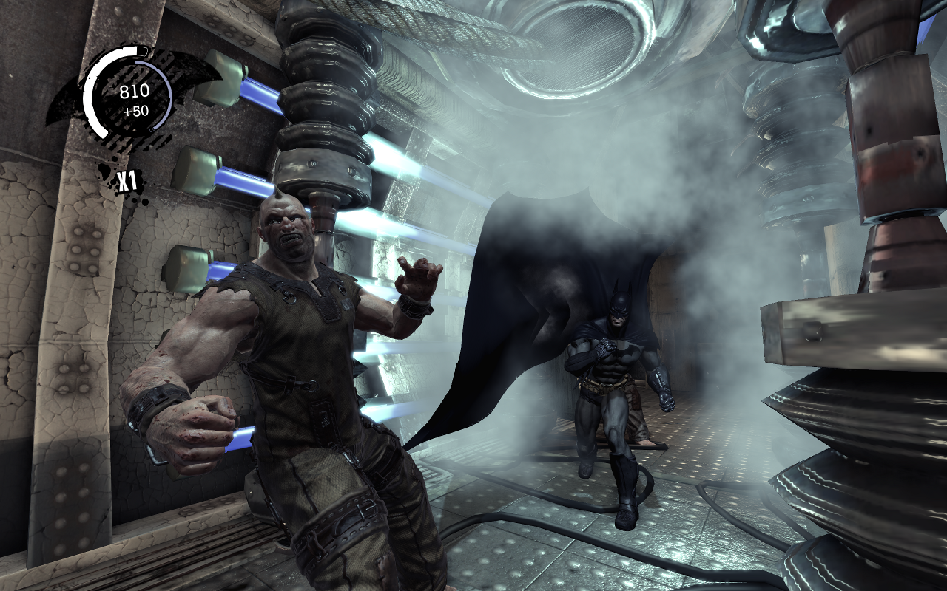
Shadows from semi-transparent objects
Fourier Opacity Mapping
Creation of FOM:
For each shadow casting primitive
  For each rasterized fragment, the shader writes:
  (using multiple textures)
Usage of FOM:
For each shadow receiving primitive:
  Visibility is looked up by:
Key feature: Sum is order independent:
  No depth sorting at creation nor usage
Ringing artifacts if using too few coefficients (7-15 reported)
where:
z is depth,
k is #used_coefficients
α is transparency
Notes:
Has been used in the game: Batman Arkham Asylum.
If smoke is what you want to do, then Jon Jansen and Lous Bavoil right now actually recommend their latest method, called Particle Shadow Mapping, which they presented at GDC this spring.

Slide 12
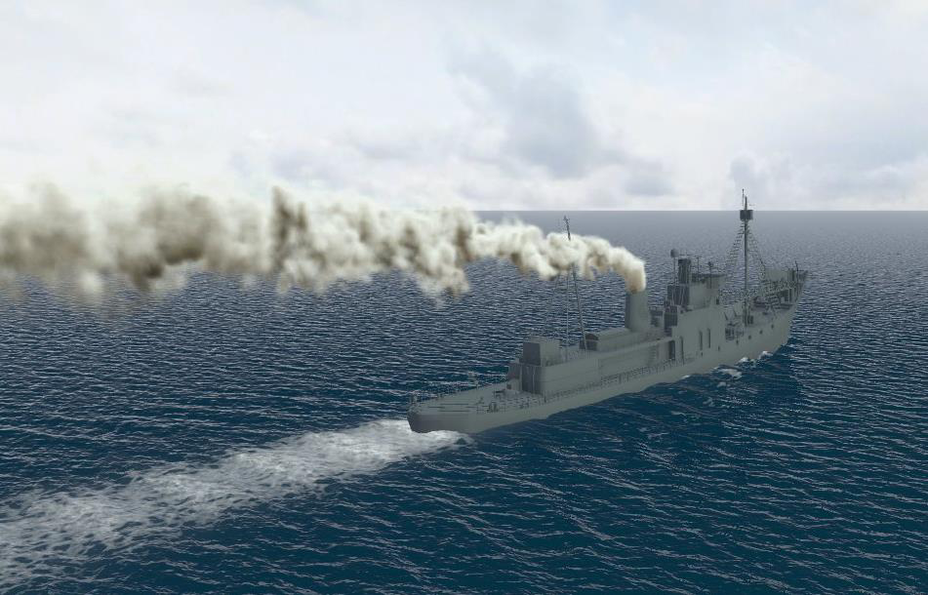
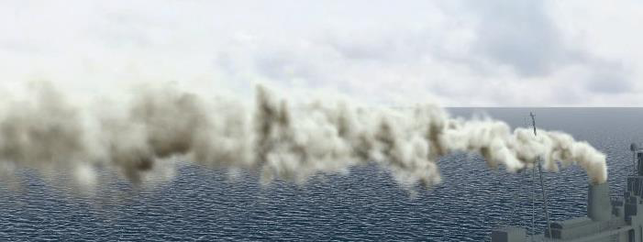
Shadows from semi-transparent objects
Particle Shadow Mapping
Particle Shadow Mapping
  by Jansen and Bavoil, GDC March 2013
    Using SV_RenderTargetArrayIndex
visibility
depth
1
2
3
4
Render target layer
Notes:
If smoke is what you want to do, then Jansen and Bavoil right now actually recommend their latest method, called Particle Shadow Mapping, which they presented at GDC this spring.
Particle shadow mapping is faster and typically gives a higher quality than Fourier Opacity Mapping. But, it only works for particles.
Here is the shadow map, and (click) here is the visibility function for a texel.
Billboards are rendered directly to a 3D texture storing their alpha values. This is done by using an array of render targets and having the geometry shader compute which layer to render the particle billboard into.
Then, the decrease of visibility (click) is propagated from the first to the last layer, to give the visibility function per texel.
And we can easily have something like 64-128 layers if we use the rgba-channels and also store as bytes into 32-bit per channel buffers.

Slide 13
Shadows from semi-transparent objects
Particle Shadow Mapping
Video:
  http://www.youtube.com/watch?v=XUSYbco0zIg
Notes:
: http://www.youtube.com/watch?v=XUSYbco0zIg

Slide 14
Scattering in Participating Media
Shadows from scattering in Participating Media:
Real-Time Single Scattering in Homogeneous Participating Media
  Ray-Marching based approaches
  Shadow-Volume based approaches
Real-Time Multiple Scattering in Homogeneous Participating Media
Area lights
  “Imperfect Voxelized Shadow Volumes”, Wyman, HPG. 2013.
Heterogeneous Participating Media
  “Illuminating and rendering heterogeneous participating media in
  real time using opacity propagation”, Giroud and Biri, 2011.
Notes:
I will now go into shadows in connection with light scattering in participating media.
There are a number of classes of algorithms for light scattering in participating media:
We have Real-time single scattering in homogeneous participating media. Here we find ray-marching based approaches and shadow-volume based approaches.
Then, we have Real-time multiple scattering in homogeneous participating media.
If you want to do single scattering for area lights, Chris Wyman presented that three days ago at HPG and also two days ago here at Siggraph.
And for heterogeneous participating media, there is this paper.
I will focus today on single and multiple scattering in homogeneous media for point-light sources.

Slide 15
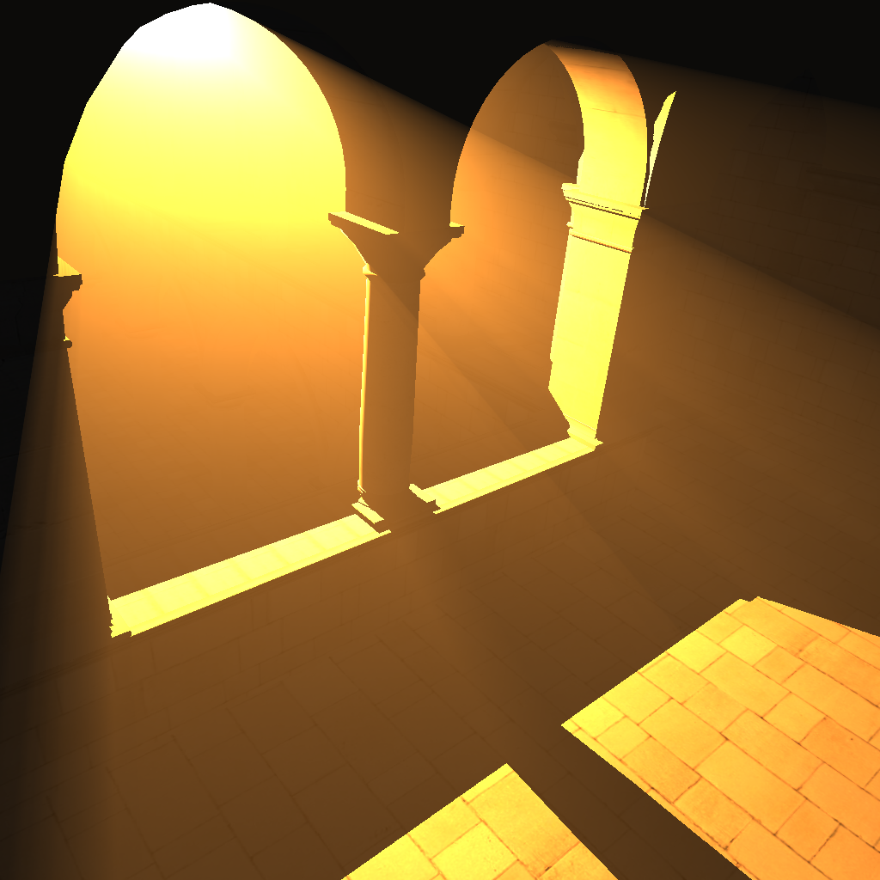
Scattering in Participating Media
Participating media scatter light
  “Photons bounce off particles in the medium”
Some scattered light reaches the observer (most doesn’t)
Thus, we can see the participating medium
Notes:
In reality, the world around us is filled with participating media, e.g., air with dust, fog, clouds and smoke. The word participating media means that the medium interacts with the light traversal.
Light is scattered, which means that “Photons bounce off particles in the medium”. The light rays will bounce around in the medium and some amount of it will eventually reach the eye. In other words, some scattered light reaches the observer (most doesn’t). This means that the observer will see the participating medium.

Slide 16
Scattering in Participating Media
Single Scattering [Blinn 82]:
In scattering
  Visible image contribution
Out scattering
  Attenuation
Absorption
  Attenuation
Out scattering
In scattering
Notes:
In the single-scattering model, (click) light travels from the light position and eventually in-scatters towards the eye at a small particle. And on its way from the light source to the point of inscattering, it attenuates due to out-scattering and absorption. And the same from the point-of-in-scattering to the eye.

Slide 17


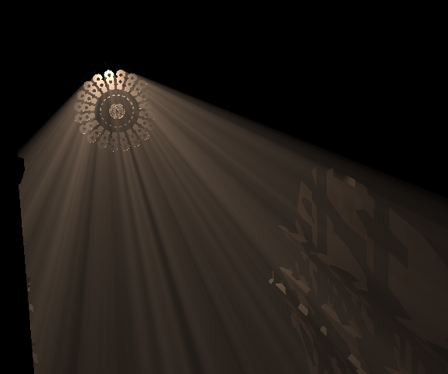

Scattering in Participating Media
Blockers cause airlight shadows
  Only in scattering along non-shadowed regions of eye ray for single scattering
Notes:
If we have objects, or blockers, casting regular shadows, then they also cause airlight shadows.
The reason is that light can only in-scatter at non-shadowed regions (click), and this means that we can see these nice light streaks or shadow streaks, here in this image.

Slide 18
Scattering in Participating Media
Blockers cause airlight shadows
  Only in scattering along non-shadowed regions of eye ray for single scattering
At surface shading:
→ attenuate the light prop. to distance to light source
Scene object
Notes:
When shading a fragment (click), the only difference is that we have to add attenuation of the light intensity proportional to the distance between the light source and the surface point. And this attenuation is due to out-scattering and absorption.

Slide 19
Scattering in Participating Media
Multiple Scattering:
  In reality, photons can bounce many times before in scattering
  In scattering happens also in shadowed regions.
Notes:
Now, for the multiple scattering model, on the other hand, we consider the fact that, in reality, photons can bounce around many times before they in-scatter.
And as you can see here, photons can actually in-scatter in the shadowed regions of the view rays.
So, being able to do this is quite new and still very approximate, but I will mention one method at the end.

Slide 20
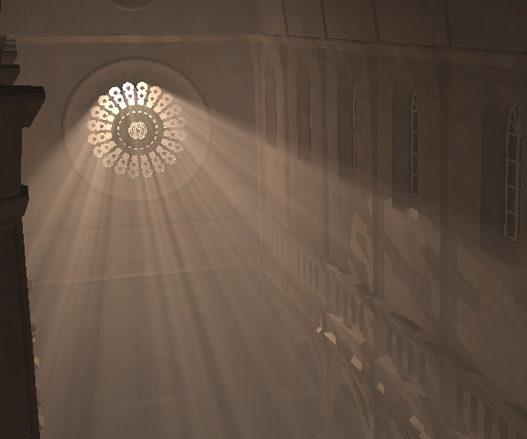
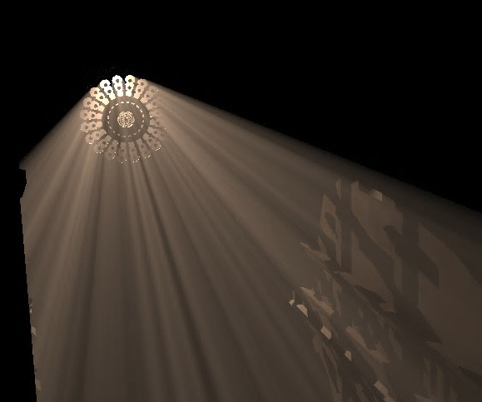
Scattering in Participating Media
Multiple scattering
Single scattering
Notes:
Here is a side-by-side comparison between single scattering and multiple scattering.
And as you see, the participating medium is visible also in the shadowed regions, for multiple scattering,
which it is not, here, for single scattering.

Slide 21
Scattering in Participating Media
At surface shading:
→ consider incoming light for full hemisphere
Multiple Scattering:
  In reality, photons can bounce many times before in scattering
  In scattering happens also in shadowed regions.
  Surface shading should consider not only one light direction but all incoming non-shadowed directions
Scene object
Notes:
And for the multiple scattering model, if we are shading a surface point, then we should actually consider the full hemisphere of possible incoming light directions.

Slide 22
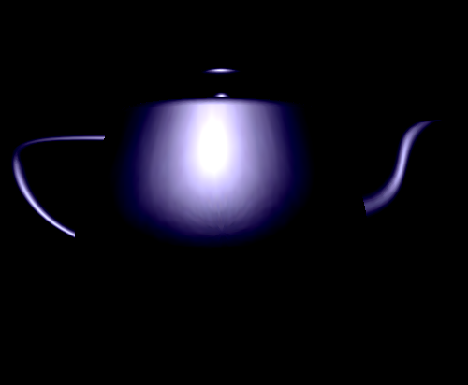
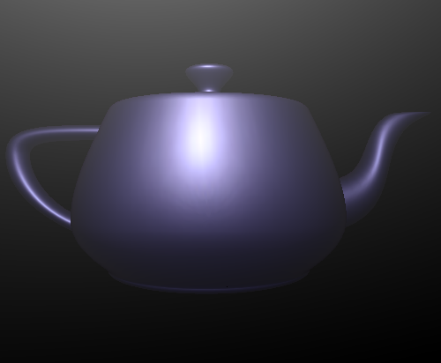
Scattering in Participating Media
At surface shading:
→ consider incoming light for full hemisphere
Multiple Scattering:
  In reality, photons can bounce many times before in scattering
  In scattering happens also in shadowed regions.
  Surface shading should consider not only one light direction but all incoming non-shadowed directions
One incoming direction
Multiple Scattering
Images from Bo Sun et al.
Scene object
Notes:
And here is a side-by-side comparison with the lighting for one incoming direction (which is the standard), and for considering the full hemisphere. And as you see, there is a quite important difference.

Slide 23
Scattering in Participating Media
Non-homogeneous media
  Smoke and clouds instead of homogeneous fog
  With single scattering or with multiple scattering
  Consider in-scattering only at parts of eye ray inside the medium
Scene object
Notes:
For a scene with a non-homogeneous medium (such as for clouds or smoke), we should only consider in-scattering for the parts of the ray (click) that are inside the participating medium, and that is typically quite time consuming for real-time purposes.

Slide 24
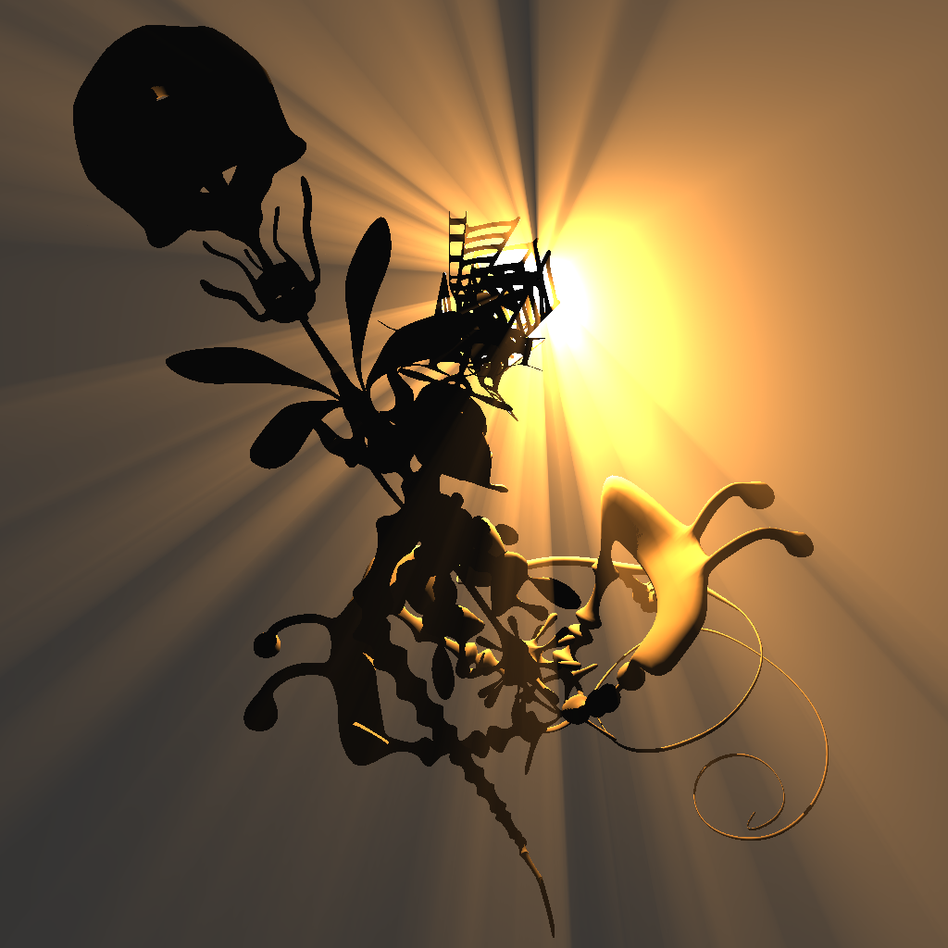
Scattering in Participating Media
If medium has low albedo
  I.e., few small particles such as
    dust, thin fog
Then, single scattering is the dominating effect.
  Let us first focus on this simplest case for real-time purposes:
    single scattering in homogeneous participating media.
Notes:
If our medium has a low albedo, which means that there is a low optical thickness or optical depth, where the particles are small and few, such as for dust and thin fog,
then the single scattering dominates over the secondary scattering.
And this gives us a reason to focus on this more simple case – the single scattering as opposed to multiple scattering.
I will now talk about single scattering in homogeneous participating media. And for that, we have the ray-marching-based approaches and shadow-volume based approaches.

Slide 25
Ray-Marching Based Single Scattering
Pseudo code:
For every pixel in screen space (A)
  Step along the eye ray, using ray marching
  For each sample position x_{j}
    Check in shadow map (B) if light source is visible
    If so, add to pixel’s color:
      in-scattered light contribution with attenuation
p
Notes:
So, here is the pseudo code for all ray-marching based approaches.

Slide 26
Ray-Marching Based Single Scattering
Ray-marching: at each point, determine if lit (shadow map)
Done with:
  CUDA (Baran et al. 2010)
  Loop in fragment shader (e.g.,
  Toth and Umenhoffer 2009,
  Chen et al. 2011)
  Alpha-blended planes (Dobashi
  et. al. 2002, Imagire et. al. 2007)
  CPU (Kajiya and Von Herzen 1984)
p
Notes:
Fixed pipeline
Transition: To speedup the ray marching, we can utilize coherency.

Slide 27
Ray-Marching Based Single Scattering
Utilize coherency (Baran et al. 2010)
  Compute ray incrementally from previous ray in same plane as the ray, light and eye
    Only new shadowed regions can appear (not new lit regions)
Notes:
Baran et al. accelerate the ray marching by realizing that we can compute the result of a ray incrementally, from a previous ray, that lies above and in the same plane as the new ray and the light and the eye. Only new shadowed regions can appear (not new lit regions) as we move to lower eye-rays in this plane.
Let’s look at these coherency planes and their intersections with the shadow-map plane and the view plane.

Slide 28
Ray-Marching Based Single Scattering
On shadow map rendering
  Skew projection such that these epipolar coherent planes become rows of the SM (Chen et al. 2011)
Notes:
Let’s look at these coherency planes’ intersections with the shadow map-plane and the view plane.
Observe that the intersections of these coherent planes are non-parallel lines in the shadow-map plane and the image plane.
What we do, is that we skew the shadow map projection so that these epipolar planes are in line with the shadow map rows.
So, the shadow map is now rectified.Ray marching along a view ray now becomes a traversal along one shadow map row

Slide 29
Ray-Marching Based Single Scattering
On shadow map rendering
  Skew projection such that these epipolar coherent planes become rows of the SM (Chen et al. 2011)

Slide 30
Ray-Marching Based Single Scattering
On shadow map rendering
  Skew projection such that these epipolar coherent planes become rows of the SM (Chen et al. 2011)

Slide 31
Ray-Marching Based Single Scattering
On shadow map rendering
  Skew projection such that these epipolar coherent planes become rows of the SM (Chen et al. 2011)
Notes:
Let’s look at these coherency planes’ intersections with the shadow map-plane and the view plane.
Observe that the intersections of these coherent planes are non-parallel lines in the shadow-map plane and the image plane (4xclick).
((click) What we do, is that we skew the shadow map projection so that these epipolar planes are in line with the shadow map rows.
So, the shadow map is now rectified.
(click) Ray marching along a view ray now becomes a traversal along one shadow map row

Slide 32
Ray-Marching Based Single Scattering
On shadow map rendering
  Skew projection such that these epipolar coherent planes become rows of the SM (Chen et al. 2011)

Slide 33
Ray-Marching Based Single Scattering
On shadow map rendering
  Skew projection such that these epipolar coherent planes become rows of the SM (Chen et al. 2011)

Slide 34
Ray-Marching Based Single Scattering
On shadow map rendering
  Skew projection such that these epipolar coherent planes become rows of the SM (Chen et al. 2011)
Raymarching along view ray becomes traversal along SM row
Notes:
Let’s look at these coherency planes’ intersections with the shadow map-plane and the view plane.
Observe that the intersections of these coherent planes are non-parallel lines in the shadow-map plane and the image plane.
What we do, is that we skew the shadow map projection so that these epipolar planes are in line with the shadow map rows.
So, the shadow map is now rectified.Ray marching along a view ray now becomes a traversal along one shadow map row

Slide 35
Ray-Marching Based Single Scattering
Shadow map is a height field
For each shadow map row (Chen et al.):
  a 1D min-max mipmap is computed
Notes:
Remember that a shadow map can be seen as a height field.
So, Chen et al computes a 1D min-max mipmap per shadow map row…
nd on ray marching, they don’t have to traverse each individual texel along the row, but can actually skip larger segments thanks to the hierarchy.
So, the traversal time becomes logarithmic instead of linear, which makes it suitable for real time.

Slide 36
Ray-Marching Based Single Scattering
Shadow map is a height field
For each shadow map row (Chen et al.):
  a 1D min-max mipmap is computed
Min/max
Min/max
Min/max
Min/max
Min/max
Min/max
Min/max

Slide 37
Ray-Marching Based Single Scattering
Shadow map is a height field
For each shadow map row (Chen et al.):
  a 1D min-max mipmap is computed
Min/max
Min/max
Min/max
Min/max
Min/max
Min/max
Min/max

Slide 38
Ray-Marching Based Single Scattering
Shadow map is a height field
For each shadow map row (Chen et al.):
  a 1D min-max mipmap is computed
Min/max
Min/max
Min/max
Min/max
Min/max
Min/max
Min/max
Notes:
Remember that a shadow map can be seen as a height field.
So, Chen et al computes a 1D min-max mipmap per shadow map row…
nd on ray marching, they don’t have to traverse each individual texel along the row, but can actually skip larger segments thanks to the hierarchy.
So, the traversal time becomes logarithmic instead of linear, which makes it suitable for real time.

Slide 39
Ray-Marching Based Single Scattering
Shadow map is a height field
For each shadow map row (Chen et al.):
  a 1D min-max mipmap is computed
  Logarithmic search time
    Algorithm O(#pixels * log d)
      d=sqrt(shadow_map_resolution)
    Real-time
Min/max
Min/max
Min/max
Min/max
Min/max
Min/max
Min/max
Notes:
So, the traversal time becomes logarithmic instead of linear, which makes it suitable for real time.

Slide 40
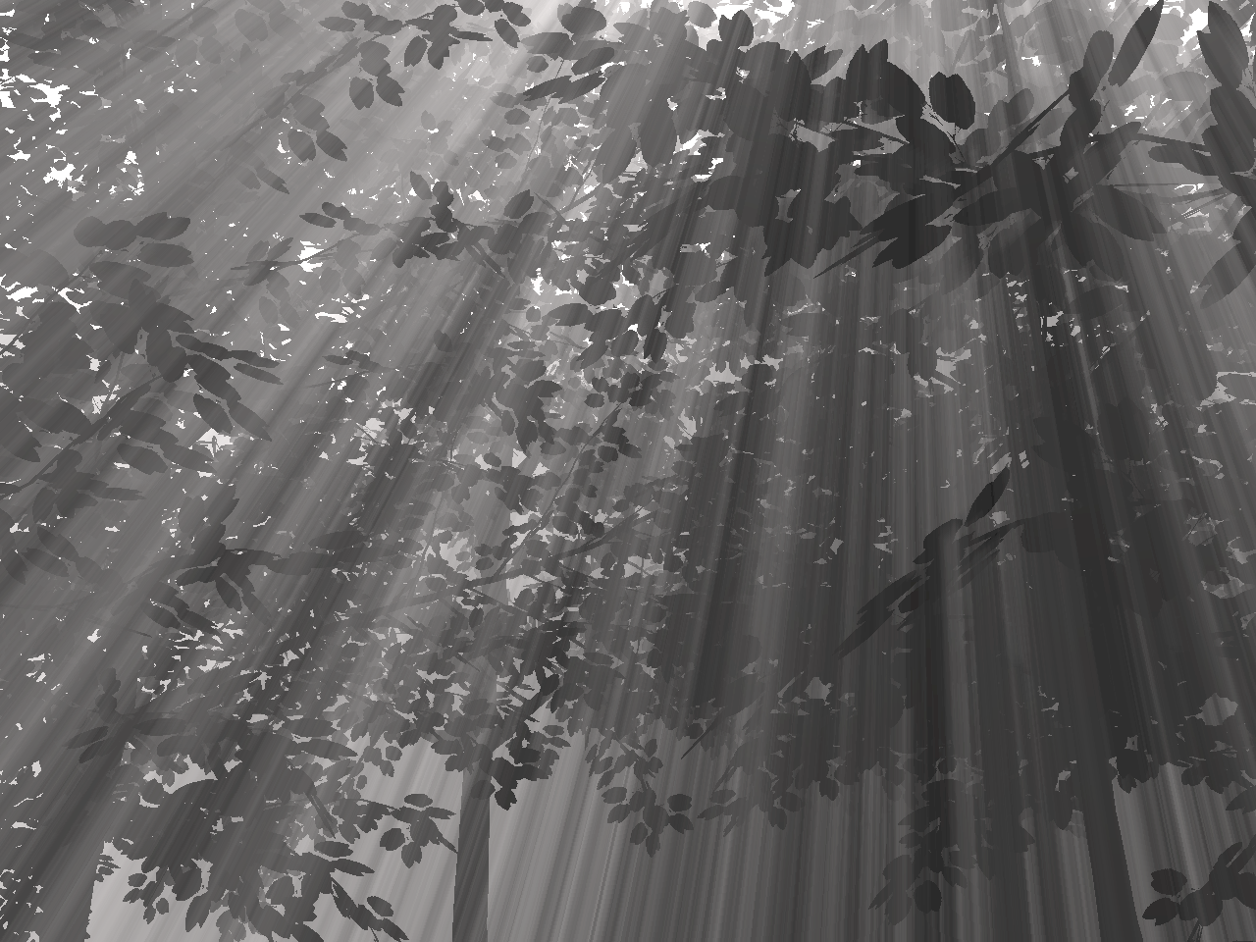
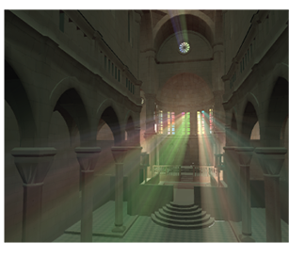
Ray-Marching Based Single Scattering
Shadow map is a height field
For each shadow map row (Chen et al.):
  a 1D min-max mipmap is computed
  Logarithmic search time
    Algorithm O(#pixels * log d)
      d=sqrt(shadow_map_resolution)
    Real-time
Min/max
Min/max
Min/max
55 fps. Image from Chen et al. 2011
Min/max
Min/max
Min/max
Min/max
Notes:
Here are nice light streaks from this foliage, and the algorithm also works for textured lights.

Slide 41
Ray-Marching Based Single Scattering
Wyman 2011:
  CUDA
  Extremely fast
  Voxelizes shadow casters
Notes:
Instead of rectifying into a 2D shadow map, Wyman voxelizes (click) the shadow casting geometry into a rectified bit grid.
And for each column of the bit grid, he then computes a binary prefix sum, which means that each voxel will become a 1 if any of the voxels in the same column and above is set to one.
For each eye-ray, he then uses CUDA to rapidly compute the number of non-shadowed voxels along the visible part of the ray. He can compute the result for 128 bits by using one float texture lookup and four popc instructions.
This is extremely fast.
One slight drawback is that in-scattering should be different at each voxel, which is not covered by the computations.
The in-scattered contribution should be scaled with the voxel’s distances to the light and eye – due to the attenuation.
This could of course be handled, by an added cost.

Slide 42
Ray-Marching Based Single Scattering
Wyman 2011:
  CUDA
  Extremely fast
  Voxelizes shadow casters
    3D bit grid

Slide 43
Ray-Marching Based Single Scattering
Wyman 2011:
  CUDA
  Extremely fast
  Voxelizes shadow casters
    3D bit grid
    For each column
      Binary prefix sum
0
1
1
1
1

Slide 44
Ray-Marching Based Single Scattering
Wyman 2011:
  CUDA
  Extremely fast
  Voxelizes shadow casters
    3D bit grid
    For each column
      Binary prefix sum
    For each eye ray
      Compute #zeroes (popc)
        128 bits at once
0
1
0
1
1
1
0
0
1
1

Slide 45
Ray-Marching Based Single Scattering
Wyman 2011:
  CUDA
  Extremely fast
  Voxelizes shadow casters
  Less accurate computations
    In-scattering should actually be different per voxel

Slide 46
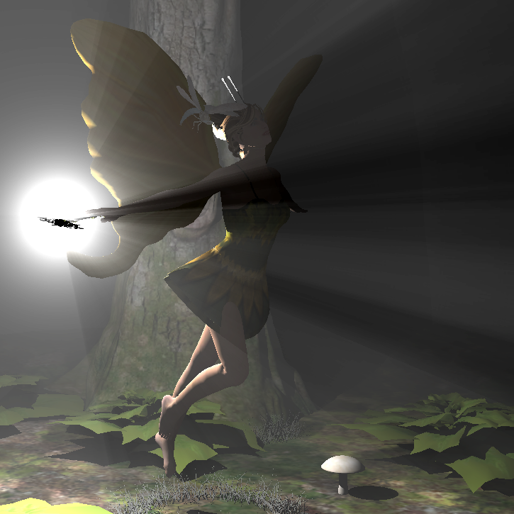
Ray-Marching Based Single Scattering
Wyman 2011:
  CUDA
  Extremely fast
  Voxelizes shadow casters
  Less accurate computations
    In-scattering should actually be different per voxel
~118 fps. Image from Wyman 2011
~90 fps. Two lights. Image from Billeter et al. 2010
Notes:
If you don’t consider the differences in attenuation, then you will not get the same quality of the gradients that you can see inside the light shafts with other methods, for instance, this one that I will describe next.
Nevertheless, Wyman’s technique is very fast and gives really nice results. It is even so fast that he can use it for area-light sources.

Slide 47
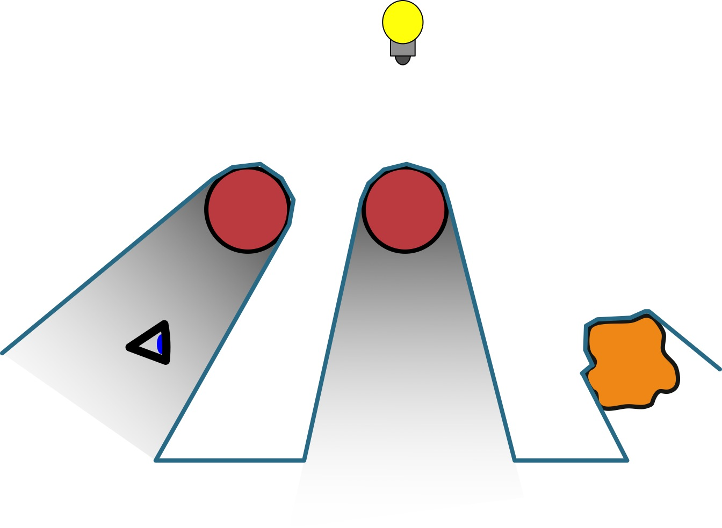
Shadow-Volume Based Single Scattering
There are of course also Shadow
Volume based approaches
  Billeter et al. 2010, Biri et al. 2006, James 2003, Nishita et al. ’87, Max ’86
  Add airlight for
  frontfacing shadow
  volume polygons
  Subtract for
  backfacing ones
-
+
-
+
Notes:
…and it shouldn’t come as a surprise that they exist, since shadow algorithms practically always have a SM and SV-counterpart.
The advantage with the SV-based approaches is that they avoid the need for ray marching. The disadvantage is that textured lights don’t work well yet.
We can use a 2D-texture to parameterize and store, a once for all precomputed lookup table that can be used to rapidly compute the airlight between two ray points. And this LUT is independent of the optical thickness and scene. The only fixed parameter is the phase function, which describes the shape of a particle, and for real-time purposes, they are mostly assumed to be spherical, meaning that they spread the light equally in all directions.
Since additions and subtractions are order independent (commutative), we can simply use addition for all front- facing polygons and subtractions for all back-facing polygons. And that will compute the correct amount of airlight.
However, shadow volumes must not overlap.

Slide 48
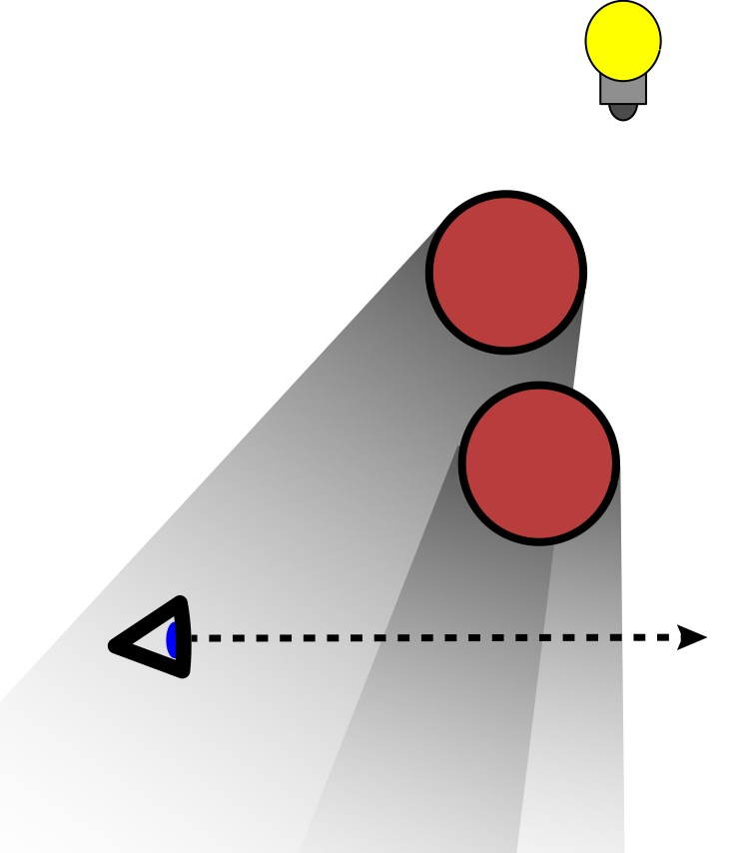
Shadow-Volume Based Single Scattering
Caveat:
  Does not work for
  intersecting shadow
  volumes
Solution:
  Create shadow volumes
  from the shadow map
  (Billeter et al. 2010)
Contribution subtracted
twice:
➔Once per overlap
Notes:
The integration doesn’t work for intersecting shadow volumes. We do not want to subtract more than once for the same shadowed region.
This is, however, easy to avoid if we create the shadow volume from a shadow map.

Slide 49
Shadow-Volume Based Single Scattering
Caveat:
  Does not work for intersecting shadow volumes
Solution:
  Create shadow volumes from the shadow map
  (Billeter et al. 2010)
    Fast if done in vertex shader
Connect shadow map
samples with triangles
and cap with the frustum planes
→ encloses volume in light
Notes:
We create a shadow map, and then connect the shadow-map samples with triangles and we also need to cap the volume with the frustum planes.
This will create a mesh that encloses the volume of the scene that is in light. So, it is actually a light volume instead of a shadow volume that we create.

Slide 50
Shadow-Volume Based Single Scattering
Caveat:
  Does not work for intersecting shadow volumes
Solution:
  Create shadow volumes from the shadow map
  (Billeter et al. 2010)
    Fast if done in vertex shader
-
+
Correct air-light integration
Notes:
And now we will see that the integration works correctly.
(click) here is the light volume,
(click) and we just add for front-facing polygons and (click) subtract for back-facing to get the (click) correct air-light integration.
And the light volume can never overlap since we created it from the shadow map.
Let’s look at the pseudo code…

Slide 51
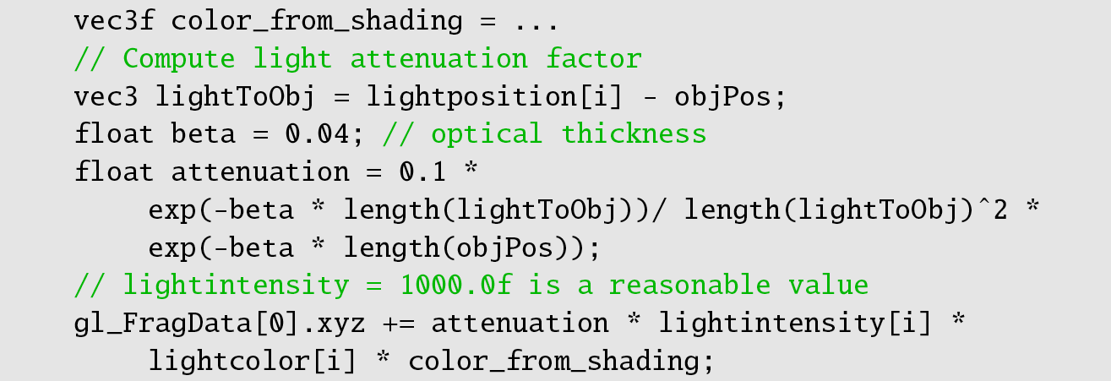
Shadow-Volume Based Single Scattering
Pseudo code (Billeter et al. 2010):
Render shadow map
Render scene from camera
  Add light attenuation in the shaders
Notes:
We start by rendering a shadow map from the light’s position.
And then we render the scene from the camera, as usual. But for the surface shading, we also consider the light attenuation between the light and the fragment.
I here show some real shader code, just to demonstrate the simple computations, and this is more or less the same situation for the ray marching based approaches as well.
So, we have the color from the shading, and just multiply that with an exponential attenuation that depends on the fragment’s distance to the eye and distance to the light source.
Then…

Slide 52
Shadow-Volume Based Single Scattering
Pseudo code (Billeter et al. 2010):
Render shadow map
Render scene from camera
  Add light attenuation in the shaders
Create the light volume
Render light-volume mesh to add airlight
  additive blending
  Shader computes airlight
  If polygon backfacing -> negate contribution
Notes:
Then, we create the light volume from the shadow map…
(and render that, from the camera position, using additive blending, and the shader computes and adds the airlight for each pixel. Or subtracts, if the triangle is back facing.
Transition: so here is that shader code…

Slide 53
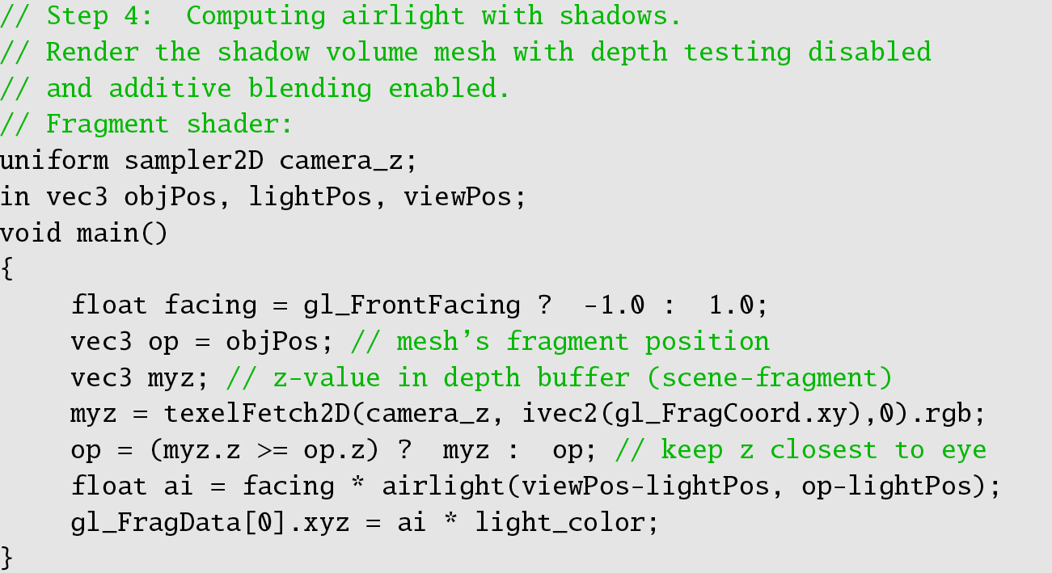
Shadow-Volume Based Single Scattering
Pseudo code (Billeter et al. 2010):
Render shadow map
Render scene from camera
  Add light attenuation in the shaders
Create the light volume
Render light-volume mesh to add airlight
  additive blending
  Shader computes airlight
  If polygon backfacing -> negate contribution

Slide 54
Shadow-Volume Based Single Scattering
Pseudo code (Billeter et al. 2010):
Render shadow map
Render scene from camera
  Add light attenuation in the shaders
Create the light volume
Render light-volume mesh to add airlight
  additive blending
  Shader computes airlight
  If polygon backfacing -> negate contribution
Notes:
The interesting part is underlined. We add or subtract the airlight, depending on the facing of the triangle.
The comparison with the depth buffer is just for robustness.

Slide 55
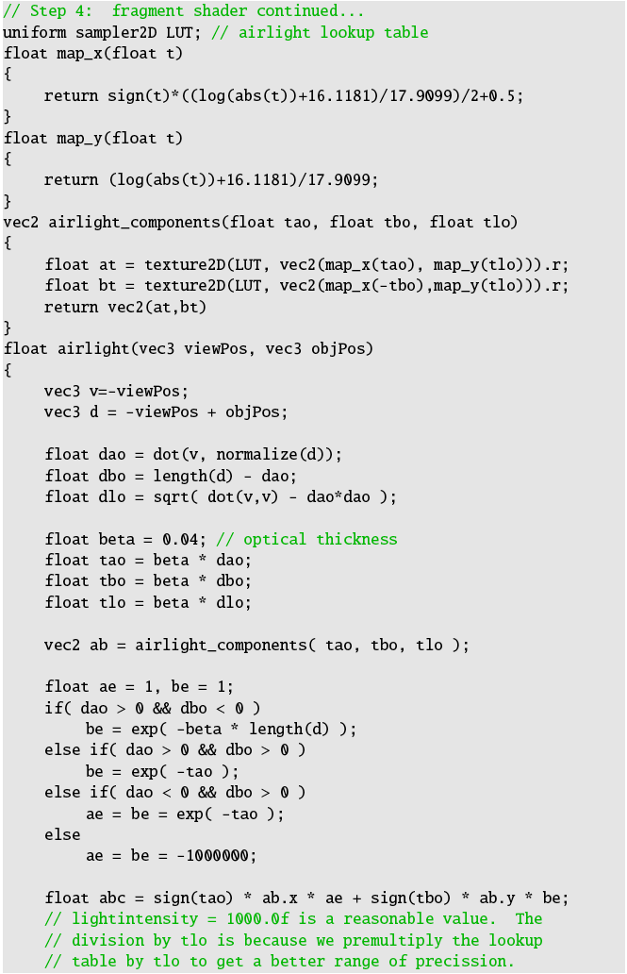

Shadow-Volume Based Single Scattering
Notes:
This is the shader for the airlight contribution
And the shader uses two texture lookups and some scalar computations, so it is quite fast.

Slide 56
Shadow-Volume Based Single Scattering
Videos at:
http://www.youtube.com/watch?v=XUSYbco0zIg
Notes:
Here are two videos. The left one uses 5 light sources, with about 100 fps on average using a GTX280.
The right video first uses 1 light source and then two. On the right, the sky is completely black, with a single point-light source and you will soon be able to notice the nice sun and sky effect, which just from the single scattering.

Slide 57
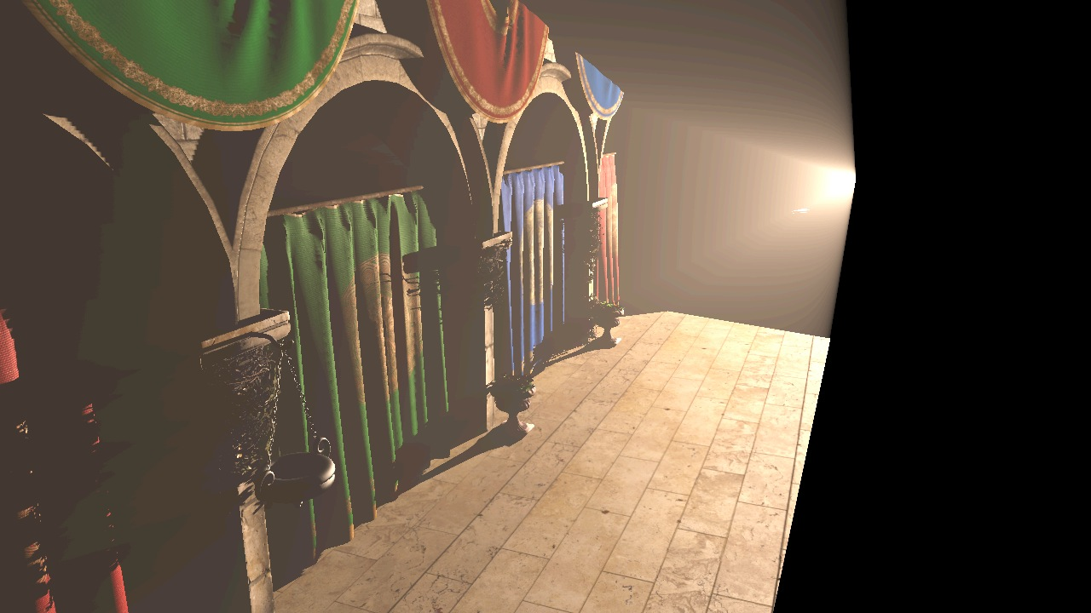
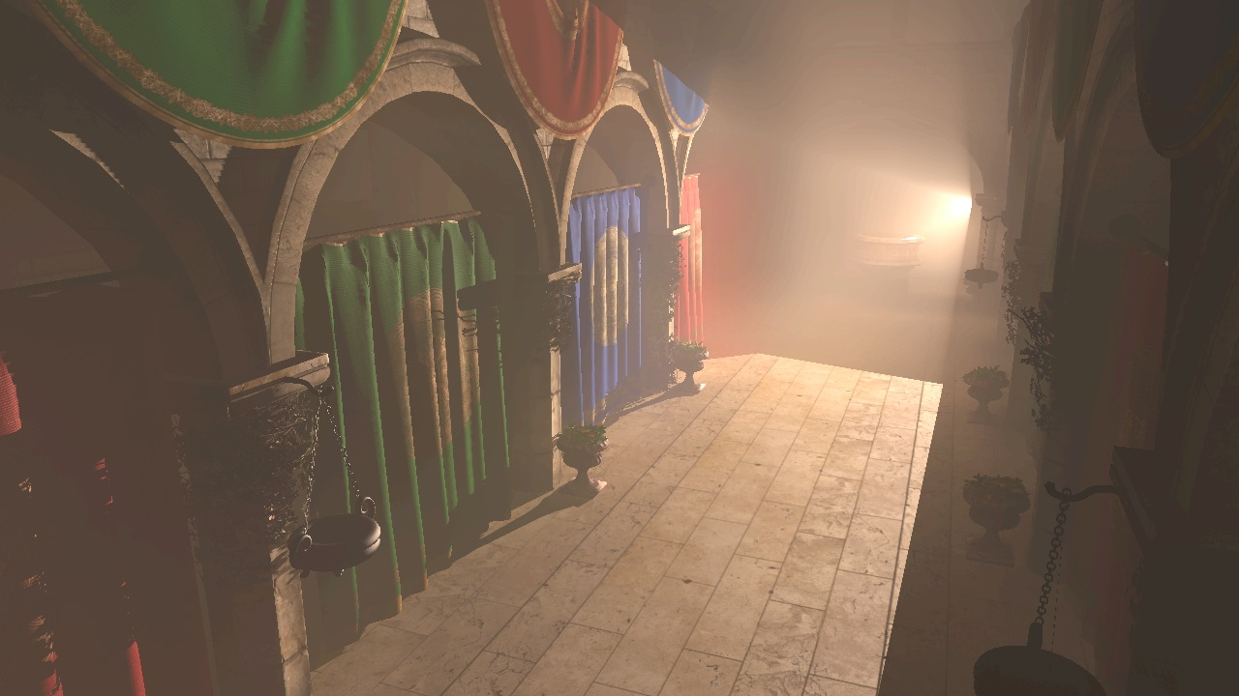
Multiple Scattering
We’ve got single-scattering
  real time
  produces quite nice results
  simple algorithms
What do we have to do to add multiple scattering?
Notes:
We have now seen how single scattering can be created, in real time, with fairly simple algorithms.
So, how can we add multiple scattering?

Slide 58
Multiple Scattering - idea
Simulate light as it passes through the scene
  “Propagation”
At every point, compute scattering:
  extinction (absorption + out-scattering)
  in-scattering
We can do this in a 3D grid
Notes:
What we need to do is to simulate how the light travels through the scene and in-scatters and out-scatters and absorbs between each delta-step.
And we can simulate this in a 3D grid.

Slide 59
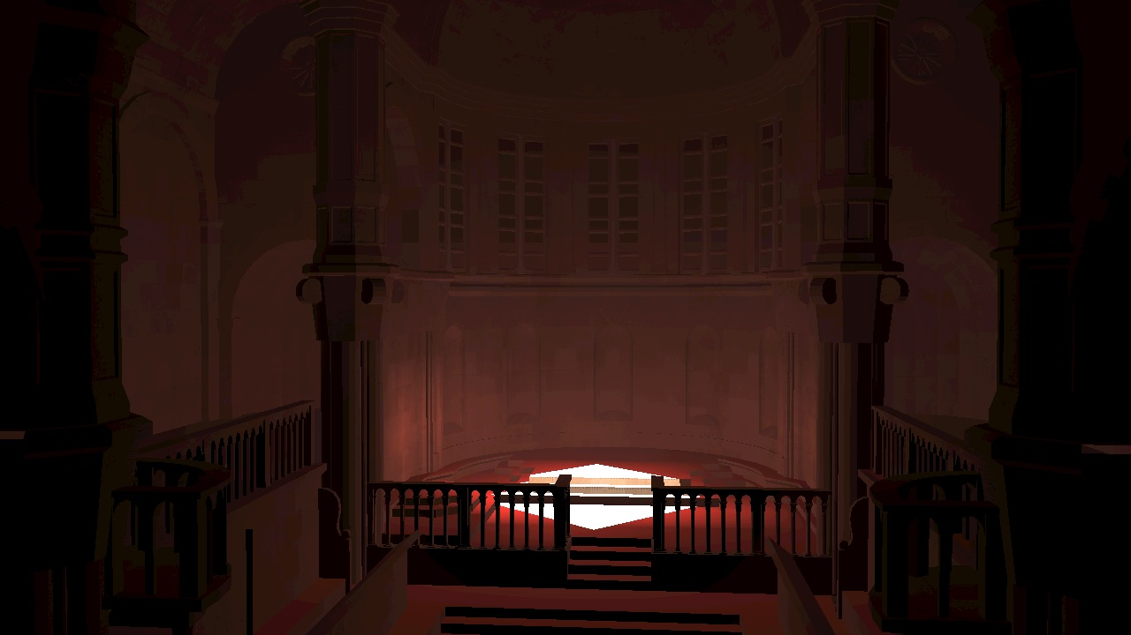
Multiple Scattering
Real-Time Multiple Scattering with Light Propagation Volumes, (Billeter et al. 2012)
  Extends “Light Propagation Volumes”,
  (Kaplanyan and Dachsbacher,
  CryEngine3, 2010)
    Indirect illumination,
    one or multiple light bounces
Notes:
We can extend the light propagation volumes, by Kaplanyan and Dachsbacher, which they used in the CryEngine…
And that method is able to simulate indirect illumination with one or multiple light bounces.

Slide 60
Multiple Scattering
Real-Time Multiple Scattering with Light Propagation Volumes, (Billeter et al. 2012)
  Extends “Light Propagation Volumes”,
  (Kaplanyan and Dachsbacher,
  CryEngine3, 2010)
    Indirect illumination,
    one or multiple light bounces
Notes:
Here is an image showing the indirect illumination. The red floor spreads red light on to the walls, and so on.

Slide 61
Multiple Scattering with LPVs
Light Propagation Volumes:
  Render scene from light
  Inject 3D grid with radiance at
  cells containing lit surfaces
    Each cell stores light as SH
    Occluders represented by SH
  Iteratively propagate the light from cell to cell
Notes:
This is the pseudo code for light propagation volumes.
We start by rendering the scene from the light sources, and this gives the direct illumination for each surface in the scene.
Then, we inject a 3D grid with the direct illumination at all cells containing lit surfaces.
And then, we iteratively start propagating the radiance from cell to cell, until we are happy with the amount of spread and light bounces.
Now, what do we have to do to add multiple scattering to this process?

Slide 62
Multiple Scattering with LPVs
Light Propagation Volumes:
  Render scene from light
  Inject 3D grid with radiance at
  cells containing lit surfaces
    Each cell stores light as SH
    Occluders represented by SH
  Iteratively propagate the light from cell to cell
Add multiple Scattering:
  Inject radiance from single scattering and propagate.
    Identified by shadow map
  Ray-march grid to visualize multiple scattering
  (Superimpose SV-based single scattering)
Notes:
Well… all we have to do is to also inject the radiance from the single scattering.
For each cell, we check if it is visible from the light source, by querying the shadow map. And if the cell is in light, we inject light proportionally to its distance to the light source.
Then we just use the light propagation method to iteratively propagate the light from cell to cell to simulate one or several light bounces.
We also super-impose single scattering, using the shadow-map-based or shadow-volume based versions, since that should require a much denser grid to visualize nicely.

Slide 63
Results
LPV Only

Slide 64
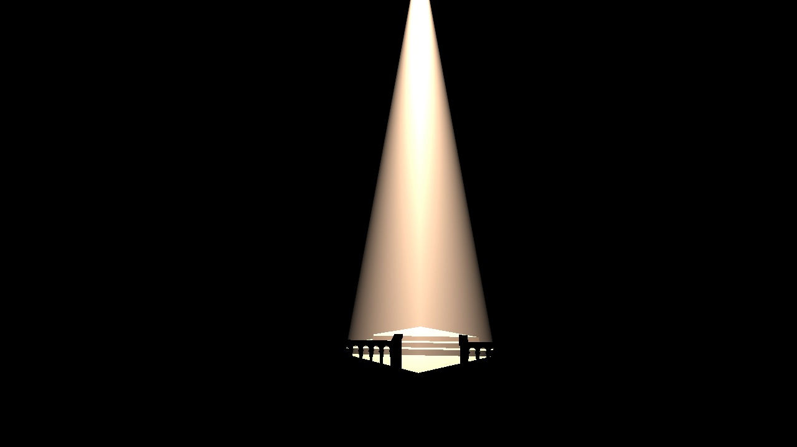
Results
Single Scattering Only

Slide 65
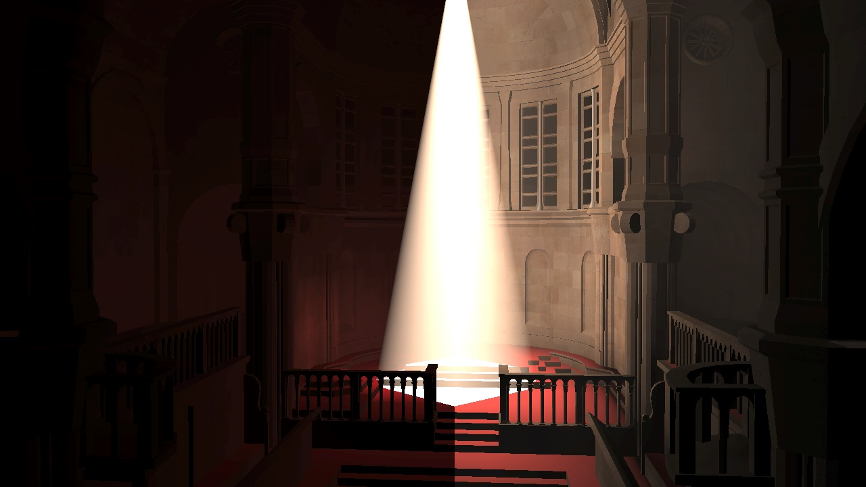
Results
LPV and Single Scattering
LPV and Multiple Scattering
Notes:
Brightness is exaggerated to highlight the differences. Note, that the color bleeding is present to the right as well, but is dominated by the multiple scattering effects.

Slide 66
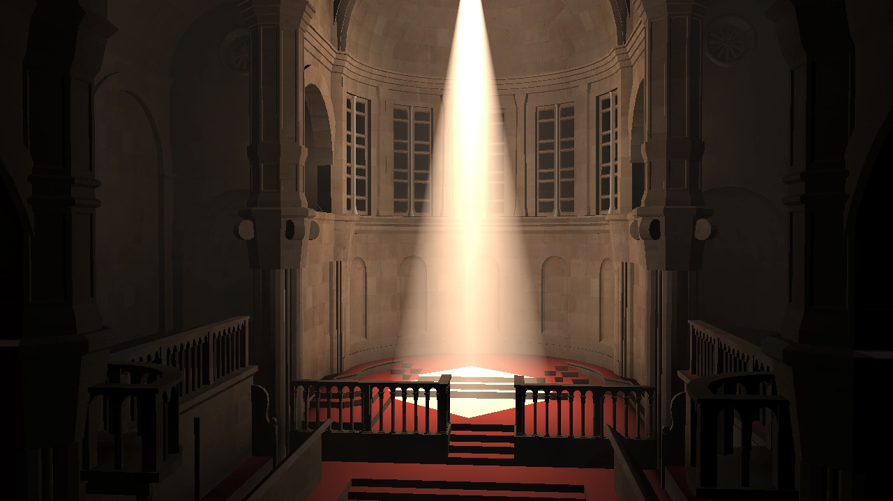
Results
Multiple Scattering

Slide 67
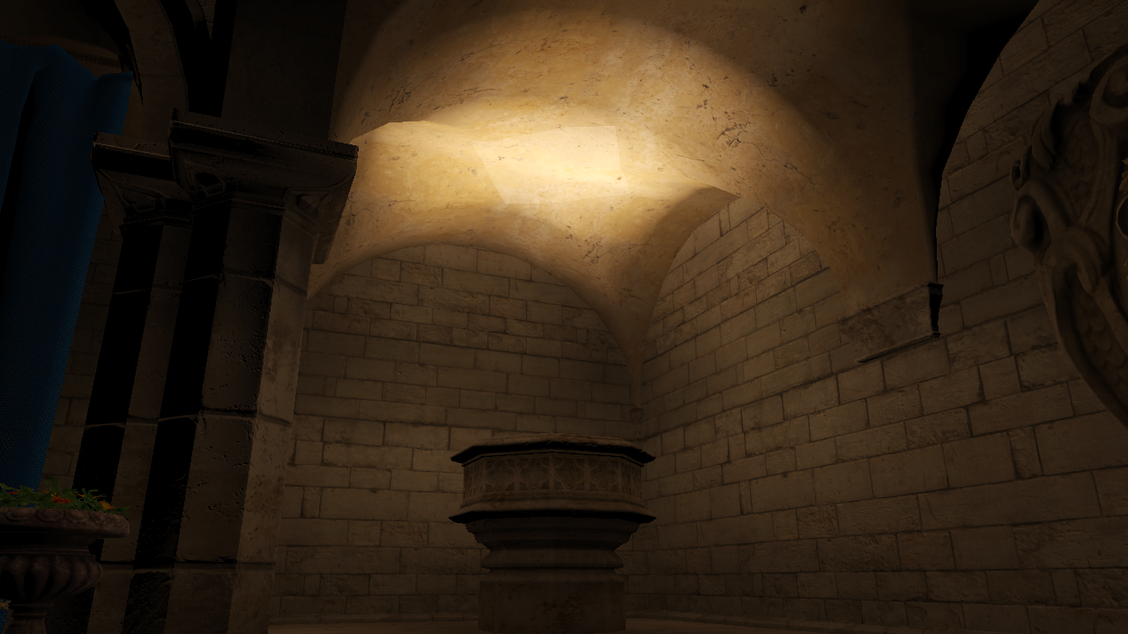
Before and After
LPV only
Notes:
LPV only – with indirect illumination and color bleeding

Slide 68
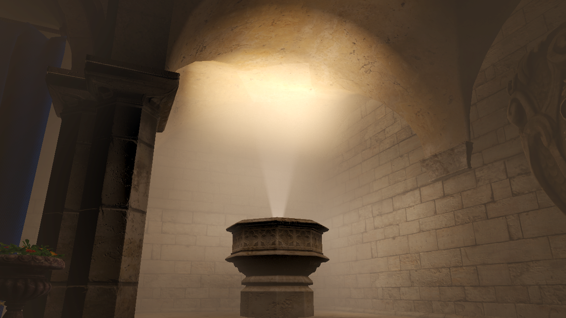
Before and After
LPV extended with multiple scattering

Slide 69
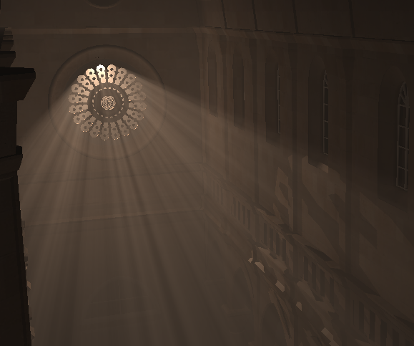
Summary – Homogeneous Participating Media
Single Scattering:
  Chen et al. 2011:
    Textured Lights
    CUDA
  Wyman 2011:
    Fastest (CUDA)
    Only shadows – not unique in-scattering per ray segment
  Billeter et al. 2010
    No need for ray marching
    Simplest – OpenGL 2.x
Multiple Scattering:
Billeter et al. 2012
Notes:
For single scattering, we have the method by Chen et al that works great for textured lights.
Wyman’s method is the fastest
and Billeter’s shadow-volume based approach has no need for ray marching. It is also probably the simplest – it works fine with OpenGL–two-point-something.
And for multiple scattering, we can propagate the scattering using light propagation volumes.

Slide 70
Volumetric Shadows
THE END

