Slide 1
Voxel DAGs and Multiresolution Hierarchies:
From Large-Scale Scenes to Pre-computed Shadows
– Attribute compression
Ulf Assarsson¹
¹ Chalmers University of Technology, Sweden
Notes:
If every voxel has an attribute, like a color.

Slide 2
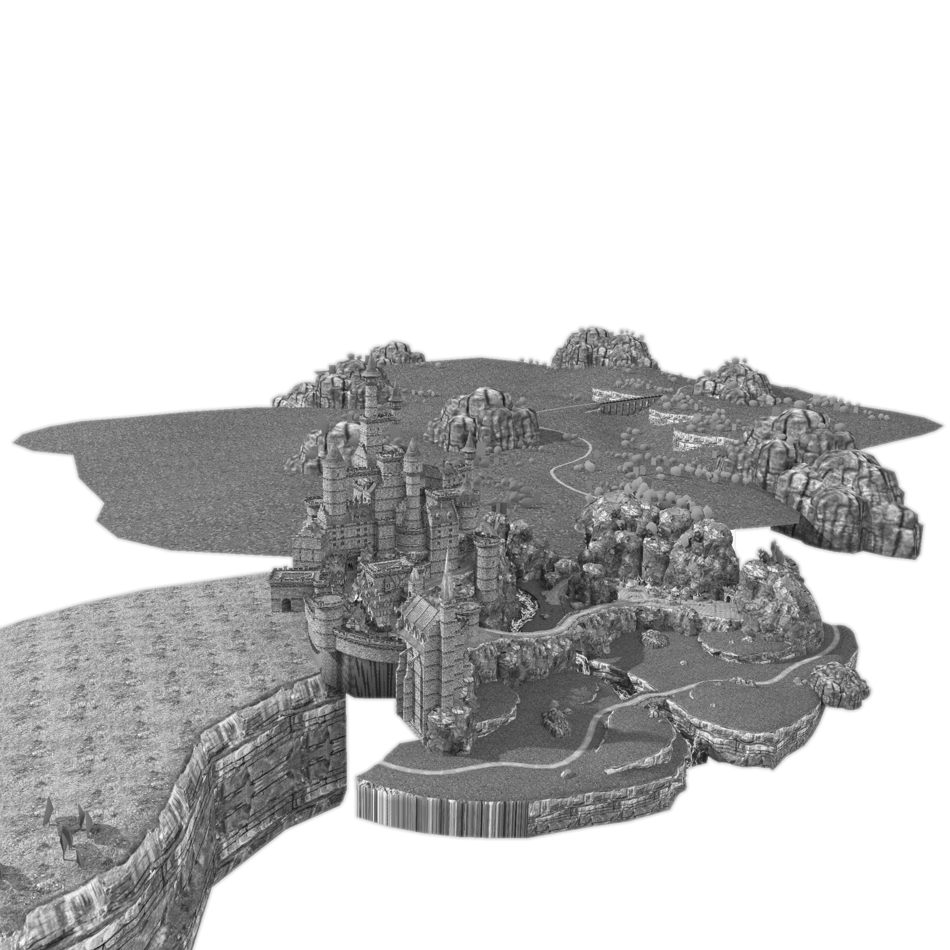
What about colors?

Slide 3
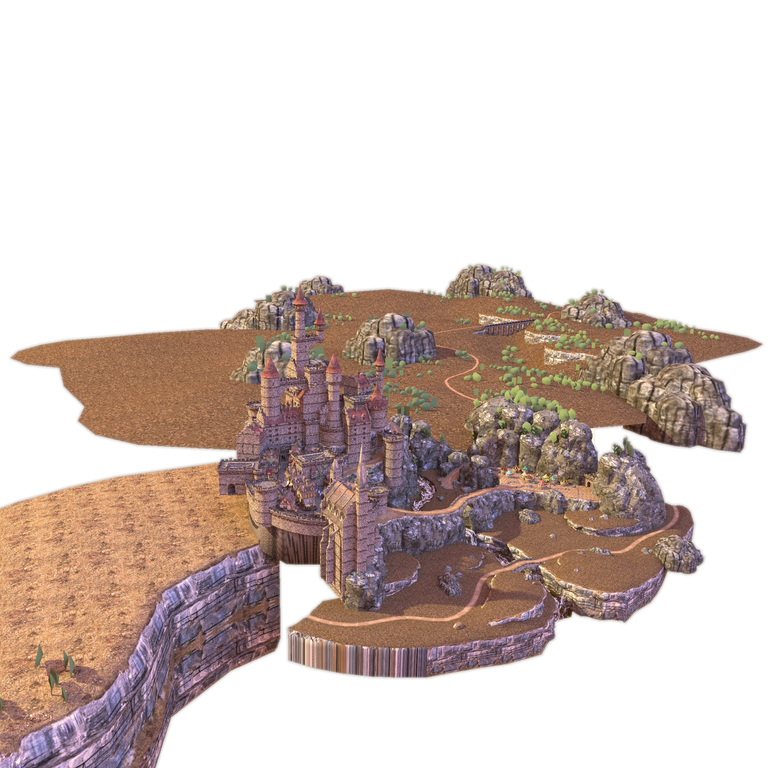
Dado, Kol, Bauszat, Thiery, Eisemann. Geometry and attribute copression for voxel scenes. Computer Graphics Forum (Eurographics 2016).
Dolonius, Sintorn, Kämpe, Assarsson. Compressing Color Data for Voxelized Surface Geometry. i3D 2017, IEEE Trans. on Vis. and Computer Graphics 2018.
What about colors?
Notes:
There are two papers on how to extend the DAGs to be used together with voxel colors
coherency

Slide 4
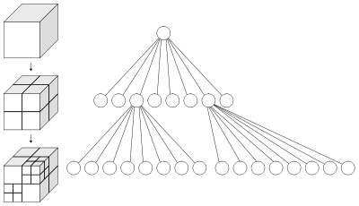
Compress geometry and colors separately with different specialized methods.
DAGs: geometry ~ ≤1 bit per voxel
So, 16-24 bits colors/voxel would be devastating for memory consumption => compression needed!
Geometry:
Voxel colors:
Two problems:
How can we compress the colors efficiently?
Connection between DAG nodes and voxel colors, with fast color lookups during run-time traversal?
0
1
1
Notes:
DAGs compress to around 1 bit or less per set voxel. Thus, 16-24-bit color information would be devastatingly expensive in terms of memory usage.
So far, DAGs haven’t stored color information – just the geometric information.
The key to the success of the DAGs was to separate colors and geometry, and so far, we have just cared about the geometry.
If the DAG nodes would contain color information, that would destroy much or often all of the merging opportunities and therefore destroy any efficient compression.
We have two problems...

Slide 5
Colors – preserving coherency
Two problems:
How can we compress the colors efficiently?
Connection between DAG nodes and voxel colors with fast color lookups during run-time traversal (i.e., visualization) ?
DAGs: geometry ~ ≤1 bit per voxel
16-24 bits colors/voxel would be devastating
Existing 3D color-compression algorithms give too low compression; we have ~100.000 times higher resolutions, but mainly surface geometry (not gas, smoke, fluids, etc).
Surfaces are two dimensional (in 3D-space)
=> makes sense to try using 2D image-compression algorithms (due to the 2D coherency).
  How unfold a surface to a flat image?
  Any distortions waste or loose precision.
Notes:
Vs 3D fourier-transform-based methods.

Slide 6
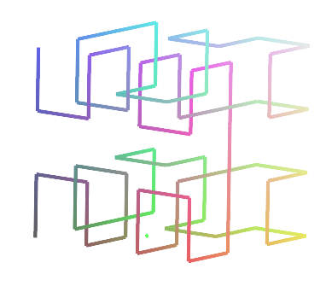
Colors – preserving coherency
Two problems:
How can we compress the colors efficiently?
Connection between DAG nodes and voxel colors with fast color lookups during run-time traversal (i.e., visualization) ?
Serializing all the 3D voxels accoring to a 3D-space-filling curve (e.g., Morton order) into a 1D stream gives us reasons to believe we maintain (much) spatial coherency.
We then outline the 1D-stream onto an image, this time using a 2D-space-filling curve, again maintaining (much) spatial coherency.
Then, we can compress this image using standard image-compression methods.
Morton order or Hilbert order:
Notes:
If we have a voxelized object like this dwarf, we want to outline the voxels somehow and compress them.
We don’t want to order the voxels in a random order, because that destroys much of the spatial coherency and would be devastating for color compression.
If we unravel the voxels in the 3D grid using a coherency-preserving space-filling curve (as this Morton order or Hilbert order), we get a sequential 1D-stream with (much) spatial coherency preserved..
Then, we outline this 1D-stream onto a 2D image using a 2D-Morton order, which again preserved much of the coherency. Then, we can compress this image using standard 2D-image compression algorithms.
So, how do we traverse the voxels according to a 3D-Morton order?

Slide 7
Colors – preserving coherency
Two problems:
How can we compress the colors efficiently?
Connection between DAG nodes and voxel colors with fast color lookups during run-time traversal (i.e., visualization) ?
Ordering voxels along a Morton curve just requires us to
enumerate the SVO/DAG-node children in the corresponding order.
  (Hilbert order is similar and easy but for DAGs requires respecting the parents’ child numbers during traversal. For SVOs, the order can be coded, at SVO construction, by the child enumeration.)
6
7
4
5
3
0
1
2
3
4
5
6
7
2
0
1
The serialization is then done by a simple depth-first traversal of the full SVO
Morton order of a node’s child voxels
Now, we have unfolded the voxel colors and can compress them.
So, what does the resulting 2D image look like… ?
Notes:
We just store the children of each node according to a Morton order. Then, a full-tree depth-first traversal will access all voxels in a Morton order.

Slide 8
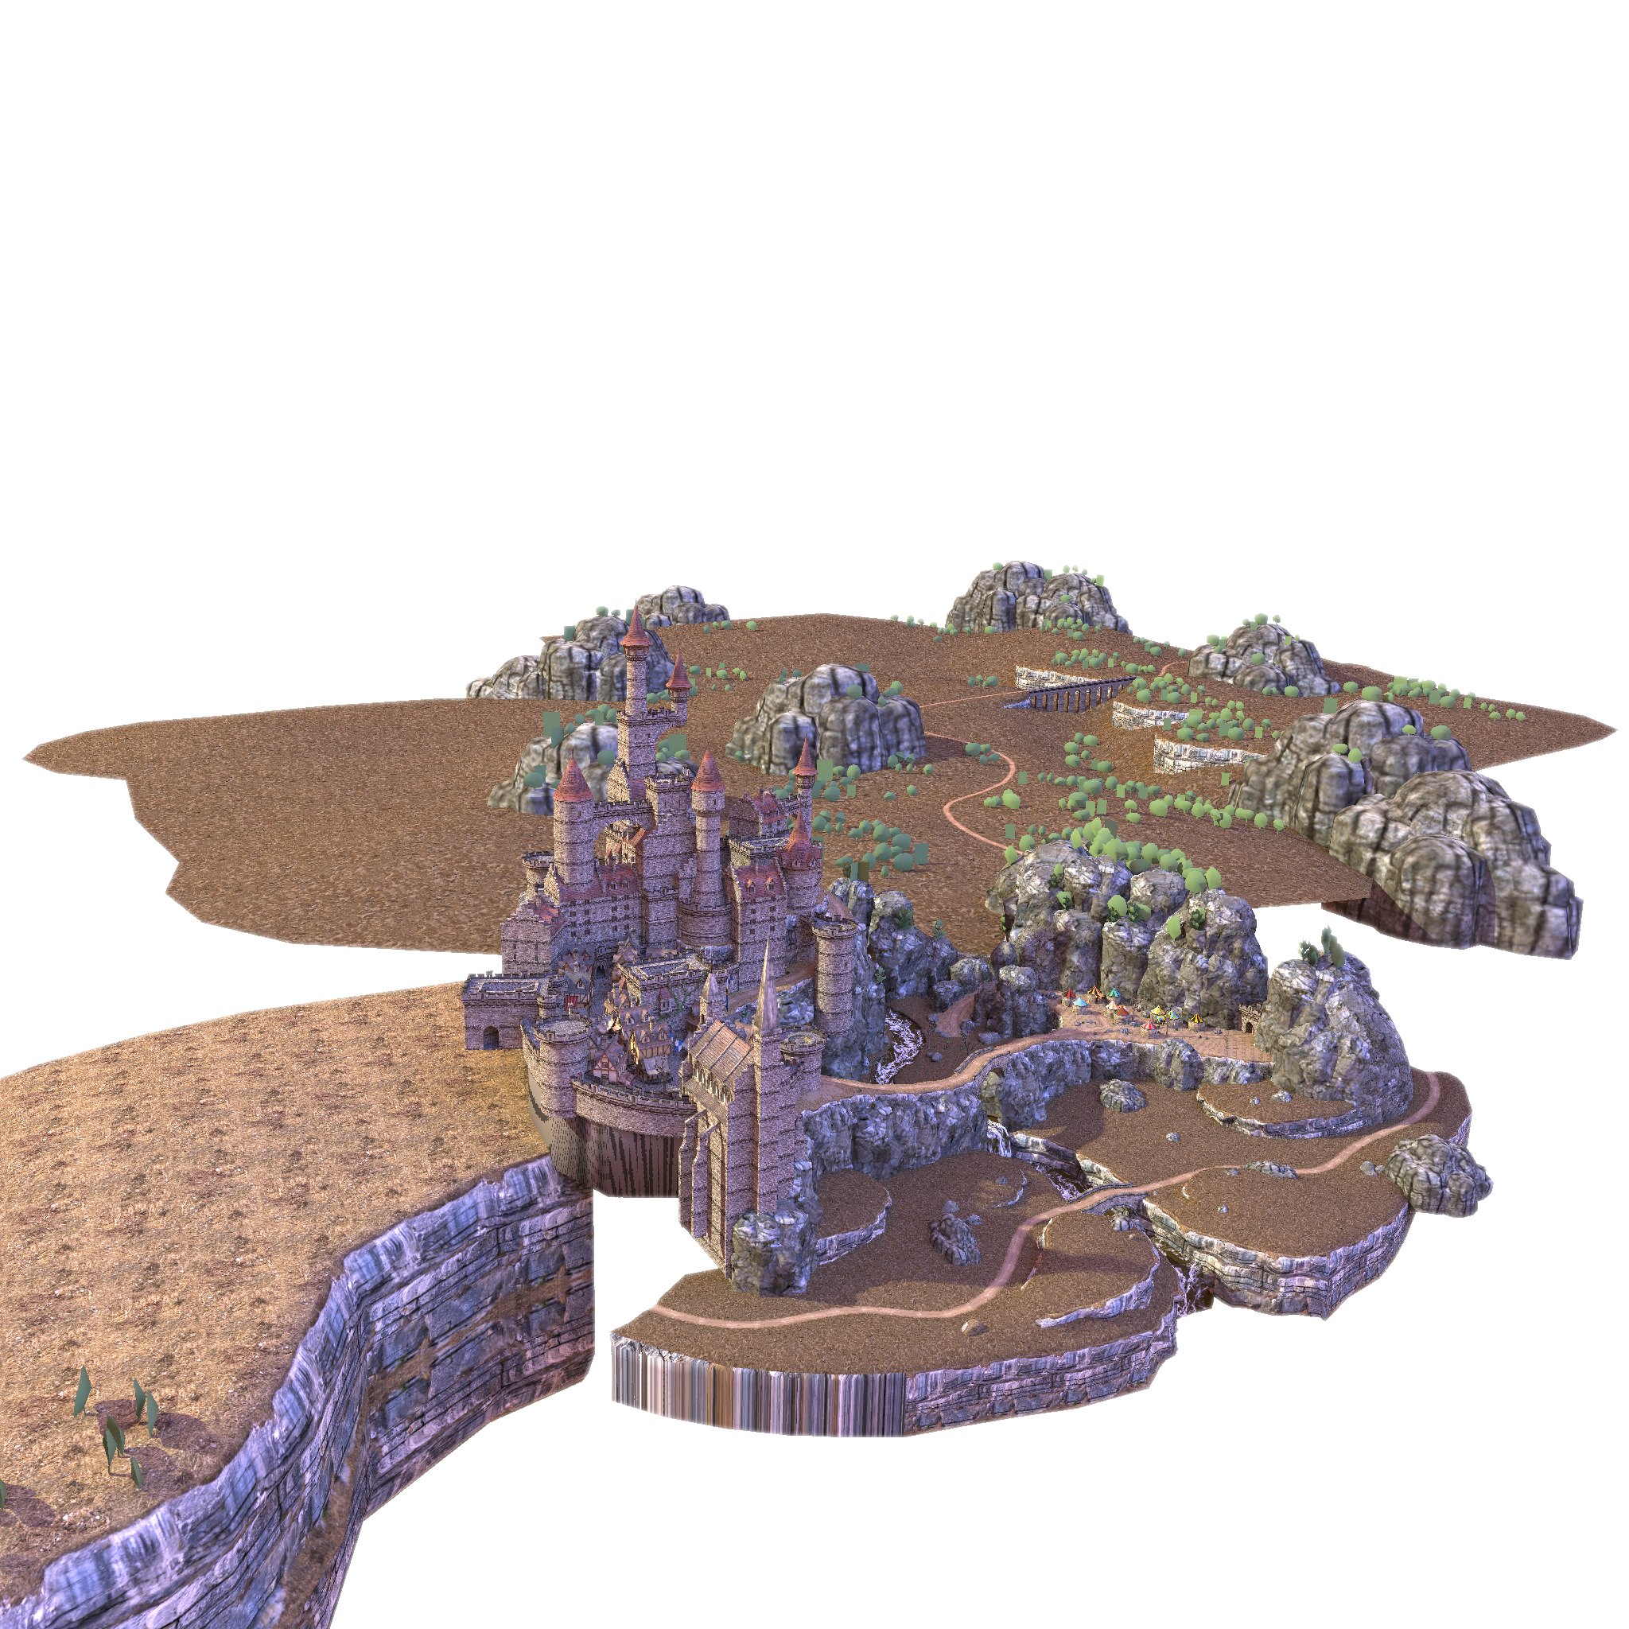
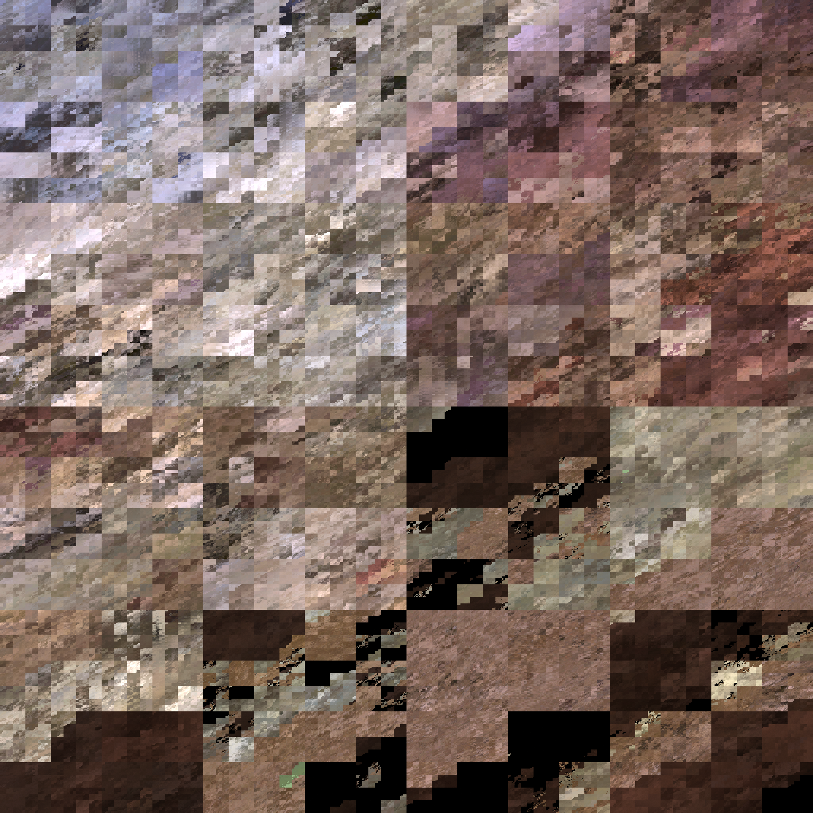
Colors – preserving coherency
Two problems:
How can we compress the colors efficiently?
Connection between DAG nodes and voxel colors with fast color lookups during run-time traversal (i.e., visualization) ?
Clearly, much coherency is preserved.
Dan Dolonius will present efficiency in a few minutes
We reach the goal of a few bits per voxel color.
How can we connect the DAG nodes and the colors?
Notes:
The image looks blocky (as expected) but it corresponds to the same block dimensions that typical block-compression algorithms prefer. So, it is at least in my opinion surprisingly good.
Dan Dolonius will present compression efficiency in a few minutes.
And he will also describe a version which can reach below 1 bit per color (not 1 bit per r,g, and b respectively, but less than 1 bit per color in total).

Slide 9
DAGs with color indices
Two problems:
How can we compress the colors efficiently?
Connection between DAG nodes and voxel colors with fast color lookups during run-time traversal?
For colors at leaf voxels only
SVO or DAG:
SVO:
Or compute index by
storing #voxels_in_subgraph¹
at each node.
Works for both SVOs and DAGs.
#v
#v
#v
#v
#v
0
1
1
#v
#v
#v
#v
#v
#v
To compute color index at i:
For each node along the path:
sum the values of all preceeding
siblings
1
1
1
1
1
1
1
1
SVO: simply store color or color index in each node
(Does not work for DAGs)
i-1
i
n-2
n-1
¹number of voxels with colors in the node’s subgraph (i.e., #leaf voxels).
The voxels are ordered according to a depth-first traversal.
Notes:
For an SVO, we can simply store the colors or color indices in each node. But for DAGs, that destroys all or most of the merging opportunities – especially if we use baked scenes.
So, we need to invent a method to insert information in the SVO that does not destroy the merging opportunities.
We can do that by storing, for each node, its ”number of voxels in the subgraph”. If we have colors at leaf levels only, that means that each node stores the number of leaf voxels in its subgraph.
Then, to compute the color index at node i, the only thing we need to do is to, for each node along the path, sum the values of all preceeding siblings.
Like this (look at right side of slide):
for each path node (red), we sum all the values of the preceeding siblings, which corresponds to all the voxels in this green subgraph…
Until we have the final correct index.
This works for DAGs as well…

Slide 10
DAGs with color indices
Two problems:
How can we compress the colors efficiently?
Connection between DAG nodes and voxel colors with fast color lookups during run-time traversal?
For colors at leaf voxels only
DAG:
SVO:
Or compute index by
storing #voxels_in_subgraph¹
at each node.
Works for both SVOs and DAGs.
#v
#v
#v
#v
#v
0
1
1
#v
#v
#v
#v
#v
#v
To compute color index at i:
For each node along the path:
sum the values of all preceeding
siblings
1
1
1
1
1
1
1
1
SVO: simply store color or color index in each node
(Does not work for DAGs)
i-1
i
n-2
n-1
¹number of voxels with colors in the node’s subgraph (i.e., #leaf voxels)
The voxels are ordered according to a depth-first traversal.
Notes:
We don’t care if two pointers point to the same node. We just sum the value that each child pointer points to.
(Transition to next slide) What about mipmap colors? Colors at all levels and not only the leaf level?

Slide 11
DAGs with color indices
Two problems:
How can we compress the colors efficiently?
Connection between DAG nodes and voxel colors with fast color lookups during run-time traversal?
For voxel colors at all level (”3D mipmaps”):
DAG:
SVO:
Or compute index by
storing #voxels_in_subgraph¹
at each node.
Works for both SVOs and DAGs.
#v
#v
#v
#v
#v
0
1
1
#v
#v
#v
#v
#v
#v
To compute color index at node x:
For each node along the path:
sum the values of all preceeding
siblings
And add #path_nodes_above node_x ²
1
1
1
1
1
1
1
1
SVO: simply store color or color index in each node
(Does not work for DAGs)
i-1
i
n-2
n-1
¹number of voxels with colors in the node’s subgraph (at all levels).
The voxels are ordered according to a depth-first traversal.
² number of nodes in the path down to (but not including) node x.
Notes:
I will toggle these slides back and forth.
As you can see, the only things that change are that the number we store at each node now includes the voxel colors at all levels – not only the leaf level.
And our node x can be at any leaf or intermediate level. And we need to add the number of path_nodes_above_node_x.
The reason for the latter is that summing all the siblings values here (green) will give the number of voxel colors in this green subgraph.
And the same for the blue and white here. But we then have missed the color stored for the root, and these two red path nodes.
So, that’s why we add this ”number of path_nodes_above_node_x”, i.e., 3. And that’s it.
Transition: However, we can optimize if we want to…

Slide 12
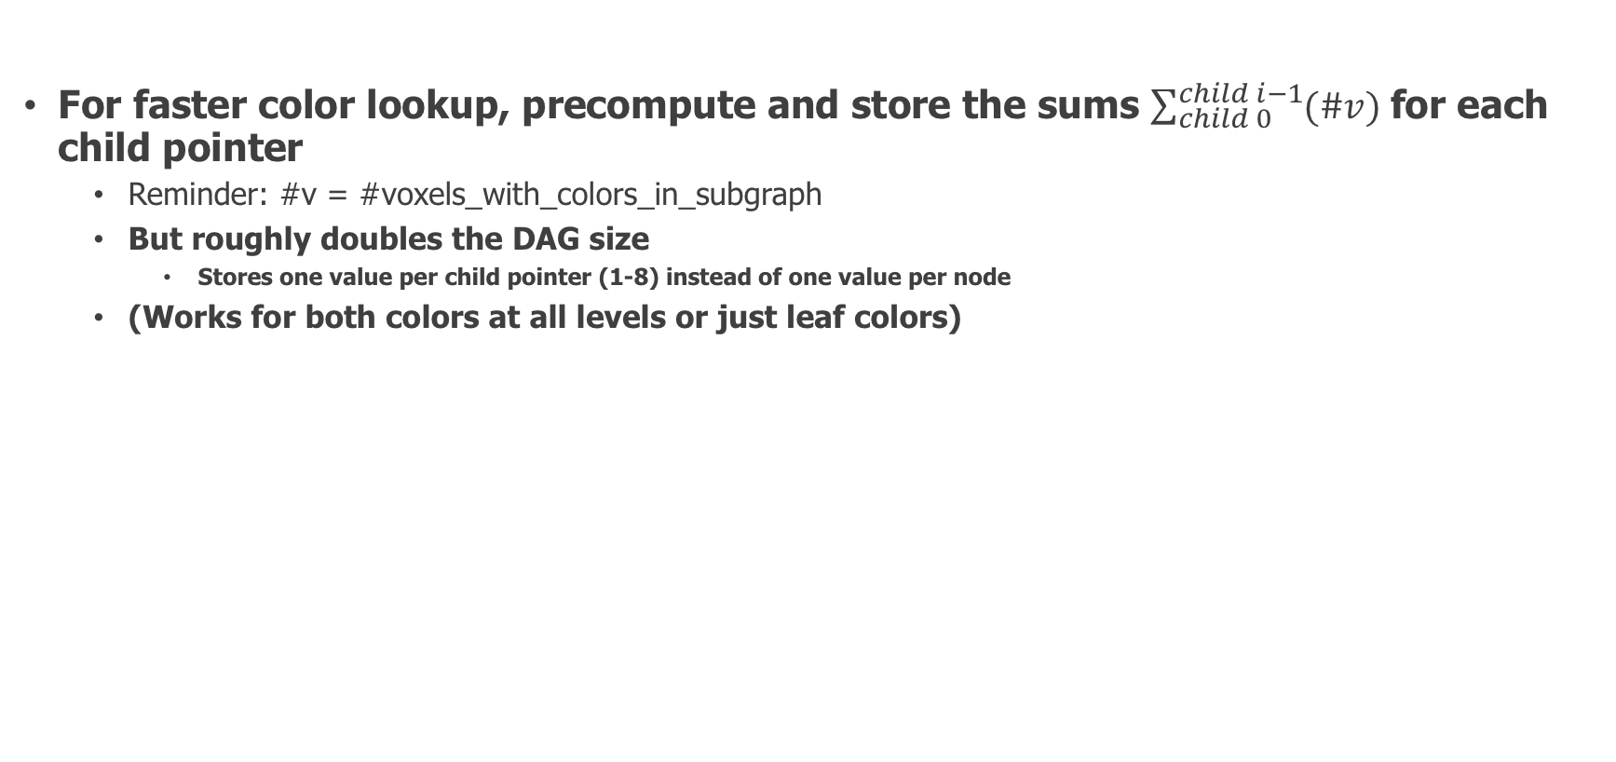
DAGs with color indices
Two problems:
How can we compress the colors efficiently?
Connection between DAG nodes and voxel colors with fast color lookups during run-time traversal?
For faster color lookup, precompute and store the sums $\sum_{child 0}^{child i−1}{(\#v)}$for each child pointer
  Reminder: #v = #voxels_with_colors_in_subgraph
  But roughly doubles the DAG size
    Stores one value per child pointer (1-8) instead of one value per node
  (Works for both colors at all levels or just leaf colors)
DAG:
#v
#v
#v
#v
#v
#v
#v
#v
#v
#v
#v
1
1
1
1
1
1
1
1
i-1
i
n-2
n-1
Notes:
However, the colors are typically accesses much more seldom than the nodes themselves, during ray traversal. So, in my research group, we prefer having the smaller DAG which boosts cache performance, and pay the slightly higher but more rare cost when the colors need to be resolved.

Slide 13
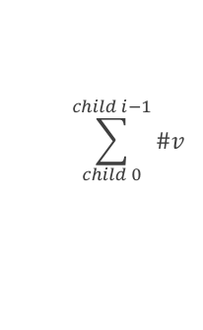


DAGs with color indices
Two problems:
How can we compress the colors efficiently?
Connection between DAG nodes and voxel colors with fast color lookups during run-time traversal?
For faster color lookup, precompute and store the sums $\sum_{child 0}^{child i−1}{(\#v)}$for each child pointer
  Reminder: #v = #voxels_with_colors_in_subgraph
  But roughly doubles the DAG size
    Stores one value per child pointer (1-8) instead of one value per node
  (Works for both colors at all levels or just leaf colors)
DAG:
$$\sum_{child 0}^{child i−1}{\#v}$$
$$Σ$$
$$Σ$$
$$Σ$$
$$Σ$$
#v
#v
#v
#v
#v
#v
1
1
1
1
1
1
1
1
i-1
i
n-2
n-1
Notes:
We lift up the prefix sums of these v-numbers (the number of subgraph voxels) to the child pointers.

Slide 14












DAGs with color indices
Two problems:
How can we compress the colors efficiently?
Connection between DAG nodes and voxel colors with fast color lookups during run-time traversal?
For faster color lookup, precompute and store the sums $\sum_{child 0}^{child i−1}{(\#v)}$for each child pointer
  Reminder: #v = #voxels_with_colors_in_subgraph
  But roughly doubles the DAG size
    Stores one value per child pointer (1-8) instead of one value per node
  (Works for both colors at all levels or just leaf colors)
DAG:
$$\sum_{child 0}^{child i−1}{\#v}$$
$$Σ$$
$$Σ$$
$$Σ$$
$$Σ$$
$$Σ$$
$$Σ$$
$$Σ$$
$$Σ$$
$$Σ$$
$$Σ$$
$$Σ$$
$$Σ$$
$$Σ$$
$$Σ$$
$$Σ$$
$$Σ$$
$$Σ$$
$$Σ$$
i-1
i
n-2
n-1
Notes:
We do that for all nodes in the whole DAG.

Slide 15
DAGs with color indices
Two problems:
How can we compress the colors efficiently?
Connection between DAG nodes and voxel colors with fast color lookups during run-time traversal?
For faster color lookup, precompute and store the sums $\sum_{child 0}^{child i−1}{(\#v)}$for each child pointer
  Reminder: #v = #voxels_with_colors_in_subgraph
  But roughly doubles the DAG size
    Stores one value per child pointer (1-8) instead of one value per node
  (Works for both colors at all levels or just leaf colors)
DAG:
$$\sum_{child 0}^{child i−1}{\#v}$$
$$Σ$$
$$Σ$$
$$Σ$$
$$Σ$$
To compute color index at node x:
For only leaf colors: just sum the values along the path
For colors at all levels: also add #path_nodes_above node_x
$$Σ$$
$$Σ$$
$$Σ$$
$$Σ$$
$$Σ$$
$$Σ$$
$$Σ$$
$$Σ$$
$$Σ$$
$$Σ$$
$$Σ$$
$$Σ$$
$$Σ$$
$$Σ$$
i-1
i
n-2
n-1
For colors at all levels, Dado’s et al description may be even simpler to understand (but is identical):
Each child pointer is appended the offset in index from the parent node to its subnodes.
Voxel index computation: just sum the values of each node along the path.
Notes:
Next, Dan will talk about the color compression in more detail.

