Slide 1
Testing automotive software
Ulf Norell
RawFP Meeting May 20, 2011

Slide 2
What is AUTOSAR?
Standard for the operating system running in your car.
A modern car contains lots of computers that need to communicate with each other.
Much of the standard defines the numerous network protocols used.

Slide 3
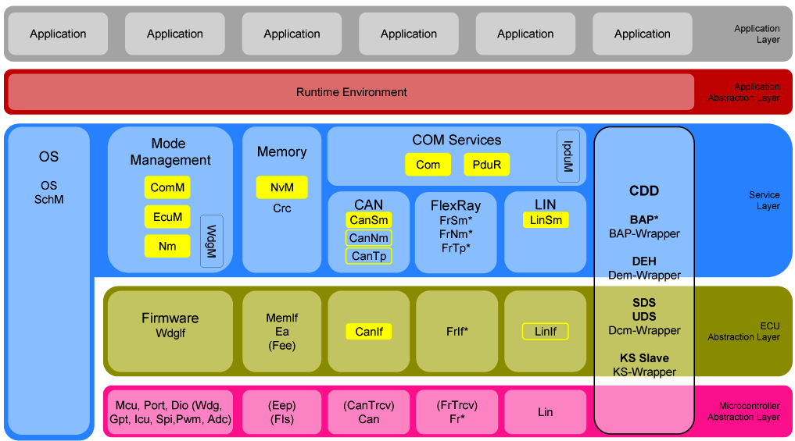
(Some) AUTOSAR components
Notes:
Missing: DEM, DCM, Ethernet

Slide 4

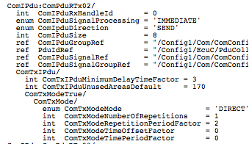
Highly configurable
Notes:
1,800 lines. XML is 10,000 lines (6 times longer)

Slide 5
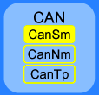
Clusters
If a developer is implementing several components they may choose to violate internal interfaces
Sometimes this might even be necessary to get acceptable performance
Testing nightmare!

Slide 6
Clusters
Solution 1: Write a test model for the cluster
Problems:
  A different developer might not have implemented all components in the cluster
  Hard figure out what the specification is
  Models get big and clunky

Slide 7
Clusters
Solution 2: Write composable models for the components
Problems:
  QuickCheck state machine models aren’t composable

Slide 8
Testing a single component
Interface functions
Test case: sequence of commands
  a call to an interface function
  return values for the callouts
The model
  keeps track of the state of the system
  predicts which callouts will be called
A
Callouts

Slide 9
Testing a single component
Interface functions
Running a test: for each command
  tell the callout functions what to return
  call the interface function
  check that the callouts were called with the right arguments
  check that the function returned the right result
A
Callouts

Slide 10
Component model
Generators for results
callouts(Call) -> Callouts
precondition(Call, Callouts) -> Bool
next_state(S, Res, Call, Callouts) -> S
postcondition(S, Call, Res, Callouts) -> Bool
Actual results

Slide 11
Testing a cluster
A
B
C
Not observable

Slide 12
Return value callback
We need return values for internal function calls
  return_value(S, Call, Callouts) -> Result

Slide 13
Specifying a cluster
components() -> list(Component)
classify_callout(Call) ->
external | {internal, Component}
interface_functions() -> list(Call)

Slide 14
Current state
I’ve got this running on a toy example
I’m currently adapting one of our AUTOSAR cluster models with encouraging results

