Slide 1
Ali Shahrokni
2013-03-14

Slide 2
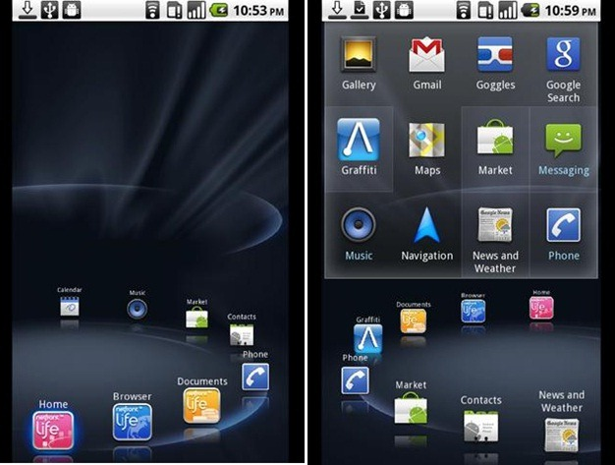

Slide 3
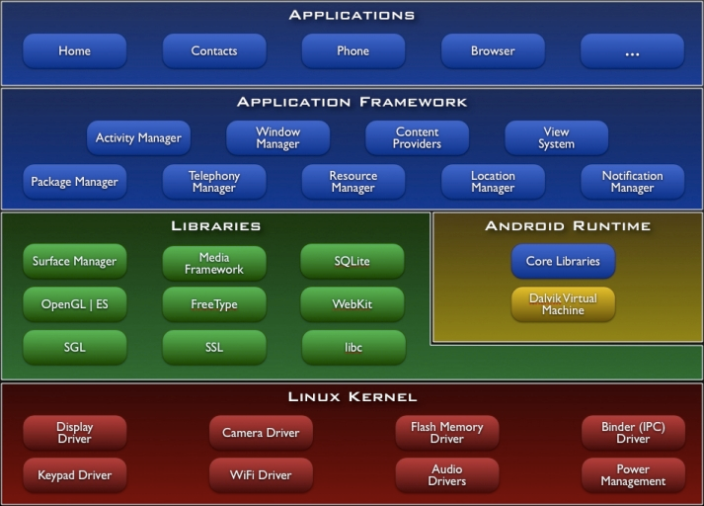

Slide 4
Application Components
Activities
Services
Content providers
Broadcast receivers

Slide 5
Java
Integrated environment developed by Google
A powerful plug-in for Eclipse by Google
Java code is compiled to Dalvik executables
runs in Dalvik VM

Slide 6
Get Started
Install JDK
Install Eclipse
Install ADT plugin for Eclipse
Install Android SDK

Slide 7
Installing JDK
http://www.oracle.com/technetwork/java/javase/downloads/
Java SE Development Kit 7 Downloads
Windows: Set up environment variable for javac.exe

Slide 8
Installing Eclipse
http://eclipse.org/downloads/
Eclipse IDE for Java developers
No installation, just run the downloaded file

Slide 9
Installing ADT plugin for Eclipse
Install http://developer.android.com/sdk/eclipse-adt.html
In Eclipse: help -> Install new software
Add
Name: Android ADT
Location: https://dl-ssl.google.com/android/eclipse/
Install developer tools

Slide 10
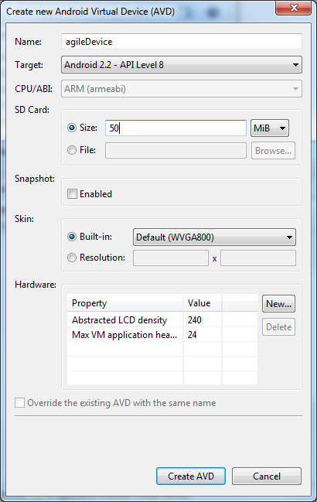
Installing Android SDK
http://developer.android.com/sdk/index.html
Android SDK manager
Install Android 2.2 (API 8)
Setting up a device
Virtual device manager
Create new AVD

Slide 11
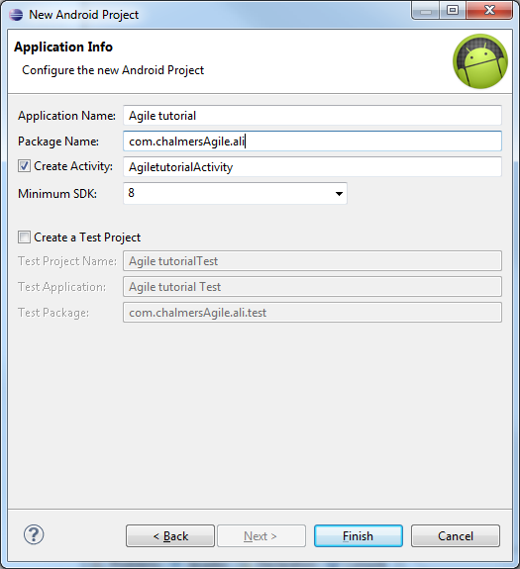
Set up Android project
Start Eclipse
Preferences -> Android: Set Android SDK location
Create new Android project
Start AVD device from the AVD manager

Slide 12
Android Introduction
Demo
Android tutorial
No java prerequisite in the tutorial
Android tutorial for beginners
http://www.youtube.com/watch?v=SUOWNXGRc6g&feature

Slide 13
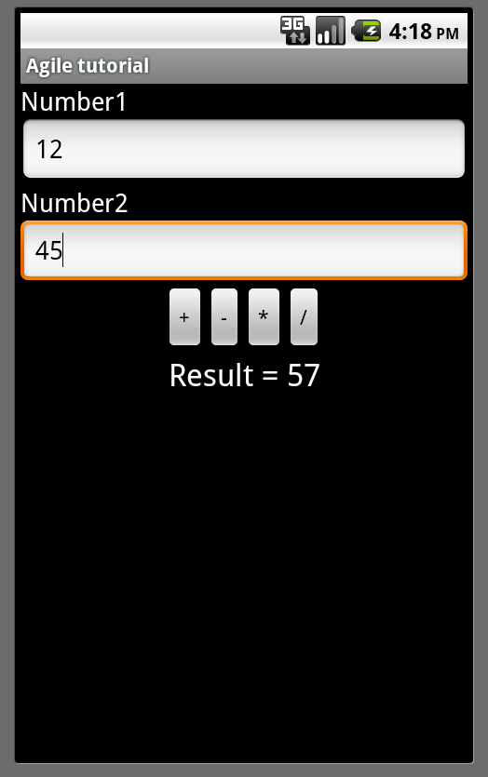
Lab
Create 2 pages
A welcome page with a link to the second page
A simple calculator

