Slide 1


New Problems in Distributed Inference for DNN Models on Robotic IoT
ApPLIED ’24, June 17, 2024, Nantes, France
Zekai Sun, Xiuxian Guan, Junming Wang, Fangming Liu, Heming Cui
The University of Hong Kong
Huazhong University of Science and
Technology University
Notes:
Hello, everyone. I’m zekai sun, a third year PhD student co supervised by Professor Cui Heming from The University of Hong Kong We are more than happy to share our paper that appeared in this year’s MICRO, which is titled, ROG A High Performance and Robust Distributed Training System for Robotic IoT.

Slide 2
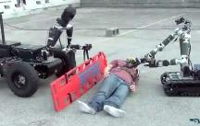
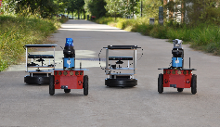
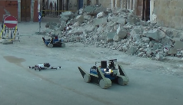
Motivation
The rapid progress in machine learning (ML) techniques has led to remarkable achievements in various fundamental robotic tasks
  e.g., object detection, robotic control, environmental perception
ML models typically require fast and energy-efficient inference.
Placing the entire model on robots not only requires additional computing accelerators on robots (e.g., GPU, FPGA, SoC), but also introduce additional energy consumption (e.g., 162% more for [30] in our experiments).
Distributed inference, which involves inference across multiple GPU devices, has emerged as a promising approach.
  Fast: accelerates the inference process by leveraging the high computing capabilities of powerful GPUs
  Energy-efficient: alleviates the local computational burden
object detection
robotic control
environmental perception
Notes:
Nowadays, many intelligent robotic tasks such as rescue and disaster response involve recognition or action control with machine learning models, and they are typically cooperatively deployed over a team of robots to leverage the limited computation resources on robots.
Since the models cannot be pretrained against every possible situations, such ML models often require real-time training to adapt to changing environments.
However, robots in the filed lack stable internet access to a cloud data center and could only communicate with other robots via the robotic IoT networks.
This motivates distributed training among the robot team via the robotic IoT to accelerate the real-time training.

Slide 3
Existing Distributed Inference on Robotic IoT
All existing parallel methods for distributed inference in the data center are ill-suited for robotic IoT.
  Data parallelism (DP): replicates the model across devices, and lets each replica handle one mini-batch (i.e., a subset that slices out of an input data set)
  Tensor parallelism (TP): splits a single DNN layer over devices;
  Pipeline parallelism (PP): places different layers of a DNN model over devices (layer partitioning) and pipelines the inference to reduce devices’ idling time (pipeline execution)
Notes:
All reduce
Gradient compression

Slide 4
Problem 1 (Data parallelism)
In data center, Data parallelism is widely used that partitions input data across multiple devices, such as GPUs.
  Each device maintains a complete model replica and independently processes a subset of the input data (mini-batch, e.g.,2 image), aggregating results to generate the final output (e.g.,16 image)..
  Data parallelism’s scalability is constrained by the total batch size.
The small batch sizes inherent to robotic IoT applications hinder the mini-batch computation, rendering DP inapplicable for robotic IoT.
  Real-time performance is crucial in robotic applications, necessitating immediate inference upon receiving inputs, which typically have smaller batch sizes (e.g.,1 image).
  For example, in our experiments, the robot constantly obtains the latest images from the camera for inference, with a batch size of only 1.
  These small batches cannot be further split into mini-batches (e.g., 1/4 of an image), a fundamental requirement for effective data parallelism
Notes:
All reduce
Gradient compression

Slide 5
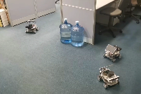
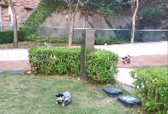
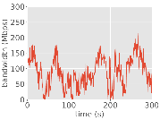
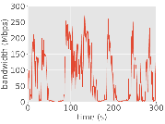
Characteristics of Robotic IoT
Robotic IoT systems’ wireless transmission is constrained by limited bandwidth
  The practical instability of wireless networks.
        The recorded bandwidth fluctuation in wireless networks caused by movement and obstacles
  The theoretical upper limit of wireless transmission technologies.
  For instance, Wi-Fi 6, the most advanced Wi-Fi technology, offers a maximum theoretical bandwidth of 1.2 Gbps for a single stream.
            GPU devices in data centers are interconnected using high-speed networking technologies such as InfiniBand or PCIe, offering bandwidths ranging from 40 Gbps to 500 Gbps
      the limited hardware resources on the robot can not fully play the potential of Wi-Fi 6.
Indoors （office）
Outdoors (garden)
Notes:
All the above problems lead us into thinking, why existing work cannot achieve the two goals.
We show that the key reason is that their model update synchronization in the granularity of a whole model is too coarse grained to adapt to the bandwidth fluctuation in robotic IoT.
We compare the real-time fluctuating bandwidth capacity of a worker against its computation and transmission of model updates in the upper right chart.
From the chart we can see that, as the coarse-grained whole model transmission cannot fit in the fluctuating bandwidth, the worker must wait until the transmission of a whole model finishes, and it has no chance to balance its transmission time with other workers adaptively against the real-time bandwidth.
This leads to inevitable imbalanced transmission time among the workers and stall.

Slide 6
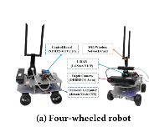
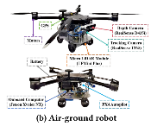
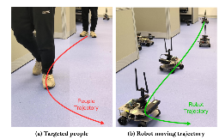
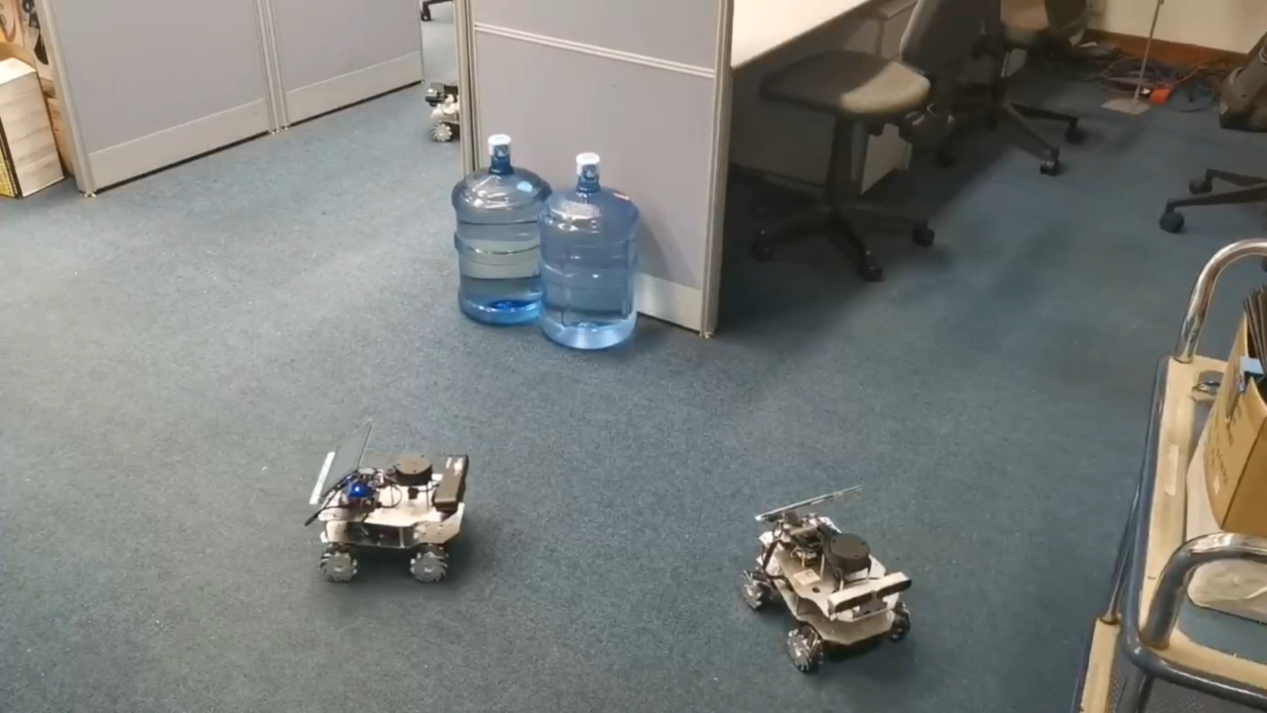
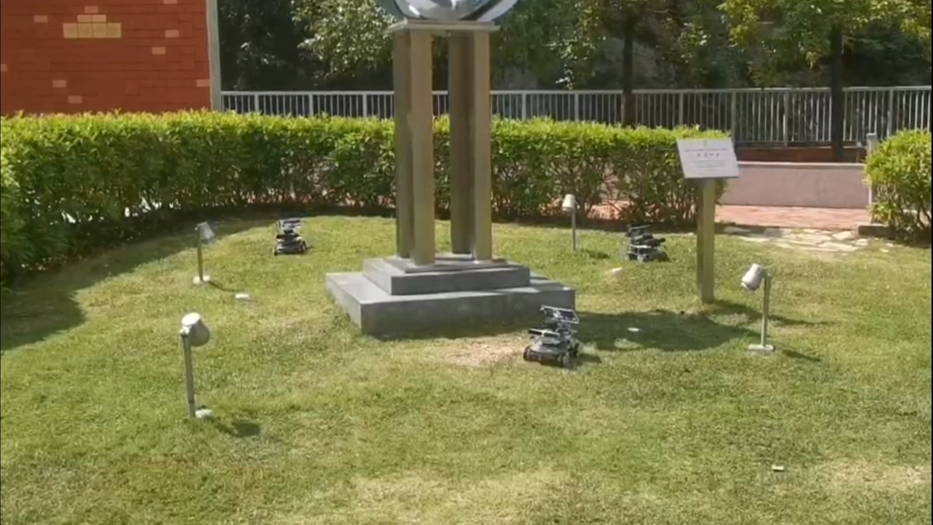
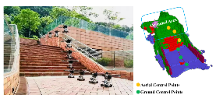
Real-world Evaluation
Evaluation settings
  Real-world robots: robots with NVIDIA Jetson Xavier NX
  Networks: mesh networks based on 802.11ac
  Real-world wireless networks and environments: indoors (laboratory with desks and separators); outdoors (campus garden with trees and bushes).
  Workload: Kapao, a real-time people-tracking application, and AGRNav, an autonomous
  navigation application.
Kapao
AGRNav
Indoor
Outdoor
Notes:
We implemented ROG as an easy to use pytorch optimizer and it is extensible to any imperative deep learning frameworks.
We evaluated ROG against the baselines such as SSP and FLOWN on real world four wheel robots equipped with high end NVIDIA Jetson Chips optimized for AI computing.
We formed the robotic IoT networks by building a mesh network among the robots based on WiFi5.
The evaluated applications include domain adaptation and implicit mapping that require real-time training of the machine learning models.
We selected two representative environments for the robotic tasks, which is indoors in our laboratory with desks and separators and outdoors in our campus garden with trees and bushes.

Slide 7
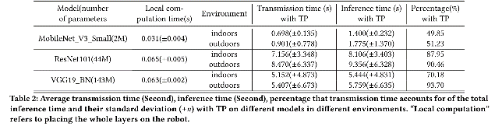
Problem 2 (Tensor parallelism )
TP is used mainly for large layers that are too large to fit in one device in data centers and require dedicated high-speed interconnects (e.g., 400 Gbps for NVLink).
  By partitioning parameter tensors of a layer across GPUs, TP allows concurrent computation on different parts of this tensor but requires an all-reduce communication to combine computation results from different devices
TP requires frequent synchronization among devices, leading to unacceptable communication overhead in robotic IoT
  e.g., the inference time with TP was up to 143.9X slower than local computation in our experiments
Notes:
All reduce
Gradient compression

Slide 8
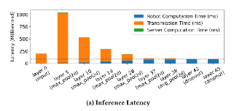
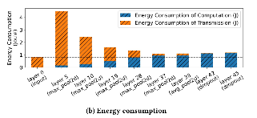
Problem 3 (Pipeline parallelism)
Existing distributed inference approaches in robotic IoT primarily adopt the PP paradigm (layer partition and pipeline execution)
Focus on layer partitioning of PP.
  pipeline execution enhances inference throughput rather than reducing the completion time of a single inference
DNN layer partitioning methods constitute various trade-offs between computation and transmission, taking into account application-specific inference speed requirements and energy consumption.
  Based on the fact that the amounts of output data in some intermediate layers of a DNN model are significantly smaller than that of its raw input data
Notes:
All reduce
Gradient compression

Slide 9
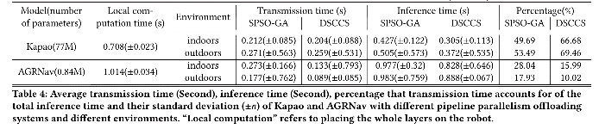
Problem 3 (Pipeline parallelism)
Existing methods based on PP face significant challenges due to transmission bottlenecks in robotic IoT, which are inherent to the PP’s scheduling mechanism
Even with optimal layer partitioning, such transmission overhead inherent to PP’s scheduling mechanism still becomes a substantial bottleneck due to the limited bandwidth of robotic IoT (e.g., up to 69% of inference time in our experiments)
Notes:
All reduce
Gradient compression

Slide 10
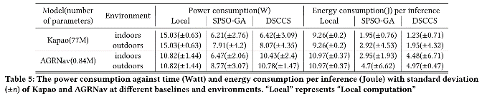
Problem 3 (Pipeline parallelism)
Such transmission overhead not only leads to prolonged inference time but also to high energy consumption during the data transmission phase, referred to as transmission energy consumption
PP is unable to overlap the transmission and computation phases within the same inference to alleviate the transmission overhead, as it can only overlap these phases across multiple inferences via pipeline execution, which increases inference throughput but not the completion time of a single inference
Notes:
All reduce
Gradient compression

Slide 11
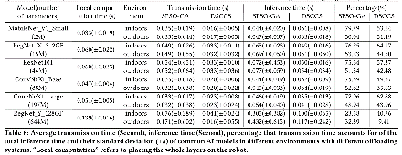
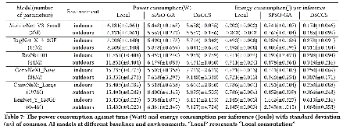
Problem 3 (Pipeline parallelism)
Validation on a larger range of models
  transmission time constitutes a significant portion of the total inference time in robotic IoT when using PP
  The inherent transmission overhead of PP’s scheduling mechanism significantly wastes both inference time and energy.
Notes:
All reduce
Gradient compression

Slide 12
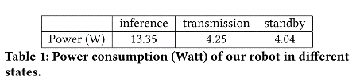
Possible Solutions
Approaches that can reduce communication costs within a single inference task appear to be viable solutions.
only lossless compression methods can be utilized to reduce the transmission volume
  quantization and model distillation potentially sacrifice accuracy with smaller models
A new parallel method that overlaps the computation and transmission phases within the existing PP’s layer partitioning framework has the potential to address the shortcomings of current distributed inference approaches.
  transmission energy consumption encompasses the energy used by the device during the data transmission phase, not merely the energy expended for the transmission itself (such as that by the wireless network card)
Notes:
In conclusion, we presented ROG, a ROw-Granulated distributed training system optimized for robotic IoT networks.
It breaks up the granularity of model synchronization into rows and applies adaptive scheduling to the transmission of each row.
By better trading off between high training throughput and high statistical efficiency under the bandwidth fluctuation in wireless networks, ROG will nurture diverse ML applications deployed on mobile robots in the field and it has broad future work.
Thanks a lot for your attention and any questions are welcome.

Slide 13
Conclusion
In this paper, we explored the problems that hinder the application of existing parallel methods for distributed inference on robotic IoT.
  The failure of data parallelism due to small batch sizes
  The unacceptable communication overhead of tensor parallelism caused by all-reduce communication
  the significant transmission bottlenecks inherent to pipeline parallelism’s scheduling mechanism.
By raising awareness of these issues, we aim to stimulate research efforts towards developing novel parallel methods that address these problems.
We envision that fast and energy-efficient inference will foster the deployment of diverse robotic tasks on real-world robots in the field.
Notes:
In conclusion, we presented ROG, a ROw-Granulated distributed training system optimized for robotic IoT networks.
It breaks up the granularity of model synchronization into rows and applies adaptive scheduling to the transmission of each row.
By better trading off between high training throughput and high statistical efficiency under the bandwidth fluctuation in wireless networks, ROG will nurture diverse ML applications deployed on mobile robots in the field and it has broad future work.
Thanks a lot for your attention and any questions are welcome.

