Slide 1
Blockchains made Lightweight:
A Median Rule for State Machine Replication
Jinfeng Dou , Christian Scheideler
June 17th, 2024

Slide 2
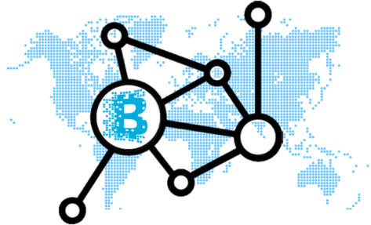
Motivation
Permissionless
proof of work
(delegated) proof of stake
BFT consensus protocols
Blockchain

Slide 3
Motivation
BFT consensus protocols
leaderless,
async msg passing
rotating leaders,
partially sync msg passing
Leaders easy to attack!
Blockchain
[1]Michael J. Fischer, Nancy A. Lynch, Mike Paterson: Impossibility of Distributed Consensus with One Faulty Process. J. ACM 32(2): 374-382 (1985)

Slide 4
Motivation
BFT consensus protocols
Goal: efficient leaderless protocol:
partial synchrony
members can only be blocked
Blockchain
trusted execution environment

Slide 5



Motivation
Our model:
n servers
synchronous rounds
adversary can adaptively block β-fraction
of servers based on state at past round
Server
Server
Server
Network
Blockchain
Client
Client
Client

Slide 6
Motivation
Our model:
n servers
synchronous rounds
adversary can adaptively block β-fraction
of servers based on state at past round
Our approach:
similar to Avalanche (median rule)
Avalanche: bit-wise consensus
We: entire (groups of) transactions
Blockchain
[2] Ignacio Amores-Sesar, Christian Cachin, Philipp Schneider: An Analysis of Avalanche Consensus. SIROCCO 2024: 27-44

Slide 7
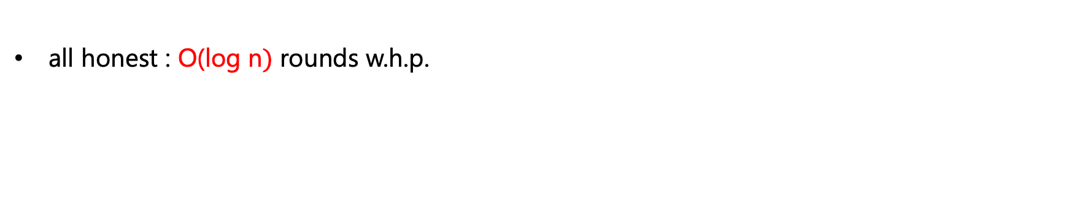
The basic median rule
z
x
y
Number?
Number?
z.
y.
Random server
x:=median{x,y,z}
Random server
all honest : O(log n$)$ rounds w.h.p.
[3]Benjamin Doerr, Leslie Ann Goldberg, Lorenz Minder, Thomas Sauerwald, Christian Scheideler: Stabilizing consensus with the power of two choices. SPAA 2011: 149-158.
6

Slide 8




The $\left(k, ℓ\right)$-median rule
8
$$5$$
2
8
$$⊥$$
5
8
$$⊥$$
Random servers reply 8,5,8,5
8=median rule {5, 8, 8}
Example: The $\left(6, 3\right)$-median rule
[3]Peter Robinson, Christian Scheideler, Alexander Setzer: Breaking the Omega(sqrt{n}) Barrier: Fast Consensus under a Late Adversary. SPAA 2018: 173-182. Pull instead of push.
7

Slide 9




The $\left(k, ℓ\right)$-median rule
8
$$⊥$$
2
$$⊥$$
$$⊥$$
$$⊥$$
8
$$⊥$$
$⊥$=median rule { 8, 8}
Random servers reply 8,8
Example: The $\left(6, 3\right)$-median rule
$β ≤1/8$ : O(log n$)$ rounds w.h.p.
8

Slide 10
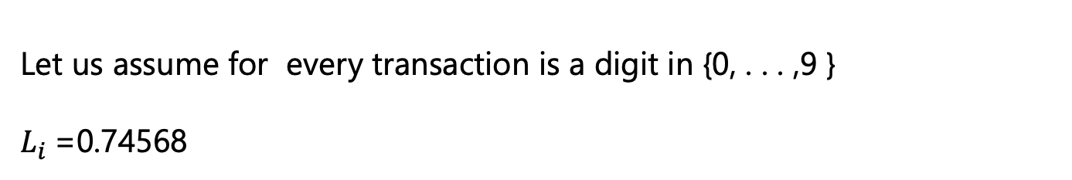

The extend $\left(k, ℓ\right)$-median rule
Transactions${{：C}_{7 }C}_{4 }C_{5 }C_{6 }C_{8 }$
Let us assume for every transaction is a digit in {0, . . . ,9 }
$L_{i}$=0.74568
Server $v_{i}$
9

Slide 11


The extend $\left(k, ℓ\right)$-median rule
0.74568
$$⊥$$
0.32578164
0.63127
$$⊥$$
0.12486
0.32578
$$⊥$$
$L_{i}^{′}$:= median rule {0.74568, 0.12486, 0.32578}
$L_{i}^{′}$:= median rule {0.74568, 0.12486, 0.32578}
$L_{i}^{′}$:= 0.32578
$\tilde{L:}$= 164
$L_{i}$:=${ L}_{i}^{′}°\tilde{L}=$ 0.32578164
Example: The extend $\left(6, 3\right)$-median rule
$β ≤1/8$ : O(log n$)$ rounds w.h.p. to achieve consensus on transaction
10

Slide 12
Motivation to design the compact $\left(k, ℓ\right)$-median rule
Size of the Bitcoin blockchain from January 2009 to May 26, 2024 (in gigabytes)
Bitcoin (BTC) blockchain size as of May 26, 2024

Slide 13


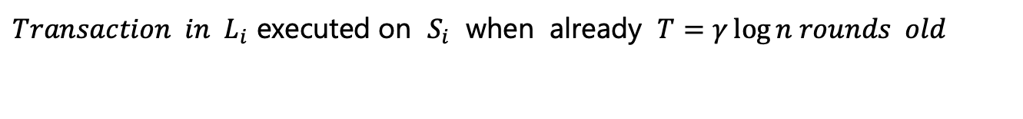


The compact $\left(k, ℓ\right)$-median rule
$$C_{1 }C_{2 }C_{3 }⋯C_{k }{ C}_{k+1 }C_{k+2 }⋯C_{l }$$
committed noncommitted
$${{ C}_{1 }C}_{2 }C_{3 }⋯C_{k }C_{k+1 }C_{k+2 }⋯C_{l }$$
Server $v_{i}$
$$L_{i}$$
$${ at time t}_{i }$$
$S_{i}$:${ \{ (x}_{1 }, t(x_{1 })),{ (x}_{2 }, t(x_{2 })), ⋯{,{ (x}_{m }, t(x_{m }))\}}_{ }$
$Transaction in L_{i}$ executed on $S_{i}$ when already $T=γ\log{n rounds old}$
12

Slide 14

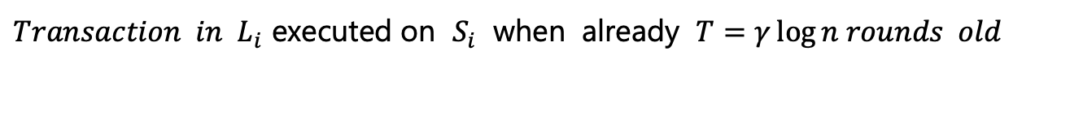

The compact $\left(k, ℓ\right)$-median rule
$$C_{1 }C_{2 }C_{3 }⋯C_{k }C_{k+1 }C_{k+2 }⋯C_{l }$$
committed noncommited
$${ at time t}_{i }$$
$$L_{i}$$
Server $v_{i}$
$S_{i}$:${ \{ (x}_{1 }, t(x_{1 })),{ (x}_{2 }, t(x_{2 })), ⋯{,{ (x}_{m }, t(x_{m }))\}}_{ }$
$S_{i}$:${ \{ (x}_{1 }, t(x_{1 })),{ (x}_{2 }, t(x_{2 })), ⋯{,{ (x}_{m }, t(x_{m }))\}}_{ }$
$Transaction in L_{i}$ executed on $S_{i}$ when already $T=γ\log{n rounds old}$
13

Slide 15


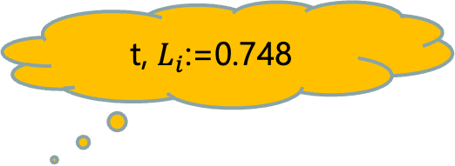








The compact $\left(k, ℓ\right)$-median rule
t-1, 0. 68
t, $L_{i}$:=0.748
t, $L_{i}$:=0.6748
t-2,$⊥$
t-2, $⊥$
0,0
t-1, 0.$6$
Receieve { $0.68$ , $0.67$, $0. 47$}
Requests containing t-2
t-1, 0.$4$7
$L_{i}^{′}$:= median {$0.$68 , $0.67$, $0.47$}
$\tilde{L:}$= 48
t-3, $⊥$
$L_{i}^{′}$:= 0.67
$L_{i}$:=${ L}_{i}^{′}°\tilde{L}=$ 0.6748
$L_{i}$:= 0.748 if 6 has waited $T=γ\log{n rounds}$
Example: The compact $\left(6, 3\right)$-median rule
14

Slide 16



The compact $\left(k, ℓ\right)$-median rule
t-1, 0. 68
t-2,$⊥$
t, $⊥$
t-2, $⊥$
0,0
t-2, $⊥$
Receieve { $0.68$, $0.47$}
t-1, 0.47
Requests containing t-2
⊥:= median {$0.$68, 0.4$7$}
t-3, $⊥$
Example: The compact $\left(6, 3\right)$-median rule
$β ≤1/8$ : O(log n$)$ rounds w.h.p. to achieve consensus on transaction
15

Slide 17
Merkle hash forest
(a,c)
(a,b)
(c,d)
(e,f)
a
b
c
d
e
f
a b c d e f

Slide 18
Merkle hash forest
(a,h)
(a,d)
(e,h)
(a,b)
(c,d)
(e,f)
(g,h)
a
b
c
d
e
f
g
h
a b c d e f g h

Slide 19
Merkle hash forest
(a,h)
(a,d)
(e,h)
(i,l)
(a,b)
(c,d)
(e,f)
(g,h)
(i,j)
(k,l)
a
b
c
d
e
f
g
h
i
j
k
l
a b c d e f g h
i j k l

Slide 20
Merkle hash forest
(a,h)
(a,d)
(e,h)
(i,l)
(a,b)
(c,d)
(e,f)
(g,h)
(i,j)
(k,l)
a
b
c
d
e
f
g
h
i
j
k
l
a b c d e f g h
i j k l

Slide 21
Thank you for your attention!

