Slide 1

The Next 700 Benchmarking Frameworks for Concurrent Data Structures
Ravil Galiev, ITMO University
Michael Spear, Lehigh University
Vitaly Aksenov, City University of London

Slide 2

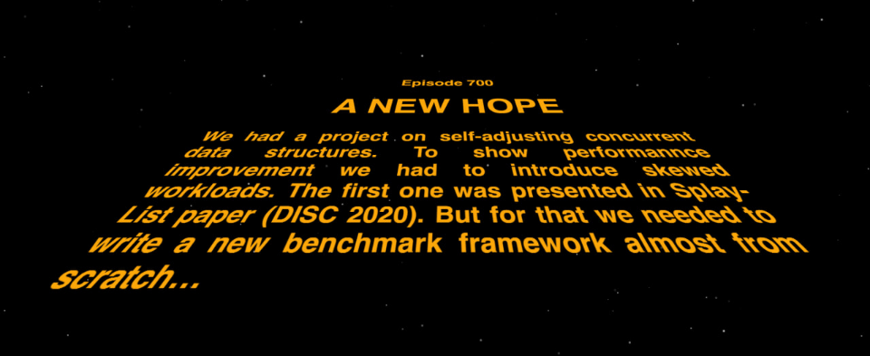
Long story short
We had a project on self-adjusting concurrent data structures
We needed to have skewed workloads to show the performance improvement
First skewed workloads were presented in Splay-List paper (DISC 2020)
But for that we needed to write a new benchmark framework almost from scratch…

Slide 3
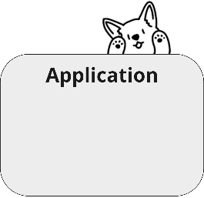
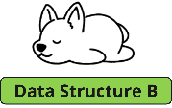


Data structures
interface Map<K, V>:
V get(K)
V insert(K, V)
V remove(K)
How to compare different data structures?
Note that we are not restricted by maps.
?

Slide 4
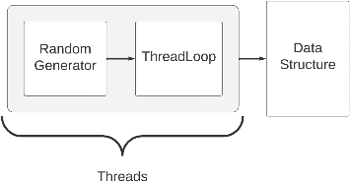

Existing solutions
Benchmarks for Concurrent Data Structures:
Synchrobench
Setbench
YCSB
TPC
Scal
Synch
Disadvantages:
Not enough different skewed workloads
Difficulty adding new workloads
Difficulty in changing parameters
In some, workloads have limited working time
Limited interface of the tested object

Slide 5
Requirements
Modularity
Duration
Heterogeneity
Realism
Exploration
Portability

Slide 6
Requirements
Modularity
  it should be easy to add new workloads and to reuse existing workloads / code
Duration
Heterogeneity
Realism
Exploration
Portability

Slide 7
Requirements
Modularity
Duration
  workloads should be able to run for a fixed number of operations, a fixed time, or infinitely
Heterogeneity
Realism
Exploration
Portability

Slide 8
Requirements
Modularity
Duration
Heterogeneity
  the benchmark should be aware of all threads, even internal modification threads; and should allow different operation mixes among threads.
Realism
Exploration
Portability

Slide 9

Requirements
Modularity
Duration
Heterogeneity
Realism
  the behavior of the benchmark should mirror real-world workloads, and be predictive of the behavior that an application would experience. In particular, this must include a robust understanding of skew, as it is an important object of study.
Exploration
Portability

Slide 10
Requirements
Modularity
Duration
Heterogeneity
Realism
Exploration
  it must be easy to vary parameters of the workload and data structure
Portability

Slide 11
Requirements
Modularity
Duration
Heterogeneity
Realism
Exploration
Portability
  it should be easy to test the same workloads in different programming languages

Slide 12

Solution
Our Framework is implemented in C++ and Java.
A workload consists of several entities of four types:
Distribution – a distribution of a random variable;
DataMap – converts an index into a key/value;
ArgsGenerator – creates operands for an operation;
ThreadLoop – defines the next operation and performs it on the data structure.

Slide 13
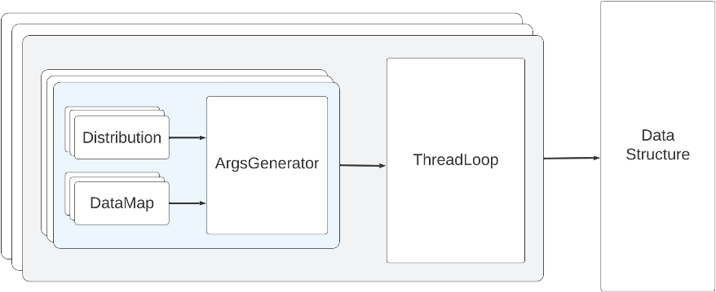
Solution

Slide 14
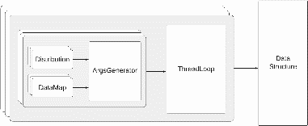
Distribution
Distribution simulates a random variable.
It generates some value from a distribution that is later translated into an appropriate key or value by an ArgsGenerator.
A Distribution's next() method generates a value within some range.
Extension: Mutable Distribution that allows to change the distribution at run time, e.g., by modifying the range of keys.
interface Distribution:
int next()
interface MutableDistribution:
int setRange(newRange)
int next(newRange)

Slide 15
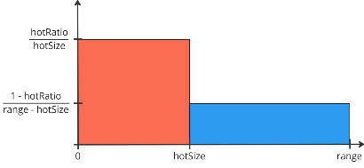
Implemented Distributions
Uniform Distribution
Zipfian Distribution
Skewed Uniform Distribution
Density function

Slide 16
DataMap
The DataMap is used by an ArgsGenerator to translate an “index-key” into a key or value, e.g., via computation and/or table lookups.
Three available implementations: a shuffled array, a hash, and an identity map.
An ArgsGenerator asks a Distribution for an index-key and passes it through DataMap to obtain an argument.
random shuffle
1 | 2 | 3 | 4 | 5 | 6 | 7 | 8
8 | 6 | 4 | 2 | 7 | 1 | 3 | 5
next(i):
return array[i]

Slide 17

ArgsGenerator
ArgsGenerators are used to generate arguments for operations.
ArgsGenerator can be stateful.
For example, a thread-private ArgsGenerator can hold a knowledge of recently requested keys in order to choose one of them in the future operations.
interface ArgsGenerator:
K nextGet()
K nextInsert()
K nextRemove()

Slide 18
Implemented ArgsGenerators
Default ArgsGenerators
Skewed Sets ArgsGenerators
Creakers and Wave ArgsGenerators
Leafs Handshake ArgsGenerators
Temporary Distributions ArgsGenerators

Slide 19
Default ArgsGenerator
The Default ArgsGenerator accepts one of the existing distributions and one of the existing DataMaps as input and selects the next key based on this distribution from the chosen DataMap.

Slide 20
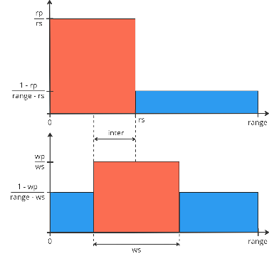
Skewed Sets ArgsGenerator
The Skewed Sets ArgsGenerator uses two Skewed Uniform Distributions separately for read and update operations:
rp% of read operations are performed on rs% of range where a key is taken uniformly.
wp% of update operations are performed on ws% of range where a key is taken uniformly.
inter% of keys are in the intersection of the working sets of read and update operations.
Note: ArgsGenerator defines an index and converts it into a key using a DataMap.
read
update

Slide 21
Creakers and Wave ArgsGenerator
The Creakers and Wave ArgsGenerator models a temporal locality: recently inserted keys are requested more often, but become obsolete over time.
For example, musical hits are listened to more often when they have just been released. Then, something new is released and the popularity of the old ones decreases.

Slide 22
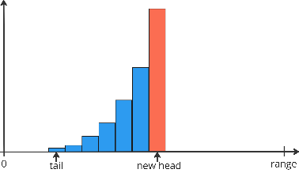
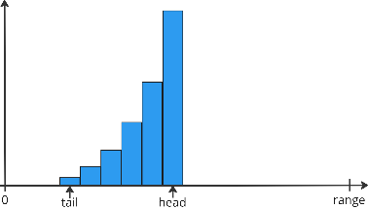

Creakers and Wave ArgsGenerator
The Wave is a subset of all keys yielded to an array and specified by a head and a tail. It generates a new key according to the following rules:
nextGet() — select a key from the Wave according to some specified distribution;
nextInsert() — select the key next to the head of the Wave, and makes it the new head (or increments the head);

Slide 23
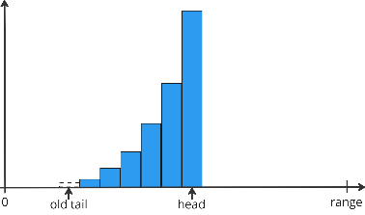


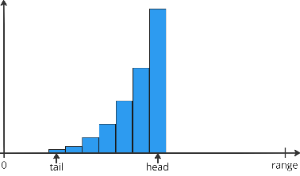
Creakers and Wave ArgsGenerator
The Wave is a subset of all keys yielded to an array and specified by a head and a tail. It generates a new key according to the following rules:
nextGet() — select a key from the Wave according to some specified distribution;
nextInsert() — select the key next to the head of the Wave, and makes it the new head (or increments the head);
nextRemove() — the Wave returns the key of the current tail and moves/increments the tail by one.

Slide 24

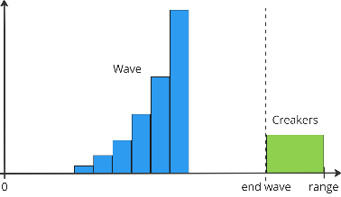
Creakers and Wave ArgsGenerator
Creakers is a subset of keys that are requested rarely but permanently.
It is used to check how well the data structure copes with such keys in the presence of rapidly growing and equally rapidly discarded keys from the Wave.
Especially important for self-adjusting data structures.

Slide 25
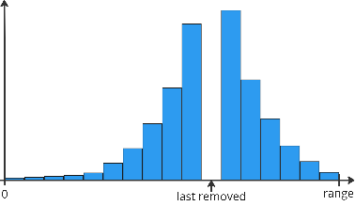
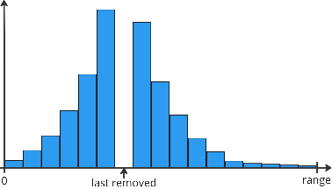
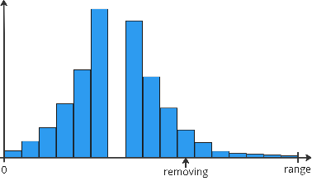
Leafs Handshake ArgsGenerators
Leafs Handshake ArgsGenerator is stateful and mutable: a key for an insert operation depends on the argument of the latest remove operation.
insert distribution
Intuitively, the closer the key to the last removed one, the more probability that this key will be selected for an insertion.
It just maintains the last removed element r, chooses the side from [r - 1, 1] and [r + 1, range] with probability 1/2, and returns an element from the chosen side using the specified distribution.

Slide 26
Temporary Distributions ArgsGenerator
The Temporary Distributions ArgsGenerator allows a generator to change over time, e.g., to model daily fluctuations in search queries.
This generator has two types of states:
k-th excited state — the keys are selected using k-th Distribution, e.g., there is a hot set of keys;
a dormant state — all keys are selected with a provided Distribution. This state happens between k-th and k+1-th excited states.
To support infinite execution, the excited states are chosen in a cyclic manner, i.e., after the latest excited state it returns to the first dormant state.
Each state is run for a number of operations (in a future: a period of time).
This reflects the daily-periodic pattern of requests, e.g., in social networks.

Slide 27
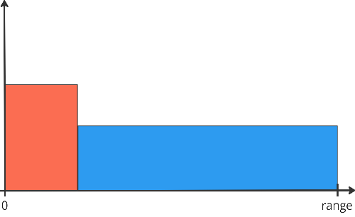
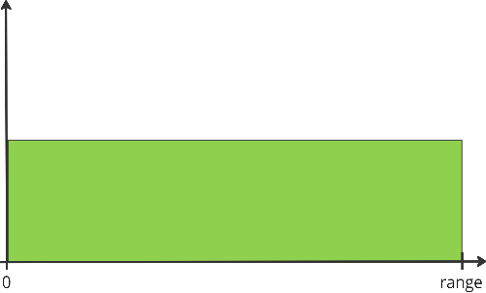
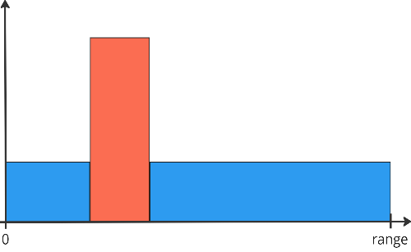
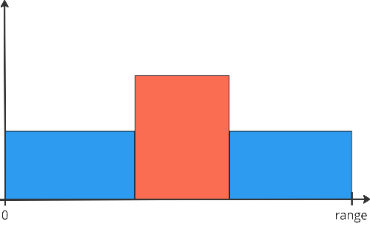
Temporary (Skewed Sets) ArgsGenerator
1-th excited state:
generates e_1 operations
distribution for all operations
dormant state:
generates d_1 operations
2-th excited state:
generates e_2 operations
dormant state:
generates d_2 operations
3-th excited state:
generates e_3 operations
dormant state:
generates d_3 operations
1-th excited state:
generates e_1 operations

Slide 28

ThreadLoop
The ThreadLoop chooses the type of an operations and asks the arguments from some argument stream.
Threads can use different ThreadLoop implementations.
Main method step() chooses and performs an operation.
step() is called in a conditional loop by run() method.
One can override run() when more complicated logic is needed, for example, a maintenance daemon thread.
ThreadLoop is also a utility class: it calculates different statistics to compare later.
interface ThreadLoop:
void step()
void run()

Slide 29
Implemented ThreadLoops
Default ThreadLoop
Temporary Operations ThreadLoop

Slide 30
Implemented ThreadLoops
Default ThreadLoop
  The Default ThreadLoop selects the next operation with some fixed probability
Temporary Operations ThreadLoop

Slide 31
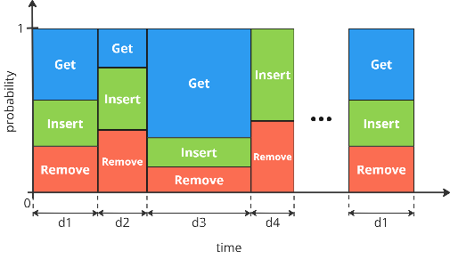
Implemented ThreadLoops
Default ThreadLoop
Temporary Operations ThreadLoop
  The Temporary Operations ThreadLoop selects the next operation depending on a time interval.

Slide 32

Experimental setup
We took three implementations of concurrent binary search trees in Java:
BCCO BST — Red crosses
Contention-Friendly BST — Green triangles
Concurrency-Optimal BST — Blue circles
?

Slide 33
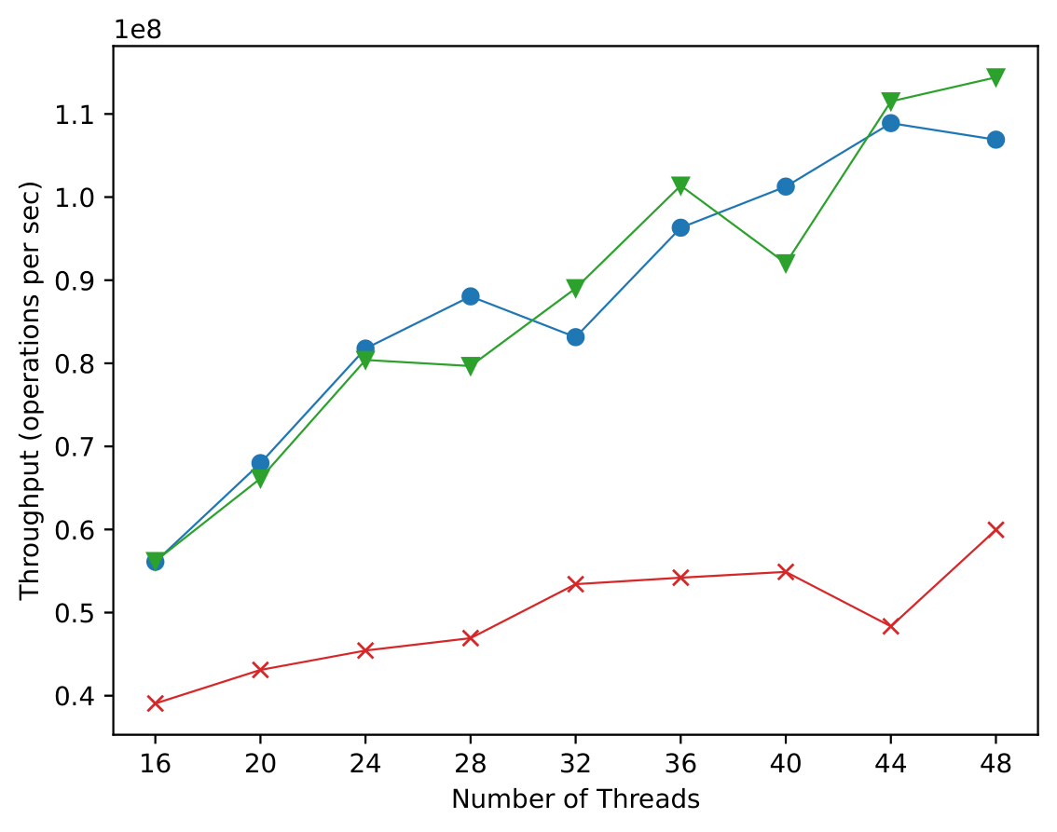
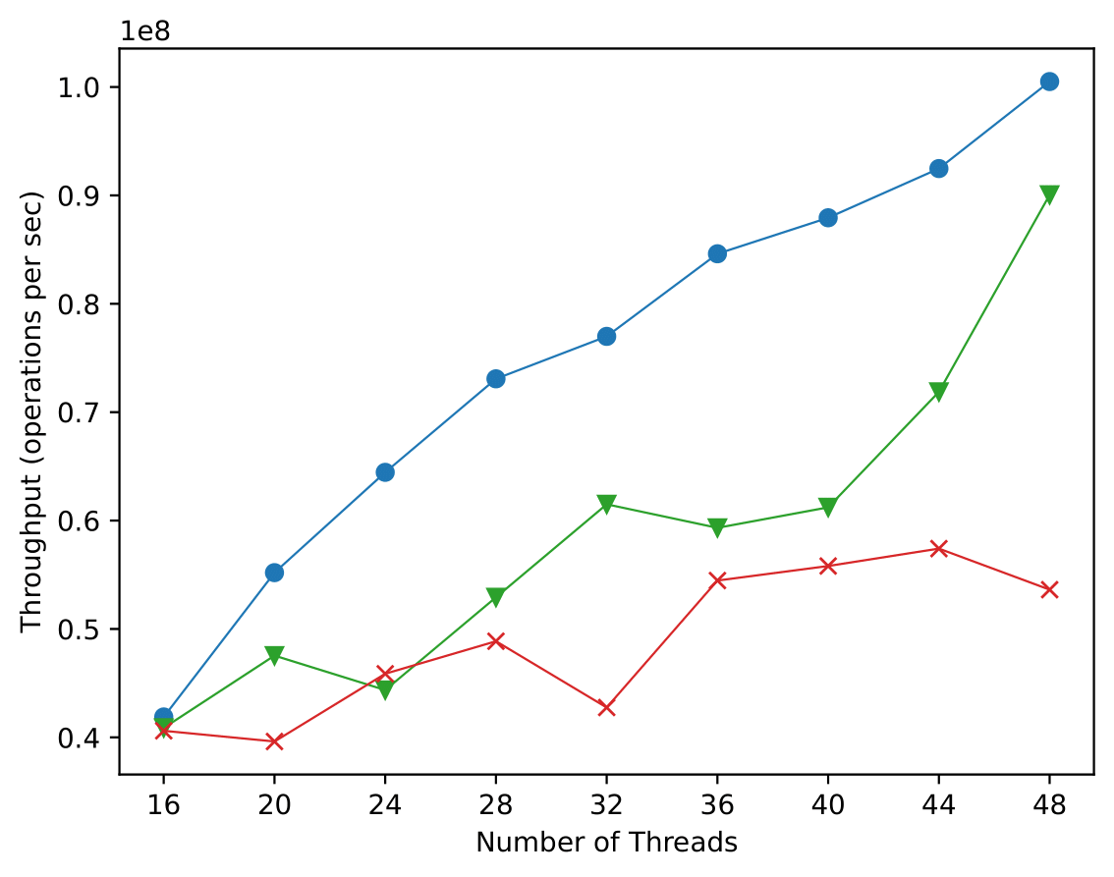
Standard Experiments
Uniform | Zipfian

Slide 34
Binary search trees analysis
All of them are partially-external and the main difference between them is how they handle physical removals and balancing rotations.
BCCO-BST — a working thread always removes nodes physically and maintains balance by rotations, if necessary.
Contention-Friendly BST — a working thread makes only logical removals. However, there is a special daemon thread responsible for physical removals and rotations.
Concurrency-Optimal BST — a thread performs physical removals immediately but does not perform rotations at all.
?

Slide 35
Non-shuffle Wave Workload
Let's try to show the strengths of BCCO-BST.
The Non-shuffle Wave Workload is based on Creakers and Wave ArgsGenerator without the Creakers and with Identity DataMap.
This workload adds new keys to the edge of the tree disrupting the balance. That leads to the performance problems of poorly balanced trees.
Notes:
Подробности описаны в 5-ой главе

Slide 36
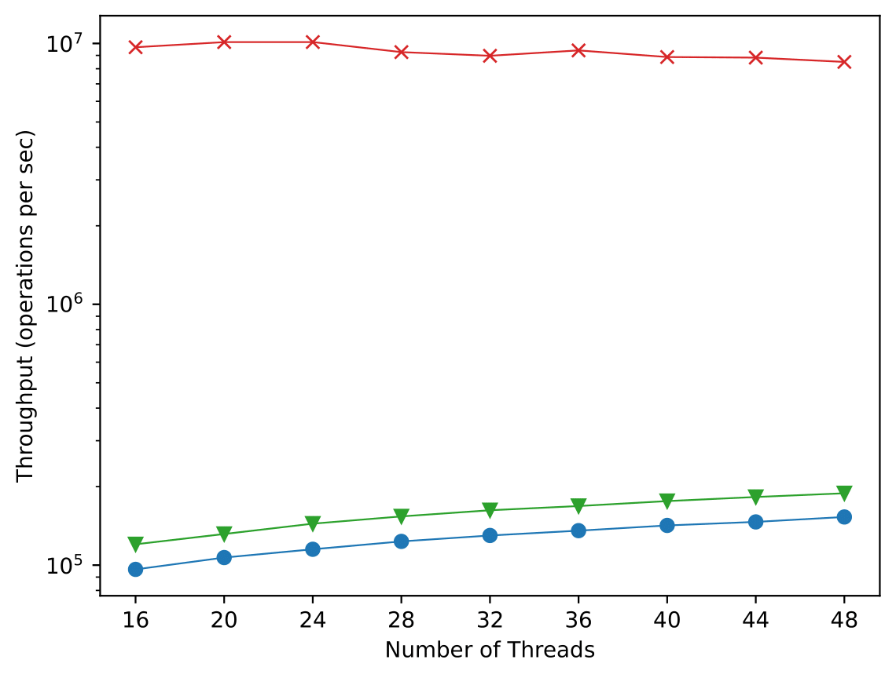
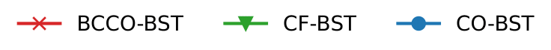
Non-shuffle Wave Workload
Parameters:
range is 10^6;
wave size is 20%;
update ratio is 5%;
wave distribution — Zipfian distribution with 𝛼=1;
without creakers.
This result is related to the fact that BCCO-BST always rotates which is not the case of CF-BST and CO-BST.
Notes:
Подробности описаны в 5-ой главе

Slide 37
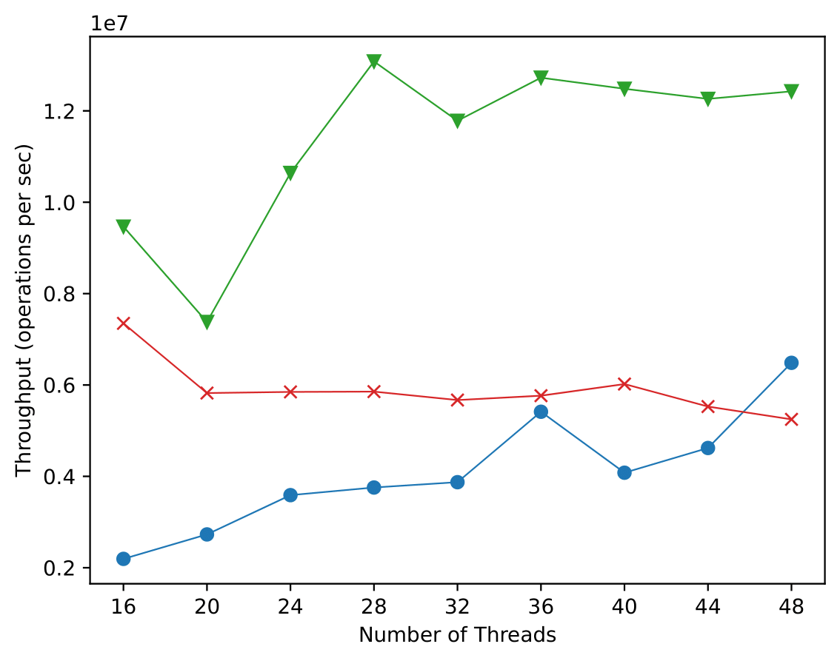
Non-shuffle Wave Workload
Parameters:
range is 5000;
wave size is 10%;
update ratio is 20%;
wave distribution — Zipfian distribution with 𝛼=1;
without creakers.
Since the tree size is quite small, the daemon thread in CF-BST manages to balance the tree quickly.

Slide 38
Binary search trees analysis
According to previous tests, we see that CF-BST does not work better, but certainly not worse than others.
Let's try to come up with a load at which CF-BST will perform worst.
We know that in CF only the daemon thread is responsible for physical removals, while in others physical removals occurs immediately.
Note that mostly leaves are physically removed from partially-external trees.

Slide 39
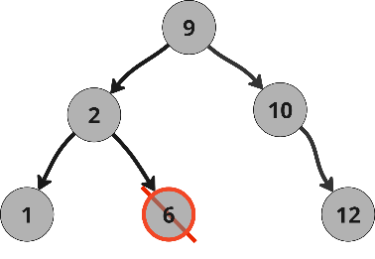
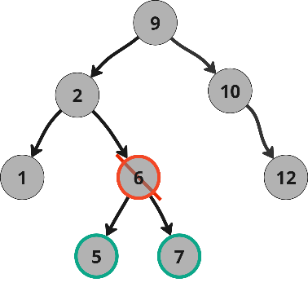
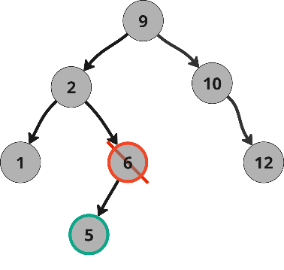
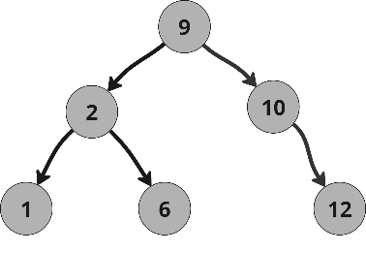
Binary search trees analysis
Suppose there are no physical deletions
remove(6)
insert(5)
insert(7)
?

Slide 40
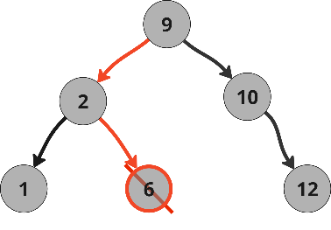
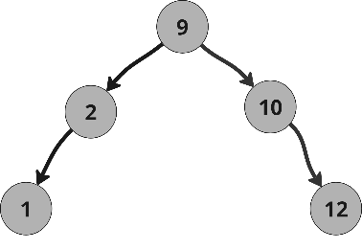
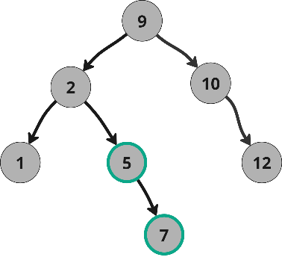
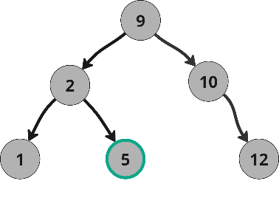
Binary search trees analysis
BCCO and CO BSTs case
remove(6)
insert(5)
insert(7)

Slide 41
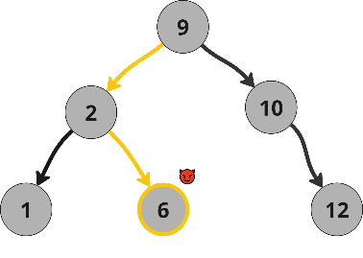
Binary search trees analysis
CF-BST case
If the daemon thread is far from the remote node, the result will be the same as the others
remove(6)
insert(5)
insert(7)
?

Slide 42
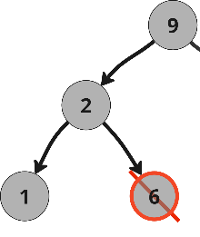
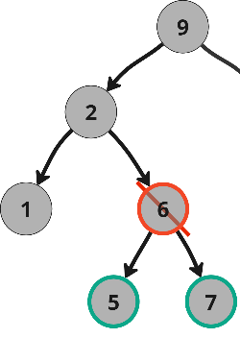
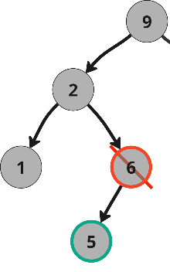
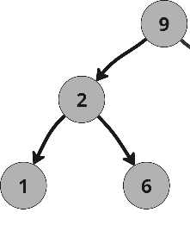
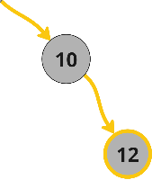
Binary search trees analysis
CF-BST case
If the daemon thread is located far from the remote node, then the daemon thread may not have time to physically remove it and the tree will grow
remove(6)
insert(5)
?
insert(7)

Slide 43
Binary search trees analysis
If there are too many situations when the daemon thread will not have time to physically remove nodes, then the tree may grow so much that this will affect the speed of work.
Let’s develop such a workload.
?

Slide 44
Infinite Leafs Handshake Workload
We need that after removing a node, its neighbors are inserted.
Therefore, when we generate the key for the:
remove operation — we save the generated key, which will be known to all threads;
insert operation — we will produce a key that is as close as possible to the recently removed one.
The name of this ArgsGenerator is Leafs Handshakes.

Slide 45
Infinite Leafs Handshake Workload
Since in order to block a remote node, there must be much more insertions relative to removals, we will soon insert all possible keys.
In order to make the test infinite, we use the Temporary Operations ThreadLoop. And it will have three time intervals:
The filling interval — there are more insertions than removal;
The read interval — there are only read operations;
The cleaning interval — there are more removals than insertions.

Slide 46
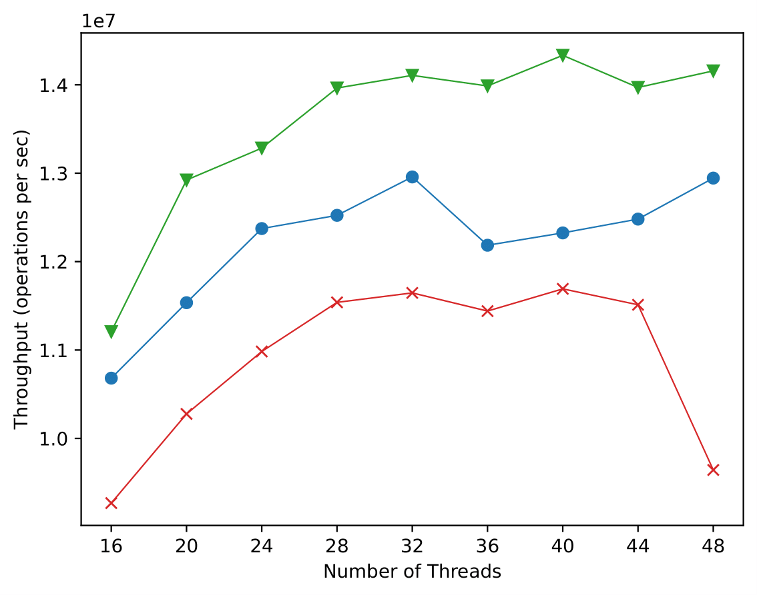
Infinite Leafs Handshake Workload
Parameters:
range is 10⁵;
durations of intervals — 10⁴ / 5000 / 10⁴;
insert ratios — 60% / 0% / 40%;
remove ratios — 40% / 0% / 60%;
distributions — uniform;
insert distribution — Zipfian distribution with 𝛼=2.
Since the tree size is quite small, the daemon thread in CF-BST manages to physically remove nodes.

Slide 47
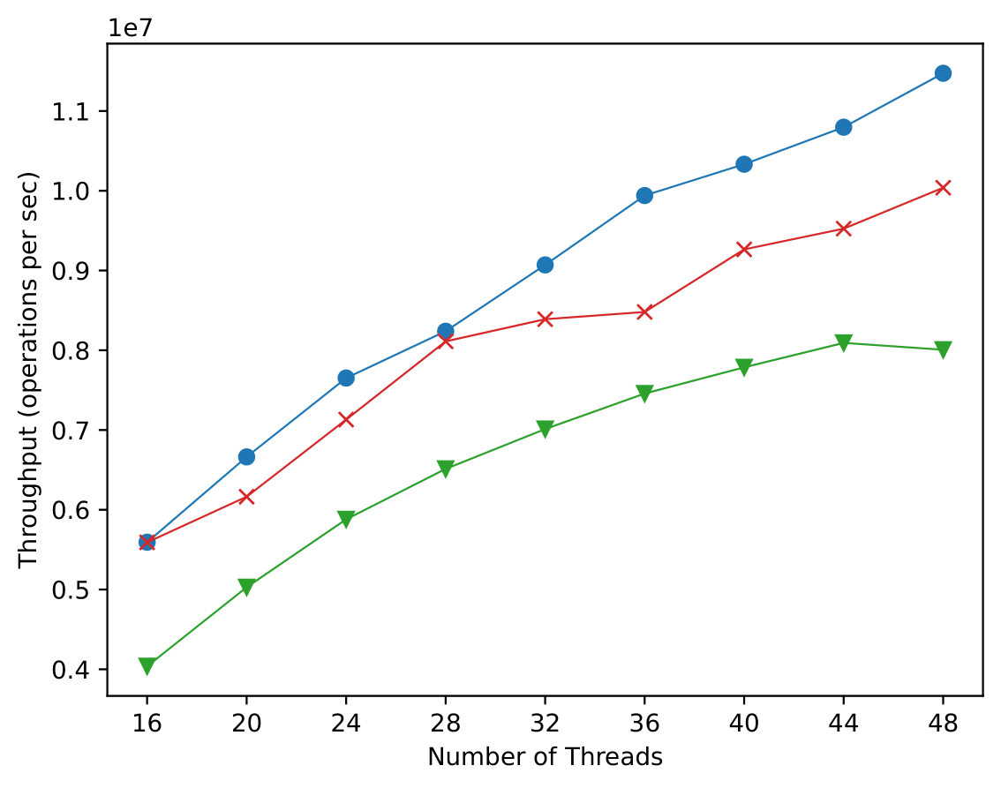
Infinite Leafs Handshake Workload
Parameters:
range is 10⁸;
durations of intervals — 10⁵ / 10⁵ / 10⁵;
insert ratios — 80% / 0% / 20%;
remove ratios — 20% / 0% / 80%;
distributions — uniform;
insert distribution — Zipfian distribution with 𝛼=0.99.
When the tree size is large, the daemon thread in CF-BST not have time to traverse the entire tree and physically remove nodes.

Slide 48
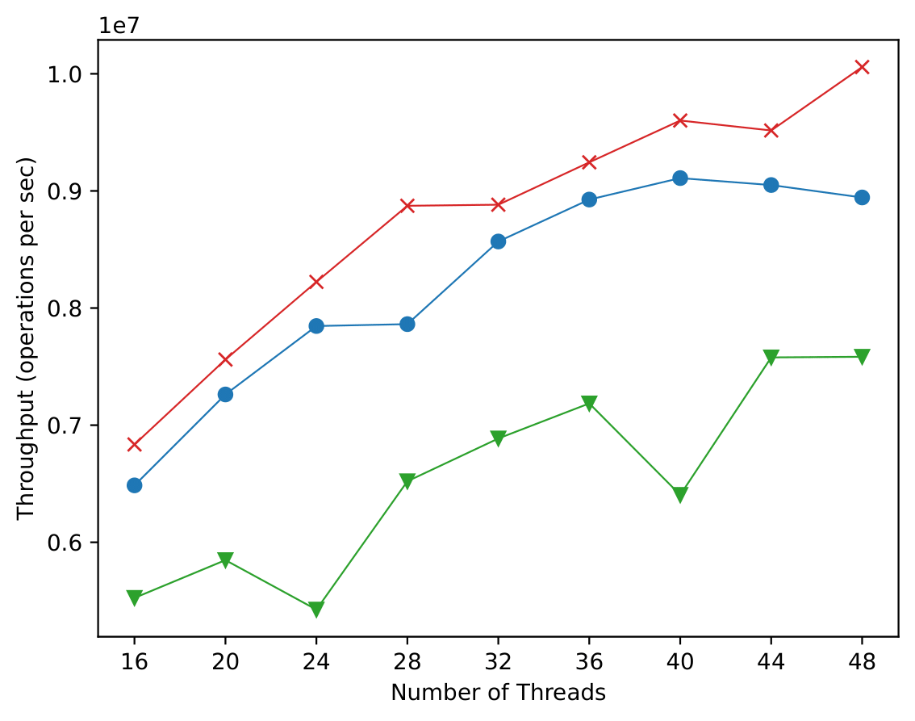
Infinite Leafs Handshake Workload
Parameters:
range is 10⁷;
durations of intervals — 20000 / 20000;
insert ratios — 90% / 10%;
remove ratios — 10% / 90%;
remove distribution — uniform;
insert distribution — Zipfian distribution with 𝛼=0.99.
The higher the skew between insert and remove operations, the worse CO-BST handles the workload. This is because with more skew there are more chances that the tree will grow non-uniformly making the CO-BST perform poorly.

Slide 49
Standard Experiments
Uniform | Zipfian

Slide 50
Experiment

Slide 51
Benchmark details
For convenient configuration, we have to use the builder pattern.
Therefore, one needs provide a builder for each entity.
The builders can be converted to the JSON format which is accepted by the benchmark as a parameter.
There is another StopCondition entity. It tells the ThreadLoop when it should terminate.

Slide 52
Benchmark details
Benchmarking consists of three parts:
Pre-filling
  sequential and multithreaded pre-fillings are possible;
Warm-up
  warm-up the JIT compiler in Java;
  warm-up the data structure to working speeds;
  warm-up specific workloads, e.g., Creakers subset in Creakers and Wave;
Test
  the main part that calculates statistics.

Slide 53
Benchmark details
The configuration contains the StopCondition and the array of the ThreadLoopBuilders and how many ThreadLoops with these configurations.
In addition, the C++ version allows for the configuration to contain parameters for pinning threads to cores.

Slide 54
Benchmark details
To interact with the data structure (in ThreadLoop), unified functions are used that calculate statistics, e.g., executeGet(), executeInsert(), and executeRemove().
Because of to unification, you can test different types of data structures (e.g., Map, Set) without changing the work of the ThreadLoop.

Slide 55
Takeaway
We implemented a benchmark framework to evaluate the efficiency of concurrent data structures.
The proposed solution meets our requirements: Modularity, Duration, Heterogeneity, Realism, Exploration, Portability.
The implemented benchmark framework is quite extensive.
https://github.com/Mr-Ravil/Benchmark-v700

Slide 56
Future work
We plan to:
study the impact of the overhead of our framework on test results;
conduct a more thorough evaluation on several operating system and CPU combinations to ensure that there are no platform-specific performance anomalies;
provide additional statistics such as:
latency;
statistics for some time ranges.

Slide 57
Future work
We intend to continue refining the tool, particularly with regard to ergonomic issues that make it easier to integrate new workloads and data structure interfaces such as stacks, queues, etc.
We also intend to release our benchmark as open-source code, and to implement a review process for new contributions, so that we can continue to grow the utility of the tool and increase its value to multiple research communities.

Slide 58

Thank you for
your attention!
Illustrations by
@svartvein

