Slide 1
Per-Triangle Shadow Volumes Using a View-Sample Cluster Hierarchy
Erik Sintorn, Viktor Kämpe, Ola Olsson and Ulf Assarsson
Chalmers University of Technology

Slide 2
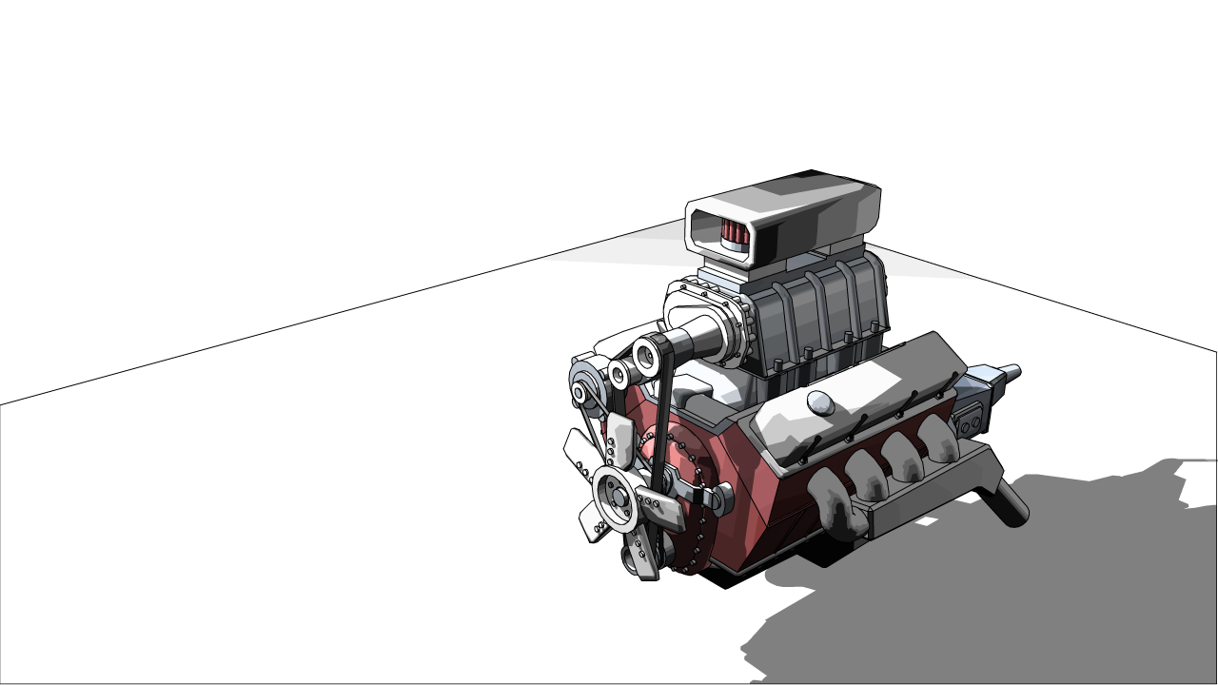
Shadow Volumes!?
Pixel Accurate Shadows are still challenging
  Raytracing, Irregular z-buffer, etc, too slow.
  Simple shadow volumes still fastest in many cases.
Shadow Maps are de-facto standard in games
  Artifacts hidden by over-filtering
  Might be unacceptable in CAD/Modelling/NPR
Notes:
Hello,
Some of you may be surprised to see me talking about Shadow Volumes in 2014, so I will start by reminding everyone that Pixel Accurate Shadows in real-time is still a challenging problem.
There are several alternative methods in the literature, but in practice Shadow Volume Methods are still by far the fastest approach in many cases.
In games, the common solution to pixel accurate shadows is to not even try, and use Shadow Maps instead. The artifacts that arise from shadow maps can usually be nicely hidden by overfiltering the result, which usually looks good.
In some cases, for example when modelling a scene, in CAD renderings and for NPR techniques, artifacts are unacceptable however, and some form of pixel accurate shadows are desired.

Slide 3
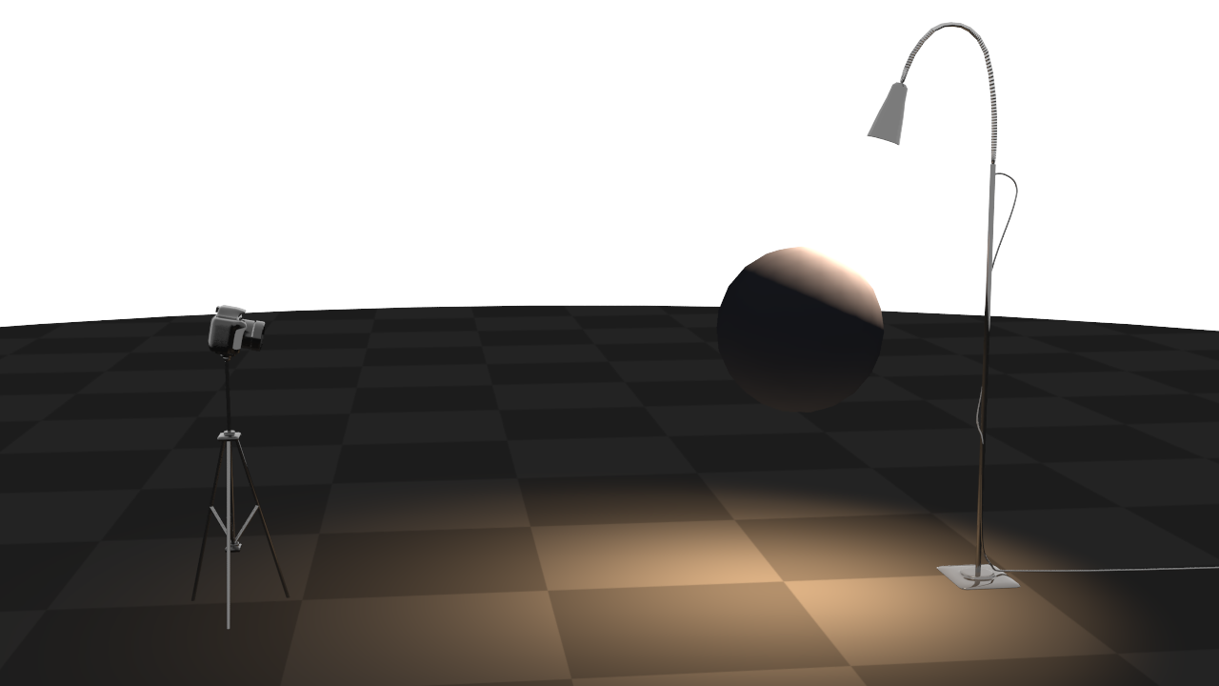
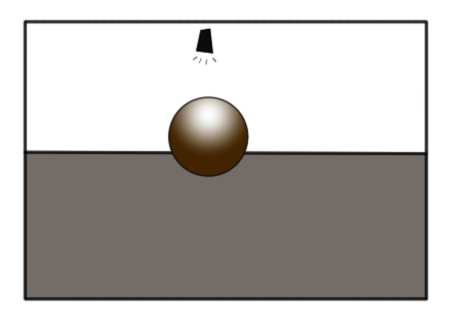
Shadow volumes
Notes:
So let’s quickly review the shadow volume method.
<click>

Slide 4
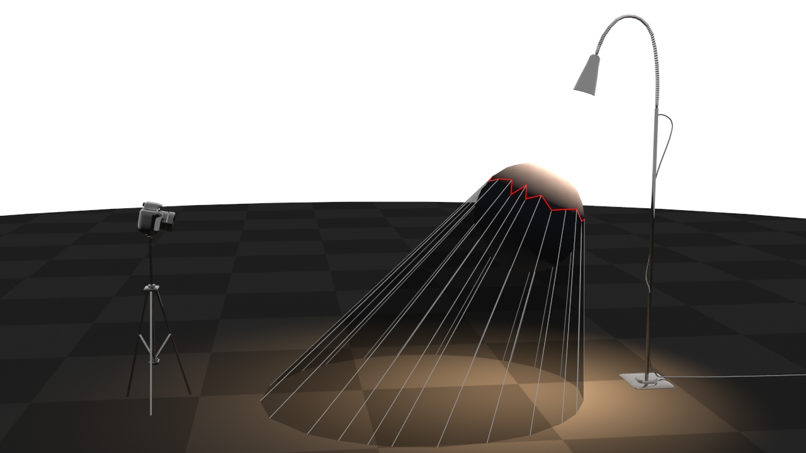

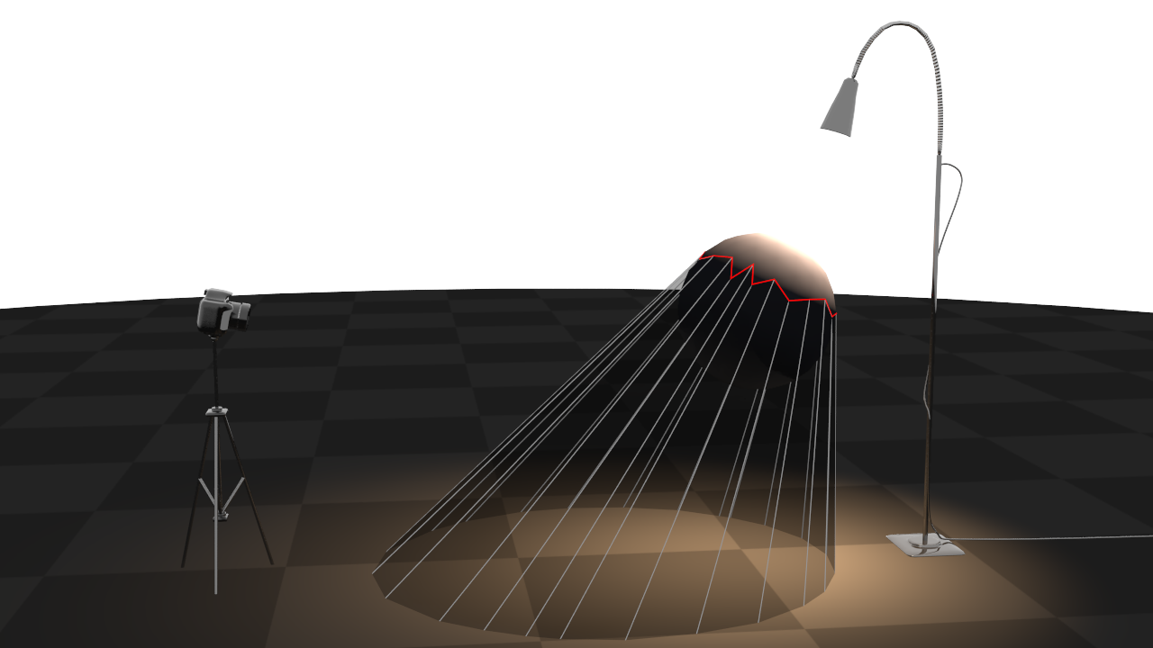



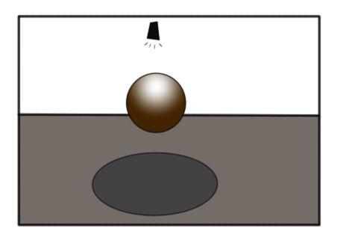

Shadow volumes
+1
+1
-1
0
1
1
1
1
1
0
0
1
1
1
1
1
1
0
0
0
1
1
1
0
0
0
0
0
Notes:
The traditional approach is to first identify all sillhouette edges of a shadow casting object.
<click>
We then extrude these edges, away from the light, to form shadow volumes.
<click>
These volumes are then rendered as seen from the camera, and for every frontfacing polygon, we increase a counter for the pixel.
<click>
For each back-facing polygon, we decrease the same counter.
<click>
The result is that when all volumes are drawn, the buffer will contain the value 0 wherever we do not have shadow, and a positive number otherwise.

Slide 5
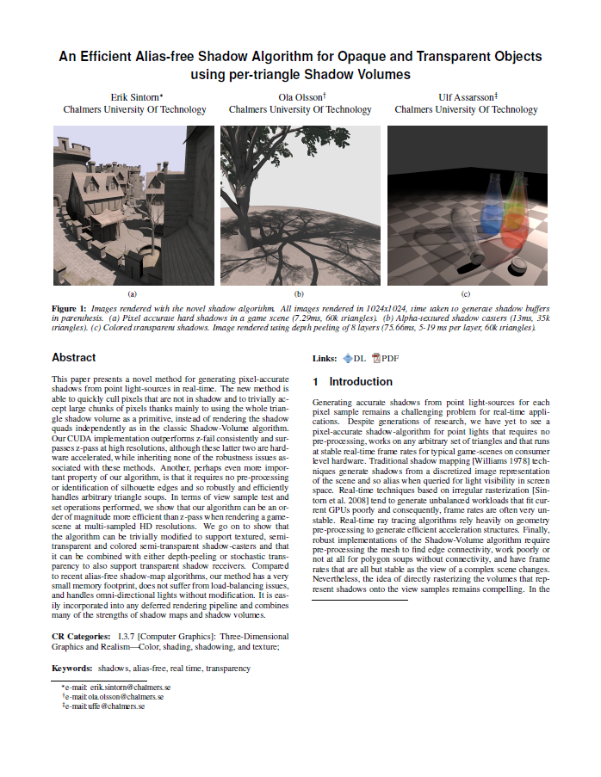
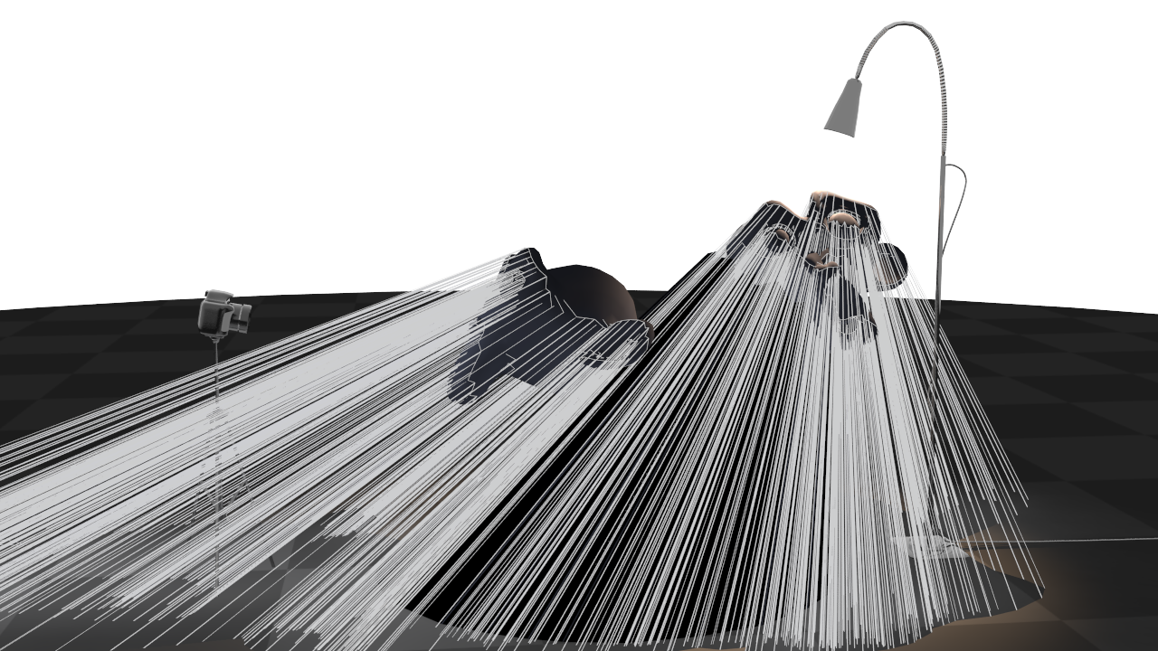
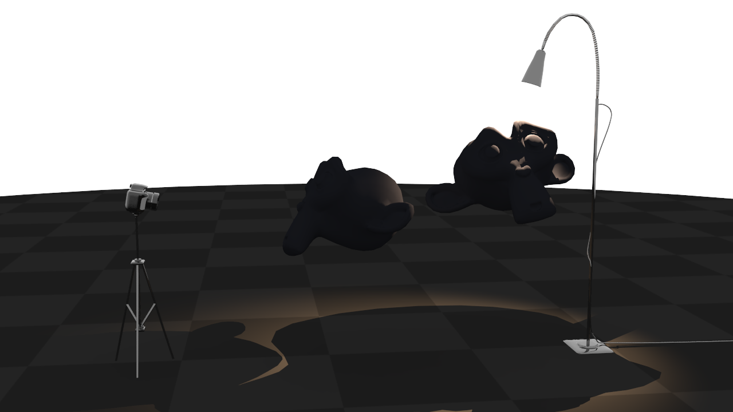
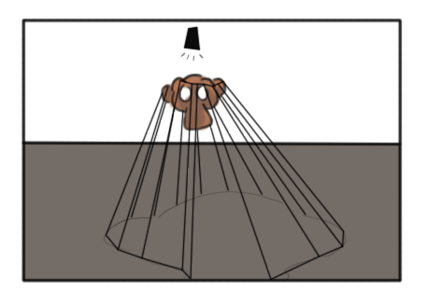

Shadow volumes
Notes:
The main problem with shadow volumes is illustrated here
<click>
Each silhouette edge will generate a potentially very large polygon on screen, and this can simply become to much for the rasterizer to handle efficiently.
That is, we get poor performance due to overdraw.

Slide 6
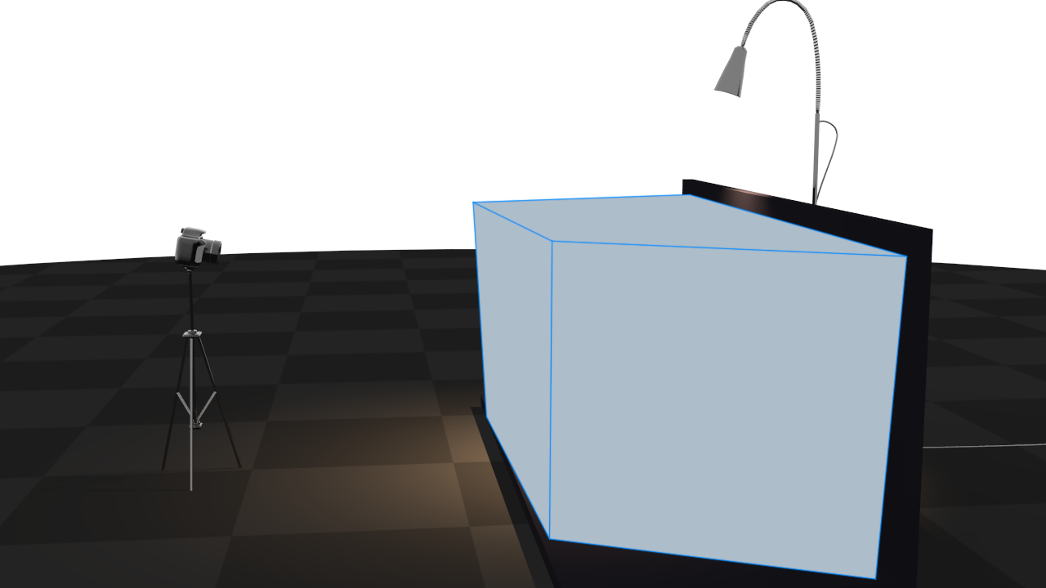
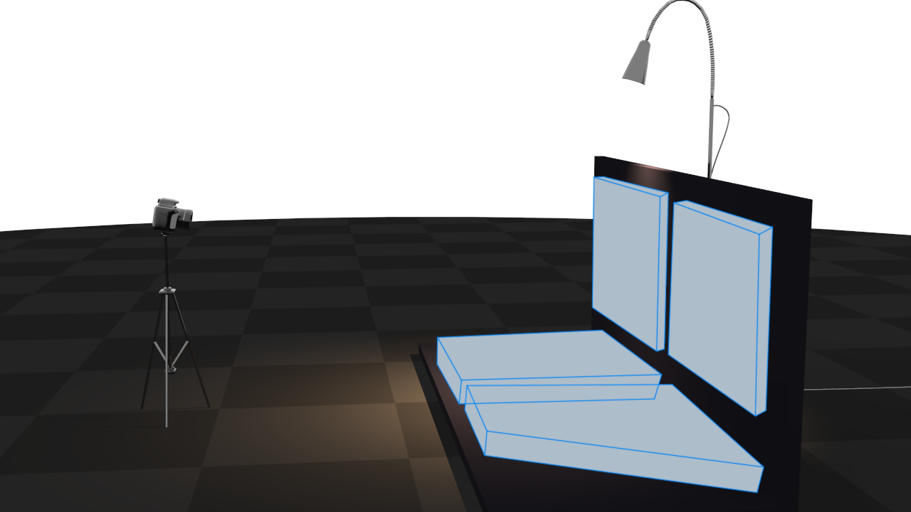
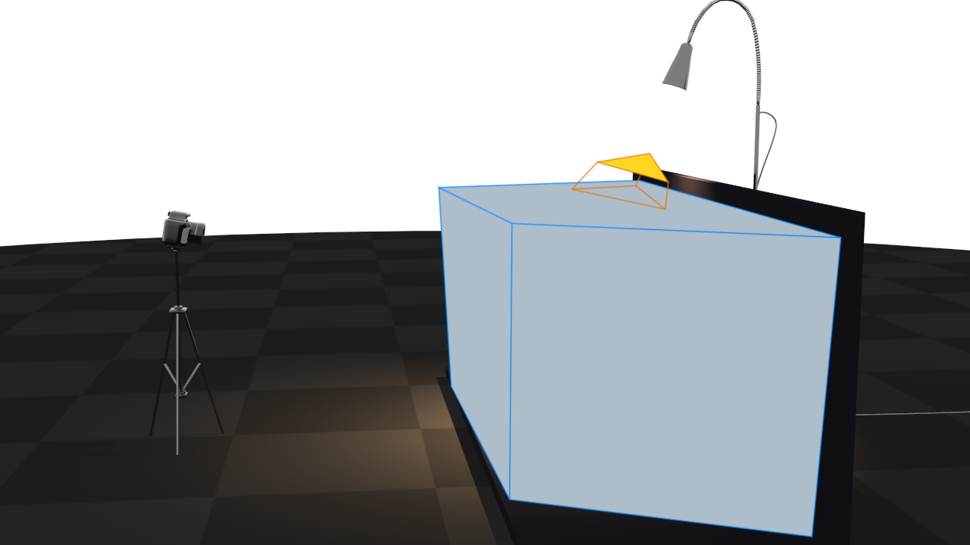
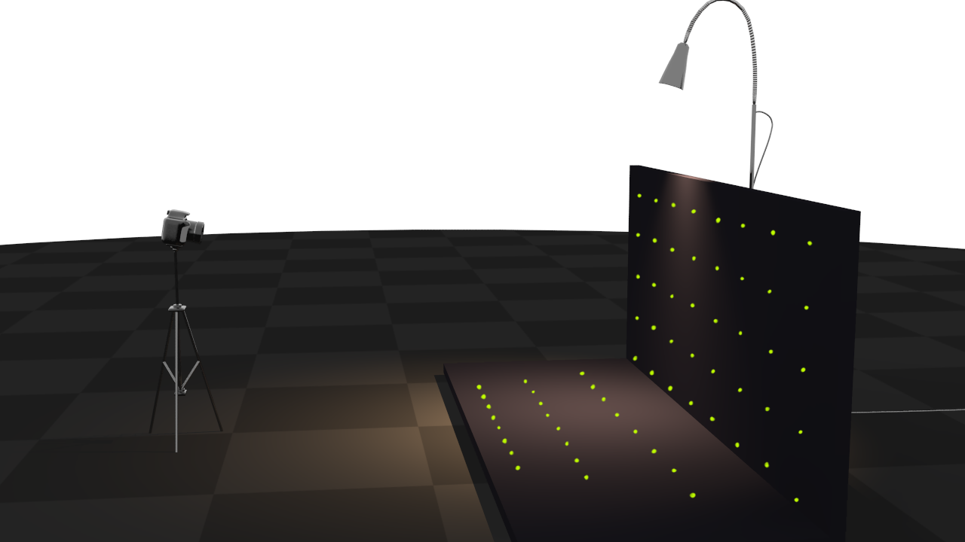
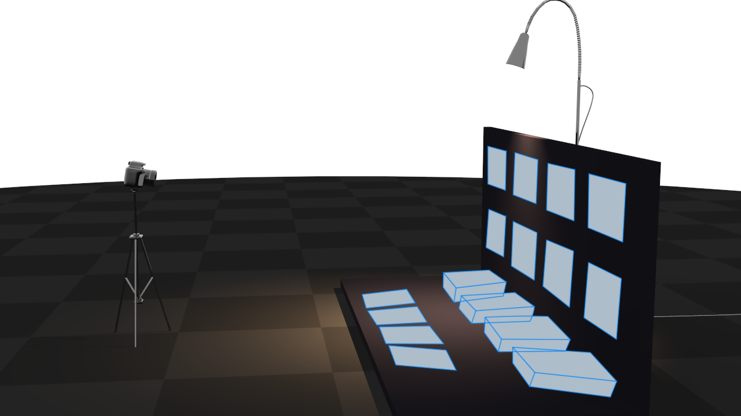
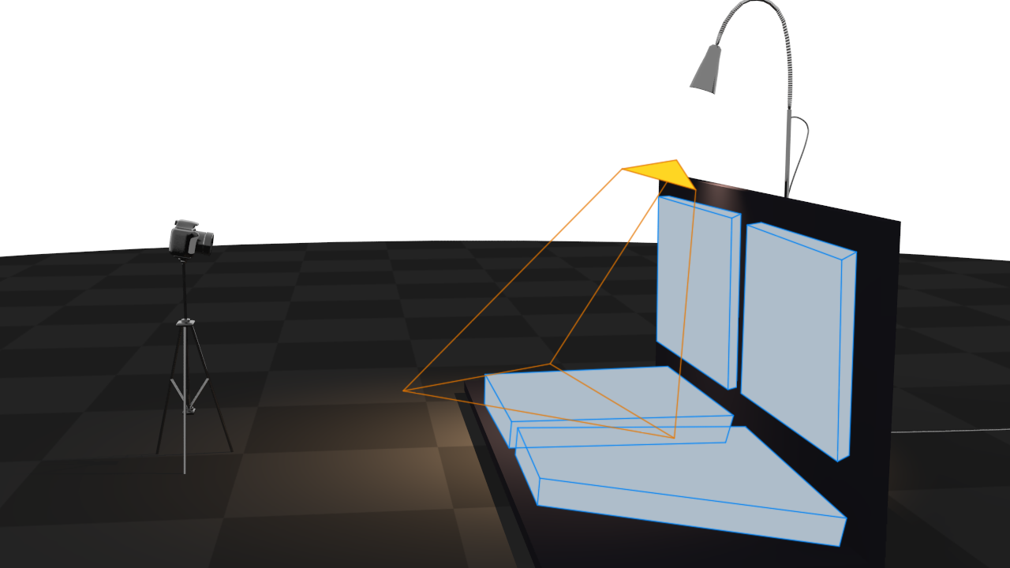
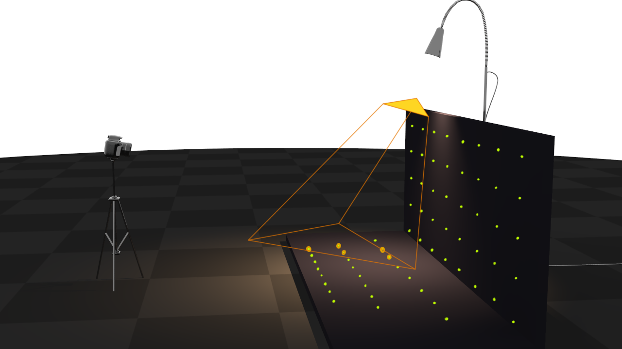
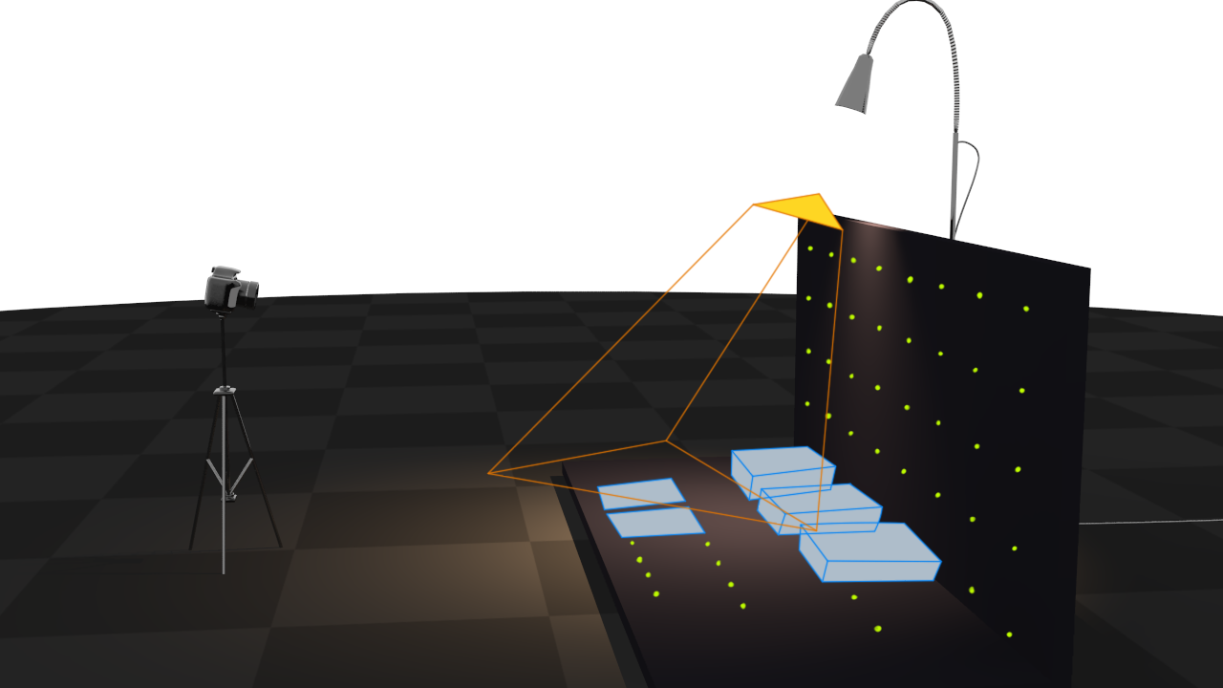
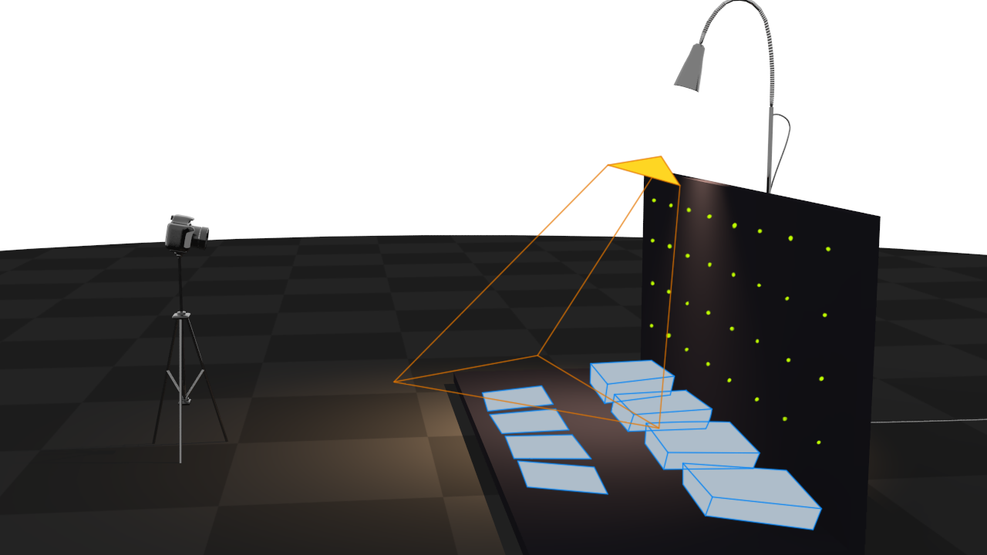
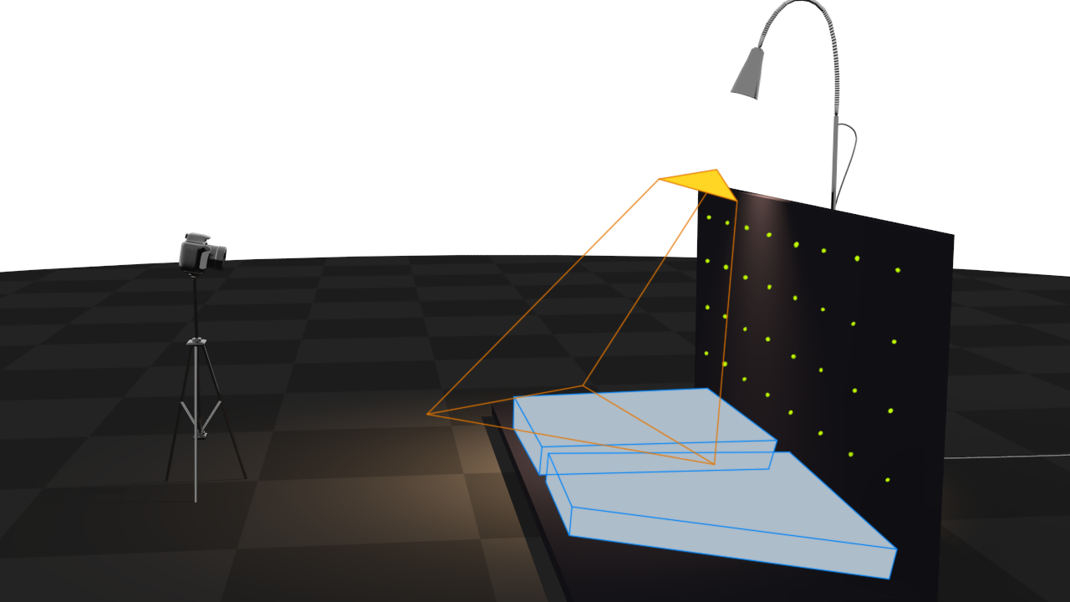
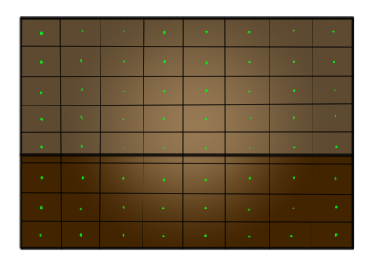
Per Triangle Shadow Volumes (PTSV)
Notes:
Which brings us to the idea of Per Triangle Shadow Volumes, that we presented at SIGGRAPH Asia a few years ago.
This algorithm begins, as before, by generating all the view-sample points for which we want to determine visibility.
<click>
We then begin building a hierarchy from these by grouping together nearby samples. (2x2 in this image)
<click>
These groups are further grouped together <click> until we only have one large bounding box containing all samples.
<click>
Now, we process all shadowcasting triangles in turn. We test the triangles shadow-volume for intersection with the root node. Here, it clealy intersects.
<click>
So we test it against all sub nodes.
Some nodes can be immediately rejected
<click>
For the remaining ones, we traverse the hierarchy again
<click>
Some are rejected
<click>
And finally, we test the remaining individual view samples.
We show in the paper that this algorithm performs much less work than the original algorithm and is often significantly faster.
It is also much more robust, and can support textured and transparent shadow-casters.

Slide 7
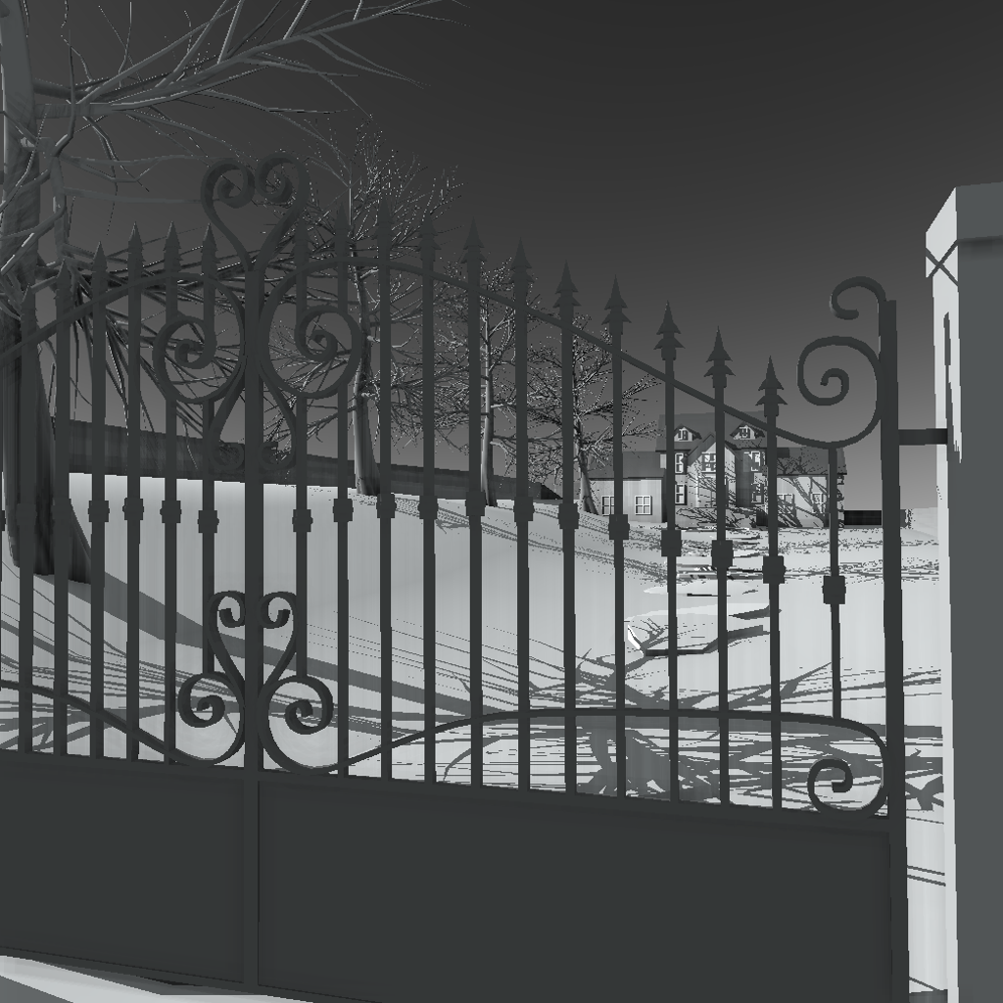
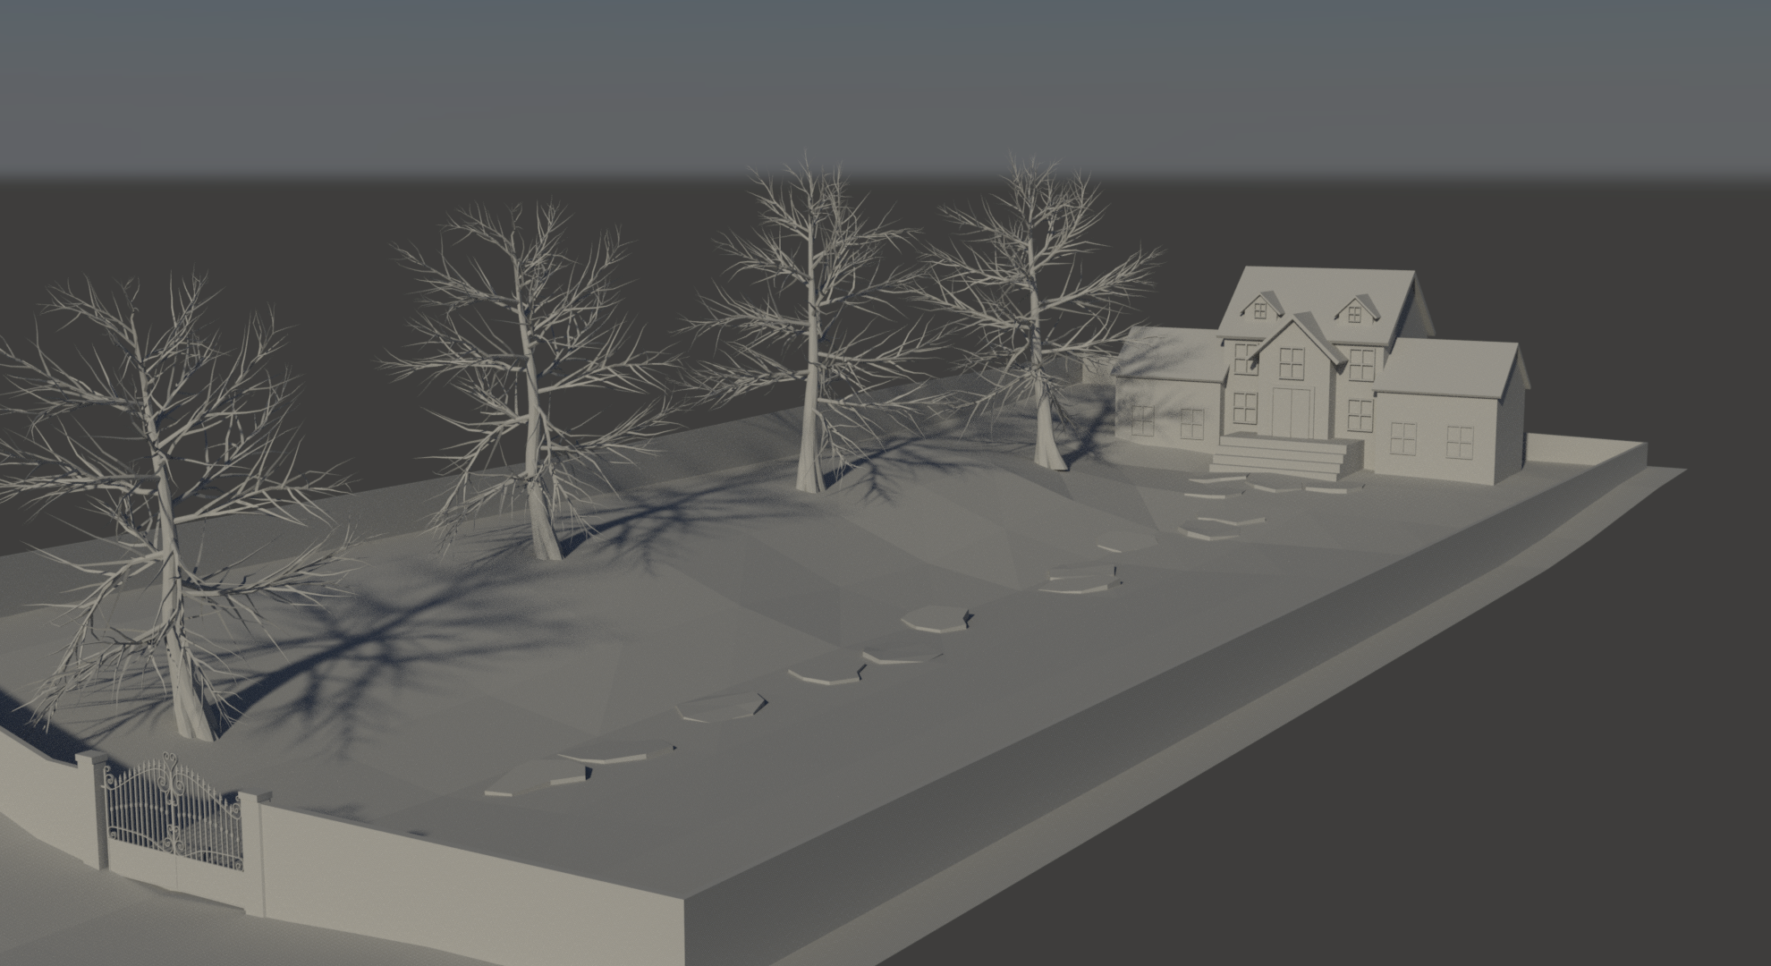
Per Triangle Shadow Volumes (PTSV)
Notes:
It is not perfect however.
Let’s examine this scene. To the left is a view of this scene which is difficult for shadow volume algorithms. To the right we see the same scene from in a different view.

Slide 8
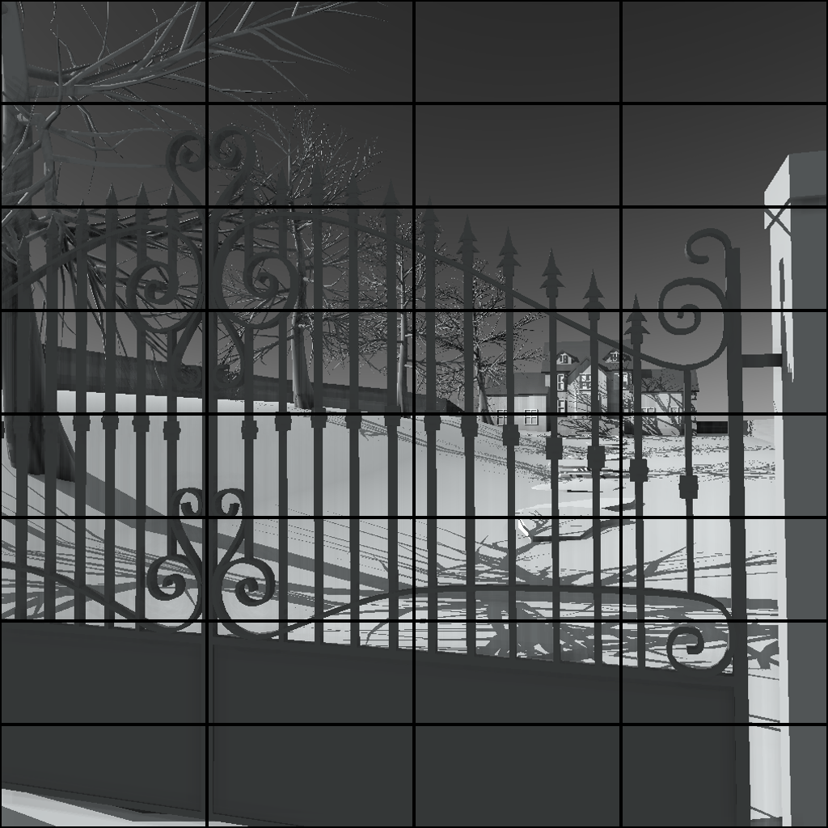
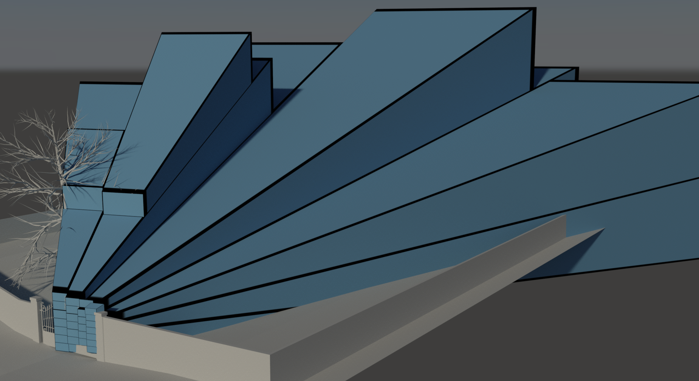
Per Triangle Shadow Volumes (PTSV)
Notes:
This is the highest level of the hierarchy that we would obtain with PTSV.

Slide 9

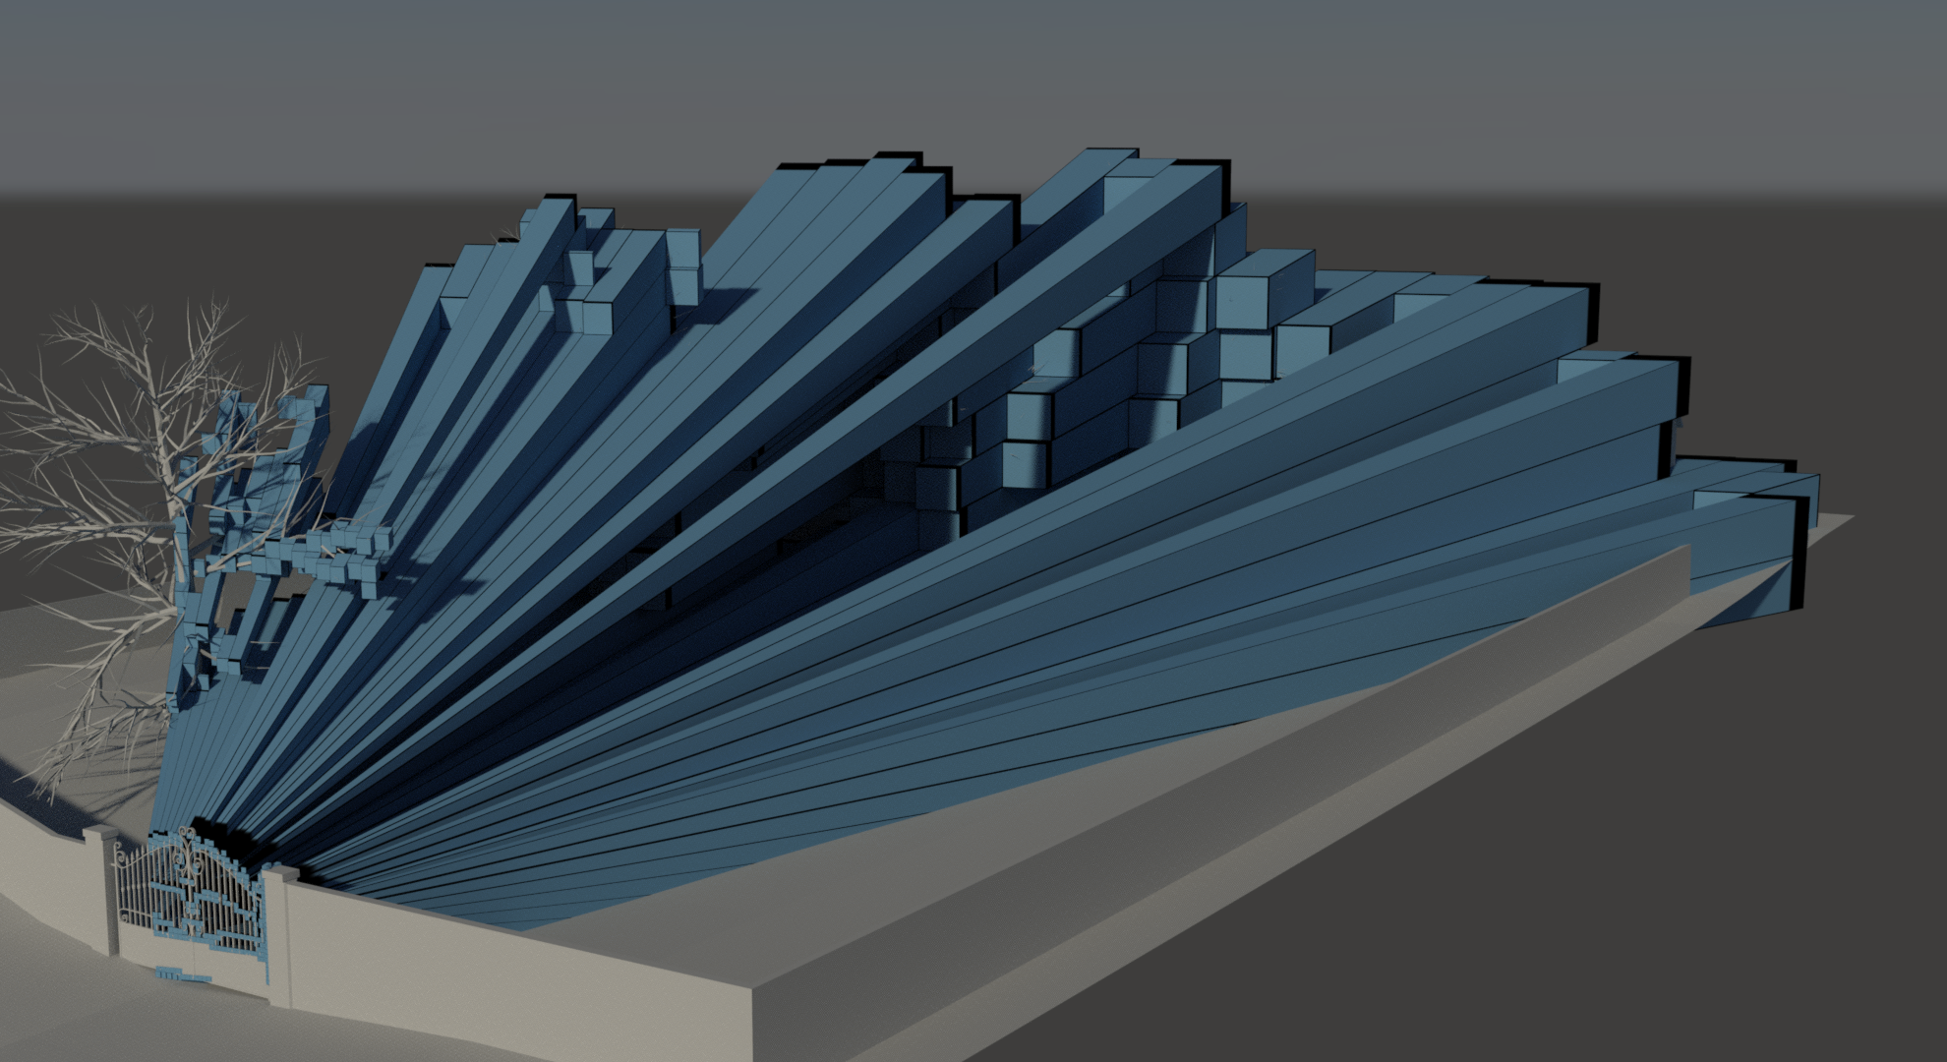
Per Triangle Shadow Volumes (PTSV)
Notes:
This is the next level…

Slide 10
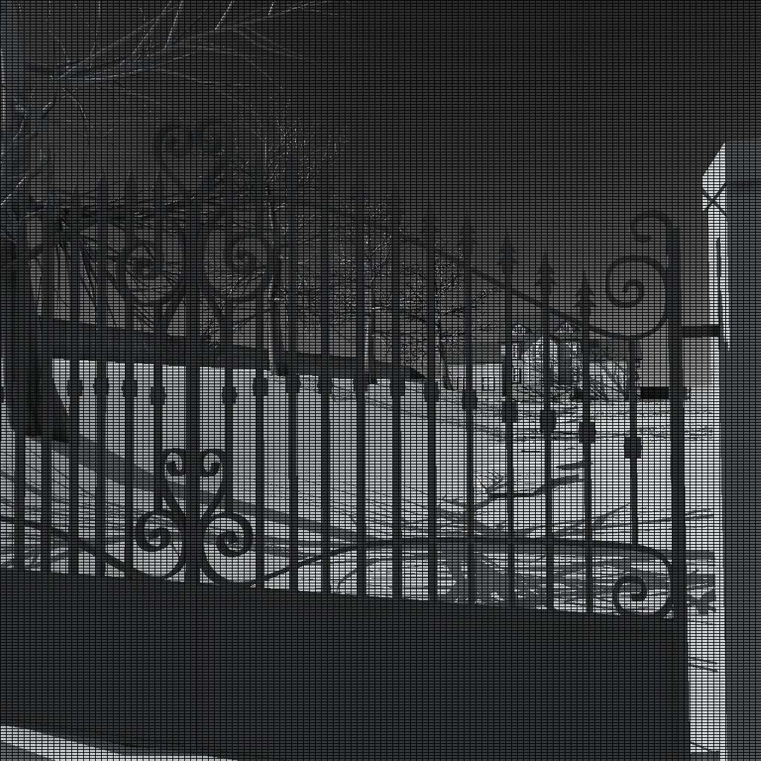
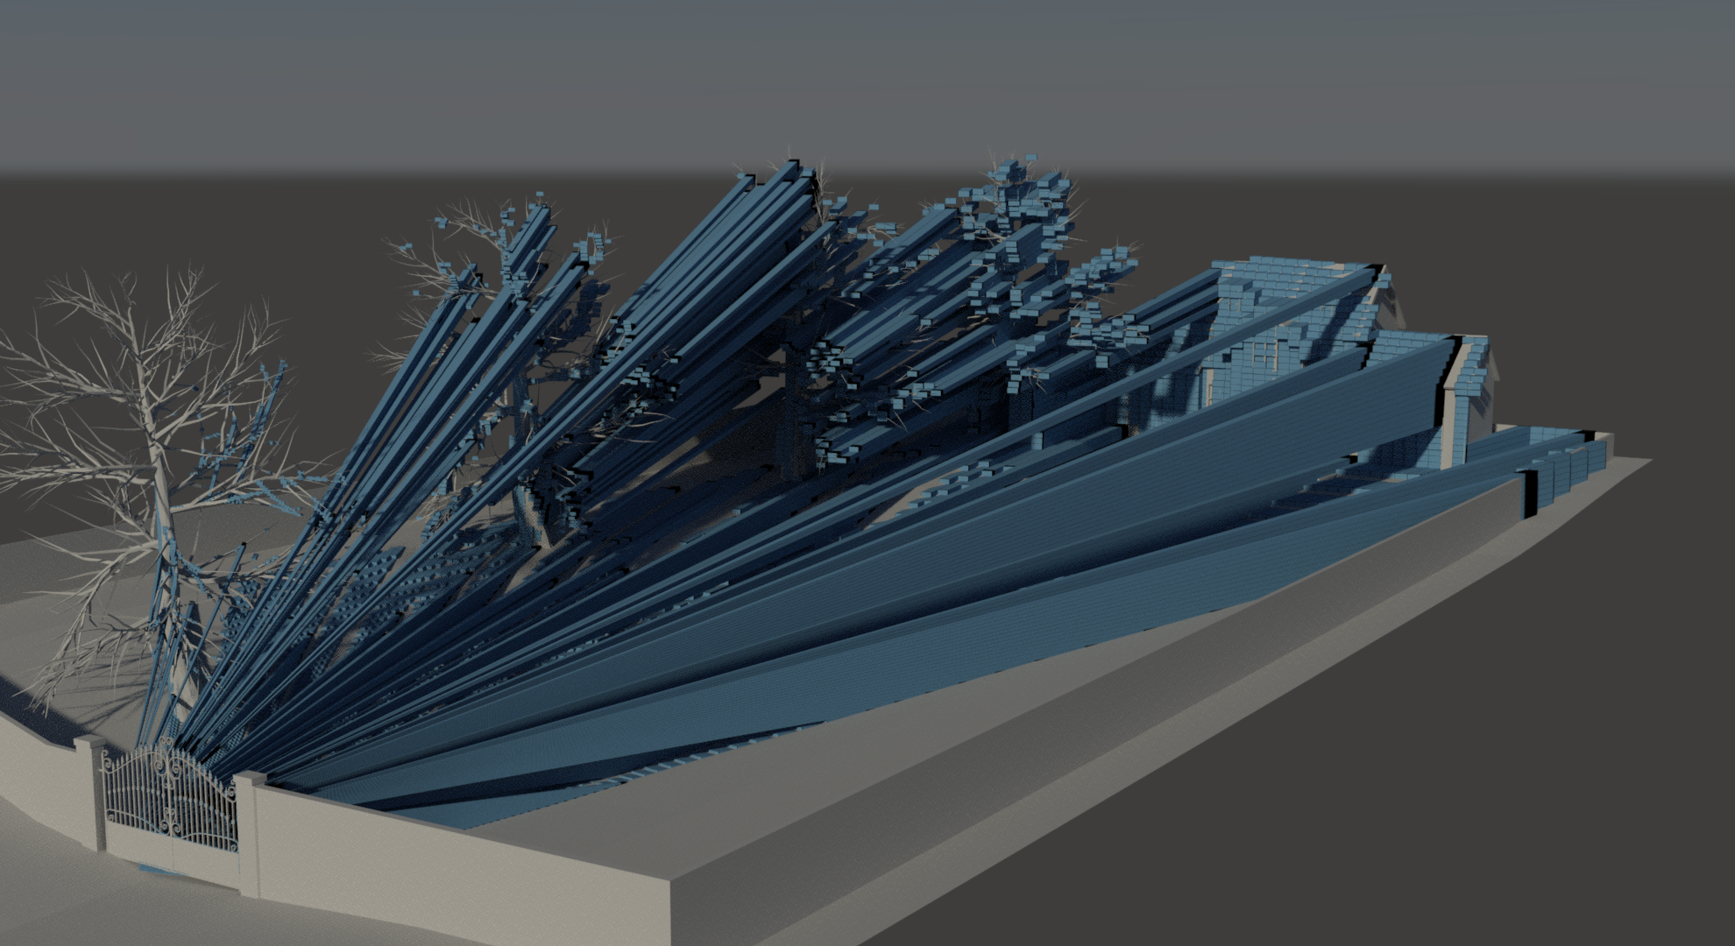
Per Triangle Shadow Volumes (PTSV)
Notes:
And this is the final level, where each box is the bounding frusta of 8x4 view samples.
We can immediately see that we don’t have a very tight fit. The problem is that many of these 8x4 tiles will contain viewsamples both from the foreground and from the background.

Slide 11
Per Triangle Shadow Volumes (PTSV)
Notes:
So, if we want to evaluate the shadows cast from a triangle up here,
<click>
We will find that this tile is intersected by the volume
<click>
And so we are going to test these two sets of samples for intersection with the volume.
But these samples are miles away and a better hierarchy should have culled them a long time ago.

Slide 12
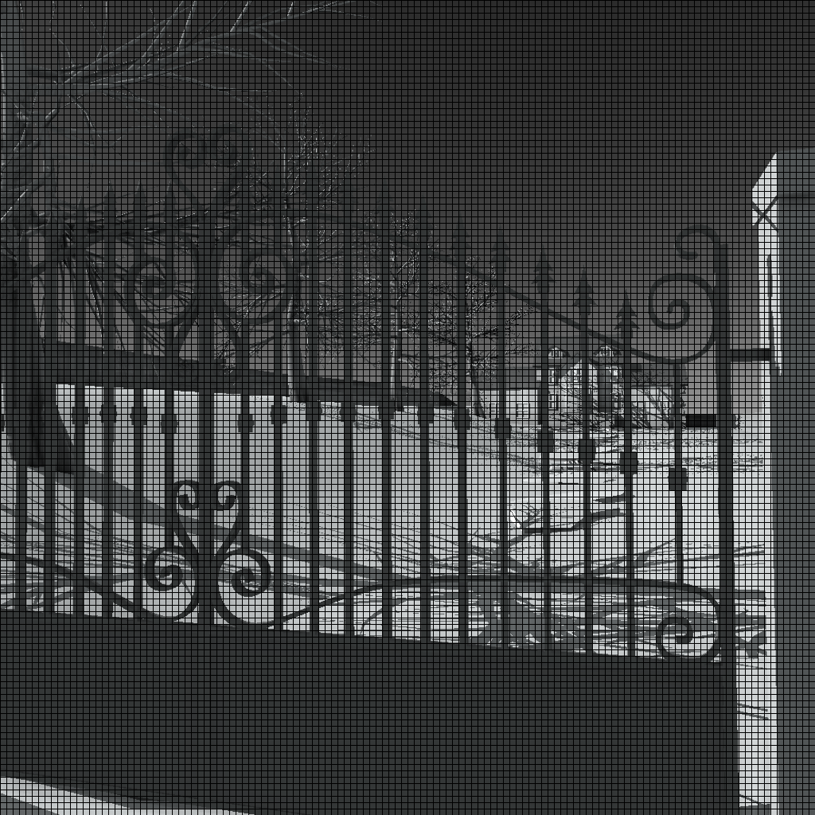
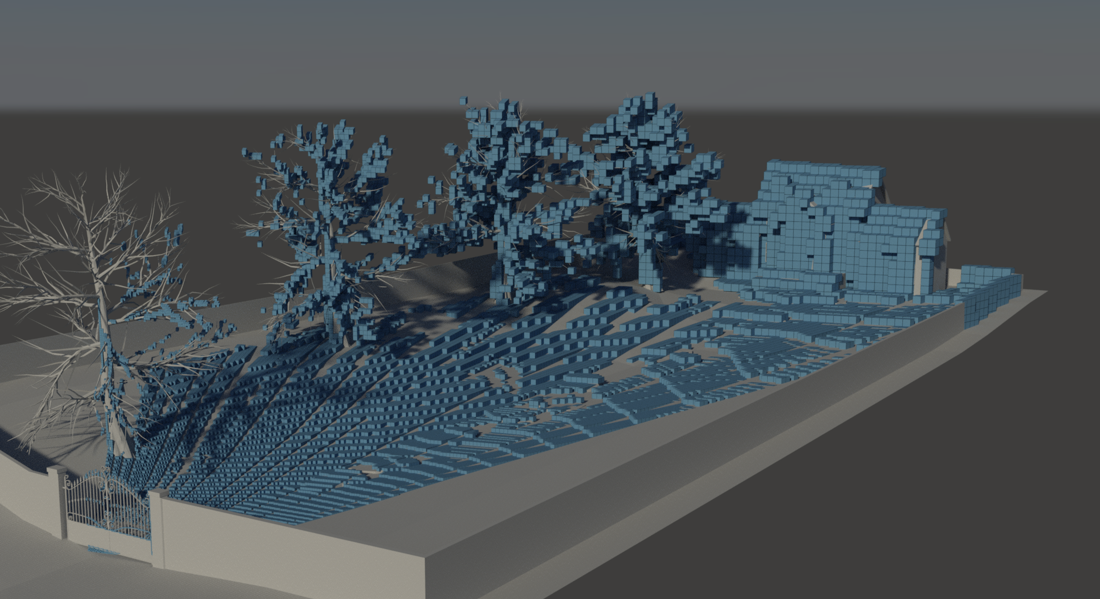
Cluster Hierarchy
Notes:
Our solution to this is, as you may have gathered from the name, to group our view-samples in clusters instead of tiles.
<click>
The samples in the foreground will now have their own little containing box, and the samples in the background will lie in another box.
The triangles shadow volume now clearly does not intersect any samples.

Slide 13

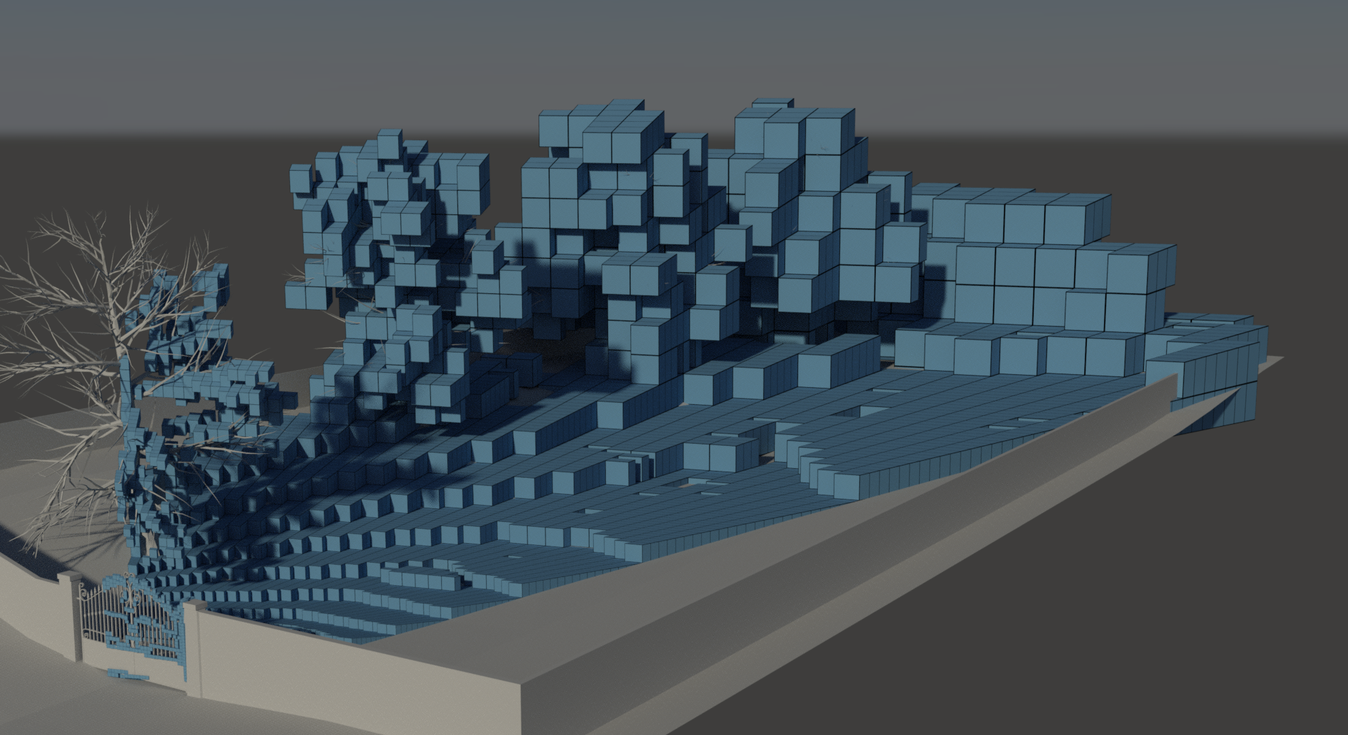
Cluster Hierarchy
Notes:
We then group 32 of these clusters together…

Slide 14

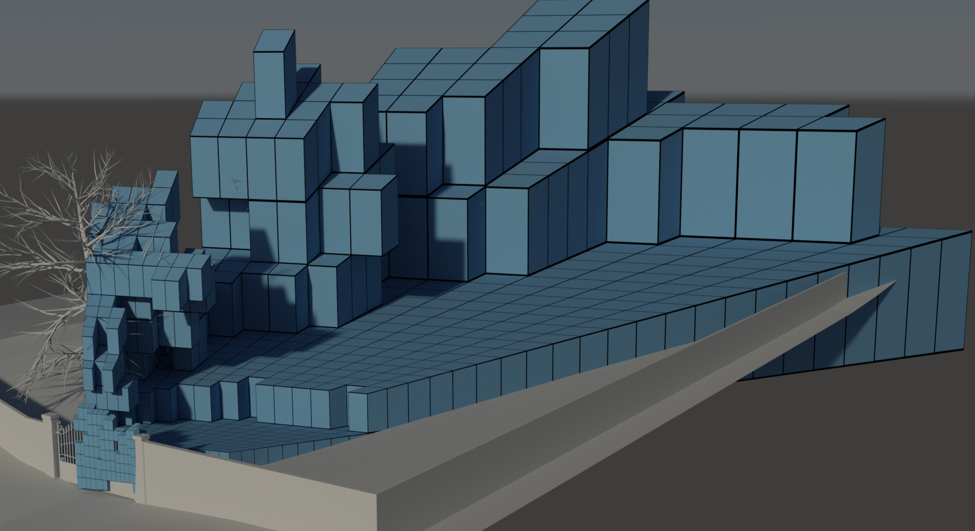
Cluster Hierarchy
Notes:
For each level…

Slide 15

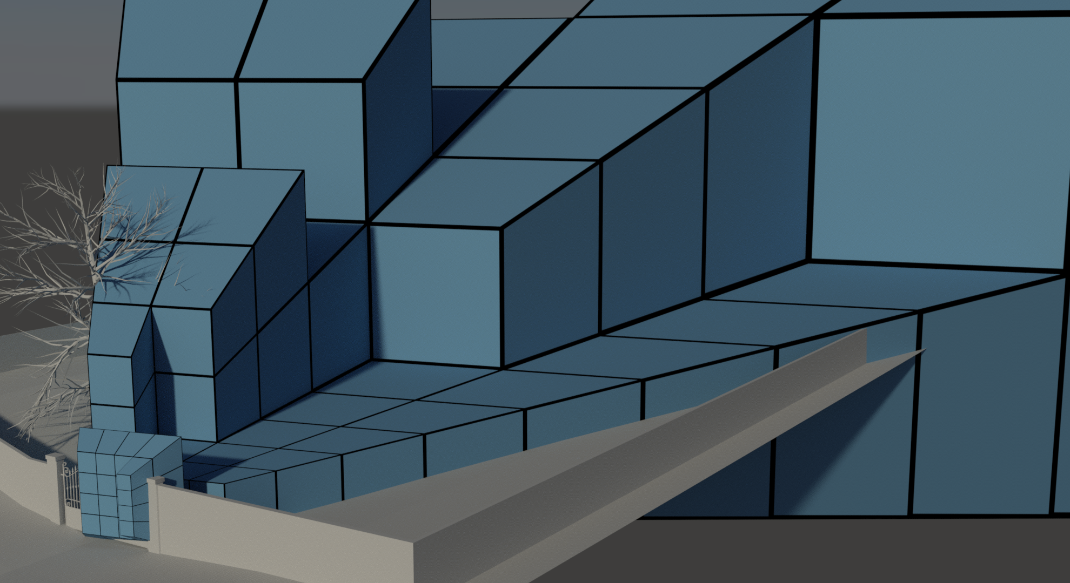
Cluster Hierarchy
Notes:
To build a hierarchy against which we can test intersection with triangle shadow volumes.

Slide 16
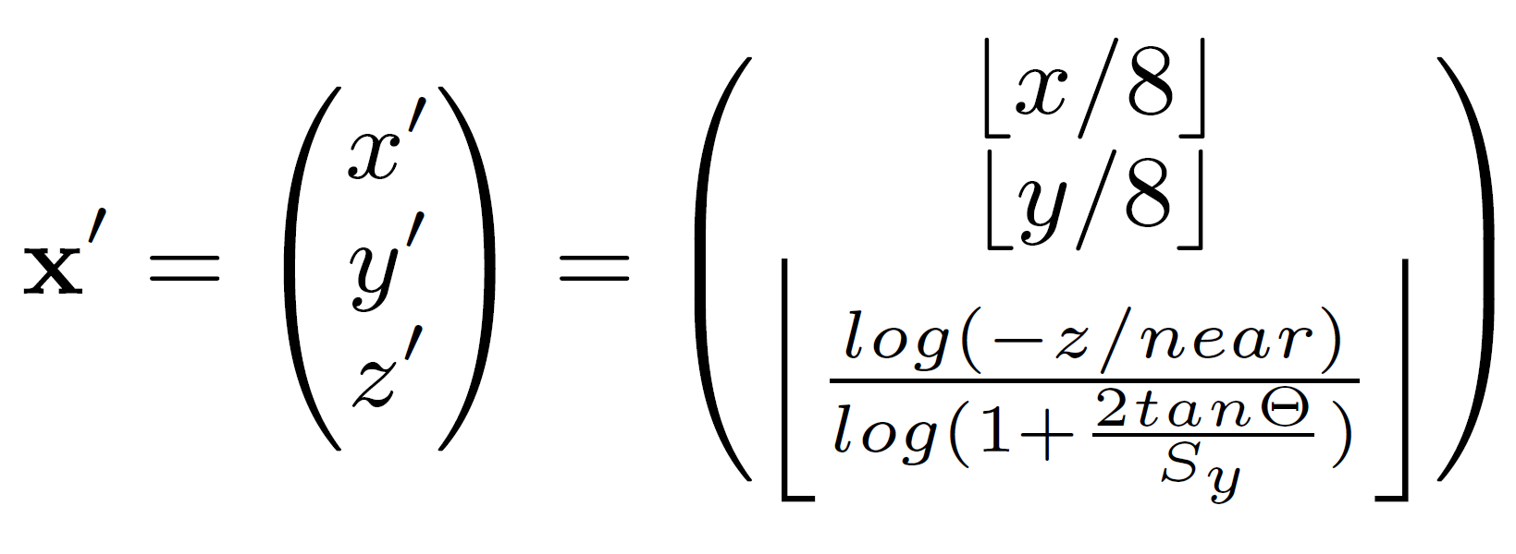
Building Cluster Hierarchy
For each view-sample, calculate coord of containing cluster
For a 1024x1024 image, we need (7,7,~9) bits
Notes:
The trick, of course, is to build and traverse this hierarchy quickly enough. In the previous paper, building the hierarchy was a simple matter of building a min-max mip map over the depth buffer.
With our approach, we need to build a true 3d hierarchy over all occupied clusters, which is a bit more difficult.
We start out by looking at each view-sample and calculate the discrete coordinate of its containing cluster in the view frustum.
The X and Y coordinates are simply the pixel coordinates divided by 8. The discrete Z is a logarithmic function of the depth.
<click>
So, for a 1024x1024 image, we need 7 bits for the x and y components, and we found that 9 bits were sufficient in all our tests to get a good distribution in z.

Slide 17




















































































Building Cluster Hierarchy
$$−$$
$$−$$
$$−$$
$$x_{6}^{′}$$
$$x_{5}^{′}$$
$$x_{4}^{′}$$
$$x_{3}^{′}$$
$$x_{2}^{′}$$
$$x_{1}^{′}$$
$$x_{0}^{′}$$
$$x^{′}=$$
$$−$$
$$−$$
$$−$$
$$y_{6}^{′}$$
$$y_{5}^{′}$$
$$y_{4}^{′}$$
$$y_{3}^{′}$$
$$y_{2}^{′}$$
$$y_{1}^{′}$$
$$y_{0}^{′}$$
morton order
$$−$$
$$z_{8}^{′}$$
$$z_{7}^{′}$$
$$z_{6}^{′}$$
$$z_{5}^{′}$$
$$z_{4}^{′}$$
$$z_{3}^{′}$$
$$z_{2}^{′}$$
$$z_{1}^{′}$$
$$z_{0}^{′}$$
$$−$$
$$−$$
$$−$$
$$−$$
$$−$$
$$z_{8}^{′}$$
$$−$$
$$−$$
$$z_{7}^{′}$$
$$−$$
$$−$$
$$z_{6}^{′}$$
$$x_{6}^{′}$$
$$y_{6}^{′}$$
$$z_{5}^{′}$$
$$x_{5}^{′}$$
$$y_{5}^{′}$$
$$z_{4}^{′}$$
$$x_{4}^{′}$$
$$y_{4}^{′}$$
$$z_{3}^{′}$$
$$x_{3}^{′}$$
$$y_{3}^{′}$$
$$z_{2}^{′}$$
$$x_{2}^{′}$$
$$y_{2}^{′}$$
$$z_{1}^{′}$$
$$x_{1}^{′}$$
$$y_{1}^{′}$$
$$z_{0}^{′}$$
$$x_{0}^{′}$$
$$y_{0}^{′}$$
$$0$$
$$0$$
$$0$$
$$0$$
$$0$$
$$0$$
$$0$$
$$0$$
$$0$$
$$z_{8}^{′}$$
$$z_{7}^{′}$$
$$z_{6}^{′}$$
$$x_{6}^{′}$$
$$y_{6}^{′}$$
$$z_{5}^{′}$$
$$x_{5}^{′}$$
$$y_{5}^{′}$$
$$z_{4}^{′}$$
$$x_{4}^{′}$$
$$y_{4}^{′}$$
$$z_{3}^{′}$$
$$x_{3}^{′}$$
$$y_{3}^{′}$$
$$z_{2}^{′}$$
$$x_{2}^{′}$$
$$y_{2}^{′}$$
$$z_{1}^{′}$$
$$x_{1}^{′}$$
$$y_{1}^{′}$$
$$z_{0}^{′}$$
$$x_{0}^{′}$$
$$y_{0}^{′}$$
Level 4:
node index
child index
Level 3:
node index
child index
Level 2:
node index
child index
Level 1:
n. idx
child index
Level 0:
ch. idx
Notes:
We now want to mark the cluster and all parent nodes as occupied
<click>
We take the cluster coordinate and store it in a single word by interleaving the bits in a Morton order
<click>
Then, we rearrange the highest bits to form a contiguous 23-bit word which uniquely identifies the cluster
In this example, we then have a total of 8M clusters, each of which needs only 1 bit of information stored. So we choose to store this as a full tree, breadth first.
<click>
For efficient traversal on an nvidia GPU, we want the hierarchy to have a fan-out of 32. Therefore, we build the next level by simply chopping of the five least significant bits.
(this means that the next level will be 4x4x2 clusters in size)
We can now mark the current cluster as occupied by setting bit number “child index”, in word number “node index” in the array for level 4
<click>
The remaining levels are built in the same way, by chopping of the five least significant bits for each level.

Slide 18
Building Cluster Hierarchy
One thread per view-sample and relying on atomics causes too much contention
  Start a warp per 8x8 tile and cooperate with atomics up to level L
  At level L, start a thread per node and do final levels
Notes:
So, we could just start a thread per viewsample and atomically mark all nodes that it resides in as occupied, but this causes a lot of contention and is quite slow.
Instead, we start one warp per 8x8 tile. Most of the time, several samples will reside in the same cluster and we only have to update that once.
Each warp only updates nodes up till some predefined level L. After that we start a thread per node at that level, and atomically update the top of the tree.

Slide 19
Traversing Triangles
Triangle setup
  Create four planes that enclose the triangles shadow volume
  Hierarchy is in clip-space, so transform planes to there
  One thread per triangle
Notes:
Then, we need to traverse each triangle shadow volume against this hierarchy.
The first step is the triangle setup pass, where we create the shadow volume for each triangle.
That is, we create the four planes that encloses the region of space that is in shadow due to this triangle. These are:
The triangles plane
And each of the planes formed by the light-source and an edge of the triangle.
A point that lies inside of all of these planes is in shadow.
Since the nodes of our hierarchy are simple axis aligned bounding boxes in clip space, we transform all planes to clip space as well.
For this pass, we simply start one thread per triangle.

Slide 20
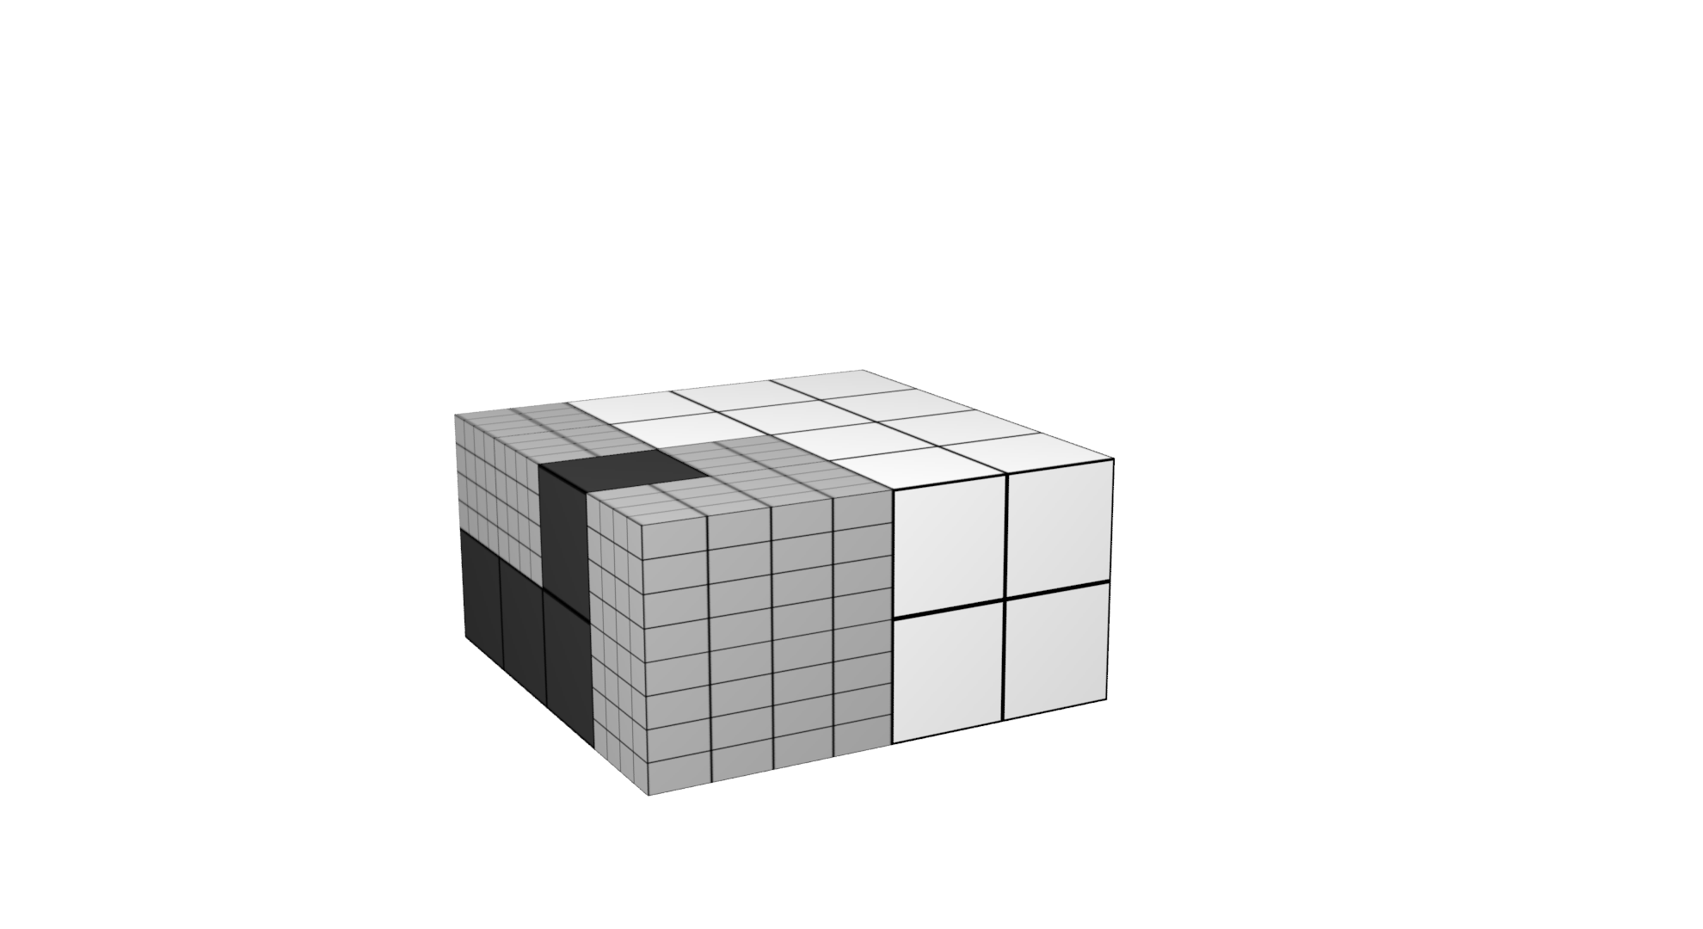
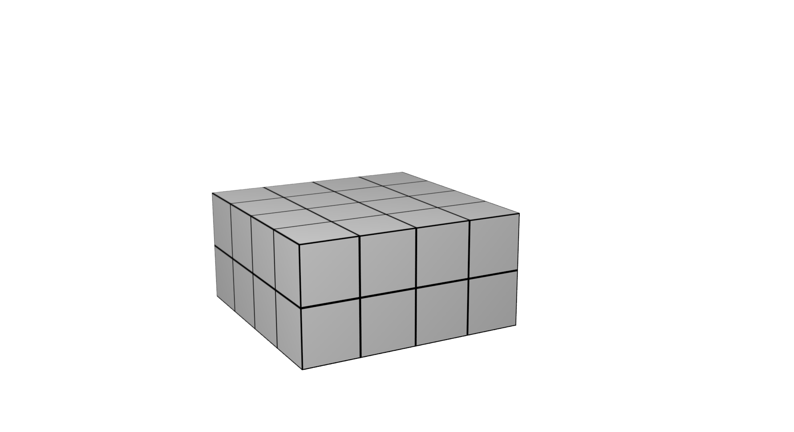
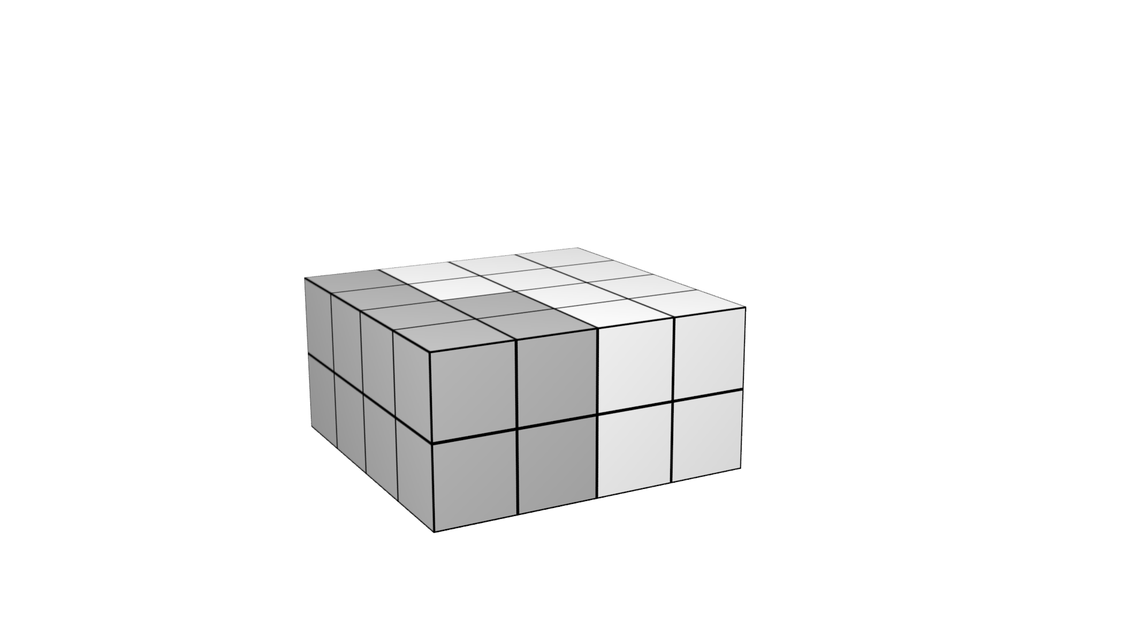

Traversing Triangles
Traversal
  One warp per shadow volume (persistent threads)
  Test 32 children in parallel
  Trivially reject and accept
  Recursively test intersected children
Notes:
Then, for the actual traversal, we want one warp (32 threads in lockstep) to take care of each shadow volume.
Starting with one triangle shadow volume and the root node of our hierarchy, one warp then tests all sub-nodes in parallel
(these are simple AABB/plane tests)
Each thread will identify if a sub-node is <click> entirely outside the shadow volume, in which case it does not have to be considered further
Or <click> entirely inside the shadow volume, in which case we only have to mark it as such and not traverse further.
The remaining nodes are intersected by the shadow volume, and are recursively traversed.
<click>.
When traversal reaches a leaf-node (that is a cluster), the threads within the warp simply test all 64 viewsamples in the tile against the shadow volume.

Slide 21
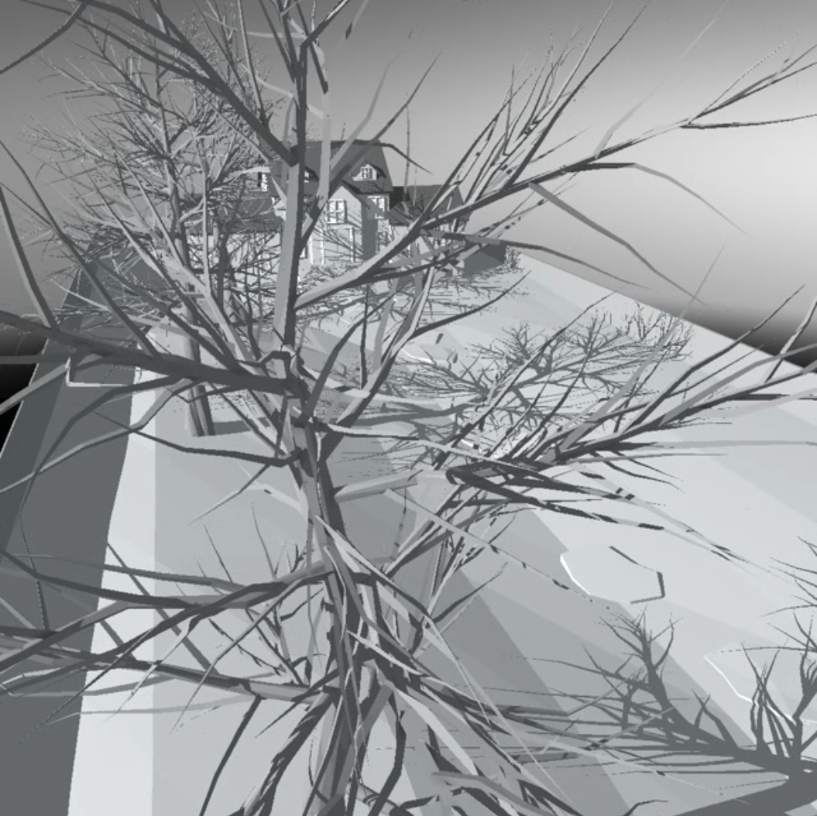
Early Results
Notes:
This is one of the animations we used to benchmark the algorithm. To the right, you see the total number of Test And Set operations performed by our method and by the original PTSV algorithm.
The number of T&S operations provide an implementation independent measurement of how efficient the algorithm is.
And the first thing we notice is that…. OUCH! Our new algorithm is MUCH less efficient.
We will fix that, but first, note the peak here <click> of the PTSV algorithm. This is caused by exactly the kind of situation that we are trying to take care of, that is lots tiles have samples in the foreground and in the background.

Slide 22
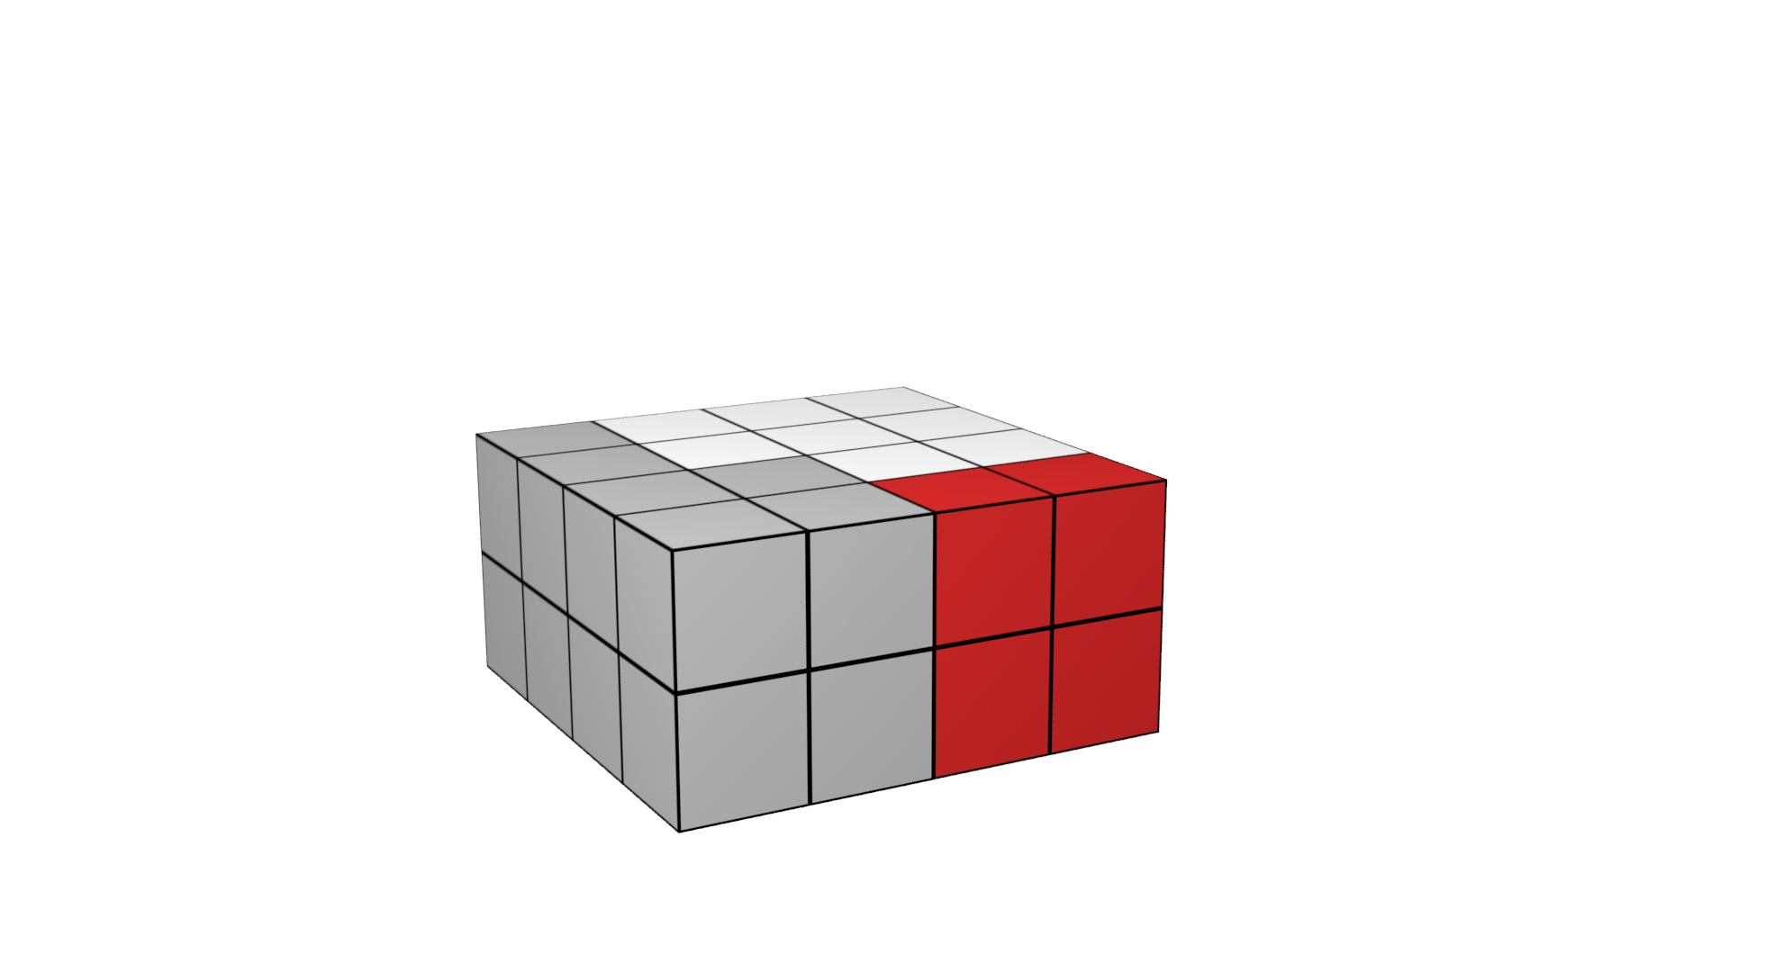
Additional Planes
Several nodes that are actually outside volume are not detected
  Not strictly outside all planes
  Add one plane per vertex
Notes:
One reason for our poor culling efficiency is that our trivial reject test is very conservative.
In this image for example <click>, these red nodes can not be detected as completely outside the volume, because they do not lie completely outside any of the planes.
We remedy this by adding one new plane per vertex. These are constructed by:
<click>
Finding the half vector between the two vectors formed by the edges that share the vertex.
<click>
We then make that vector orthogonal to the vector between the vertex and the light-source.
<click>
This gives us the normal of a plane that effectively removes almost all false positives.

Slide 23
Additional Planes
Notes:
So, if we add these planes and measure the number of test and set operations again, we can see that we are closer to our goal. We now perform a similar amount of work as the original PTSV algorithm, but we have completely removed the spike I pointed out earlier.
We still perform slightly more work though, which is annoying since we meant to build a better hierarchy.
One reason for this is that the bounding box for a node in the original algorithm has exact z-bounds from the depth buffer, whereas our hierarchy has only implicit bounds based on a rough discretization of the view frustum.
To fix that, we now consider storing a complete explicit bounding box with each node.

Slide 24
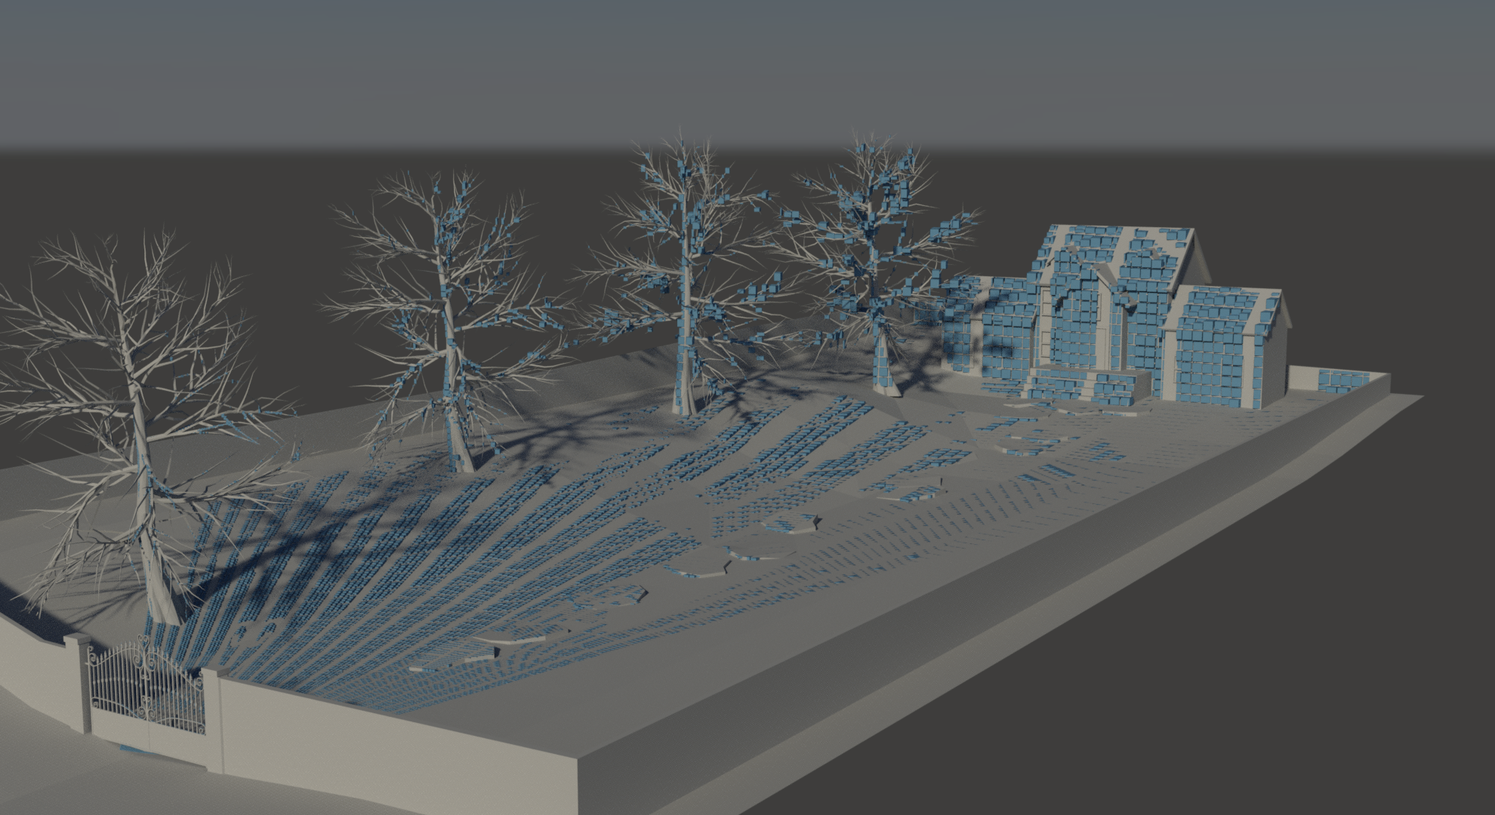
Explicit Bounds
Notes:
Here is the result. To the left is the original hierarchy with only implicit bounds, and to the left we have an explicit bounding box for each node.
We can see that the resulting volume is much smaller for all levels of the hierarchy.
So this is the leaf level…

Slide 25
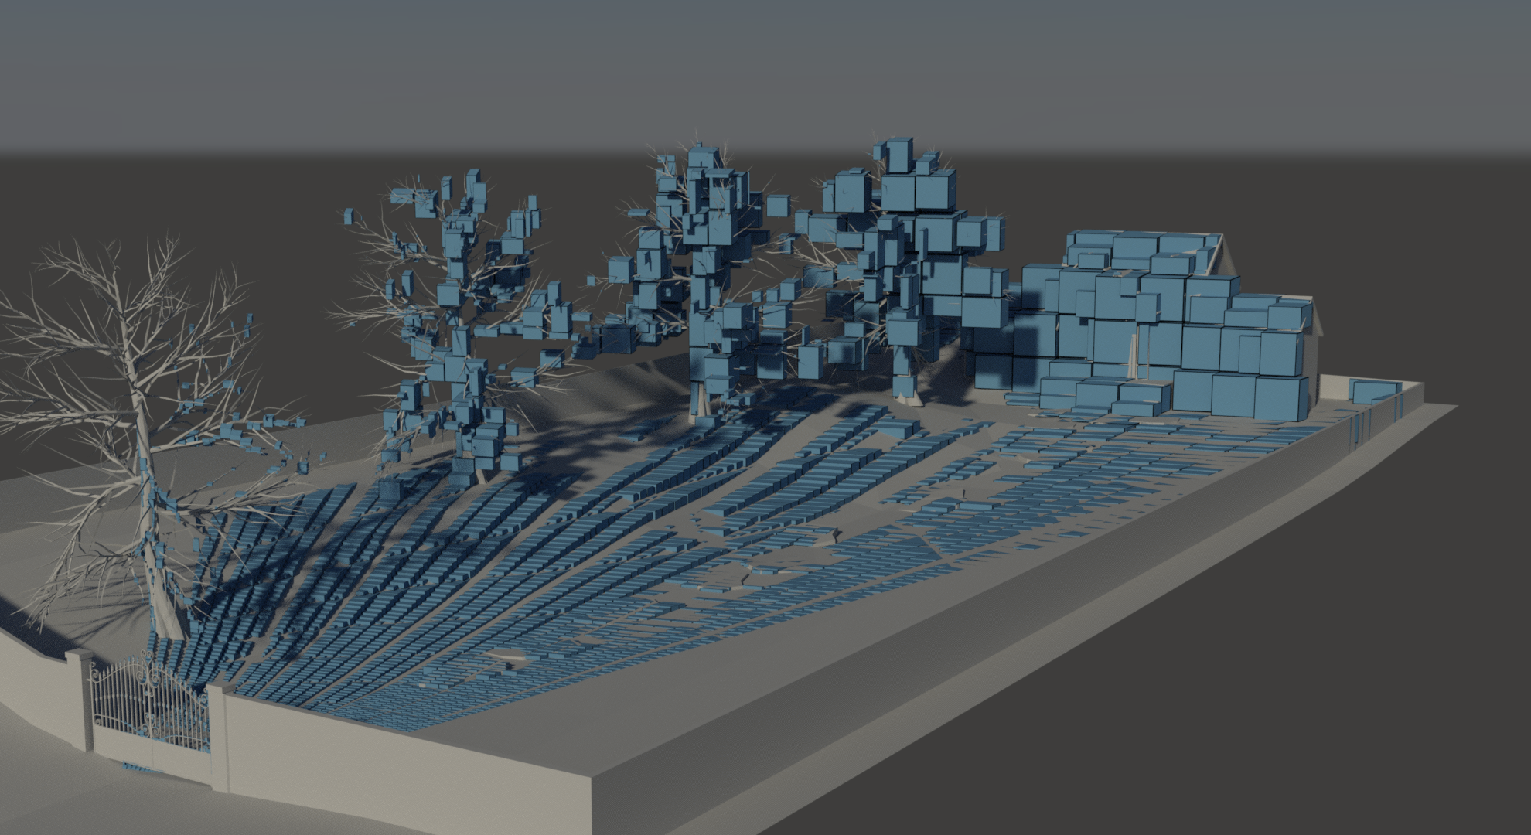
Explicit Bounds
Notes:
Level above that

Slide 26
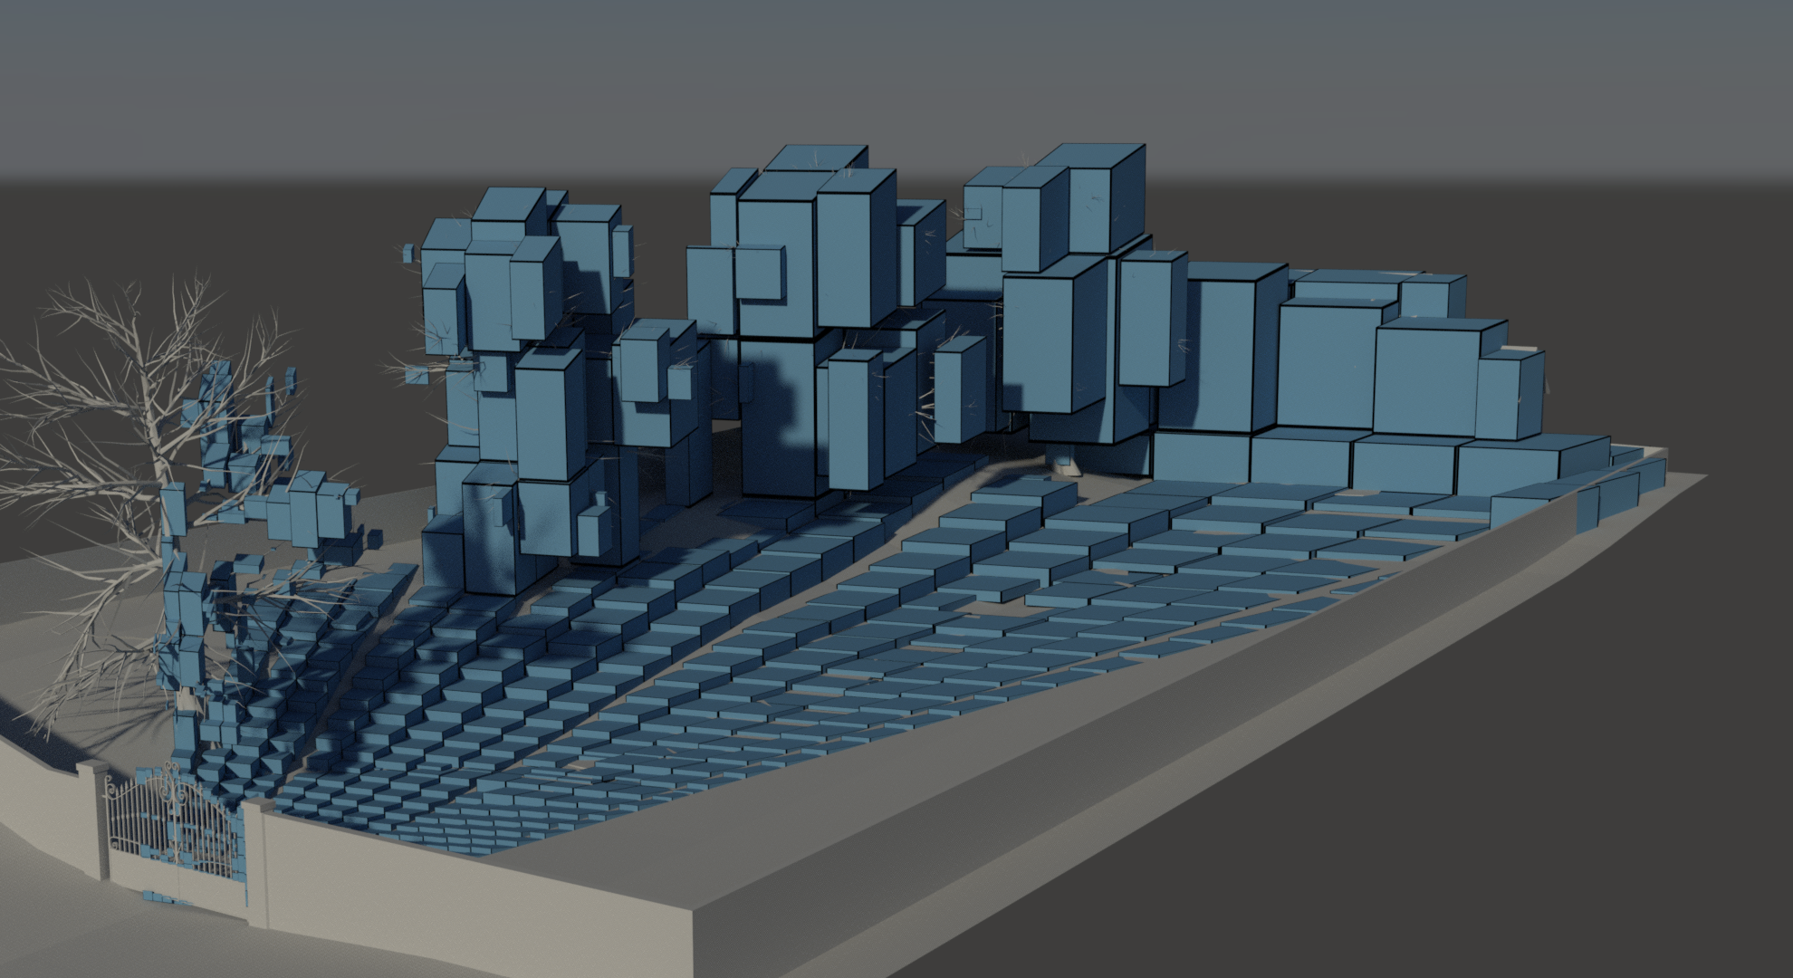
Explicit Bounds
Notes:
Level above that…

Slide 27
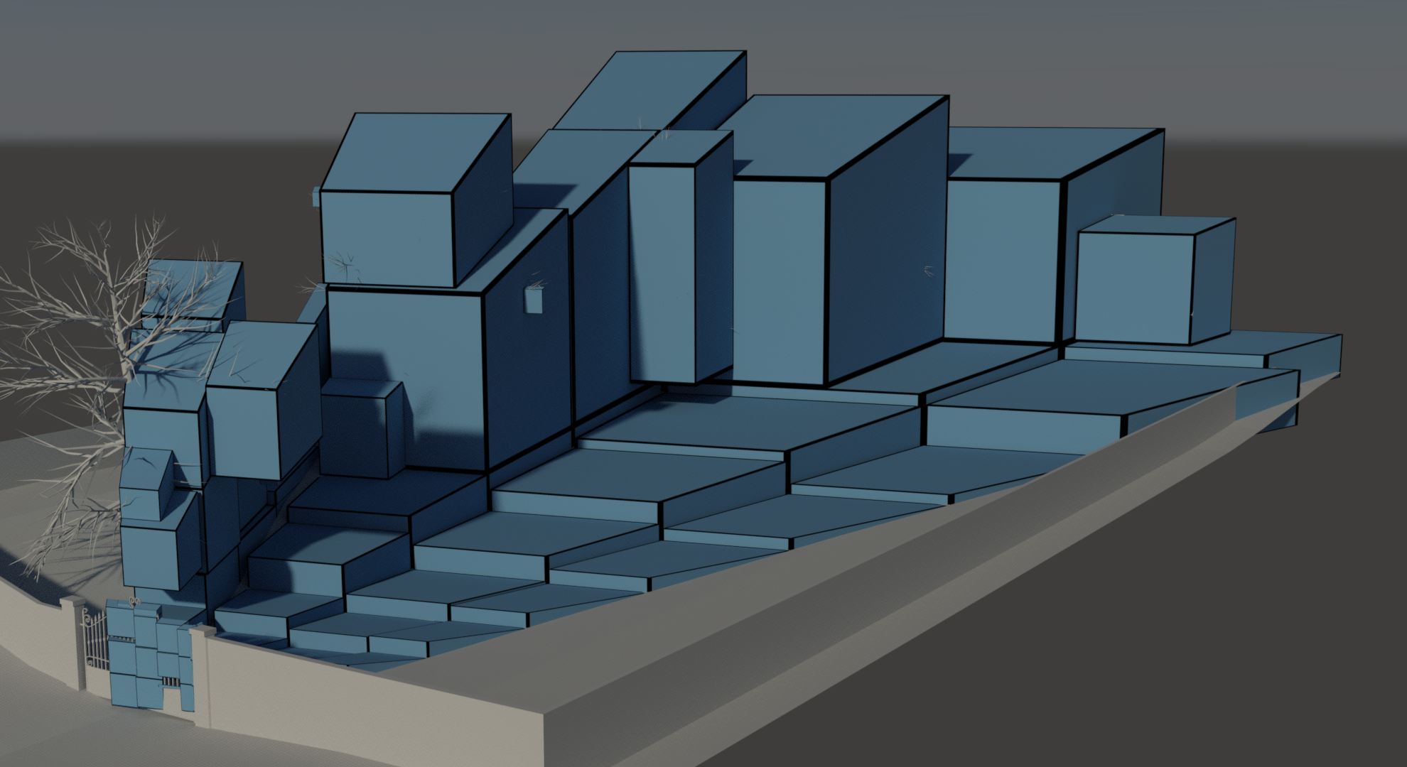
Explicit Bounds
Bounds are created and propagated same as when building simple tree
Storing a full tree is now expensive at high resolutions
  1 bit/Node vs. 6 floats per AABB
  Since final level can at most have 8x8 divisions in z...
Store a compact list of AABBs and just a pointer in the full tree
  1 bit/node + 1 bit/node + Compact List of AABBs
  1024x1024: 57MB vs 1MB
Notes:
And the top level.
<click>
Adding these explicit bounds is simple. We simply calculate and propagate them the same way that we build the simple tree.
However, while each cluster only requires a single bit of information for the simpler tree, we now need six floats to store a complete AABB.
If this is too expensive, we can store a compact list of bounding boxes and just store a pointer in the full tree.
Still, storing bounds is more expensive. With bounding boxes, we need 57MB of memory instead of slightly more than 1MB.

Slide 28
Explicit Bounds
Notes:
So is it worth it? Yep.
The algorithm now consistently performs much fewer test and set operations than the original PTSV algorithm in all scenes we have tested.
So, what about actual performance?

Slide 29
Performance
Notes:
Performance is quite proportional to the number of test and set operations. For this animation we can see that our new algorithm outperforms the original PTSV algorithm consistently, and is much better than traditional ZPASS algorithm except in cases where ZPASS has nothing to draw.
Another interesting thing to note is that on the TITAN gpu, even the original PTSV algorithm actually performs better than traditional ZPASS most of the time.
This is better than what we could report for these resolutions when we wrote that paper, but makes sense since ZPASS is entirely dependent on the pixel throughput, which has not changed much between the GTX480 and the TITAN.

Slide 30
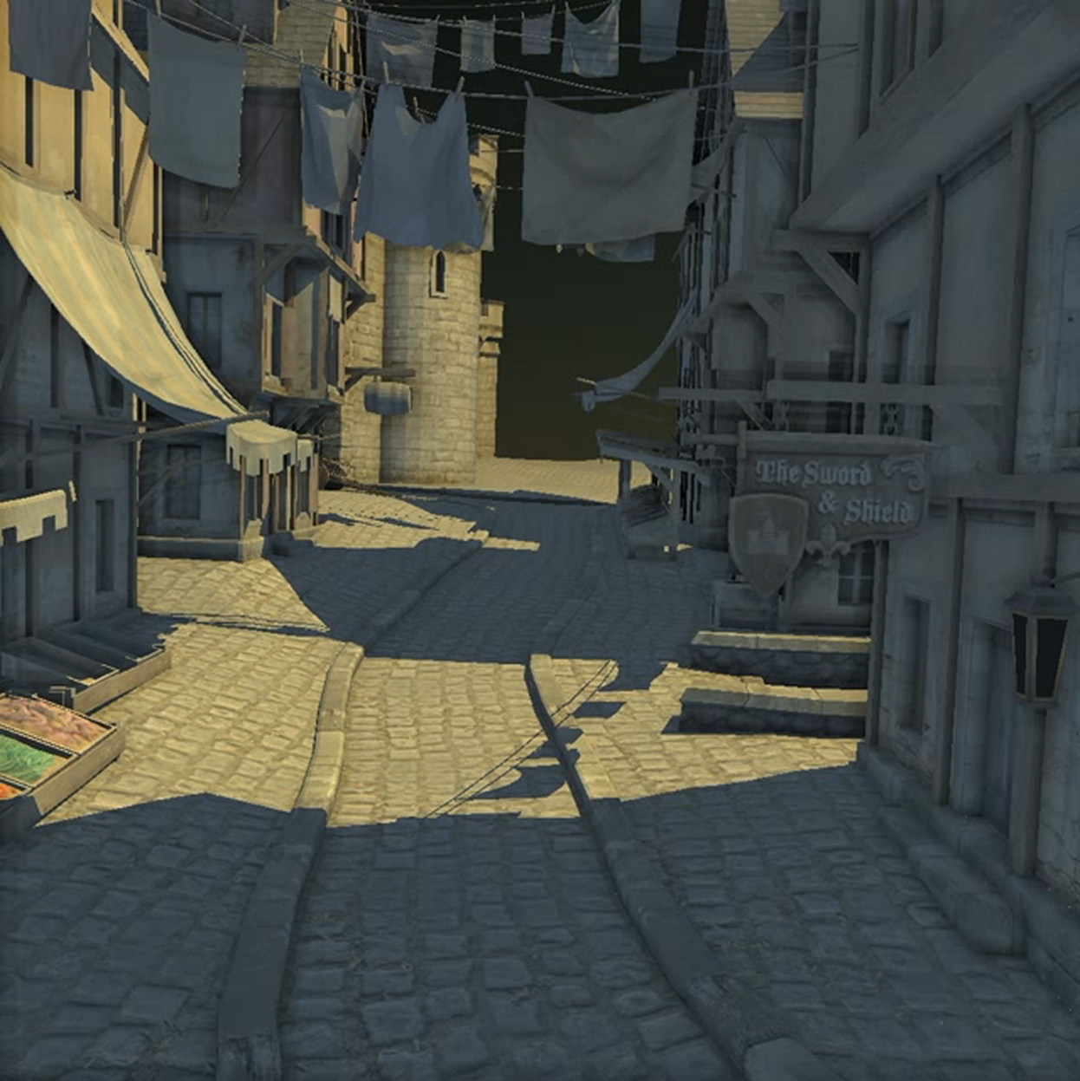
Performance
Notes:
Let’s look at another animation which we have used to benchmark our results. This is a part of a simple gamescene, from the Unreal Development Kit.
Again, we can see that our new algorithm outperforms both ZPASS and PTSV almost consistently.
However, we can also see that performance is very spiky, with a few worst case spikes that are not very flattering.
We found that these spikes depend almost exclusively on poor load-balancing.

Slide 31
Load Balancing
Some shadow volumes will intersect many more boxes than others
  If such a volume is started late, all other processors will have to idle till it is done ☹
Split traversal in two passes!
  First pass traverses only down to level L. If that level is reached, output job tuple (SV, Node Key)
  Second pass is fed by that job list. Amount of work per warp is much more uniform.
Notes:
The problem is that some few shadow volumes may simply intersect a lot more bounding boxes than the rest. If one multiprocessor starts working on such a volume late in the game, the other processors will have to idle till it is done.
We fix this by splitting the traversal into two passes. In the first pass we only traverse down to some predefined level. I f we reach that level, we output a job on a compact list (a job being a shadow volume and the node at which traversal should be resumed). In the second pass each warp will pick an item from this list and resume the job.

Slide 32
Performance
Notes:
This works very well. Performance is increased overall, and the nasty spikes are removed.

Slide 33
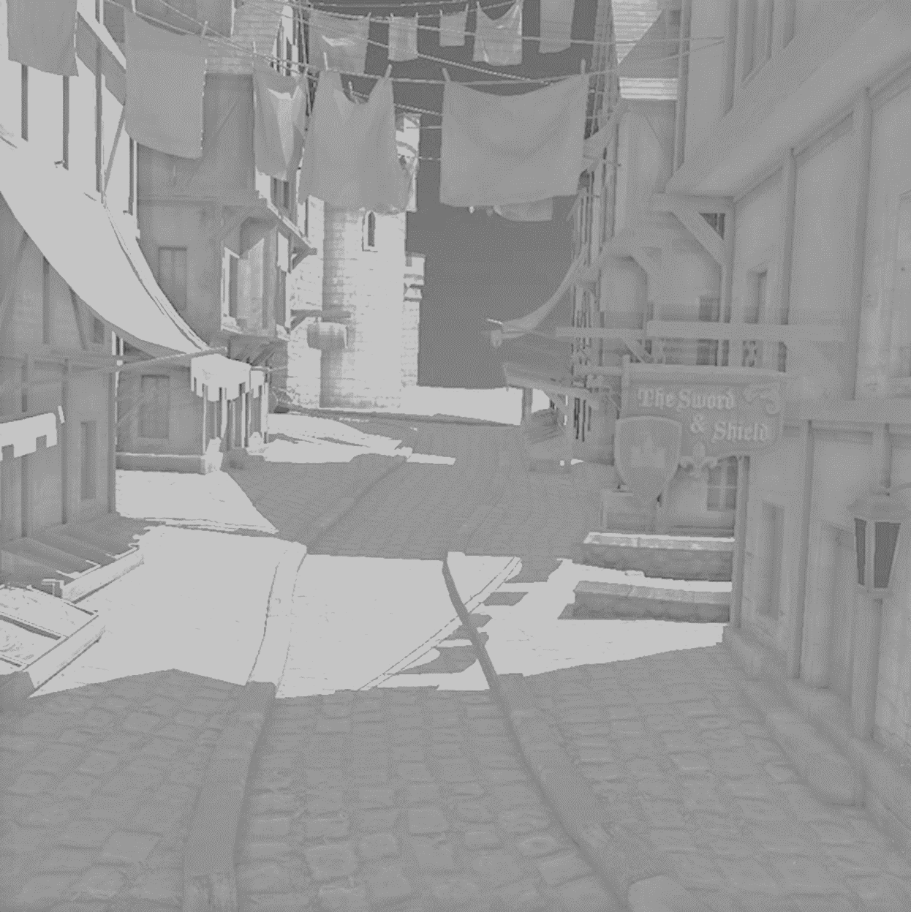
Algorithm break-down
Traversal (65%)
Build Hierarchy (23%)
Merge TA (10%)
Triangle Setup (2%)
Notes:
Finally, let’s look at a break-down of the algorithm when we render shadows at 1080p.
Traversal is the most expensive part, on average it’s 65% of running time in this animation.
Building the hierarchy, complete with bounding boxes, takes up 23% of the running time at this resolution.
<click>
It is interesting to compare this to rendering at 720p or 1024x1024. With approximately half the number of view samples to work on, building the hierarchy takes about half the time of 1080p.
The total running time at 1080p is much less than twice that of 720p though, because the traversal part of the algorithm scales much better to higher resolutions (it can trivially accept more nodes).

Slide 34
Thanks!
Questions?

