Slide 1
Pathtracing In Practice
Advanced Computer Graphics 2014
Erik Sintorn

Slide 2
Overview
Motivation and problem statement
Light Transport Equation (aka The Rendering Equation)
Monte Carlo Integration
Naïve Path Tracing
Making Path Tracing usable
Separating Direct and Indirect lighting
Importance sampling
Stratified sampling
Multiple Importance Sampling

Slide 3
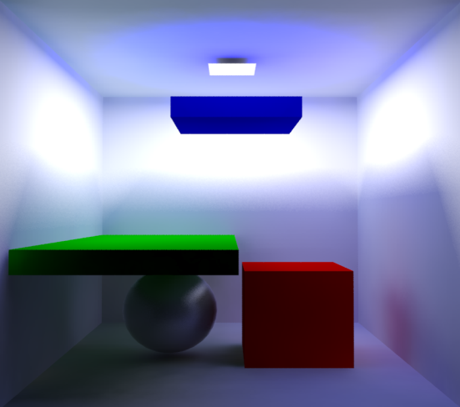
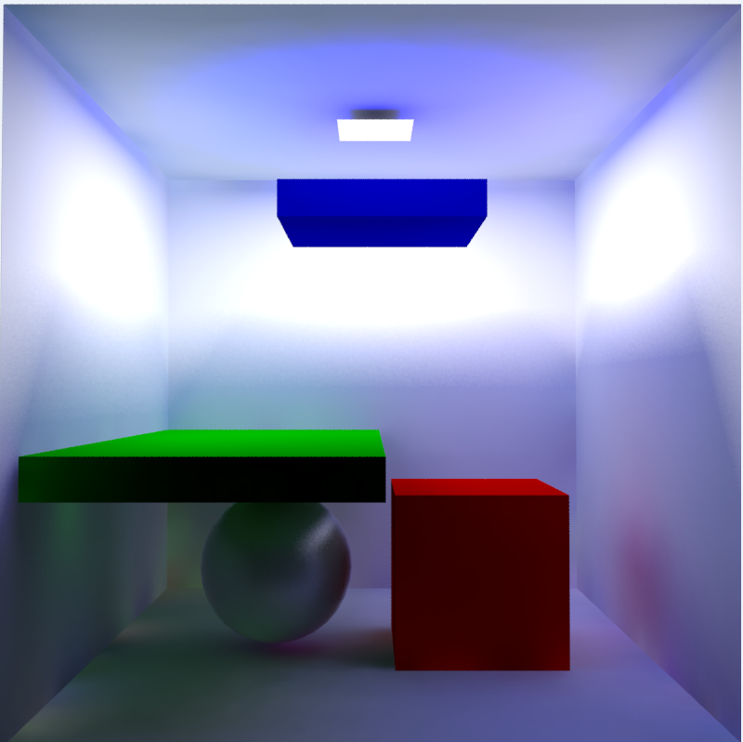
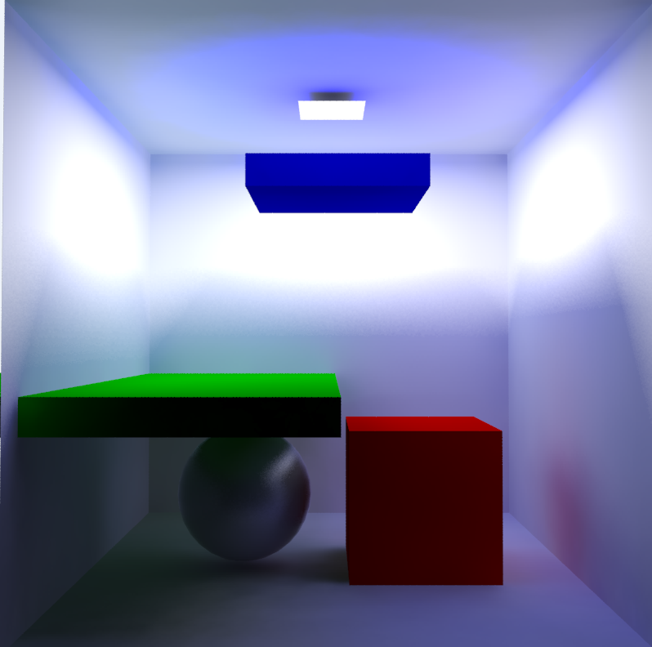
Why bother with physically correct rendering?
As opposed to making up shaders that look good
When something goes wrong, you can reason about why, and how to fix it.
It is easy to hack a material shader that looks realistic for specific lighting conditions, but extremely difficult to hack something that allways looks realistic.
Why bother with unbiased solutions, as opposed to e.g. Photon mapping or Irradiance caching?
An unbiased method (e.g. path-tracing) may take longer to converge
But we will know early if something looks wrong
Photon mapping, 1m 32 seconds
x10 Photons
Photon mapping, 47 seconds
Photon mapping, 4m
x100 Photons

Slide 4
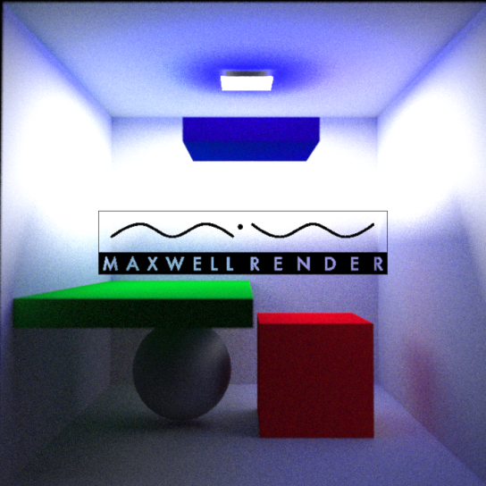
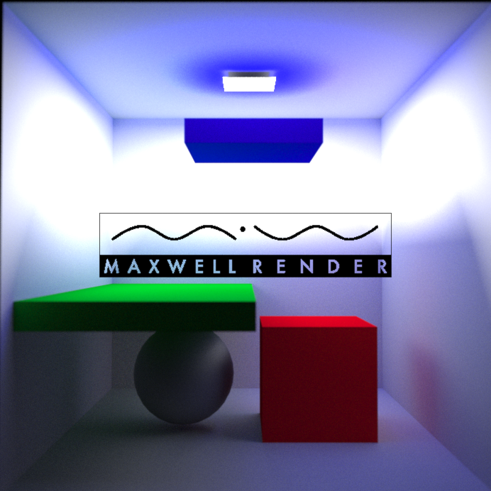
Why bother with physically correct rendering?
Path Tracing, 5m
Path tracing, 30 seconds
Path tracing, 20 minutes

Slide 5
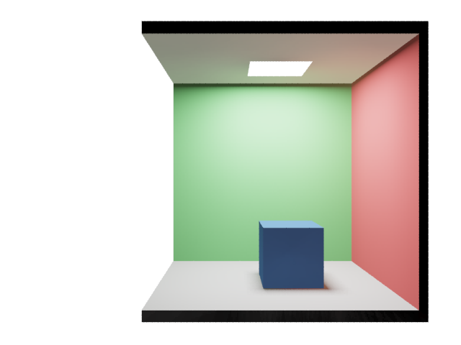
Where does an image come from?
Pinhole Camera

Slide 6
Where does an image come from?
Photon emitted
From some random point on the light.
Carries some energy E
Flies in some random direction.
Pinhole Camera
Notes:
Position, direction and energy come from properties of the light.

Slide 7
Where does an image come from?
Pinhole Camera
Hits a surface
Some of the energy of some
frequencies is absorbed. The rest is reflected in some direction
Notes:
The amount of absorbed energy is a material property (loosely its color)
The direction in which it is reflected depends on the BRDF of the material.
Here, the material is red and diffuse, so green and blue frequencies will be absorbed and the reddish photon may bounce of in most any direction.

Slide 8
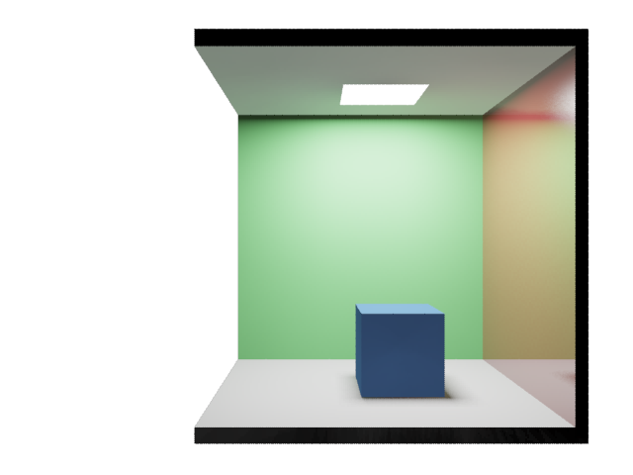
Where does an image come from?
Pinhole Camera
Notes:
Here, the surface is more of a mirror so little energy will be absorbed and the photon is more likely to bounce in the perfect reflection direction

Slide 9
Where does an image come from?
Pinhole Camera
Keeps bouncing on surfaces
Loosing energy at each hit
Notes:
The photon will keep bouncing on the surfaces…

Slide 10
Where does an image come from?
Until it leaves the scene…
Or just runs out of energy
Pinhole Camera
Notes:
We could keep following this photon until it left the scene, or ran out of energy.

Slide 11
Where does an image come from?
Or happens to hit our film
Pinhole Camera
Notes:
Or, by some freak chance it happens to reflect off a surface, go through the little pinhole and land on our film. Then we have a “pixel value”.
We could generate images like this, by just tracing photon after photon around the scene and record the ones that end up on the film.
But it would take forever.

Slide 12
Light Transport Equation
Radiance:
$$W/{(m}^{2}sr)$$
$L_{o}\left(p,ω\right)$?
$$p$$
$$ω$$
$$L_{o}\left(p,ω\right)=L_{e}\left(p,ω\right)+\int_{Ω}{f\left(p,ω,ω^{′}\right)L_{i}\left(p,ω^{′}\right)\cos\left(n,ω^{′}\right)dω′}$$
Notes:
Since most of the paths traced would have been wasted, we normally do this simulation backwards instead.
So, we shoot a ray through the pixel we are interested in, until we hit a surface.
Then we ask: What radiance will leave this point in the direction of my pixel?
The answer is easy… ☺

Slide 13
Light Transport Equation
$$ω$$
$$p$$
Reflected radiance
Emitted radiance
$$L_{o}\left(p,ω\right)=L_{e}\left(p,ω\right)+\int_{Ω}{f\left(p,ω,ω^{′}\right)L_{i}\left(p,ω^{′}\right)\cos\left(n,ω^{′}\right)dω′}$$
Notes:
Okay, let’s look at it in detail.
The first term is the radiance that is emitted from point p, in direction omega. We only have emitted radiance from lightsources.
The second term is all the radiance that is reflected at point p in direction omega, from any other direction w’

Slide 14
Light Transport Equation
Integrate over all directions $ω^{′}$ in the hemisphere around $p$
$$ω′$$
$$ω$$
$$p$$
Reflected radiance
Emitted radiance
$$L_{o}\left(p,ω\right)=L_{e}\left(p,ω\right)+\int_{Ω}{f\left(p,ω,ω^{′}\right)L_{i}\left(p,ω^{′}\right)\cos\left(n,ω^{′}\right)dω′}$$

Slide 15
Light Transport Equation
Integrate over all directions $ω^{′}$ in the hemisphere around $p$
The radiance incoming to point $p$ from direction $ω^{′}$
$$L_{i}\left(p,ω^{′}\right)$$
$$ω′$$
$$ω$$
$$p$$
Reflected radiance
Emitted radiance
$$L_{o}\left(p,ω\right)=L_{e}\left(p,ω\right)+\int_{Ω}{f\left(p,ω,ω^{′}\right)L_{i}\left(p,ω^{′}\right)\cos\left(n,ω^{′}\right)dω′}$$

Slide 16
Light Transport Equation
The amount of incoming radiance that hits $1m^{2}$
$$\cos\left(n,ω^{′}\right)$$
$$n$$
Integrate over all directions $ω^{′}$ in the hemisphere around $p$
$$ω^{′}$$
$$α$$
The radiance incoming to point $p$ from direction $ω^{′}$
$$α$$
$$1m^{2}$$
$$L_{i}\left(p,ω^{′}\right)$$
$$ω′$$
$$ω$$
$$p$$
Reflected radiance
Emitted radiance
$$L_{o}\left(p,ω\right)=L_{e}\left(p,ω\right)+\int_{Ω}{f\left(p,ω,ω^{′}\right)L_{i}\left(p,ω^{′}\right)\cos\left(n,ω^{′}\right)dω′}$$
Notes:
This cosine term tells us which amount of the incoming radiance from direction w’ will land on a unit surface area.
This is independent of the material.

Slide 17
Light Transport Equation
The amount of incoming radiance that hits $1m^{2}$
$$\cos\left(n,ω^{′}\right)$$
$$n$$
Integrate over all directions $ω^{′}$ in the hemisphere around $p$
$$ω^{′}$$
$$α$$
The radiance incoming to point $p$ from direction $ω^{′}$
$$α$$
$$1m^{2}$$
$$L_{i}\left(p,ω^{′}\right)$$
The BRDF tells us what fraction of the radiance incoming from $ω^{′}$ will be reflected in direction $ω.$
$$ω′$$
$$ω$$
$$p$$
Reflected radiance
Emitted radiance
$$L_{o}\left(p,ω\right)=L_{e}\left(p,ω\right)+\int_{Ω}{f\left(p,ω,ω^{′}\right)L_{i}\left(p,ω^{′}\right)\cos\left(n,ω^{′}\right)dω′}$$
Notes:
Finally, the BRDF tells us what fraction of the radiance that lands on this unit area, from direction w’, will be reflected in direction w.
This is a spectral value (but often split into a color and a float brdf).
A mirrorish surface will only have high values when w is approx. reflection of w’.
A diffuse surface has a constant brdf.

Slide 18
Light Transport Equation
$$p′$$
$$L_{i}\left(p,ω^{′}\right)$$
$$=$$
$$L_{o}\left(p^{′},−ω^{′}\right)$$
$$−ω′$$
$$ω′$$
$$L_{e}\left(p^{′},−ω′\right)+\int_{Ω}{f\left(p′,−ω′,ω^{′′}\right)L_{i}\left(p′,ω^{′}\right)\cos\left(n′,ω^{′}\right)dω′}$$
$$=$$
$$ω$$
$$p$$
Reflected radiance
Emitted radiance
$$L_{o}\left(p,ω\right)=L_{e}\left(p,ω\right)+\int_{Ω}{f\left(p,ω,ω^{′}\right)L_{i}\left(p,ω^{′}\right)\cos\left(n,ω^{′}\right)dω′}$$
Notes:
We (usually) cannot solve this equation analytically, since it depends on a scene which we have no nice mathematical description of.

Slide 19
Monte Carlo Integration
Reflected radiance
Emitted radiance
$$L_{o}\left(p,ω\right)≈L_{e}\left(p,ω\right)+\frac{1}{N}\sum_{i=0}^{N}{\frac{f\left(p,ω,ω_{i}\right)L_{i}\left(p,ω_{i}\right)\cos\left(n,ω_{i} \right)}{p(ω_{i})}}$$
Notes:
But we can estimate the value of any integral using monte carlo integration.
We then take N random samples over the domain of the integral.

Slide 20
Monte Carlo Integration
$$L_{o}\left(p,ω\right)=E\left[L_{e}\left(p,ω\right)+\frac{1}{N}\sum_{i=0}^{N}{\frac{f\left(p,ω,ω_{i}\right)L_{i}\left(p,ω_{i}\right)\cos\left(n,ω_{i} \right)}{p\left(ω_{i}\right)}}\right]$$
Notes:
This is an unbiased estimator, so the expected value will be exactly the radiance we are after.

Slide 21
Monte Carlo Integration
Sample hemisphere
uniformly :
$p\left(ω_{i}\right)= \frac{1}{2π}$
$$L_{o}\left(p,ω\right)=E\left[L_{e}\left(p,ω\right)+\frac{1}{1}\sum_{i=0}^{1}{\frac{f\left(p,ω,ω_{i}\right)L_{i}\left(p,ω_{i}\right)\cos\left(n,ω_{i} \right)}{p\left(ω_{i}\right)}}\right]$$
$$L_{o}\left(p,ω\right)=E\left[L_{e}\left(p,ω\right)+\frac{f\left(p,ω,ω_{i}\right)L_{i}\left(p,ω_{i}\right)\cos\left(n,ω_{i} \right)}{p\left(ω_{i}\right)}\right]$$
Notes:
Even if we only take ONE sample
And even if we sample the hemisphere perfectly uniformly (making the PDF constant)

Slide 22
Monte Carlo Integration
Sample hemisphere
uniformly :
$p\left(ω_{i}\right)= \frac{1}{2π}$
$$L_{o}\left(p,ω\right)=E\left[L_{e}\left(p,ω\right)+2πf\left(p,ω,ω_{i}\right)L_{i}\left(p,ω_{i}\right)\cos\left(n,ω_{i} \right)\right]$$
Notes:
Now we have a very simple estimator for the correct outgoing radiance from p.
Since it is unbiased we can evaluate this for every pixel, time and time again and the average will converge towards the correct value.

Slide 23
Naive Pathtracing
$$p$$
$$L_{o}\left(p,ω\right)≈L_{e}\left(p,ω\right)+2πf\left(p,ω,ω_{i}\right)L_{i}\left(p,ω_{i}\right)\cos\left(n,ω_{i} \right)$$
$$L_{o}\left(p,ω\right)≈L_{e}\left(p,ω\right)+2πf\left(p,ω,ω_{i}\right)L_{i}\left(p,ω_{i}\right)\cos\left(n,ω_{i} \right)$$
Notes:
This leads to a basic path-tracing algorithm:
We trace a ray through the pixel, to find the first intersection point p

Slide 24
Naive Pathtracing
$$ω_{i}$$
$$p$$
$$L_{o}\left(p,ω\right)≈L_{e}\left(p,ω\right)+2πf\left(p,ω,ω_{i}\right)L_{i}\left(p,ω_{i}\right)\cos\left(n,ω_{i} \right)$$
$$L_{o}\left(p,ω\right)≈L_{e}\left(p,ω\right)+2πf\left(p,ω,ω_{i}\right)L_{i}\left(p,ω_{i}\right)\cos\left(n,ω_{i} \right)$$
$$L_{o}\left(p,ω\right)≈L_{e}\left(p,ω\right)+2πf\left(p,ω,ω_{i}\right)L_{i}\left(p,ω_{i}\right)\cos\left(n,ω_{i} \right)$$
Notes:
Then, we choose a random direction wi on the hemisphere

Slide 25
Naive Pathtracing
$$ω_{i}$$
$$p$$
$$L_{o}\left(p,ω\right)≈0+2πf\left(p,ω,ω_{i}\right)L_{i}\left(p,ω_{i}\right)\cos\left(n,ω_{i} \right)$$

Slide 26
Naive Pathtracing
$$p′$$
$$ω_{i}$$
$$p$$
$$L_{o}\left(p,ω\right)≈0+2πf\left(p,ω,ω_{i}\right)L_{o}\left(p′,{−ω}_{i}\right)\cos\left(n,ω_{i} \right)$$
$$L_{o}\left(p,ω\right)≈0+2πf\left(p,ω,ω_{i}\right)L_{i}\left(p,ω_{i}\right)\cos\left(n,ω_{i} \right)$$
Notes:
To evaluate the Li term, we shoot a ray in the direction wi, and note that Li can be replaced by Lo from that point.
We know how to evaluate Lo!

Slide 27
Naive Pathtracing
$$p′$$
$$ω_{i}$$
$$p$$
$$L_{o}\left(p,ω\right)≈0+2πf\left(p,ω,ω_{i}\right)\left[L_{e}\left(p^{′},−ω_{i}\right)+2πf\left(p^{′},−ω_{i},ω_{j}\right)L_{i}\left(p′,ω_{j}\right)\cos\left(n′,ω_{j} \right)\right]\cos\left(n,ω_{i} \right)$$
Notes:
So we plug in the same equation again

Slide 28
Naive Pathtracing
$$ω_{j}$$
$$p′$$
$$ω_{i}$$
$$p$$
$$L_{o}\left(p,ω\right)≈0+2πf\left(p,ω,ω_{i}\right)\left[0+2πf\left(p^{′},−ω_{i},ω_{j}\right)L_{i}\left(p′,ω_{j}\right)\cos\left(n′,ω_{j} \right)\right]\cos\left(n,ω_{i} \right)$$
Notes:
Choose a new random direction and evaluate the brdf and costerm

Slide 29
Naive Pathtracing
$$p′$$
$$ω_{j}$$
$$p′$$
$$ω_{i}$$
$$p$$
$$L_{o}\left(p,ω\right)≈0+2πf\left(p,ω,ω_{i}\right)\left[0+2πf\left(p^{′},−ω_{i},ω_{j}\right)L_{i}\left(p′,ω_{j}\right)\cos\left(n′,ω_{j} \right)\right]\cos\left(n,ω_{i} \right)$$
Notes:
Shoot a new ray to find the next ray on the path…

Slide 30
Naive Pathtracing
$$p′′$$
$$ω_{j}$$
$$p′$$
$$ω_{i}$$
$$p$$
$$L_{o}\left(p,ω\right)≈0+2πf\left(p,ω,ω_{i}\right)\left[0+2πf\left(p^{′},−ω_{i},ω_{j}\right)L_{o}\left(p′′,{−ω}_{j}\right)\cos\left(n′,ω_{j} \right)\right]\cos\left(n,ω_{i} \right)$$
Notes:
And hit the light! We replace Li by Lo from the new point and since this is a light-source, with no reflections…

Slide 31
Naive Pathtracing
$$p′′$$
$$ω_{j}$$
$$p′$$
$$ω_{i}$$
$$p$$
$$L_{o}\left(p,ω\right)≈0+2πf\left(p,ω,ω_{i}\right)\left[0+2πf\left(p^{′},−ω_{i},ω_{j}\right)L_{e}\left(p^{′′},−ω_{i}\right)\cos\left(n′,ω_{j} \right)\right]\cos\left(n,ω_{i} \right)$$
Notes:
We only have to replace Lo by Le and we are done.

Slide 32
Naive Pathtracing
$$p′′$$
$$ω_{j}$$
$$p′$$
$$ω_{i}$$
$$p$$
What’s so naïve about this?
Notes:
What is so naïve about this algorithm?
The problem is that it was pure luck that we hit a light-source so soon.
For the majority of paths, the contribution will be close to zero before we ever hit a light…
Still, it works, and we have an unbiased estimate value of our pixel. Since it is unbiased, we can keep doing this infinitely many times and average the results to get the final correct image.

Slide 33
Separating Direct And Indirect Illumination
$$p′$$
$$p$$
$$p′′$$
direct illumination
indirect illumination
$$L_{o}\left(p,ω\right)=\int_{S}{f\left(p,ω,p→q\right)L_{e}\left(q,q→p\right)G\left(p,q\right)V\left(p,q\right)dq+}\int_{Ω}{f(p,ω,}ω′)L_{i}(p,ω′)cos⁡(n,ω′)dω′$$
Notes:
Talk about surface form of integral

Slide 34
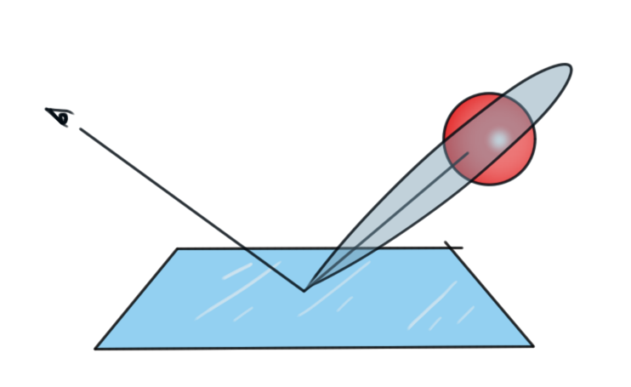
Importance Sampling
So far we have sampled incoming light uniformly over the hemisphere. Why is that a bad idea?

Slide 35
Importance Sampling
So far we have sampled incoming light uniformly over the hemisphere. Why is that a bad idea?

Slide 36
Importance Sampling
So far we have sampled incoming light uniformly over the hemisphere. Why is that a bad idea?
We want to shoot more samples where the function we are integrating is high!
One common type of importance sampling is to create a distribution that resembles the BRDF

Slide 37
Importance Sampling
$L_{o}\left(p,ω\right)≈L_{e}\left(p,ω\right)+\frac{1}{N}\sum_{i=0}^{N}{\frac{f\left(p,ω,ω_{i}\right)L_{i}\left(p,ω_{i}\right)\cos\left(n,ω_{i} \right)}{p\left(ω_{i}\right)}}$
We need to make sure our PDF is not low where the function we are sampling can be high
Or we will accumulate samples with extremely high variance
EXAMPLE: We can always generate samples with cosine distribution: $L_{o}\left(p,ω\right)≈L_{e}\left(p,ω\right)+\frac{1}{N}\sum_{i=0}^{N}{\frac{f\left(p,ω,ω_{i}\right)L_{i}\left(p,ω_{i}\right)\cos\left(n,ω_{i} \right)}{\frac{\cos\left(n,ω_{i} \right)}{π}}=}$ $L_{e}\left(p,ω\right)+\frac{π}{N}\sum_{i=0}^{N}{f\left(p,ω,ω_{i}\right)L_{i}\left(p,ω_{i}\right)}$

Slide 38
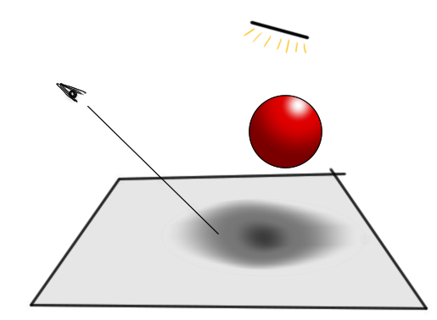
Stratified Sampling
Another standard variance reduction method
When just choosing samples randomly over the domain, they may “clump” and take a long while to converge
It will converge to 0.5 after unlimited time. But after four samples I still have prob=1/8 that the pixel will be considered all in shadow
or completely unshadowed

Slide 39
Stratified Sampling
Divide domain into “strata”
Don’t sample one strata again until all others have been sampled once.

Slide 40
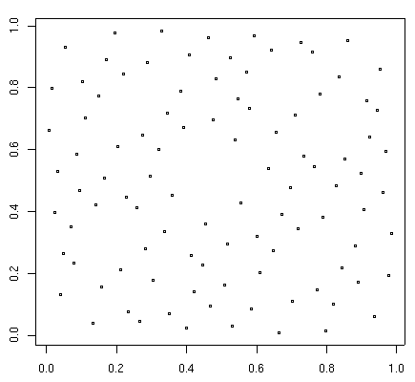
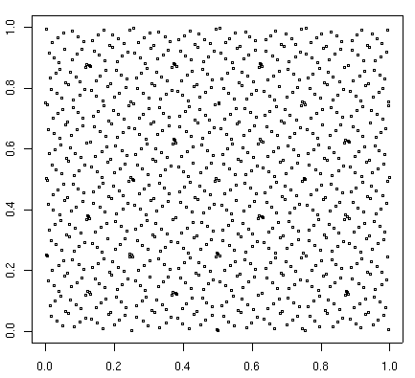
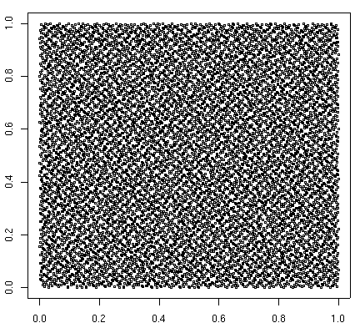
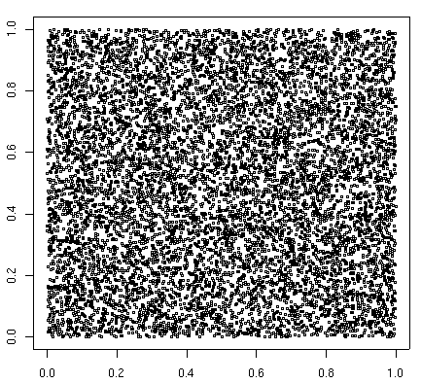
Stratified Sampling
If we know how many samples we want to take, we can get good stratification from “jittering”
If not, we want any sequence of samples to have good stratification. We can use a Low Discrepancy Sequence
SOBOL: 100 samples
SOBOL: 1000 samples
SOBOL: 10000 samples
RANDOM: 10000 samples

Slide 41
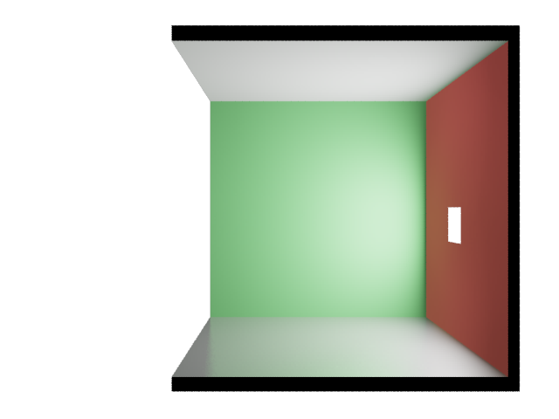
Multiple Importance Sampling
$$p$$
direct illumination
indirect illumination
$$L_{o}\left(p,ω\right)=\int_{S}{f\left(p,ω,p→q\right)L_{e}\left(q,q→p\right)G\left(p,q\right)V\left(p,q\right)dq+}\int_{Ω}{f(p,ω,}ω′)L_{i}(p,ω′)cos⁡(n,ω′)dω′$$

Slide 42
Multiple Importance Sampling
$$p$$

Slide 43
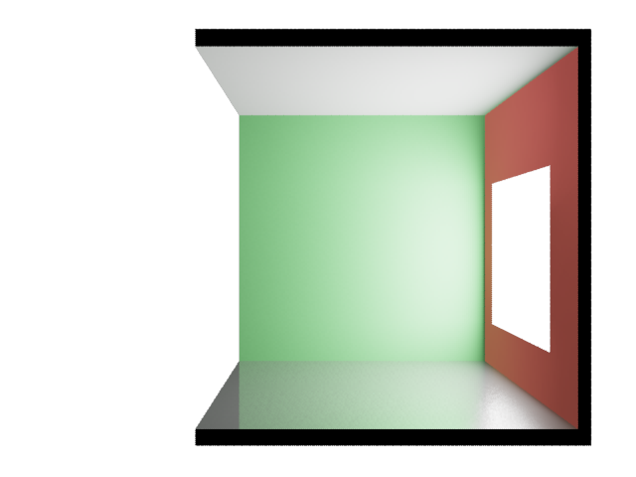
Multiple Importance Sampling
$$p$$

Slide 44
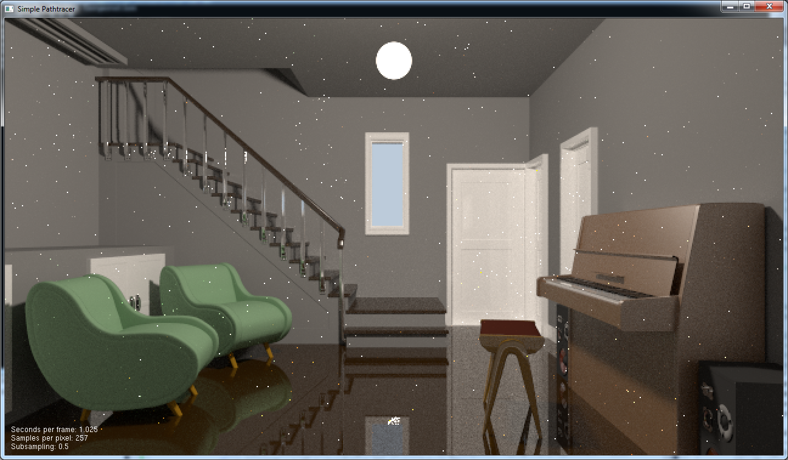
Multiple Importance Sampling
$$p$$

Slide 45
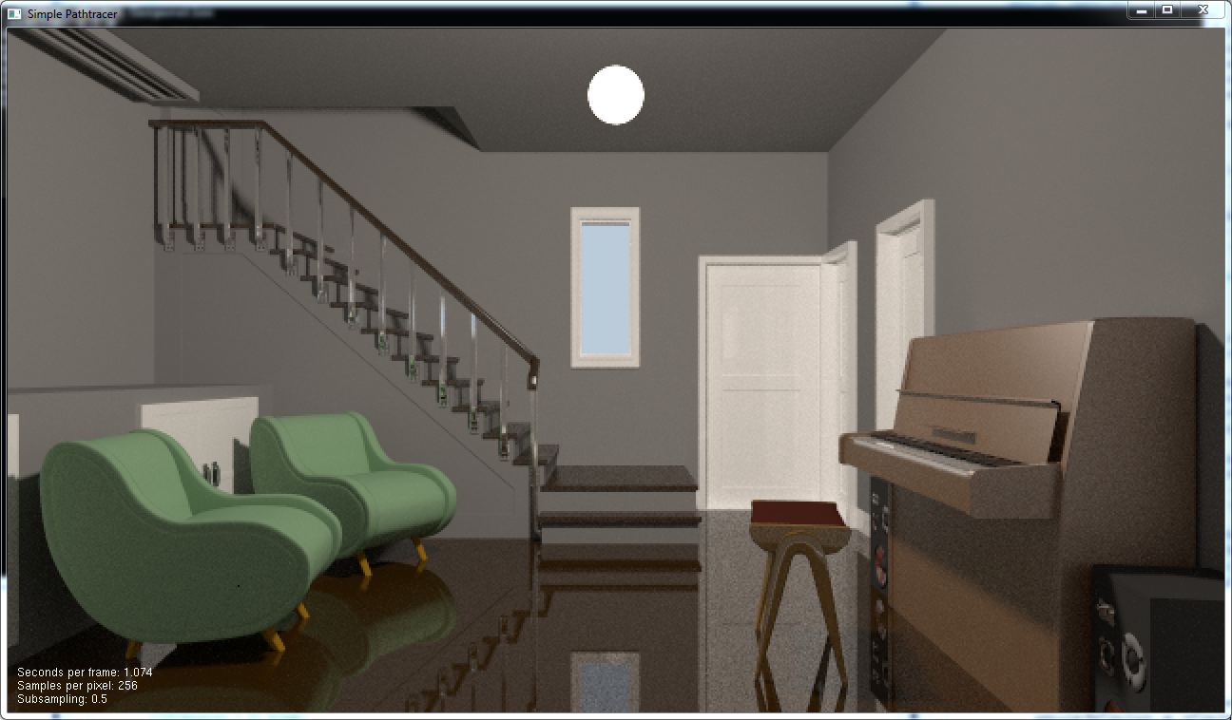
Multiple Importance Sampling
Do both!
Sample brdf first
Then light
PDF of this sampling strategy is (weighted) sum
- Only very low if neither technique is likely to choose dir
$$p$$

Slide 46
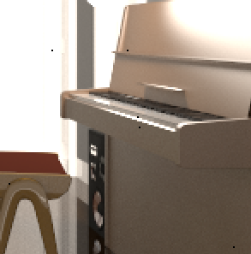
Highlight Antialiasing
Why is there still heavy aliasing in this image after ~3000 SPP?

Slide 47
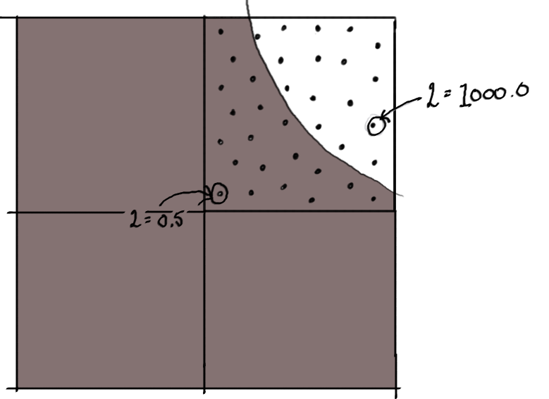
Highlight Antialiasing
Why is there still heavy aliasing in this image after ~3000 SPP?
$\frac{19∗0.5+16∗1000}{(19+16)}=457.41$
=

Slide 48
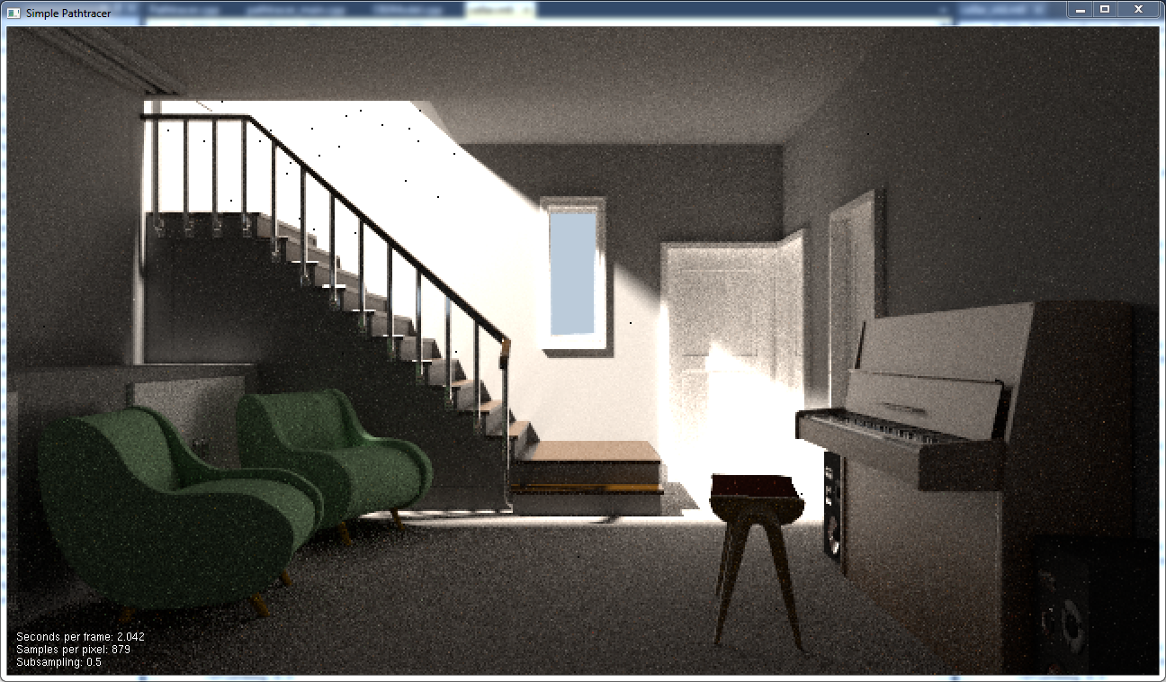
Bidirectional Path Tracing
Are we done now?

Slide 49
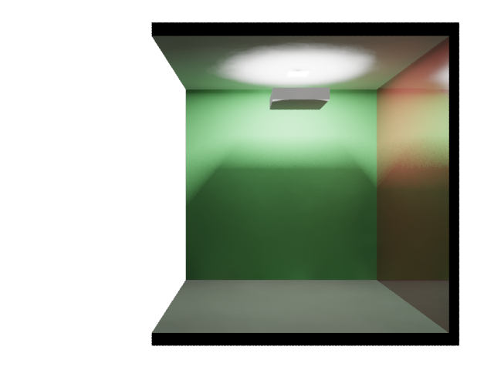
Bidirectional Path Tracing

Slide 50
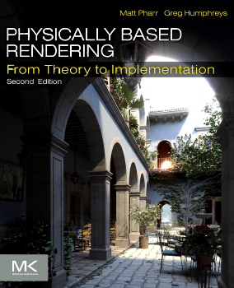
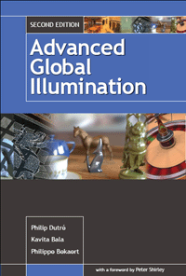
Further Reading

