Slide 1
Light Transport
Advanced Computer Graphics 2017
Erik Sintorn
Notes:
Good Afternoon
Last time, we talked about the basic mathematics of Light Transport.
We saw what a BRDF really is, how dirfferent kinds of materials can be represented mathematically, and where the “rendering equation” comes from.
Today, we are going to look at algorithms for actually using this maths to produce images.
In particular, we will be looking at variants of the “path tracing” algorithm which are extremely popular these days.

Slide 2
Before we start:
Remember to choose a subject for your presentation soon.
And your project.
Student representatives:
JOHAN BACKMAN johback@student.chalmers.se
KEVIN BJÖRKLUND kevinb@student.chalmers.se
JONAS HULTÉN jonashu@student.chalmers.se
HAMPUS LIDIN lidin@student.chalmers.se
VICTOR OLAUSSON vicola@student.chalmers.se
Come for a quick talk with me during recess.
Muddy Cards!

Slide 3
Light Transport Simulation
Rendering an image is a matter of ”simulating” how light propagates through a virtual scene and lands on a virtual camera film.
Many algorithms exist, and the best one depends on many factors.
For a long time, Photon Mapping and Irradiance Caching were extremely popular.
Trade correctness for speed.
Will cover these only very briefly.
Notes:
The path tracing algorithm was actually introduced in the same paper as the rendering equeation.
- It is simply the algorithm you end up with if you use standard mathematical tools to try to numerically solve the rendering equation.
The algorithm is convergent and unbiased. We will define those terms properly later, but it basically means that if you let it run long enough, you will get the correct result.
For a long time though, “long enough” was way too long. It is only in recent years that the guarantee of a correct final result has outweighed the fact that you can get great images much faster if you cheat a little.
<click>
So, throughout the nineties and early 2000:s, other global illumination algorithms, such as photon mapping and irradiance caching, have been used instead. We will begin the lecture by looking quickly at what they are.
<click>
But you should know that today, almost all commercial renderers use some form of unbiased path tracing (at least as an option).

Slide 4
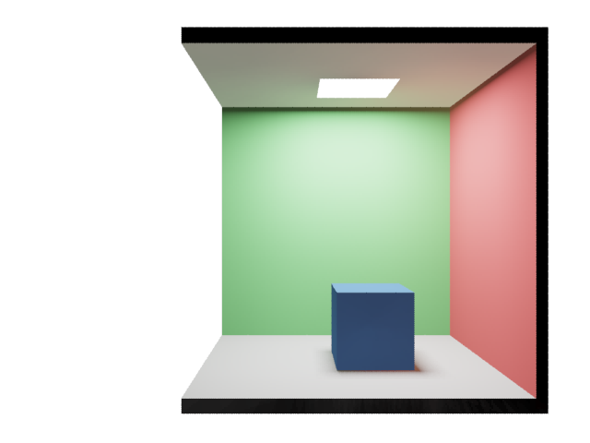
Photon Mapping
Pinhole Camera
Notes:
What are these previous techniques and why are people steering away from using them?
One biased technique is photon mapping. The idea here is to first trace and store a large number of photons from the light.
<click>
Then, we shoot a ray from the camera, and to evaluate indirect lighting, we shoot secondary rays. Where a secondary ray hits, we gather a number of nearby photons to evaluate the outgoing radiance.
The “cheat” here is that the red photons that we gather here did not actually land on the point we are considering. If we shoot enough photons, so that we can collect enough photons while not taking any that lie far away, this is an acceptable approximation and works well.

Slide 5
Irradiance Caching
Pinhole Camera
Notes:
Another popular biased technique is irradiance caching where
<click>
we first trace rays from the camera and gather global illumination information by shooting lots of more rays.
<click>
We do that for a number of points
<click>
But when possible
<click>
We avoid shooting more rays, by interpolating the result from previous rays.
The “cheat” in this algorithm is of course that the interpolation does not have to be correct, or even close to correct.
The point for which we interpolate could have a completely different view of the scene, and it is difficult or impossible to know that beforehand.

Slide 6
Path Tracing
Path tracing is an algorithm for rendering images.
Introduced by James Kajiya in 1986 as a numerical solution to the Rendering Equation.
The algorithm is convergent and unbiased.
Has long been considered too noisy/slow to be used in industry.
Today, almost all commercial renderers use some form of unbiased pathtracing (at least optionally).
Pixar (for example) only switched completely very recently.
Why the sudden popularity?
Notes:
The path tracing algorithm was actually introduced in the same paper as the rendering equeation.
- It is simply the algorithm you end up with if you use standard mathematical tools to try to numerically solve the rendering equation.
The algorithm is convergent and unbiased. We will define those terms properly later, but it basically means that if you let it run long enough, you will get the correct result.
For a long time though, “long enough” was way too long. It is only in recent years that the guarantee of a correct final result has outweighed the fact that you can get great images much faster if you cheat a little.
<click>
So, throughout the nineties and early 2000:s, other global illumination algorithms, such as photon mapping and irradiance caching, have been used instead. We will begin the lecture by looking quickly at what they are.
<click>
But you should know that today, almost all commercial renderers use some form of unbiased path tracing (at least as an option).

Slide 7
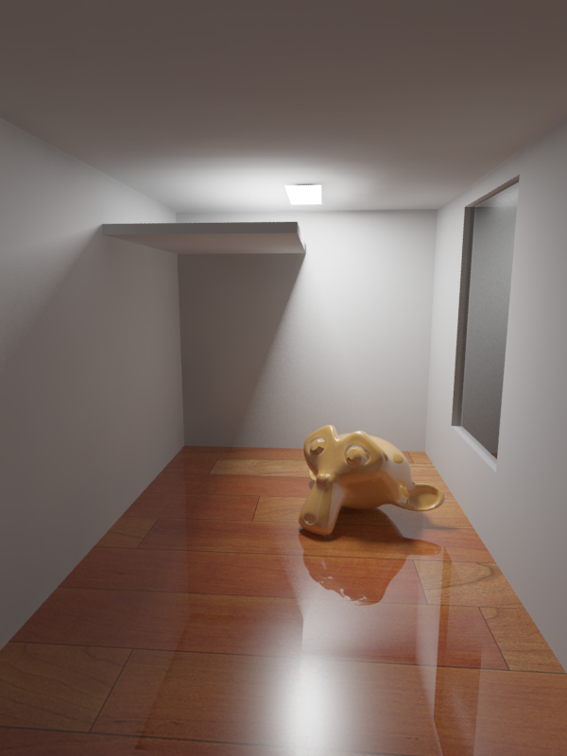
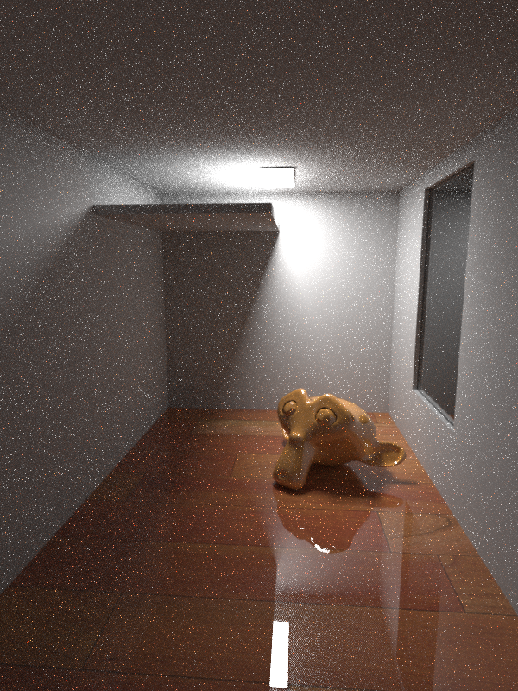
Mental Ray (photon mapping) 32s
iRay (path tracing) 32s
Notes:
So why would we want to cheat at all. Well:
This is an example image rendered with biased photon mapping to the left, and unbiased path-tracing to the right.
Well, the most obvious difference in these images is that the old fashioned photon mapping image is noise free and nice looking, after 32 seconds,
While the pathtraced image is noisy and unusable after 32 seconds…

Slide 8
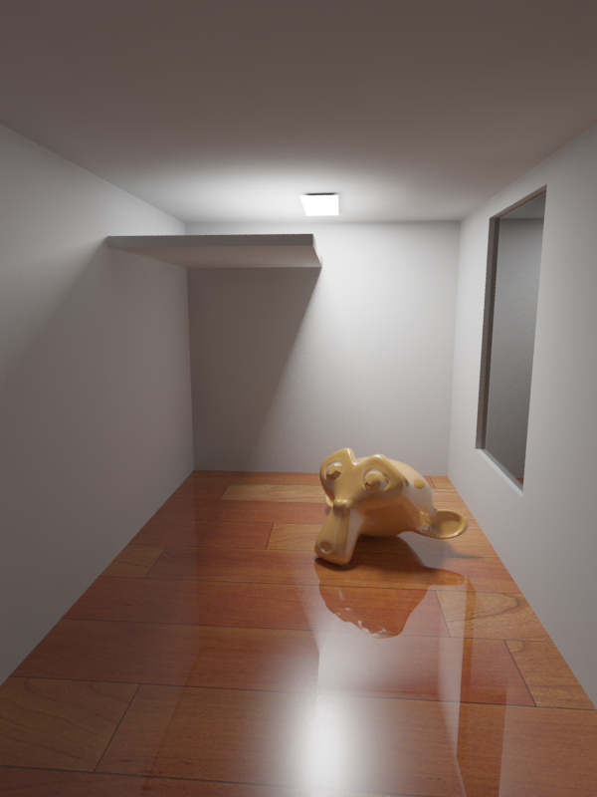
Mental Ray (photon mapping) 2m8s
iRay (path tracing) 2m8s
Notes:
If we yank up rendering quality, MR takes 2m and 8 seconds.
Iray still gives us a pretty noisy image.

Slide 9
Mental Ray (photon mapping) 2m8s
iRay (path tracing) 2m8s
iRay (path tracing) ~1h
Notes:
Here are the same images again, together with the iRay result after one hour, where it has really converged.
So… Why do we care about pathtracing? If it’s this much slower?
<se om dom har några svar>
Quick Answers:
The MR image is WRONG (due to approximations and errors):
Wrong overall intensity
Reflection of light on walls is weird
Specular highlights are wrong (on monkey and reflections)
Separate caustic photon mapping is not on
These errors are not inherent in the photon mapping algorithm. If we used a much larger initial photon map, and used a separate caustics photon map, and set some tweakable parameters just right, we could probably still get an image that looks very close to the path traced image and in less time.
* The point is that it is very hard to know how the photon mapper should be set up to be good enough (varies dramatically from scene to scene).
* Trial and error makes it more costly (in terms of time spent) in the long run.

Slide 10
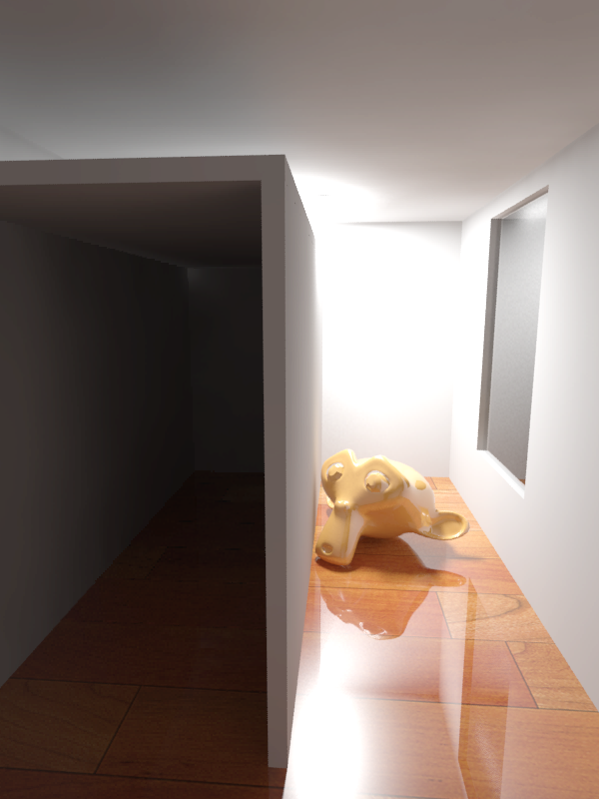
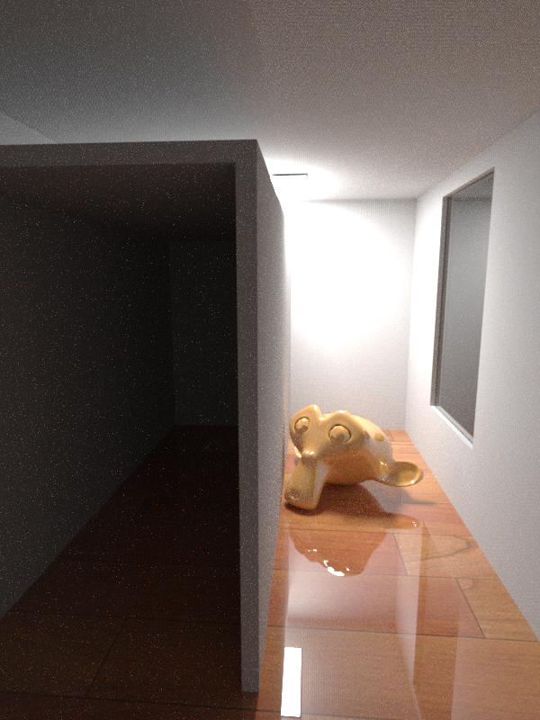
Mental Ray 15m, 100M Photons, FG 1.0
iRay (path tracing) 15m
Artifacts never go away
Scene specific tuning choices
Immediate response
Much easier to parallelize
Notes:
Here is another image which shows some additional problems with photon mapping.
The main reasons why people are moving towards unbiased renderers, I think, are:
Immediate response
After only a few seconds the PT image can be “read” and we will know if the final image will look good
With PM/IC it may take minutes until we se a first image
Artifacts in photon-mapping images are introduced in the beginning, but not visible until the image is done
The MR image above has light leakage which will not go away. We have to restart the image.
So… We can’t “wait until the image is complete”
Path tracing is much easier to parallelize (especially over many machines)
Parallelizing Photon Mapping means creating parts of the photon map on different machines, then merging them
Complete photon map could be to large to hold on one machine
MR/VRAY requires you to make difficult scene specific decisions, PT “just works”
Number of GI photons
Number of Caustic photons
Number of Rays per FG sample?

Slide 11
Where does an image come from?
Pinhole Camera
Notes:
So, without further ado, let’s recap where an image comes from…

Slide 12
Where does an image come from?
Photon emitted
From some random point on the light.
Carries some energy E
Flies in some random direction.
Pinhole Camera
Notes:
Position, direction and energy come from properties of the light.

Slide 13
Where does an image come from?
Pinhole Camera
Hits a surface
Some of the energy of some
frequencies is absorbed. The rest is reflected in some direction
Notes:
The amount of absorbed energy is a material property (loosely its color)
The direction in which it is reflected depends on the BRDF of the material.
Here, the material is red and diffuse, so green and blue frequencies will be absorbed and the reddish photon may bounce of in most any direction.

Slide 14
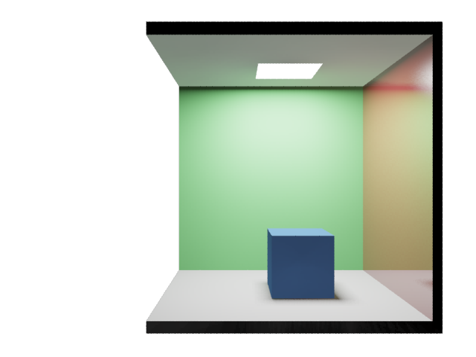
Where does an image come from?
Pinhole Camera
Notes:
Here, the surface is more of a mirror so little energy will be absorbed and the photon is more likely to bounce in the perfect reflection direction

Slide 15
Where does an image come from?
Pinhole Camera
Keeps bouncing on surfaces
Loosing energy at each hit
Notes:
The photon will keep bouncing on the surfaces…

Slide 16
Where does an image come from?
Until it leaves the scene…
Or just runs out of energy
Pinhole Camera
Notes:
We could keep following this photon until it left the scene, or ran out of energy.

Slide 17
Where does an image come from?
Or happens to hit our film
Pinhole Camera
Notes:
Or, by some freak chance it happens to reflect off a surface, go through the little pinhole and land on our film. Then we have a “pixel value”.
We could generate images like this, by just tracing photon after photon around the scene and record the ones that end up on the film.
But we don’t do that. Why? [it would take forever]

Slide 18
Light Transport Equation
Radiance:
$$W/{(m}^{2}sr)$$
$L_{o}\left(p,ω\right)$?
$$p$$
$$ω$$
$$L_{o}\left(p,ω\right)=L_{e}\left(p,ω\right)+\int_{Ω}{f\left(p,ω,ω^{′}\right)L_{i}\left(p,ω^{′}\right)\cos\left(n,ω^{′}\right)dω′}$$
Notes:
Since most of the paths traced would have been wasted, we normally do this simulation backwards instead.
So, we shoot a ray through the pixel we are interested in, until we hit a surface.
Then we ask: What radiance will leave this point in the direction of my pixel?
The answer is easy… ☺

Slide 19
Light Transport Equation
$$ω$$
$$p$$
Reflected radiance
Emitted radiance
$$L_{o}\left(p,ω\right)=L_{e}\left(p,ω\right)+\int_{Ω}{f\left(p,ω,ω^{′}\right)L_{i}\left(p,ω^{′}\right)\cos\left(n,ω^{′}\right)dω′}$$
Notes:
Okay, let’s look at it in detail.
The first term is the radiance that is emitted from point p, in direction omega. We only have emitted radiance from lightsources.
The second term is all the radiance that is reflected at point p in direction omega, from any other direction w’

Slide 20
Light Transport Equation
Integrate over all directions $ω^{′}$ in the hemisphere around $p$
$$ω′$$
$$ω$$
$$p$$
Reflected radiance
Emitted radiance
$$L_{o}\left(p,ω\right)=L_{e}\left(p,ω\right)+\int_{Ω}{f\left(p,ω,ω^{′}\right)L_{i}\left(p,ω^{′}\right)\cos\left(n,ω^{′}\right)dω′}$$

Slide 21
Light Transport Equation
Integrate over all directions $ω^{′}$ in the hemisphere around $p$
The radiance incoming to point $p$ from direction $ω^{′}$
$$L_{i}\left(p,ω^{′}\right)$$
$$ω′$$
$$ω$$
$$p$$
Reflected radiance
Emitted radiance
$$L_{o}\left(p,ω\right)=L_{e}\left(p,ω\right)+\int_{Ω}{f\left(p,ω,ω^{′}\right)L_{i}\left(p,ω^{′}\right)\cos\left(n,ω^{′}\right)dω′}$$

Slide 22
Light Transport Equation
Convert between irradiance parallel to $ω$ and irradiance on surface.
$$\cos\left(n,ω^{′}\right)$$
$$n$$
Integrate over all directions $ω^{′}$ in the hemisphere around $p$
$$ω^{′}$$
$$α$$
The radiance incoming to point $p$ from direction $ω^{′}$
$$α$$
$$1m^{2}$$
$$L_{i}\left(p,ω^{′}\right)$$
$$ω′$$
$$ω$$
$$p$$
Reflected radiance
Emitted radiance
$$L_{o}\left(p,ω\right)=L_{e}\left(p,ω\right)+\int_{Ω}{f\left(p,ω,ω^{′}\right)L_{i}\left(p,ω^{′}\right)\cos\left(n,ω^{′}\right)dω′}$$
Notes:
This cosine term tells us which amount of the incoming radiance from direction w’ will land on a unit surface area.
This is independent of the material.

Slide 23
Light Transport Equation
Convert between irradiance parallel to $ω′$ and irradiance on surface.
$$\cos\left(n,ω^{′}\right)$$
$$n$$
Integrate over all directions $ω^{′}$ in the hemisphere around $p$
$$ω^{′}$$
$$α$$
The radiance incoming to point $p$ from direction $ω^{′}$
$$α$$
$$1m^{2}$$
$$L_{i}\left(p,ω^{′}\right)$$
The BRDF tells us the differential outgoing radiance in direction $ω$ due to irradiance on surface.
$$ω′$$
$$ω$$
$$p$$
Reflected radiance
Emitted radiance
$$L_{o}\left(p,ω\right)=L_{e}\left(p,ω\right)+\int_{Ω}{f\left(p,ω,ω^{′}\right)L_{i}\left(p,ω^{′}\right)\cos\left(n,ω^{′}\right)dω′}$$
Notes:
Finally, the BRDF tells us what fraction of the radiance that lands on this unit area, from direction w’, will be reflected in direction w.
This is a spectral value (but often split into a color and a float brdf).
A mirrorish surface will only have high values when w is approx. reflection of w’.
A diffuse surface has a constant brdf.

Slide 24
Light Transport Equation
$$p′$$
$$L_{i}\left(p,ω^{′}\right)$$
$$=$$
$$L_{o}\left(p^{′},−ω^{′}\right)$$
$$−ω′$$
$$ω′$$
$$L_{e}\left(p^{′},−ω′\right)+\int_{Ω}{f\left(p′,−ω′,ω^{′′}\right)L_{i}\left(p′,ω^{′}\right)\cos\left(n′,ω^{′}\right)dω′}$$
$$=$$
$$ω$$
$$p$$
Reflected radiance
Emitted radiance
$$L_{o}\left(p,ω\right)=L_{e}\left(p,ω\right)+\int_{Ω}{f\left(p,ω,ω^{′}\right)L_{i}\left(p,ω^{′}\right)\cos\left(n,ω^{′}\right)dω′}$$
Notes:
We (usually) cannot solve this equation analytically, since it depends on a scene which we have no nice mathematical description of.
We can already calculate the values of all the other terms, but how do we get the value of Li? <click>
Well, we shoot a ray in the direction w’ <click> and we know that the incoming radiance at point p (in direction w) is going to equal the outgoing radiance at point p’ (in direction –w’).
So how do we get the outgoing radiance?
Yes, <click> we already have an expression for that so we plug it in.
Then we can evaluate most of the terms and then we need to evaluate this new “incoming radiance” term, which we do by shooting another ray, and so on.
So we will end up with an infinitely long expression with nested integrals that are essentially infinitely long sums. How do we solve this numerically?

Slide 25
Numerical Integration
4
$$\frac{X}{N}$$
Area =$\int_{0}^{X}{f\left(x\right)dx}$
$$f(x)$$
0
0
$$x$$
X
Notes:
Let’s begin by looking at how we could solve a simple 1D integral.
As you know, the integral of a simple 1D function like this one is the “area” under the function.
<click>
A straightforward way of approximating this integral then, would be to divide the domain into N pieces, evaluating f for a middle sample in each of these pieces and multiply by the “width” of each box…
Is this a good way for us to solve the integral over the hemisphere?
The algorithm we would end up with has a number of serious drawbacks
If we shoot 100 rays every time we hit a point, we need to shoot one million rays to get three bounces. We won’t see any result before that.
If we choose our new directions as the midpoints of each section, we would get clearly visible aliasing artifacts (the algorithm is highly biased).
We have no way of making sure we shoot rays where they matter!

Slide 26
Monte Carlo Integration
We can estimate any integral $\int_{a}^{b}{f\left(x\right)dx}$ using MC: $F_{N}=\frac{1}{N}\sum_{i=1}^{N}{\frac{f(X_{i})}{p(X_{i})}}$
$X_{i}$ is a random sample drawn with probability density function $p(x)$
In this case, domain is [0,1] and probability is constant, so $p\left(x\right)=1$
4
Area =$\int_{0}^{X}{f\left(x\right)dx}$
0
0
1.0
Notes:
Instead, we will use a method called Monte Carlo Integration.
The theory is that we can estimate any integral by averaging the contributions from randomly drawn samples, divided by their probability density function.
[stop and point ant the equation, X_i is …]
We will talk a bit more about the probability density function, p, later, but for now you can just think of it as the probability that we choose sample Xi.
Let’s start with a simple example where the domain is from 0 to 1 and we have equal probability of picking any random sample X_i. The pdf is then 1.0.

Slide 27
Monte Carlo Integration
$$F_{N}=\frac{1}{N}\sum_{i=1}^{N}{\frac{f(X_{i})}{p(X_{i})}}=\frac{1}{1}1.8$$
4
Convergent: As N approaches infinity, $F_{N}$ approaches $\int_{0}^{X}{f\left(x\right)dx}$
Unbiased:
Regardless of N, the expected value ${E[F}_{N}]=\int_{0}^{X}{f\left(x\right)dx}.$
Which means that just averaging the results of an infinite number of bad approximations will yield the correct value!
$$f\left(X_{1}\right)=1.8$$
Area =$\int_{0}^{X}{f\left(x\right)dx}$
0
0
$X_{1}=0.2$7
1.0
Notes:
So, with a single sample, we would draw a random sample X (we happened to pick 0.27) and evaluating the function for that point (it was 1.8).
This is not much of an approximation, but the Monte Carlo Integration method has two very important properties:
It is: (click, see box)

Slide 28
Monte Carlo Integration
$$F_{N}=\frac{1}{N}\sum_{i=1}^{N}{\frac{f(X_{i})}{p(X_{i})}}=\frac{1}{3}(1.8+1.0+0.2)$$
4
$$f\left(X_{1}\right)=1.8$$
$$f\left(X_{2}\right)=1.0$$
Area =$\int_{0}^{X}{f\left(x\right)dx}$
$$f\left(X_{3}\right)=0.2$$
0
0
$X_{2}=0.$05
$X_{1}=0.2$7
$X_{3}=0.$8
1.0
Notes:
Let’s take two more samples. We can already see that the areas of the boxes give a better approximation to the integral

Slide 29
Monte Carlo Integration
$$F_{N}=\frac{1}{N}\sum_{i=1}^{N}{\frac{f(X_{i})}{p(X_{i})}}=…$$
4
0
Area =$\int_{0}^{X}{f\left(x\right)dx}$
0
0
1.0
Notes:
And better…

Slide 30
Monte Carlo Integration
$$F_{N}=\frac{1}{N}\sum_{i=1}^{N}{\frac{f(X_{i})}{p(X_{i})}}=…$$
4
4
Area =$\int_{0}^{X}{f\left(x\right)dx}$
0
0
1.0
Notes:
And better.
So, we can see that an infinite N should yield the correct value.

Slide 31
Monte Carlo Integration
Reflected radiance
Emitted radiance
$$L_{o}\left(p,ω\right)=L_{e}\left(p,ω\right)+\int_{Ω}{f\left(p,ω,ω^{′}\right)L_{i}\left(p,ω^{′}\right)\cos\left(n,ω^{′}\right)dω′}$$
$$L_{o}\left(p,ω\right)≈L_{e}\left(p,ω\right)+\frac{1}{N}\sum_{i=0}^{N}{\frac{f\left(p,ω,ω_{i}\right)L_{i}\left(p,ω_{i}\right)\cos\left(n,ω_{i} \right)}{p(ω_{i})}}$$
Notes:
Now that we have a tool for estimating integrals, let’s go back to the problem we are trying to solve.
To evaluate the reflected radiance, we turn our integral into a sum of N samples.

Slide 32
Monte Carlo Integration
$$L_{o}\left(p,ω\right)=E\left[L_{e}\left(p,ω\right)+\frac{1}{N}\sum_{i=0}^{N}{\frac{f\left(p,ω,ω_{i}\right)L_{i}\left(p,ω_{i}\right)\cos\left(n,ω_{i} \right)}{p\left(ω_{i}\right)}}\right]$$
Notes:
Remember that this is an unbiased estimator, so the expected value will be exactly the radiance we are after.

Slide 33
Monte Carlo Integration
Sample hemisphere
uniformly :
$p\left(ω_{i}\right)= \frac{1}{2π}$
$$L_{o}\left(p,ω\right)=E\left[L_{e}\left(p,ω\right)+\frac{1}{1}\sum_{i=0}^{1}{\frac{f\left(p,ω,ω_{i}\right)L_{i}\left(p,ω_{i}\right)\cos\left(n,ω_{i} \right)}{p\left(ω_{i}\right)}}\right]$$
$$L_{o}\left(p,ω\right)=E\left[L_{e}\left(p,ω\right)+\frac{f\left(p,ω,ω_{i}\right)L_{i}\left(p,ω_{i}\right)\cos\left(n,ω_{i} \right)}{p\left(ω_{i}\right)}\right]$$
Notes:
Even if we only take ONE sample!
(This is how we will end up with the pathtracing algorithm)
<click>
For now, let’s say we sample the hemisphere uniformly. Then the PDF is a constant expression.

Slide 34
Monte Carlo Integration
Sample hemisphere
uniformly :
$p\left(ω_{i}\right)= \frac{1}{2π}$
$$L_{o}\left(p,ω\right)=E\left[L_{e}\left(p,ω\right)+2πf\left(p,ω,ω_{i}\right)L_{i}\left(p,ω_{i}\right)\cos\left(n,ω_{i} \right)\right]$$
Notes:
Now we have a very simple estimator for the correct outgoing radiance from p.
Since it is unbiased we can evaluate this for every pixel, time and time again and the average will converge towards the correct value.

Slide 35
Naive Pathtracing
$$p$$
$$L_{o}\left(p,ω\right)≈L_{e}\left(p,ω\right)+2πf\left(p,ω,ω_{i}\right)L_{i}\left(p,ω_{i}\right)\cos\left(n,ω_{i} \right)$$
$$L_{o}\left(p,ω\right)≈L_{e}\left(p,ω\right)+2πf\left(p,ω,ω_{i}\right)L_{i}\left(p,ω_{i}\right)\cos\left(n,ω_{i} \right)$$
Notes:
This leads to a basic path-tracing algorithm:
We trace a ray through the pixel, to find the first intersection point p
<click>
By now we know p and w, so we can evaluate the Emittance term.

Slide 36
Naive Pathtracing
$$ω_{i}$$
$$p$$
$$L_{o}\left(p,ω\right)≈L_{e}\left(p,ω\right)+2πf\left(p,ω,ω_{i}\right)L_{i}\left(p,ω_{i}\right)\cos\left(n,ω_{i} \right)$$
$$L_{o}\left(p,ω\right)≈L_{e}\left(p,ω\right)+2πf\left(p,ω,ω_{i}\right)L_{i}\left(p,ω_{i}\right)\cos\left(n,ω_{i} \right)$$
$$L_{o}\left(p,ω\right)≈L_{e}\left(p,ω\right)+2πf\left(p,ω,ω_{i}\right)L_{i}\left(p,ω_{i}\right)\cos\left(n,ω_{i} \right)$$
Notes:
Then, we choose a random direction wi on the hemisphere
<click>
Now, we can evaluate the the brdf and the cosine term
<click>

Slide 37
Naive Pathtracing
$$ω_{i}$$
$$p$$
$$L_{o}\left(p,ω\right)≈0+2πf\left(p,ω,ω_{i}\right)L_{i}\left(p,ω_{i}\right)\cos\left(n,ω_{i} \right)$$

Slide 38
Naive Pathtracing
$$p′$$
$$ω_{i}$$
$$p$$
$$L_{o}\left(p,ω\right)≈0+2πf\left(p,ω,ω_{i}\right)L_{o}\left(p′,{−ω}_{i}\right)\cos\left(n,ω_{i} \right)$$
$$L_{o}\left(p,ω\right)≈0+2πf\left(p,ω,ω_{i}\right)L_{i}\left(p,ω_{i}\right)\cos\left(n,ω_{i} \right)$$
Notes:
To evaluate the Li term, we shoot a ray in the direction wi, and note that Li can be replaced by Lo from that point.
<click>
We know how to evaluate Lo!

Slide 39
Naive Pathtracing
$$p′$$
$$ω_{i}$$
$$p$$
$$L_{o}\left(p,ω\right)≈0+2πf\left(p,ω,ω_{i}\right)\left[L_{e}\left(p^{′},−ω_{i}\right)+2πf\left(p^{′},−ω_{i},ω_{j}\right)L_{i}\left(p′,ω_{j}\right)\cos\left(n′,ω_{j} \right)\right]\cos\left(n,ω_{i} \right)$$
Notes:
So we plug in the same equation again

Slide 40
Naive Pathtracing
$$ω_{j}$$
$$p′$$
$$ω_{i}$$
$$p$$
$$L_{o}\left(p,ω\right)≈0+2πf\left(p,ω,ω_{i}\right)\left[0+2πf\left(p^{′},−ω_{i},ω_{j}\right)L_{i}\left(p′,ω_{j}\right)\cos\left(n′,ω_{j} \right)\right]\cos\left(n,ω_{i} \right)$$
Notes:
Choose a new random direction and evaluate the brdf and costerm

Slide 41
Naive Pathtracing
$$p′$$
$$ω_{j}$$
$$p′$$
$$ω_{i}$$
$$p$$
$$L_{o}\left(p,ω\right)≈0+2πf\left(p,ω,ω_{i}\right)\left[0+2πf\left(p^{′},−ω_{i},ω_{j}\right)L_{i}\left(p′,ω_{j}\right)\cos\left(n′,ω_{j} \right)\right]\cos\left(n,ω_{i} \right)$$
Notes:
Shoot a new ray to find the next ray on the path…

Slide 42
Naive Pathtracing
$$p′′$$
$$ω_{j}$$
$$p′$$
$$ω_{i}$$
$$p$$
$$L_{o}\left(p,ω\right)≈0+2πf\left(p,ω,ω_{i}\right)\left[0+2πf\left(p^{′},−ω_{i},ω_{j}\right)L_{o}\left(p′′,{−ω}_{j}\right)\cos\left(n′,ω_{j} \right)\right]\cos\left(n,ω_{i} \right)$$
Notes:
And hit the light! We replace Li by Lo from the new point and since this is a light-source, with no reflections…

Slide 43
Naive Pathtracing
$$p′′$$
$$ω_{j}$$
$$p′$$
$$ω_{i}$$
$$p$$
$$L_{o}\left(p,ω\right)≈0+2πf\left(p,ω,ω_{i}\right)\left[0+2πf\left(p^{′},−ω_{i},ω_{j}\right)L_{e}\left(p^{′′},−ω_{i}\right)\cos\left(n′,ω_{j} \right)\right]\cos\left(n,ω_{i} \right)$$
Notes:
We only have to replace Lo by Le and we are done.
We now have one unbiased estimate of what the outgoing radiance from p is. Since it is unbiased, we can just repeat the process a large number of times and average the values to get a good, correct, result.

Slide 44
Naive Pathtracing
$$p′′$$
$$ω_{j}$$
$$p′$$
$$ω_{i}$$
$$p$$
What’s so naïve about this?
Notes:
What is so naïve about this algorithm?
The problem is that it was pure luck that we hit a light-source so soon.
For the majority of paths, the contribution will be close to zero before we ever hit a light…
So, the algorithm so far works! But we need to do more to make it fast.

Slide 45
Surface form of LTE
Notes:
To make it snappier, we can divide our integral over reflected light into direct and indirect light.
We will simply say that light that comes directly from the lightsource without bouncing will be calculated separately, and the sum of that and the remaining light will still be the total outgoing radiance.
For the direct light, we will write the integral in the surface form instead. The difference here is that instead of integrating over all incoming directions, we integrate over all the surfaces in the scene.
<click>
First note that there is a simple relationship between the tiny solid angle and the area of the surface that we see through that solid angle.
That is, we can write dw as a function of that little area, and, <click> put that in the equation instead.
We have now changed from integrating over the hemisphere to integrating over all visible area elements in the scene instead.
<click>
We can turn that into an integral over ALL surface elements in the scene, by multiplying with a function V, which is 1 if the surface is visible and 0 otherwise.
If we also bundle the cosines and distance between the points into a Geometry term which we call G,
We have written the rendering equation on the surface form.
This is also the basis for the radiosity type algorithms, which we will not talk about.

Slide 46
Separating Direct And Indirect Illumination
$$p′$$
$$p$$
$$p′′$$
direct illumination
indirect illumination
$$L_{o}\left(p,ω\right)=\int_{A}{f\left(p,q→p\right)L_{i}\left(p,q→p\right)G\left(p,q\right)V\left(p,q\right)dA+}\int_{Ω}{f(p,ω,}ω′)L_{i}(p,ω′)cos⁡(n,ω′)dω′$$
Notes:
Now let’s get back to calculating outgoing radiance.
We will now write it as two different integrals.
In the first integral we calculate the direct illumination by integrating over the surfaces of all light-sources in the scene.
In the second integral, we calculate the indirect illumination by integrating over all directions on the hemisphere above the point p.
We solve both integrals with monte carlo integration as before, using a single sample, which leads to the standard path-tracing algorithm.
<click>
So, at each bounce, we choose ONE random point on the lightsource and shoot one shadow ray to evaluate the V term and if V is not zero, we calculate the brdf and geometry terms and multiply by the radiance incoming from the light-source.
Then, we choose ONE random direction on the hemisphere, and shoot a ray to evaluate the incoming radiance as before.
Before I go on with some techniques for improving speeds even more, I should say something about when we terminate this algorithm.
Any ideas? When can we stop tracing indirect rays?
Throughput close to zero
After some maximum number of bounces
Russian roulette. Stop tracing with probability P and if we continue, multiply the rest of the paths contribution with 1/P.

Slide 47
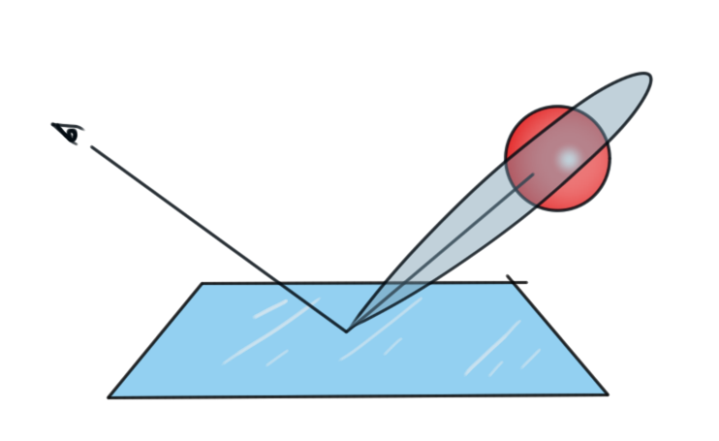
Importance Sampling
So far we have sampled incoming light uniformly over the hemisphere. Why is that a bad idea?
We want to shoot more samples where the function we are integrating is high!
Notes:
So far, we have said that whenever we want to shoot a ray in a new direction, we just pick a direction randomly from the hemisphere.
Why could that be a bad idea?
…
So, let’s say that we have a mirror like surface like this one. The brdf (and therefore the function we are integrating) is going to be zero or close to zero in most directions, and very high in the reflection direction.
If we shoot rays uniformly over the hemisphere <click>
Most rays will contribute little or nothing at all to the final result.
<click>
What we want to do is to shoot more rays in the direction where they matter the most.
The trick is to do that, and still have an unbiased and convergent algorithm. This is called importance sampling.

Slide 48
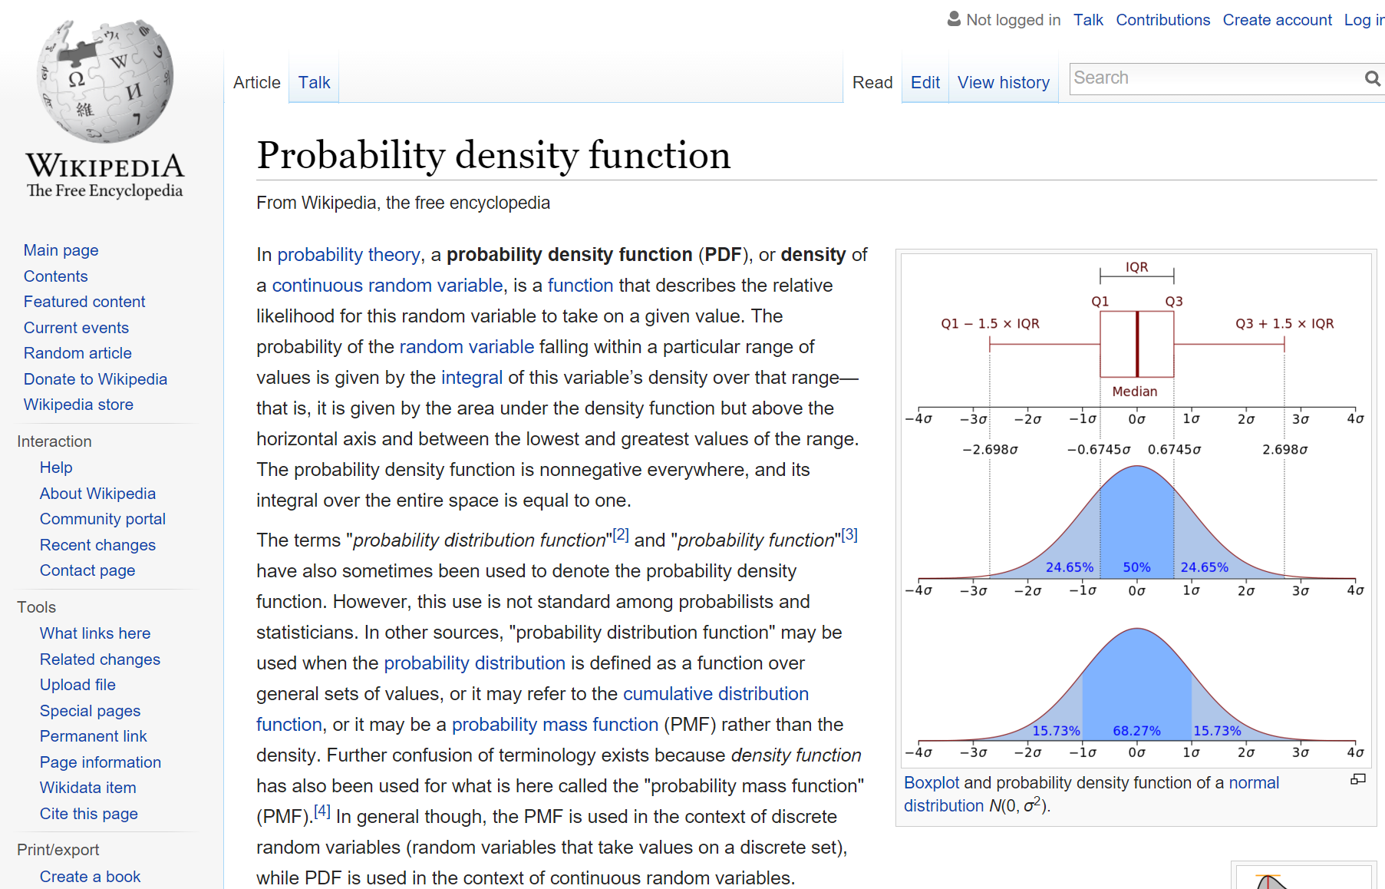
Probability Density Function
Monte Carlo Integration
$$F_{N}=\frac{1}{N}\sum_{i=1}^{N}{\frac{f(X_{i})}{p(X_{i})}}$$
$p(X)$ = $\frac{dP(X)}{dX}$
$$\int{p\left(X\right)dX=1}$$
Notes:
And this is where the PDF comes in.
Monte Carlo Integration let’s us take random samples, at X_i, of our function f in any way we want, as long as we can provide a PDF for the sampling scheme.
Now… Say I have a bucket with all numbers between 0.0 and 1.0 in it. Written on infinitely many pingpong balls, say.
What is the probability that I pick the ball that has 0.5 written on it?
[…]
Right. The probability is zero. What is the probability that I pick a number between 0.45 and 0.55?
[…]
Right, if the distribution is uniform, that probability is 0.1, or 10%.
The probability density is the <click> relative likelihood for a random variable to take on a given value, and is obtained by dividing the probability of taking a sample from a very small range surrounding X, with the size of that very small range.
If we sum up the probabilities of taking a sample from all of these little ranges, we should end up with 1.0, so the integral of the pdf has to be one.
Now let’s see how we can use this to understand importance sampling.

Slide 49
Importance Sampling
Monte Carlo Integration
$$F_{N}=\frac{1}{N}\sum_{i=1}^{N}{\frac{f(X_{i})}{p(X_{i})}}$$
4
$$p\left(x\right)=\frac{1}{3}$$
0
1
2
3
Notes:
Here, is a function, and we have tried to estimate its integral using Monte Carlo Integration using uniformly distributed samples.
Thus, the pdf is constant, and since the domain is 0 to 3, its value is 1/3.
In this function, we can see that we would really like to concentrate our samples between 1 and 2, since that’s where the big changes in the function are.

Slide 50
Importance Sampling
Monte Carlo Integration
$$F_{N}=\frac{1}{N}\sum_{i=1}^{N}{\frac{f(X_{i})}{p(X_{i})}}$$
$$p\left(X\right)=\frac{2}{3}$$
$$p\left(X\right)=\frac{1}{6}$$
4
$$p\left(X\right)=\left\{\begin{matrix}\frac{1}{6} & 0<X<1 \\ \frac{2}{3} & 1<X<2 \\ \frac{1}{6} & 2<X<3\end{matrix}\right.$$
$$p\left(X\right)=\frac{1}{6}$$
0
1
2
3
Notes:
So let’s do that. We choose a sampling scheme where we are four times as likely to pick a number between 1 and 2, as we are to pick a number between 0 and 1 or 2 and 3.
So, the probability of picking a number between 1 and 2 is 2/3, and since this is true for the whole range (which is 1), the pdf is also 2/3.

Slide 51
Importance Sampling
Monte Carlo Integration
$$F_{N}=\frac{1}{N}\sum_{i=1}^{N}{\frac{f(X_{i})}{p(X_{i})}}$$
$$p\left(X\right)=\frac{2}{3}$$
$$p\left(X\right)=\frac{1}{6}$$
4
$$p\left(X\right)=\left\{\begin{matrix}\frac{1}{6} & 0<X<1 \\ \frac{2}{3} & 1<X<2 \\ \frac{1}{6} & 2<X<3\end{matrix}\right.$$
$$p\left(X\right)=\frac{1}{6}$$
0
1
2
3
Notes:
Now, if we try monte carlo integration with this sampling scheme, we will draw many more samples from the important region, but since we divide each sample with the pdf, they will not “weigh” as much as the samples from the outer regions.

Slide 52
Importance Sampling
4
Example: $p\left(X\right)=a e^{(−\frac{{\left(x−1.5\right)}^{2}}{2c^{2}})}$
0
1
2
3
Notes:
Usually, we will create a sampling scheme by first sampling a variable from a uniform distribution (with rand()) and then transforming this sample in some way so we get the distribution that we want.
The sampling scheme that we use for monte carlo integration can be anything, as long as we can describe the pdf correctly.
In order for the importance sampling to work well though, we need a sampling scheme that has a high pdf where the function we are integrating is high.

Slide 53
Importance Sampling
4
Example: $p\left(X\right)=a e^{(−\frac{{\left(x−1.5\right)}^{2}}{2c^{2}})}$
$$f\left(x\right)=HIGH$$
$$\frac{f\left(x\right)}{p(x)}=HUGE$$
$$p\left(x\right)=LOW$$
0
1
2
3
Notes:
Because, consider this example.
Our sampling scheme gives us a pdf like the dashed line, so we are very likely to pick samples around 1.5. But the function we are integrating also has a very high value around 0.2, and there, the PDF is very low.
Now, let’s say we take 100 samples to integrate this function. If one of those samples happens to be in *this* region, we will weigh that sample by the pdf, and get a huge contribution that might dominate the result.
If we happen not to take a sample from there (since that is unlikely) we will get a completely different result.
So, using importance sampling with a poorly chosen sampling scheme can actually make the solution converge slower than not importance sampling at all.

Slide 54
Notes:
And… On this slide I meant to go through how you obtain such a sampling scheme from the Blin Microfacet BRDF that we talked about last time.
But, honestly, it took me two hours yesterday to understand my own slide from last year and there is no way I can give you anything you can follow in five minutes.
Instead, I will give you a super short, super high level recipe for how it’s done, and you will have to look up the details yourself
(I’ll be glad to help you though)
<click>
First you figure out what the PDF should be. You want a distribution that is somehow proportional to your BRDF, or at least to some function that itself is similar to your BRDF.
So, then you can find how to normalize that function, and you have your PDF.
Then… You try to express the Cumulative Distribution Function for your pdf. This is the function that says “what is the probability of drawing a sample that is LESS than x”.
Then you calculate the inverse of that CDF.
Then you can draw a sample with your wanted PDF, by drawing a uniformly distributed sample and plugging that into the inverse CDF.
Often, computing the CDF and its inverse is not too easy, so the derivations of most sampling schemes for BRDFs are rather based on trying to express your PDF in terms that you already know how to sample.
I understand that this slide is not very helpful. I just haven’t found a way to explain this without going into extreme detail. Maybe next year.
For now, we have more important stuff to talk about.

Slide 55
$$f\left(x\right)=x^{2}$$
$$p\left(x\right)∝x^{2}⇒p\left(x\right)=kx^{2}$$
$$\int_{0}^{1}{p\left(x\right)dx=1}⇒k=3$$
$$\int_{0}^{1}{p\left(x\right)dx=1}⇒k=3$$
Notes:
And… On this slide I meant to go through how you obtain such a sampling scheme from the Blin Microfacet BRDF that we talked about last time.
But, honestly, it took me two hours yesterday to understand my own slide from last year and there is no way I can give you anything you can follow in five minutes.
Instead, I will give you a super short, super high level recipe for how it’s done, and you will have to look up the details yourself
(I’ll be glad to help you though)
<click>
First you figure out what the PDF should be. You want a distribution that is somehow proportional to your BRDF, or at least to some function that itself is similar to your BRDF.
So, then you can find how to normalize that function, and you have your PDF.
Then… You try to express the Cumulative Distribution Function for your pdf. This is the function that says “what is the probability of drawing a sample that is LESS than x”.
Then you calculate the inverse of that CDF.
Then you can draw a sample with your wanted PDF, by drawing a uniformly distributed sample and plugging that into the inverse CDF.
Often, computing the CDF and its inverse is not too easy, so the derivations of most sampling schemes for BRDFs are rather based on trying to express your PDF in terms that you already know how to sample.
I understand that this slide is not very helpful. I just haven’t found a way to explain this without going into extreme detail. Maybe next year.
For now, we have more important stuff to talk about.

Slide 56
Importance Sampling
$$L_{o}\left(p,ω\right)=\int_{Ω}{f\left(p,ω,ω^{′}\right)L_{i}\left(p,ω^{′}\right)\cos\left(n,ω^{′}\right)dω′}$$
When evaluating the Rendering Equation, we do not know the function we want to integrate
Since it depends on the incoming light over the hemisphere
But we do know the BRDF, so we importance sample on that
Notes:
How do we use importance sampling in pathtracing then?
When we are evaluating the rendering equation, we don’t really know the function we are integrating, since it depends on the incoming radiance from all directions on the hemisphere.
We do know the brdf however, and if the incoming radiance is mostly smooth, the function we are integrating will be proportional to that.
So, the first step, at least, is to simply use a sampling scheme that has a PDF that looks like the BRDF.

Slide 57
Notes:
And… On this slide I meant to go through how you obtain such a sampling scheme from the Blin Microfacet BRDF that we talked about last time.
But, honestly, it took me two hours yesterday to understand my own slide from last year and there is no way I can give you anything you can follow in five minutes.
Instead, I will give you a super short, super high level recipe for how it’s done, and you will have to look up the details yourself
(I’ll be glad to help you though)
<click>
First you figure out what the PDF should be. You want a distribution that is somehow proportional to your BRDF, or at least to some function that itself is similar to your BRDF.
So, then you can find how to normalize that function, and you have your PDF.
Then… You try to express the Cumulative Distribution Function for your pdf. This is the function that says “what is the probability of drawing a sample that is LESS than x”.
Then you calculate the inverse of that CDF.
Then you can draw a sample with your wanted PDF, by drawing a uniformly distributed sample and plugging that into the inverse CDF.
Often, computing the CDF and its inverse is not too easy, so the derivations of most sampling schemes for BRDFs are rather based on trying to express your PDF in terms that you already know how to sample.
I understand that this slide is not very helpful. I just haven’t found a way to explain this without going into extreme detail. Maybe next year.
For now, we have more important stuff to talk about.

Slide 58
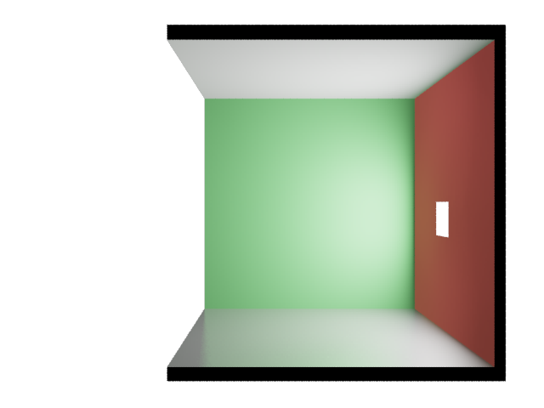
Multiple Importance Sampling
$$p$$
Notes:
For direct lighting, we don’t usually importance sample on the BRDF, but rather we pick a direction by sampling a point on the light.
In this case, that looks like a pretty good idea, since <next slide>

Slide 59
Multiple Importance Sampling
$$p$$
Notes:
If we importance sampled based on the brdf instead, most rays would miss the lightsource.

Slide 60
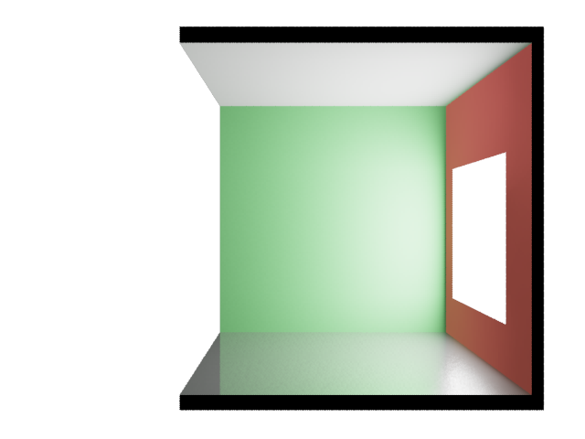
Multiple Importance Sampling
Low p(x), high f(x)
$$p$$
$$L_{o}\left(p,ω\right)=\int_{Ω}{f\left(p,ω,ω^{′}\right)L_{i}\left(p,ω^{′}\right)\cos\left(n,ω^{′}\right)dω′}$$
Notes:
But consider this case, where the brdf is pretty narrow, and the lightsource is large.
Here, most of the chosen directions will contribute very little to the result, and occasionally we will choose a direction where the BRDF is high.
If you look at the function we are integrating… the function will be high when the product of the brdf and the incoming light is high, but we importance sample only on when the incoming light is high.
So we will get a noisy result.

Slide 61
Multiple Importance Sampling
$$p$$
$$L_{o}\left(p,ω\right)=\int_{Ω}{f\left(p,ω,ω^{′}\right)L_{i}\left(p,ω^{′}\right)\cos\left(n,ω^{′}\right)dω′}$$
Notes:
So, in this particular case, it would have been better to importance sample the BRDF.

Slide 62
Multiple Importance Sampling
Low p(x), high f(x)
$$p$$
$$L_{o}\left(p,ω\right)=\int_{Ω}{f\left(p,ω,ω^{′}\right)L_{i}\left(p,ω^{′}\right)\cos\left(n,ω^{′}\right)dω′}$$
Notes:
But consider this case! If I importance sample on the BRDF I would mostly pick directions where I have no incoming light.
Then, with extremely low probability I might pick a direction that hits the lightsource, and that sample will be boosted a LOT since it’s so unlikely.

Slide 63
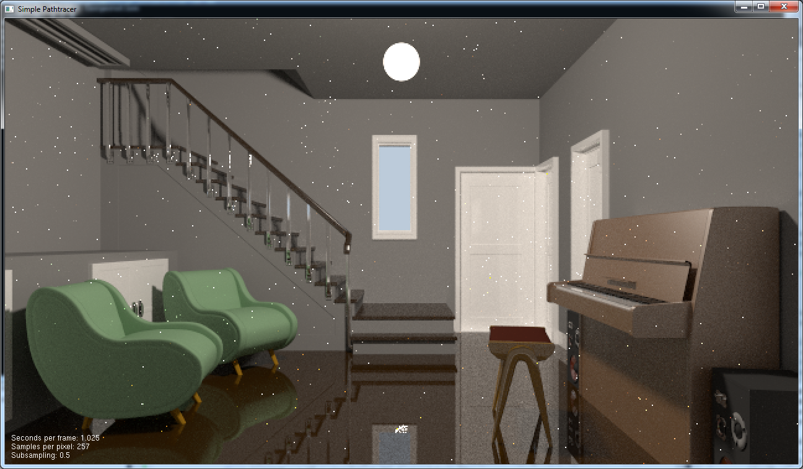
Multiple Importance Sampling
Notes:
In practice then, neither solution is very good.
This is an image from my pathtracer, where I have importance sampled direct lighting only by picking random points on the light source.

Slide 64
Multiple Importance Sampling
Notes:
I will now try to show in one dimension what happens, and how we can fix it.
Let’s say we have a function f(x) like this, and we sample it using a scheme which has a pdf that is a simple Gaussian that matches it.
We can think of this function as our brdf.

Slide 65
Multiple Importance Sampling
Notes:
The ratio f(x)/pdf(x) is the weighted contribution we get from a sample at x.
In this case you can see that the weights are all fairly equal, which is good, since it means little noise.

Slide 66
Multiple Importance Sampling
Notes:
Now I add another function, which we will think of as the incoming light.
I have drawn the pdf of another sampling scheme that matches this distribution well.

Slide 67
Multiple Importance Sampling
Notes:
And again the ratio g(x)/pdf_g(x) is a fairly constant thing showing that sampling g(x) using this sampling scheme will work well.

Slide 68
Multiple Importance Sampling
Notes:
Now, I have drawn in the product of f and g. This represents the actual outgoing radiance, which is the function we will be integrating.
(it is multiplied by 10, just so we can actually see the curve)

Slide 69
Multiple Importance Sampling
Notes:
Here I show what the contribution of each sample will be if we importance sample f*g using the light (point at orange)
Or using the brdf (point at blue)
In either case, we will have very high contributions for samples that will only be picked with very low probability.
So we will get very much noise.
(break and show why this becomes noise on a grid on the blackboard)

Slide 70
Multiple Importance Sampling
Need to estimate:
$$\int{f\left(x\right)g\left(x\right)dx}$$
Could Use:
$0.5\left(\frac{f\left(X\right)g\left(X\right)}{p_{f}\left(X\right)}+\frac{f\left(Y\right)g\left(Y\right)}{p_{g}\left(Y\right)}\right)$?
Notes:
So, we need a better sampling scheme.
Now, I’m going to suggest that we take one sample from each distribution.
Let’s say that I have two buckets
One contains samples taken from the light distribution, and the other contains samples taken from the brdf distribution
I pick one sample from each distribution, and hand them to you.
You evaluate your function with the light sample, and divide by the lights pdf,
Then you evaluate the function with the brdf sample, and divide by that brdf
Then you take the average of the results. Will that be better?
NO! Because either sample may have been one of those unlikely samples that still have a high contribution and introduce a lot of noise.
Okay. Let’s say I take one sample from each bucket, but then I mix ‘em up in my hands like this… before giving them to you.
So now you have a sample x that you can evaluate, but what is the PDF?
Since you don’t know which distribution it is from <clicki>

Slide 71
Multiple Importance Sampling
Need to estimate:
$$\int{f\left(x\right)g\left(x\right)dx}$$
Could Use:
$0.5\left(\frac{f\left(X\right)g\left(X\right)}{p_{f}\left(X\right)}+\frac{f\left(Y\right)g\left(Y\right)}{p_{g}\left(Y\right)}\right)$?
Better (MIS):
$$0.5\left(\frac{f\left(X\right)g\left(X\right)}{{0.5(p}_{f}\left(X\right)+p_{g}(X))}+\frac{f\left(Y\right)g\left(Y\right)}{{0.5(p}_{f}\left(Y\right)+p_{g}(Y))}\right)$$
Notes:
Since you don’t know which distribution it is from <clicki>
All you can do is to say that the sample is half likely to be from one bucket and half likely to be from the other.
Then you evaluate the other sample for which you have the same pdf.
<click>

Slide 72
Multiple Importance Sampling
Need to estimate:
$$\int{f\left(x\right)g\left(x\right)dx}$$
Could Use:
$0.5\left(\frac{f\left(X\right)g\left(X\right)}{p_{f}\left(X\right)}+\frac{f\left(Y\right)g\left(Y\right)}{p_{g}\left(Y\right)}\right)$?
Better (MIS):
$$\frac{f\left(X\right)g\left(X\right)}{p_{f}\left(X\right)+p_{g}(X)}+\frac{f\left(Y\right)g\left(Y\right)}{p_{f}\left(Y\right)+p_{g}(Y)}$$
Notes:
So both samples will be weighed as though they were from a distribution that had the pdf being the sum of the two individual buckets.
We did not break any rules when doing this, but let’s see what happens:

Slide 73
Multiple Importance Sampling
Notes:
The green line here is the combined pdf.
As you can see it’s fairly high whenever either function is high.

Slide 74
Multiple Importance Sampling
Notes:
And this is how much each sample will contribute.
It’s not a flat line, but it’s much better than what we had before.
This is what is called Multiple Importance Sampling.
It can be used whenever we want to sample a function that is a combination of functions for which we have good sampling schemes, and it can be very useful.

Slide 75
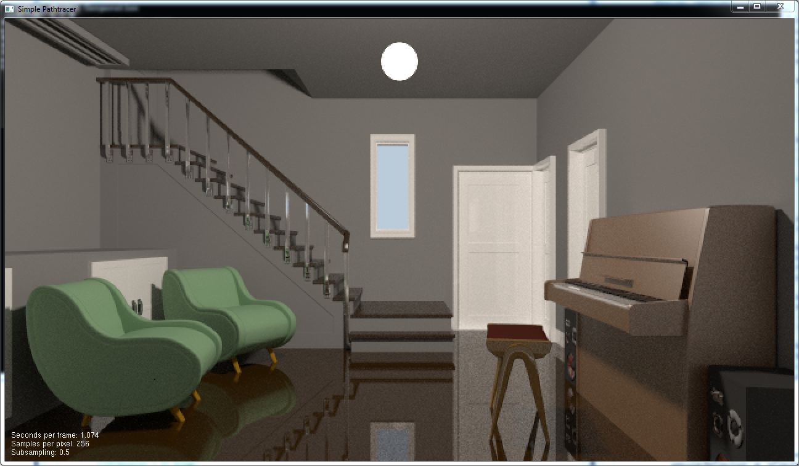
Multiple Importance Sampling
Do both!
Sample brdf first
Then light
PDF of this sampling strategy is (weighted) sum
- Only very low if neither technique is likely to choose dir
$$p$$
Notes:
This is what my pathtracer produced when I added multiple importance sampling for direct lighting, but rendered for exactly as long as before.

Slide 76
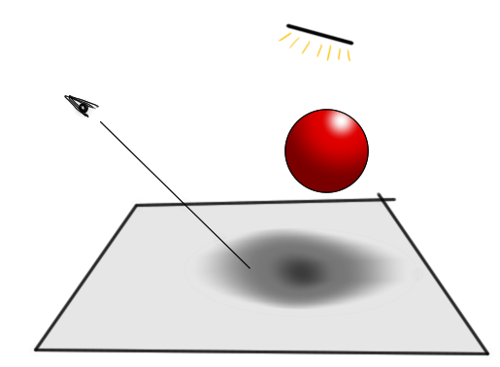
Stratified Sampling
Another standard variance reduction method
When just choosing samples randomly over the domain, they may “clump” and take a long while to converge
It will converge to 0.5 after unlimited time. But after four samples I still have prob=1/8 that the pixel will be considered all in shadow
or completely unshadowed
Notes:
Okay.
We are getting close to the end.
Importance Sampling, and Mutliple Importance Sampling are two important methods for reducing variance (noise) in our rendered images.
Another important tool is to use stratified sampling.

Slide 77
Stratified Sampling
Divide domain into “strata”
Don’t sample one strata again until all others have been sampled once.

Slide 78
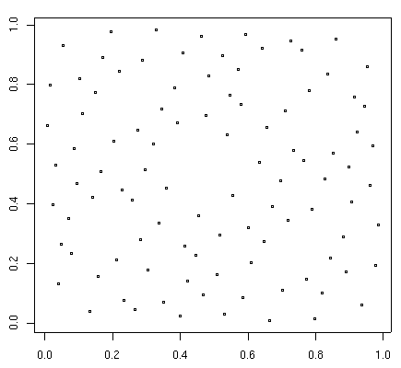
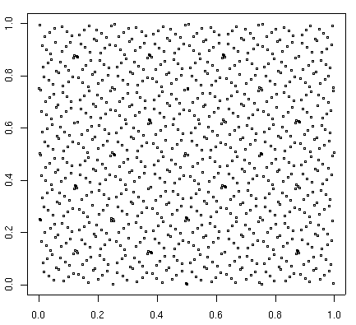
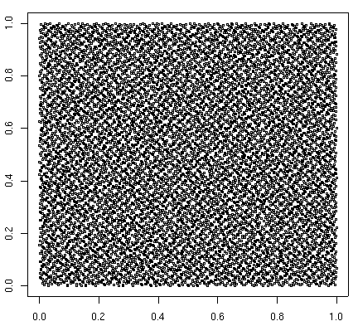
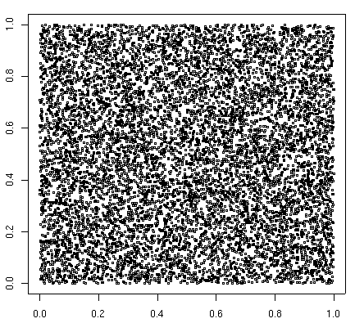
Stratified Sampling
If we know how many samples we want to take, we can get good stratification from “jittering”
If not, we want any sequence of samples to have good stratification. We can use a Low Discrepancy Sequence
SOBOL: 100 samples
SOBOL: 1000 samples
SOBOL: 10000 samples
RANDOM: 10000 samples

Slide 79
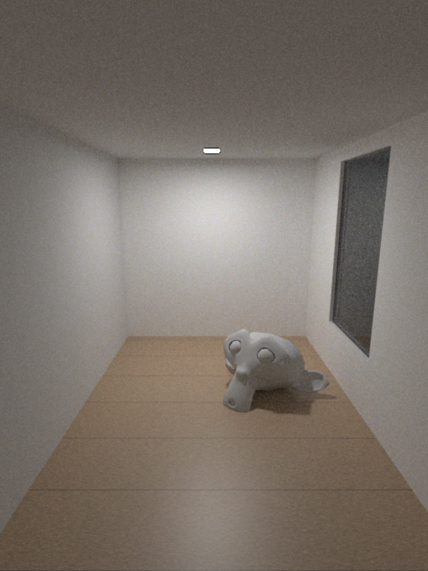
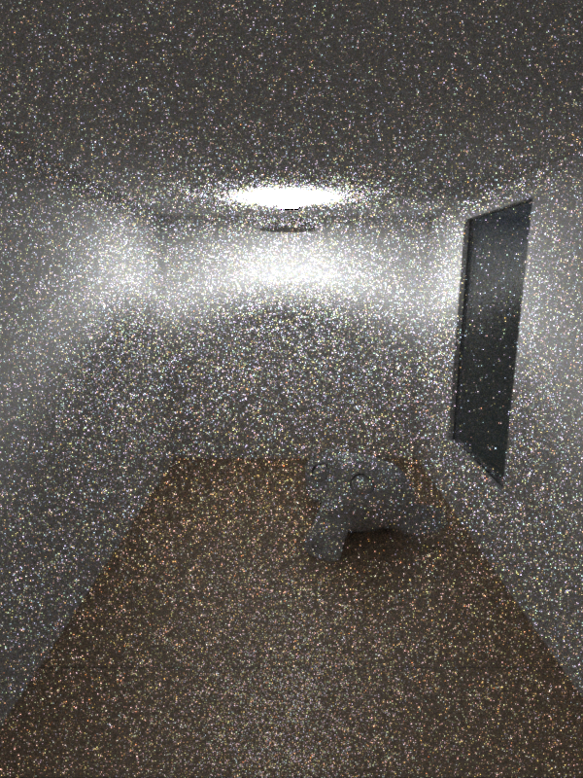
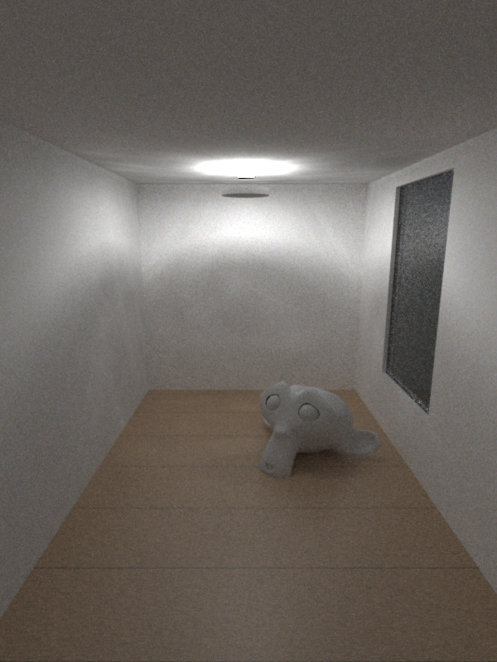
Are we done yet?
Pathtracing 3m
Pathtracing 3m
Bidirectional Pathtracing 3m
Notes:
Var vi klara då? Är path-tracing den perfekta lösningen?
Nope. I de första två bilderna här ser vi exakt samma scen renderad i tre minuter med an brute force pathtracer. Enda skillnaden är att i den andra bilden har jag lagt in en liten disk under ljuskällan.
Eftersom all belysning i scenen nu kommer från indirekt ljus så slutar pathtracningen nästan att fungera!
Vi varje studs kommer vi ju nu att skjuta en stråle mot ljuskällan som blir helt meningslös eftersom allt ligger i skugga.
En lösning på detta är att använda photon mapping, men det ville vi ju inte. Så en annan lösning är att använda Bidirectional Path tracing. Många renderare gör det, men så vitt jag vet varken Arnold eller Octane.

Slide 80
Pathtracing
Notes:
Med vanlig pathtracing kommer vi alltså få studsa runt i scenen tills vi på ren flax råkar träffa ljuskällan.

Slide 81
Bidirectional Pathtracing
Notes:
Med bidirectional path tracing skjuter vi först en path från kameran <click>
Sedan en path från ljuset <click>
Sedan kopplar vi ihop alla punkter på kamerapathen med alla punkter på ljuspathen (om dom ser varandra) <click>
Resultatet blir att vi, med nästan samma mängd arbete, får en massa ljusbärande paths!
There is a LOT of math behind “connecting the vertices” though. But we don’t have time for that today.

Slide 82
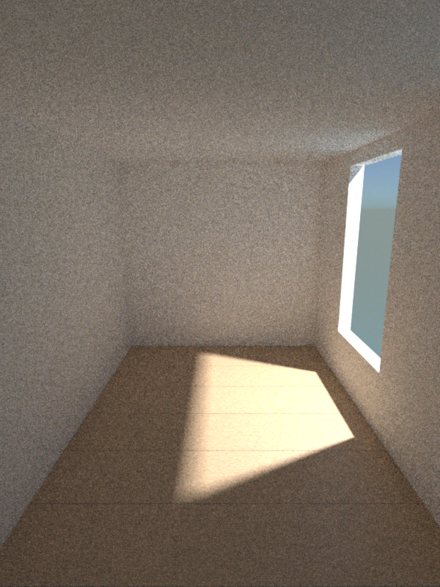
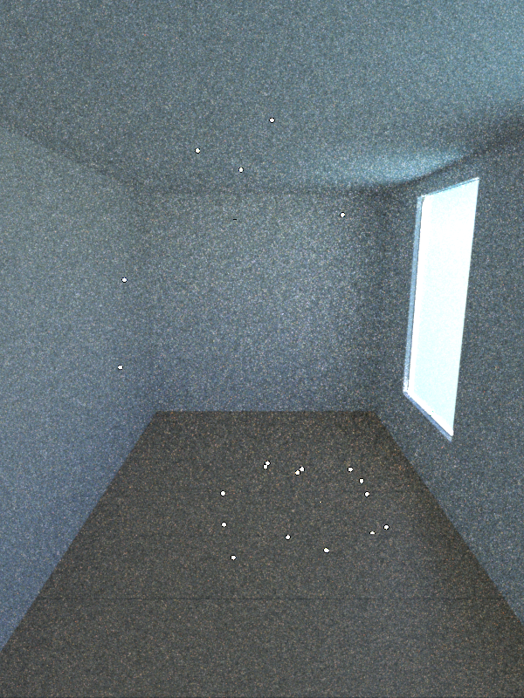
Bidirectional Path Tracing
Pathtracing 3m
Pathtracing 3m
Bidirectional Pathtracing 3m
Notes:
Här är ett annat fall där brute force pathtracing inte funkar.
Enda skillnaden mellan första och andra bilden är att jag lagt in en glasskiva I fönstret I den andra.
Eftersom fönstret, fasten det är av glas, kommer ligga skugga ljuskällan överallt kommer vi inte få något bidrag alls från ljuskällan
Förutom de vita prickarna här som kommer från paths som råkat studsa på fönsterbläcket utanför fönstret.
Med bidirectional path tracing funkar det här fint, eftersom varje kamerapath kommer att kopplas ihop med en ljuspath som tagit sig igenom fönstret.
I mitt tycke är bidirectional path tracing nästan enbart en förbättring. Det går att kontstruera enkla scener där brute force pathtracing konvergerar snabbare, men I nästan alla fall får man betydligt bättre bilder med bidirectional. Jag skulle tippa att Arnold kommer börja tillåta bidirectional (eller något alternativ) inom en snar framtid, om dom skall ha en chans.
Dock hjälper de här bilderna kanske att se varför folk ofta uppfattar brute force path tracing som snabbare? Om vi jämför den första och sista bilden så är ju den första rejält mindre noisig. Och i det här fallet skulle det ju duga fint att inte ha någon riktig glas ljuskiva i fönstret.

Slide 83
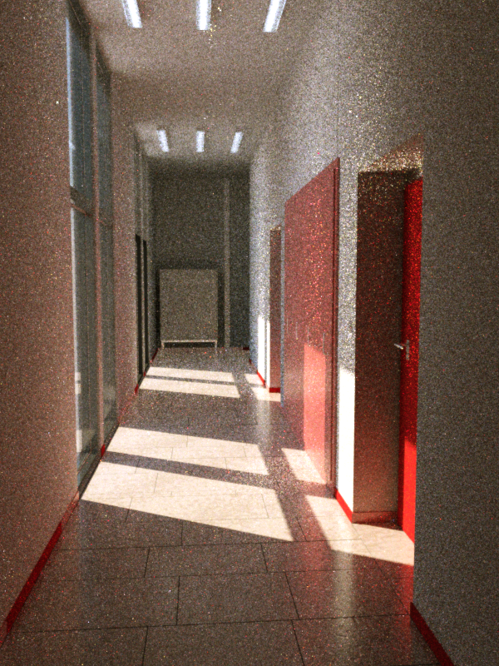
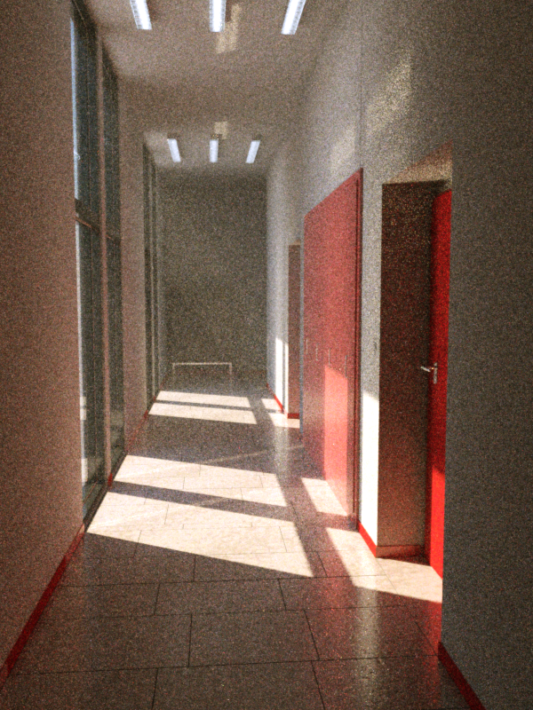
Pathtracing 75SPP (~5min)
Bidirectional Pathtracing 45SPP (~5min)
Notes:
Här är en lite mer realistisk scen att jämföra med. Båda bilderna är renderade I fem minuter eller så.
Lägg märke till att:
Path tracing är noisigare I almänhet
Path tracing misslyckas totalt med glasskåpet längst bort I korridoren.
Path tracing ger oss inga vettiga caustics.

Slide 84
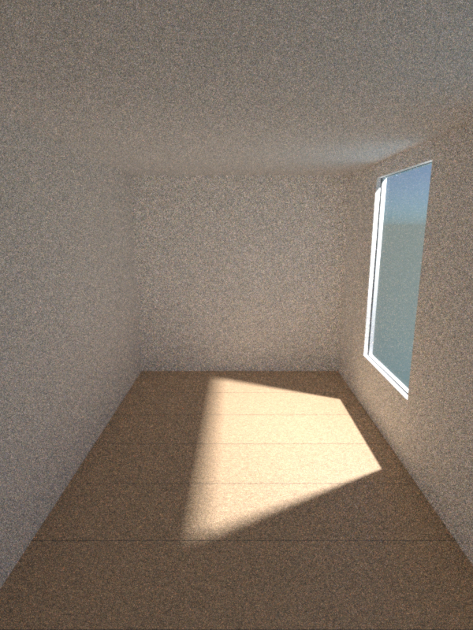
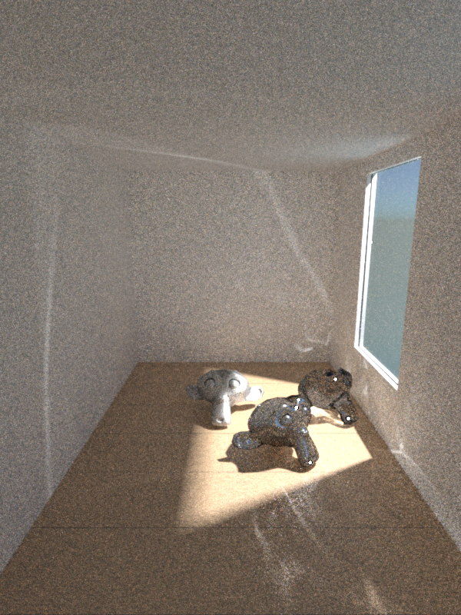
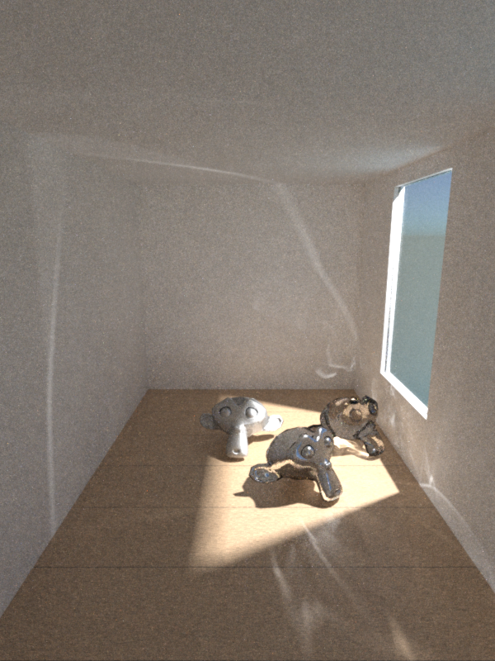
Are we done yet?
Bidirectional Pathtracing 30m
Bidirectional Pathtracing 30m
Metropolis Light Transport 30m
Notes:
Är Bidirectional path tracing det bästa vi kan göra då?
Svaret är…. Ibland. Men för lite krångligare scener kan det fortfarande ta en hisklig tid att konvergera (och man kan konstruera scener som aldrig konvergerar)
I de första två bilderna här har jag renderat samma scen, lika länge, med enda skillnaden att jag slängt in lite aphuvuden på golvet I den andra bilden.
Första bilden är på väg att konvergera, men I den andra behövs flera timmar till. (Skulle synas bättre med 15 minuters renderingar.)
Skälet är förståss att vare sig vi vill eller inte så kommer aporna att generera en massa komplexa caustic paths, som är svåra för bidirection path tracern att hitta.
Ett “korrekt” sätt att hantera det här är att använda Metropolis Light Transport (photon mapping hade också funkat, men har sina problem som sagt)

Slide 85
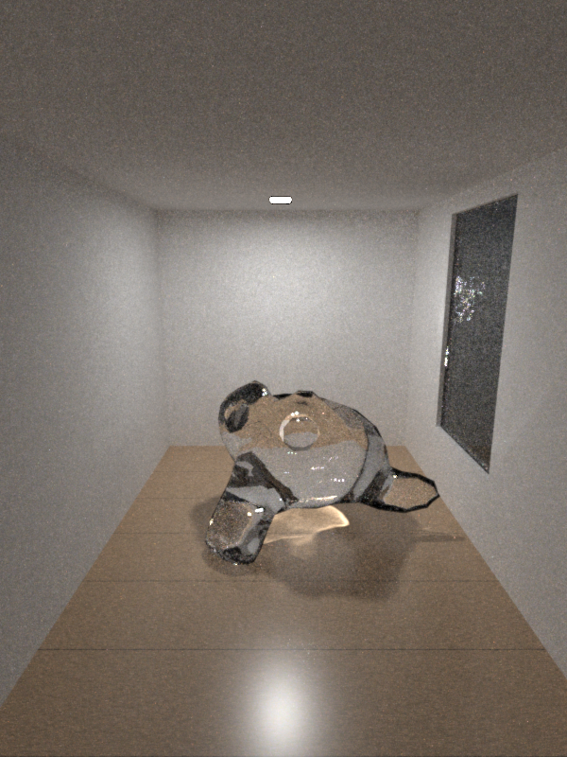
Metropolis Light Transport
Notes:
Med metropolis så börjar vi från en brute force eller bidirectional path, precis som vanligt.

Slide 86
Metropolis Light Transport
Notes:
Men om vi hittar en path som har högt inflytande på pixelfärgen så kastar vi inte bort den och börjar om. Istället muterar vi den lite grann för att utforska liknande paths.
<flippa fram och tillbaks>

Slide 87
Metropolis Light Transport
Notes:
Vi muterar den också så den hamnar i andra pixlar. På så vis kommer vi, så fort vi hittat t.ex. En stark caustic, att utforska den ordentligt innan vi skapar en helt ny path.
Again, there is a lot more to than, “just mutating”. Maybe next year. Or see the “further reading” slide.

Slide 88
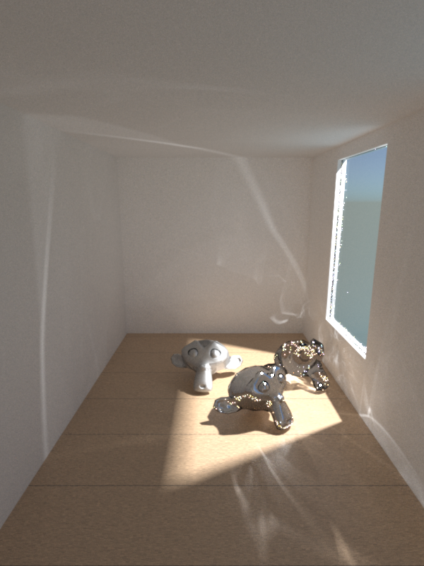
Bidirectional Path Tracing
BD 5m
BD 2h
BD 19h 4m 12240 SPP
Notes:
Här är en jämförelse. Detta är bidirectional pathtracing efter 5 min, 2h och 19h
<klick>

Slide 89
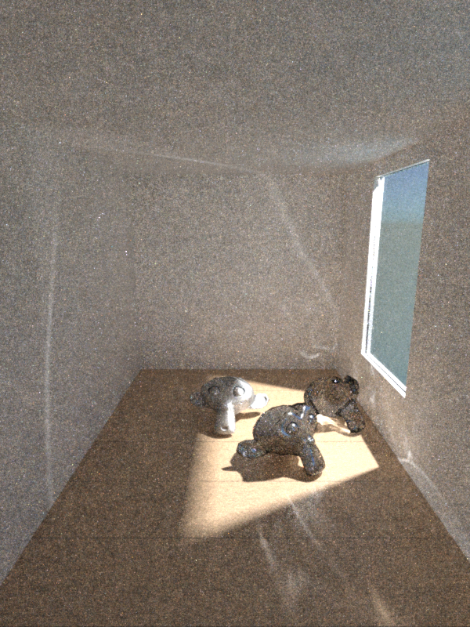
Metropolis Light Transport
MLT 5m
MLT 2h
MLT 17h35m, 9300 SPP
Notes:
Och här är Metropolis efter 5m, 2h och 19h.
<flippa fram och tillbaks>
Som ni ser är MLT hyffsat klar efter två timmar, medans bidirectional måste hålla på hela natten och ändå inte lyckas konvergera överallt
(brute force skall vi inte tala om)
En sak som är lite besvärligt med MLT är att istället för noise får vi stora hopp I bildkvalitet när den plötsligt hittar en stark path.
Till exempel så ser vi inte den starka reflektionen på metallapans kind alls efter 5 minuter och sedan poppar den plötsligt fram efter någon timma.
Detta kan vara problematiskt I animationer. Man kan acceptera ett visst noise I en animation, men det får ju inte an att en stor tydlig caustic poppar in och ut I olika frames.

Slide 90
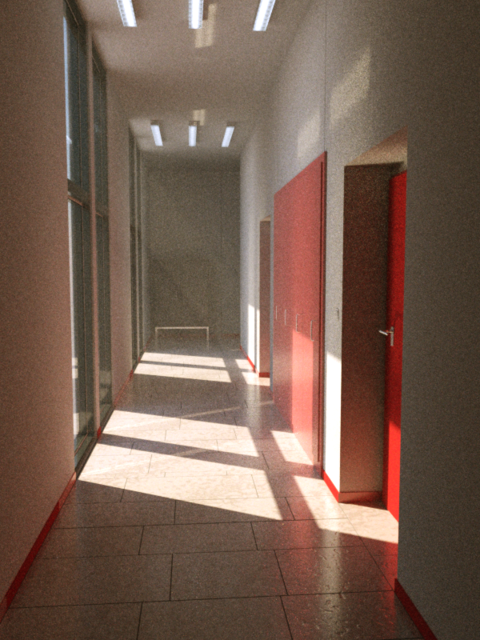
Bidirectional Path Tracing
5min
25min
1h15min
Notes:
Korridor exemplet igen. Här ser vi bidirectional path tracing efter 5 minuter, 25 minuter och 1h15min
<klick>

Slide 91
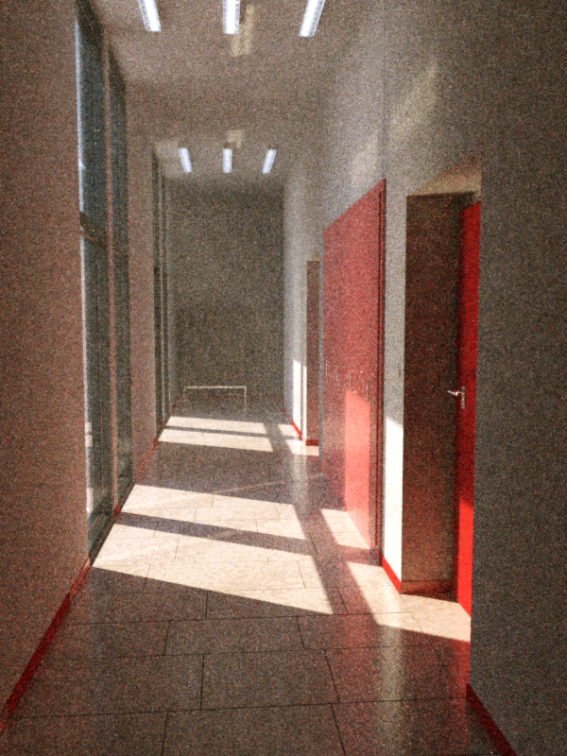
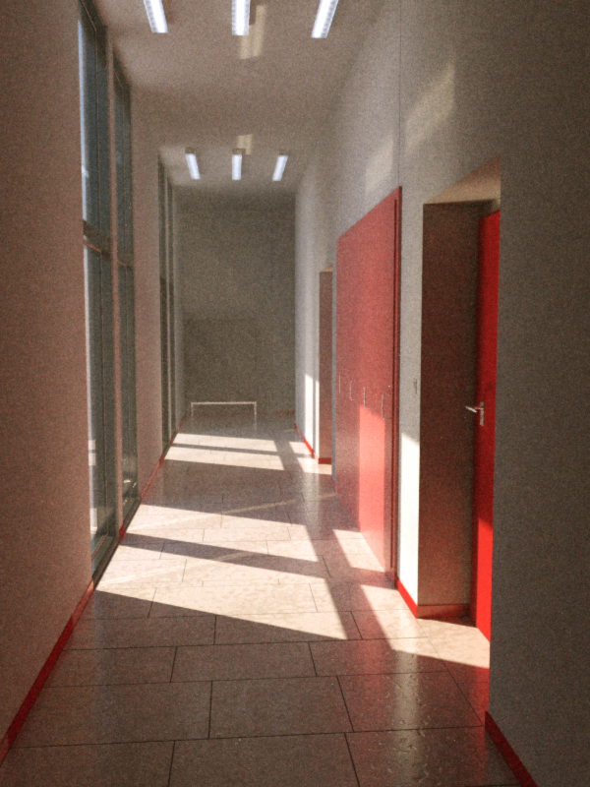
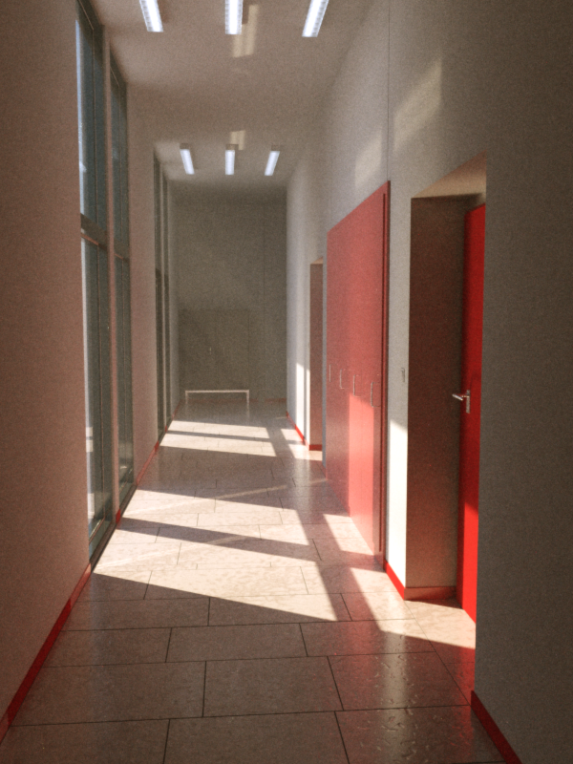
Metropolis Light Transport
5min
25min
1h
Notes:
Och här är MLT.
Inte lika chockernade skillnader i den här scenen.
<flippa fram och tillbaks>
Vad kan ni se?
Rödare färgton i metropolis, förmodligen på grund av dcen starkt belysta knallröda dörren
Caustics i fönstrena som inte syns i bidirectional
Lite mer definition på glasskåpet i MLT
MLT är inte lika självklart alltid bättre. Dessutom är det hiskeligt svårt att få rätt, vilket nog är stora skälet att få renderare använder det. Octance har ett mode som heter PMC som använder en variant av metropolis. Maxwell använder det hela tiden.

Slide 92
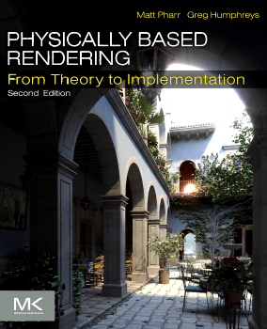
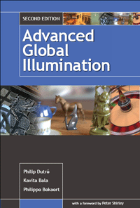
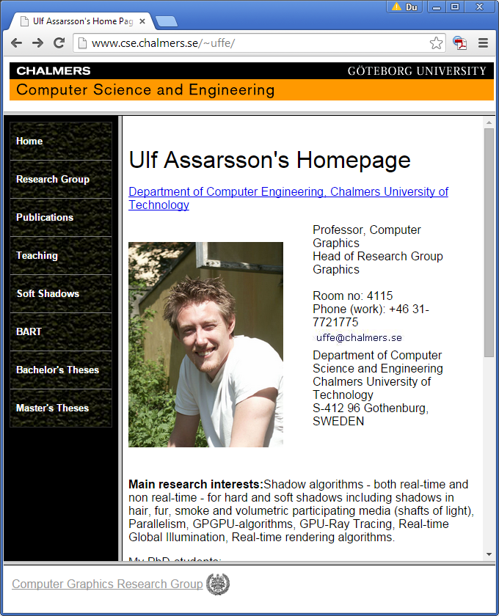
Further Reading
Pathtracing Lab

