Slide 1
Course on Computer Communication and Networks
Lecture 5
Chapter 3; Transport Layer, Part B
EDA344/DIT 420, CTH/GU

Slide 2


Roadmap Transport Layer
transport layer services
multiplexing/demultiplexing
connectionless transport: UDP
principles of reliable data transfer
connection-oriented transport: TCP
  reliable transfer
    Acknowledgements
    Retransmissions
    Connection management
    Flow control and buffer space
  Congestion control
    Principles
    TCP congestion control

Slide 3
TCP: Overview RFCs: 793,1122,1323, 2018, 5681
full duplex data:
  bi-directional data flow in same connection
  MSS: maximum segment size
connection-oriented:
  handshaking (exchange of control msgs) inits sender & receiver state before data exchange
flow control:
  sender will not overwhelm receiver
congestion control:
  sender will not flood network (but still try to maximize throughput)
point-to-point:
  one sender, one receiver
reliable, in-order byte steam:
pipelined:
  TCP congestion and flow control set window size
Notes:
Mod TO

Slide 4
TCP segment structure
32 bits
URG: urgent data
(generally not used)
counting
by bytes
of data
(not segments!)
source port #
dest port #
sequence number
ACK: ACK # valid
acknowledgement number
head
len
not
used
U
receive window
A
PSH: push data now
(generally not used)
P
R
S
F
# bytes
rcvr willing
to buffer
(flow control)
checksum
Urg data pointer
RST, SYN, FIN:
connection estab
(setup, teardown
commands)
options (variable length)
application
data
(variable length)
Internet
checksum
(as in UDP)

Slide 5
Roadmap Transport Layer
transport layer services
multiplexing/demultiplexing
connectionless transport: UDP
principles of reliable data transfer
connection-oriented transport: TCP
  reliable transfer
    Acknowledgements
    Retransmissions
    Connection management
    Flow control and buffer space
  Congestion control
    Principles
    TCP congestion control

Slide 6
TCP seq. numbers, ACKs
outgoing segment from sender
source port #
dest port #
sequence number
acknowledgement number
sequence numbers:
  “number” of first byte in segment’s data
acknowledgements:
  seq # of next byte expected from other side
  cumulative ACK
rwnd
checksum
window size
N
  sender sequence number space
sent
ACKed
sent, not-yet ACKed
(“in-flight”)
usable
but not
yet sent
not
usable
incoming segment to sender
source port #
dest port #
sequence number
acknowledgement number
A
rwnd
checksum

Slide 7
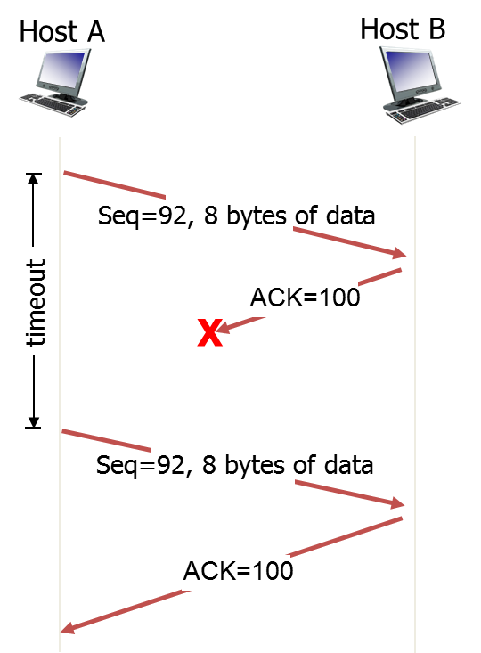

TCP seq. numbers, ACKs
Always ack next in-order expected byte
Host A
Host B
User
types
‘C’
Seq=42, ACK=79, data = ‘C’
host ACKs receipt of ‘C’, echoes back ‘C’
Seq=79, ACK=43, data = ‘C’
host ACKs
receipt
of echoed ‘C’
Seq=43, ACK=80
Simple example scenario
Based on telnet msg exchange

Slide 8
TCP: cumulative Ack - retransmission scenarios
Host A
Host B
Host A
Host B
SendBase=92
Seq=92, 8 bytes of data
Seq=92, 8 bytes of data
Seq=100, 20 bytes of data
timeout
Seq=100, 20 bytes of data
timeout
ACK=100
X
ACK=100
ACK=120
ACK=120
Seq=92, 8
bytes of data
SendBase=100
Seq=120, 15 bytes of data
SendBase=120
ACK=120
SendBase=120
Cumulative ACK
(Premature) timeout

Slide 9
TCP ACK generation [RFC 1122, RFC 5681]
Event
in-order segment arrival,
no gaps,
everything else already ACKed
in-order segment arrival,
no gaps,
one delayed ACK pending
out-of-order segment arrival
higher-than-expect seq. #
gap detected
TCP Receiver action
Delayed ACK. Wait max 500ms
for next segment then
send ACK
immediately send single
cumulative ACK
send (duplicate) ACK, indicating seq. #
of next expected byte
Notes:
Mod TO

Slide 10
From RFC 1122
TCP SHOULD implement a delayed ACK, but an ACK should not be excessively delayed; in particular, the delay MUST be less than 0.5 seconds, and in a stream of full-sized segments there SHOULD be an ACK for at least every second segment.
A delayed ACK gives the application an opportunity to update the window and perhaps to send an immediate response. In particular, in the case of character-mode remote login, a delayed ACK can reduce the number of segments sent by the server by a factor of 3 (ACK, window update, and echo character all combined in one segment).
In addition, on some large multi-user hosts, a delayed ACK can substantially reduce protocol processing overhead by reducing the total number of packets to be processed.
However, excessive delays on ACK's can disturb the round-trip timing and packet "clocking" algorithms.
We also emphasize that this is a SHOULD, meaning that an implementor should indeed only deviate from this requirement after careful consideration of the implications.
Notes:
TO

Slide 11
Roadmap Transport Layer
transport layer services
multiplexing/demultiplexing
connectionless transport: UDP
principles of reliable data transfer
connection-oriented transport: TCP
  reliable transfer
    Acknowledgements
    Retransmissions
    Connection management
    Flow control and buffer space
  Congestion control
    Principles
    TCP congestion control

Slide 12
Q: how to set TCP timeout value?
application
transport
network
link
physical
longer than end-to-end RTT
  but that varies!!!
too short timeout: premature, unnecessary retransmissions
too long: slow reaction to loss
segment
network
link
physical
application
transport
network
link
physical
application
transport
network
link
physical
application
transport
network
link
physical
segment

Slide 13

TCP round trip time, timeout estimation
EstimatedRTT = (1-α)*EstimatedRTT + α*SampleRTT
exponential weighted moving average: influence of past sample decreases exponentially fast
typical value: α = 0.125
RTT: gaia.cs.umass.edu to fantasia.eurecom.fr
RTT (milliseconds)
sampleRTT
EstimatedRTT
DevRTT = (1-β)*DevRTT +
β*|SampleRTT-EstimatedRTT|
time (seconds)
(typically, β = 0.25)
TimeoutInterval = EstimatedRTT + 4*DevRTT
“safety margin”

Slide 14
TCP fast retransmit (RFC 5681)
time-out can be long:
  long delay before resending lost packet
IMPROVEMENT: detect lost segments via duplicate ACKs
Host A
Host B
Seq=92, 8 bytes of data
Seq=100, 20 bytes of data
X
TCP fast retransmit
ACK=100
if sender receives 3 duplicate ACKs for same data
resend unacked segment with smallest seq #
  likely that unacked segment lost, so don’t wait for timeout
timeout
ACK=100
ACK=100
Seq=100, 20 bytes of data
Implicit NAK!
Q: Why need at least 3?
Notes:
Mod TO
RFC 2581 obsolete…

Slide 15
Roadmap Transport Layer
transport layer services
multiplexing/demultiplexing
connectionless transport: UDP
principles of reliable data transfer
connection-oriented transport: TCP
  reliable transfer
    Acknowledgements
    Retransmissions
    Connection management
    Flow control and buffer space
  Congestion control
    Principles
    TCP congestion control

Slide 16
Connection Management
before exchanging data, sender/receiver “handshake”:
agree to establish connection + connection parameters
application
application
connection state: ESTAB
connection variables:
  seq # client-to-server
  server-to-client
  rcvBuffer size
  at server,client
connection state: ESTAB
connection Variables:
  seq # client-to-server
  server-to-client
  rcvBuffer size
  at server,client
network
network
Socket clientSocket =
newSocket("hostname","port number");
Socket connectionSocket = welcomeSocket.accept();

Slide 17
Setting up a connection: TCP 3-way handshake
client state
server state
LISTEN
choose init seq num, x
send TCP SYN msg
SYNSENT
SYN=1, Seq=x
choose init seq num, y
send TCP SYN/ACK
msg, acking SYN
Reserve buffer
SYN RCVD
SYN=1, Seq=y
ACK=1; ACKnum=x+1
received SYN/ACK(x)
server is live;
send ACK for SYN/ACK;
this segment may contain
client-to-server data
ESTAB
ACK=1, ACKnum=y+1
received ACK(y)
indicates client is live
ESTAB
Notes:
Mod TO

Slide 18
TCP: closing a connection
client state
server state
ESTAB
ESTAB
clientSocket.close()
FIN_WAIT_1
can no longer
send but can
receive data
FIN=1, seq=x
CLOSE_WAIT
ACK=1; ACKnum=x+1
can still
send data
FIN_WAIT_2
wait for server
close
LAST_ACK
FIN=1, seq=y
TIME_WAIT
can no longer
send data
ACK=1; ACKnum=y+1
timed wait
(typically 30s)
CLOSED
simultaneous FINs
can be handled
CLOSED
RST: alternative way to close connection
immediately, when error occurs
Notes:
Mod TO

Slide 19
TCP – Closing a connection: Reset
RST
RST is used to signal an error condition and causes an immediate close of the connection on both sides
RST packets are not supposed to carry data payload, except for an optional human-readable description of what was the reason for dropping this connection.
Examples:
  A TCP data segment when no session exists
  Arrival of a segment with incorrect sequence number
  Connection attempt to non-existing port
  Etc.
Notes:
TO

Slide 20
Roadmap Transport Layer
transport layer services
multiplexing/demultiplexing
connectionless transport: UDP
principles of reliable data transfer
connection-oriented transport: TCP
  reliable transfer
    Acknowledgements
    Retransmissions
    Connection management
    Flow control and buffer space
  Congestion control
    Principles
    TCP congestion control

Slide 21
TCP flow control
application
process
application
might remove data from
TCP socket buffers ….
application
TCP socket
receiver buffers
OS
… slower than TCP
is delivering
(i.e. slower than sender is sending)
TCP
code
flow control
IP
code
receiver controls sender, so sender won’t overflow receiver’s buffer by transmitting too much, too fast
from sender
receiver protocol stack

Slide 22
TCP flow control
to application process
receiver “advertises” free buffer space through rwnd value in header
  RcvBuffer size set via socket options (typical default 4 Kbytes)
  OS can autoadjust RcvBuffer
sender limits unacked (“in-flight”) data to receiver’s rwnd value
  s.t. receiver’s buffer will not overflow
RcvBuffer
buffered data
rwnd
free buffer space
TCP segment payloads
receiver-side buffering
source port #
dest port #
To sender
sequence number
acknowledgement number
A
rwnd
checksum
3-22

Slide 23
Q: Is TCP stateful or stateless?

Slide 24

















Internet transport-layer protocols
reliable, in-order delivery: TCP; also provides
  flow control
  connection setup
  congestion control
application
transport
network
data link
physical
network
data link
physical
network
data link
physical
network
data link
physical
logical end-end transport
network
data link
physical
unreliable, unordered delivery: UDP
  no-frills extension of “best-effort” IP
network
data link
physical
network
data link
physical
network
data link
physical
application
transport
network
data link
physical

Slide 25
Roadmap Transport Layer
transport layer services
multiplexing/demultiplexing
connectionless transport: UDP
principles of reliable data transfer
connection-oriented transport: TCP
  reliable transfer
    Acknowledgements
    Retransmissions
    Connection management
    Flow control and buffer space
  Congestion control
    Principles
    TCP congestion control

Slide 26
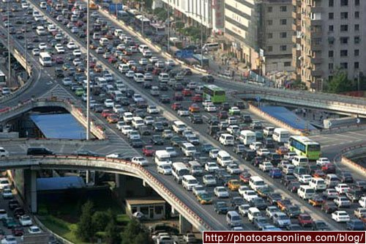
Principles of congestion control
congestion:
informally: “many sources sending too much data too fast for network to handle”
Manifestations?
  lost packets (buffer overflow at routers)
  long delays (queueing in router buffers)

Slide 27
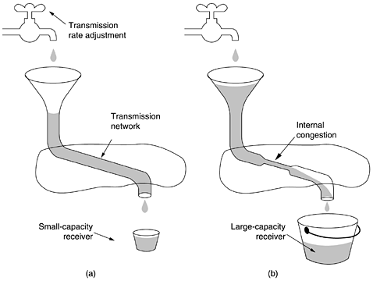
Distinction between flow control and congestion control
Fig. A. Tanenbaum
Computer Networks
Need for flow control
Need for congestion control

Slide 28

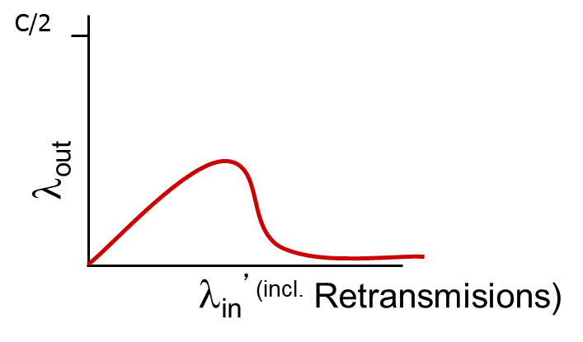
Causes/costs of congestion
original data: λ_{in}
throughput: λ_{out}
Host A
output link capacity: R
link buffers
Host B
Recall queueing behaviour + losses
Losses => retransmissions => even higher load…
R/2
λ_{out}
delay
λ_{in}
R/2
λ_{in}
R/2
Ideal per-connection throughput: R/2 (if 2 connections)
reality ☹

Slide 29
Causes/costs of congestion
original data: λ_{in}
throughput: λ_{out}
two senders, two receivers, average rate of data is λ_{in}
one router, infinite buffers
output link capacity: R
(no retransmission in the “picture” yet)
Host A
unlimited shared output link buffers
Host B
R/2
λ_{out}
delay
λ_{in}
R/2
λ_{in}
R/2
maximum per-connection throughput: R/2
large delays as arrival rate, λ_{in}, approaches capacity

Slide 30
Causes/costs of congestion: scenario 2
Realistic buffers bounded =>: duplicates
packets can be lost, dropped at router due to full buffers
sender times out, sending two copies
R/2
when sending at R/2, some packets are retransmissions including duplicated that are delivered!
λ_{out}
λ_{in}
R/2
“costs” of congestion:
more work (retrans) for given “goodput” (application-level throughput)
unneeded retransmissions: links carry multiple copies of pkt

Slide 31
Causes/costs of congestion: scenario 3
Consider 4 streams
C/2
λ_{out}
λ_{in}^{’(incl.} Retransmisions)
another cost of congestion:
when packets dropped, any “upstream transmission capacity used for that packet was wasted!

Slide 32
Approaches towards congestion control
Not present in Internet’s
network layer protocols
approach taken by TCP
end-end congestion control:
no explicit feedback from network
congestion inferred from end-system observed loss, delay
network-assisted congestion control:
routers collaborate for optimal rates + provide feedback to end-systems eg.
  a single bit indicating congestion
  explicit rate for sender to send at

Slide 33
Roadmap Transport Layer
transport layer services
multiplexing/demultiplexing
connectionless transport: UDP
principles of reliable data transfer
connection-oriented transport: TCP
  reliable transfer
    Acknowledgements
    Retransmissions
    Connection management
    Flow control and buffer space
  Congestion control
    Principles
    TCP congestion control

Slide 34
TCP congestion control: additive increase multiplicative decrease
end-end control (no network assistance), sender limits transmission
How does sender perceive congestion?
  loss = timeout or 3 duplicate acks
  TCP sender reduces rate (Congestion Window) then
  Additive Increase: increase cwnd by 1 MSS every RTT until loss detected
  Multiplicative Decrease: cut cwnd in half after loss
  To start with: slow start
rate
cwnd
~
bytes/sec
~
RTT
additively increase window size …
…. until loss occurs (then cut window in half)
AIMD saw tooth
behavior: probing
for bandwidth
cwnd: TCP sender
congestion window size
time

Slide 35
TCP Slow Start
when connection begins, increase rate exponentially until first loss event:
  initially cwnd = 1 MSS
  double cwnd every ack of previous “batch”
  done by incrementing cwnd for every ACK received
summary: initial rate is slow but ramps up exponentially fast
  then, saw-tooth
Host A
Host B
one segment
RTT
two segments
four segments
time

Slide 36
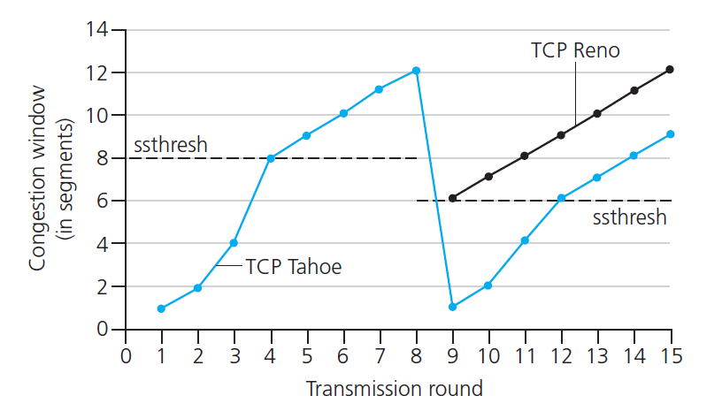
TCP cwnd: from exponential to linear growth + reacting to loss
Reno: loss indicated by timeout or 3 duplicate ACKs:
cwnd is cut in half; then grows linearly
Implementation:
variable ssthresh (slow start threshold)
on loss event, ssthresh = ½*cwnd
Non-optimized: loss indicated by timeout:
cwnd set to 1 MSS; then window slow start to threshold, then grows linearly
Notes:
Mod TO

Slide 37
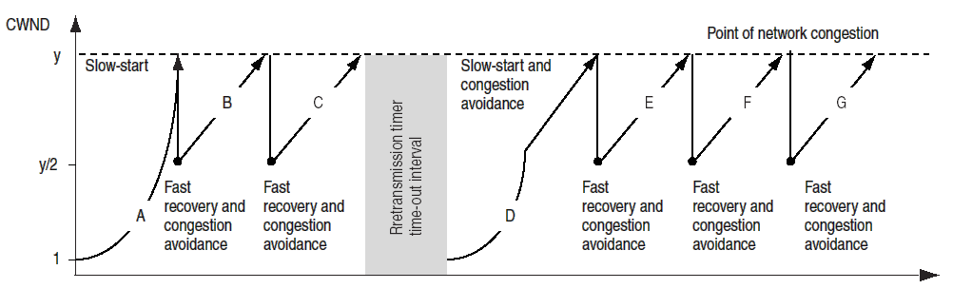
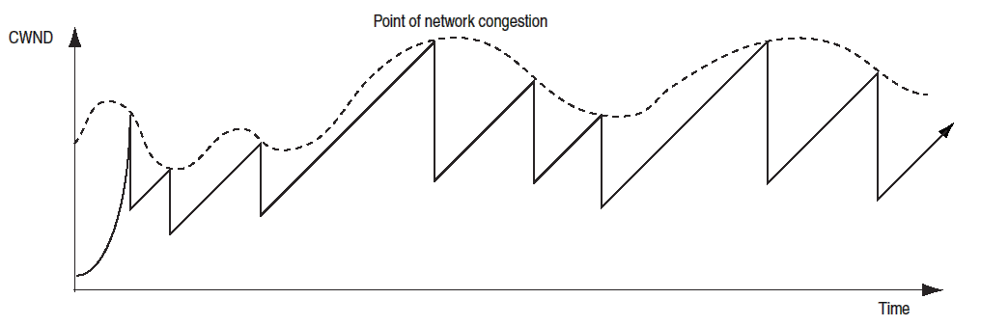
Fast recovery (Reno)
Session’s experience
Notes:
TO

Slide 38


Summary: TCP Congestion Control
New
ACK!
New
ACK!
.
duplicate ACK
new ACK
dupACKcount++
new ACK
cwnd = cwnd + MSS (MSS/cwnd)
dupACKcount = 0
transmit new segment(s), as allowed
cwnd = cwnd+MSS
dupACKcount = 0
transmit new segment(s), as allowed
Λ
cwnd = 1 MSS
ssthresh = 64 KB
dupACKcount = 0
cwnd > ssthresh
slow
start
Λ
congestion
avoidance
timeout
ssthresh = cwnd/2
cwnd = 1 MSS
dupACKcount = 0
retransmit missing segment
duplicate ACK
timeout
dupACKcount++
ssthresh = cwnd/2
cwnd = 1 MSS
dupACKcount = 0
retransmit missing segment
timeout
New
ACK!
ssthresh = cwnd/2
cwnd = 1
dupACKcount = 0
retransmit missing segment
New ACK
dupACKcount == 3
cwnd = ssthresh
dupACKcount = 0
dupACKcount == 3
ssthresh= cwnd/2
cwnd = ssthresh + 3
retransmit missing segment
ssthresh= cwnd/2
cwnd = ssthresh + 3
retransmit missing segment
fast
recovery
duplicate ACK
cwnd = cwnd + MSS
transmit new segment(s), as allowed

Slide 39
Q: How many windows does a TCP’s sender maintain?
Fig. A. Tanenbaum
Computer Networks
Need for flow control
Need for congestion control

Slide 40
TCP combined flow-ctrl, congestion ctrl windows
sender sequence number space
Min{cwnd, rwnd}
TCP sending rate:
send min {cwnd, rwnd} bytes, wait for ACKS, then send more
last byte
ACKed
last byte sent
sent, not-yet ACKed
(“in-flight”)
sender limits transmission:
cwnd is dynamic, function of perceived network congestion,
rwnd dymanically limited by receiver’s buffer space
LastByteSent-
LastByteAcked
Min{cwnd, rwnd}
<

Slide 41
TCP Fairness
fairness goal: if K TCP sessions share same bottleneck link of bandwidth R, each should have average rate of R/K
TCP connection 1
bottleneck
router
capacity R
TCP connection 2

Slide 42
Roadmap Transport Layer
transport layer services
multiplexing/demultiplexing
connectionless transport: UDP
principles of reliable data transfer
connection-oriented transport: TCP
  reliable transfer
    Acknowledgements
    Retransmissions
    Connection management
    Flow control and buffer space
  Congestion control
    Principles
    TCP congestion control

Slide 43
Chapter 3: summary
principles behind transport layer services:
  Addressing
  reliable data transfer
  flow control
  congestion control
instantiation, implementation in the Internet
  UDP
  TCP
next:
leaving the network “edge” (application, transport layers)
into the network “core”

Slide 44
Some review questions on this part
Describe TCP’s flow control
Why does TCp do fast retransmit upon a 3rd ack and not a 2nd?
Describe TCP’s congestion control: principle, method for detection of congestion, reaction.
Can a TCP’s session sending rate increase indefinitely?
Why does TCP need connection management?
Why does TCP use handshaking in the start and the end of connection?
Can an application have reliable data transfer if it uses UDP? How or why not?

Slide 45
Reading instructions chapter 3
KuroseRoss book
Other resources (further study)
  Eddie Kohler, Mark Handley, and Sally Floyd. 2006. Designing DCCP: congestion control without reliability. SIGCOMM Comput. Commun. Rev. 36, 4 (August 2006), 27-38. DOI=10.1145/1151659.1159918 http://doi.acm.org/10.1145/1151659.1159918
  http://research.microsoft.com/apps/video/default.aspx?id=104005
  Exercise/throughput analysis TCP in following slides
Careful | Quick
3.1, 3.2, 3.4-3.7 | 3.3

Slide 46
Extra slides, for further study

Slide 47
TCP throughput
avg. TCP throughput as function of window size, RTT?
  ignore slow start, assume always data to send
W: window size (measured in bytes) where loss occurs
  avg. window size (# in-flight bytes) is ¾ W
  avg. trhoughput is 3/4W per RTT
3
W
avg TCP trhoughput =
RTT
bytes/sec
4
W
W/2

Slide 48
TCP Futures: TCP over “long, fat pipes”
example: 1500 byte segments, 100ms RTT, want 10 Gbps throughput
requires W = 83,333 in-flight segments
throughput in terms of segment loss probability, L [Mathis 1997]:
  ➜ to achieve 10 Gbps throughput, need a loss rate of L = 2·10⁻¹⁰ – a very small loss rate!
new versions of TCP for high-speed
1.22
.
MSS
TCP throughput =
RTT
L

Slide 49
Why is TCP fair?
two competing sessions:
additive increase gives slope of 1, as throughout increases
multiplicative decrease decreases throughput proportionally
R
equal bandwidth share
loss: decrease window by factor of 2
congestion avoidance: additive increase
Connection 2 throughput
loss: decrease window by factor of 2
congestion avoidance: additive increase
Connection 1 throughput
R

Slide 50
Fairness (more)
Fairness and UDP
multimedia apps often do not use TCP
  do not want rate throttled by congestion control
instead use UDP:
  send audio/video at constant rate, tolerate packet loss
Fairness, parallel TCP connections
application can open multiple parallel connections between two hosts
web browsers do this
e.g., link of rate R with 9 existing connections:
  new app asks for 1 TCP, gets rate R/10
  new app asks for 11 TCPs, gets R/2

Slide 51
TCP delay modeling (slow start – related)
Q: How long does it take to receive an object from a Web server after sending a request?
TCP connection establishment
data transfer delay
Notation, assumptions:
Assume one link between client and server of rate R
Assume: fixed congestion window, W segments
S: MSS (bits)
O: object size (bits)
no retransmissions (no loss, no corruption)
Receiver has unbounded buffer

Slide 52
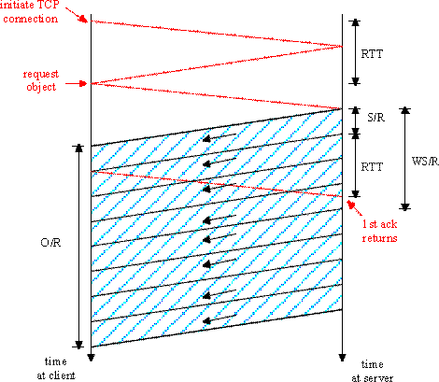
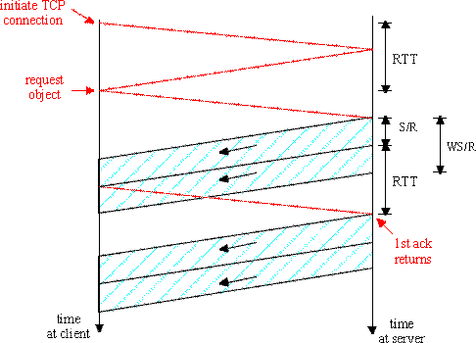
TCP delay Modeling: simplified, fixed window
K:= O/WS
Case 2: WS/R < RTT + S/R:
wait for ACK after sending window’s worth of data sent
delay = 2RTT + O/R
+ (K-1)[S/R + RTT - WS/R]
Case 1: WS/R > RTT + S/R:
ACK for first segment in window returns before window’s worth of data nsent
delay = 2RTT + O/R

Slide 53
TCP Delay Modeling: Slow Start
Delay components:
2 RTT for connection estab and request
O/R to transmit object
time server idles due to slow start
Server idles:
P = min{K-1,Q} times
where
Q = #times server stalls until cong. window is larger than a “full-utilization” window (if the object were of unbounded size).
- K = #(incremental-sized) congestion-windows that “cover” the object.
Example:
O/S = 15 segments
K = 4 windows
Q = 2
Server idles P = min{K-1,Q} = 2 times

Slide 54
TCP Delay Modeling (slow start - cont)

Slide 55
TCP Delay Modeling
Recall K = number of windows that cover object
How do we calculate K ?
Calculation of Q, number of idles for infinite-size object,
is similar.

