Slide 1
Course on Computer Communication and Networks Lecture 3 Chapter 2: Application-layer
EDA344/DIT 420, CTH/GU

Slide 2
Chapter 2: Application Layer
Chapter goals:
conceptual + implementation aspects of network application protocols
client server paradigm
specific protocols:
http, smtp, pop, dns,
p2p & streaming, CDN: later in the course)

Slide 3
Applications and application-layer protocols
Application: communicating, distributed processes
running in network hosts in “user space”
e.g., email, file transfer, the Web
Application-layer protocols
Are only one “piece” of an application -others are e.g. user agents.
Web: browser
E-mail: mail reader
streaming audio/video: media player
application
transport
network
data link
physical
application
transport
network
data link
physical
application
transport
network
data link
physical
App-layer protocols:
define messages exchanged and actions taken
use services provided by lower layer protocols

Slide 4
Client-server architecture
server:
always-on
permanent host address
clusters of servers for scaling
clients:
communicate with server
may be intermittently connected
may have dynamic host addresses
do not communicate directly with each other
client/server

Slide 5
Peer2Peer architecture
peer-peer
no always-on server
peers request service from other peers, provide service in return
peers are intermittently connected and may change addresses
complex management

Slide 6
Roadmap
Addressing and Applications needs from transport layer
Http
General description and functionality
Authentication, cookies and related aspects
Caching and proxies
SMTP (POP, IMAP)
DNS

Slide 7
Addressing, sockets
socket: Internet application programming interface
2 processes communicate by sending data into socket, reading data out of socket (like sending out, receiving in via doors)
Q: how does a process “identify” the other process with which it wants to communicate?
IP address (unique) of host running other process
“port number” - allows receiving host to determine to which local process the message should be delivered

Slide 8
Roadmap
Addressing and Applications needs from transport layer
Http
General description and functionality
Authentication, cookies and related aspects
Caching and proxies
SMTP (POP, IMAP)
DNS

Slide 9
Transport service requirements: common apps
application
file transfer
e-mail
Web documents
real-time audio/video
interactive games
text messaging
data loss
no loss
no loss
no loss
loss-tolerant
loss-tolerant
no loss
throughput
elastic
elastic
elastic
audio: 5kbps-1Mbps
video:10kbps-5Mbps
few kbps up
elastic
time sensitive
no
no
no
y, 100’s msec
y, 100’s msec
yes and no

Slide 10
Services to upper layer by Internet transport protocols
TCP service:
connection-oriented reliable transport between sending and receiving process
correct, in-order delivery of data
setup required between client, server
does not provide: timing, bandwidth guarantees
UDP service:
connectionless
Unreliable, “best-effort” transport between sending and receiving process
does not provide: timing, or bandwidth guarantee

Slide 11
Internet apps: application, transport protocols
application
layer protocol
SMTP [RFC 2821]
Telnet [RFC 854]
HTTP [RFC 2616]
FTP [RFC 959]
HTTP (e.g., YouTube), RTP [RFC 1889]
SIP, RTP, proprietary
(e.g., Skype)
underlying
transport protocol
TCP
TCP
TCP
TCP
TCP or UDP
TCP or UDP
application
e-mail
remote terminal access
Web
file transfer
streaming multimedia
Internet telephony

Slide 12
Roadmap
Addressing and Applications needs from transport layer
Http
General description and functionality
Authentication, cookies and related aspects
Caching and proxies
SMTP (POP, IMAP)
DNS

Slide 13
Web and HTTP
First, some jargon…
web page consists of objects
object can be HTML file, JPEG image, Java applet, audio file,…
web page consists of base HTML-file which includes several referenced objects
each object is addressable by a URL, e.g.,
www.someschool.edu/someDept/pic.gif
host name
path name

Slide 14
HTTP: hypertext transfer protocol overview
Web’s application layer protocol
http client: web browser; requests, receives, displays Web objects
http server: Web server sends objects
HTTP request
PC running
Firefox browser
HTTP response
uses TCP:
client initiates TCP connection to server, port 80
server accepts TCP connection
HTTP messages (application-layer protocol messages) exchanged
TCP connection closed
HTTP request
server
running
Apache Web
server
HTTP response
iphone running
Safari browser

Slide 15
http example
user enters URL
eg www.someSchool.edu/someDepartment/home.index
(contains text,
references to 10
jpeg images)
1a. http client initiates TCP connection to http server (process) at www.someSchool.edu. Port 80 is default for http server.
1b. http server at host www.someSchool.edu waiting for TCP connection at port 80. “accepts” connection, notifying client
2. client sends http request message (containing URL) into TCP connection socket
3. server receives request, forms response message with requested object (someDepartment/home.index), sends message into socket
4. client receives response msg with file, displays html. Parsing html file, finds 10 referenced jpeg objects
4a. server closes TCP connection.
time
6. Steps 1-5 repeated for each of 10 jpeg objects

Slide 16
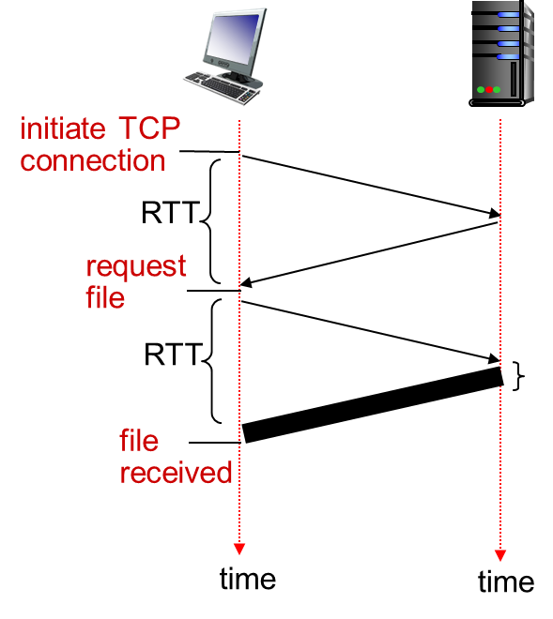
Non-persistent and persistent http
Non-persistent (http1.0)
server parses request, responds, closes TCP connection
non-persistent HTTP response time = 2RTT+ file transmission time
new TCP connection for each object => extra overhead per object
Persistent
on same TCP connection: server parses request, responds, parses new request,..
Client sends requests for all referenced objects as soon as it receives base HTML;
Less overhead per object
Objects are fetched sequentially (http 1.1)
- update http/2: fetches in priority ordering
With both, browsers can open parallel sessions

Slide 17
HTTP request message
two types of HTTP messages: request, response
HTTP request message:
ASCII (human-readable format)
carriage return character
request line
(GET, POST,
HEAD commands)
line-feed character
GET /index.html HTTP/1.1\r\n
Host: www-net.cs.umass.edu\r\n
User-Agent: Firefox/3.6.10\r\n
Accept: text/html,application/xhtml+xml\r\n
Accept-Language: en-us,en;q=0.5\r\n
Accept-Encoding: gzip,deflate\r\n
Accept-Charset: ISO-8859-1,utf-8;q=0.7\r\n
Keep-Alive: 115\r\n
Connection: keep-alive\r\n
\r\n
header
lines
carriage return,
line feed at start
of line indicates
end of header lines

Slide 18
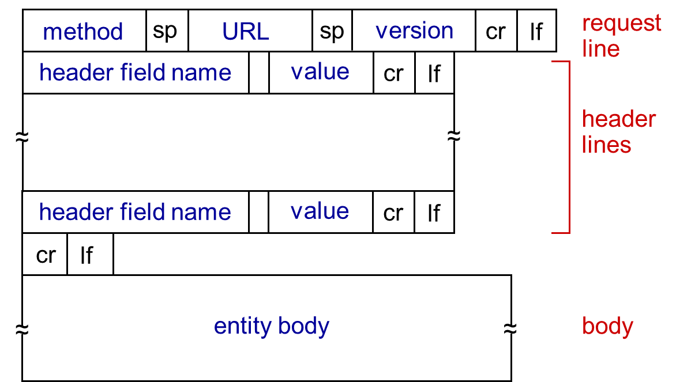
HTTP request message: general format
HTTP/1.0 (non-persistent)
GET
POST (eg data to some input form)
HEAD: asks server to send only header
HTTP/1.1 (persistent)
GET, POST, HEAD
PUT: uploads file in body to path specified in URL field
DELETE: deletes file specified in the URL field

Slide 19
HTTP response message
status line
(protocol
status code
status phrase)
HTTP/1.1 200 OK\r\n
Date: Sun, 26 Sep 2010 20:09:20 GMT\r\n
Server: Apache/2.0.52 (CentOS)\r\n
Last-Modified: Tue, 30 Oct 2007 17:00:02 GMT\r\n
ETag: "17dc6-a5c-bf716880"\r\n
Accept-Ranges: bytes\r\n
Content-Length: 2652\r\n
Keep-Alive: timeout=10, max=100\r\n
Connection: Keep-Alive\r\n
Content-Type: text/html; charset=ISO-8859-1\r\n
\r\n
data data data data data ...
header
lines
data, e.g.,
requested
HTML file
200 OK: request succeeded, requested object in this msg
301 Moved Permanently: requested object moved, new location specified later in this message (Location:)
400 Bad Request: request message not understood
404 Not Found: requested document not found on this server
505 HTTP Version Not Supported

Slide 20
Trying out HTTP (client side) for yourself
1. Telnet to a Web server:
telnet cis.poly.edu 80
opens TCP connection to port 80
(default HTTP server port) at cis.poly.edu.
anything typed in sent
to port 80 at cis.poly.edu
2. type in a GET HTTP request:
GET /~ross/ HTTP/1.1
Host: cis.poly.edu
by typing this in (hit carriage
return twice), you send
this minimal (but complete)
GET request to HTTP server
3. look at response message sent by HTTP server!

Slide 21
Topic of the programming assignment
http server
Study RFC
Work with the implemantation
It is optional, but recommended! You will learn good things

Slide 22
Roadmap
Addressing and Applications needs from transport layer
Http
General description and functionality
Authentication, cookies and related aspects
Caching and proxies
SMTP (POP, IMAP)
DNS

Slide 23
HTTP is “stateless”
HTTP server maintains no information about past client requests
aside
protocols that maintain “state” are complex!
past history (state) must be maintained
if server/client crashes, their views of “state” may be inconsistent, must be reconciled
Q: how do web applications keep state though?

Slide 24
Cookies: keeping “state”
client
server
ebay 8734
usual http request msg
Amazon server
creates ID
1678 for user
cookie file
usual http response
set-cookie: 1678
backend
database
create
entry
ebay 8734
amazon 1678
usual http request msg
cookie: 1678
cookie-
specific
action
access
usual http response msg
one week later:
access
ebay 8734
amazon 1678
usual http request msg
cookie: 1678
cookie-
specific
action
usual http response msg

Slide 25
Cookies (continued)
aside
cookies can bring:
authorization
shopping carts
recommendations
user session state
Cookies and privacy:
cookies permit sites to learn a lot about you
you may supply name and e-mail to sites
search engines use cookies to learn yet more
advertising companies obtain info across sites

Slide 26
Roadmap
Addressing and Applications needs from transport layer
Http
General description and functionality
Authentication, cookies and related aspects
Caching and proxies
SMTP (POP, IMAP)
DNS

Slide 27
Web Caches (proxy server)
Goal: satisfy client request without involving origin server
user configures browser: Web accesses via web cache
client sends all http requests to web cache; the cache(proxy) server acts as a usually caches do
Hierarchical, cooperative caching, ICP: Internet Caching Protocol (RFC2187)
origin
server
Proxy
server
http request
http request
client
http response
http response
http request
http request
http response
http response
client
origin
server

Slide 28
Why Web Caching?
Assume: cache is close to client (e.g., in same network)
smaller response time
decrease traffic to distant servers
link out of institutional/local ISP network can be bottleneck
Important for large data applications (e.g. video,…)
Performance effect:
origin
servers
public
Internet
1.5 Mbps
access link
institutional
network
10 Mbps LAN
institutional
cache
E(delay)=hitRatio*LocalAccDelay + (1-hitRatio)*RemoteAccDelay

Slide 29
Roadmap
Addressing and Applications needs from transport layer
Http
General description and functionality
Authentication, cookies and related aspects
Caching and proxies
SMTP (POP, IMAP)
DNS

Slide 30
Electronic Mail
outgoing
message queue
User Agent
a.k.a. “mail reader: composing, editing, reading mail messages -e.g., Outlook,
Mail Servers
SMTP protocol between mail servers to send email messages
client: sending mail server
“server”: receiving mail server
user mailbox
user
agent
mail
server
user
agent
SMTP
mail
server
user
agent
SMTP
SMTP
mail
server
user
agent
user
agent
user
agent

Slide 31
Scenario: Alice sends message to Bob
1) Alice, UA: message “to” bob@someschool.edu
2) Alice, UA: sends message to her mail server’s queue
3) Alice, mail server: TCP connection with Bob’s mail server (acting as a client of SMTP)
4) Alice’s mail server sends Alice’s message over the TCP connection
5) Bob’s mail server places the message in Bob’s mailbox
6) Bob invokes his UA to read message
user
agent
mail
server
user
agent
1
mail
server
2
3
6
4
Alice’s mail server
5
Bob’s mail server

Slide 32
Sample SMTP interaction
S: 220 hamburger.edu
C: HELO crepes.fr
S: 250 Hello crepes.fr, pleased to meet you
C: MAIL FROM: <alice@crepes.fr>
S: 250 alice@crepes.fr... Sender ok
C: RCPT TO: <bob@hamburger.edu>
S: 250 bob@hamburger.edu ... Recipient ok
C: DATA
S: 354 Enter mail, end with "." on a line by itself
C: Do you like ketchup?
C: How about pickles?
C: .
S: 250 Message accepted for delivery
C: QUIT
S: 221 hamburger.edu closing connection
SMTP (RFC 2821) uses TCP, port 25
three phases
handshaking (greeting)
transfer of messages
closure
You can try it out through
telnet servername 25
see 220 reply from server
enter HELO, MAIL FROM, RCPT TO, DATA, QUIT commands

Slide 33
SMTP & Mail message format
header
blank
line
RFC 822: standard for text message format:
header lines, e.g.,
To:, From:, Subject:
different from SMTP MAIL FROM, RCPT TO: commands
Body: the “message”
ASCII 7-bit characters only
body

Slide 34
Mail access protocols
user
agent
mail access
protocol
user
agent
SMTP
SMTP
(e.g., POP,
IMAP)
sender’s mail
server
receiver’s mail
server
SMTP: delivery/storage to receiver’s server
mail access protocol: retrieval from server
POP: Post Office Protocol [RFC 1939]: authorization, download
IMAP: Internet Mail Access Protocol [RFC 1730]: more features, including manipulation of stored msgs on server

Slide 35
Roadmap
Addressing and Applications needs from transport layer
Http
General description and functionality
Authentication, cookies and related aspects
Caching and proxies
SMTP (POP, IMAP)
DNS

Slide 36
DNS: Domain Name System
People: many identifiers:
SSN, name, Passport #
Internet hosts, routers: IP address (32 bit) - used for addressing datagrams (129.16.237.85)
name (alphanumeric addresses) hard to process @ router
“name”, e.g., (www.cs.chalmers.se)- used by humans
Q: map between IP addresses and name ?

Slide 37
Hostname to IP address translation
Example: www.chalmers.se 129.16.71.10
File with mapping may be edited on the system
Unix: /etc/hosts
Windows: c:\windows\system32\drivers\etc\hosts
Example of an entry manually entered in the file:
“129.16.20.245 fibula.ce.chalmers.se fibula”
Does not scale for all possible hosts, hard to change
All hosts need one copy of the file
Impossible on the Internet
Alternative: DNS, a large distributed database
DNS – Domain Name System
37

Slide 38
DNS: services, structure
DNS services
hostname to IP address translation
host aliasing
canonical, alias names
mail server aliasing
load distribution
replicated Web servers: many IP addresses correspond to one name
why not centralize DNS?
single point of failure
traffic volume
maintenance
A: would not scale!

Slide 39
DNS: a distributed, hierarchical database
…
…
Root DNS Servers
aka Top- Level Domains
com DNS servers
org DNS servers
edu DNS servers
yahoo.com
DNS servers
pbs.org
DNS servers
poly.edu
DNS servers
umass.edu
DNS servers
amazon.com
DNS servers

Slide 40
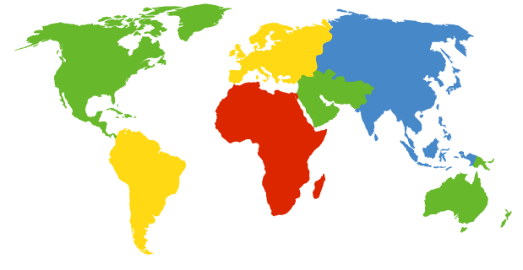
DNS: root name servers
c. Cogent, Herndon, VA (5 other sites)
d. U Maryland College Park, MD
h. ARL Aberdeen, MD
j. Verisign, Dulles VA (69 other sites )
k. RIPE London (17 other sites)
i. Netnod, Stockholm (37 other sites)
e. NASA Mt View, CA
f. Internet Software C.
Palo Alto, CA (and 48 other sites)
m. WIDE Tokyo
(5 other sites)
a. Verisign, Los Angeles CA
(5 other sites)
b. USC-ISI Marina del Rey, CA
l. ICANN Los Angeles, CA
(41 other sites)
g. US DoD Columbus, OH (5 other sites)
13 logical root name “servers” worldwide - each “server” replicated many times http://www.root-servers.org/

Slide 41
TLD, authoritative, local servers
top-level domain (TLD) servers:
responsible for com, org, net, edu, aero, jobs, all top-level country domains, e.g.: uk, fr, ca, jp
Network Solutions maintains servers for .com TLD
Educause for .edu TLD
authoritative DNS servers:
organization’s own DNS server(s), providing authoritative hostname to IP mappings for organization’s named hosts
can be maintained by organization or service provider
Local name server
acts as proxy for clients, caches entries for TTL
Sends queries to DNS hierarchy
each ISP has one

Slide 42
DNS name resolution example
root DNS server
host at cis.poly.edu wants IP address for gaia.cs.umass.edu
2
3
TLD DNS server
4
5
iterated query:
contacted server replies with name of server to contact
“I don’t know this name, but ask this server”
local DNS server
dns.poly.edu
7
6
1
8
authoritative DNS server
dns.cs.umass.edu
requesting host
cis.poly.edu
gaia.cs.umass.edu

Slide 43
DNS name resolution example
root DNS server
recursive query:
puts burden of name resolution on contacted name server
heavy load at upper levels of hierarchy?
2
3
7
6
TLD DNS
server
local DNS server
dns.poly.edu
5
4
1
8
authoritative DNS server
dns.cs.umass.edu
requesting host
cis.poly.edu
gaia.cs.umass.edu

Slide 44
DNS: caching, updating records
once (any) name server learns mapping, it caches mapping
cache entries timeout after some time (TTL)
TLD servers typically cached in local name servers
thus root name servers not often visited
cached entries may be out-of-date (best effort name-to-address translation!)
if name host changes IP address, may not be known Internet-wide until all TTLs expire
update/notify mechanisms proposed IETF standard
RFC 2136

Slide 45
DNS records
DNS: distributed db storing resource records (RR)
RR format: (name, value, type, ttl)
type=A
name is hostname
value is IP address
type=CNAME
name is alias name for some “canonical” (the real) name
Eg www.ibm.com is really
servereast.backup2.ibm.com
value is canonical name
type=NS
name is domain (e.g., foo.com)
value is hostname of authoritative name server for this domain
type=MX
value is name of mailserver associated with name

Slide 46
DNS protocol, messages
query and reply messages (use UDP), both with same message format
identification: 16 bit # for query, reply to query uses same #
2 bytes
2 bytes
identification
flags
flags:
query or reply
recursion desired
recursion available
reply is authoritative
# questions
# answer RRs
# authority RRs
# additional RRs
name, type fields
for a query
questions (variable # of questions)
RRs in response
to query
answers (variable # of RRs)
records for
authoritative servers
authority (variable # of RRs)
additional “helpful”
info that may be used
additional info (variable # of RRs)

Slide 47
Inserting records into DNS
example: new startup “Network Utopia”
register name networkuptopia.com at DNS registrar (e.g., Network Solutions)
provide names, IP addresses of authoritative name server (primary and secondary)
registrar inserts two RRs into .com TLD server: (networkutopia.com, dns1.networkutopia.com, NS)
(dns1.networkutopia.com, 212.212.212.1, A)
Adding a new host/service to domain:
Add to authoritative name server
type A record for www.networkuptopia.com
type MX record for networkutopia.com (mail)

Slide 48
DNS and security risks
DDoS attacks
Bombard root servers
Mitigation (it actually works ☺): local DNS servers cache IPs of TLD servers, allowing root server bypass
Bombard TLD servers
Potentially more dangerous
Redirect attacks
Man-in-middle
Intercept queries
DNS poisoning
Send bogus replies to DNS server, which caches
Exploit DNS for DDoS
Send queries with spoofed source address: target IP

Slide 49
Summary
Addressing and Applications needs from transport layer
application architectures
client-server
(p2p: will study later in the course, after the layers-centered study)
specific protocols:
Http (connection to programming assignment)
Caching etc
SMTP (POP, IMAP)
DNS
Coming soon, after a first pass of the 4 top layers
- P2P applications
- video streaming and content distribution networks

Slide 50
Resources
Reading list main textbook:
Study: 5/e,6/e: 2.2, 2.4-2.5, 5/e: 2.7-2.9, 6/e: 2.7-2.8, 7/e: 2.2-2.4
Quick reading: 5/e,6/e: 2.1, 2.3, 2.6, 7/e: 2.1, 2.5
Review questions from the book, useful for summary study
Chapter 2: 4, 5, 6, 7, 8, 9, 10, 11, 12, 13, 16, 19, 20

Slide 51
Example review question Properties of transport service of interest to the app.
Data loss
some apps (e.g., audio) can tolerate some loss
other apps (e.g., file transfer, telnet) require 100% reliable data transfer
In-order vs arbitrary-order delivery
Bandwidth, Timing, Security
some apps (e.g., multimedia, interactive games) require minimum amount of bandwidth, and/or low delay and/or low jitter
other apps (elastic apps, e.g. file transfer) are ok with any bandwidth, timing they get
Some apps also require confidentiality, integrity (more in network security)

Slide 52
Extra slides/notes

Slide 53
HTTP: Conditional GET: client-side caching
client
server
Goal: don’t send object if client has up-to-date stored (cached) version
client: specify date of cached copy in http request
If-modified-since: <date>
server: response contains no object if cached copy up-to-date:
HTTP/1.0 304 Not Modified
http request msg
If-modified-since: <date>
object
not
modified
http response
HTTP/1.0
304 Not Modified
http request msg
If-modified-since: <date>
object
modified
http response
HTTP/1.1 200 OK
…
<data>

Slide 54
Caching example:
assumptions:
avg object size: 100K bits
avg request rate from browsers to origin servers:15/sec
i.e. avg data rate to browsers: 1.50 Mbps
RTT from institutional router to any origin server: 2 sec
access link rate: 1.54 Mbps
consequences:
LAN utilization: 1.5%
access link utilization = 99%
total delay = Internet delay + access delay + LAN delay
= 2 sec + minutes + quite_small
origin
servers
public
Internet
1.54 Mbps
access link
problem!
institutional
network
100Mbps LAN

Slide 55
Caching example: faster access link
assumptions:
avg object size: 100K bits
avg request rate from browsers to origin servers:15/sec
i.e. avg data rate to browsers: 1.50 Mbps
RTT from institutional router to any origin server: 2 sec
access link rate: 1.54 Mbps
consequences:
LAN utilization: 1.5%
access link utilization = 99%
total delay = Internet delay + access delay + LAN delay
= 2 sec + minutes + usecs
origin
servers
public
Internet
1.54 Mbps
access link
154 Mbps
154 Mbps
institutional
network
9.9%
100Mbps LAN
msecs
Cost: increased access link speed (not cheap!)

Slide 56
Caching example: install local cache
assumptions:
avg object size: 100K bits
avg request rate from browsers to origin servers:15/sec
i.e. avg data rate to browsers: 1.50 Mbps
RTT from institutional router to any origin server: 2 sec
access link rate: 1.54 Mbps
consequences:
LAN utilization: 1.5%
access link utilization
total delay
origin
servers
public
Internet
1.54 Mbps
access link
institutional
network
?
100Mbps LAN
?
local web
cache
How to compute link
utilization, delay?
Cost: web cache (cheap!)

Slide 57
Caching example: install local cache
Calculating access link utilization, delay with cache:
suppose cache hit rate is 0.4
40% requests satisfied at cache, 60% requests satisfied at origin
origin
servers
public
Internet
access link utilization:
60% of requests use access link
data rate to browsers over access link = 0.6*1.50 Mbps = .9 Mbps
utilization = 0.9/1.54 = .58
1.54 Mbps
access link
total delay
= 0.6 * (delay from origin servers) +0.4 * (delay when satisfied at cache)
= 0.6 (2.01) + 0.4 (~msecs)
= ~ 1.2 secs
less than with 154 Mbps link (and cheaper too!)
institutional
network
100Mbps LAN
local web
cache

Slide 58
FTP: separate control, data connections
FTP client contacts FTP server at port 21, using TCP
client authorized over control connection
client browses remote directory, sends commands over control connection
when server receives file transfer command, server opens 2nd TCP data connection (for file) to client
after transferring one file, server closes data connection
TCP control connection,
server port 21
FTP
client
TCP data connection,
server port 20
FTP
server
server opens another TCP data connection to transfer another file
control connection: “out of band”
FTP server maintains “state”: current directory, earlier authentication

Slide 59
FTP commands, responses
sample commands:
sent as ASCII text over control channel
USER username
PASS password
LIST return list of file in current directory
RETR filename retrieves (gets) file
STOR filename stores (puts) file onto remote host
sample return codes
status code and phrase (as in HTTP)
331 Username OK, password required
125 data connection already open; transfer starting
425 Can’t open data connection
452 Error writing file

Slide 60
POP3 protocol
S: +OK POP3 server ready
C: user bob
S: +OK
C: pass hungry
S: +OK user successfully logged on
authorization phase
client commands:
user: declare username
pass: password
server responses
+OK
-ERR
transaction phase, client:
list: list message numbers
retr: retrieve message by number
dele: delete
quit
C: list
S: 1 498
S: 2 912
S: .
C: retr 1
S: <message 1 contents>
S: .
C: dele 1
C: retr 2
S: <message 1 contents>
S: .
C: dele 2
C: quit
S: +OK POP3 server signing off

Slide 61
POP3 (more) and IMAP
more about POP3
previous example uses POP3 “download and delete” mode
Bob cannot re-read e-mail if he changes client
POP3 “download-and-keep”: copies of messages on different clients
POP3 is stateless across sessions
IMAP
keeps all messages in one place: at server
allows user to organize messages in folders
keeps user state across sessions:
names of folders and mappings between message IDs and folder name

