Slide 1
Course on Computer Communication and Networks
Lecture 16
Synthesis, Summary/flashback and Projection (related topics – continuation of study)
EDA344/DIT 420, CTH/GU

Slide 2
Important for the exam
When/where: wednesday March 15, 14.00-18.00, SB-building
You may have with you:
English-X dictionary
no calculators, PDAs, etc (if/where numbers matter, do rounding)
Grading
30-40, 41-50, 51-60 (out of 60)= 3, 4, 5 (CTH)
30-44, 45-60 (out of 60) = G, VG (GU)
To think during summary-study
Have overview, critical eye; explain; ask yourselves: why is this so? / how does it work (or not work)?

Slide 3
Synthesis: a day in the life of a web request
Putting lots-of-what-we-learned together: synthesis!
  goal: identify, review protocols (at all layers) involved in seemingly simple scenario: requesting www page
  scenario: student attaches laptop to campus network, requests/receives www.google.com

Slide 4


A day in the life …. : scenario
browser
DNS server
Comcast network
68.80.0.0/13
school network
68.80.2.0/24
web page
web server
Google’s network
64.233.160.0/19
64.233.169.105

Slide 5
A day in the life… connecting to the Internet
DHCP
DHCP
UDP
IP
Eth
Phy
connecting laptop needs to get its own IP address: use DHCP
DHCP
DHCP
DHCP
DHCP
DHCP request encapsulated in UDP, encapsulated in IP, encapsulated in Ethernet
DHCP
DHCP
UDP
IP
Eth
Phy
DHCP
DHCP
DHCP
DHCP
Ethernet frame broadcast (dest: FFFFFFFFFFFF) on LAN, received at router running DHCP server
router
(runs DHCP)
Ethernet demux’ed to IP demux’ed to UDP demux’ed to DHCP

Slide 6
A day in the life… connecting to the Internet
DHCP
DHCP
UDP
IP
Eth
Phy
DHCP server formulates DHCP ACK containing client’s IP address (and also IP address of first-hop router for client, name & IP address of DNS server)
DHCP
DHCP
DHCP
frame forwarded (switch learning) through LAN, demultiplexing at client
DHCP
DHCP
UDP
IP
Eth
Phy
DHCP
DHCP
DHCP
router
(runs DHCP)
DHCP client receives DHCP ACK reply
DHCP
Client now has IP address, knows name & addr of DNS
server, IP address of its first-hop router

Slide 7
A day in the life… ARP (before DNS, before HTTP)
DNS
UDP
IP
Eth
Phy
before sending HTTP request, need IP address of www.google.com: DNS
DNS
DNS
DNS
ARP
ARP query
DNS query created, encapsulated in UDP, encapsulated in IP, encasulated in Eth. In order to send frame to router, need MAC address of router interface: ARP
ARP
ARP reply
Eth
Phy
ARP query broadcast, received by router, which replies with ARP reply giving MAC address of router interface
client now knows MAC address of first hop router, so can now send frame containing DNS query

Slide 8
A day in the life… using DNS
DNS
UDP
IP
Eth
Phy
DNS
DNS server
DNS
UDP
IP
Eth
Phy
DNS
DNS
DNS
DNS
DNS
DNS
DNS
DNS
Comcast network
68.80.0.0/13
IP datagram forwarded from campus network to destination (DNS-server) network, routed (tables created by RIP, OSPF and BGP routing protocols) to DNS server
IP datagram containing DNS query forwarded via LAN switch from client to 1st hop router
demux’ed to DNS server
DNS server replies to client with IP address of www.google.com

Slide 9
A day in the life… TCP connection carrying HTTP
HTTP
HTTP
TCP
IP
Eth
Phy
SYNACK
SYN
SYNACK
SYN
SYNACK
SYN
SYN
to send HTTP request, client first opens TCP socket to web server
TCP SYN segment (step 1 in 3-way handshake) inter-domain routed to web server
TCP
IP
Eth
Phy
SYNACK
SYN
SYNACK
SYN
SYNACK
SYNACK
SYN
web server responds with TCP SYNACK
web server
64.233.169.105
TCP connection established!

Slide 10
A day in the life… HTTP request/reply
web page finally (!!!) displayed
HTTP
HTTP
TCP
IP
Eth
Phy
HTTP
HTTP
HTTP
HTTP
HTTP
HTTP
HTTP
HTTP
HTTP request sent into TCP socket
IP datagram containing HTTP request routed to www.google.com
HTTP
HTTP
TCP
IP
Eth
Phy
HTTP
HTTP
HTTP
web server responds with HTTP reply (containing web page)
HTTP
web server
64.233.169.105
IP datgram containing HTTP reply routed back to client

Slide 11
Principles, Organisation
Network Problems
Mobility, performance, security, …, …
serving different types of traffic,
connecting transparently different networks,
routing, congestion control,
access to shared (broadcast) transmission medium
producer-consumer problems, flow and error control
Layering : principle, why

Slide 12
Highlights
Software-defined networks
network security issues
TCP/IP, LAN protocol stack
delays performance
routing, also with mobility
multiple access protocols (wired, wireless)
reliable data transfer
datagram vs VC
congestion control

Slide 13
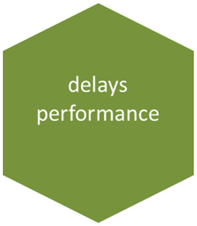
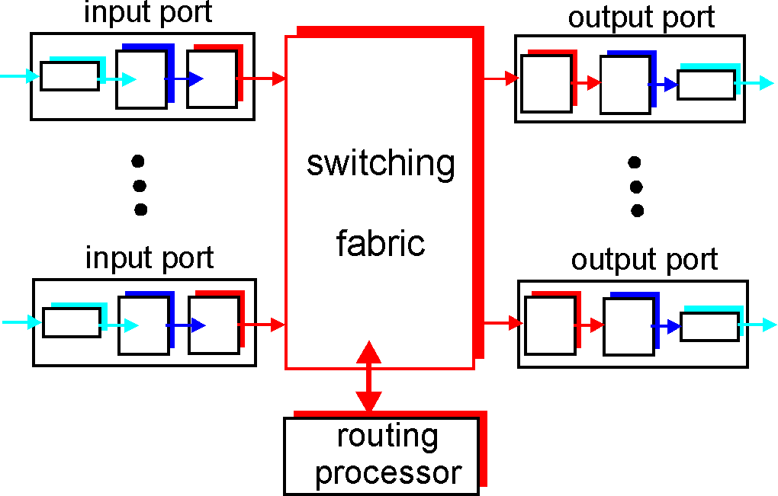
Types of delay; performance
Propagation, transmission, queueing, processing
Throughput (effective bandwidth), Utilization -- efficiency
Packet-switching: impact of store&forward, pipelines, space-time diagrams
Sliding windows performance
Relation between delays-losses
transmission
A
propagation
B
nodal
processing
queuing

Slide 14
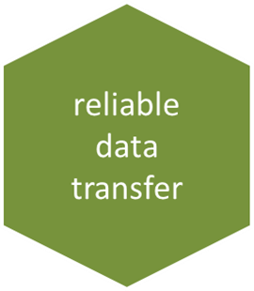
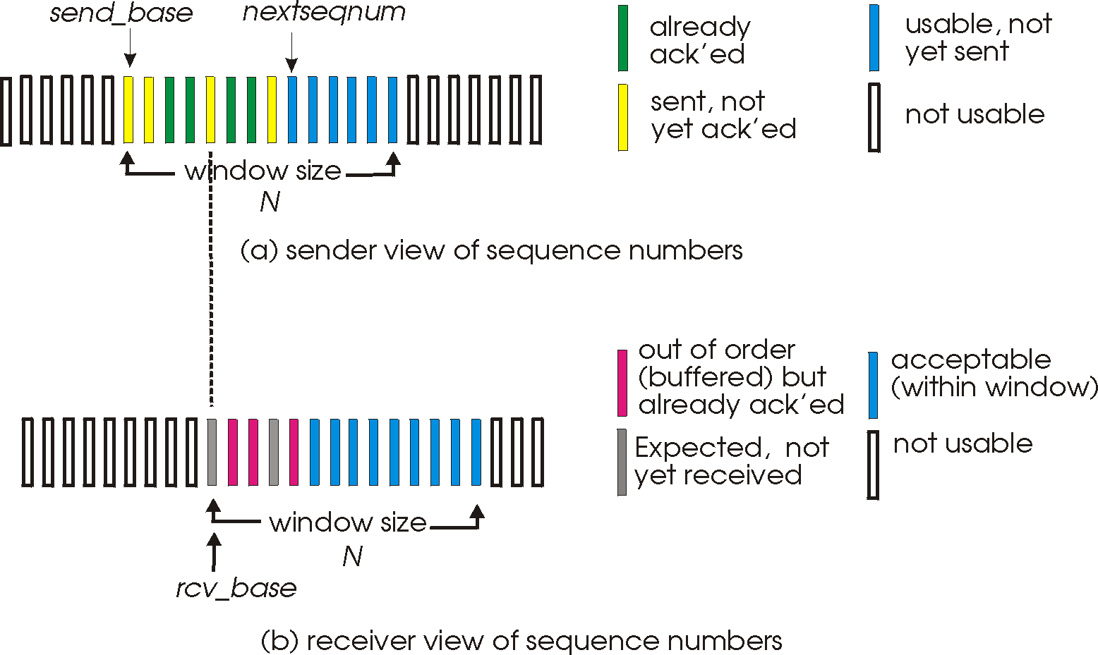
Reliable data transfer
Guaranteed, in-order, correct delivery:
  stop&wait
  sliding windows
  sequence numbers
  window sizes
  dynamic windows (TCP)
  performance
  flow control
Error detection: checksums
Error control: go-back-n, selective repeat, FEC methods

Slide 15
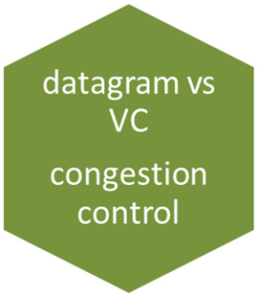
Datagram vs VC end-to-end comm.
Congestion
Control
RT traffic/streaming

Slide 16
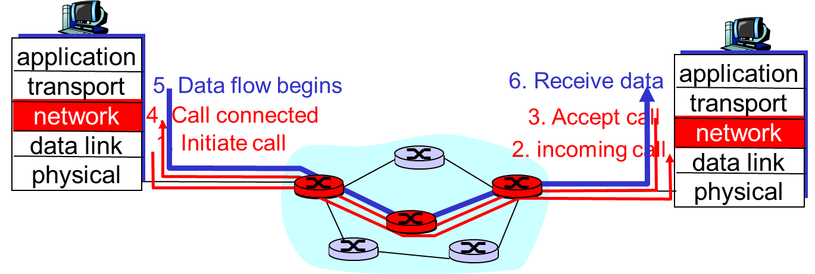
Datagram vs VC end-to-end communication
Conceptual differences
Decisions, comparison

Slide 17
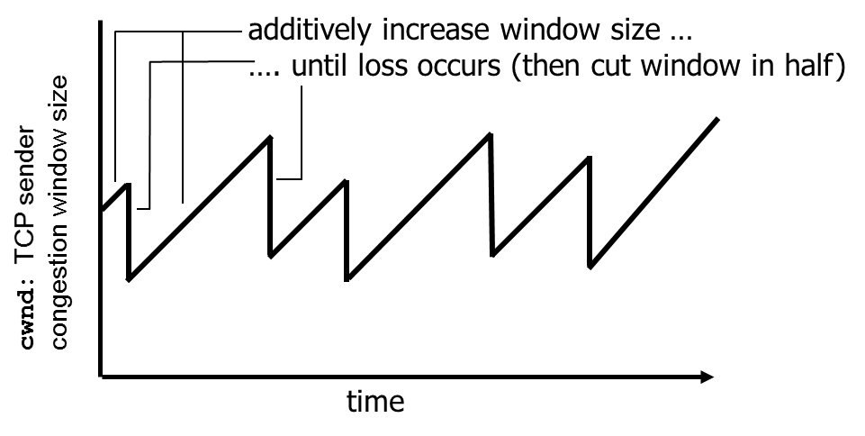
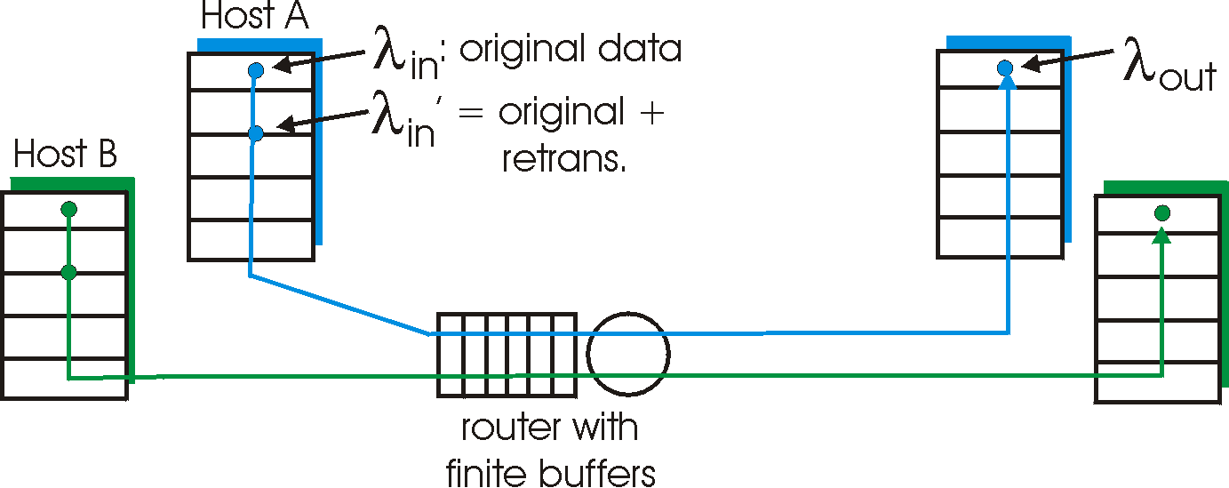
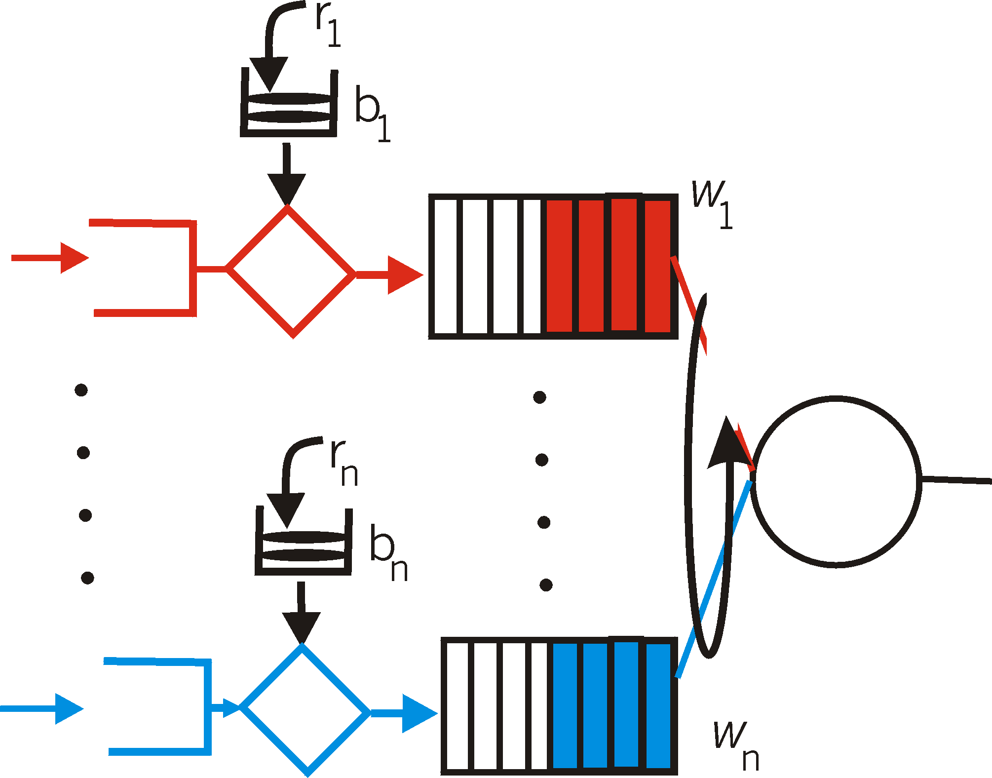
Congestion control (CC)
why, how congestion occurs
CC in TCP and performance; implied weaknesses
CC in other ways, e.g. VC-based networks
  Real-time (RT)-traffic resource reservation:
    traffic shaping and policing
  rate-based

Slide 18
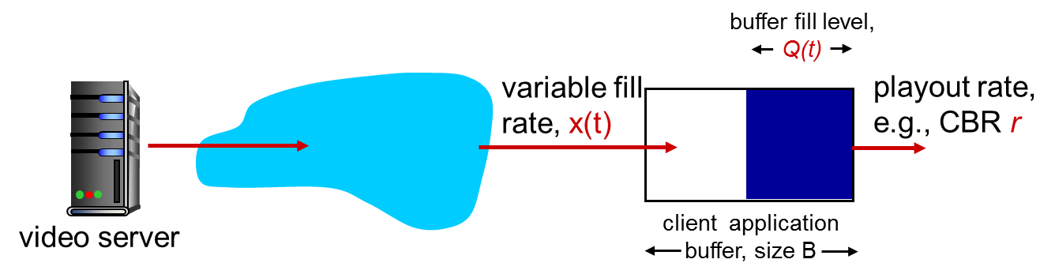
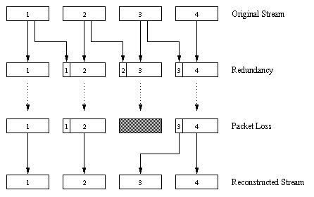
RT/streaming traffic
Internet context
Application-level solutions (playout delay, forward-error-control, caching-CDN)
Intserv, Diffserv, traffic engineering, SDN
Conceptual needs:
packet/flow marking
Admission control
Traffic shaping & policing
Packet scheduling

Slide 19
Highlights
Software-defined networks
network security issues
TCP/IP, LAN protocol stack
delays performance
routing, also with mobility
multiple access protocols (wired, wireless)
reliable data transfer
datagram vs VC
congestion control

Slide 20
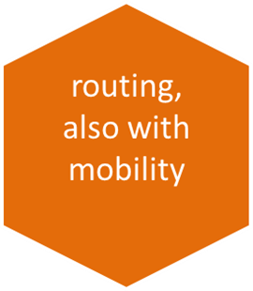

Routing, also with mobility
Routing algorithms, protocols
Forwarding in routers
Resource, policy issues
Data plane and control plane in SDN
Addressing mobility, tunneling
5
B
3
C
2
5
A
2
1
F
3
1
2
D
E
1
Mobile
Switching
Center
Public telephone
network, and
Internet
Mobile
Switching
Center

Slide 21
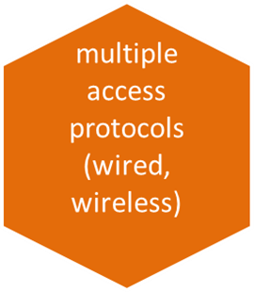
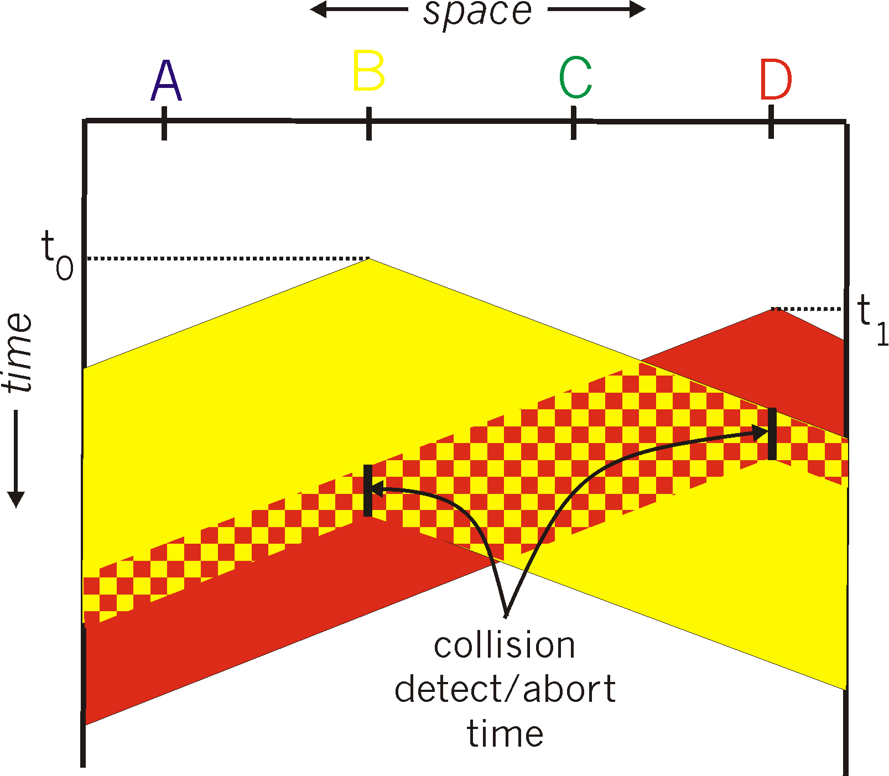

Medium access: multiple access methods
Strategies: (functionality, appropriateness)
Contention-based (random access), wired/wireless:
  Aloha, CSMA(CD/CA)
Collision-free:
  Channel partitioning: TDMA, FDMA, CDMA
  Taking turns: e.g. tokens, reservation-based
A
B
C
A’s signal
strength
C’s signal
strength
space

Slide 22
Highlights
Software-defined networks
network security issues
TCP/IP, LAN protocol stack
delays performance
routing, also with mobility
multiple access protocols (wired, wireless)
reliable data transfer
datagram vs VC
congestion control

Slide 23
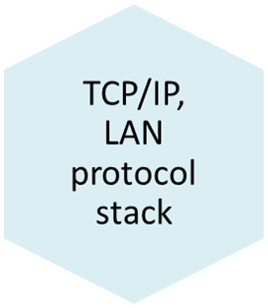
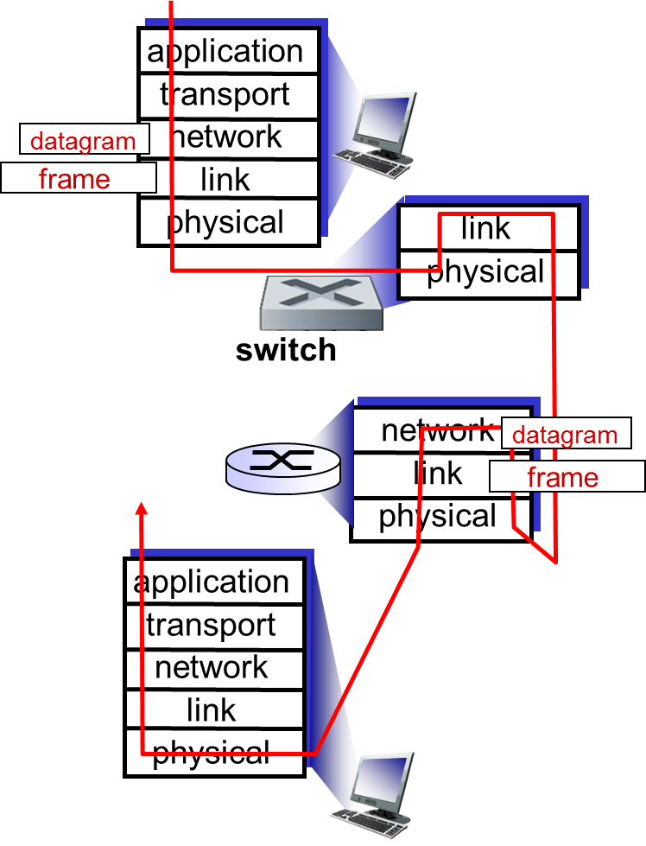
TCP/IP protocol stack, applications, evolution
Instantiation of network- solutions
(Routing, Congestion Control, Flow & error control, applications, link layer technologies)
Advantages, limitations, updates
New types of applications and how they function given the existing state of Internet

Slide 24
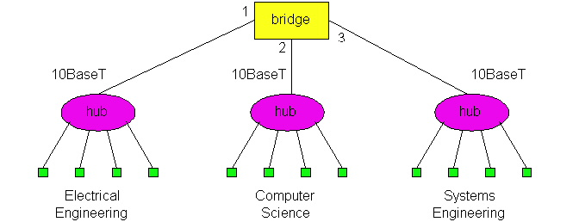
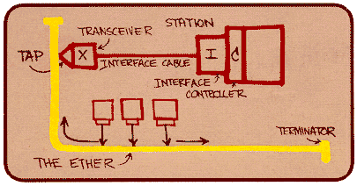
LANs & related link technologies
Protocol Examples: wired, wireless
  Ethernet, 802.xy, GSM:
    Functionality, performance under low/high load
Connecting devices;
  functionalities and differences (Hubs, switches)
  Algorithms for switch-”routing”: learning& forwarding of packets
ARP
switch

Slide 25
Highlights
Software-defined networks
network security issues
TCP/IP, LAN protocol stack
delays performance
routing, also with mobility
multiple access protocols (wired, wireless)
reliable data transfer
datagram vs VC
congestion control

Slide 26




Security issues
C, I, A and methods to achieve them
  The language of cryptography
  Message integrity, signatures
Instantiation in Internet: SSL, IPsec
Firewalls
Alice
Bob
channel
data, control messages
secure
sender
s
data
secure
receiver
data
Trudy

Slide 27
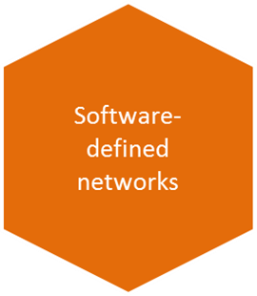
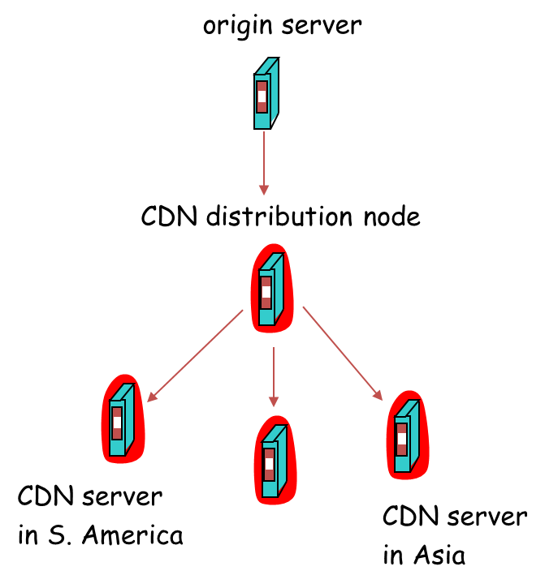
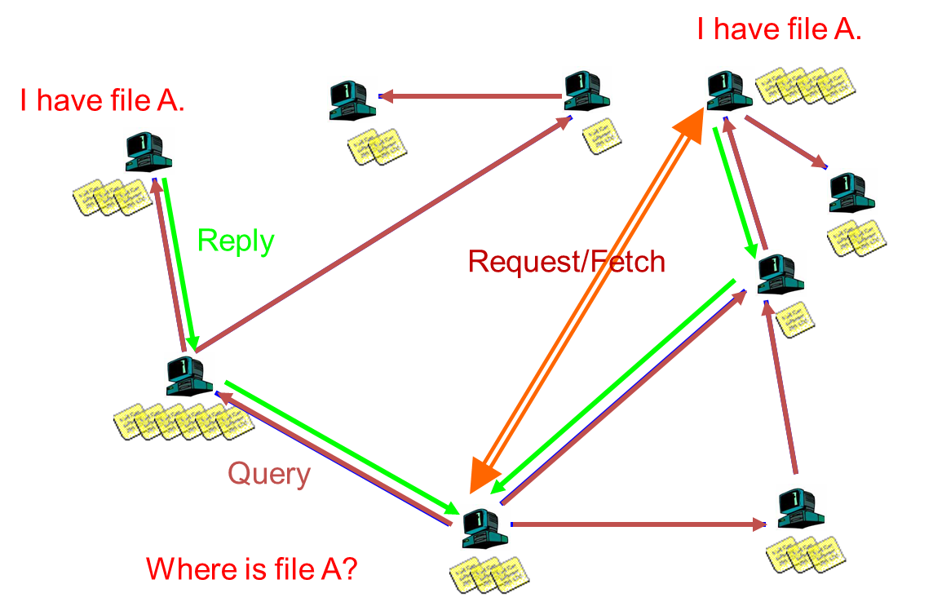
Overlays, CDN, SDN
P2P/streaming applications-infrastructure (application-layer networking)
traffic engineering, tunneling
Software-defined networks: separation of control and execution planes; virtualization of ”network layer functionality”: eg. routing table updates implemented elsewhere (not in particular routers)
(related to data centers, 5G; Internet of Things)
… complement the networking infrastructure …

Slide 28
Main questions asked by you:
How can we have reliable data transfer on top of UDP
  Implementation at app-layer
Difference between addressing in transport layer and in network layer? (e.g. TCP headers add source and destination IP addresses but these addresses are also added in the network layer: Is it redundant ?)
  Some redundancy yes, TCP uses it for demux
”special” IP address(mask) 192.168.0.0/16
  Local, behind NAT; was standard global address in earlier, classful IP-addressing; preserved for historical & engineering reasons
Working with time-space diagrams
  See next slide
Discuss exercise on slide 12 of 12.lectureNWcoreAndMediaSDN
  Discussed in class

Slide 29
4: eg What is a full-utilization window?
sender
receiver
first packet bit transmitted, t = 0
last bit transmitted, t = L / R
first packet bit arrives
RTT
last packet bit arrives, send ACK
last bit of 2nd packet arrives, send ACK
last bit of 3rd packet arrives, send ACK
ACK arrives, send next
packet, t = RTT + L / R
E.g. for 100% utilization, calculate how many packets can fill in RTT + L / R, ie (RTT + L / R)/ (L / R)

Slide 30
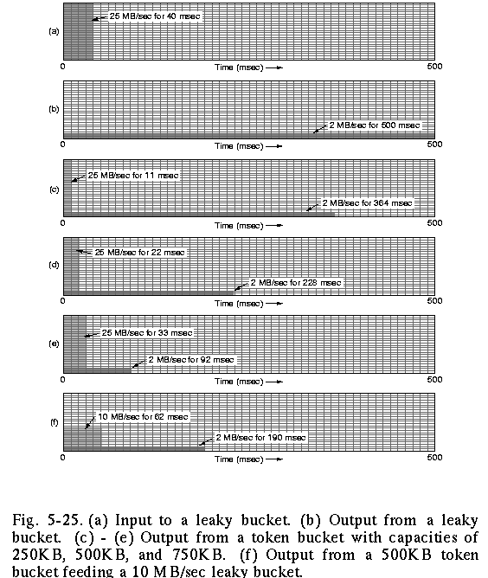
5: Policing: the effect of buckets
input
output pure leaky bucket, 2MBps
output token bucket 250KB, 2MBps
output token bucket 500KB, 2MBps
output token bucket 750KB, 2MBps
output token bucket 500KB, 2MBps, feeding 10MBps leaky bucket

Slide 31
Synthesis cont.
1. Reflections, prespectives
2. Networking constantly evolving

Slide 32
The Internet: virtualizing networks
1974: multiple unconnected nets
  ARPAnet
  data-over-cable networks
  packet satellite network (Aloha)
  packet radio network
… differing in:
  addressing conventions
  packet formats
  error recovery
  routing
ARPAnet
satellite net
"A Protocol for Packet Network Intercommunication",
V. Cerf, R. Kahn, IEEE Transactions on Communications,
May, 1974, pp. 637-648.

Slide 33
The Internet: virtualizing networks
Internetwork layer (IP):
addressing: internetwork appears as single, uniform entity, despite underlying local network heterogeneity
network of networks
Gateway:
“embed internetwork packets in local packet format”
route (at internetwork level) to next gateway
gateway
ARPAnet
satellite net

Slide 34
Internet structure: network of networks
Question: given millions of access ISPs, how to connect them together?
…
…
access
net
access
net
access
net
access
net
access
net
access
net
access
net
…
…
access
net
access
net
access
net
access
net
access
net
access
net
…
access
net
access
net
…
access
net

Slide 35
Internet structure: network of networks
Option: connect each access ISP to every other access ISP?
…
…
access
net
access
net
access
net
access
net
access
net
…
…
access
net
access
net
…
connecting each access ISP to each other directly doesn’t scale: O(N²) connections.
…
…
access
net
access
net
…
access
net
access
net
access
net
…
access
net
…
access
net
access
net
…
access
net

Slide 36
Internet structure: network of networks
Option: connect each access ISP to a global transit (imaginary) ISP? Customer and provider ISPs have economic agreement.
…
…
access
net
access
net
access
net
access
net
access
net
access
net
access
net
…
…
global
ISP
access
net
access
net
access
net
access
net
access
net
access
net
…
access
net
access
net
…
access
net

Slide 37
Internet structure: network of networks
But if one global ISP is viable business, there will be competitors ….
…
…
access
net
access
net
access
net
access
net
access
net
access
net
access
net
ISP A
…
…
access
net
ISP B
access
net
ISP C
access
net
access
net
access
net
access
net
…
access
net
access
net
…
access
net

Slide 38
Internet structure: network of networks
But if one global ISP is viable business, there will be competitors …. which must be interconnected
Internet exchange point
(ca 300 in the world;
multiple ISPs peering/switching;
3rd company)
…
…
access
net
access
net
access
net
access
net
access
net
access
net
access
net
ISP A
…
…
IXP
access
net
access
net
ISP B
ISP C
access
net
access
net
peering link
(no payment to each-other)
access
net
access
net
…
access
net
access
net
…
access
net

Slide 39
Internet structure: network of networks
… and regional networks may arise to connect access nets to ISPS
…
…
access
net
access
net
access
net
access
net
access
net
access
net
access
net
ISP A
…
…
IXP
access
net
access
net
ISP B
ISP C
access
net
access
net
access
net
regional net
access
net
…
access
net
access
net
…
access
net

Slide 40
Internet structure: network of networks
… and content provider networks (e.g., Google, Microsoft, Akamai ) may run their own network, to bring services, content close to end users
…
…
access
net
access
net
access
net
access
net
access
net
access
net
access
net
ISP A
…
…
Content provider network
IXP
access
net
access
net
ISP B
ISP B
access
net
access
net
access
net
regional net
access
net
…
access
net
access
net
…
access
net

Slide 41
Internet structure: network of networks
Tier 1 ISP
Tier 1 ISP
Google
IXP
IXP
IXP
Regional ISP
Regional ISP
access
ISP
access
ISP
access
ISP
access
ISP
access
ISP
access
ISP
access
ISP
access
ISP
at center: small # of well-connected large networks
  “tier-1” commercial ISPs (e.g., AT&T, NTT, TeliaSonera, DeutcheTelecom), national & international coverage
  A new form of content provider network (e.g, Google): private network that connects it data centers to Internet, often bypassing tier-1, regional ISPs

Slide 42
Synthesis cont.
1. Reflections, prespectives
2. Networking constantly evolving

Slide 43
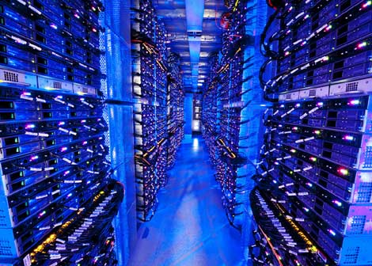
Data center networks
10’s to 100’s of thousands of hosts, often closely coupled, in close proximity:
  e-business (e.g. Amazon)
  content-servers (e.g., YouTube, Akamai, Apple, Microsoft)
  search engines, data mining (e.g., Google)
challenges:
  multiple applications, each serving massive numbers of clients
  managing/balancing load, networking, data bottlenecks
Inside a 40-ft Microsoft container,
Chicago data center

Slide 44
Data center networks(SDN-relevance)
load balancer: application-layer routing
receives external client requests
directs workload within data center
returns results to external client (hiding data center internals from client)
  Distributed systems & networks working together
Internet
Border router
Load
balancer
Load
balancer
Access router
B
Tier-1 switches
A
C
Tier-2 switches
TOR switches
Server racks
1
2
3
4
5
6
7
8

Slide 45
Data center networks (SDN-relevance)
rich interconnection among switches, racks:
  increased throughput between racks (multiple routing paths possible)
  increased reliability via redundancy
  Distributed systems & networks working together
Tier-1 switches
Tier-2 switches
TOR switches
Server racks
1
2
3
4
5
6
7
8

Slide 46
guest lecture (joint with Adv. Distributed Systems course)
will be rescheduled outside the Study Period
Niklas Gustavsson, engineering team leader at Spotify, Gothenburg

Slide 47

More examples: a story in progress + possible followup course...
Overlays useful here, too:

Slide 48
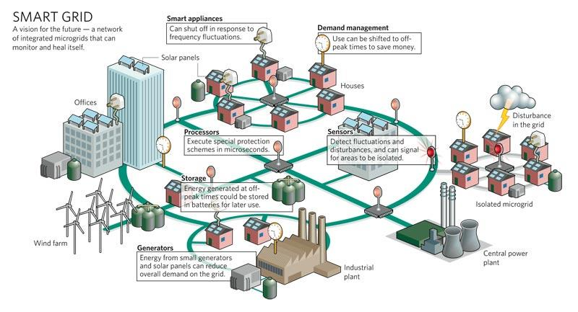
New power grids: be adaptive!
Bidirectional power and information flow
  – Micro-producers or “prosumers”, can share resources
  – Distributed energy resources
Communication + resource-administration (distributed system) layer: IoT
Notes:
Bidirectional power flow
Communications layer
= From “water pipes” model to “traffic network” model

Slide 49

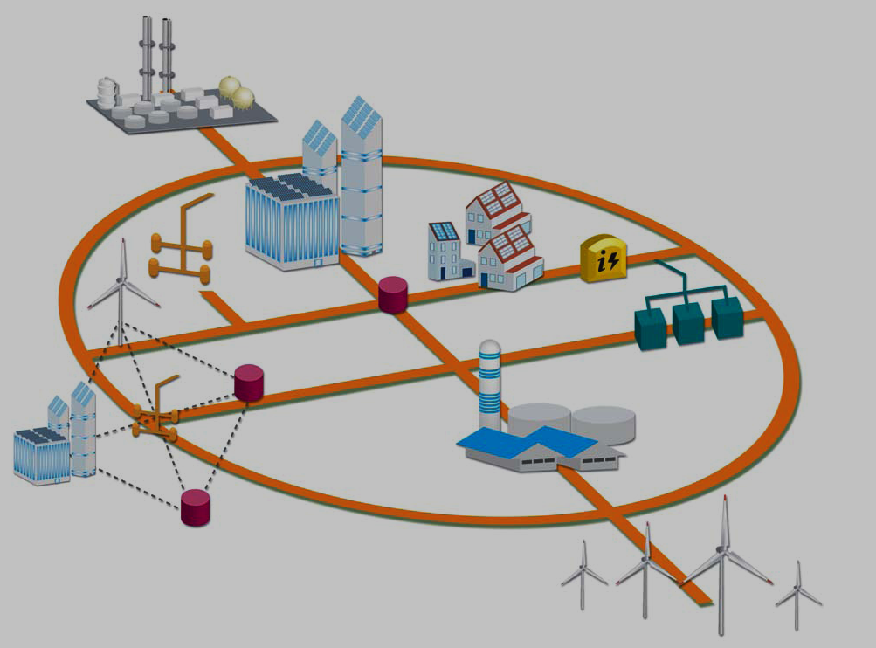

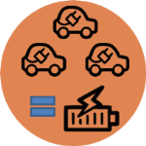
El-networks as distributed cyber-physical systems
Overlay network
El- link and/or communication link
Computing+ communicating device
Cyber system
Physical system
Course (DAT300, LP1):
ICT Support Cyberphysical Systems
Connecting Distributed Systems, Networks, Data processing and Security in CPS
Notes:
Info-centered ElNet: information overlay on the energy distribution system

Slide 50
Thank you
Recall, important for the exam:
When/where: wednesday March 15, 14.00-18.00, SB
You may have with you:
English-X dictionary
no calculators, PDAs, etc (if/where numbers matter, do rounding)
To think during last, summary-study
Overview; critical eye; explain; ask yourselves: why is this so? / How does it work?
Good luck with all your efforts!!!
“If you hear a voice within you say ‘you cannot paint,’ then by all means paint, and that voice will be silenced.” – Vincent Van Gogh

