Slide 1

Chapter 8
Network Security
Slides adapted from the book and Tomas Olovsson

Slide 2

Roadmap
8.1 What is network security?
8.2 Principles of cryptography
8.3 Message integrity
Security protocols and measures:
Securing TCP connections: SSL
Network layer security: IPsec
Firewalls

Slide 3
What is security? CIA!
Confidentiality: only sender, intended receiver should “understand” message contents
  sender encrypts message
  receiver decrypts message
Integrity: sender, receiver want to ensure message not altered (in transit, or afterwards) without detection
Availability: services must be accessible and available to users
The book also includes Authentication: it is normally seen as a mechanism to implement the services above
Notes:
Mod TO

Slide 4
Internet security threats
Packet sniffing:
  broadcast media
  promiscuous NIC reads all packets passing by
  can read all unencrypted data (e.g. passwords)
  e.g.: C sniffs B’s packets
A
C
src:B dest:A payload
B
Countermeasures?

Slide 5

Internet security threats
Packet sniffing: countermeasures
  One host per segment of broadcast media
    Use switches (not hubs)
  Segment network
    Use routers
  Encryption
switch
A
B
C

Slide 6
Internet security threats
IP Spoofing:
  can generate “raw” IP packets directly from application, putting any value into IP source address field
  receiver can’t tell if source is spoofed,
  e.g.: C pretends to be B
A
C
src:B dest:A payload
B
Countermeasures?

Slide 7
Internet security threats
IP Spoofing: ingress filtering
  routers should not forward incoming and outgoing packets with invalid addresses
    Outgoing datagram source address not in router’s network (egress filtering)
    Incoming datagram has internal address as source address (ingress filtering)
A
C
B
src:B dest:A payload

Slide 8




Communication threats – Summary
Impersonation (identity spoofing)
Data origin spoofing
Impersonation (identity spoofing)
Data origin spoofing
Eavesdropping (passive)
Modification
Insertion, Deletion
Delay, Replay, Flood
Client
Bob
Server
Alice
Notes:
Mod TO

Slide 9
Roadmap
8.1 What is network security?
8.2 Principles of cryptography
8.3 Message integrity
Security protocols and measures:
Securing TCP connections: SSL
Network layer security: IPsec
Firewalls

Slide 10



The language of cryptography
Alice’s
encryption
key
Bob’s
decryption
key
K
K
A
B
plaintext
encryption
algorithm
ciphertext
decryption
algorithm
plaintext
Trudy
Symmetric key crypto: sender & receiver keys identical
Asymmetric key crypto (or Public-key crypto):
One key for encryption, another for decryption.
One of the keys can be public, the other private.
Notes:
Mod TO

Slide 11
Symmetric key cryptography
K
K
A-B
A-B
plaintext
message, m
encryption
algorithm
ciphertext
decryption
algorithm
plaintext
m = K ( )
K (m)
K (m)
A-B
A-B
A-B
symmetric key crypto: Bob and Alice share the same (symmetric) key: K
Q: how do Bob and Alice agree on key value?
A-B
Notes:
Korr TO

Slide 12
Block Encryption (ECB mode)
Block size depends on cipher: DES=64 bits, AES=128 bits, …
Independent of key length.
Plaintext
block
Symmetric Key
(encrypts and decrypts)
The algorithm is publicly known!
Block
cipher
Problem: same plaintext
always results in the same
ciphertext (“block effect”)
Ciphertext
block (same size)
This mode is called
electronic codebook
mode (ECB)
Chapter 6.2

Slide 13
CBC – Cipher block chaining mode
Plaintext
Identical blocks
now encrypted
differently.
May not always be practical, for example for hard disk encryption.
IV – init. vector
for first block
f
Block cipher
Note that there
is no protection
against replays
and alteration!
Ciphertext
Chapter 6.3

Slide 14
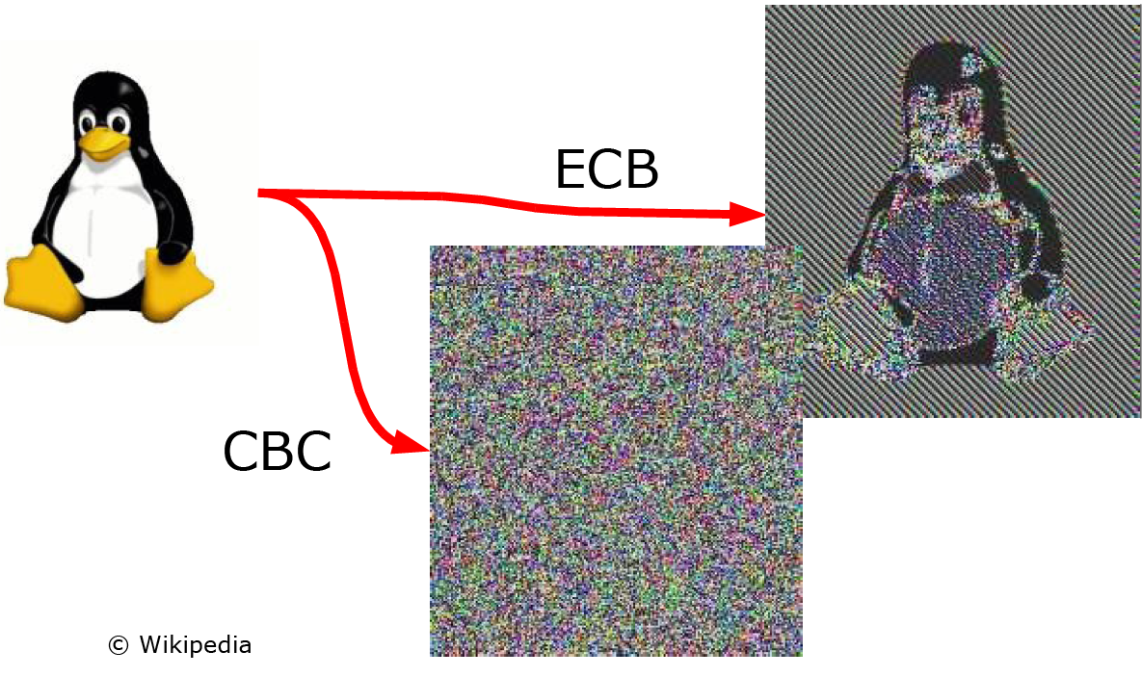
ECB vs. CBC
Identical blocks
give identical
results

Slide 15
Symmetric Key Ciphers
DES (Data Encryption Standard)
  Designed by IBM 1975, Adopted by NIST* 1977
  Criticized for key length (64→ 56) and mysterious “S-boxes”
  Turned out to have protection against differential cryptanalysis (found 1990)
  Probably more effort is spent on cracking DES than on all other ciphers together
  Today key length is a major problem: 56-bit keys can be cracked
3-DES (repeating DES three times with different keys)
  3-DES probably secure today but too computational intensive
AES (Advanced Encryption Standard)
  Replaces DES as of 2001
  Result of an official competition
  Key lengths: 128, 192 or 256 bits
  Brute force decryption: if DES takes 1 second, AES-128 takes 149 trillion years,
  AES-256 would take 10⁵² years
RC4, RC5, RC6
  RC4 is considered weak but it is fast
…
EFF DES cracker.
Jan 19, 1999: 22h15m
*NIST = National Institute of Standards and Technology, US, formerly NBS
Notes:
TO

Slide 16
Key Length and Number of Possible Keys
Key Length
in Bits
Number of Possible Keys
1
2
2
4
40
WEAK
1,099,511,627,776
56
72,057,594,037,927,900
112
5,192,296,858,534,830,000,000,000,000,000,000
168
3.74144E+50
Strong
256
1.15792E+77
512
1.3408E+154
Figure 7-3
Notes:
TO

Slide 17


Asymmetric key encryption
One key is used to encrypt, the other to decrypt
One key can be public – the other kept secret
Based on mathematically hard problems
  Factorization of very large primes (RSA)
Slow because of the large numbers involved
  1024 bits and up (RSA), 384 bits (ECC)
  2¹⁰²⁴ = 10³⁰⁸ which means >300 digit numbers
Ciphers:
  RSA – Rivest, Shamir, Adleman (Patent expired 2000)
  ECC – Elliptic Curve Cryptosystem
768-bit RSA was reported cracked Jan 2010:
  They generated a five-terabyte decryption table. It would have taken around 1,500 years using a single AMD Opteron-based PC (they used a cluster)
1024-bit RSA is too short to protect against extremely large organizations
  Use 2048-bit RSA keys in sensitive applications
"the overall effort [as] sufficiently low that even for short-term protection of data of little value, 768-bit RSA moduli can no longer be recommended."
Notes:
TO

Slide 18
Asymmetric key encryption
1
One key is normally made public
(“Public key encryption”)
You decide whether it is the encryption or
decryption key that is public:
Encryption key public: everyone can send encrypted messages to owner of the private key
Decryption key public: only one can encrypt, everyone can verify that the secret key has been used.
  Can be used to sign documents and data.
2
Useful?
Notes:
TO

Slide 19
Example 1: Public Key Encryption
+
Bob’s public
key
K
B
-
Bob’s private
key
K
B
plaintext
message, m
encryption
algorithm
ciphertext
decryption
algorithm
plaintext
message
+
K (m)
-
+
B
m = K (K (m))
B
B

Slide 20

Example 2: Digital Signatures
Simple digital signature for message m:
Bob signs m by encrypting with his private key K_{B}, creating “signed” message, K_{B}(m)
-
-
Bob’s message, m:
-
Bob’s private
key
K
B
Dear Alice
Oh, how I have missed you. I think of you all the time! …(blah blah blah)
Bob
Bob’s message, m,
in clear-text
Public key
encryption
algorithm
Signature = Message encrypted
with Bob’s private key
-
K
(m)
B

Slide 21


Relative performance
Hash functions
SHA-512
SHA-1
MD5
Symmetric
ciphers
200-1,000 Mbyte/s
RC4
AES
DES
3-DES
performance
100 Mbyte/s
Asymmetric
ciphers
RSA
0.1 Mbyte/s
Use asymmetric algorithms to agree on symmetric keys,
symmetric algorithms for bulk data encryption,
and hash functions for integrity protection if encryption
is not needed
Notes:
TO

Slide 22
Roadmap
8.1 What is network security?
8.2 Principles of cryptography
8.3 Message integrity
Security protocols and measures:
Securing TCP connections: SSL
Network layer security: IPsec
Firewalls

Slide 23
Message Integrity
Bob receives msg from Alice, wants to ensure:
message originally came from Alice
message not changed since sent by Alice
Just encryption is not enough!
Contents can be changed even if it is encrypted
Solution: add some kind of checksum (hash) to the message before it is encrypted:
Data packet (payload)
Hash
Encrypted packet

Slide 24
(Cryptographic) hash functions
Input: arbitrary length bit-string
Output: fixed length bit-string
  Not a one-to-one mapping,
  output space typically 128 bits
Requirements:
  Computationally efficient: Typically >10 times faster than symmetric ciphers
  Must be repeatable (same input → same output)
  Impossible to reverse the computation (preimage resistant)
  Infeasible to find an input X with a given hash
  Infeasible to find two inputs resulting in the same hash (pseudo-randomness)
Today’s hash functions are not based on mathematical foundations – may lead to problems
f(x)
x
hash
“SSL broken! Hackers create rogue CA certificate using MD5 collisions”
[www.zdnet.com]
Notes:
TO

Slide 25
Hash functions
input
Even a single
bit change
should give a
completely
different
result →
avalanche effect
SHA-512 has
80 rounds
Non-linear
function

Slide 26
Hash functions
  Even just one changed bit gives a completely different result:
  md5(“hello”) = 5d41402abc4b2a76b9719d911017c592
  md5(“Hello”) = 8b1a9953c4611296a827abf8c47804d7
MD5 – Message Digest 5 (RFC 1321, 1992)
  128-bit message digest → 10³⁸ different hashes
  Avoid in new implementations - weak
SHA-1 – Secure Hash Algorithm
  Designed by NSA, became NIST standard 1995: FIPS-180-2
  160-bit message digest → 10⁴⁸ different hashes
  Avoid if collisions may cause problems in application, otherwise ok
SHA-2 (family name for SHA-224, SHA-256, SHA-384 and SHA-512)
  Similar design as SHA-1, but at least today SHA-1 attacks not applicable
SHA-3 – next generation hash functions
  Keccak - winner of open competition (NIST draft 2014)
  Arbitrary digest size (standard proposes 224, 256, 384 and 512 bit digests)
“As of 2012, an estimat-ed cost of $2.77M to break a single hash value by renting CPU power from cloud servers.”
- SHA-1, Wikipedia
Notes:
TO

Slide 27
Keyed Hash – No need to encrypt message
s
shared secret (not sent)
s
message
message
message
H(m+s)
H(m+s)
compare
Authenticates sender
Verifies message integrity
No encryption !
Example: HMAC (Key-Hashing for Message Authentiction)

Slide 28
End point (User) Authentication
Alice says “I am Alice” and sends her
secret password to “prove” it.
(Just like the FTP protocol)
Alice’s
password
“I’m Alice”
Failure scenario??
OK

Slide 29
End point (User) Authentication
Alice says “I am Alice” and sends her
secret password to “prove” it.
Alice’s
password
“I’m Alice”
playback attack: Trudy records Alice’s packet
and later
plays it back to Bob
Alice’s
password
“I’m Alice”

Slide 30
Authentication: another try
Another attempt: Alice says “I am Alice” and sends her
encrypted secret password to “prove” it.
encrypted
password
“I’m Alice”
Failure scenario??
OK
record
and
playback
still works!

Slide 31
Authentication: Challenge response
Goal: avoid playback attack
Nonce: number (R) used only once–in-a-lifetime
To prove Alice is “live”, Bob sends Alice nonce, R.
Alice must return R, encrypted with shared secret key
“I am Alice”
R
K (R)
Alice is live, and only Alice knows key to encrypt nonce, so it must be Alice!
A-B
Failures, drawbacks?

Slide 32
Summary
Encryption for confidentiality
Hashes for data integrity
Sequence numbers for replay protection
Authentication (mutual) for identity protection
Symmetric encryption for bulk data
Asymmetric encryption for key negotiation

Slide 33
Roadmap
8.1 What is network security?
8.2 Principles of cryptography
8.3 Message integrity
Security protocols and measures:
Securing TCP connections: SSL
Network layer security: IPsec
Firewalls
Application
SSL
TCP
IP

Slide 34
SSL: Secure Sockets Layer
widely deployed security protocol
  supported by almost all browsers, web servers
  https
  billions $/year over SSL
mechanisms: [Woo 1994], implementation: Netscape
variation -TLS: transport layer security, RFC 2246
provides
  confidentiality
  integrity
  authentication
original goals:
  Web e-commerce transactions
  encryption (especially credit-card numbers)
  Web-server authentication
  optional client authentication
  minimum hassle in doing business with new merchant
available to all TCP applications
  secure socket interface

Slide 35
SSL and TCP/IP
Application
Application
SSL
TCP
TCP
IP
IP
normal application
application with SSL
SSL provides application programming interface (API) to applications
C and Java SSL libraries/classes readily available

Slide 36
Real SSL connection
handshake: ClientHello
handshake: ServerHello
handshake: Certificate
handshake: ServerHelloDone
handshake: ClientKeyExchange
ChangeCipherSpec
everything
henceforth
is encrypted
handshake: Finished
ChangeCipherSpec
handshake: Finished
application_data
application_data
Alert: warning, close_notify
TCP FIN follows

Slide 37
SSL record protocol
data
data
fragment
MAC
data
fragment
MAC
record
header
encrypted
data and MAC
record
header
encrypted
data and MAC
record header: content type; version; length
MAC: includes sequence number, MAC key M_{x}
fragment: each SSL fragment 2¹⁴ bytes (~16 Kbytes)

Slide 38

What is network-layer confidentiality ?
between two network entities:
sending entity encrypts datagram payload, payload could be:
  TCP or UDP segment, ICMP message, OSPF message ….
all data sent from one entity to other would be hidden:
  web pages, e-mail, P2P file transfers, TCP SYN packets …
IPsec
IPsec

Slide 39
The two modes of IPSec
IPsec
IPsec
IPsec
IPsec
Tunnel mode
  edge routers IPsec-aware
  protects communication gw-to-gw (over Internet)
  Virtual Private Network (VPN)
Transport mode
  hosts IPsec-aware
  protects communication all the way from end-to-end

Slide 40
IPsec services
data integrity
confidentiality
origin authentication
replay attack prevention
two protocols providing different service models:
Authentication Header (AH) protocol
  provides source authentication & data integrity but not confidentiality
Encapsulation Security Protocol (ESP)
  provides source authentication, data integrity, and confidentiality
  more widely used than AH

Slide 41
Virtual Private Networks (VPNs)
motivation:
institutions often want private networks for security.
  costly: separate routers, links, DNS infrastructure.
VPN: institution’s inter-office traffic is sent over public Internet instead
  encrypted before entering public Internet
  logically separate from other traffic

Slide 42


Virtual Private Networks (VPNs)
public
Internet
laptop
w/ IPsec
IP
header
IPsec
header
Secure
payload
salesperson
in hotel
IP
header
IPsec
header
Secure
payload
IP
header
IPsec
header
Secure
payload
router w/
IPv4 and IPsec
router w/
IPv4 and IPsec
IP
header
payload
IP
header
payload
branch office
headquarters

Slide 43
What happens?
headquarters
Internet
branch office
200.168.1.100
193.68.2.23
R1
security association
R2
172.16.1/24
172.16.2/24
before sending data, “security association (SA)” established from sending to receiving entity
“enchilada” authenticated
encrypted
new IP
header
ESP
hdr
original
IP hdr
Original IP
datagram payload
ESP
trl
ESP
auth
SPI
Seq
#
padding
pad
length
next
header

Slide 44


Firewalls
firewall
isolates organization’s internal net from larger Internet, allowing some packets to pass, blocking others
administered
network
public
Internet
trusted “good guys”
untrusted “bad guys”
firewall

Slide 45
Firewalls: why
prevent denial of service attacks:
  SYN flooding: attacker establishes many bogus TCP connections, no resources left for “real” connections
prevent illegal modification/access of internal data
  e.g., attacker replaces CIA’s homepage with something else
allow only authorized access to inside network
  set of authenticated users/hosts
three types of firewalls:
  stateless packet filters
  stateful packet filters
  application gateways

Slide 46
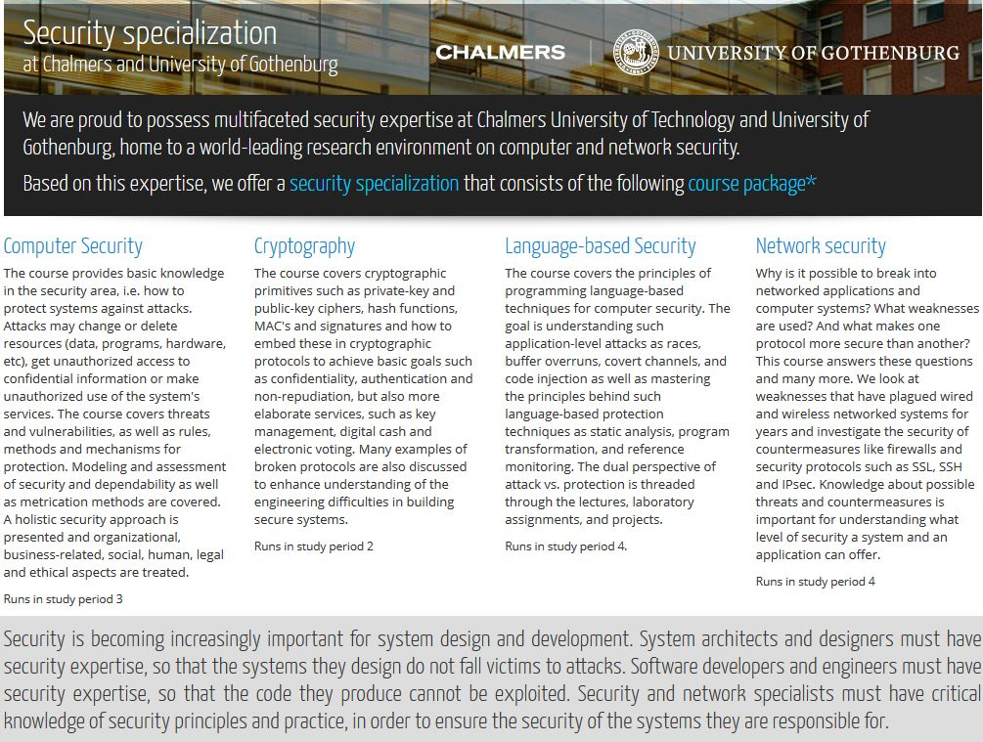
Security Courses at Chalmers http://www.cse.chalmers.se/edu/master/secspec/
Computer Security EDA 263
Network Security EDA 491
Cryptography TDA 352
Language based security TDA 602
Fault Tolerant Computer Systems EDA 122

Slide 47
Some review questions
What is the difference between symmetric and asymmetric cryptography? Give examples of applications where each can be applied.
Can you “decrypt” a hash of a message to get the original message? Explain your answer.
What is the purpose of a nonce in an end-point authentication protocol? What is the main property of a nonce?

Slide 48
Reading instructions
Kurose Ross (Course book)
  8.1 – 8.4, 8.6, 8.7, 8.9.1
Other resources (extra material):
  http://shattered.it/ - information about practical SHA-1 collision
  https://thehackernews.com/ - security news

