Slide 1
Course on Computer Communication and Networks
Lecture 12
Continuously evolving Internet-working
Part 2: QoS, traffic engineering, SDN, IoT
EDA344/DIT 420, CTH/GU

Slide 2


Recall: Internet protocol stack layers
Application: protocols supporting n/W applications
  http (web), smtp (email),
  p2p, media streaming, CPS/IoT apps
Transport: end2end data transfer protocols
  UDP, TCP
Network: routing of datagrams, connecting different physical networks
  IP addressing, routing,
  Virtualization, traffic engineering, Software Defined Networks
link: data transfer between neighboring nodes
  Ethernet, WiFi, …
physical: protocols for bit-transmission/receipt on the physical medium between neighboring nodes
application
transport
network
link
physical
UDP
TCP

Slide 3


Let’s hit the road again☺: Roadmap
NW support for multimedia / QoS: [Ch. 7.5 (7e 9.5) ]
Improving timing/QoS guarantees in Networks (also related with congestion-control): Packet scheduling and policing
A VC (ATM) approach [incl. Ch 3.62-3.6.3 (7e 3.7.2)]
Internet approaches
  Diff-serv, Int-serv + RSVP,
  Traffic Engineering MPLS [incl. ch 5.5. (7/e 6.5)]
SDN [cf separate notes @pingpong docs, 7e ch 4.4, 5.5)]
Internet-of-Things in evolution: more types of traffic/devices… [optional study, just browse example protocols mentioned]

Slide 4
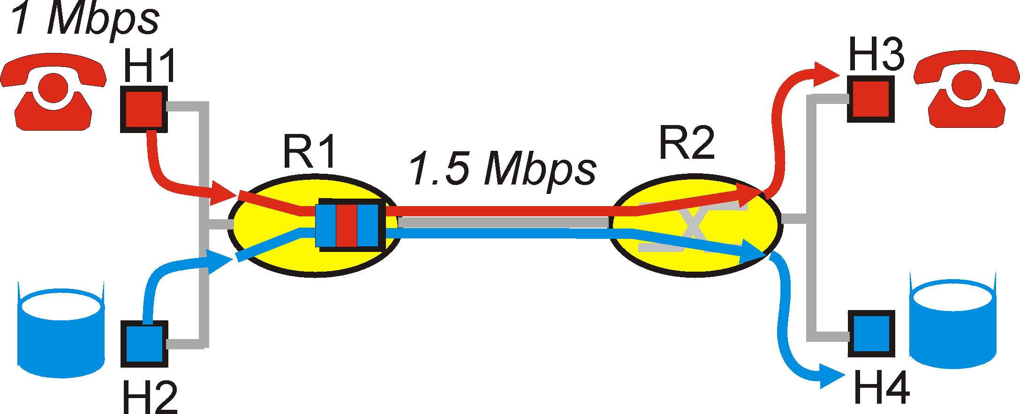
Timing/bandwidth guarantees in networks
aka Quality of Service (QoS): agreement on
Traffic characteristics (packet rate, sizes, …)
Network service guarantees (delay, jitter, loss rate, …)
model for resource sharing and congestion studies: questions/principles for QoS in Network Core
Distinguish traffic?
Control offered load? (isolate different ”streams”?)
Resources? (utilization)
Control acceptance of new sessions?
Packet classification & scheduling (bandwidth allocation)
Traffic shaping/policing (enforce contract terms)
Admission control

Slide 5
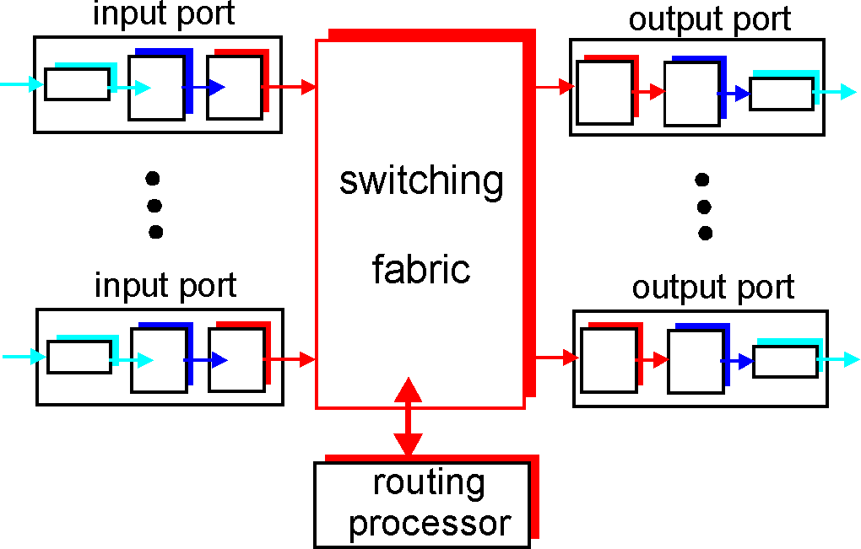
Where does this go in?
Scheduling = choosing the next packet for transmission on a link (= allocate bandwidth)

Slide 6
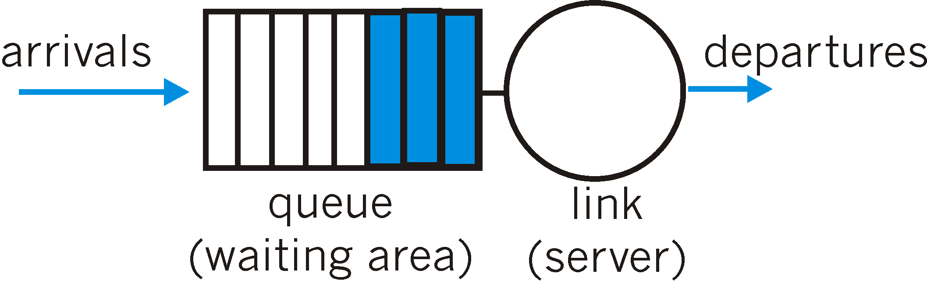
Packet Scheduling: FIFO
FIFO: in order of arrival to the queue
  if buffer full: a discard policy determines which packet to discard among the arrival and those already queued

Slide 7
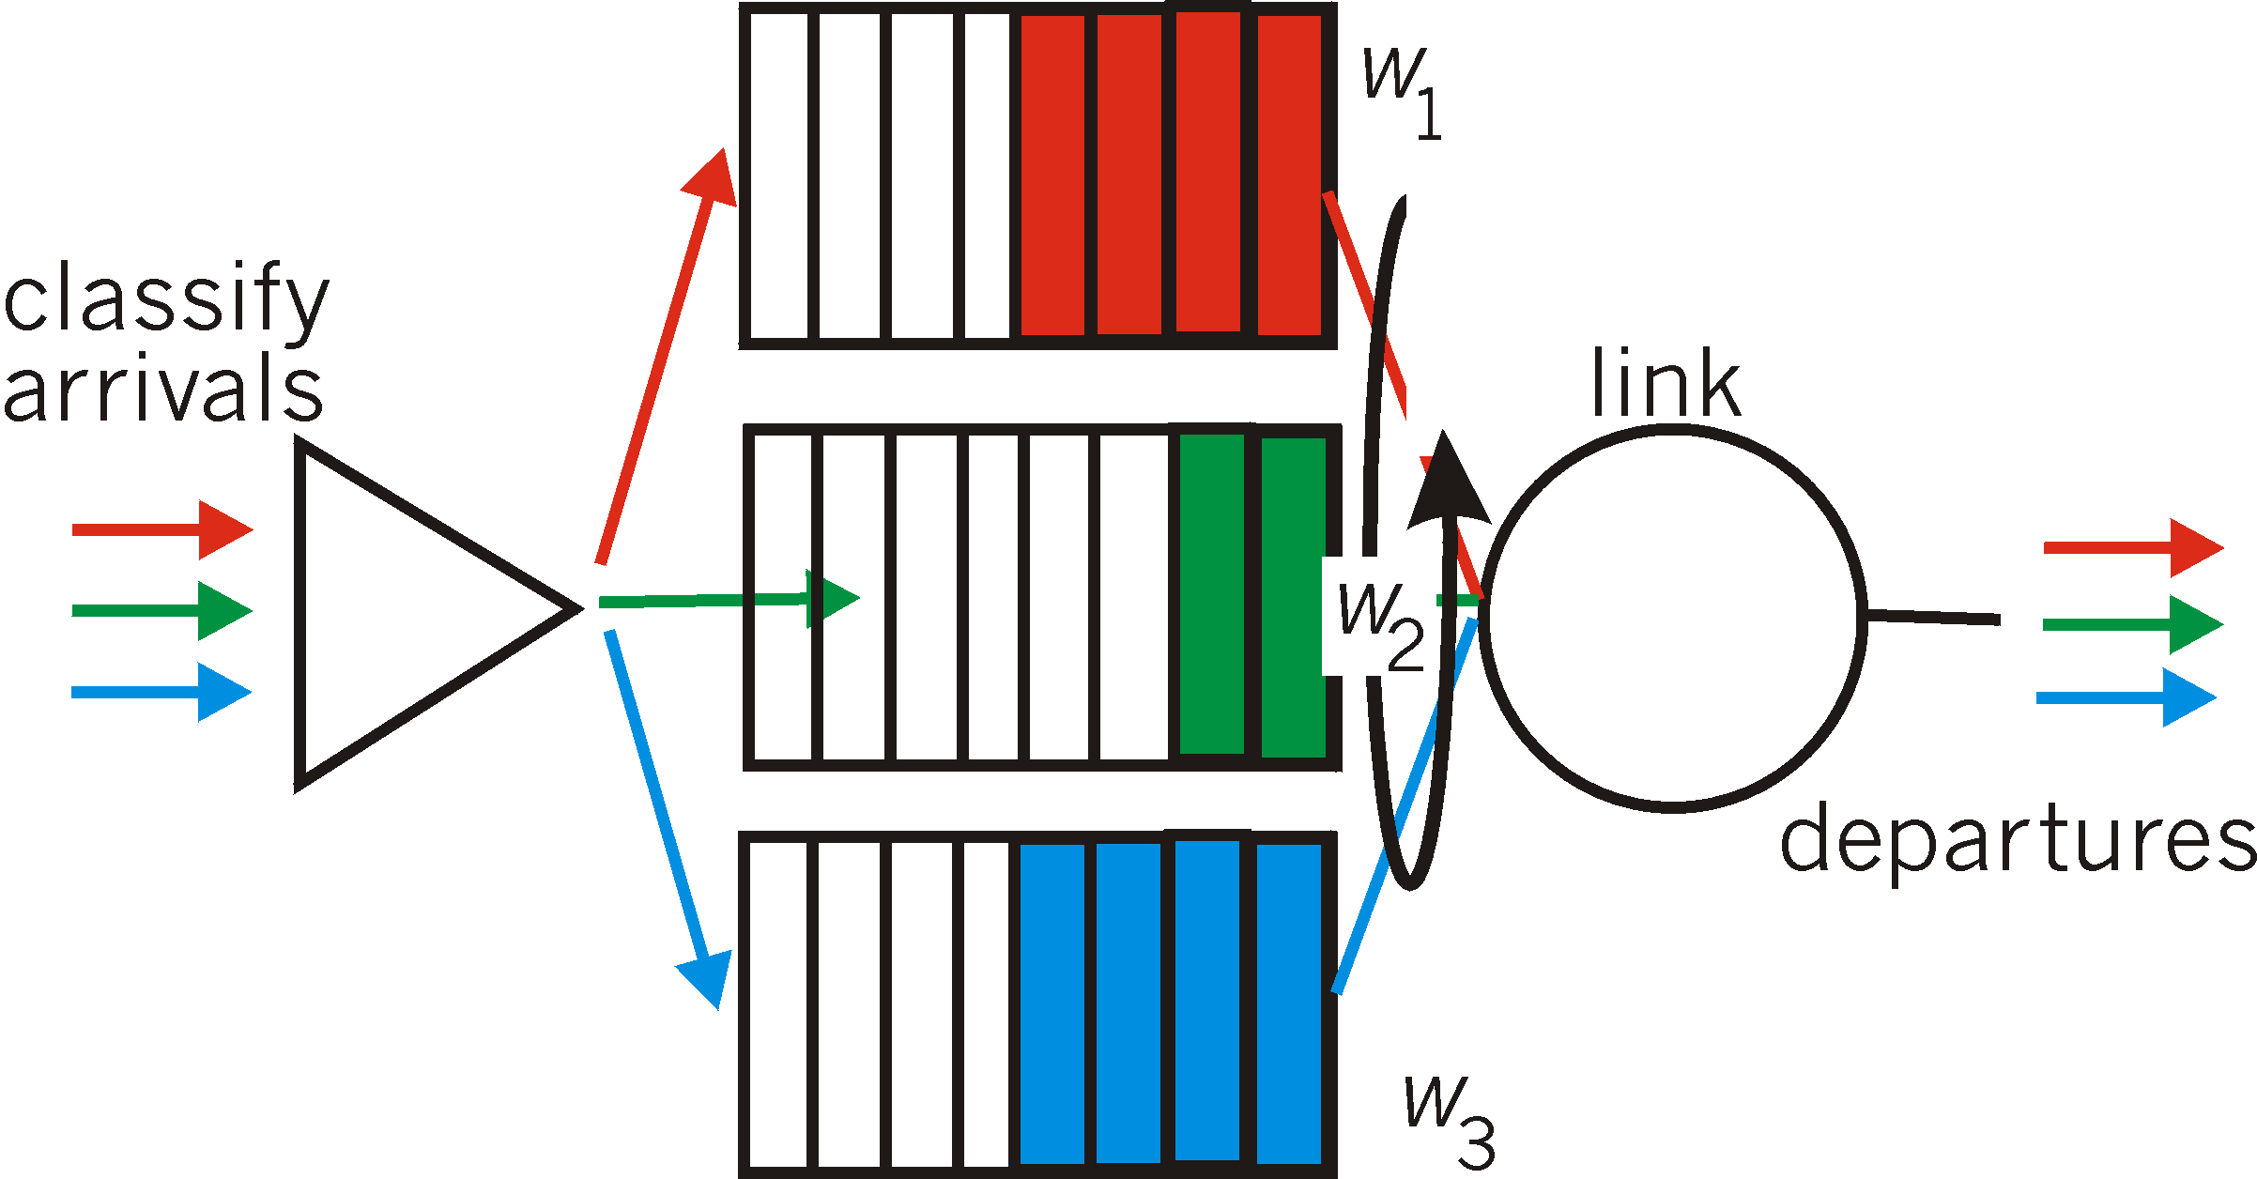
Packet Scheduling: Weighted Fair Queueing
Weighted Fair Queuing: generalized Round Robin, including priorities (weights)
  provide each class with a differentiated amount of service
  class i receives a fraction of service w_{i}/∑(w_{j})
There are a lot more decision options about packet scheduling: work-conserving policies, delays, …

Slide 8
Policing Mechanisms
Idea: shape the packet traffic :network provider does traffic policing, ie enforces the ”shape” agreed.
Traffic shaping, to limit transmission rates:
  (Long term) Average Rate (e.g.100 pkts/sec or 6000 packets per min)
  Peak Rate: e.g.1500 pkts/sec peak
  (Max.) Burst Size: Max. number of packets sent consecutively, ie over a very short period of time

Slide 9
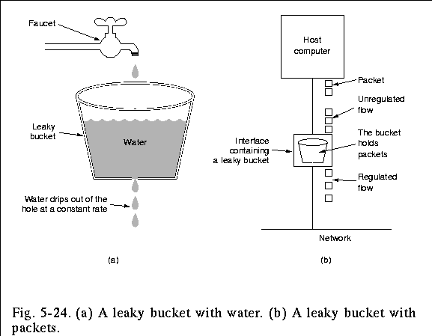
Policing Mechanisms: Pure Leaky Bucket
Idea: eliminates bursts completely; may cause unnecessary packet losses

Slide 10
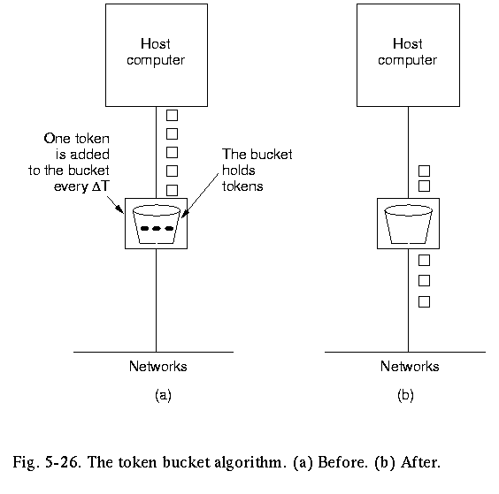
Policing Mechanisms:LeakyToken Bucket
Idea: packets sent by consuming tokens produced at constant rate r
  limit input to specified Burst Size (b= bucket capacity) and Average Rate (max admitted #packets over time period t is b+rt).
  to avoid still much burstiness, put a leaky bucket -with higher rate; after the token bucket)

Slide 11
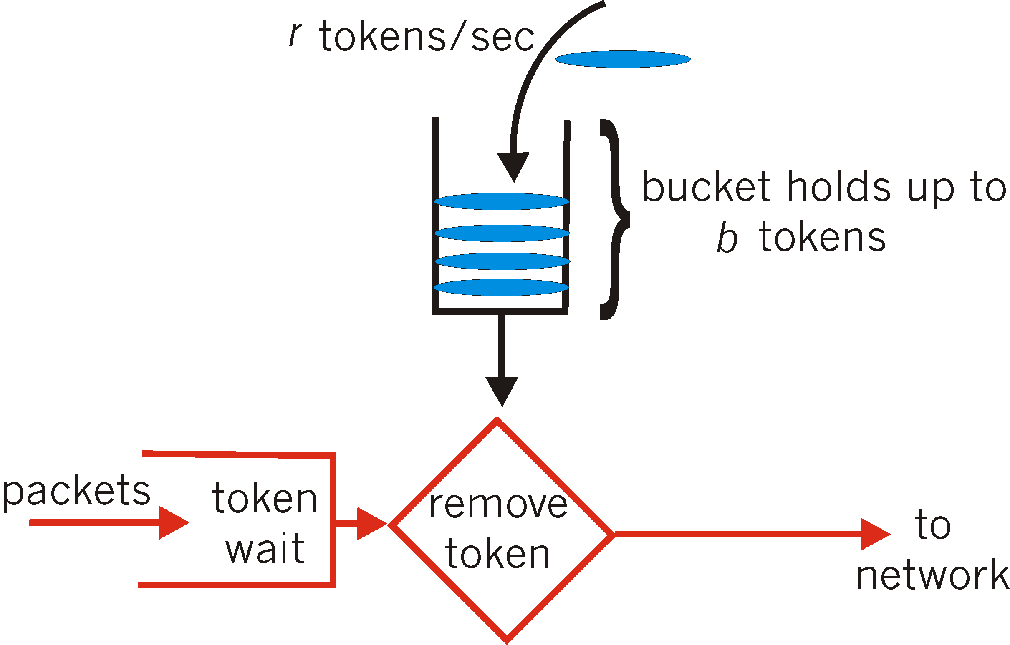
Policing Mechanisms: token bucket
Another way to illustrate token buckets:

Slide 12
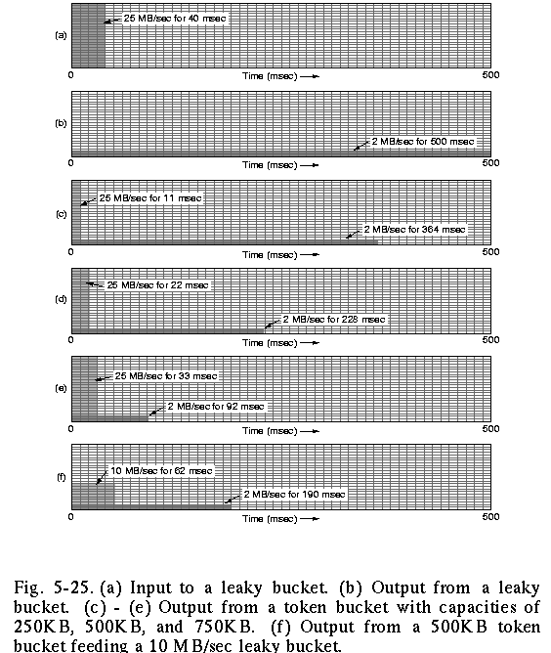
Policing: the effect of buckets
input
output pure leaky bucket, 2MBps
output token bucket 250KB, 2MBps
output token bucket 500KB, 2MBps
output token bucket 750KB, 2MBps
output token bucket 500KB, 2MBps, feeding 10MBps leaky bucket

Slide 13
Roadmap
NW support for multimedia / QoS: [Ch. 7.5 (7e 9.5) ]
Improving timing/QoS guarantees in Networks (also related with congestion-control): Packet scheduling and policing
A VC (ATM) approach [incl. Ch 3.62-3.6.3 (7e 3.7.2)]
Internet approaches
  Diff-serv, Int-serv + RSVP,
  Traffic Engineering MPLS [incl. ch 5.5. (7/e 6.5)]
SDN [cf separate notes @pingpong docs, 7e ch 4.4, 5.5)]
Internet-of-Things in evolution: more types of traffic/devices… [optional study, just browse example protocols mentioned]

Slide 14
Virtual Circuit example:
ATM: Asynchronous Transfer Mode nets
Internet ‘s IP:
today’s de facto standard for global data networking
1980’s:
telco’s develop ATM specifications: competing network standard for carrying high-speed voice/data
ATM principles:
virtual-circuit networks: switches maintain state for each “call”
small (48 byte payload, 5 byte header) fixed length cells (like packets)
  fast switching
  small size good for voice
well-defined interface between “network” and “user” (think of classic telecom)

Slide 15
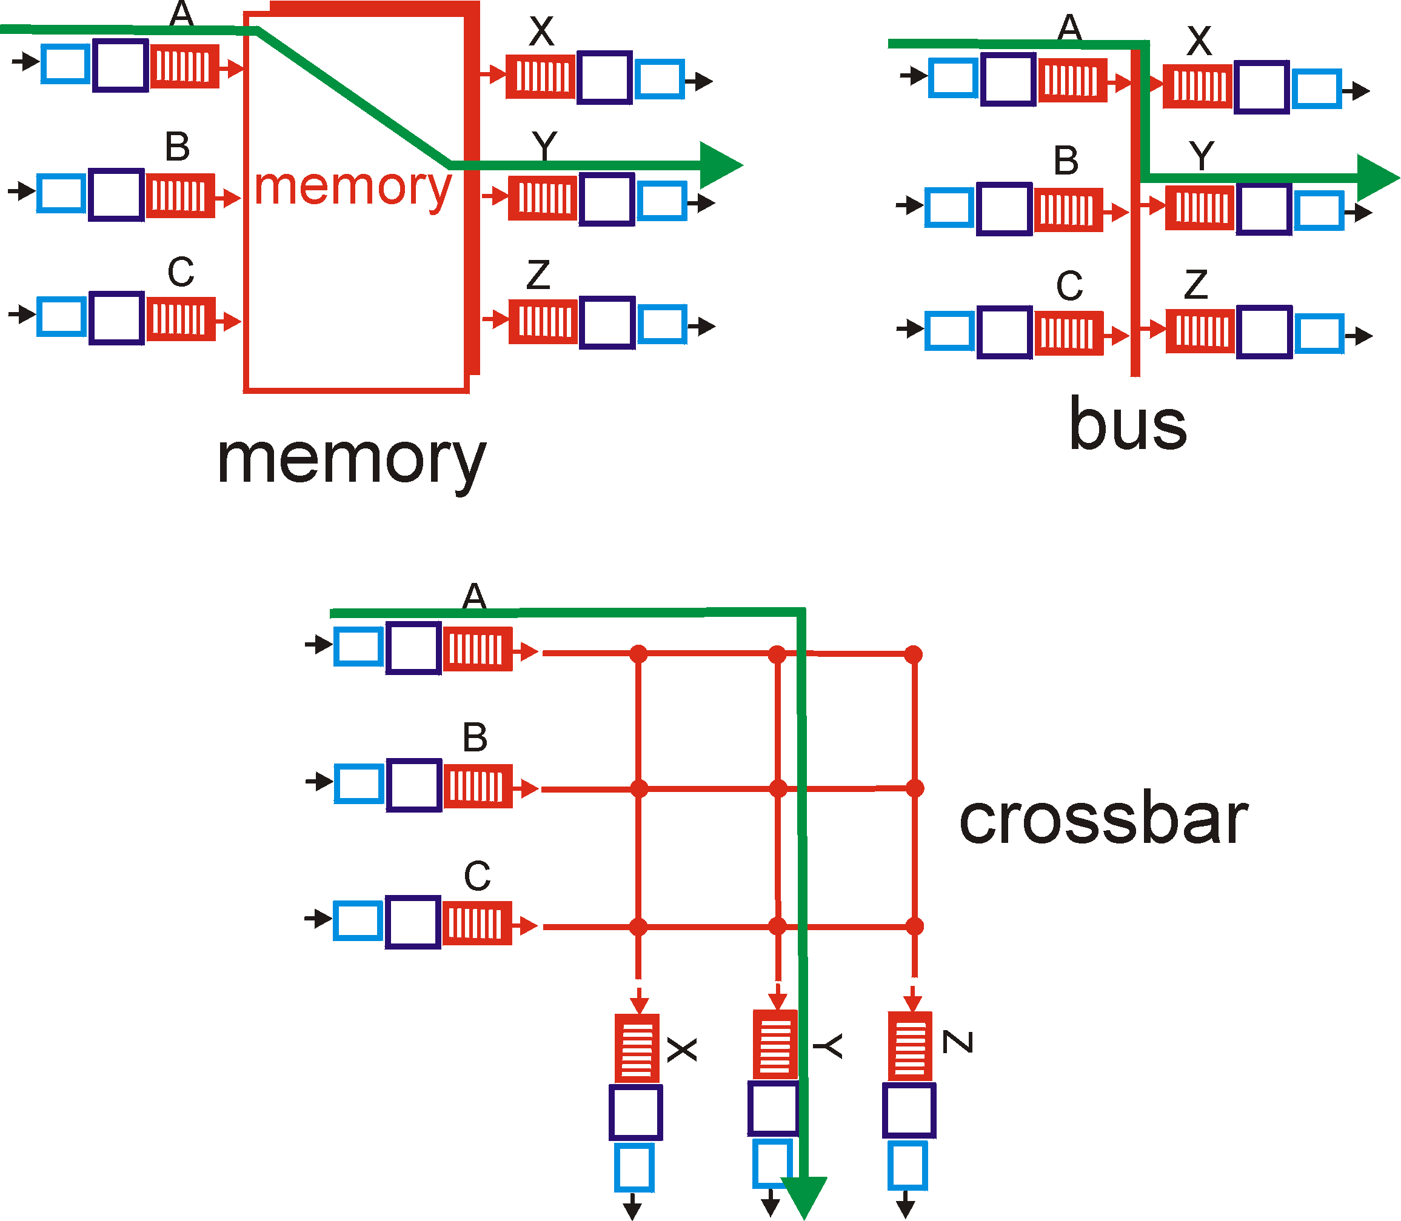
Recall: switching fabrics
ATM switches: VC technology
  support for virtual channels, virtual circuits (based on Banyan crossbar switches)
ATM routing: as train travelling for routers (hence no state for each ”stream/passenger”, but for each ”train” = virtual path)

Slide 16
Example VC technology
ATM Network service models:
Service
Model
Constant Bit Rate
VariableBR
(RT/nRT)
Available BR
UndefinedBR
Guarantees ?
Example
voice
Video/
“streaming”
www-browsing
Background file transfer
Congestion
control
Admission
control
Admission
control
Yes, feedback
discard pkts
Bandwidth
constant
rate
guaranteed
rate
guaranteed
minimum
none
Loss
yes
yes
no
no
Order
yes
yes
yes
yes
Timing
yes
yes
no
no
With ABR you can get min guaranteed capacity and better, if possible; with UBR you can get better, but you may be thrown out in the middle ☹

Slide 17
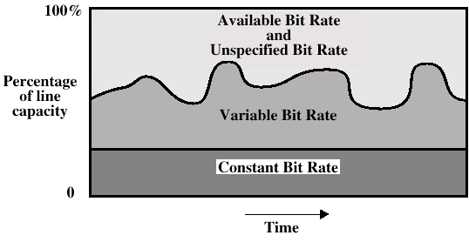
ATM Bit Rate Services

Slide 18
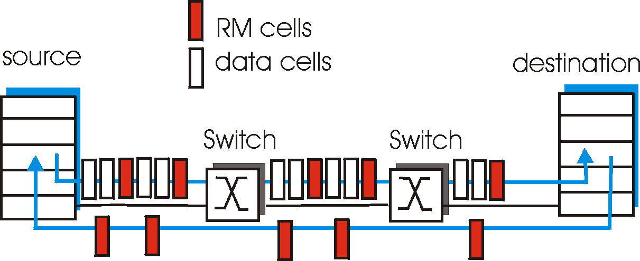
ATM (VC) Congestion Control
Several different strategies:
Admission control and resource reservation (CBR and VBR traffic:
  reserve resources when opening a VC; traffic shaping and policing (use bucket-like methods)
Rate-based congestion control: (ABR traffic)
  idea = feedback to the sender and intermediate stations on the available (= max. acceptable) rate on the VC.
  similar to ”choke packets” (option provided in ICMP, which is not used in implementations…)

Slide 19
Roadmap
NW support for multimedia / QoS: [Ch. 7.5 (7e 9.5) ]
Improving timing/QoS guarantees in Networks (also related with congestion-control): Packet scheduling and policing
A VC (ATM) approach [incl. Ch 3.62-3.6.3 (7e 3.7.2)]
Internet approaches
  Diff-serv, Int-serv + RSVP,
  Traffic Engineering MPLS [incl. ch 5.5. (7/e 6.5)]
SDN [cf separate notes @pingpong docs, 7e ch 4.4, 5.5)]
Internet-of-Things in evolution: more types of traffic/devices… [optional study, just browse example protocols mentioned]

Slide 20
Internet bandwidth guarantee support possibilities?
Diffserv approach:
provide functional components to build service classes
  Network core: stateless, simple
  Combine flows into aggregated flows
  Classification, shaping, admission at the network edge

Slide 21

Diffserv Architecture
Edge router:
per-flow traffic management
marks packets as in-profile and out-profile
marking
r
scheduling
.
b
.
.
Core router:
per class traffic management
buffering and scheduling based on marking at edge
preference given to in-profile packets

Slide 22
Edge-router Packet Marking
Rate A
B
User packets
-Class-based marking: packets of different classes marked differently
  Profile within class: pre-negotiated rate A, bucket size B
- Packet is marked in the Type of Service (TOS) in IPv4, and Traffic Class in IPv6

Slide 23
DiffServ Core Functions
Forwarding: according to “Per-Hop-Behavior” (PHB) specified for the particular packet class; PHB is strictly based on classification marking
  PHB does not specify what mechanisms to use to ensure required PHB performance behavior
  Examples:
    Class A gets x% of outgoing link bandwidth over time intervals of a specified length
    Class A packets leave before packets from class B
Advantage:
No state info to be maintained by routers

Slide 24



Another approach:
Intserv: QoS guarantee scenario
Resource reservation per individual application session (admission control, continuous)
call setup, signaling (RSVP)
  Maintains state a la VC (but soft state, ie times out)
    responsibility at the client to renew reservations
request/
reply
  Requires QoS-sensitive scheduling (e.g., WFQ)

Slide 25
Roadmap
NW support for multimedia / QoS: [Ch. 7.5 (7e 9.5) ]
Improving timing/QoS guarantees in Networks (also related with congestion-control): Packet scheduling and policing
A VC (ATM) approach [incl. Ch 3.62-3.6.3 (7e 3.7.2)]
Internet approaches
  Diff-serv, Int-serv + RSVP,
  Traffic Engineering MPLS [incl. ch 5.5. (7/e 6.5)]
SDN [cf separate notes @pingpong docs, 7e ch 4.4, 5.5)]
Internet-of-Things in evolution: more types of traffic/devices… [optional study, just browse example protocols mentioned]

Slide 26
Recall: the Internet concept: virtualizing networks
1974: multiple unconnected nets
  ARPAnet
  data-over-cable networks
  packet satellite network (Aloha)
  packet radio network
… differing in:
  addressing conventions
  packet formats
  error recovery
  routing
ARPAnet
satellite net
"A Protocol for Packet Network Intercommunication", V. Cerf, R. Kahn, IEEE Transactions on Communications, May, 1974, pp. 637-648.

Slide 27
The Internet: virtualizing networks
Internetwork layer (IP):
addressing: internetwork appears as single, uniform entity, despite underlying local network heterogeneity
network of networks
Gateway:
“embed internetwork packets in local packet format”
route (at internetwork level) to next gateway
gateway
ARPAnet
satellite net

Slide 28
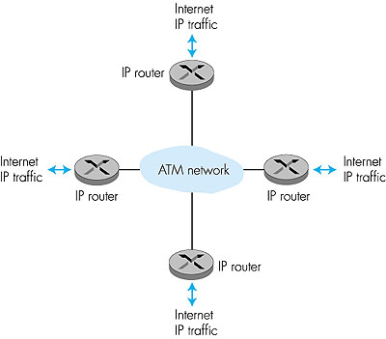
What happened?
ATM: network or link layer?
Vision: end-to-end transport: “ATM from desktop to desktop”
  ATM is a network technology
Reality: used to connect IP backbone routers
  “IP over ATM”
  ATM as switched link layer, connecting IP routers

Slide 29
e.g. IP-Over-ATM
“Classic” IP over eg Ethernet
3 “networks” (e.g., LAN segments)
MAC and IP addresses
IP over ATM
replace “network” (e.g., LAN segment) with ATM network, (ATM + IP addresses)
Run datagram routing on top of virtual-circuit routing ….
ATM
network
Ethernet
LANs
Ethernet
LANs

Slide 30
Cerf & Kahn’s Internetwork Architecture
What is virtualized?
two layers of addressing: internetwork and local network
new layer (IP) makes everything homogeneous at internetwork layer
underlying local network technology
  Cable, satellite, 56K telephone modem
  Ethernet, other LAN
  ATM
  NEWER: MPLS (Multiprotocol Label Switching Protocol): for traffic engineering
… “invisible” at internetwork layer. Looks like a link layer technology to IP

Slide 31

Traffic engineering:
difficulties with traditional Internet routing
5
3
v
w
5
2
u
2
1
z
3
1
2
x
y
1
Q: what if network operator wants to split u-to-z traffic along uvwz and uxyz (load balancing)?
A: can’t do it (or need a new routing algorithm)
Notes:
Note: implicit assumption here: destination based forwarding

Slide 32

Traffic engineering:
difficulties with traditional Internet routing
5
v
3
w
2
v
w
5
u
2
1
z
3
z
1
2
x
y
x
1
y
Q: what if w wants to route blue and red traffic differently?
A: can’t do it (with destination based forwarding, and LS, DV routing)
Notes:
Note: implicit assumption here: destination based forwarding

Slide 33
Multiprotocol label switching (MPLS) in IP networks: VC-inspired
goal: speed up IP forwarding by using fixed length label (instead of IP address) to do forwarding; utilize multiple S-T paths simultanaoulsy
  borrow ideas from Virtual Circuit (VC) approach but IP datagram still keeps IP address
label-switched router
  forwards packets to outgoing interface based only on label value (don’t inspect IP address)
  MPLS protocol’s forwarding table distinct from IP forwarding tables
PPP or Ethernet
header
IP header
remainder of link-layer frame
MPLS header
MPLS router must co-exist
with IP-only routers
label
Exp
S
TTL
20
3
1
5

Slide 34
MPLS versus IP paths
entry router (R4) can use different MPLS routes to A based, e.g., on source address
(needs MPLS-capable routers)
R6
D
R4
R3
R5
A
R2
IP routing: path to destination determined by destination address alone
IP-only
router
MPLS routing: path to destination can be based on source and dest. address
  fast reroute: precompute backup routes in case of link failure or congestion (eg for CDN distribution)
MPLS and
IP router

Slide 35
MPLS forwarding tables
Flexibilty allows Traffic Engineering (adapting Routing to suit different purposes; relates to Software-defined Networks)
in out out
label label dest interface
10 A 0
in out out
label label dest interface
12 D 0
8 A 1
10 6 A 1
12 9 D 0
R6
0
0
D
1
1
R4
R3
R5
0
0
A
R2
in out out
label label dest interface
R1
in out out
label label dest interface
6 - A 0
8 6 A 0

Slide 36
Roadmap
NW support for multimedia / QoS: [Ch. 7.5 (7e 9.5) ]
Improving timing/QoS guarantees in Networks (also related with congestion-control): Packet scheduling and policing
A VC (ATM) approach [incl. Ch 3.62-3.6.3 (7e 3.7.2)]
Internet approaches
  Diff-serv, Int-serv + RSVP,
  Traffic Engineering MPLS [incl. ch 5.5. (7/e 6.5)]
SDN [cf separate notes @pingpong docs, 7e ch 4.4, 5.5)]
Internet-of-Things in evolution: more types of traffic/devices… [optional study, just browse example protocols mentioned]

Slide 37
Recall: Traditional Internet,
per-router control plane
Individual routing algorithm components in each and every router interact with each other in control plane to compute forwarding tables
Routing
Algorithm
control
plane
data
plane

Slide 38
Recall: logically separated control plane
A distinct (typically remote) controller interacts with local control agents (CAs) in routers to compute forwarding tables
compute tables seperately
and distribute
Remote Controller
control
plane
data
plane
CA
CA
CA
CA
CA

Slide 39
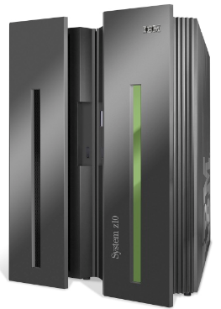

Analogy: mainframe to PC evolution*
App
App
App
App
App
App
App
App
App
App
App
Specialized
Applications
Open Interface
Specialized
Operating
System
Windows
(OS)
Linux
Mac
OS
or
or
Specialized
Hardware
Open Interface
Microprocessor
Vertically integrated
Closed, proprietary
Slow innovation
Small industry
Horizontal
Open interfaces
Rapid innovation
Huge industry
* Slide courtesy: N. McKeown

Slide 40
Software defined networking (SDN)
4. programmable control applications
…
3. control plane functions external to data-plane switches
routing
access control
load
balance
Remote Controller
control
plane
data
plane
CA
2. control, data plane separation
CA
CA
CA
CA
1: generalized“ flow-based” forwarding (e.g., OpenFlow)

Slide 41
SDN perspective: data plane switches
Data plane switches
fast, simple implementing generalized data-plane forwarding in hardware
switch flow table computed by controller
API for table-based switch control (e.g., OpenFlow)
protocol for communicating with controller (e.g., OpenFlow)
network-control applications
…
routing
access
control
load
balance
control
plane
northbound API
SDN Controller
(network operating system)
southbound API
data
plane
SDN-controlled switches

Slide 42
SDN perspective: SDN controller
SDN controller (network OS):
maintain network state information
interacts with network control applications “above” via northbound API
interacts with network switches “below” via southbound API
implemented as distributed system for performance, scalability, fault-tolerance, robustness
network-control applications
…
routing
access
control
load
balance
control
plane
northbound API
SDN Controller
(network operating system)
southbound API
data
plane
SDN-controlled switches

Slide 43
SDN perspective: control applications
network-control apps:
“brains” of control: implement control functions using lower-level services, API provided by SDN controller
unbundled: can be provided by 3rd party: distinct from routing vendor, or SDN controller
network-control applications
…
routing
access
control
load
balance
control
plane
northbound API
SDN Controller
(network operating system)
southbound API
data
plane
SDN-controlled switches

Slide 44
Components of SDN controller
routing
access
control
load
balance
Interface layer to network control apps: abstractions API
Interface, abstractions for network control apps
…
network graph
RESTful
API
intent
Network-wide state management layer: state of networks links, switches, services: a distributed database
…
statistics
flow tables
SDN
controller
Network-wide distributed, robust state management
…
Link-state info
host info
switch info
…
communication layer: communicate between SDN controller and controlled switches
OpenFlow
SNMP
Communication to/from controlled devices

Slide 45
Roadmap
NW support for multimedia / QoS: [Ch. 7.5 (7e 9.5) ]
Improving timing/QoS guarantees in Networks (also related with congestion-control): Packet scheduling and policing
A VC (ATM) approach [incl. Ch 3.62-3.6.3 (7e 3.7.2)]
Internet approaches
  Diff-serv, Int-serv + RSVP,
  Traffic Engineering MPLS [incl. ch 5.5. (7/e 6.5)]
SDN [cf separate notes @pingpong docs, 7e ch 4.4, 5.5)]
Internet-of-Things in evolution: more types of traffic/devices… [optional study, just browse example protocols mentioned]

Slide 46
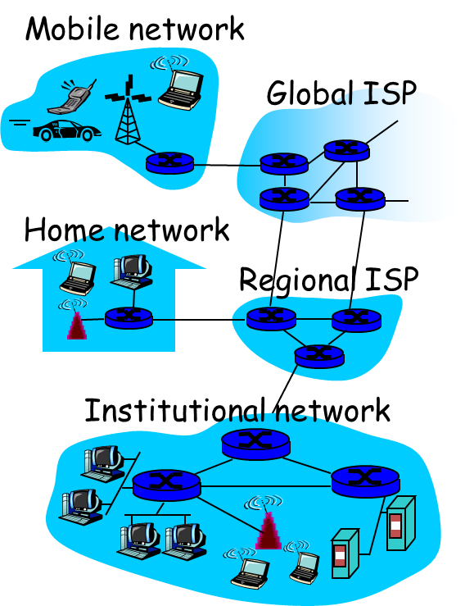
Recall: Internet & its context….
Multimedia
approx 10 yrs ago
continuous evolution ….

Slide 47
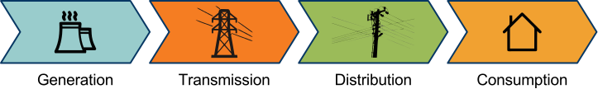



Example:
Data networking technologies in Smart Grids
“Here be SCADA”
 | SONET - Synchronous Optical Network WDM - Wavelength Division Multiplexing Satellite/VSAT IP Radio | Twisted pair / Fiber optics BPL - Broadband over Power Lines WiMax - Worldwide Interoperability for Microwave Access GPRS
 | Ethernet rules~ | Ethernet rules! (IEC 61850) | Ethernet rules? Hint: not always
?
Communication
technologies
Communication
protocols
?
Slides: Giorgos Georgiadis

Slide 48
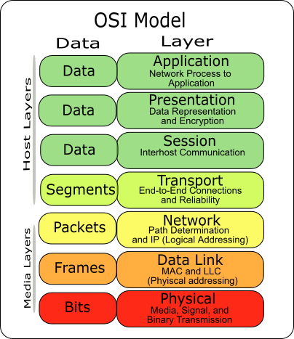




Approximate overview of shaping new stacks
Protocols @ Distribution’s last mile
OpenADR REST-based (i.e. CoAP) |  | ZigBee | 6LoW PAN | HomePlug
XMPP BACNet LonWorks Modbus | WiFi
Proprietary | Ethernet / Gigabit Ethernet | IEEE 802.15.4 |  | Proprietary, part 2: HomePlug
Slides: Giorgos Georgiadis
(see extra slides for more refs&notes)

Slide 49
Summary & Study list
NW support for multimedia / QoS: [Ch. 7.5 (7e 9.5) ]
Improving timing/QoS guarantees in Networks (also related with congestion-control): Packet scheduling and policing
A VC (ATM) approach [incl. Ch 3.62-3.6.3 (7e 3.7.2)]
Internet approaches
  Diff-serv, Int-serv + RSVP,
  Traffic Engineering MPLS [incl. ch 5.5. (7/e 6.5)]
SDN [cf separate notes @pingpong docs, 7e ch 4.4, 5.5)]
Internet-of-Things in evolution: more types of traffic/devices… [optional study, just browse example protocols mentioned]
Internet core and transport protocols do not provide guarantees for multimedia streaming traffic
Applications take matters into own hands
  interesting evolving methods
Another type of service at the core (VC-like) would imply a different situation
  Internet core is re-shaping (Traffic engineering, SDN, Intserv & Diffserv
Internet-of-Things in evolution
  even more types of traffic…

Slide 50
Extra slides/notes for further study

Slide 51
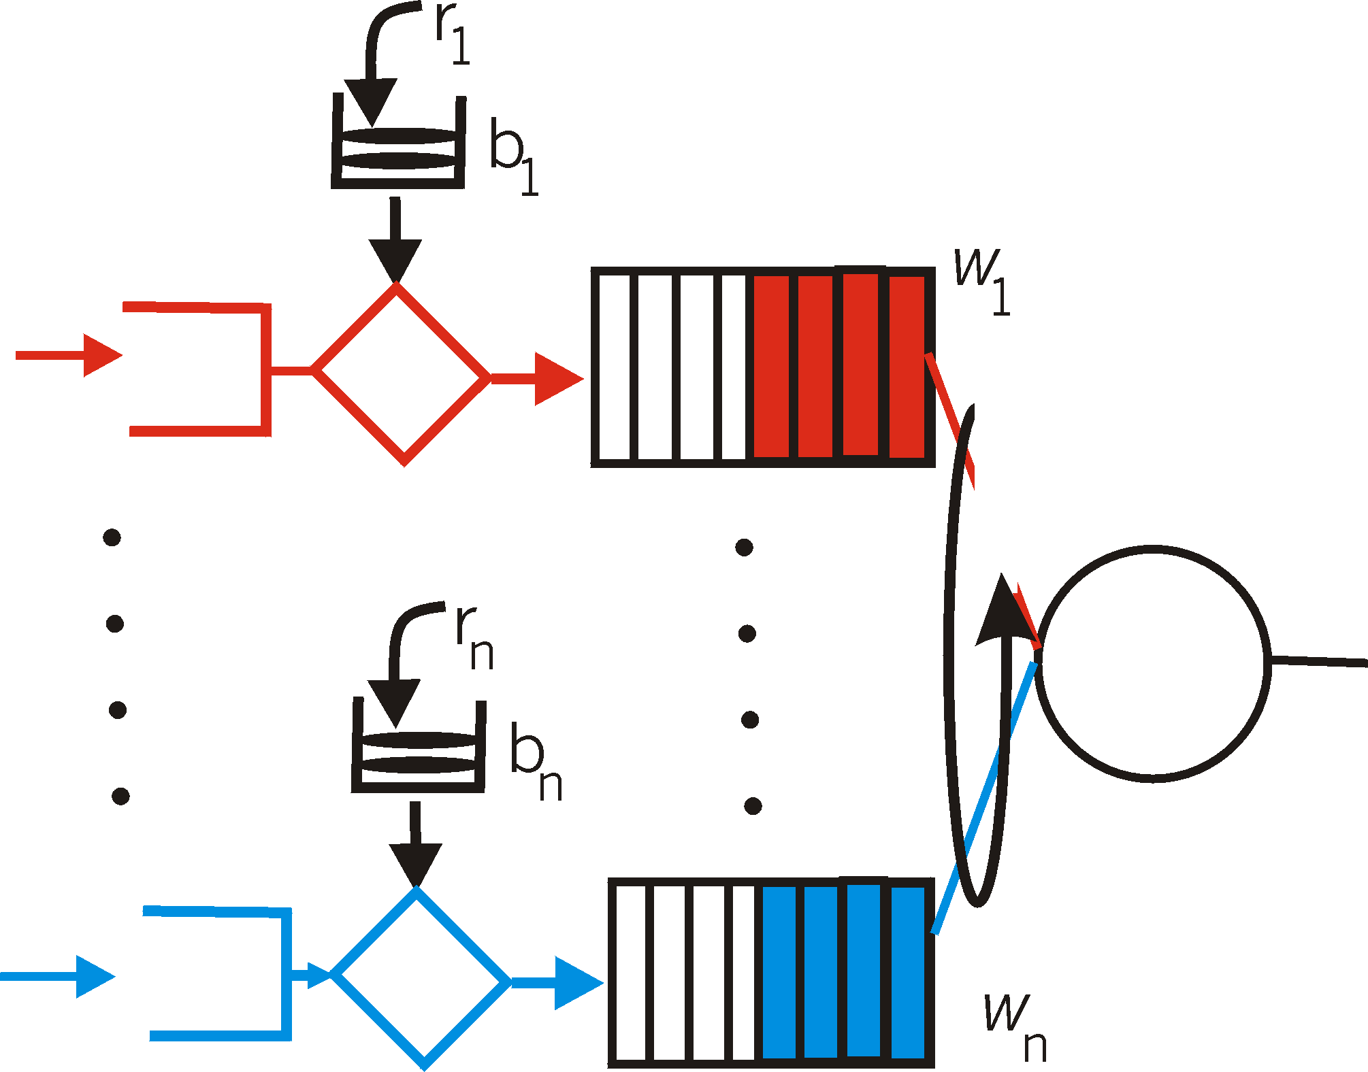
Token bucket + WFQ…
…can be combined to provide upper bound on packet delay in queue:
b_{i} packets in queue, packets are serviced at a rate of at least R · w_{i}/∑ (wj) packets per second, then the time until the last packet is transmitted is at most
b_{i} /(R · w_{i}/∑ (wj))

Slide 52

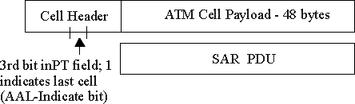
ATM cell (small packet)
48-byte payload
  Why?: small payload -> short cell-creation delay for digitized voice
  halfway between 32 and 64 (compromise!)
Header: 5bytes
  VCI: virtual channel ID
  PT: Payload type (e.g. Resource Management cell versus data cell)
  CLP: Cell Loss Priority bit
    CLP = 1 implies low priority cell, can be discarded if congestion
  HEC: Header Error Checksum
Cell header
Cell format

Slide 53
ATM ABR congestion control
ABR: available bit rate:
“elastic service”
if path “underloaded”:
  sender should use available bandwidth
if path congested:
  sender throttled to minimum guaranteed rate
RM (resource management) cells:
interspersed with data cells
bits in RM cell set by switches (“network-assisted”)
  NI bit: no increase in rate (mild congestion)
  CI bit: congestion indication two-byte ER (explicit rate) field in RM cell
  congested switch may lower ER value in cell
  sender’ send rate thus minimum supportable rate on path

Slide 54
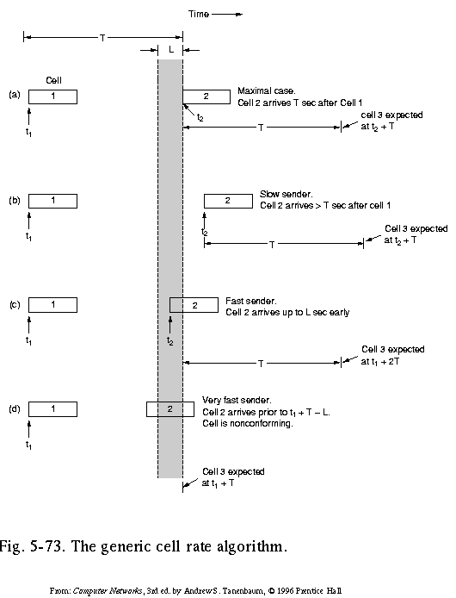
Traffic Shaping and Policing in ATM
Enforce the QoS parameters: check if Peak Cell Rate (PCR) and Cell Delay Variation (CDVT) are within the negotiated limits:
Generic Cell Rate Algo: introduce:
expected next time for a successive cell, based on T = 1/PCR
border time L ( = CDVT) < T in which next transmission may start (but never before T-L)
A nonconforming cell may be discarded, or its Cell Loss Priority bit be set, so it may be discarded in case of congestion

Slide 55
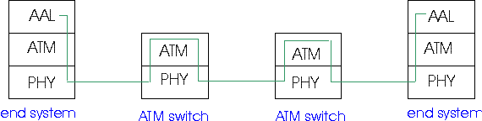
ATM Adaptation (Transport) Layer: AAL
Basic idea: cell-based VCs need to be ”complemented ”to be supportive for applications.
Several ATM Adaptation Layer (AALx) protocols defined, suitable for different classes of applications
  AAL1: for CBR (Constant Bit Rate) services, e.g. circuit emulation
  AAL2: for VBR (Variable Bit Rate) services, e.g., MPEG video
  .....
”suitability” has not been very successful
computer science community introduced AAL5, (simple, elementary protocol), to make the whole ATM stack usable as switching technology for data communication under IP!

Slide 56
IP-Over-ATM
app
transport
IP
AAL
ATM
phy
app
transport
IP
Eth
phy
IP
AAL
ATM
phy
Eth
ATM
phy
phy
ATM
phy
felaktig dribbling
AAL: ATM adaptation layer intended for transport layer functionality (with AAL1-4 services: cons/var/avail/undefined bit-rate traffic) but implementations did not allow such use; AAL5 made for use under IP….

Slide 57
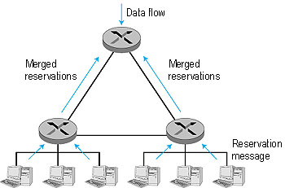
RSVP: resource reservation protocol
RSVP: a leading candidate for signaling protocol
  allows reservations for bandwidth in multicast trees
  is receiver-oriented (the receiver of a
    data flow initiates and maintains the
    resource reservation for the flow).
  Maintains soft-state
    receivers renew interest regularly
  does not specify how the network
    provides the reserved bandwidth, only
    allows the applications to reserve it.
  is not a routing protocol; it depends on
    an underlying routing protocol to
    determine the routes for the flows; when a route changes,
    RSVP re-reserves resources.
  does not define the admission test, but it assumes that the routers perform such a test and that RSVP can interact with the test.

Slide 58
MPLS capable routers
a.k.a. label-switched router
forward packets to outgoing interface based only on label value (don’t inspect IP address)
  MPLS forwarding table distinct from IP forwarding tables
flexibility: MPLS forwarding decisions can differ from those of IP
  use destination and source addresses to route flows to same destination differently (traffic engineering)
  re-route flows quickly if link fails: pre-computed backup paths (useful for VoIP)

Slide 59
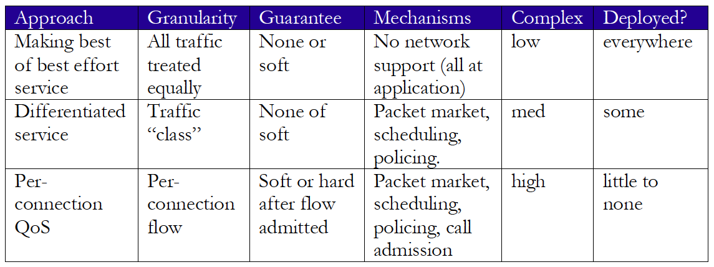
Network support for multimedia

Slide 60
Software defined networking (SDN)
Internet network layer: historically has been implemented via distributed, per-router approach
  monolithic router contains switching hardware, runs proprietary implementation of Internet standard protocols (IP, RIP, IS-IS, OSPF, BGP) in proprietary router OS (e.g., Cisco IOS)
  different “middleboxes” for different network layer functions: firewalls, load balancers, NAT boxes, ..
~2005: renewed interest in rethinking network control plane

Slide 61
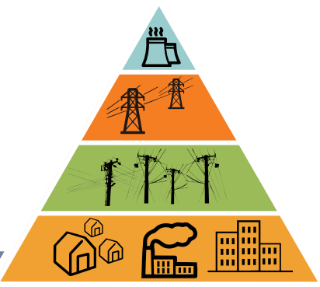
Data networking technologies in Smart Grids
Presentation by
Giorgos Georgiadis
(former CTH / curr. Bosch R&D)

Slide 62
Recall: Internet & its context….
Multimedia
approx 10 yrs ago
continuous evolution ….

Slide 63
Introduction
1
“Here be SCADA”
 | SONET - Synchronous Optical Network WDM - Wavelength Division Multiplexing Satellite/VSAT IP Radio | Twisted pair / Fiber optics BPL - Broadband over Power Lines WiMax - Worldwide Interoperability for Microwave Access GPRS
 | Ethernet rules~ | Ethernet rules! (IEC 61850) | Ethernet rules? Hint: not always
?
Communication
technologies
Communication
protocols
?
Fig. Giorgos Georgiadis

Slide 64
Approximate overview of shaping new stacks
Protocols @ Distribution’s last mile
OpenADR REST-based (i.e. CoAP) |  | ZigBee | 6LoW PAN | HomePlug
XMPP BACNet LonWorks Modbus | WiFi
Proprietary | Ethernet / Gigabit Ethernet | IEEE 802.15.4 |  | Proprietary, part 2: HomePlug

Slide 65
PHY/DataLink protocols
3
Ethernet
  Not much to say
HomePlug
  Honorable mention: popular home automation protocol
  Powerline based
  Speed: ~200mbps
  Otherwise, vanilla protocol:
    i.e. using TDMA,
    Two kinds of nodes,
    …
OpenADR REST-based (i.e. CoAP) |  | ZigBee | 6LowPAN | HomePlug
XMPP BACNet LonWorks Modbus | WiFi
Proprietary | Ethernet / Gigabit Ethernet | IEEE 802.15.4 |  | Proprietary, part 2: HomePlug

Slide 66
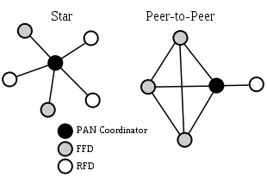
PHY/DataLink protocols
4
IEEE 802.15.4
  Radio based, usually 2.4GHz
  Small packets (<=127bytes)
  Medium speed (~250kbps)
  Originally DSSS
  Topologies supported:
    Star
    Peer-to-peer
  Roles supported:
    Full-function device
    Reduced-function device
OpenADR REST-based (i.e. CoAP) |  | ZigBee | 6LowPAN | HomePlug
XMPP BACNet LonWorks Modbus | WiFi
Proprietary | Ethernet / Gigabit Ethernet | IEEE 802.15.4 |  | Proprietary, part 2: HomePlug

Slide 67
Higher protocols
5
6LoWPAN
  “IPv6 over LoW Power wireless Area Networks”
  Builds on 802.15.4, IPv6
  Aimed at low power devices (sensors, controllers)
  Topologies
    Star, peer-to-peer + Mesh
  Many Challenges:
    IP packets >=1280bytes (!)
    128bit IP addresses
    …
OpenADR REST-based (i.e. CoAP) |  | ZigBee | 6LoWPAN | HomePlug
XMPP BACNet LonWorks Modbus | WiFi
Proprietary | Ethernet / Gigabit Ethernet | IEEE 802.15.4 |  | Proprietary, part 2: HomePlug

Slide 68
Higher protocols
6
ZigBee
  Builds on 802.15.4, but not IP
  Aimed at low power devices too (sensors, controllers)
    Speed 250kbps
    Packet 127bytes
    Battery powered devices (supports sleep)
  Topologies supported
    Mesh (jump to: example)
  Roles supported
    Coordinator, router, end node
  Different profiles exist:
    ZigBee Home Automation
    Zigbee Smart Energy
    Zigbee IP, ...
OpenADR REST-based (i.e. CoAP) |  | ZigBee | 6LoWPAN | HomePlug
XMPP BACNet LonWorks Modbus | WiFi
Proprietary | Ethernet / Gigabit Ethernet | IEEE 802.15.4 |  | Proprietary, part 2: HomePlug

Slide 69
Higher protocols
8
More protocols, same story:
  XMPP, BACNet, LonWorks, Modbus, …
  Wired
  Proprietary, build around specific companies (BACNet, LonWorks) or legacy protocols (Modbus)
  Today gateway devices to “break out” to Ethernet are in use
  Simple topologies (i.e bus), same roles as before
But what is the connecting thread over all?
  Open standards!
  Internet! (of Things?)
OpenADR REST-based (i.e. CoAP) |  | ZigBee | 6LoWPAN | HomePlug
XMPP BACNet LonWorks Modbus | WiFi
Proprietary | Ethernet / Gigabit Ethernet | IEEE 802.15.4 |  | Proprietary, part 2: HomePlug

Slide 70
Towards interoperability
9
OpenADR
  ADR: Advanced Metering Response
  Trying to ‘unify’ different solutions in a high level protocol
  Formalizing:
    Roles
    Messages
    Device detection
  Simple topologies (i.e bus), same roles as before
REST-based APIs
  I.e. Costrained Application Protocol
  Ultimately, HTTP-based
  Verb oriented: GET, PUT, DELETE, …
OpenADR REST-based (i.e. CoAP) |  | ZigBee | 6LoWPAN | HomePlug
XMPP BACNet LonWorks Modbus | WiFi
Proprietary | Ethernet / Gigabit Ethernet | IEEE 802.15.4 |  | Proprietary, part 2: HomePlug

Slide 71
Towards interoperability
10
Ethernet/IP-based integration
  Remember:
    Radio band: 2.4GHz (WiFI, ZigBee, 6LoWPAN)
    Similar topologies, roles
    Made for low energy devices, but flops/watt/kr increase!
    Ethernet gateways commonly used
  Solution: make them (formally) interoperable
    ZigBee Smart Energy v2.0
    ZigBee, WiFi, HomePlug on board
    6LoWPAN coming soon
OpenADR REST-based (i.e. CoAP) |  | ZigBee | 6LoWPAN | HomePlug
XMPP BACNet LonWorks Modbus | WiFi
Proprietary | Ethernet / Gigabit Ethernet | IEEE 802.15.4 |  | Proprietary, part 2: HomePlug

Slide 72
Conclusion
11
Ethernet + misc communication technologies
Ethernet vs non-ethernet
  Why?
    Design for low energy devices (smaller packets, lower comm speed)
    Peer to peer, mesh topologies
  Now + Future?
    Devices’ specs catching up
    Importance of being connected (to the Internet?)
    Topologies still important (i.e. reliability)
    Will probably remain radio-based

