Slide 1
Course on Computer Communication and Networks
Lecture 6
Network Layer – part 1: Data Plane
Chapter 4 (7/e)
(6/e Ch4-first part)
EDA344/DIT 423, CTH/GU

Slide 2
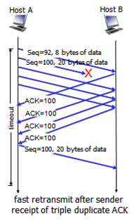
From last week’s review questions
Q: Can an application have reliable data transfer over UDP? If yes how? If no, why?
Student correct A: Yes, if the application layer itself takes care of all the extra functions needed to add reliability on top of UDP’s service
Q: How can an ACK have the same number in the same TCP session?
Student correct A: The ACK will have the same number if the package after [the first acknowledged one] it was lost [or arrives out of order]. The ACK is then retransmitted.
Q: Can a TCP’s session sending rate increase indefinitely?
Student correct A: …there are several limits, how fast the receiver can receive, if a sequence is lost then the sending rate will be halved, and also the limits of the hardware
Student Q: Some people argue that the network layer is more correctly called the internet layer. Why do we use the term network layer instead?

Slide 3
The Internet: bridging networks
Internetwork layer (IP main “actor”):
internetwork appears as single, uniform entity, despite underlying local network heterogeneity
network of networks
Gateway:
“embed internetwork packets in local packet format”
route (at inter-network level) to next gateway
gateway
ARPAnet
satellite net

Slide 4

















Network layer
application
transport
network
data link
physical
Consider transporting a segment from Sender to Receiver
S: encapsulates segments into datagrams
R: delivers segments to transport layer
network layer protocols in every host, router
  examine headers in all datagrams passing through
network
data link
physical
network
data link
physical
network
data link
physical
network
data link
physical
network
data link
physical
network
data link
physical
network
data link
physical
network
data link
physical
network
data link
physical
application
transport
network
data link
physical
network
data link
physical
network
data link
physical

Slide 5
NW layer’s actual job - routing and forwarding
Interplay between the two:
routing algorithm
routing algorithm determines
path through network
(control-plane functionality)
local forwarding table
header value
output link
forwarding table determines
local forwarding at this router
(data-plane functionality)
a b c d
a’ b’ c’ d’
a” b” c” d”
1
2
3
value in arriving
packet’s header
0111
1
3
2

Slide 6


Roadmap Network Layer
Forwarding versus routing
Network layer service models
  Network layer architecture (shift): Software-Defined Networks
Inside a router: switching fabrique
The Internet Network layer: IP, Addressing & related
(Next) Control, routing
  path selection
  instantiation, implementation in the Internet

Slide 7
Network service model
Q: What service model for “channel” carrying packets from sender to receiver?
(general networking scope, ie not only Internet-scope)
example services for individual packets:
guaranteed delivery
guaranteed delivery with less than 40 msec
example services for a flow of packets:
in-order delivery
guaranteed min/avg/max arrival rate to flow
datagram network provides network-layer connectionless service
  classic Internet model
virtual-circuit network can provide network-layer connection-oriented service
  not present in classic Internet protocols but efforts to simulate behaviour are being made

Slide 8
Virtual circuits:
“source-to-dest path behaves almost like telephone circuit”
call setup, teardown for each call before data can flow
  signaling protocols to setup, maintain, teardown VC (ATM, frame-relay, X.25; not in IP)
each packet carries VC identifier (not destination host)
every router maintains “state” for each passing connection
resources (bandwidth, buffers) may be allocated to VC (dedicated resources = predictable service)
application
transport
network
data link
physical
5. Data flow begins
6. Receive data
application
transport
network
data link
physical
4. Call connected
3. Accept call
1. Initiate call
2. incoming call

Slide 9

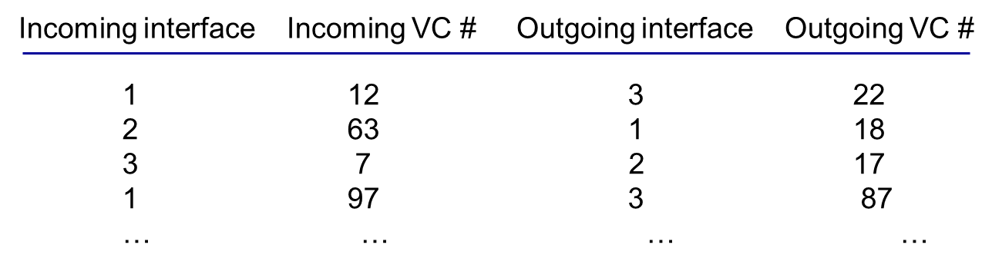
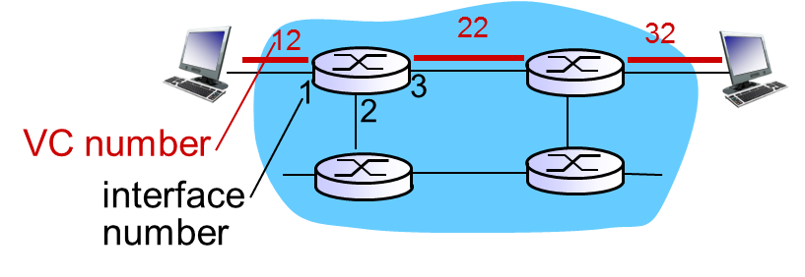
Virtual Circuits forwarding table
routing algorithm
VC routers must maintain
connection state information!
local forwarding table
dest address
output link
address-range 1
address-range 2
address-range 3
address-range 4
3
2
2
1
Incoming VC# in packet’s header
1
3
2

Slide 10

Datagram networks (the Internet model)
no call setup at network layer
routers: no state about end-to-end connections
  no network-level concept of “connection”
packets forwarded using only destination host address
application
transport
network
data link
physical
application
transport
network
data link
physical
1. send datagrams
2. receive datagrams

Slide 11
Datagram (IP) forwarding table
4 billion IP addresses, so rather than list individual destination address
list range of addresses
(aggregate table entries)
routing algorithm
local forwarding table
dest address
output link
address-range 1
address-range 2
address-range 3
address-range 4
3
2
2
1
IP destination address in
arriving packet’s header
1
3
2

Slide 12
Datagram or VC network: why?
“Classic” Internet (datagram)
data exchange among computers
  “elastic” service, no strict timing req.
many link types
  different characteristics
  uniform service difficult
“smart” end systems (computers)
  can adapt, perform control, error recovery
  simple network core, complexity at edge
VC (eg ATM: a past’s vision of the future’s ww-network)
evolved from telephony
human conversation:
  strict timing, reliability requirements
  need for guaranteed service
“dumb” end systems
  “Classic” telephones
  complexity in the core of network
Re-shaping in progress ….
Software-Defined Networks

Slide 13
Roadmap Network Layer
Forwarding versus routing
Network layer service models
  Network layer architecture (shift): Software-Defined Networks
How a router works: switching fabrique
The Internet Network layer: IP, Addressing & related
(Next) Control, routing
  path selection
  instantiation, implementation in the Internet

Slide 14

Per-router (“classic” Internet) control plane
Individual routing algorithm (control) components in each and every router interact (in the control plane)
Routing
Algorithm
control
plane
data
plane
values in arriving
packet header
0111
1
3
2

Slide 15
Logically separated control plane
A distinct (can be centralized/remote/distributed) controller interacts with local control agents (CAs)
  this architecture (Software Defined Networking) can enable new functionality
  (will be discussed more later in the course)
Remote Controller
control
plane
data
plane
CA
values in arriving packet header [more values than just the destination address can be used for the forwarding]
CA
CA
CA
CA
0111
1
3
2

Slide 16
Roadmap Network Layer
Forwarding versus routing
Network layer service models
  Network layer architecture (shift): Software-Defined Networks
Inside a router
The Internet Network layer: IP, Addressing & related
(Next) Control, routing
  path selection
  instantiation, implementation in the Internet

Slide 17
Router architecture overview
forwarding tables computed,
pushed to input ports
routing
processor
routing, management
control plane (software)
forwarding data plane (hardware)
high-seed
switching
fabric
router input ports
router output ports

Slide 18
Input port functions
lookup,
forwarding
queueing
line
termination
link
layer
protocol
(receive)
switch
fabric
physical layer:
bit-level reception
data link layer:
e.g., Ethernet
switching:
given datagram dest., lookup output port using forwarding table in input port memory (“match plus action”)
goal: complete input port processing at ‘line speed’
queuing: if datagrams arrive faster than forwarding rate into switch fabric

Slide 19
Switching fabrics
transfer packet from input buffer to appropriate output buffer
switching rate: rate at which packets can be transfer from inputs to outputs
  often measured as multiple of input/output line rate
  N inputs: switching rate N times line rate desirable
three types of switching fabrics:
memory
memory
bus
crossbar

Slide 20
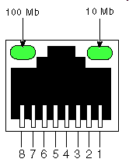
Switching via memory
first generation routers:
traditional computers with switching under direct control of CPU
packet copied to system’s memory
speed limited by memory bandwidth (2 bus crossings per datagram)
input
port
(e.g.,
Ethernet)
output
port
(e.g.,
Ethernet)
memory
system bus

Slide 21
Switching via a bus
datagram from input port memory
to output port memory via a shared bus
bus contention: switching speed limited by bus bandwidth
32 Gbps bus, Cisco 5600: sufficient speed for access and enterprise routers
bus

Slide 22
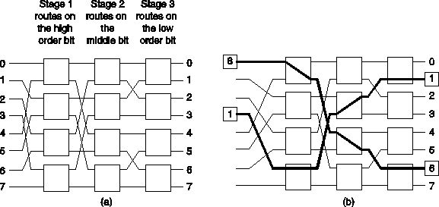
Switching Via an Interconnection Network
Overcome bus bandwidth limitations
Banyan networks, other interconnection nets (also used in multi-processors-memory interconnects)
  Cisco 12000: switches at 60 Gbps
  Example Banyan interconnect: using 3-bit link address
crossbar

Slide 23
Output ports
datagram
buffer
queueing
switch
fabric
link
layer
protocol
(send)
line
termination
buffering required when datagrams arrive from fabric faster than the transmission rate
scheduling discipline chooses among queued datagrams for transmission
Datagram (packets) can be lost due to congestion, lack of buffers
Priority scheduling – who gets best performance
(vs network neutrality)

Slide 24
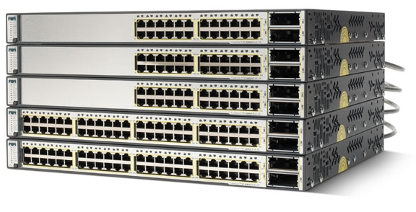
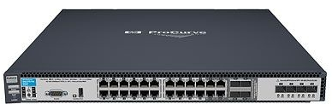
Example contemporary routers
Cisco Catalyst 3750E
Stackable (can combine units)
64 Gbps bandwidth
13 Mpps (packets per second)
12,000 address entries
Price: from 100 kSEK
HP ProCurve 6600-24G-4XG Switch
10 Gbps
Up to 75 Mpps (64-byte packets)
Latency: < 2.4 µs (FIFO 64-byte packets)
10,000 address entries
Price approx. 50 kSEK
Notes:
TO

Slide 25
Roadmap Network Layer
Forwarding versus routing
Network layer service models
  Network layer architecture (shift): Software-Defined Networks
How a router works
The Internet Network layer: IP, Addressing & related
(Next) Control, routing
  path selection
  instantiation, implementation in the Internet

Slide 26
The Internet network layer
host, router network layer functions:
transport layer: TCP, UDP
routing protocols
path selection
OSPF, BGP
IP protocol
addressing conventions
datagram format
packet handling conventions
network
layer
forwarding
table
ICMP protocol
error reporting
router “signaling”
link layer
physical layer

Slide 27
IPv4 datagram format
IP protocol version
number
32 bits
total datagram
length (bytes)
header length
(bytes)
head.
len
type of
service
ver
length
for
fragmentation/
reassembly
“type” of data (prio)
16-bit identifier
flgs
fragment
offset
max number
remaining hops
(decremented at
each router)
time to
live
upper
layer
header
checksum
32 bit source IP address
upper layer protocol
to deliver payload to
32 bit destination IP address
options (if any)
e.g. timestamp,
record route
taken, specify
list of routers
to visit.
how much overhead?
20 bytes of TCP
20 bytes of IP
= 40 bytes + app layer overhead
data
(variable length,
typically a TCP
or UDP segment)

Slide 28
Roadmap Network Layer
Forwarding versus routing
Network layer service models
  Network layer architecture (shift): Software-Defined Networks
How a router works
The Internet Network layer: IP, Addressing & related
  Hierarchical addressing
(Next) Control, routing
  path selection
  instantiation, implementation in the Internet

Slide 29
IP addressing: introduction
IP address: 32-bit id for host/router interface
interface: connection between host/router and physical link
  routers have multiple interfaces
  end-host typically has 1-2 interfaces (e.g., wired Ethernet and wireless 802.11)
223.1.1.1
223.1.2.1
223.1.1.2
223.1.1.4
223.1.2.9
223.1.1.3
223.1.3.27
223.1.2.2
223.1.3.1
223.1.3.2
223.1.1.1 = 11011111 00000001 00000001 00000001
223
1
1
1

Slide 30
Subnets
IP address:
  subnet part: high order bits (variable number)
  host part: low order bits
what’s a subnet ?
  Devices that can physically reach each other without intervening router
  device interfaces have same subnet-part (prefix) of IP address
223.1.1.1
223.1.1.2
223.1.2.1
223.1.1.4
223.1.2.9
223.1.1.3
223.1.2.2
223.1.3.27
subnet
223.1.3.1
223.1.3.2
network consisting of 3 subnets

Slide 31
Subnets
recipe
to determine the subnets: detach each interface from its host or router, i.e. create islands of isolated networks
each isolated network is a subnet
223.1.1.0/24
223.1.2.0/24
223.1.1.1
223.1.1.2
223.1.2.1
223.1.1.4
223.1.2.9
223.1.2.2
223.1.1.3
223.1.3.27
subnet
223.1.3.1
223.1.3.2
223.1.3.0/24
subnet mask: eg /24
defines how to find the subnet part of the address …

Slide 32
IP addressing: CIDR
CIDR: Classless InterDomain Routing
  subnet portion of address of arbitrary length
  address format: a.b.c.d/x, where x is # bits in subnet portion of address
subnet
part
host
part
11001000 00010111 00010000 00000000
200.23.16.0/23

Slide 33
Subnets, masks, calculations
Example subnet: 192.168.5.0/24
 | Binary form | Dot-decimal notation
IP address | 11000000.10101000.00000101.10000010 | 192.168.5.130
Subnet mask | 11111111.11111111.11111111.00000000 --------24 first bits set to 1------ | 255.255.255.0
Network prefix: bitwise AND of (address, mask) | 11000000.10101000.00000101.00000000 | 192.168.5.0
Host part (obtained with similar calculation, with a mask having the 8 last bits = 1) | 00000000.00000000.00000000.10000010 | 0.0.0.130

Slide 34
CIDR Address Masks
CIDR Notation Dotted Decimal
/1 128.0.0.0
/2 192.0.0.0
/3 224.0.0.0
/4 240.0.0.0
/5 248.0.0.0
/6 252.0.0.0
/7 254.0.0.0
/8 255.0.0.0
/9 255.128.0.0
/10 255.192.0.0
/11 255.224.0.0
/12 255.240.0.0
/13 255.248.0.0
/14 255.252.0.0
/15 255.254.0.0
/16 255.255.0.0
CIDR Notation Dotted Decimal
/17 255.255.128.0
/18 255.255.192.0
/19 255.255.224.0
/20 255.255.240.0
/21 255.255.248.0
/22 255.255.252.0
/23 255.255.254.0
/24 255.255.255.0
/25 255.255.255.128
/26 255.255.255.192
/27 255.255.255.224
/28 255.255.255.240
/29 255.255.255.248
/30 255.255.255.252
/31 255.255.255.254
/32 255.255.255.255
2013 Ali Salehson, Chalmers, CSE Networks and Systems
34

Slide 35
Classless Address: example
    An ISP has an address block 122.211.0.0/16
    A customer needs max. 6 host addresses,
    ISP can e.g. allocate: 122.211.176.208/29
      3 bits enough for host part
    subnet mask 255.255.255.248
Reserved addresses
 | Dotted Decimal | Last 8 bits
Network | 122.211.176.208 | 11010000
1st address | 122.211.176.209 | 11010001
…………. | ………………… | …………
6th address | 122.211.176.214 | 11010110
Broadcast | 122.211.176.215 | 11010111
RFC 3021 “The network address itself {<Network-number>, 0} is an
obsolete form of directed broadcast, but it may still be used by older hosts.”
35

Slide 36
Roadmap Network Layer
Forwarding versus routing
Network layer service models
  Network layer architecture (shift): Software-Defined Networks
How a router works
The Internet Network layer: IP, Addressing & related
  Hierarchical addressing
  How to get addresses
(Next) Control, routing
  path selection
  instantiation, implementation in the Internet

Slide 37
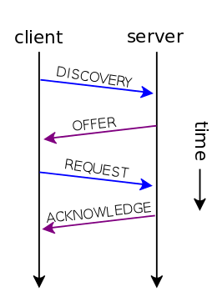
IP addresses: how to get one (for an end-host)?
hard-coded by system admin in a file
Windows: control-panel->network->configuration->tcp/ip->properties;
UNIX: /etc/rc.config
DHCP
DHCP: Dynamic Host Configuration Protocol: dynamically get address:
  host broadcasts “DHCP discover” msg
  DHCP server (in same subnet) responds with “DHCP offer” msg
  host requests IP address: “DHCP request” msg
  DHCP server sends address: “DHCP ack” msg
DHCP returns more than just allocated IP address:
  address of first-hop router for client
  name and IP address of DNS sever
  network mask (indicating network versus host portion of address)

Slide 38
IP addresses: how to get one (net-part)?
Q: how does network get subnet part of IP addr?
A: gets allocated portion of its provider ISP’s address space; eg:
ISP's block 11001000 00010111 00010000 00000000 200.23.16.0/20
Organization 0 11001000 00010111 00010000 00000000 200.23.16.0/23
Organization 1 11001000 00010111 00010010 00000000 200.23.18.0/23
Organization 2 11001000 00010111 00010100 00000000 200.23.20.0/23
... ….. …. ….
Organization 7 11001000 00010111 00011110 00000000 200.23.30.0/23
3 bits, 8 networks

Slide 39
Hierarchical Addressing: Route Aggregation
Hierarchical addressing allows efficient advertisement of routing information
The “outside” does not need to know about subnets.
Organization 0
200.23.16.0/23
Organization 1
200.23.18.0/23
“Send me anything
with addresses
beginning
200.23.16.0/20”
Organization 2
200.23.20.0/23
.
ISP #1
.
.
.
Internet
.
Organization 7
.
200.23.30.0/23
ISP #2
“Send me anything
with addresses
beginning
199.31.0.0/16”

Slide 40
Forwarding: longest prefix matching
longest prefix matching
when looking for forwarding table entry for given destination address, use longest address prefix that matches destination address
Destination Address Range
11001000 00010111 00010*** *********
11001000 00010111 00011000 *********
11001000 00010111 00011*** *********
otherwise
Link interface
0
1
2
3
examples:
DA: 11001000 00010111 00010110 10100001
which interface?
DA: 11001000 00010111 00011000 10101010
which interface?

Slide 41

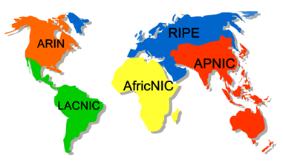
IP Addressing: the last word...
Q: How does an ISP get block of addresses?
A: ICANN: http://www.icann.org/
Internet Corporation for Assigned Names and Numbers
  allocates addresses
  manages DNS
  assigns domain names, resolves disputes
ISPs obtain IP addresses from a
Local Internet Registry (LIR) or
National Internet Registry (NIR),
their appropriate Regional Internet Registry (RIR, 5 worldwide).

Slide 42
Roadmap Network Layer
Forwarding versus routing
Network layer service models
  Network layer architecture (shift): Software-Defined Networks
How a router works
The Internet Network layer: IP, Addressing & related
  Hierarchical addressing
  How to get addresses
  NAT
(Next) Control, routing
  path selection
  instantiation, implementation in the Internet

Slide 43
(Well, it was not really the last word…)
NAT: network address translation
rest of
Internet
local network
(e.g., home network)
10.0.0/24
10.0.0.1
10.0.0.4
10.0.0.2
138.76.29.7
10.0.0.3
(it is all about extending the IP address space; it also “hides” addresses)
all datagrams leaving local
network have same single source NAT IP address: 138.76.29.7, different source port numbers
datagrams with source or destination in this
network have 10.0.0/24 address for source,
destination (as usual)

Slide 44
NAT: network address translation
NAT translation table
WAN side addr LAN side addr
2: NAT router
changes datagram
source addr from
10.0.0.1, 3345 to
138.76.29.7, 5001,
updates table
1: host 10.0.0.1
sends datagram to
128.119.40.186, 80
138.76.29.7, 5001 10.0.0.1, 3345
…… ……
S: 10.0.0.1, 3345
D: 128.119.40.186, 80
10.0.0.1
1
2
S: 138.76.29.7, 5001
D: 128.119.40.186, 80
10.0.0.4
10.0.0.2
138.76.29.7
S: 128.119.40.186, 80
D: 10.0.0.1, 3345
4
S: 128.119.40.186, 80
D: 138.76.29.7, 5001
3
10.0.0.3
4: NAT router
changes datagram
dest addr from
138.76.29.7, 5001 to 10.0.0.1, 3345
3: reply arrives
dest. address:
138.76.29.7, 5001

Slide 45
NAT: network address translation
16-bit port-number field:
  64k simultaneous connections with a single LAN-side address!
NAT is controversial:
  routers should in principle process up to layer 3
  violates end-to-end argument
    NAT possibility must be taken into account by app designers, e.g., P2P applications
  address shortage should instead be solved by IPv6

Slide 46
Roadmap Network Layer
Forwarding versus routing
Network layer service models
  Network layer architecture (shift): Software-Defined Networks
How a router works
The Internet Network layer: IP, Addressing & related
  Hierarchical addressing
  How to get addresses
  NAT
  IPv6
(Next) Control, routing
  path selection
  instantiation, implementation in the Internet

Slide 47
IPv6: motivation
initial motivation: 32-bit address space almost completely allocated.
additional motivation: header format must help to:
  speed processing/forwarding
  distinguishing types of traffic (for potentially different services)
IPv6 datagram format:
  fixed-length 40 byte header
  no fragmentation allowed
  128-bit addresses (2¹²⁸ = 10³⁸ hosts)
  Standard subnet size: 2⁶⁴ hosts

Slide 48
IPv6 datagram format
priority: identify priority among datagrams in flow
flow Label: identify datagrams in same “flow.”
(concept of“flow” not well defined).
checksum: removed entirely to reduce processing time at each hop
options: allowed, but outside of header, indicated by “Next Header” field
ver
pri
flow label
payload len
next hdr
hop limit
source address
(128 bits)
destination address
(128 bits)
data
32 bits

Slide 49
Transition from IPv4 to IPv6
not all routers can be upgraded simultaneously
  how can the network operate with mixed IPv4 and IPv6 routers?
tunneling: IPv6 datagram carried as payload in IPv4 datagram among IPv4 routers
IPv4 header fields
IPv4 source, dest addr
IPv6 datagram
IPv4 datagram

Slide 50
Tunneling (6in4 – static tunnel)
A
B
IPv4 tunnel
connecting IPv6 routers
E
F
logical view:
IPv6
IPv6
IPv6
IPv6
A
B
C
D
E
F
physical view:
IPv6
IPv6
IPv4
IPv4
IPv6
IPv6
flow: X
src: A
dest: F
data
src:B
dest: E
src:B
dest: E
flow: X
src: A
dest: F
data
Flow: X
Src: A
Dest: F
data
Flow: X
Src: A
Dest: F
data
A-to-B:
IPv6
B-to-C:
IPv6 inside
IPv4
B-to-C:
IPv6 inside
IPv4
E-to-F:
IPv6
Notes:
Mod TO – real solution is Teredo RFC 4380, where [D+E] is a Teredo server and the tunnel uses UDP port 3544. Supported by most modern systems.

Slide 51
IPv6: adoption
Google: 8% of clients access services via IPv6
NIST: 1/3 of all US government domains are IPv6 capable
Long (long!) time for deployment, use
  20 years and counting!
  think of application-level changes in last 20 years: www, streaming media, social media, skype, …
  Why?

Slide 52

Roadmap Network Layer
Forwarding versus routing
Network layer service models
  Network layer architecture (shift): Software-Defined Networks
How a router works
The Internet Network layer: IP, Addressing & related
  Hierarchical addressing
  How to get addresses
  NAT
  IPv6
(Next) Control, routing
  path selection
  instantiation, implementation in the Internet

Slide 53
Reading instructions Network Layer
(incl. next lecture)
KuroseRoss book
Careful | Quick
6/e: 4.1-4.6 7/e: 4.1-4.3, 5.2-5.4, 5.5, 5.6, [new- SDN, data and control plane 4.4, 5.5: in subsequent lectures, connecting to multimedia/streaming Study material available through the pingpong-system] | 6/e: 4.7 7/e: 5.7

Slide 54
Review questions for this part
network layer service models
  Contrast virtual circuit and datagram routing (simplicity, cost, purposes, what service types they may enable)
forwarding versus routing
  Explain the interplay between routing and forwarding
how a router works
  What is inside a router? How/where do queueing delays happen inside a router? Where/why can packets be dropped at a router?
What is subnet? What is subnet masking?
  Practice masking calculations, dividing address spaces
Explain how to get an IP packet from source to destination
Explain how NAT works.

Slide 55
Some complementary material /video-links
IP addresses and subnets http://www.youtube.com/watch?v=ZTJIkjgyuZE&list=PLE9F3F05C381ED8E8&feature=plcp
How does PGP choose its routes http://www.youtube.com/watch?v=RGe0qt9Wz4U&feature=plcp
Some taste of layer 2: no worries if not all details fall in place, need the lectures also to grasp them.
Hubs, switches, routers http://www.youtube.com/watch?v=reXS_e3fTAk&feature=related
What is a broadcast + MAC address http://www.youtube.com/watch?v=BmZNcjLtmwo&feature=plcp
Broadcast domains: http://www.youtube.com/watch?v=EhJO1TCQX5I&feature=plcp

Slide 56
Extra slides

Slide 57
Network layer service models:
Network
Architecture
Internet
ATM
ATM
ATM
ATM
Service
Model
best effort
CBR
VBR
ABR
UBR
Guarantees ?
Congestion
feedback
no (inferred
via loss)
no
congestion
no
congestion
yes
no
Bandwidth
none
constant
rate
guaranteed
rate
guaranteed
minimum
none
Loss
no
yes
yes
no
no
Order
no
yes
yes
yes
yes
Timing
no
yes
yes
no
no
Internet models being extented
(will study these later on)

Slide 58
Input port queuing
fabric slower than input ports combined -> queueing may occur at input queues
  queueing delay and loss due to input buffer overflow!
Head-of-the-Line (HOL) blocking: queued datagram at front of queue prevents others in queue from moving forward
switch
fabric
switch
fabric
output port contention:
only one red datagram can be transferred.
lower red packet is blocked
one packet time later: green packet experiences HOL blocking

Slide 59
Output port queueing
switch
fabric
switch
fabric
at t, packets move
from input to output
one packet time later
buffering when arrival rate via switch exceeds output line speed
queueing (delay) and loss due to output port buffer overflow!

Slide 60


DHCP client-server scenario
DHCP
server
223.1.1.0/24
223.1.1.1
223.1.2.1
223.1.1.2
arriving DHCP
client needs
address in this
network
223.1.1.4
223.1.2.9
223.1.3.27
223.1.2.2
223.1.1.3
223.1.2.0/24
223.1.3.1
223.1.3.2
223.1.3.0/24

Slide 61
DHCP client-server scenario
DHCP server: 223.1.2.5
DHCP discover
arriving
client
src : 0.0.0.0, 68
dest.: 255.255.255.255,67
yiaddr: 0.0.0.0 (your IP addr)
transaction ID: 654
DHCP offer
src: 223.1.2.5, 67
dest: 255.255.255.255, 68
yiaddrr: 223.1.2.4
transaction ID: 654
lifetime: 3600 secs
DHCP request
src: 0.0.0.0, 68
dest:: 255.255.255.255, 67
yiaddrr: 223.1.2.4
transaction ID: 655
lifetime: 3600 secs
Q:Why a request msg?
Several DHCP servers may answer and offer addresses
DHCP ACK
src: 223.1.2.5, 67
dest: 255.255.255.255, 68
yiaddrr: 223.1.2.4
transaction ID: 655
lifetime: 3600 secs
Notes:
Mod TO

Slide 62
NAT traversal problem
client wants to connect to server with address 10.0.0.1
  server address 10.0.0.1 local to LAN (client can’t use it as destination addr)
  only one externally visible address: 138.76.29.7
solution1: statically configure NAT to forward incoming connection requests at given port to server
  e.g., (123.76.29.7, port 2500) always forwarded to 10.0.0.1 port 25000
Solution 2: automate the above through a protocol (universal plug-and-play)
Solution 3: through a proxy/relay (will discuss in connection to p2p applications)
10.0.0.1
client
?
10.0.0.4
138.76.29.7
NAT
router

Slide 63
NAT traversal problem
solution 2: Universal Plug and Play (UPnP) Internet Gateway Device (IGD) Protocol. Allows NATed host to:
  learn public IP address (138.76.29.7)
  add/remove port mappings (with lease times)
  i.e., automate static NAT port map configuration
10.0.0.1
IGD
NAT
router

Slide 64


NAT traversal problem
solution 3 (application): relaying (used in Skype)
  NATed server establishes connection to relay
  External client connects to relay
  relay bridges packets between two connections
2. connection to
relay initiated
by client
1. connection to
relay initiated
by NATted host
10.0.0.1
3. relaying
established
Client
138.76.29.7
NAT
router

Slide 65
IP fragmentation, reassembly
network links have MTU (max.transfer size) - largest possible link-level frame
  different link types, different MTUs
large IP datagram divided (“fragmented”) within net
  one datagram becomes several datagrams
  “reassembled” only at final destination
  IP header bits to identify + order related fragments
…
fragmentation:
in: one large datagram
out: 3 smaller datagrams
reassembly
…

Slide 66
IP fragmentation, reassembly
length
=4000
ID
=x
fragflag
=0
offset
=0
example:
4000 byte datagram
MTU = 1500 bytes
one large datagram becomes
several smaller datagrams
1480 bytes in
data field
length
=1500
ID
=x
fragflag
=1
offset
=0
offset =
1480/8
length
=1500
ID
=x
fragflag
=1
offset
=185
length
=1040
ID
=x
fragflag
=0
offset
=370

Slide 67
Getting a datagram from source to dest.

Slide 68
Getting a datagram from source to dest.
forwarding table in A
Dest. Net. next router Nhops
223.1.1 1
223.1.2 223.1.1.4 2
IP datagram:
223.1.3 223.1.1.4 2
misc
fields
source
IP addr
dest
IP addr
data
A
223.1.1.1
datagram remains unchanged, as it travels source to destination
addr fields of interest here
223.1.2.1
223.1.1.2
223.1.1.4
223.1.2.9
B
223.1.2.2
E
223.1.1.3
223.1.3.27
223.1.3.1
223.1.3.2

Slide 69
Getting a datagram from source to dest.
misc
fields
Dest. Net. next router Nhops
223.1.1.1
223.1.1.3
data
223.1.1 1
Starting at A, given IP datagram addressed to B:
look up net. address of B
find B is on same net. as A (B and A are directly connected)
link layer will send datagram directly to B (inside link-layer frame)
223.1.2 223.1.1.4 2
223.1.3 223.1.1.4 2
A
223.1.1.1
223.1.2.1
223.1.1.2
223.1.1.4
223.1.2.9
B
223.1.2.2
E
223.1.1.3
223.1.3.27
223.1.3.1
223.1.3.2

Slide 70
Getting a datagram from source to dest.
misc
fields
Dest. Net. next router Nhops
223.1.1.1
223.1.2.3
data
223.1.1 1
Starting at A, dest. E:
look up network address of E
E on different network
routing table: next hop router to E is 223.1.1.4
link layer is asked to send datagram to router 223.1.1.4 (inside link-layer frame)
datagram arrives at 223.1.1.4
continued…..
223.1.2 223.1.1.4 2
223.1.3 223.1.1.4 2
A
223.1.1.1
223.1.2.1
223.1.1.2
223.1.1.4
223.1.2.9
B
223.1.2.2
E
223.1.1.3
223.1.3.27
223.1.3.1
223.1.3.2

Slide 71
Getting a datagram from source to dest.
Dest. next
misc
fields
network router Nhops interface
223.1.1.1
223.1.2.3
data
223.1.1 - 1 223.1.1.4
Arriving at 223.1.4, destined for 223.1.2.2
look up network address of E
E on same network as router’s interface 223.1.2.9
  router, E directly attached
link layer sends datagram to 223.1.2.2 (inside link-layer frame) via interface 223.1.2.9
datagram arrives at 223.1.2.2!!! (hooray!)
223.1.2 - 1 223.1.2.9
223.1.3 - 1 223.1.3.27
A
223.1.1.1
223.1.2.1
223.1.1.2
223.1.1.4
223.1.2.9
B
223.1.2.2
E
223.1.1.3
223.1.3.27
223.1.3.1
223.1.3.2

