Slide 1
Course on Computer Communication and Networks
Lecture 2
Chapter 1: Introduction:
Part B: Network structure, performance, security prelude
CTH EDA344/GU DIT 423

Slide 2
The Internet concept: bridging networks
1974: multiple unconnected nets
… differing in: addressing conventions, packet formats, routing, physical medium
ARPAnet
satellite net
"A Protocol for Packet Network Intercommunication", V. Cerf, R. Kahn, IEEE Transactions on Communications, May, 1974, pp. 637-648.

Slide 3
The Internet: bridging networks
Internetwork layer (IP):
internetwork appears as single, uniform entity, despite underlying local network heterogeneity
network of networks
Gateway:
“embed internetwork packets in local packet format”
route (at inter-network level) to next gateway
gateway
ARPAnet
satellite net

Slide 4
















A closer look at network structure:
network edge: hosts:
run application programs e.g. Web, email, …
… based on network services available
mobile network
global ISP
home
network
access networks:
connect end-hosts to the Internet
through physical media: wired, wireless links
regional ISP
network core:
interconnected routers
network of networks
institutional
network

Slide 5



A closer look at network structure:
network edge: hosts:
run application programs e.g. Web, email, …
… based on network services available
application
transport
network
link
physical
access networks:
connect end-hosts to the Internet
through physical media: wired, wireless links
link
physical
Types of communication service available by the transport layer @ Internet:
connection-oriented: reliable, in-order data delivery (TCP)
connectionless: “best effort”, arbitrary order data-delivery (UDP)
Q: How & based on what “core” functionality?
  (…main Q for the Internet….)
switch
network
link
physical
application
transport
network
link
physical
UDP
TCP
router
network core:
interconnected routers
network of networks

Slide 6


Roadmap
Zooming into core
  Ways of data transfer
  Routing
  Performance: delays (& loss)
  …. throughput
Network/Internet structure complemented:
  access net, physical media
  backbones, NAPs, ISPs
Security prelude

Slide 7
Network Core: how is data transferred through the net?
Packet Switching
10 Mbs
Ethernet
A
C
1.5 Mbs
B
queue of packets
waiting for output
link
45 Mbs
D
E
Application messages divided into packets
packets share network resources
resources used as needed
store and forward:
packets move one hop at a time
  transmit over link; wait their turn at next link

Slide 8

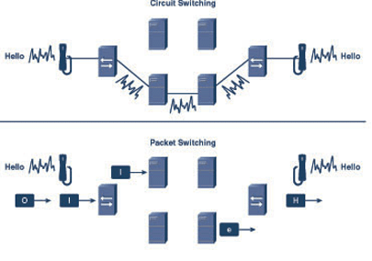
Alternative Core: Circuit Switching
(analogue telephony)
End-end resources dedicated for “call”
dedicated resources (link bandwidth, switch capacity): no sharing
circuit-like (guaranteed) latency bound
call setup required
Example video for Circuit vs packet switching
  http://www.youtube.com/watch?v=Dq1zpiDN9k4&feature=related

Slide 9
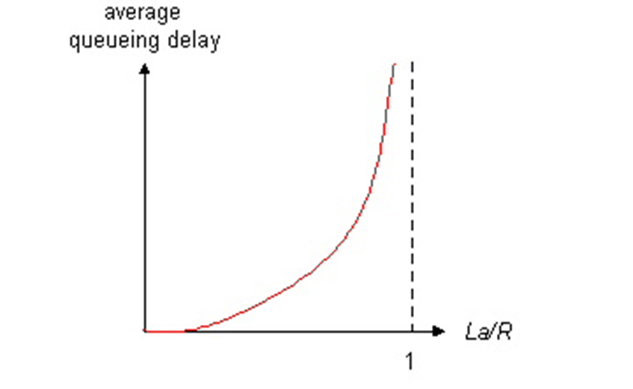

Packet switching versus circuit switching
Packet switching allows more users to use the network!
Q: what happens with > 35 users?
Still circuit-like behavior?
1 Mbit link
each user/connection:
  100Kbps when “active”
  active 10% of time (bursty behaviour)
circuit-switching how many users/connections can be multiplexed?:
  10
packet switching
  with n= 35 users:
  P(active simultaneously k > 10 , i.e. some needs to wait) < 0.0004
  ⇒ almost all of the time, same queuing behaviour as in circuit switching)
Traffic intensity:
(aggregated
input rate/bandwidth)
n users
1 Mbps link
Hint: The probability of k out of n users active (p=0.1 in our example)

Slide 10
Roadmap
Zooming into core
  Ways of data transfer
  Routing
  Performance: delays, (& loss) …
  …. throughput
Network/Internet structure complemented:
  access net, physical media
  backbones, NAPs, ISPs
Security prelude

Slide 11
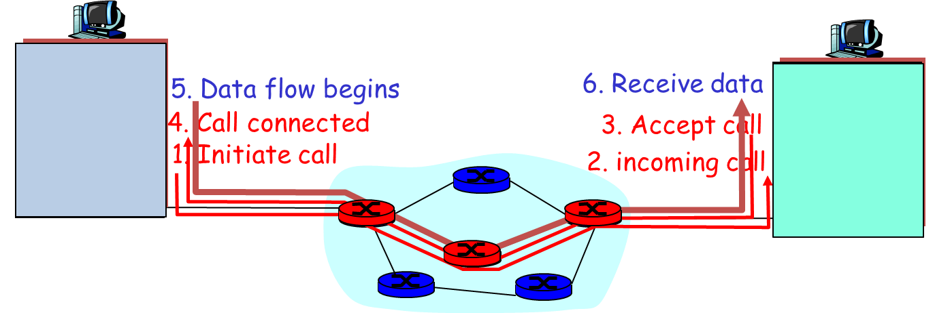
(Can we combine the benefits of CS & PS?)
Routing and network-core main design issue
What is routing’s role?
find routes from source to destination
path selection algorithms
Important design issue/type of service offered at network layer:
  Option 1: datagram network:
    destination address determines next hop
    routes may change during session
  Option 2: virtual circuit network: resource reservation+sharing!!
    path determined at call setup, remains fixed thru session
    combining packet-switching with circuit switching behaviour
    routers can prioritize, must maintain per-session state (or similar)
Simple to implement & maintain
(Internet main approach)
Expensive, but better to provide guarantees (Internet’s new concerns; more to appear soon at a lecture near you…)

Slide 12
Roadmap
Zooming into core
  Ways of data transfer
  Routing
  Performance: delays, (& loss) …
  …. throughput
Network/Internet structure complemented:
  access net, physical media
  backbones, NAPs, ISPs
Security prelude

Slide 13
Delays (latencies) in packet-switched networks
1. nodal processing:
  check bit errors
  determine output link
2. queuing
  time waiting at output link for transmission
  depends on congestion level of router
3. Transmission delay:
R=link bandwidth (bps)
L=packet length (bits)
time to send bits into link = L/R
4. Propagation delay:
d = length of physical link
s = propagation speed in medium (~2x10⁸ m/sec)
propagation delay = d/s
transmission
A
propagation
B
nodal
processing
queueing

Slide 14

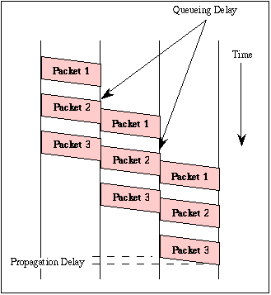
Visualize delays: packet switching
store and forward behavior visualization
time to send bits into link = L/R
propagation delay = d/s
fig. Gorry Fairhurst

Slide 15
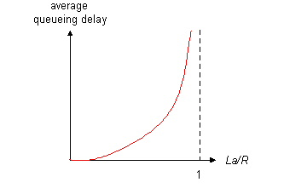

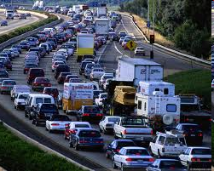
Queueing delay (revisited) …
R=link bandwidth (bps)
L=packet length (bits)
a=average packet arrival rate
traffic intensity = La/R
La/R ~ 0
La/R is 1 or more
La/R ~ 0: average queueing delay small
La/R -> 1: delays become large
La/R > 1: more “work” arriving than can be serviced, average delay infinite! Queues may grow unlimited, packets can be lost

Slide 16
Delays and packet loss
Link queue (aka buffer) has finite capacity
packet arriving to full queue dropped (aka lost)
buffer
(waiting area)
packet being transmitted
A
B
packet arriving to
full buffer is lost

Slide 17
Roadmap
Zooming into core
  Ways of data transfer
  Routing
  Performance: delays, (& loss)…
  …. throughput
Network/Internet structure complemented:
  access net, physical media
  backbones, NAPs, ISPs
Security prelude

Slide 18
Throughput
throughput: rate (bits/time unit) at which bits are transferred between sender/receiver
  instantaneous: rate at given point in time
  average: rate over longer period of time
link capacity
R_{s} bits/sec
link capacity
R_{c} bits/sec
server, with
file of F bits
to send to client
pipe that can carry
fluid at rate
R_{s} bits/sec)
pipe that can carry
fluid at rate
R_{c} bits/sec)
server sends bits
(fluid) into pipe

Slide 19
Throughput (more)
R_{s} < R_{c} What is average end-end throughput?
R_{s} bits/sec
R_{c} bits/sec
R_{s} > R_{c} What is average end-end throughput?
R_{s} bits/sec
R_{c} bits/sec
bottleneck link
link on end-end path that constrains end-end throughput

Slide 20
… “Real” Internet delays and routes (1)…
What do “real” Internet delay & loss look like?
Traceroute program: provides delay measurement from source to router along end-end Internet path towards destination. For all i:
  sends three packets that will reach router i on path towards destination
  router i will return packets to sender
  sender times interval between transmission and reply.
3 probes
3 probes
3 probes

Slide 21
…“Real” Internet delays and routes (2)…
traceroute: gaia.cs.umass.edu to www.eurecom.fr
Three delay measurements from
gaia.cs.umass.edu to cs-gw.cs.umass.edu
1 cs-gw (128.119.240.254) 1 ms 1 ms 2 ms
2 border1-rt-fa5-1-0.gw.umass.edu (128.119.3.145) 1 ms 1 ms 2 ms
3 cht-vbns.gw.umass.edu (128.119.3.130) 6 ms 5 ms 5 ms
4 jn1-at1-0-0-19.wor.vbns.net (204.147.132.129) 16 ms 11 ms 13 ms
5 jn1-so7-0-0-0.wae.vbns.net (204.147.136.136) 21 ms 18 ms 18 ms
6 abilene-vbns.abilene.ucaid.edu (198.32.11.9) 22 ms 18 ms 22 ms
7 nycm-wash.abilene.ucaid.edu (198.32.8.46) 22 ms 22 ms 22 ms
8 62.40.103.253 (62.40.103.253) 104 ms 109 ms 106 ms
9 de2-1.de1.de.geant.net (62.40.96.129) 109 ms 102 ms 104 ms
10 de.fr1.fr.geant.net (62.40.96.50) 113 ms 121 ms 114 ms
11 renater-gw.fr1.fr.geant.net (62.40.103.54) 112 ms 114 ms 112 ms
12 nio-n2.cssi.renater.fr (193.51.206.13) 111 ms 114 ms 116 ms
13 nice.cssi.renater.fr (195.220.98.102) 123 ms 125 ms 124 ms
14 r3t2-nice.cssi.renater.fr (195.220.98.110) 126 ms 126 ms 124 ms
15 eurecom-valbonne.r3t2.ft.net (193.48.50.54) 135 ms 128 ms 133 ms
16 194.214.211.25 (194.214.211.25) 126 ms 128 ms 126 ms
17 * * *
18 * * *
19 fantasia.eurecom.fr (193.55.113.142) 132 ms 128 ms 136 ms
trans-oceanic
link
* means no reponse (probe lost, router not replying)

Slide 22
Roadmap
Zooming into core
  Ways of data transfer
  Routing
  Performance: delays, (& loss) …
  …. throughput
Network/Internet structure complemented:
  access net, physical media
  backbones, NAPs, ISPs
Security prelude

Slide 23

Access networks and physical media
Q: How to connect end systems to first router?
residential access nets
institutional access networks (school, company)
keep in mind:
bandwidth (bits per second)?
shared or dedicated?

Slide 24
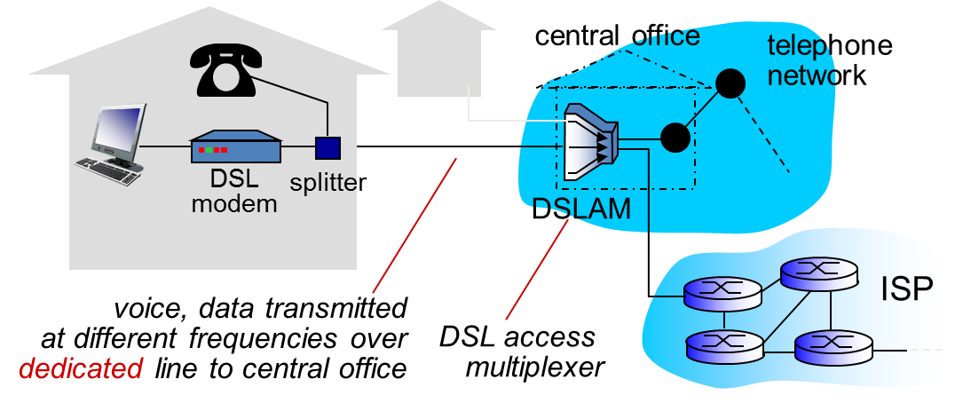



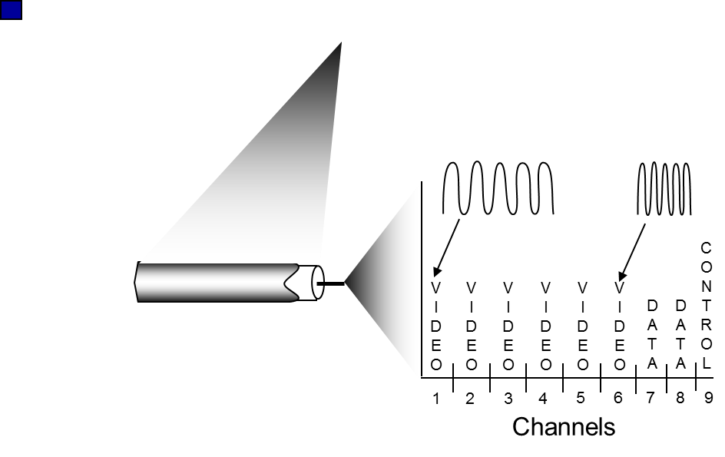
Access nets: digital subscriber line (DSL) & cable network
cable headend
…
cable
modem
splitter
CMTS
ISP
data, TV transmitted at different
frequencies over shared cable
distribution network
cable modem
termination system
use existing telephone line to central office DSLAM
Multiplexing data/voice over DSL phone line to Internet/telephone net
typically < 1 Mbps upstream, < 10 Mbps downstream
(HFC: hybrid fiber coax) network of cables, attaches homes to ISP router
ca 2 Mbps upstream, 30Mbps downstream, homes share access network to cable headend
unlike DSL, which has dedicated access to central office

Slide 25





Access net: home network
wireless
devices
to/from headend or central office
often combined
in single box
Modem or fiber box
wireless access
point (54 Mbps)
router, firewall, NAT
wired Ethernet (100 Mbps)

Slide 26









Enterprise access networks (Ethernet)
institutional link to
ISP (Internet)
institutional router
Ethernet
switch
institutional mail,
web servers
typically used in companies, universities, etc
  10 Mbps, 100Mbps, 1Gbps, 10Gbps transmission rates

Slide 27


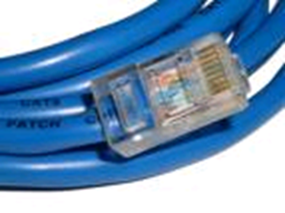
Guided physical Media: coax, fiber, twisted pair
Coaxial cable:
wire (signal carrier) within a wire (shield)
broadband: multiple channels multiplexed on cable (HFC, cable TV)
Fiber optic cable:
low attenuation: fewer repeaters
low error rate: light pulses immune to electromagnetic noise
high-speed operation: e.g., 10-100 Gps
Twisted Pair (TP)
two insulated copper wires
  Category 3: traditional phone wires, 10 Mbps Ethernet
  Category 5/6: more twists, higher insulation: 100-1000 Mbps/10 Gbps

Slide 28
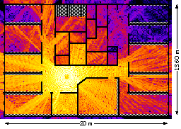
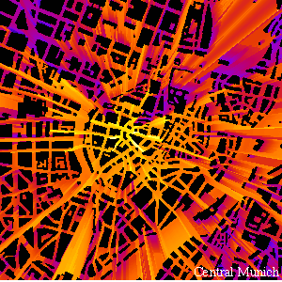
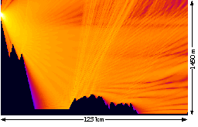
Unguided Physical media: Radio
Properties: Attenuation, Multipath propagation
radio links (Mbps): terrestrial microwave, LAN/WiFi, wide-area/cellular, satellite
Signal can fade with distance, can get obstructed, can take many different paths between sender and receiver due to reflection, scattering, diffraction
signal at sender
signal at receiver

Slide 29
Wireless access networks
“adhoc” or via base station aka “access point”
wireless LANs (10’s m)
  802.11 (WiFi): ca 10-50 Mbps
wider-area wireless access (10’s km)
  provided by telco operator
  ~1-10 Mbps over cellular system
  3G, 4G, 5G evolving (for IoT)
router
base
station
mobile
hosts

Slide 30
Roadmap
Zooming into core
  Ways of data transfer
  Routing
  Performance: delays, (& loss)…
  …. throughput
Network/Internet structure complemented:
  access net, physical media
  backbones, NAPs, ISPs
Security prelude

Slide 31
Internet structure: network of networks
Question: given millions of access ISPs, how to connect them together?
…
…
access
net
access
net
access
net
access
net
access
net
access
net
access
net
…
…
access
net
access
net
access
net
access
net
access
net
access
net
…
access
net
access
net
…
access
net

Slide 32
Internet structure: network of networks
Option: connect each access ISP to every other access ISP?
…
…
access
net
access
net
access
net
access
net
access
net
…
…
access
net
access
net
…
connecting each access ISP to each other directly doesn’t scale: O(N²) connections.
…
…
access
net
access
net
…
access
net
access
net
access
net
…
access
net
…
access
net
access
net
…
access
net

Slide 33
Internet structure: network of networks
Option: connect each access ISP to one global transit ISP?
Customer and provider ISPs have economic agreement.
…
…
access
net
access
net
access
net
access
net
access
net
access
net
access
net
…
…
global
ISP
access
net
access
net
access
net
access
net
access
net
access
net
…
access
net
access
net
…
access
net

Slide 34
Internet structure: network of networks
But if one global ISP is viable business, there will be competitors ….
…
…
access
net
access
net
access
net
access
net
access
net
access
net
ISP A
access
net
…
…
access
net
ISP B
access
net
ISP C
access
net
access
net
access
net
access
net
…
access
net
access
net
…
access
net

Slide 35
Internet structure: network of networks
But if one global ISP is viable business, there will be competitors …. which must be interconnected
…
Internet exchange point
(approx. 400 in the world)
access
net
access
net
…
access
net
access
net
access
net
IXP
access
net
access
net
ISP A
…
…
access
net
IXP
ISP B
access
net
ISP C
access
net
access
net
peering link
access
net
access
net
…
access
net
access
net
…
access
net

Slide 36
Internet structure: network of networks
… and regional networks may arise to connect access nets to ISPs
…
…
access
net
access
net
access
net
access
net
access
net
IXP
access
net
access
net
ISP A
…
…
access
net
IXP
ISP B
access
net
ISP C
access
net
access
net
access
net
regional net
access
net
…
access
net
access
net
…
access
net

Slide 37
Internet structure: network of networks
… and content provider networks (e.g., Google, Microsoft, Akamai) may run their own network, to bring services, content close to end users
…
…
access
net
access
net
access
net
access
net
access
net
IXP
access
net
access
net
ISP A
…
…
Content provider network
access
net
IXP
ISP B
access
net
ISP C
access
net
access
net
access
net
regional net
access
net
…
access
net
access
net
…
access
net

Slide 38
Internet structure: network of networks
Tier 1 ISP
Tier 1 ISP
Private,
e.g. Google
IXP
IXP
IXP
Regional ISP
Regional ISP
access
ISP
access
ISP
access
ISP
access
ISP
access
ISP
access
ISP
access
ISP
access
ISP
at center: small # of well-connected large networks
“tier-1” commercial ISPs (e.g., Level 3, Sprint, AT&T, NTT, Telia), national & international coverage
content provider network (e.g., Google): private network that connects its (but this might change soon) data centers to Internet, often bypassing tier-1, regional ISPs

Slide 39
Internet structure: network of networks
A packet passes through many networks … (Food for thought: implications/requirements?)
local
ISP
Tier 3
ISP
local
ISP
local
ISP
local
ISP
Tier-2 ISP
Tier-2 ISP
Tier 1 ISP
Tier 1 ISP
Tier 1 ISP
Tier-2 ISP
Tier-2 ISP
Tier-2 ISP
local
ISP
local
ISP
local
ISP
local
ISP

Slide 40
Roadmap
Zooming into core
  Ways of data transfer
  Routing
  Performance: delays, …
  …. throughput, loss
Network/Internet structure complemented:
  access net, physical media
  backbones, NAPs, ISPs
Security prelude

Slide 41
Network Security Prelude
The field of network security is about:
  how adversaries can attack computer networks
  how we can defend networks against attacks (mitigation)
  how to design architectures that are immune to attacks (prevention)
Internet not originally designed with (much) security in mind
  original vision: “a group of mutually trusting users attached to a transparent network” ☺
  Internet protocol designers playing “catch-up”
  Security considerations in all layers!

Slide 42
Bad guys can put malware into hosts via Internet
Malware can get in host from a virus, worm, or trojan horse.
Spyware malware can record keystrokes, web sites visited, upload info to collection site.
Infected host can be enrolled in a botnet, used for spam and DDoS attacks.
Malware is often self-replicating: from an infected host, seeks entry into other hosts

Slide 43
Bad guys can sniff packets
Packet sniffing:
  Shared/broadcast medium (shared Ethernet, wireless)
  promiscuous network interface reads/records all packets passing by
A
C
src:B dest:A payload
B
Wireshark software used for end-of-chapter labs is a (free) packet-sniffer
NOTE: be aware that it is inappropriate to use outside the scope of the lab

Slide 44
Bad guys can use false source addresses
IP spoofing: send packet with false source address
A
C
src:B dest:A payload
B

Slide 45
Bad guys can record and playback
record-and-playback: sniff sensitive info (e.g., password), and use later
  password holder is that user from system point of view
C
A
src:B dest:A user: B; password: foo
B

Slide 46

Chapter 1: Summary
Covered a “ton” of material!
what’s the Internet
what’s a protocol?
protocol layers, service models
network edge (types of service)
network core (ways of transfer, routing)
performance, delays, loss
access net, physical media
backbones, NAPs, ISPs
Security concerns
(history: read more in corresponding section, interesting & fun ☺)
In order to have:
context, overview, “feeling ” of networking
A point of reference for context in the focused discussions to come

Slide 47
Reading instructions (incl.next lecture)
1. Kurose Ross book
Careful | Quick
6/e, 7/e: 1.3, 1.4, 1.5 | the rest
Extra Reading (optional)
Computer and Network Organization: An Introduction,
by Maarten van Steen and Henk Sips, Prentice Hall
(very good introductory book for non-CSE students)

Slide 48
Review questions
Review questions from Kurose-Ross book, chapter 1 (for basic study)
6/e, 7/e: R11, R12, R13, R16, 17, R18, R19, R20, R21, R22, R23, R24, R25, R28.
Extra questions, for further study: delay analysis in packet switched networks:
http://www.comm.utoronto.ca/~jorg/teaching/ece466/material/466-SimpleAnalysis.pdf

