Slide 1
Course on Computer Communication and Networks
Lecture 16
Synthesis, Summary/flashback and Projection (related topics – continuation of study)
EDA344/DIT 423, CTH/GU

Slide 2
Important for the exam
When/where: wednesday March 14, 14.00-18.00, SB-building
You may have with you:
English-X dictionary
no calculators, PDAs, etc (if/where numbers matter, do rounding)
Grading
30-40, 41-50, 51-60 (out of 60)= 3, 4, 5 (CTH)
30-44, 45-60 (out of 60) = G, VG (GU)
To think during summary-study
Have overview, critical eye; explain; ask yourselves: why is this so? / how does it work (or not work)?

Slide 3


Roadmap
Synthesis:
Putting lots-of-what-we-learned together: a day in the life of a web request
  goal: identify, review protocols (at all layers) involved in seemingly simple scenario:
  Scenario requesting www page: student attaches laptop to campus network, requests/receives www.google.com
…….

Slide 4
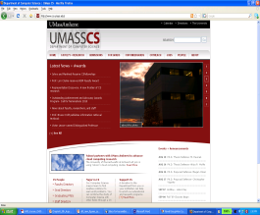
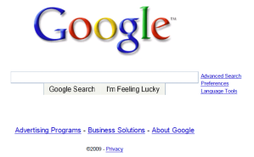
A day in the life …. : scenario
browser
DNS server
Comcast network
68.80.0.0/13
school network
68.80.2.0/24
web page
web server
Google’s network
64.233.160.0/19
64.233.169.105

Slide 5
A day in the life… connecting to the Internet
DHCP
DHCP
UDP
IP
Eth
Phy
connecting laptop needs to get its own IP address: use DHCP
DHCP
DHCP
DHCP
DHCP
DHCP request encapsulated in UDP, encapsulated in IP, encapsulated in Ethernet
DHCP
DHCP
UDP
IP
Eth
Phy
DHCP
DHCP
DHCP
DHCP
Ethernet frame broadcast (dest: FFFFFFFFFFFF) on LAN, received at router running DHCP server
router
(runs DHCP)
Ethernet demux’ed to IP demux’ed to UDP demux’ed to DHCP

Slide 6
A day in the life… connecting to the Internet
DHCP
DHCP
UDP
IP
Eth
Phy
DHCP server formulates DHCP ACK containing client’s IP address (and also IP address of first-hop router for client, name & IP address of DNS server)
DHCP
DHCP
DHCP
frame forwarded (switch learning) through LAN, demultiplexing at client
DHCP
DHCP
UDP
IP
Eth
Phy
DHCP
DHCP
DHCP
router
(runs DHCP)
DHCP client receives DHCP ACK reply
DHCP
Client now has IP address, knows name & addr of DNS
server, IP address of its first-hop router

Slide 7
A day in the life… ARP (before DNS, before HTTP)
DNS
UDP
IP
Eth
Phy
before sending HTTP request, need IP address of www.google.com: DNS
DNS
DNS
DNS
ARP
ARP query
DNS query created, encapsulated in UDP, encapsulated in IP, encasulated in Eth. In order to send frame to router, need MAC address of router interface: ARP
ARP
ARP reply
Eth
Phy
ARP query broadcast, received by router, which replies with ARP reply giving MAC address of router interface
client now knows MAC address of first hop router, so can now send frame containing DNS query

Slide 8
A day in the life… using DNS
DNS
UDP
IP
Eth
Phy
DNS
DNS server
DNS
UDP
IP
Eth
Phy
DNS
DNS
DNS
DNS
DNS
DNS
DNS
DNS
Comcast network
68.80.0.0/13
IP datagram forwarded from campus network to destination (DNS-server) network, routed (tables created by OSPF and BGP routing protocols) to DNS server
IP datagram containing DNS query forwarded via LAN switch from client to 1st hop router
demux’ed to DNS server
DNS server replies to client with IP address of www.google.com

Slide 9
A day in the life… TCP connection carrying HTTP
HTTP
HTTP
TCP
IP
Eth
Phy
SYNACK
SYN
SYNACK
SYN
SYNACK
SYN
SYN
to send HTTP request, client first opens TCP socket to web server
TCP SYN segment (step 1 in 3-way handshake) inter-domain routed to web server
TCP
IP
Eth
Phy
SYNACK
SYN
SYNACK
SYN
SYNACK
SYNACK
SYN
web server responds with TCP SYNACK
web server
64.233.169.105
TCP connection established!

Slide 10
A day in the life… HTTP request/reply
web page finally (!!!) displayed
HTTP
HTTP
TCP
IP
Eth
Phy
HTTP
HTTP
HTTP
HTTP
HTTP
HTTP
HTTP
HTTP
HTTP request sent into TCP socket
IP datagram containing HTTP request routed to www.google.com
HTTP
HTTP
TCP
IP
Eth
Phy
HTTP
HTTP
HTTP
web server responds with HTTP reply (containing web page)
HTTP
web server
64.233.169.105
IP datgram containing HTTP reply routed back to client

Slide 11
Roadmap
Synthesis: a day in the life of a web request
Putting lots-of-what-we-learned together: synthesis!
  goal: identify, review protocols (at all layers) involved in seemingly simple scenario: requesting www page
  scenario: student attaches laptop to campus network, requests/receives www.google.com
Highlights
…..

Slide 12
Principles, Organisation
Network Problems
Continuously evolving applications, mobility, performance, security, …, …
serving different types of traffic,
connecting transparently different networks,
routing, congestion control,
access to shared (broadcast) transmission medium
producer-consumer problems, flow and error control
Layering : principle, why

Slide 13
Highlights
Evolving types of applications: media, CDN, IoT
network security issues
TCP/IP, LAN evolving protocol stack (http2, quic, …)
delays performance
Routing + mobility + SDN
multiple access protocols (wired, wireless)
reliable data transfer
datagram vs VC
congestion control

Slide 14
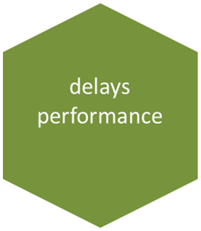
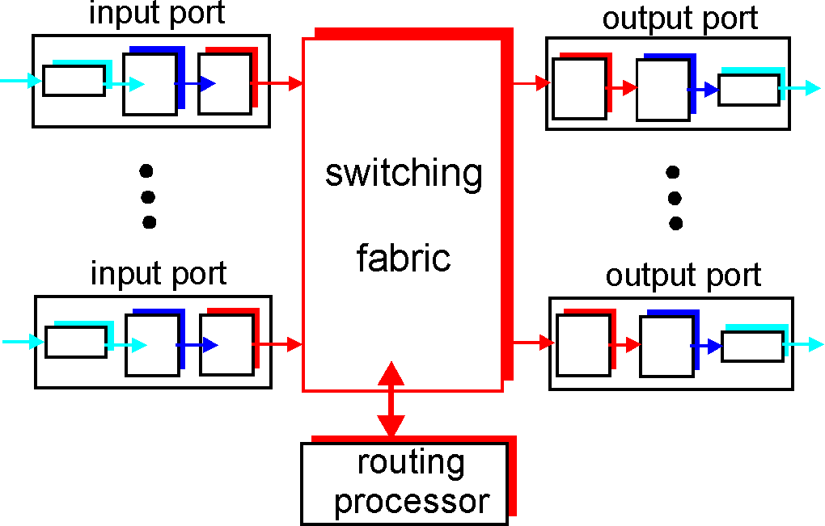
Types of delay; performance
Propagation, transmission, queueing, processing
Throughput (effective bandwidth), utilization -- efficiency
Packet-switching: impact of store&forward, pipelines, space-time diagrams
Sliding windows performance
Relation between delays-losses
transmission
A
propagation
B
nodal
processing
queuing

Slide 15
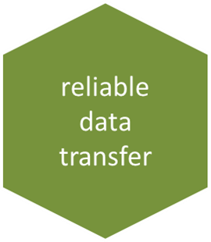
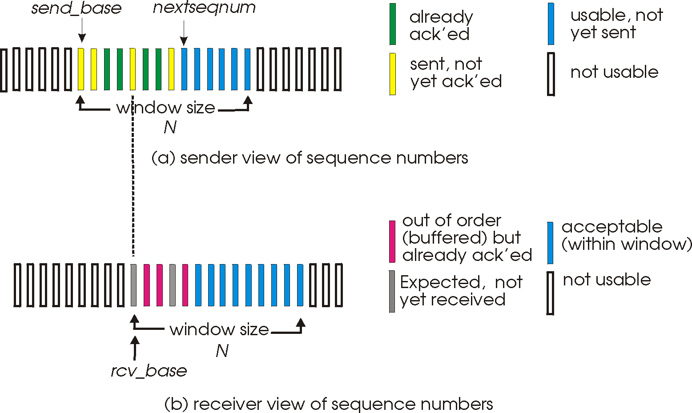
Reliable data transfer
Guaranteed, in-order, correct delivery:
  stop&wait
  sliding windows
  sequence numbers
  window sizes
  dynamic windows (TCP)
  flow control
Error detection: checksums
Error control: go-back-n, selective repeat, FEC methods

Slide 16
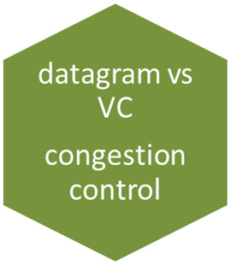
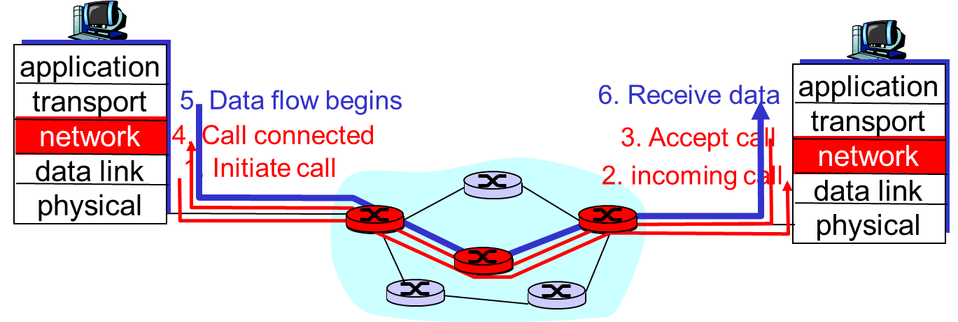
Datagram vs VC end-to-end comm.
Conceptual differences
Congestion
Control
RT traffic/streaming

Slide 17
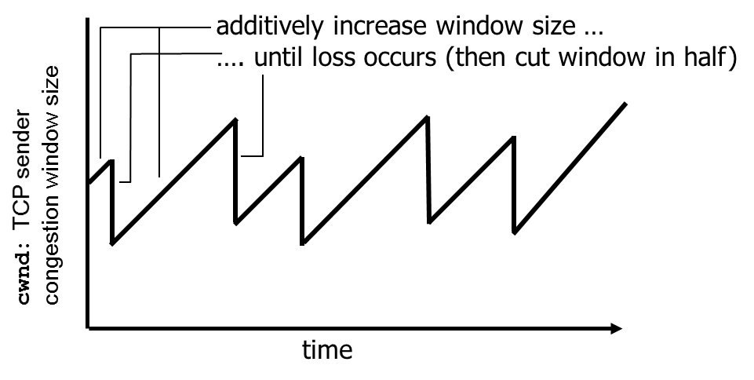
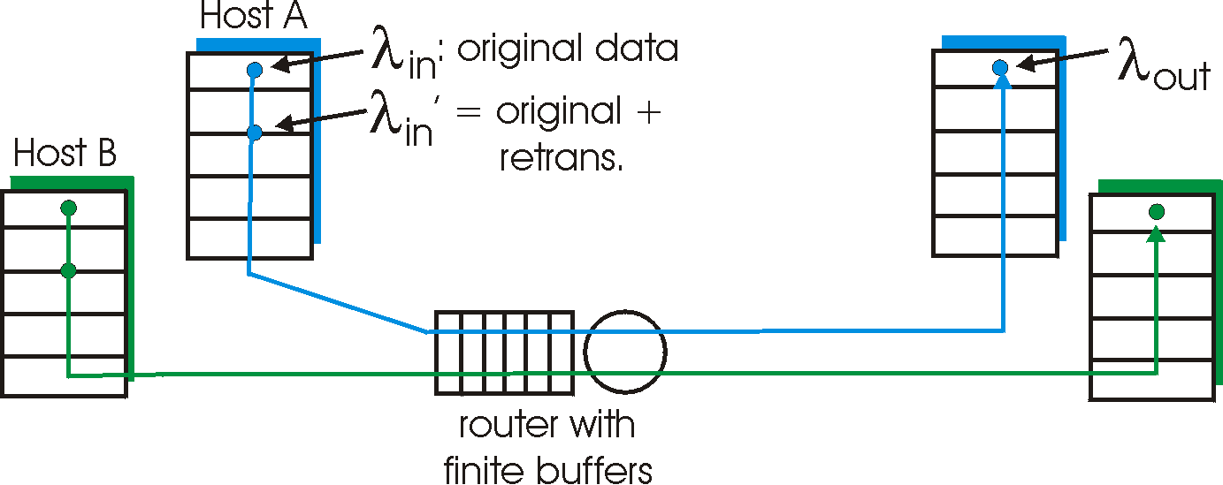
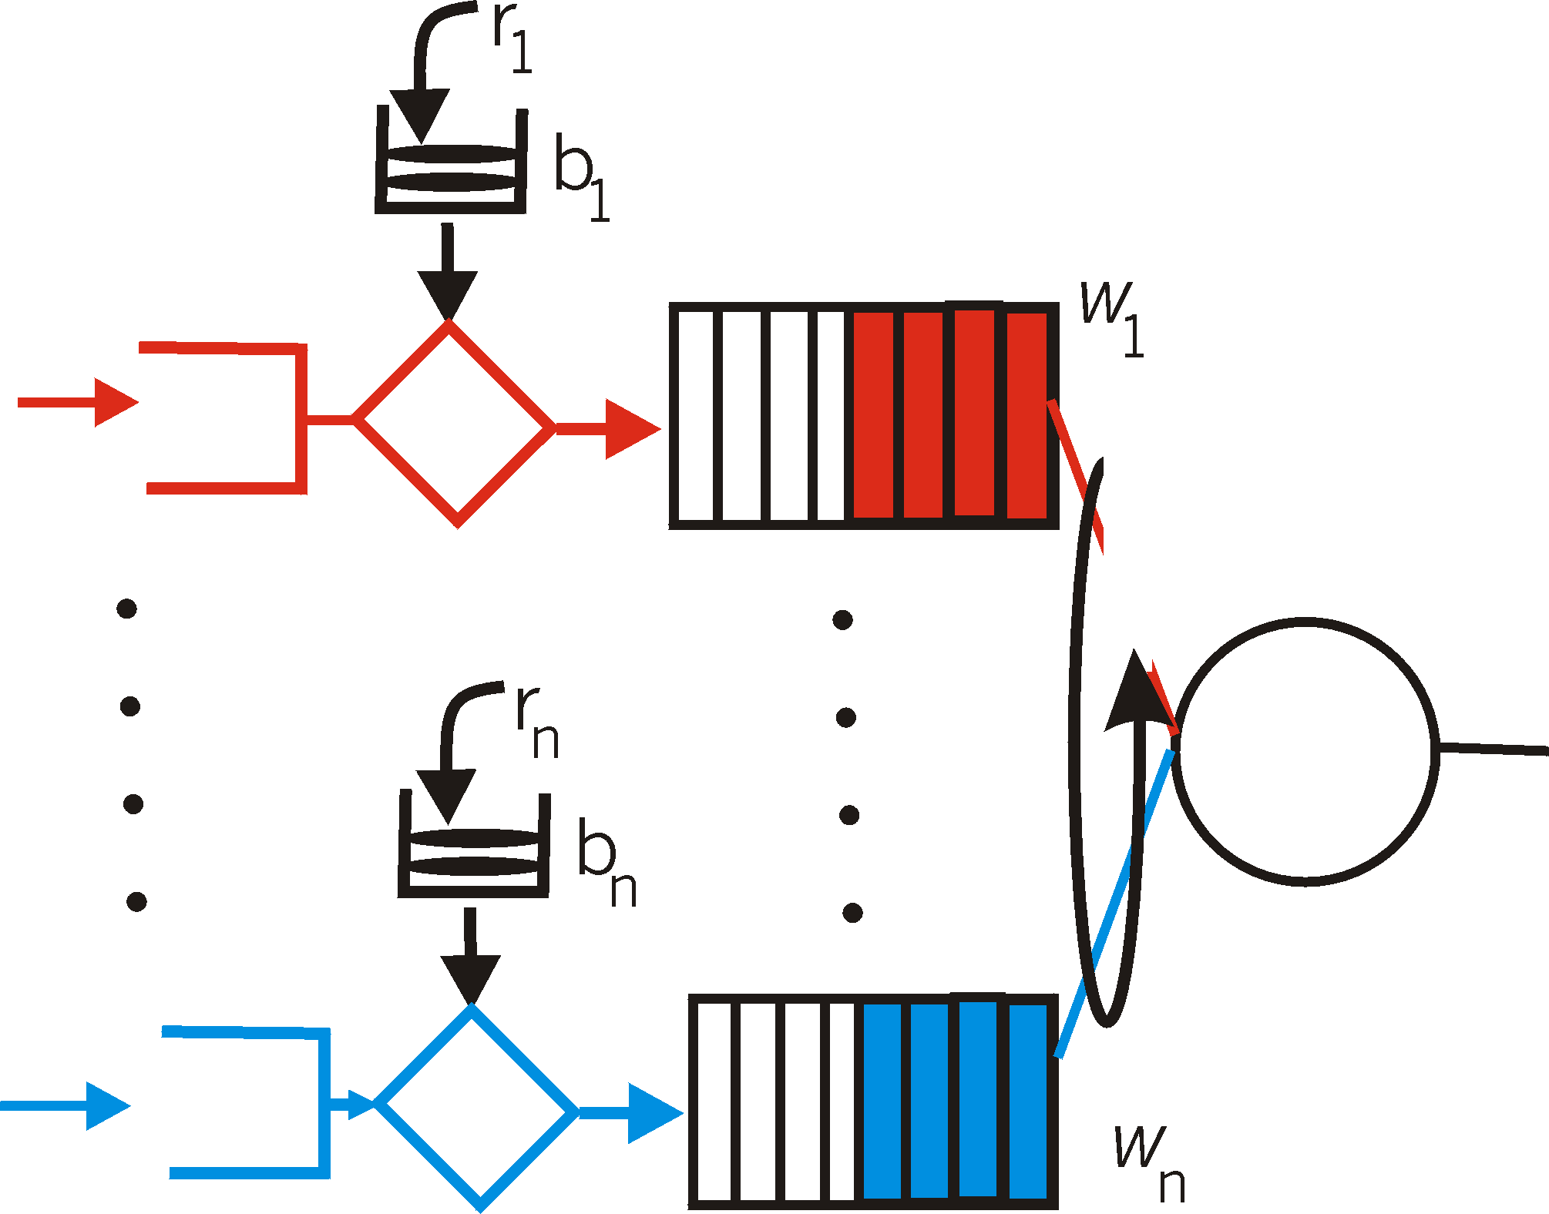
Congestion control (CC)
why, how congestion occurs
CC in TCP and performance; implied weaknesses
CC in other ways, e.g. VC-based networks
  Real-time (RT)-traffic resource reservation:
    traffic shaping and policing
  rate-based

Slide 18
Highlights
Evolving types of applications: media, CDN, IoT
network security issues
TCP/IP, LAN evolving protocol stack (http2, quic, …)
delays performance
Routing + mobility + SDN
multiple access protocols (wired, wireless)
reliable data transfer
datagram vs VC
congestion control

Slide 19
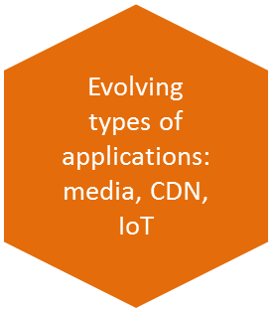
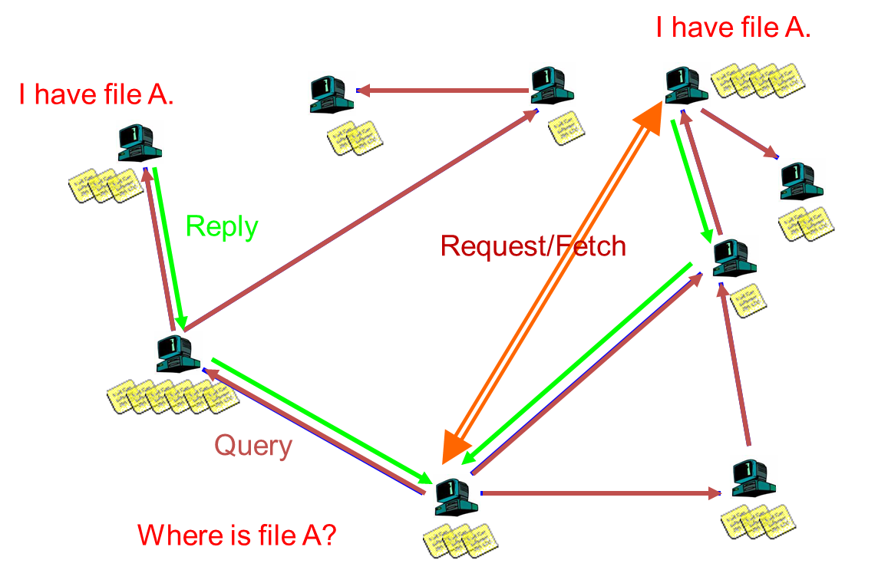
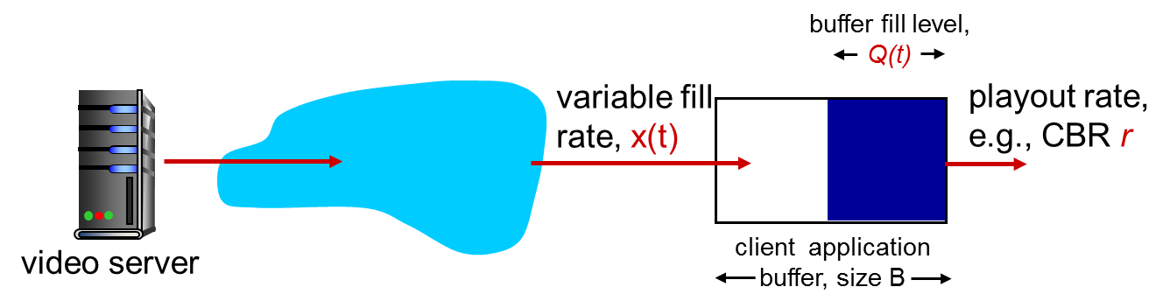
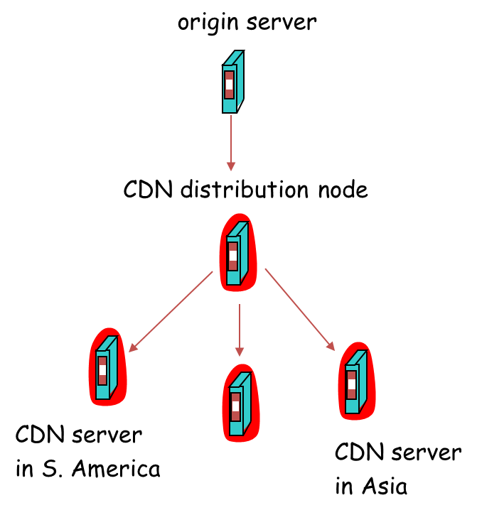
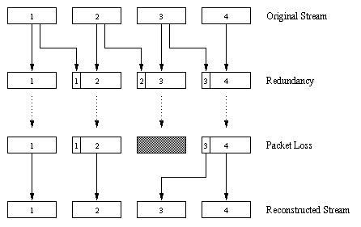
Evolving types of applications ++
P2P/streaming applications-infrastructure (application-layer networking)
Varying approaches for MM apps, besides conceptual, VC-related
  Application-level solutions (playout delay, forward-error-control, caching-CDN, FEC)
20

Slide 20
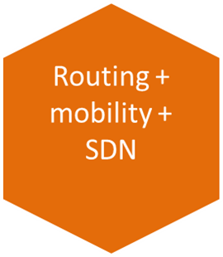
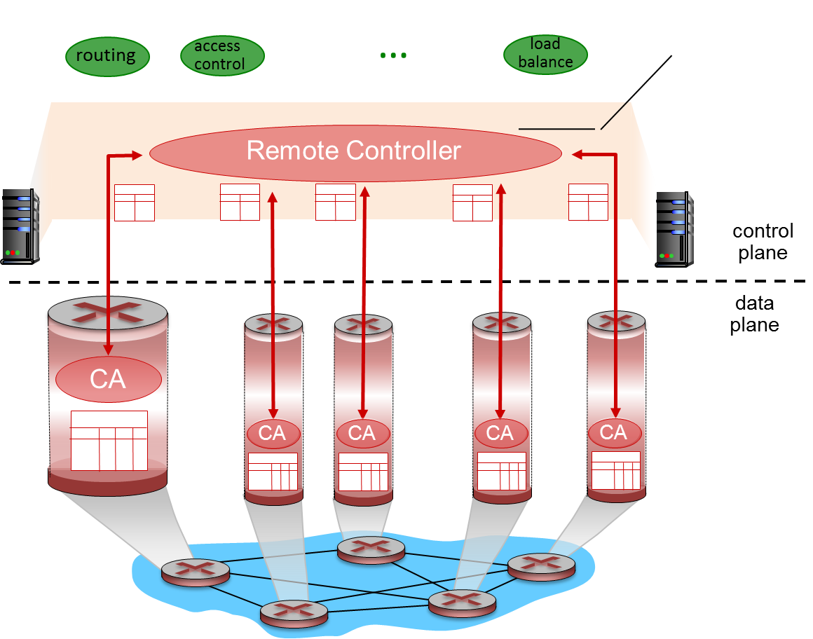

Routing + mobility + SDN
Routing algorithms, protocols
Forwarding in routers
Resource, policy issues
Data plane and control plane in SDN
Addressing mobility, tunneling
5
B
3
C
2
5
A
2
1
F
3
1
2
D
1
E
Mobile
Switching
Center
Public telephone
network, and
Internet
Mobile
Switching
Center

Slide 21
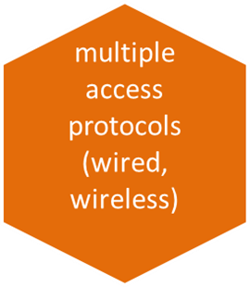
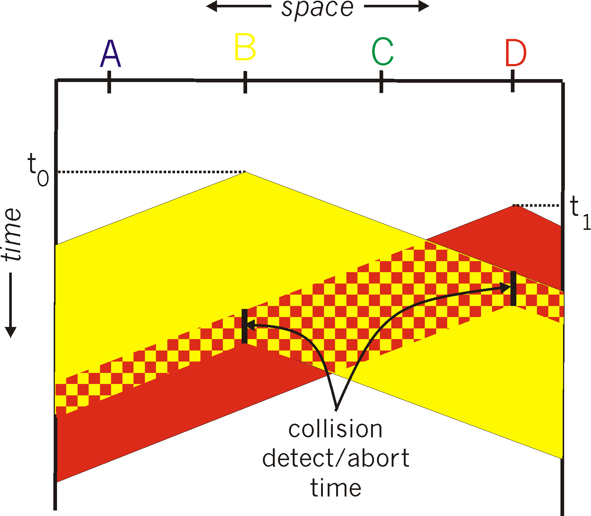

Medium access: multiple access methods
Strategies: (functionality, appropriateness)
Contention-based (random access), wired/wireless:
  Aloha, CSMA(CD/CA)
Collision-free:
  Channel partitioning: TDMA, FDMA, CDMA
  Taking turns: e.g. tokens, reservation-based
A
B
C
A’s signal
strength
C’s signal
strength
space

Slide 22




Security issues
C, I, A and methods to achieve them
  The language of cryptography
  Message integrity, signatures
Instantiation in Internet: SSL, IPsec
Firewalls
Alice
Bob
channel
data, control messages
secure
sender
s
data
secure
receiver
data
Trudy

Slide 23
Highlights
Evolving types of applications: media, CDN, IoT
network security issues
TCP/IP, LAN evolving protocol stack (http2, quic, …)
delays performance
Routing + mobility + SDN
multiple access protocols (wired, wireless)
reliable data transfer
datagram vs VC
congestion control

Slide 24
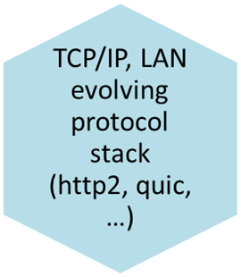
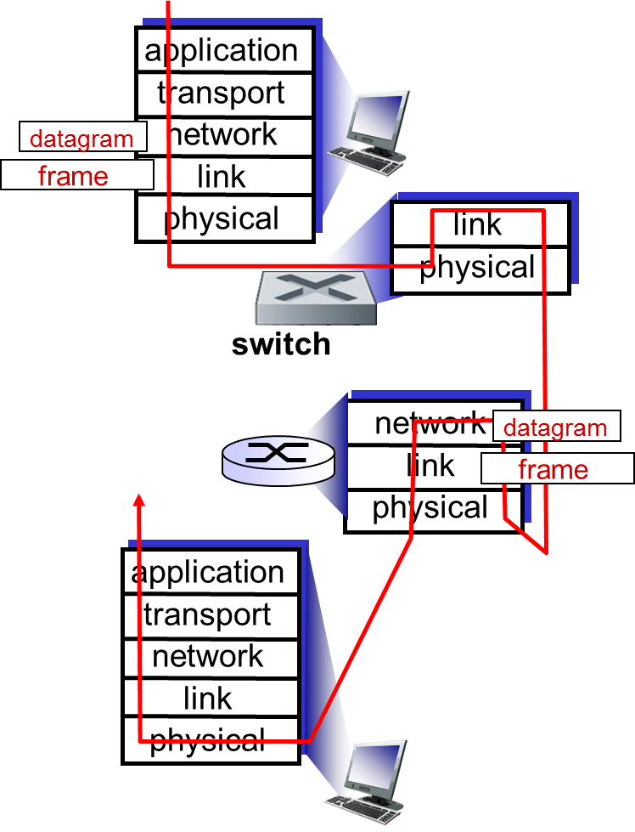
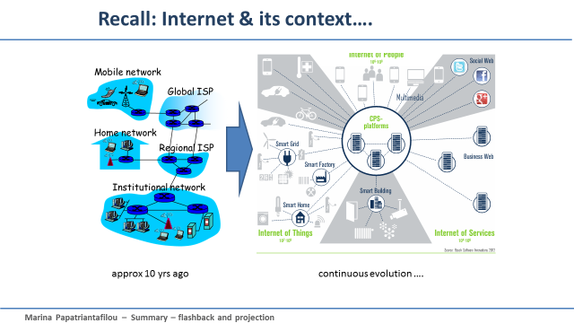
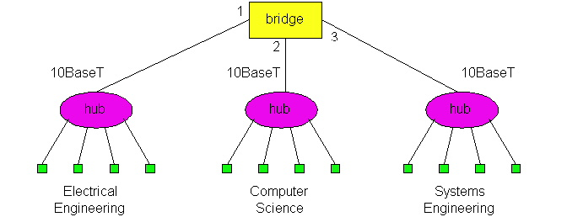
TCP/IP protocol stack, applications, evolution
Instantiation of network solutions, advantages, limitations, updates
  http, DNS, SMTP,
  TCP. UDP, IP, routing protocols
  LAN Protocol Examples: wired, wireless: Ethernet, 802.xy, GSM:
  Connecting devices: functionalities and differences (Hubs, switches)
  Algorithms for switch-”routing”: learning& forwarding of packets
  ARP
New types of applications and how they function in the Internet
  Changing NW-edge: Intserv/diffserv, http2, quic, IoT-related protocols…
switch

Slide 25
Roadmap
Synthesis: a day in the life of a web request
Putting lots-of-what-we-learned together: synthesis!
  goal: identify, review protocols (at all layers) involved in seemingly simple scenario: requesting www page
  scenario: student attaches laptop to campus network, requests/receives www.google.com
Highlights
Some questions asked by you

Slide 26
some questions asked by you:
How can we have reliable data transfer on top of UDP
  Implementation at app-layer
RDT with only NACK possible?:
  no-lossy channel
    Timeout => ok, msg received
  lossy channel:
    Cannot tell difference between late or lost….
Working with time-space diagrams
  Eg. what is a full utilization window?
sender
receiver
first packet bit transmitted, t = 0
last bit transmitted, t = L / R
first packet bit arrives
RTT
last packet bit arrives, send ACK
last bit of 2nd packet arrives, send ACK
last bit of 3rd packet arrives, send ACK
ACK arrives, send next
packet, t = RTT + L / R
E.g. for 100% utilization, calculate how many packets can fill in RTT + L / R, ie (RTT + L / R)/ (L / R)

Slide 27
Roadmap
Synthesis: a day in the life of a web request
Putting lots-of-what-we-learned together: synthesis!
  goal: identify, review protocols (at all layers) involved in seemingly simple scenario: requesting www page
  scenario: student attaches laptop to campus network, requests/receives www.google.com
Highlights
Some questions asked by you
Reflections, prespectives
…….

Slide 28
The Internet: virtualizing networks
Internetwork layer (IP):
addressing: internetwork appears as single, uniform entity, despite underlying local network heterogeneity
network of networks
Gateway:
“embed internetwork packets in local packet format”
route (at internetwork level) to next gateway
gateway
ARPAnet
satellite net

Slide 29
Internet structure: network of networks
… and content provider networks (e.g., Google, Microsoft, Akamai ) may run their own network, to bring services, content close to end users
…
…
access
net
access
net
access
net
access
net
access
net
access
net
access
net
ISP A
…
…
Content provider network
IXP
access
net
access
net
ISP B
ISP B
access
net
access
net
access
net
regional net
access
net
…
access
net
access
net
…
access
net

Slide 30
Internet structure: network of networks
Tier 1 ISP
Tier 1 ISP
Google
IXP
IXP
IXP
Regional ISP
Regional ISP
access
ISP
access
ISP
access
ISP
access
ISP
access
ISP
access
ISP
access
ISP
access
ISP

Slide 31
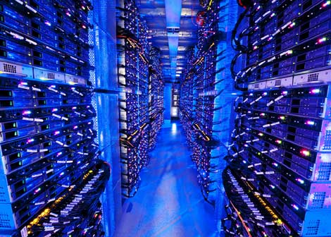
Data center networks
10’s to 100’s of thousands of hosts, often closely coupled, in close proximity:
  e-business (e.g. Amazon)
  content-servers (e.g., YouTube, Akamai, Apple, Microsoft)
  search engines, data mining (e.g., Google)
challenges:
  multiple applications, each serving massive numbers of clients
  managing/balancing load, networking, data bottlenecks
Inside a 40-ft Microsoft container,
Chicago data center

Slide 32
Data center networks
load balancer: application-layer routing
directs client requests (workload) within data center
rich interconnection among switches, racks:
  increased throughput between racks (multiple routing paths possible)
  increased reliability via redundancy
  Distributed systems & networks working together (guest lectures relevance)
Internet
Border router
Load
balancer
Load
balancer
Access router
B
Tier-1 switches
A
C
Tier-2 switches
TOR switches
Server racks
1
2
3
4
5
6
7
8

Slide 33
Thank you!
Synthesis: a day in the life of a web request
Putting lots-of-what-we-learned together: synthesis!
  goal: identify, review protocols (at all layers) involved in seemingly simple scenario: requesting www page
  scenario: student attaches laptop to campus network, requests/receives www.google.com
Highlights
Some questions asked by you
Reflections, prespectives
Recall, important for the exam:
When/where: wednesday March 14, 14.00-18.00, SB
You may have with you:
English-X dictionary
no calculators, PDAs, etc (if/where numbers matter, do rounding)
To think during last, summary-study
Overview; critical eye; explain; ask yourselves: why is this so? / How does it work?
Good luck with all your efforts!!!
“If you hear a voice within you say ‘you cannot paint,’ then by all means paint, and that voice will be silenced.” – Vincent Van Gogh

