Slide 1
Course on Computer Communication and Networks
Lecture 10
Continuously evolving Internet-working
Part A: p2p networking, media streaming, CDN
(TBC in part B: QoS, traffic engineering, SDN, IoT)
EDA344/DIT 423, CTH/GU

Slide 2
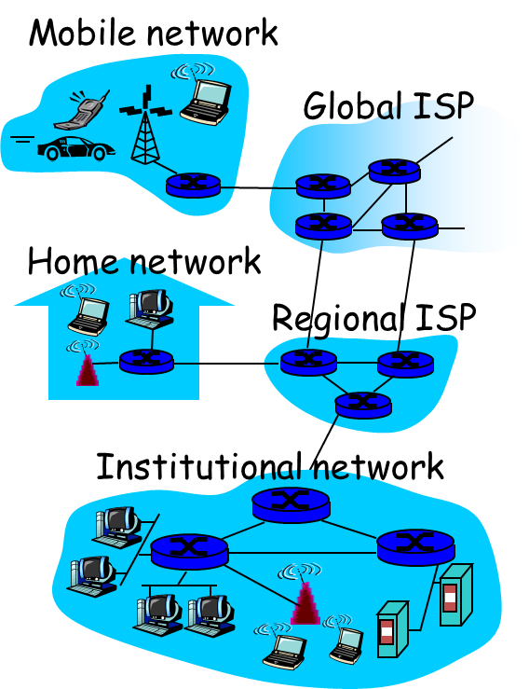
Internet & its context….
Multimedia
approx 10 yrs ago
continuous evolution ….

Slide 3
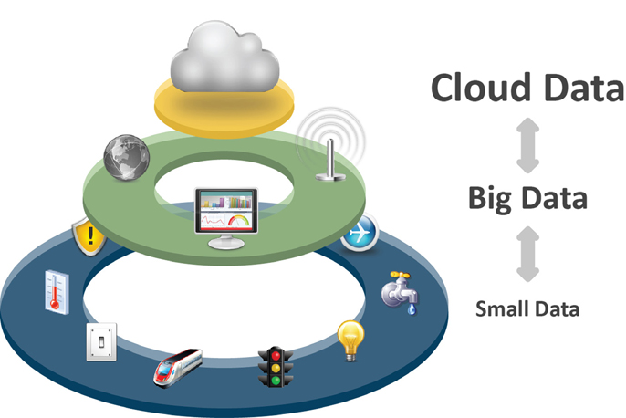
Internet, Data processing and Distributed Computing in interplay: IoT
http://www.iebmedia.com/

Slide 4


Internet protocol stack layers&protocols
Application: protocols supporting network applications
  http (web), smtp (email), p2p, streaming, CDN, …
transport: process2process (end2end) data transfer
  UDP, TCP
network: routing of datagrams (independent data-packets), connecting different physical networks
  IP addressing, routing protocols, virtualization, virtualization, …
link: data transfer between neighboring (physically connected) hosts
  Ethernet, WiFi, …
physical: bit-transmission on the physical medium between neighboring nodes
application
transport
network
link
physical
UDP
TCP

Slide 5
Recall: the Internet concept: virtualizing networks
1974: multiple unconnected nets
  ARPAnet
  data-over-cable networks
  packet satellite network (Aloha)
  packet radio network
… differing in:
  addressing conventions
  packet formats
  error recovery
  routing
ARPAnet
satellite net
"A Protocol for Packet Network Intercommunication", V. Cerf, R. Kahn, IEEE Transactions on Communications, May, 1974, pp. 637-648.

Slide 6
The Internet: virtualizing networks
Internetwork layer (IP):
addressing: internetwork appears as single, uniform entity, despite underlying local network heterogeneity
network of networks
Gateway:
“embed internetwork packets in local packet format”
route (at internetwork level) to next gateway
gateway
ARPAnet
satellite net

Slide 7
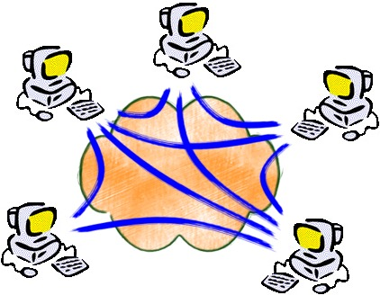
Notice: virtualization & network overlays
Overlay: a network implemented on top of a network
What else to do with this?

Slide 8


Roadmap
P2P apps and overlays for info sharing Ch: 2.5 7e (2.6 6/e)
Collaborate/form-overlays to find content:
  Unstructured overlays
  Structured Overlays/DHT
Collaborate/form-overlays to fetch content
Media Streaming Ch 9.1-9.3 & 2.6 7e (7.1-7.3 6/e)
  Application classes, challenges
  Today’s applications representative technology
    Recovery from jitter and loss
    Streaming protocols and new proposals
    CDN: overlays infrastructure for content delivery

Slide 9

















Pure P2P architecture
no always-on server
arbitrary end systems communicate directly
peers are intermittently connected and may change IP addresses
examples:
  file distribution/sharing
  Streaming multimedia (KanKan)
  VoIP (Skype)

Slide 10


P2P: centralized directory
File-sharing peer-to-peer (p2p) applications: preliminaries
Background: Common Primitives in file-sharing p2p apps:
Join: how do I begin participating?
Publish: how do I advertise my file?
Search: how to I find a file?
Fetch: how to I retrieve a file?
Bob
centralized
directory server
File transfer:
HTTP
1
peers
1
original “Napster” design (1999, S. Fanning)
1) when peer connects, it informs central server:
  IP address, content
2) Alice queries directory server for “LetItBe”
3) Alice requests file from Bob
1
3
2
1
Alice
Q: What is p2p in this?

Slide 11
Roadmap
P2P apps and overlays for info sharing Ch: 2.5 7e (2.6 6/e)
Collaborate/form-overlays to find content:
  Unstructured overlays
  Structured Overlays/DHT
Collaborate/form-overlays to fetch content
Media Streaming Ch 9.1-9.3 & 2.6 7e (7.1-7.3 6/e)
  Application classes, challenges
  Today’s applications representative technology
    Recovery from jitter and loss
    Streaming protocols and new proposals
    CDN: overlays infrastructure for content delivery

Slide 12
P2p Gnutella (no directory): protocol
Query Flooding:
Join: on startup, client connects to a few other nodes (learn from bootstrap-node); these become its “neighbors” (overlay!! ☺)
Publish: no need
Search: ask “neighbors”, who ask their neighbors, and so on... when/if found, reply to sender.
Fetch: get the file directly from peer
File transfer:
HTTP
Query
QueryHit
Query
Query
QueryHit
Query
QueryHit
Query

Slide 13


KaZaA : distributed directory
“Smart” Query Flooding:
Join: on startup, client contacts a “supernode” ... may at some point become one itself
Publish: send list of files to supernode
“Super Nodes”
insert(X,
123.2.21.23)
...
Publish
I have X!
123.2.21.23

Slide 14
KaZaA: Search
“Smart” Query Flooding:
Search: send query to supernode, supernodes flood query amongst themselves.
Fetch: get the file directly from peer(s); can fetch simultaneously from multiple peers
search(A)
-->
123.2.22.50
“Super Nodes”
search(A)
-->
123.2.0.18
123.2.22.50
Query
Replies
Where is file A?
Skype’s architecture
(so far…)
Q: Compare with Napster, Gnutella (publishing, searching)
123.2.0.18

Slide 15
Roadmap
P2P apps and overlays for info sharing Ch: 2.5 7e (2.6 6/e)
Collaborate/form-overlays to find content:
  Unstructured overlays
  Structured Overlays/DHT
Collaborate/form-overlays to fetch content
Media Streaming Ch 9.1-9.3 & 2.6 7e (7.1-7.3 6/e)
  Application classes, challenges
  Today’s applications representative technology
    Recovery from jitter and loss
    Streaming protocols and new proposals
    CDN: overlays infrastructure for content delivery

Slide 16
Problem revisited: formulation
How to find data in a distributed file sharing system?
(aka “routing” to the data, i.e. content-oriented routing)
N₂
N₃
Publisher
N₁
Key=“LetItBe”
Value=MP3 data
Internet
N₅
?
N₄
Client
Lookup(“LetItBe”)
How to do Lookup?

Slide 17
Centralized Solution
Central server (Napster)
N₂
N₃
Publisher
N₁
Key=“LetItBe”
Value=MP3 data
Internet
DB
N₅
N₄
Client
Lookup(“LetItBe”)
O(peers,items) state at server, O(1) at client, O(1) cost of update
O(1) search communication overhead
Single point of failure

Slide 18
Fully decentralized (elementary distributed) solution
Flooding (Gnutella, etc.)
N₂
N₃
Publisher
N₁
Key=“LetItBe”
Value=MP3 data
Internet
N₅
N₄
Client
Lookup(“LetItBe”)
O(1) state per node, O(1) cost of update
Worst case O(peers, items) complexity per lookup

Slide 19
Better Distributed Solution?
(with some more structure? In-between the two? Yes)
balance the update/lookup complexity;
Abstraction: a lookup data structure (distributed “hash-table” DHT) :
  insert(key, item);
  item = get(key);
Each node (peer) is responsible for
Maintaining part of the database in a structured manner (ie the entries that are hash-mapped to it)
Knowing its overlay neighbours & who to start asking for what
Eg. overlay (used for propagating queries) can be a ring (eg Chord, also having shortcuts for binary serach) or cube, tree, butterfly network, etc
Publisher
Key=“LetItBe”
Value=MP3 data
N₂
N₃
N₁
Internet
N₅
N₄
Client
Lookup(“LetItBe”)

Slide 20
Roadmap
P2P apps and overlays for info sharing Ch: 2.5 7e (2.6 6/e)
Collaborate/form-overlays to find content:
  Unstructured overlays
  Structured Overlays/DHT
Collaborate/form-overlays to fetch content
Media Streaming Ch 9.1-9.3 & 2.6 7e (7.1-7.3 6/e)
  Application classes, challenges
  Today’s applications representative technology
    Recovery from jitter and loss
    Streaming protocols and new proposals
    CDN: overlays infrastructure for content delivery

Slide 21

Second generation p2p: focus on fetching
Motivation:
Popularity exhibits temporal locality (Flash Crowds)
Can bring file “provider” to “its knees”
Idea:
Files are “chopped” in chunks; fetch from many sources (swarming)
Overlay: nodes “hold hands” with those who share chunks at similar rates
torrent: group of
peers exchanging
chunks of a file
tracker: tracks peers
participating in torrent
Join: contact a server, aka “tracker” get a list of peers.
Publish: can run a tracker server.
Search: Out-of-band. E.g., use search-engine, or DHT, … to find a tracker, which gives list of peers to contact
Fetch: Download chunks from several of peers. Upload chunks you have to them.
obtain list
of peers
trading
chunks
Used by publishers to distribute software, other large files
peer

Slide 22
Roadmap
P2P apps and overlays for info sharing Ch: 2.5 7e (2.6 6/e)
Collaborate/form-overlays to find content:
  Unstructured overlays
  Structured Overlays/DHT
Collaborate/form-overlays to fetch content
Media Streaming Ch 9.1-9.3 & 2.6 7e (7.1-7.3 6/e)
  Application classes, challenges
  Today’s applications representative technology
    Recovery from jitter and loss
    Streaming protocols and new proposals
    CDN: overlays infrastructure for content delivery

Slide 23


multimedia applications: network audio and video
(“continuous media”)

Slide 24
Multimedia: audio
analog audio signal sampled at constant rate
  telephone: 8,000 samples/sec
  CD music: 44,100 samples/sec
  eg: 8,000 samples/sec, 256 quantized levels: 64,000 bps
receiver converts bits back to analog signal:
example rates
CD: 1.411 Mbps
MP3: 96, 128, 160 kbps
Internet telephony: 5.3 kbps and up
quantization error
quantized value of
analog value
analog
signal
audio signal amplitude
time
sampling rate
(N sample/sec)

Slide 25

Multimedia: video
spatial coding example: instead of sending N values of same color (all purple), send only two values: color value (purple) and number of repeated values (N)
video: sequence of images (arrays of pixels) displayed at constant rate
  e.g. 24 images/sec
CBR: (constant bit rate): video encoding rate fixed
VBR: (variable bit rate): video encoding rate changes as amount of spatial, temporal coding changes
examples:
  MPEG 1 (CD-ROM) 1.5 Mbps
  MPEG2 (DVD) 3-6 Mbps
  MPEG4 (often used in Internet, < 1 Mbps)
……………………...…
……………………...…
frame i
temporal coding example: instead of sending complete frame at i+1, send only differences from frame i
frame i+1

Slide 26
Multimedia networking: application types
streaming stored audio, video
  streaming: can begin play before downloading entire file (implies storing/buffering at client)
  e.g., YouTube, Netflix,
streaming live audio, video
  e.g., live sporting event, …
conversational voice/video
  interactive nature limits delay tolerance; e.g., Skype
Fundamental characteristics:
typically delay sensitive
  end-to-end delay
  delay jitter
loss tolerant: infrequent losses cause only minor glitches
In contrast to traditional data-traffic apps, which are loss intolerant but delay tolerant.
Jitter is the variability of packet delays within the same packet stream

Slide 27
Recall Internet’s transport services: TCP, UDP
no guarantees on delay….
?
?
?
?
?
?
But you said multimedia apps require
Delay/jitter (ie bandwidth) guarantees to be
effective!
?
?
?
?
?
Internet multimedia applications
use application-level techniques to mitigate
(as best possible) effects of delay, loss;
(Also complementing with “traffic engineering”
& Software-Defined Networking in NW core: discussion next lectures)

Slide 28
Solution Approaches in Internet
To mitigate impact of “best-effort” protocols:
Several applications use UDP to avoid TCP’s ack-based progress (and slow start)…
Buffer content at client and control playback to remedy jitter
Different error control methods (no ack)
Exhaust all uses of caching, proxys, etc
Adapt compression level to available bandwidth
add more bandwidth
Traffic engineering, SDN

Slide 29
Roadmap
P2P apps and overlays for info sharing Ch: 2.5 7e (2.6 6/e)
Collaborate/form-overlays to find content:
  Unstructured overlays
  Structured Overlays/DHT
Collaborate/form-overlays to fetch content
Media Streaming Ch 9.1-9.3 & 2.6 7e (7.1-7.3 6/e)
  Application classes, challenges
  Today’s applications representative technology
    Recovery from jitter and loss
    Streaming protocols and new proposals
    CDN: overlays infrastructure for content delivery

Slide 30
Streaming: recovery from jitter
playout delay small => higher loss rate
constant bit
rate video
transmission
client video
reception
constant bit
rate video
playout at client
Cumulative data
variable
network
delay
buffered
video
client playout
delay
time
client-side buffering and playout delay: compensate for network-added delay, delay jitter

Slide 31

Client-side buffering, playout
buffer fill level, Q(t)
variable fill
rate, x(t)
playout rate,
e.g., CBR r
video server
client application
buffer, size B
client
1. Initial fill of buffer until …
2. … playout begins at t_{p,}
3. buffer fill level varies as fill rate x(t) varies, but playout rate r is constant

Slide 32
Client-side buffering, playout
buffer fill level, Q(t)
variable fill
rate, x(t)
playout rate,
e.g., CBR r
video server
client application
buffer, size B
playout buffering: average fill rate (x), playout rate (r):
x < r: buffer eventually empties (causing freezing of video playout until buffer again fills)
x > r: need to have enough buffer-space to absorb variability in x(t)
initial playout delay tradeoff:
+ buffer empty less likely with larger delay, but
- larger delay until user begins watching

Slide 33
Roadmap
P2P apps and overlays for info sharing Ch: 2.5 7e (2.6 6/e)
Collaborate/form-overlays to find content:
  Unstructured overlays
  Structured Overlays/DHT
Collaborate/form-overlays to fetch content
Media Streaming Ch 9.1-9.3 & 2.6 7e (7.1-7.3 6/e)
  Application classes, challenges
  Today’s applications representative technology
    Recovery from jitter and loss
    Streaming protocols and new proposals
    CDN: overlays infrastructure for content delivery

Slide 34
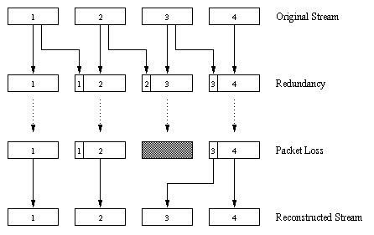
Recovery From Packet Loss: Forward Error Correction (FEC)
Eg. 1. through piggybacking Lower Quality Stream
sender
receiver
Why care about FEC?

Slide 35
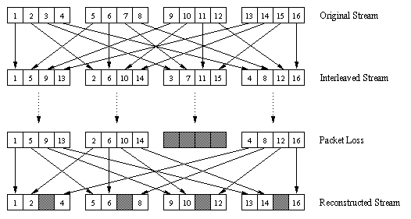
Recovery From Packet Loss/FEC (cont)
2. Interleaving:
  Upon loss, have a set of partially filled chunks
  Playout time must adapt to receipt of group (risk wrt Real-Time requirements)
sender
receiver

Slide 36
Roadmap
P2P apps and overlays for info sharing Ch: 2.5 7e (2.6 6/e)
Collaborate/form-overlays to find content:
  Unstructured overlays
  Structured Overlays/DHT
Collaborate/form-overlays to fetch content
Media Streaming Ch 9.1-9.3 & 2.6 7e (7.1-7.3 6/e)
  Application classes, challenges
  Today’s applications representative technology
    Recovery from jitter and loss
    Streaming protocols and new proposals
    CDN: overlays infrastructure for content delivery

Slide 37
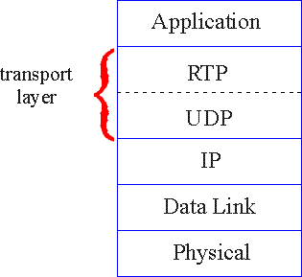

Real-Time Protocol (RTP) RFC 3550
RTP specifies packet structure for carrying audio, video data
  payload type (encoding)
  sequence numbering
  time stamping
RTP does not provide any mechanism to ensure timely data delivery or other guarantees
RTP encapsulation only seen at end systems
RTP packets encapsulated in UDP segments
interoperability: e.g. if two Internet phone applications run RTP, then they may be able to work together

Slide 38
Streaming multimedia: UDP
server sends at rate appropriate for client
  often: send rate = encoding rate
  send rate can be oblivious to congestion levels (is this good? selfish?)
short playout delay to remove network jitter
BUT: UDP may not go through firewalls

Slide 39

Streaming multimedia: HTTP (ie through TCP)
multimedia file retrieved via HTTP GET
send at maximum possible rate under TCP
variable rate, x(t)
video
file
TCP send buffer
TCP receive buffer
application playout buffer
server
client
fill rate fluctuates due to TCP congestion control, retransmissions (in-order delivery)
larger/adaptive playout delay: to smooth TCP saw-tooth delivery rate
HTTP/TCP passes easier through firewalls

Slide 40


Streaming multimedia: DASH:
Dynamic, Adaptive Streaming over HTTP
1.5 Mbps encoding
28.8 Kbps encoding
server:
  divides video file into multiple chunks
  each chunk stored, encoded at different rates
  manifest file: provides URLs for different chunks
client:
  periodically measures server-to-client bandwidth
  consulting manifest, requests one chunk at a time, at appropriate coding rate
    can choose different coding rates at different points in time (depending on available bandwidth at time)

Slide 41
HTTP/2 (HTTP/2.0, RFC 7540)
Derived from SPDY (introduced by Google)
Does not require changes to existing web apps
New: how data is framed and transported, e.g.:
  header compression + websites can “minify” resources e.g. images, scripts
  server can "push" content, i.e. respond with more data than the client requested
  prioritization of requests, multiplexing
Some criticism
violates the protocol layering principle, e.g. duplicates flow control (transport layer issue)
overwhelming complexity [P.H. Kamp, ACM queue 2015]
Common client implementations (Firefox, Chrome, Safari, Opera, IE, Edge) only support HTTP/2 over encrypted channels (TLS)

Slide 42
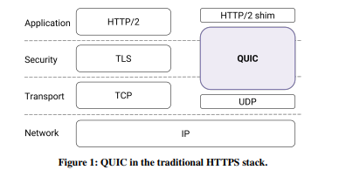
QUIC (Quick UDP Internet Connections)
Announced publicly in 2013 [Google], … to improve performance of connection-oriented web apps that used TCP
supports MUXed connections over UDP
designed for security protection equivalent to TLS/SSL
bandwidth estimation to avoid congestion (congestion avoidance into the application space)
Langley et-al; Quic; ACM SIGCOMM '17, DOI: https://doi.org/10.1145/3098822.3098842
See also: Kohler et-al DCCP:. SIGCOMM Comp. Commun. 2006, DOI=10.1145/1151659.1159918 http://doi.acm.org/10.1145/1151659.1159918
2015: Internet Draft of a specification for QUIC submitted to the IETF for standardization
QUIC working group: multipath support & forward error correction (FEC) as next steps

Slide 43
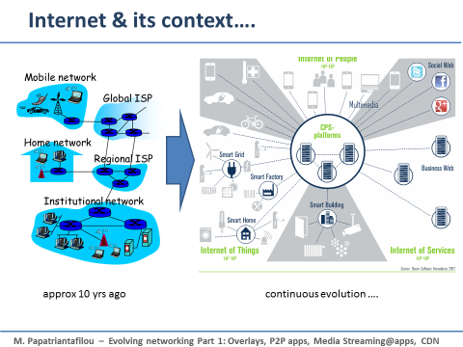
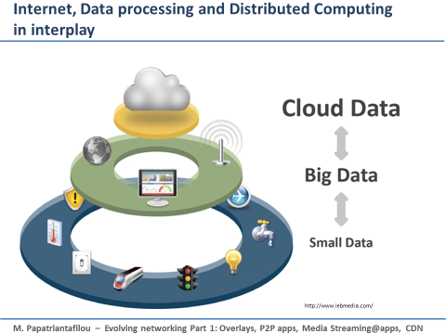
Roadmap
P2P apps and overlays for info sharing Ch: 2.5 7e (2.6 6/e)
Collaborate/form-overlays to find content:
  Unstructured overlays
  Structured Overlays/DHT
Collaborate/form-overlays to fetch content
Media Streaming Ch 9.1-9.3 & 2.6 7e (7.1-7.3 6/e)
  Application classes, challenges
  Today’s applications representative technology
    Recovery from jitter and loss
    Streaming protocols and new proposals
    CDN: overlays infrastructure for content delivery

Slide 44
Content distribution networks (CDNs)
  Resembles DNS and overlay networks in P2P applications!
  KanKan does use a mixed p2p &CDN approach
Scalability big problem to stream large files from single origin server in real time to millions end-hosts
A solution: Content replication at more servers
  content downloaded to CDN servers in pull or push manner
  content “close” to user avoids impairments (loss, delay) of long paths
    enter deep: push CDN servers deep into many access networks
    bring home: smaller number (10’s) of larger clusters in IPX near (but not within) access networks
    Eg Google, Netflix use combinations of those with private networks
origin server
CDN distribution node
Video link: http://vimeo.com/26469929

Slide 45





Content Distribution Networks (CDNs)
CDN: stores copies of content at CDN nodes
  e.g. Netflix stores copies of MadMen
subscriber requests content from CDN
  directed to nearby copy, retrieves content
  may choose different copy if network path congested
…
…
…
manifest file
…
where’s Madmen?
…
…
Notes:
45
Akamai: 100,000+ servers in 1000+ clusters in 1000+ networks in 70+ countries serving trillions of requests a day.
How many people use Netflix?

Slide 46
CDN: “simple” content access scenario
Bob (client) requests video http://netcinema.com/6Y7B23V
video stored in CDN at http://KingCDN.com/NetC6y&B23V
1. Bob gets URL for video http://netcinema.com/6Y7B23V
from netcinema.com
web page
2. resolve http://netcinema.com/6Y7B23V
via Bob’s local DNS
1
2
6. request video from
KINGCDN server,
streamed via HTTP/DASH
5
4&5. Resolve
http://KingCDN.com/NetC6y&B23
via KingCDN’s authoritative DNS, which returns IP address of KIingCDN
server with video
netcinema.com
3. netcinema’s DNS returns URL
http://KingCDN.com/NetC6y&B23V
4
3
Eg Netflix’ CDN approach
netcinema’s
authorative DNS
KingCDN.com
KingCDN
authoritative DNS
youtube.com/watch?v=LkLLpYdDINA
youtube.com/watch?v=tbqcsHg-Q_o

Slide 47
Case study: Netflix
upload copies of multiple versions of video to CDNs
Amazon cloud
Netflix registration,
accounting servers
CDN
server
3. Manifest file
returned for
requested video
2. Bob browses
Netflix video
2
3
1
CDN
server
1. Bob manages Netflix account
4. DASH streaming
CDN
server
Netflix uploads copy of video to cloud, which
  creates multiple versions of movie (different encodings) in cloud
  uploads versions from cloud to CDN servers;
user downloads the suitable encoding from them
youtube.com/watch?v=LkLLpYdDINA
youtube.com/watch?v=tbqcsHg-Q_o

Slide 48
Up to this point summary Internet Multimedia
use UDP to avoid TCP congestion control (delays) for time-sensitive traffic; or multiple TCP connections (DASH + new http/2, ….)
  Buffering and client-side adaptive playout delay: to compensate for delay
  error recovery (on top of UDP)
    FEC, interleaving, error concealment
CDN: bring content closer to clients
server side matches stream bandwidth to available client-to-server path bandwidth
  chose among pre-encoded stream rates
  dynamic server encoding rate
Q: could this be simpler with Network (layer) support?

Slide 49
Roadmap
P2P apps and overlays for info sharing Ch: 2.5 7e (2.6 6/e)
Collaborate/form-overlays to find content:
  Unstructured overlays
  Structured Overlays/DHT
Collaborate/form-overlays to fetch content
Media Streaming Ch 9.1-9.3 & 2.6 7e (7.1-7.3 6/e)
  Application classes, challenges
  Today’s applications representative technology
    Recovery from jitter and loss
    Streaming protocols and new proposals
    CDN: overlays infrastructure for content delivery
Next: could this be simpler with Network (layer) support?

Slide 50
Reading instructions and pointers for further study
P2P apps and overlays for info sharing Ch: 2.5 7e (2.6 6/e)
Media Streaming & support from applications Ch 9.1-9.3 & 2.6 7e ( 7.1-7.3 6/e)
Upkar Varshney, Andy Snow, Matt McGivern, and Christi Howard. 2002. Voice over IP. Commun. ACM 45, 1 (January 2002), 89-96. DOI=10.1145/502269.502271
Jussi Kangasharju, James Roberts, Keith W. Ross, Object replication strategies in content distribution networks, Computer Communications, Volume 25, Issue 4, 1 March 2002, Pages 376-383, ISSN 0140-3664, http://dx.doi.org/10.1016/S0140-3664(01)00409-1 .
K.L Johnson, J.F Carr, M.S Day, M.F Kaashoek, The measured performance of content distribution networks, Computer Communications, Volume 24, Issue 2, 1 February 2001, Pages 202-206, ISSN 0140-3664, http://dx.doi.org/10.1016/S0140-3664(00)00315-7 .
Eddie Kohler, Mark Handley, and Sally Floyd. 2006. Designing DCCP: Congestion control without reliability. SIGCOMM Comput. Commun. Rev. 36, 4 (August 2006), 27-38. DOI=10.1145/1151659.1159918 http://doi.acm.org/10.1145/1151659.1159918
Langley et-al; Quic; ACM SIGCOMM '17, DOI: https://doi.org/10.1145/3098822.3098842
Applications in p2p sharing, eg dissemination and media streaming
  J. Mundinger, R. R. Weber and G. Weiss. Optimal Scheduling of Peer-to-Peer File Dissemination. Journal of Scheduling, Volume 11, Issue 2, 2008. [arXiv] [JoS]
  Christos Gkantsidis and Pablo Rodriguez, Network Coding for Large Scale Content Distribution, in IEEE INFOCOM, March 2005 (Avalanche swarming: combining p2p + media streaming)

Slide 51
Review questions
R2.21, R2.24, R9.5, R9.7, R9.8, R9.9, R9.11 (7e)
What is CDN? Explain the motivation for introducing them and outline their functionality.
Consider Bob (client) requests video http://netcinema.com/6Y7B23V; video stored in CDN at http://KingCDN.com/NetC6y&B23V. Describe the networking steps (protocols, nodes) that make it possible for Bob to watch the video.

Slide 52
Extra notes / for further study

Slide 53
Gnutella: Search
I have file A.
I have file A.
Reply
Request/Fetch
Query
Where is file A?
Q: Compare with Napster

Slide 54
Discussion +, -?
Napster
Pros:
  Simple
  Search scope is O(1)
Cons:
  Server maintains O(peers,items) State
  Server performance bottleneck
  Single point of failure
Gnutella:
Pros:
  Simple
  Fully de-centralized
  Search cost distributed
Cons:
  Search scope is O(peers, items)
  Search time is O(???)

Slide 55
Synch questions:
how are the ”neighbors” connected?
what is the overlay here useful for?
  Edge is not a single physical link E.g. edge between peer X and Y if they know each-other’s IP addresses or there’s a TCP connection
  Used for supporting the search operation (aka routing in p2p networks)

Slide 56
KaZaA: Discussion
Pros:
  Tries to balance between search overhead and space needs (trading-off Napster’s & Gnutella’s extremes)
  Tries to take into account node heterogeneity:
    Peer’s Resources (eg bandwidth)
Cons:
  No real guarantees on search scope or search time
  Super-peers may “serve” a lot!
P2P architecture used by Skype, Joost (communication, video distribution p2p systems)

Slide 57
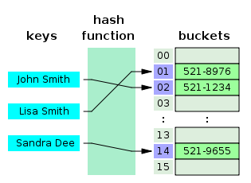
(Recalling hash tables)
figure source: wikipedia; "Hash table 3 1 1 0 1 0 0 SP" by Jorge Stolfi - Own work. Licensed under CC BY-SA 3.0 via Commons - https://commons.wikimedia.org/wiki/File:Hash_table_3_1_1_0_1_0_0_SP.svg#/media/File:Hash_table_3_1_1_0_1_0_0_SP.svg

Slide 58
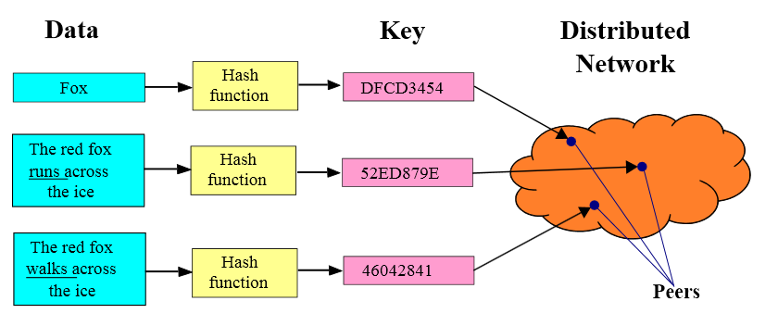
Distributed Hash Tables (DHT)
  Implementation:
  Hash function maps entries to nodes (insert)
  Node-overlay has structure (Distributed Hash Table ie a distributed data structure, eg. Ring, Tree, cube) using it, do:
  Lookup/search: find the node responsible for item; that one knows where the item is
Upon being queried:
”I do not know DFCD3454
but can ask some Neighbour/s
in the DHT and propagate the
search to find the owner”
figure source: wikipedia

Slide 59
Distributed-Hash-Table-Based p2p sharing
Join:
  get connected in the overlay through info from bootstrap-node & using the specific DHT algorithm (eg Chord)
  Start maintaining of files that you are responsible for (following the hash function)
  NOTE: upon leaving DHT needs restructuring!
Publish: tell which files you have, to the peers that will be responsible for them (according to the hash function)
Search: ask the appropriate neighbour, who either is responsible for the searched file or will ask the next appropriate neighbor, and so on; guaranteed search time; commonly in O(logNodes)
Fetch: get the file directly from peer
Publisher
Key=“LetItBe”
Value=MP3 data
N₂
N₃
N₁
Internet
N₅
N₄
Client
Lookup(“LetItBe”)
Challenges [cf related literature@end of notes]:
  Keep the hop count (asking chain) small
  Keep the routing tables (#neighbours) “right size”
  Stay robust despite rapid changes in membership (churn)

Slide 60
e.g. Circular DHT (1)
O(N) messages
on avgerage to resolve
query, when there
are N peers
0001
Who’s responsible
for key 1110 ?
I am
0011
1111
1110
1110
0100
1110
1100
1110
0101
1110
1110
1010
1000
60

Slide 61
Circular DHT with shortcuts
1
Who’s responsible
for key 1110?
3
15
4
12
5
10
8
Here: reduced from 6 to 2 messages.
possible to design shortcuts so O(log N) neighbors, O(log N) messages in query

Slide 62
Swarming: File distribution
Peer joining torrent:
  has no chunks, but will accumulate over time
  gets list of peers from tracker, connects to subset of peers (“neighbors”) who share at similar rates (tit-for-tat)
while downloading, peer uploads chunks to other peers.
once peer has entire file, it may (selfishly) leave or (altruistically) remain
tracker: tracks peers
participating in torrent
torrent: group of
peers exchanging
chunks of a file
obtain list
of peers
trading
chunks
peer

Slide 63

e.g. P2P & streaming Case study: Skype
inherently P2P: pairs of users communicate.
proprietary application-layer protocol (inferred via reverse engineering)
hierarchical overlay with SNs
Index maps usernames to IP addresses; distributed over SNs
Skype clients (SC)
Skype
login server
Supernode
(SN)

Slide 64
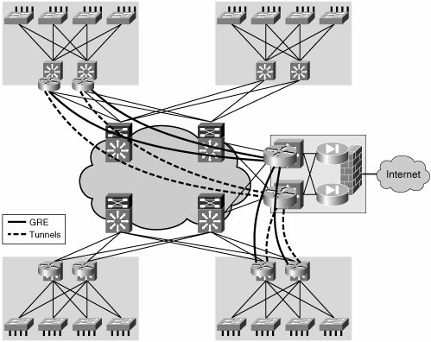
Router Overlays – in support of Software Defined Networks
for e.g.
- distributing responibility of control and routing (5G)
- protection/mitigation of flooding attacks, collaborate for filtering flooding packets
Cf eg: Fu, Z., & Papatriantafilou, M. Off the Wall: Lightweight Distributed Filtering to Mitigate Distributed Denial of Service Attacks. In IEEE SRDS 2012.

