Slide 1
Course on Computer Communication and Networks
Lecture 1
Chapter 1: Introduction
Part A: Internet, Protocol Layering and Data
CTH EDA344/ GU DIT 423

Slide 2
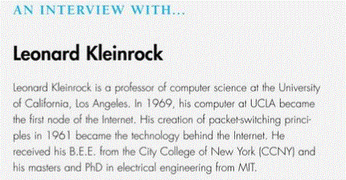
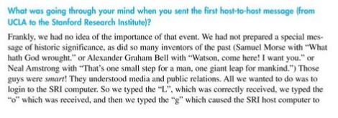
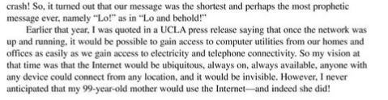
Leonard Kleinrock about the Internet
And a little more …. https://www.youtube.com/watch?v=Zc1tZ8JsZvg

Slide 3


Roadmap
What’s the Internet
  Nuts&bolts view
  Service view
  Distinction between network edge and network core
Layers of abstraction, protocols
  ISO/OSI & Internet layer structure
  Data communication through layers: physical and logical view

Slide 4


the Internet: “nuts and bolts” view (1- HW)
PC
millions of connected (computing) devices: end-hosts = end systems
  running network apps
Mobile network
server
Global ISP
wireless
laptop
cellular
handheld
Home network
communication links
fiber, copper, radio, satellite
transmission rate = bandwidth
Regional ISP
access
points
Institutional network
wired
links
Connecting devices, eg routers: forward packets (chunks of data)
router

Slide 5

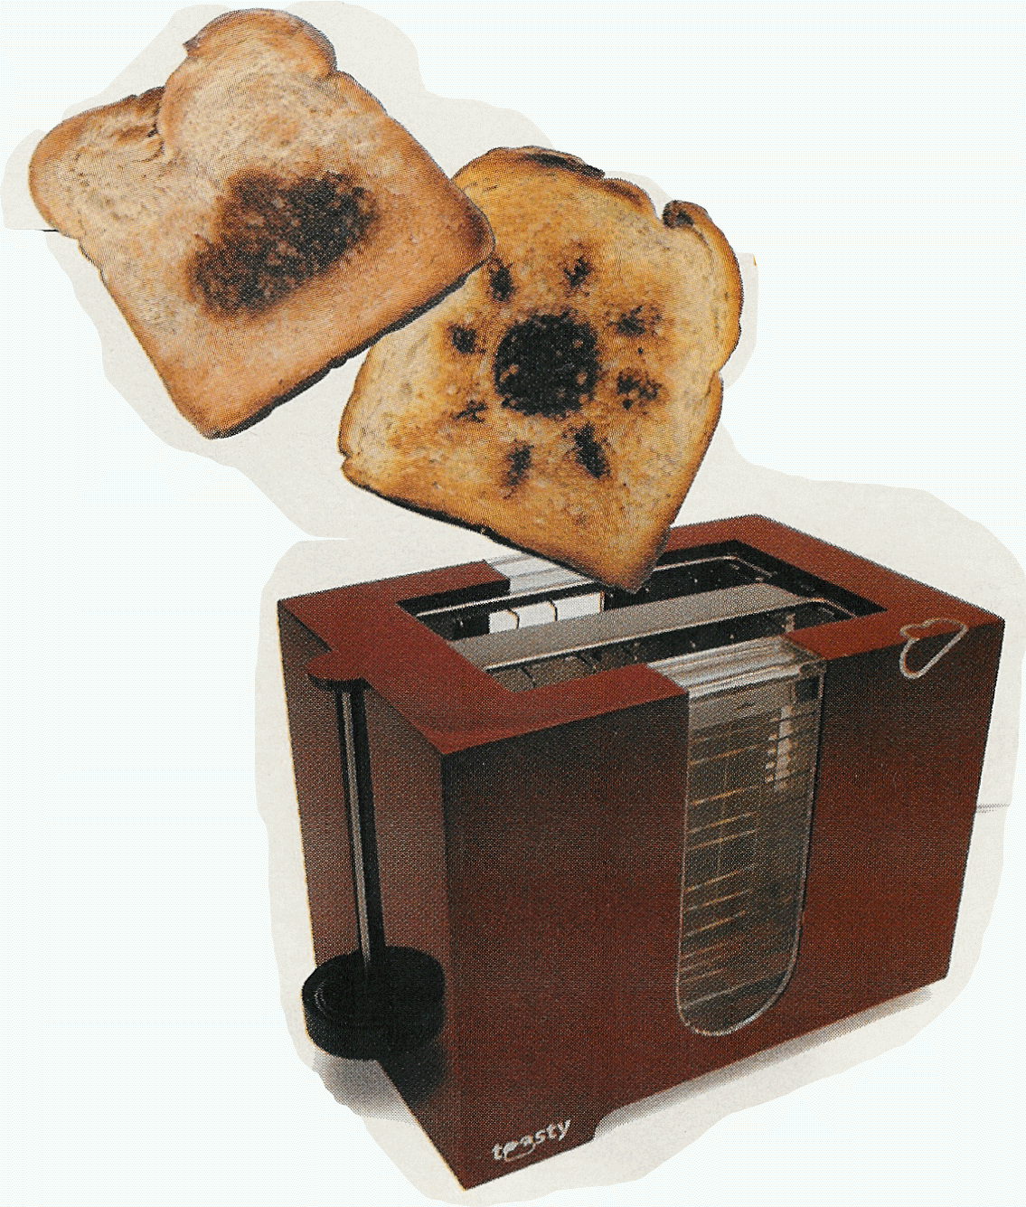



”Fun” internet appliances in “Internet of things”
Web-enabled toaster +
weather forecaster
IP picture frame
http://www.ceiva.com/
Tweet-a-watt:
monitor energy use
Slingbox: watch,
control cable TV remotely
Internet
refrigerator
Internet phones

Slide 6

the Internet: “nuts and bolts” view (2-”SW”)
protocols control sending, receiving of msgs
  e.g., TCP, IP, HTTP, Skype, Ethernet
Internet: “network of networks”
  loosely hierarchical
Mobile network
Global ISP
Home network
Regional ISP
Institutional network

Slide 7

the Internet: service view
communication infrastructure enables distributed applications:
  Web, VoIP, email, games, e-commerce, file sharing
communication services provided to apps:
  Reliable, in-order data delivery from source to destination (aka connection-oriented)
  “best effort” (unreliable) data delivery (aka connectionless)

Slide 8
A closer look at (any big) network’s structure:
network edge: applications and hosts
access networks, physical media: wired, wireless communication links
network core:
  interconnected routers
  network of networks

Slide 9

Networks are complex and evolving….
  Hosts, routers, links
  Services, applications
  Hardware, software
  Networks of Networks
  ….
Is there any hope of organizing structure, study, development of networks?

Slide 10
Roadmap
What’s the Internet
  Nuts&bolts view
  Service view
  Distinction between network edge and network core
Layers of abstraction, protocols
  ISO/OSI & Internet layer structure
  Data communication through layers: physical and logical view

Slide 11
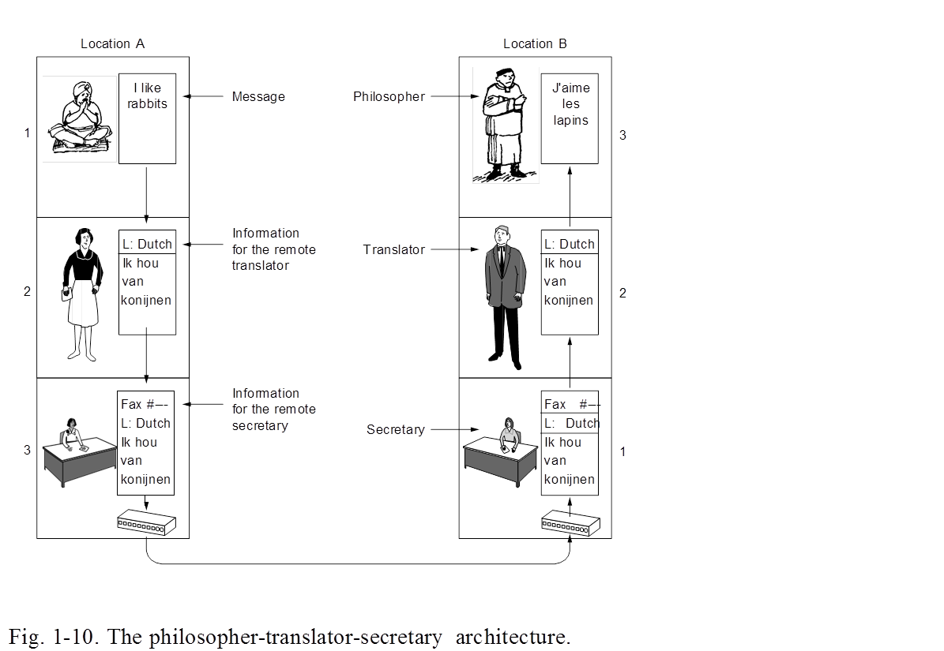
Terminology:
Layers, Protocols, Interfaces
  Each layer implements services
  via its own internal-layer actions
  relying on services by layer below
  It provides services to the upper layer (shielding from implementation details) and uses services of the layer below
  Logical communication, protocol
  Logical communication, protocol
Layer n on a host carries a conversation with layer n on another host
  host-to-host interface: defines message exchanges (incl. format, order, and more) with peer entity = logical communication, protocol
  Logical communication, protocol
Fig. A. Tanenbaum Computer Networks

Slide 12


What’s a protocol?
Examples: a human protocol and a computer network protocol:
Hi
TCP connection
req.
Hi
TCP connection
reply.
Got the
time?
time
Get http://gaia.cs.umass.edu/index.htm
2:00
<file>
host-to-host interface: defines
messages exchanges with peer entity: format, order of msgs
actions todo on msg transmission, receipt

Slide 13
Another example:
Layering of airline functionality
ticket (purchase)
baggage (check)
gates (load)
runway (takeoff)
airplane routing
ticket (complain)
baggage (claim
gates (unload)
runway (land)
airplane routing
ticket
baggage
gate
takeoff/landing
airplane routing
airplane routing
airplane routing
departure
airport
intermediate air-traffic
control centers
arrival
airport
System architecture: set of layers, interfaces
Protocol stack: protocol implementation

Slide 14
Why layering?
Dealing with complex systems:
structure allows to identify & relate complex system’s pieces
  layered reference model for discussion
modularization eases maintenance:
  change of implementation of layer’s service transparent to rest of system
  e.g., change in gate procedure doesn’t affect rest of system

Slide 15
Roadmap
What’s the Internet
  Nuts&bolts view
  Service view
  Distinction between network edge and network core
Layers of abstraction, protocols
  ISO/OSI & Internet layer structure
  Data communication through layers: physical and logical view

Slide 16
Layering – Some “history”:
The OSI Reference Model
ISO (International Standards Organization) defined the OSI (Open Systems Interconnect) model to help vendors create interoperable network implementation
Fig. Steen, Sips : Computer and Network organization
``X dot" series (X.25, X. 400, X.500) OSI model implementation (protocol stack)

Slide 17


Internet protocol stack layers&protocols
Application: protocols supporting network applications
  http (web), smtp (email), p2p, streaming, CDN, …
transport: process2process (end2end) data transfer
  UDP, TCP
network: routing of datagrams (independent data-packets), connecting different physical networks
  IP addressing, routing protocols, virtualization, virtualization, virtualization……
link: data transfer between neighboring (physically connected) hosts
  Ethernet, WiFi, …
physical: bit-transmission on the physical medium between neighboring nodes
application
transport
network
link
physical
UDP
TCP

Slide 18
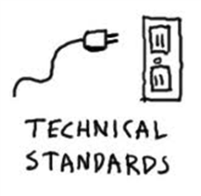
Internet protocol stack
Architecture simple but not as thoroughly thought as OSI‘s
Internet stack “missing”:
  Presentation layer: interpret meaning of data, e.g., encryption, compression,
  Session layer: synchronization, checkpointing, …
Successful protocol suite (de-facto standard)
  was there when needed (OSI implementations were too complicated)
  freely distributed with UNIX
Accumulates “fat” around its waist though…
Internet standards
RFC: Request for comments
IETF: Internet Engineering Task Force

Slide 19
Roadmap
What’s the Internet
  Nuts&bolts view
  Service view
  Distinction between network edge and network core
Layers of abstraction, protocols
  ISO/OSI & Internet layer structure
  Data communication through layers: physical and logical view

Slide 20

Layered communication:
Encapsulation
source
message
M
application
transport
network
link
physical
segment
H_{t}
M
H_{t}
datagram
H_{n}
H_{n}
H_{t}
M
frame
H_{l}
H_{n}
H_{t}
M
link
physical
Logical communication
Physical communication
switch
destination
H_{n}
H_{t}
M
network
link
physical
M
application
transport
network
link
physical
H_{l}
H_{n}
H_{t}
M
H_{n}
H_{t}
M
H_{t}
M
H_{n}
H_{t}
M
H_{l}
H_{n}
H_{t}
M
router

Slide 21

Chapter 1a: Summary
We discussed
what’s the Internet
what’s a protocol?
protocol layers, service models
We will continue (next lecture) with
Network edge & network core services & functionality overview
More on Internet structure overview
  access nets, physical media
  backbones, NAPs, ISPs
Performance concerns: delays, loss
Security concerns
To provide :
context, overview, “feel” of networking
A point of reference for context in the “zoom-in” discussions to come

Slide 22
Quiz questions
How do we call a communication service that delivers packets in-order, without omissions or duplicates?
  best-effort
  connection-oriented
  connectionless
  streaming
What is defined through a a data-communication protocol
host-to-host interface
message structure
communication frequency
(d) services

Slide 23
Reading instructions (incl.next lecture)
1. Kurose Ross book
Careful | Quick
6/e, 7/e: 1.3, 1.4, 1.5 | the rest
Extra Reading (optional)
Computer and Network Organization: An Introduction,
by Maarten van Steen and Henk Sips, Prentice Hall
(very good introductory book for students from programs other than CSE/IT)

Slide 24
Review questions
Review questions from Kurose-Ross book, chapter 1 (for basic study)
6/e, 7/e: R11, R12, R13, R16, 17, R18, R19, R20, R21, R22, R23, R24, R25, R28.
Extra questions, for further study: delay analysis in packet switched networks:
http://www.comm.utoronto.ca/~jorg/teaching/ece466/material/466-SimpleAnalysis.pdf

Slide 25
