Slide 1
TDA357 Databases
Design recap quiz

Slide 2
What is this?
This quiz was used in the TDA357/DIT620 lecture on Wednesday 2016-11-09 8:00-10:00
Students participated using kahoot
  Part 1 (Questions 1-14 from this slide-deck, Questions 1–14 in kahoot)
    https://goo.gl/NsKEmt
  Part 2 (Questions 15-21 from this slide-desk, Questions 1-7 in kahoot):
    https://goo.gl/syOy36

Slide 3
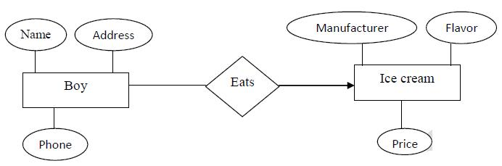
Q1: How many icecreams does one boy eat?

Slide 4
Q2: How many boys can eat one ice cream?

Slide 5
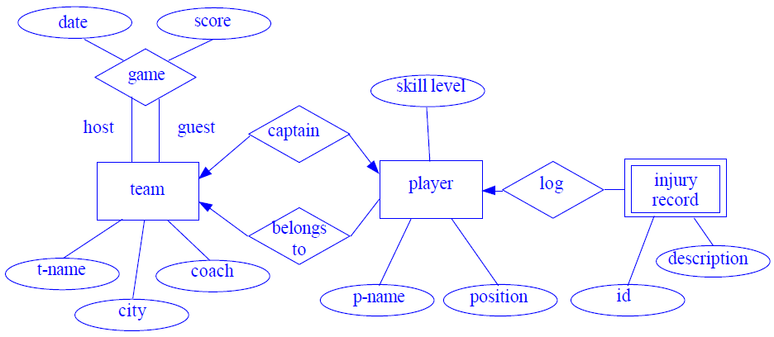
Q3: How many captains can a team have?

Slide 6
Q4: How many teams can a player be captain of?

Slide 7
Q5: Can a player be a captain without belonging to that team?

Slide 8
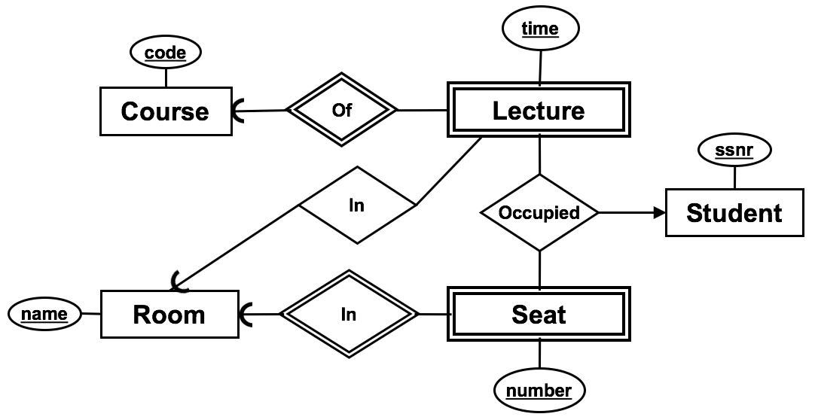
Q6: How many lectures can be held in a room?

Slide 9
Q7: what is “injury record”?

Slide 10
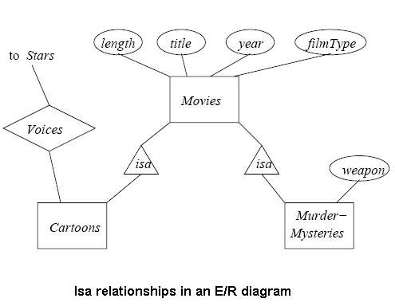
Q8: what is “cartoons”?

Slide 11
Q9: Draw the ER diagram
A person has a name, birthday and SSN.
Names and birthdays are not unique

Slide 12
A9
name
name
birthdate
ssn
Person
ssn
Person
(A)
(B)
name
birthdate
name
birthdate
ssn
Person
ssn
Person
(C)
(D)

Slide 13
Q10: Draw the ER diagram
A person has a name, birthday and SSN.
Names and birthdays are not unique
A person can create many paintings
but paintings are created by exactly one person

Slide 14

A10
name
birthdate
name
birthdate
name
birthdate
ssn
Person
Person
ssn
ssn
Person
Creates
Creates
Creates
Painting
Painting
Painting
(A)
(B)
(C)

Slide 15
Q11: Draw the ER diagram
A person has a name, birthday and SSN.
Names and birthdays are not unique
A person can create many paintings
but paintings are created by exactly one person
People (a group of persons) can also own paintings

Slide 16
A11
Person
Person
Person
Person
Creates
Creates
Creates
Owns
Creates
Owns
owner
owns
Painting
Painting
Painting
Painting
(A)
(B)
(C)
(D)

Slide 17
Q12: Draw the ER diagram
A person has a name, birthday and SSN.
Names and birthdays are not unique
A person can create many paintings
but paintings are created by exactly one person
People (a group of persons) can also own paintings
Only painters create paintings. Painters are people.

Slide 18
A12
Person
isPainter
Painter
Talent
Painter
ISA
Creates
Owns
Creates
Creates
Person
Person
Owns
Owns
Painting
Painting
Painting
(A)
(B)
(C)

Slide 19
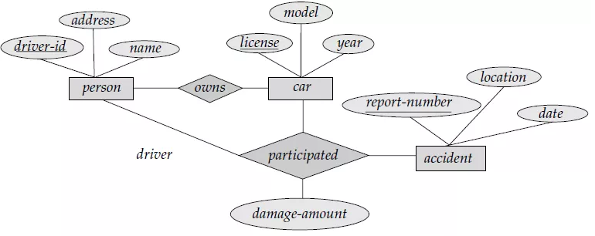
Q13: Create the relational scheme for the entities only

Slide 20
A13
person (id, name, address)
car (license, year, model)
accident (reportnum, date, location, personid, car)
(A)
person (id, name, address)
car (license, year, model)
accident (reportnum, date, location)
(B)
person (id, name, address)
car (license, year, model, owner)
accident (reportnum, date, location, personid, car)
(C)

Slide 21
Q14: Create the relational scheme for the relationships only
person (id, name, address)
car (license, year, model)
accident (reportnum, date, location)

Slide 22
A14
ownedBy(person, car)
person -> Person.id
car -> Car.license
participated(person, car, accident, amount)
person -> Person.id
car -> Car.license
accident -> Accident.reportnum
(A)
ownedBy(person, car)
person -> Person.id
car -> Car.license
participated(person, car, accident)
person -> Person.id
car -> Car.license
accident -> Accident.reportnum
(B)
ownedBy(person, car)
person -> Person.id
car -> Car.license
participated(person, car, accident, amount)
(person, car) -> ownedBy.(person, car)
accident -> Accident.reportnum
(C)

Slide 23
Q15: Create the relational scheme
name
birthdate
ssn
Person
Creates
name
Painting

Slide 24
A15
Person(ssn, name, birthdate)
Painting(name, painter)
painter -> Person.ssn
(A)
Person(ssn, name, birthdate)
Painting(name)
createdBy(work, painter)
work -> Painting.name
painter -> Person.ssn
(B)
name
birthdate
ssn
Person
Creates
Person(ssn, name, birthdate)
Painting(name)
createdBy(work, painter)
work -> Painting.name
painter -> Person.ssn
(C)
Person(ssn, name, birthdate)
Painting(name)
createdBy(work, painter)
work -> Painting.name
painter -> Person.ssn
(D)
name
Painting

Slide 25
Q16: Create the relational scheme
age
Person
ISA
name
Owns
Painter
name
value
salary
Painting

Slide 26
A16
Person(name, age)
Painter(name, age, salary)
Painting(name, value)
ownedBy(work, painter)
work -> Painting.name
painter -> Person.name
(A)
Person(name, age, salary)
salary can be NULL
Painting(name, value)
ownedBy(work, painter)
work -> Painting.name
painter -> Person.name
(B)
Person(name, age)
Painter(name, salary)
name -> Person.name
Painting(name, value)
ownedBy(work, painter)
work -> Painting.name
painter -> Person.name
(C)
age
Person
ISA
name
Owns
Painter
name
value
salary
Painting

Slide 27
Q17: calculate the closure of {a}
R(a, b, c, d, e, f)
  a → b
  a → c
  c, d → e, f
  b → e
  {a}⁺ = ?

Slide 28
Q18: which of these are superkeys of R?
R(a, b, c, d, e, f)
  a → b
  a → c
  c, d → e, f
  b → e
  {a}
  {a, d}
  {c, b, d}
  {a, b, c, d, e, f}

Slide 29
Q19: what are the keys of R?
R(a, b, c, d, e, f)
  a → b
  a → c
  c, d → e, f
  b → e
  c → a, b
  {a, d}
  {a, c}
  {a, d, c}
  {c, d}

Slide 30
Q20: after splitting, how many non-trivial FDs in F⁺?
R(a, b, c, d, e)
  a → b, c
  b → d
  d → e

Slide 31
Q21: How many FDs or R are in BCNF?
R(a, b, c, d)
  a → b, c, d
  b, c → a, d
  d → b

Slide 32
Q22: Which FDs of R are in BCNF?
R(a, b, c, d, e)
  a → b, c (1)
  c → d, e (2)

Slide 33
Q23: which BCNF decomposition is correct?
R(a, b, c, d, e)
  a → b, c
  c → d, e
R1(a, b, c)
  a → b, c
R2(d, e)
  d → e
(A)
R1(a, b, c, d, e)
  a → b, c
R2(c)
  c -> R1.c
(B)
R1(a, b, c)
  a → b, c
R2(c, d, e)
  c → d, e
  c -> R1.c
(C)

Slide 34
Q24: which attribute of R is not prime?
R(a, b, c, d)
  a, b → c
  b → d
  c → a

Slide 35
Q25: Which FDs of R violate 3NF?
R(a, b, c, d, e)
  a → b, c, d, e (1)
  b, c → a, d (2)
  d → e (3)

