Slide 1
GPU Architecture and Programming
Erik Sintorn
Postdoc, Computer Graphics Group

Slide 2
Outline
Part 1: Motivation If you’re not into hardware, why should you care?
Part 2: History lesson
Where did GPUs come from, and what were they meant to do?
Part 3 GPU Architecture
What is a modern GPU, and how does it work?
Part 4: General Purpose GPU Programming
A little bit about non-gfx GPU programming

Slide 3
Outline
Part 1: Motivation If you’re not into hardware, why should you care?
Part 2: History lesson
Where did GPUs come from, and what were they meant to do?
Part 3 GPU Architecture
What is a modern GPU, and how does it work?
Part 4: General Purpose GPU Programming
A little bit about non-gfx GPU programming
Notes:
So, let’s start with some motivation. Why would you care about how the graphics hardware works?

Slide 4
Why care about GPU hardware?
Really, why? Aren’t OpenGL and DX there so we don’t have to care?
Graphics applications are never “fast enough”
Unlike, say, the rendering of a web page.
If you can do something twice as fast, you can make something else look better.
Knowing a little about how the HW works can lead to very much faster programs.
Unlike on a CPU, it is easy to write very slow code.
Conventional wisdom does not apply
As we will see, the GPU is a very different kind of beast.
Notes:
Properly ask first.
When rendering a web page, there will be some clear limit to how fast is fast enough. If it takes 10ms to fetch and 10ms to transmit, there is no need to optimize rendering from 1ms to 1ns.

Slide 5
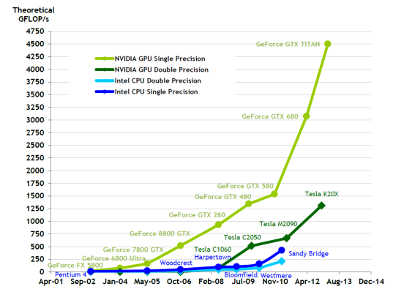
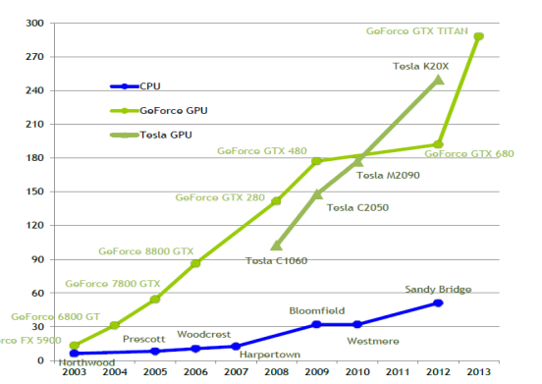
Then I won’t program GPUs! (yes you will)
Compute Power
Memory Bandwidth.
In every pocket™ & PC…
And supercomputer…
5 / Top 10 at least.
More on the way!
GPU
Notes:
(Forget graphics then!)
Sheer compute power
10x and increasing vs CPUs.
Lot’s of ifs and buts, but for problems where you can actually use this, CPUs are out of the question.
Memory Bandwidth
Similar development
So for purely streaming problems, running on a GPU is also a no-brainer.
GPUs are everywhere (your phone, tv, CAR goddamit).
They are also in every new CPU ☺
Look at the size of the GPU part of this midrange Intel CPU. You are not fully utilizaing this chip if you are not also using the GPU.
And most, if not all by now, of the largest super computers have GPU nodes.
Point being: GPU’s are not just a thing that makes video games fast anymore. They are a different type of processor that turns up everywhere.

Slide 6
Outline
Part 1: Motivation If you’re not into hardware, why should you care?
Part 2: History lesson
Where did GPUs come from, and what were they meant to do?
Part 3 GPU Architecture
What is a modern GPU, and how does it work?
Part 4: General Purpose GPU Programming
A little bit about non-gfx GPU programming
Notes:
So, hopefully you have been properly motivated now, and we can start the history lesson.

Slide 7
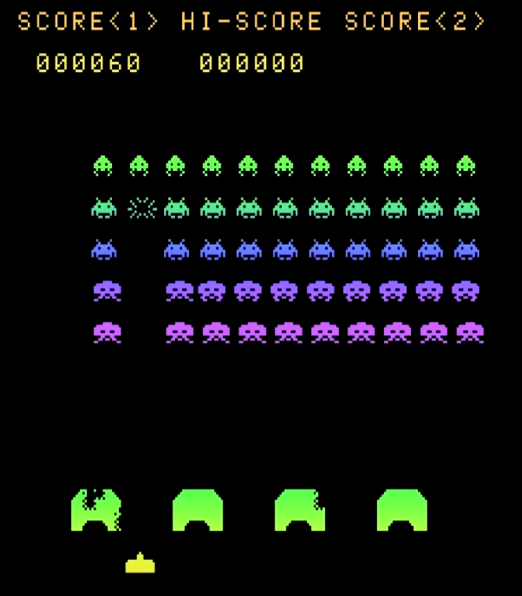
Space Invaders - 1978
Notes:
Graphics hardware history is very intertwined with video games history, obviously.
As a matter of fact, all the big aspects of what a modern GPU is were in place long before people started using GPUs for anything other than rendering nifty computer games.
And we can probably still argue that the current development of GPUs will be whatever makes games run faster.
And actually, there was “graphics hardware” long before what we call GPUs now existed.
Early arcade games and home computers often had little coprocessors whose only job was to draw “sprites” on the screen.

Slide 8
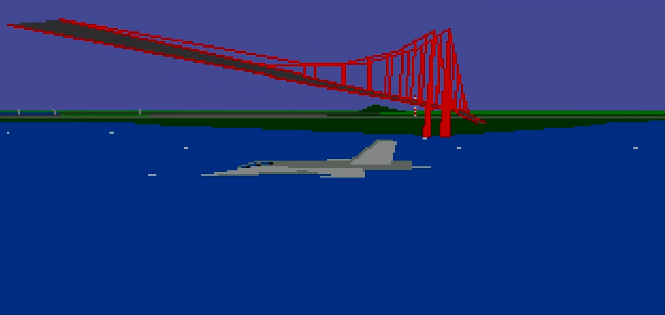
F/A-18 Interceptor - 1988
Notes:
In the late eighties games started appearing that did “3D graphics” the way it’s done today.
That is, the world was modelled as a bunch of triangles and each triangle was transformed to the camera and drawn to screen each frame.
However, all of this was mostly done on the CPU and you are looking at the coolest 3D graphics I knew of when I was 8, and most games were still 2D sprite based stuff that looked way better.

Slide 9
DOOM 1993
Notes:
But in 1993 that changed completely. The game DOOM from ID software showed that 3D games could look fantastic, and were super fun to play.
Interestingly, DOOM really didn’t use proper 3D graphics at all, but some very cool tricks that made it possible to run on a 386 CPU with no extra graphics hardware.

Slide 10
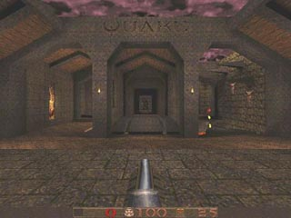
Quake 1996
Notes:
In 1996 though, Id software started selling their next big hit, “Quake”, which is a proper 3d games, with textured triangles transformed and drawn to screen every frame.
This was another huge hit, and tons of true 3D games followed.

Slide 11
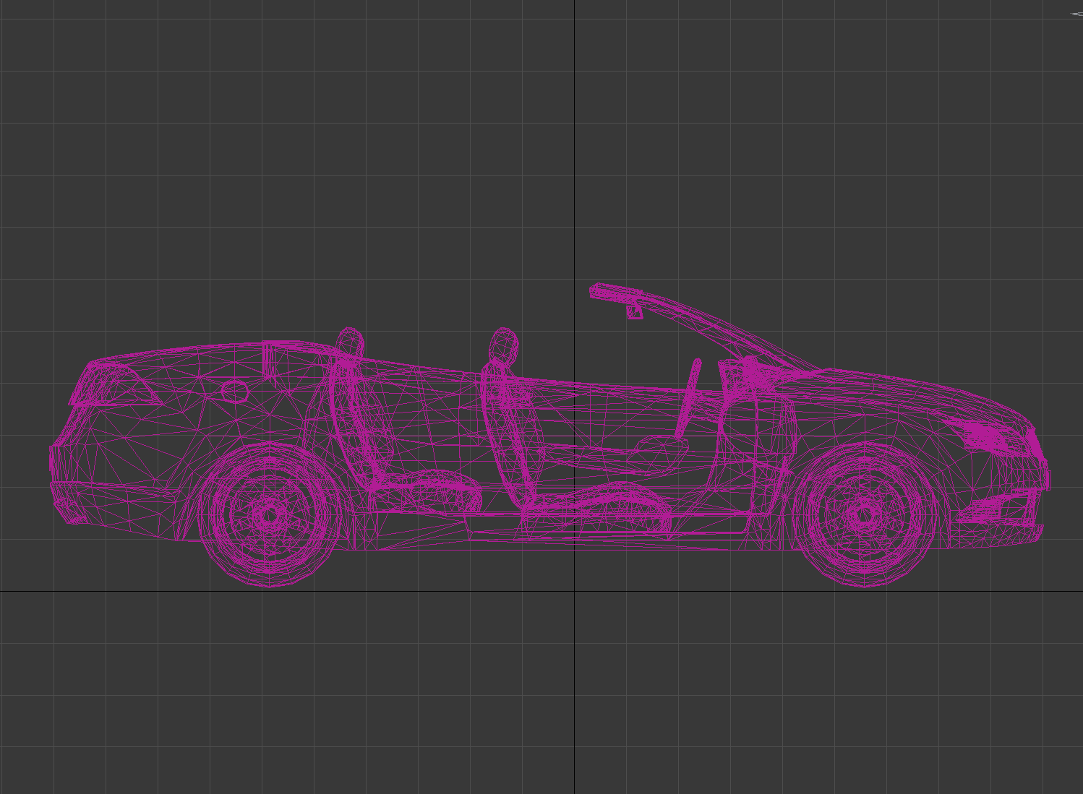
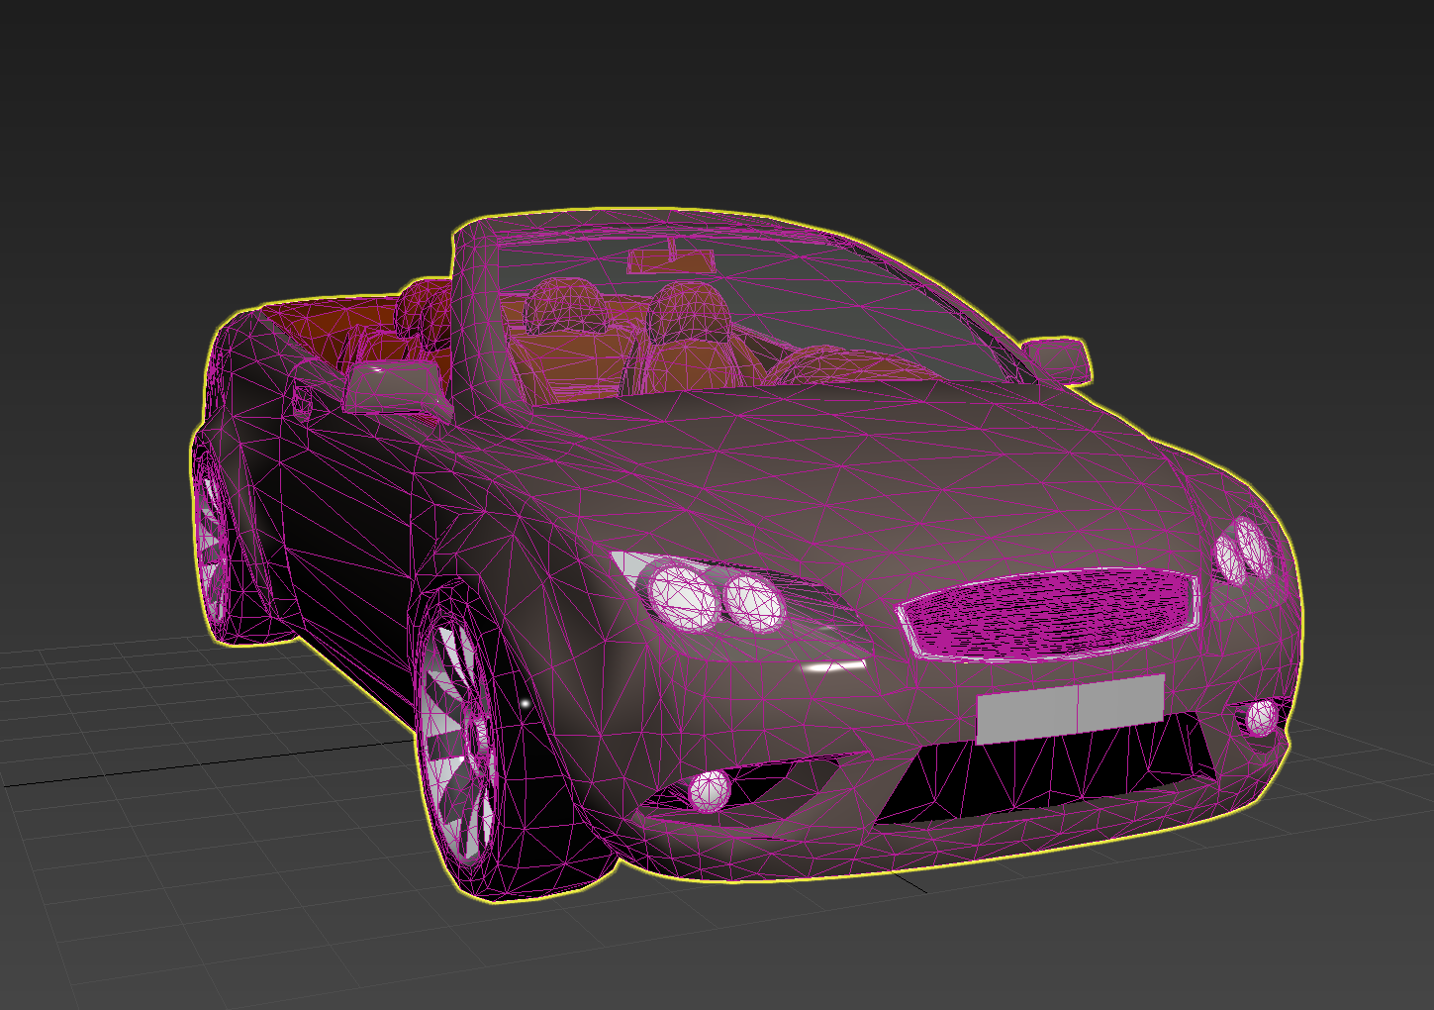
Vertex Transformation
Transform
Scene: Triangles in world-space
Rendered Image
Rasterization
Notes:
These games had the scene described by triangles, and each frame every triangle had to be:
Transformed into camera space (basically a matrix multiplication per vertex)
<click>
Rasterized (drawn onto each pixel that it covers)
The second part of this, rasterizing textured triangles, was extremely hard work for the CPUs of the day.

Slide 12
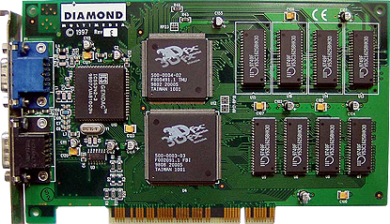
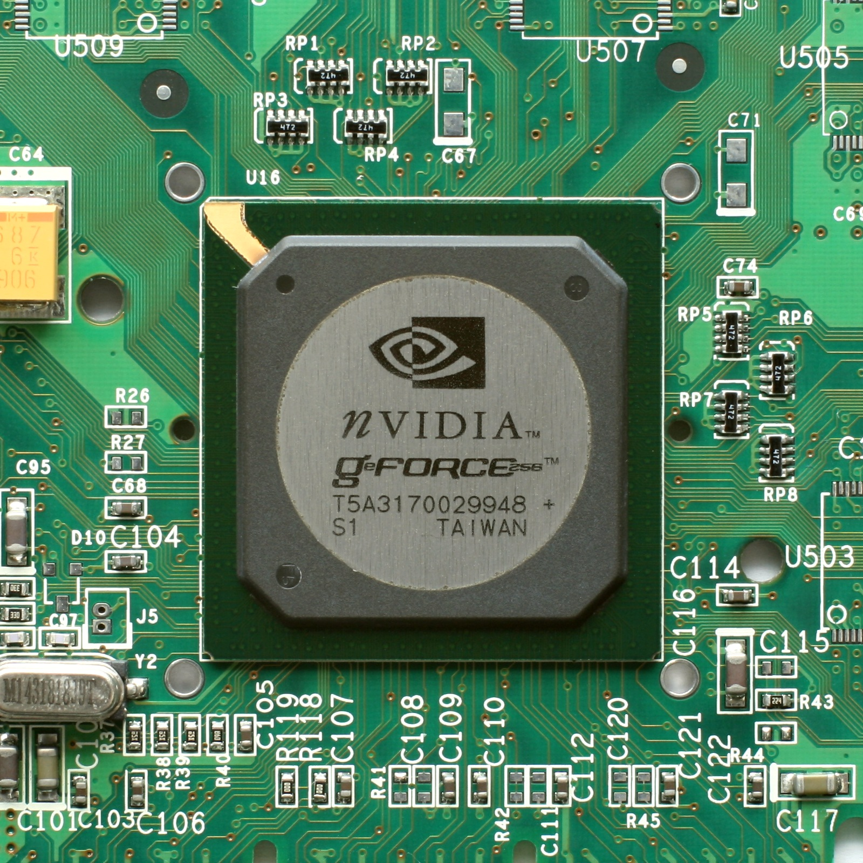
Enter the GPU!
3dFX Voodoo 1 (1996) – Rasterize Triangles In Hardware
NVIDIA GeForce 256 (1999)
Triangle transformation and Lighting calculations in HW!
Notes:
This led to the birth of the modern GPU. Although the first 3d graphics accelerators only took care of the rasterization.
You fed them 2d points, and an image, and they drew a textured triangle onto screen.
<click>
In 1999, NVIDIA released the first 3d accelerator that also did the triangle transforms in hardware. Now you fed it 3d points and a matrix, and it drew the image for you!

Slide 13
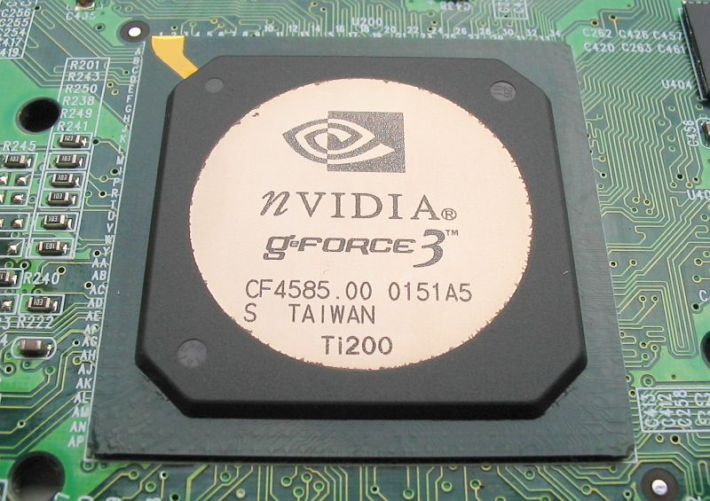
Programmable shading
GeForce 3 (2001)
DOOM 3 (2004)
Notes:
The next huge step was in 2001, when nVidia released the GeForce 3 card.
This card had “programmable shading”, which meant a lot more flexibility:
Pixel Shaders: Are little programs that the developer writes that calculate the color of a triangle for every pixel that it covers.
This allows for much more complex lighting calculations than were possible before.
Vertex Shaders: Are little programs that run for each triangle vertex. This allowed programmers to have control over the transformations, and made it possible to move animation to the gpu.
This card was also used in the original Xbox, and all subsequent cards from all manufacturers included this functionality.
The programs that could be run were still very limited though (no loops for example…). The pixel and vertex shading units were also different hardware units with different capabilities.

Slide 14
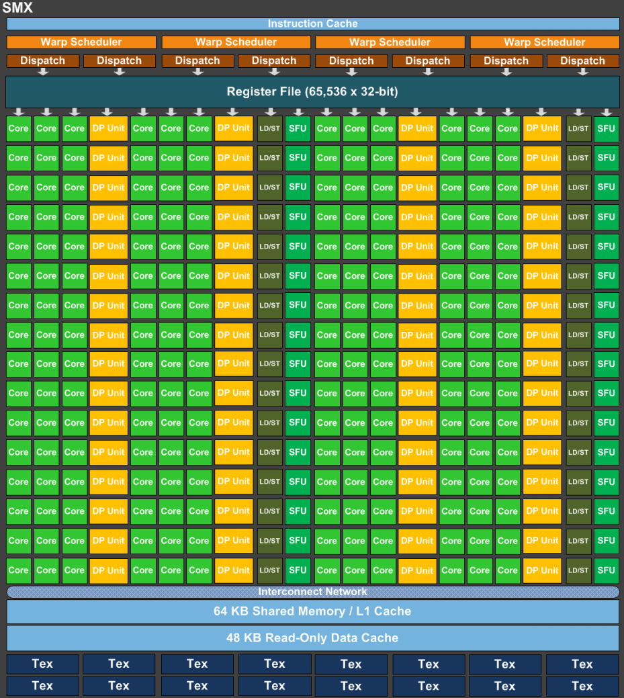
Block Diagram of 2006 GPU
Input Assembly
VS
VS
VS
VS
Primitive Assembly
Triangle Setup
Rasterizer
FS
FS
FS
FS
FS
FS
Z-culling
Blending
Notes:
So in 2006, the actual hardware blocks of a GPU looked a lot like the “Graphics Pipeline” you are being tought in in middle school.
[Go through the stages very quickly.]
There was one big problem with this layout. Any suggestions?
[say load-balancing]
If we only render a few, very large triangles, the fragment shaders will be superbusy, but the vertex shaders will be idle.
If we render thousands of very small triangles, the fragment shaders will idle.

Slide 15
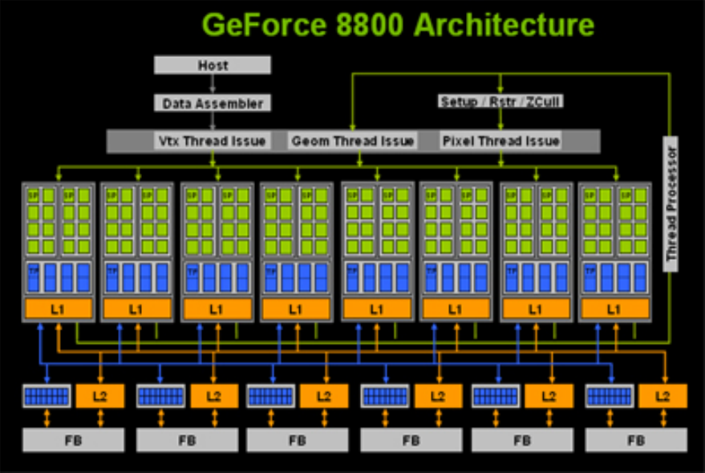
G80 and Unified Shader Architecture
GeForce 8800 GT (2007)
Notes:
Things evolved quickly though and in 2007 (the year I started my Ph.D studies) the GeForce 8800 GT was released.
This card looked very much like all modern GPUs do today.
The separate shading units were replaced by a bunch of Streaming Multiprocessors, each containing 16 tiny little cores (ALU:s), some texture units and an L1 cache.
Fragment and Vertex shading was scheduled onto these SMs as needed.
At the same time, nvidia released CUDA. A c-like programming language that allows you to program these things for other things than graphics.
Researchers had been doing non-graphics stuff on GPUs for some time, by abusing the OpenGL or DirectX apis, but now it was suddenly much easier for a non graphics nerd to make use of the computing power in these chips.
<click>
Looking at this graph, again, you can see that there was already a huge gap in the theoretical throughput between GPUs and CPUs.

Slide 16
Key Observations
Many small independent and identical jobs
Abundant data parallelism.
Lots of ALU operations
Small matrix linear algebra
Many MADs
High/Streaming bandwidth requirements
Lots of data touched just once.
Notes:
So, next we are going to look at a modern GPU in a bit more detail but it’s basically the same machine, just scaled up many many times.
The most important thing that a GPU needs to be able to do (because gamers are still where all the money comes from) is to shade vertices and fragments.
That means that the most important workload has:
Abundant data parallelism (need to do exactly the same thing for lots of different input triangles or fragments)
For each little program we need to do lots of ALU operations
Most data is touched only once
So that is what they are designed for, and that, as we will see, is what they do well.

Slide 17
Outline
Part 1: Motivation If you’re not into hardware, why should you care?
Part 2: History lesson
Where did GPUs come from, and what were they meant to do?
Part 3 GPU Architecture
What is a modern GPU, and how does it work?
Part 4: General Purpose GPU Programming
A little bit about non-gfx GPU programming
Notes:
Now, we are going to talk about how these GPUs really work, and how they differ from CPUs.

Slide 18
Disclaimer
Companies are very secretive about hardware
There are a lot of things the public simply don’t know about the details of how a GPU is build.
My info comes either from public presentations or from other (smarter) people who have made qualified guesses.
These are extremely complex hardware systems
So there are many things I know that I don’t really know how they work
And many things I think I understand how they work, but I really don’t.
And many things I have simplified or skipped over just to make this lecture manageable.

Slide 19
GPU Pipeline
Primitive Assembly
Pixel Coordinate Integer Snapped vertices
Vertex Indices and Vertices
Triangle Setup
Device Memory
Input Assembly
Edge equations, etc…
vertex cache
Rasterizer
32 input vertices
32 quads
Multi Processor
Multi Processor
Multi Processor
Multi Processor
Vertex Shading
.
FragmentShading
.
32 shaded vertices
Z-culling
32 shaded fragments
Blending
non culled fragments
Notes:
So that finally brings us to discussing modern graphics hardware!
Don’t read this slide.
It shows the graphics pipeline, the way it’s actually divided into blocks in hardware, and I will go through it step by step.
DISCLAIMER:
In this part of the lecture, we will go through stuff that is extremely complicated, which means that there are many things I will skip over, and many things I don’t really know.
It is also a part which is kept very secret, which means it is hard to find information about much of this, and the information I have found contains some guesswork.

Slide 20
Vertex Processing
Vertex Indices and Vertices
Input Assembly:
Read vertices from indices
Data cache helps
Output vertex shader input
Unless already cached
Fill a queue with 32 vertex inputs
Device Memory
Input Assembly
vertex cache
32 input vertices
Multi Processor
Multi Processor
Multi Processor
Multi Processor
Notes:
When the host has finished reading all your OpenGL stuff and you finally submit a drawcall, the input vertices in model space, and vertex indices, are available as a buffer object in Device Memory.
They will be read, in order, by a HW block that does Input Assembly. <click>
[Read what it does]
<click>
This produces 32 inputs for our vertex shader. These inputs are sent along to one of many Multi Processors.

Slide 21
Vertex Processing
Vertex Indices and Vertices
Device Memory
Input Assembly
vertex cache
32 input vertices
Multi Processor
Multi Processor
Multi Processor
Multi Processor
Vertex Shading
.
Vertex Shading:
Your GLSL vertex shader
calculates projected vertices
and other values that you want
to send along to the fragment
shader later on.
32 shaded vertices
Notes:
You have all written vertex shaders. They are little programs that take an input vertex and transform it into view space and then projects it.
<click>
The output of the 32 vertex shaders is sent out of the multiprocessor and written into some buffer (probably in device memory).
<click>
We also update the vertex cache in the input assembler, so it doesn’t have to reshade the same vertex again, if it is used by the next few triangles (it probably is).

Slide 22
Primitive Assembly
Primitive Assembly
Vertex Indices and Vertices
Device Memory
Input Assembly
Primitive Assembly & co:
Grab 3 vertices
Cull if they are all outside some clipping plane.
Clip triangles (may produce more primitives)
Homogenization and viewport- transform
Snap vertices to subpixel cords
Back face culling
vertex cache
32 input vertices
Multi Processor
Multi Processor
Multi Processor
Multi Processor
Vertex Shading
.
32 shaded vertices
Notes:
Once there are “shaded” vertices in the buffer, the Primitive Assembly begins.
This HW block will pick (if we are rendering triangles) three vertices and wants to start the process of generating a triangle.

Slide 23
Triangle Setup
Primitive Assembly
Pixel Coordinate Integer Snapped vertices
Vertex Indices and Vertices
Triangle Setup
Device Memory
Input Assembly
vertex cache
32 input vertices
Triangle Setup
For each triangle
Set up the edge equations of all three edges.
Also set up plane equations for all values that will be interpolated
And some other stuff I won’t mention
Multi Processor
Multi Processor
Multi Processor
Multi Processor
Vertex Shading
.
32 shaded vertices
Notes:
So the Primitive Assembly outputs three integer window coordinate vertices that make up one triangle
<click>
And sends them to the “Triangle Setup” block.
This block does some preparation work for each triangle, that the rasterizer needs.
It calculates, the “edge equation” for each edge (I will tell you why soon)
It also calculates the values needed to later interpolate all the per fragment varying values.
And it calculates some other stuff that have to do with fast parallel rasterization which I don’t have time to explain. See Ryg’s blog.

Slide 24
Rasterization
Primitive Assembly
Pixel Coordinate Integer Snapped vertices
Vertex Indices and Vertices
Triangle Setup
Device Memory
Input Assembly
Edge equations, etc…
vertex cache
Rasterizer
32 input vertices
Multi Processor
Multi Processor
Multi Processor
Multi Processor
Vertex Shading
.
32 shaded vertices
Notes:
So it outputs all of this data, per triangle, to the
<click>
Rasterizer
The job of the rasterizer is to generate one fragment per pixel that the triangle covers.
Is anyone in here old or nerdy enough to have written a rasterizer themselves in software?
Good, because all the “best practices” of how to write a rasterizer on a CPU are more or less useless in hardware.
The basic idea is quite simple:

Slide 25
Rasterization
Primitive Assembly
Pixel Coordinate Integer Snapped vertices
Vertex Indices and Vertices
Triangle Setup
Device Memory
Input Assembly
Edge equations, etc…
vertex cache
Rasterizer
32 input vertices
Multi Processor
Multi Processor
Multi Processor
Multi Processor
Vertex Shading
.
32 shaded vertices
Notes:
We want to generate a fragment for each pixel that is inside the triangle.

Slide 26
Rasterization
Primitive Assembly
Pixel Coordinate Integer Snapped vertices
Vertex Indices and Vertices
Triangle Setup
Device Memory
Input Assembly
Edge equations, etc…
vertex cache
Rasterizer
32 input vertices
Multi Processor
Multi Processor
Multi Processor
Multi Processor
Vertex Shading
.
32 shaded vertices
Notes:
We could start by looping over all the samples that are covered by the bounding box of the triangle.

Slide 27
Rasterization
Primitive Assembly
Pixel Coordinate Integer Snapped vertices
Vertex Indices and Vertices
Triangle Setup
Device Memory
Input Assembly
Edge equations, etc…
vertex cache
Rasterizer
32 input vertices
Multi Processor
Multi Processor
Multi Processor
Multi Processor
Vertex Shading
.
32 shaded vertices
Notes:
Now for each sample, we plug it into the edge equation of the first edge, to get the signed distance to the edge. If the distance is positive, the sample is outside.

Slide 28
Rasterization
Primitive Assembly
Pixel Coordinate Integer Snapped vertices
Vertex Indices and Vertices
Triangle Setup
Device Memory
Input Assembly
Edge equations, etc…
vertex cache
Rasterizer
32 input vertices
Multi Processor
Multi Processor
Multi Processor
Multi Processor
Vertex Shading
.
32 shaded vertices
Notes:
We do the same thing for the next edge

Slide 29
Rasterization
Primitive Assembly
Pixel Coordinate Integer Snapped vertices
Vertex Indices and Vertices
Triangle Setup
Device Memory
Input Assembly
Edge equations, etc…
vertex cache
Rasterizer
32 input vertices
Multi Processor
Multi Processor
Multi Processor
Multi Processor
Vertex Shading
.
32 shaded vertices
Notes:
And the next

Slide 30
Rasterization
Primitive Assembly
Pixel Coordinate Integer Snapped vertices
Vertex Indices and Vertices
Triangle Setup
Device Memory
Input Assembly
Edge equations, etc…
vertex cache
Rasterizer
32 input vertices
Multi Processor
Multi Processor
Multi Processor
Multi Processor
Vertex Shading
.
32 shaded vertices
Notes:
The pixels that lie inside all three edges are the ones we want to create fragments for.
We can do this in a parallel fashion that is really very efficient, but for large triangles we would still have to do very many tests.

Slide 31
Rasterization
Primitive Assembly
Pixel Coordinate Integer Snapped vertices
Vertex Indices and Vertices
Triangle Setup
Device Memory
Input Assembly
Edge equations, etc…
vertex cache
Rasterizer
32 input vertices
Multi Processor
Multi Processor
Multi Processor
Multi Processor
Vertex Shading
.
32 shaded vertices
Notes:
So in reality, the rasterizer first does a coarse rasterization, working on blocks of 8x8 pixels.

Slide 32
Rasterization
Primitive Assembly
Pixel Coordinate Integer Snapped vertices
Vertex Indices and Vertices
Triangle Setup
Device Memory
Input Assembly
Edge equations, etc…
vertex cache
Rasterizer
32 input vertices
Multi Processor
Multi Processor
Multi Processor
Multi Processor
Vertex Shading
.
32 shaded vertices
Notes:
Then, if it can decide that the whole block is outside any of the edges, it can ignore the fragments within.

Slide 33
Rasterization
Primitive Assembly
Pixel Coordinate Integer Snapped vertices
Vertex Indices and Vertices
Triangle Setup
Device Memory
Input Assembly
Edge equations, etc…
vertex cache
Rasterizer
32 input vertices
Multi Processor
Multi Processor
Multi Processor
Multi Processor
Vertex Shading
.
32 shaded vertices
Notes:
And if it finds that the whole block is inside all edges, it can just immediately output all fragments.
This is called hierarchical rasterization.

Slide 34
Rasterization
Primitive Assembly
Pixel Coordinate Integer Snapped vertices
Vertex Indices and Vertices
Triangle Setup
Device Memory
Input Assembly
Edge equations, etc…
vertex cache
Rasterizer
32 input vertices
32 frags
Multi Processor
Multi Processor
Multi Processor
Multi Processor
Rasterizer
Collects 32 fragments in a queue.
When full, send them away for fragment shading.
Vertex Shading
.
32 shaded vertices
Notes:
[Skipping the fact that these are 2x2 quads on purpose here. Too much info.]

Slide 35
Primitive Assembly
Primitive Assembly
Pixel Coordinate Integer Snapped vertices
Vertex Indices and Vertices
Triangle Setup
Device Memory
Input Assembly
Edge equations, etc…
vertex cache
Rasterizer
32 input vertices
32 frags
Multi Processor
Multi Processor
Multi Processor
Multi Processor
Scheduling
ALUs load/storeSFU
Vertex Shading
.
cache
Texture Units
32 shaded vertices
Notes:
Now it’s time for the multiprocessor to run these 32 fragment programs.
I will talk about this in more detail later, but let’s just mention a few little things about the MP.
It contains <click> a large number of ALUs and load/store units and stuff. These are the blocks that actually run every ASM command.
It also contains <click> a big block of scheduling logic. This is because one MP can have many groups of 32 threads in flight at the same time. More about that later.
Then it has <click> a very small L1 cache
And <click> a bunch of texture units.
Why does texture addressing and filtering have to have their own hardware? Why not just run that as code on the ALUs?
It’s a LOT of code
Actually, more than you’d think because it has to do texture decompression.
It can be very efficiently pipelined.

Slide 36
Fragment Shading
Primitive Assembly
Pixel Coordinate Integer Snapped vertices
Vertex Indices and Vertices
Triangle Setup
Device Memory
Input Assembly
Edge equations, etc…
vertex cache
Rasterizer
Hi-z
32 input vertices
32 frags
Early Z
Multi Processor
Multi Processor
Multi Processor
Multi Processor
Scheduling
ALUs load/storeSFU
Vertex Shading
.
cache
Texture Units
32 shaded vertices
Z-culling
32 shaded fragments
Notes:
When the program is finished, it will output 32 shaded fragments
These will now be tested against the z-buffer (and update the zbuffer).
<click>
Wait what!? Why don’t we test the fragments until now? If they are culled, we didn’t need to do the shading at all!
The shader may include discard commands or commands that modify the depth of the fragment.
If it doesn’t, we actually do try to cull it much earlier <click>
In fact, the rasterizer has a little zbuffer of its own, which keeps track of, e.g., the lowest depth that has been written to any 8x8 block, so it can discard whole blocks in the coarse rasterization stage. <click>
This is called the hierarchical z buffer.

Slide 37
Cull&Blend
Primitive Assembly
Pixel Coordinate Integer Snapped vertices
Vertex Indices and Vertices
Triangle Setup
Device Memory
Input Assembly
Edge equations, etc…
vertex cache
Rasterizer
Hi-z
32 input vertices
32 frags
Early Z
Multi Processor
Multi Processor
Multi Processor
Multi Processor
Scheduling
ALUs load/storeSFU
Vertex Shading
.
prefetch
cache
Texture Units
32 shaded vertices
Z-culling
32 shaded fragments
Blending
non culled fragments
Notes:
Finally, if the fragment wasn’t culled, it needs to be blended into the framebuffer.
So we need to read the current color out of memory, do a simple blending operation on it, and write it back.
If you think about it, that sounds kind of horrible, since memory latency is very very slow!
How is this block not always the bottleneck!?
There is a cache
<click> The cache is prefetched efter early z

Slide 38
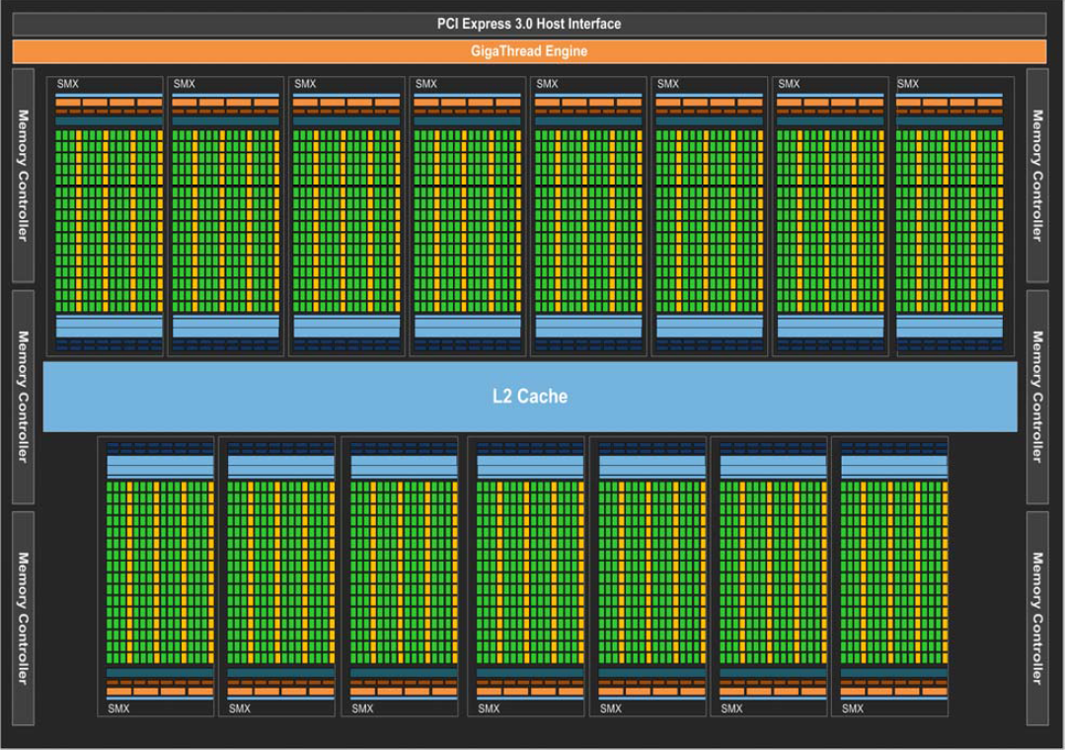
Kepler GK110 (GTX780/Titan)
15 Cores (SMX)
192 Single Precision ALUs / Core (2880 total)
64 Double Precision ALUs / Core (960 total)
2048 Threads / Core (30k total)
64 x 6 = 384 bit bus
336 Gb/s Bandwidth
64kb L1 cache / core
1.5 Mb L2 Cache
Notes:
So here it is, the whole shebang.
This is an overview of the GK110 architecture, which we find in the GTX780 and Titan cards.
<click>
As you can see, it contains 15 separate cores (or SMXs as nvidia call them these days)
<click>
Each core contains 192 single precision ALUs
<click>
And 64 double precision ALUs
<click>
Each core can have 2048 active threads (30k total)
<click>
It has a 384 bit memory bus
<click>
The memory bandwidth is 336 Gb/s
<click>
There is a little 64kb L1 cache per core
<click>
And a 1.5MB L2 cache shared by all cores

Slide 39
Kepler GK110 (GTX780/Titan)
A warp of 32 threads are executed in lockstep
Two independent instructions in one warp can run in one clock
Four warps can run simultaneously
Warp #1, Instruction #1
Warp #1, Instruction #2
Warp #2, Instruction #1
Warp #2, Instruction #2
Warp #4, Instruction #1
Warp #4, Instruction #2
Warp #3, Instruction #1
Warp #3, Instruction #2
Notes:
Let’s take a closer look at one of these cores.
Except for the SP and DP ALUs, we have
Special Function Units – That do square roots and sines and some integer bit tricks and stuff
Load/Store units that issue memory reads and writes
Threads on an nvidia GPU are executed in groups of 32, called a warp.
Two independent instructions from a warp can run simultaneously in one clock
And the scheduler can issue instructions from four warps at the same time, so if we have another warp that wants to run two independent SP FP operations, it can do that.
If we have another warp which wants to run two independent DP operations, it can do that
And if we have another warp that wants to run one load operation and one sqrt, it can do that.
Note that the scheduler cannot always find enough eligible warps to to actually fill the SMX during one clock, and then we will not get full performance.
This is why, even though we can only run four warps at a time, we really want to have 64 warps assigned to each SMX so that it has lots of instructions to choose from.
Even so, if the code does not have independent instructions, we can only use half the GPU.

Slide 40
Warp divergence
32 threads in a warp are run simultaneously.
So, if we have divergence within a warp, both paths must be taken
Threads that don’t fulfill the condition are masked out
if(something) {
a = 0.0f;
} else {
a = 1.0f
}
Notes:
Another important thing to realize is that since 32 threads within a warp will run in lockstep, branching within a warp is very expensive.
If only half of the threads fulfill a requirement, the code within the if statement will be run, but the other threads will be masked out.
<click>
Then, the else statement will also be run, with the other threads masked out.
This can get really ugly if you don’t think about it, with potentially only one thread taking each branch.
Branching between warps is perfectly fine.

Slide 41
The Memory Hierarchy
GPU Core
CPU Core
ALUs
Instr. Logic
Instr. Logic
Registers
$L1*
ALU
$L2/L3
Regs.
ALUs
$L2
$L1
DRAM
DRAM
Notes:
Another thing that is peculiar to GPU architecture is the miniscule cache system
This is partly to make more room for ALUs and registers, but also because much of graphics data is streaming (That is, it is read and written only once)
For streaming access, caching is simply a waste of energy and transistors, and can be directly harmful!
So this illustration should give you a sense of scale, nothing more.
We see that registers are much more prominent, and cache much less so.
In fact, the L1 cache is more or less useless. So how can we run anything fast?

Slide 42
Latency hiding
CPU
fetch
compute
f
compute
f
compute
f
compute
f
compute
f
compute
f
compute
f
cache hit
for(int i=0; i<…; i++)
{
a = <fetch data>; b = compute(a);
}
GPU
Warp#1
fetch
compute
fetch
compute
Warp#2
fetch
compute
fetch
compute
Warp#3
fetch
compute
fetch
compute
Warp#4
fetch
compute
fetch
Warp#5
fetch
compute
fetch
Warp#6
fetch
compute
fetch
Notes:
This is one of the major differences between a GPU and a CPU.
Both machines need to overcome the fact that the processor is “much faster” than the memory, and the CPU mainly does this with caches, while the GPU uses what is called Latency Hiding.
Consider a piece of code like this: <click>
<click>
Memory fetches on cache misses are slow on all architectures, so the CPU will have to wait for memory for a while.
But subsequent fetches will (hopefully) be in cache and so the CPU will spend most of its time doing useful computations.
A GPU works like this: <click>
Here, we don’t expect to hit any caches, so whenever a fetch is issued, the warp immediately yields and another warp will execute instead.
When we run out of eligible warps, it is warp #1’s turn again, and hopefully the fetch has completed and he can compute.
Then it is warp #2’s turn and he can compute, and so on.
In this way, we can also keep the machine busy with important work most of the time.

Slide 43
Latency hiding
CPU
fetch
compute
f
compute
f
compute
f
compute
f
compute
f
compute
f
compute
f
cache hit
for(int i=0; i<…; i++)
{
a = <fetch data>; b = compute(a);
}
GPU
Warp#1
c
Wasting time
Wasting time
Wasting time
fetch
fetch
c
fetch
c
fetch
Warp#2
fetch
c
fetch
c
fetch
c
fetch
Warp#3
fetch
c
fetch
c
fetch
c
fetch
Warp#4
fetch
c
fetch
c
fetch
c
fetch
Warp#5
fetch
c
fetch
c
fetch
c
fetch
Warp#6
fetch
c
fetch
c
fetch
c
fetch
Notes:
Therefore, it is important to have enough compute work to do between memory fetches.
Otherwise we will be wasting time waiting for memory.
This is a common cause of underutilizing the GPU.
In practice, this means in GPU code, you almost never precompute little things and save them for later, because you probably don’t slow things down by just recomputing it.

Slide 44
Latency hiding
CPU
fetch
compute
f
compute
f
compute
f
compute
f
compute
f
compute
f
compute
f
cache hit
for(int i=0; i<…; i++)
{
a = <fetch data>; b = compute(a);
}
GPU
Wasting time
Wasting time
Warp#1
fetch
compute
fetch
compute
fetch
compute
Warp#2
fetch
compute
fetch
compute
fetch
compute
Warp#3
fetch
compute
fetch
compute
fetch
compute
Notes:
Similarly, it’s important that we have enough active threads, or we won’t be able to hide enough latency.

Slide 45
Context Switching
In order for this approach to work, context switching must be very fast
No time to push state to memory (obviously)
All threads must be live
Need huge register file
Need to keep number of used registers down (for full occupancy < 32 registers / thread)
That’s really hard (consider any recursive algorithm…).
Notes:
For latency hiding to work, switching to another warp must be very fast.
We obviously cannot do like the CPU and push all register contents to memory.
Instead, we need to have a large enough register file that all threads can be live and ready to be launched.
For the same reason, we should strive to use as few registers as possible (or at least below 32) per thread.
That can be really difficult.
If, for example, you want to traverse a tree you have to make sure that your stack takes no more than 32 words.

Slide 46
Coalesced Reads/Writes
Scattered reads or writes within a warp can be very expensive.
If all threads in a warp read consecutive 32 bit words they will be coalesced into as few fetches as possible.
If they cannot be coalesced…
GPU
Only thread#1 has his value!
Only thread#1 and #2 have their values!
Warp#1
fetch
fetch
fetch
Warp#2
fetch
fetch
fetch
Warp#3
fetch
fetch
fetch
Warp#4
fetch
fetch
fetch
Warp#5
fetch
fetch
fetch
Warp#6
fetch
fetch
fetch
Notes:
It is very important to try to keep reads and writes in a warp to be nearby between threads.
Reads and writes from the 32 threads will be coalesced into as few fetches/stores as possible.
If they are very scattered and cannot be coalesced: <click>
When warp#1 is active again, it only has the value for thread #1, so it has to issue another fetch.
This can easily bring performance down severely as memory latency cannot be hidden.

Slide 47
Shared Memory
Each SMX has 64kb that can be used either as L1 cache or as fast scratchpad (shared) memory.
It’s not much (32 bytes per thread at full occupancy)
But very useful if e.g. each block (group of warps) can cooperate on something.
Notes:
So far, we have not mentioned the “shared memory” on the SMX.
Parts of the L1 cache can be sacrificed and be used as shared memory instead.
If each thread needs its own little part of shared, it’s not much (32 bytes per thread)
But if a warp, or better yet a group of warps (called a “block”) can cooperate on the same data, it can be very useful.

Slide 48
Atomic Operations and Synchronization
If two threads write to the same memory location, the result is undefined.
But most modern GPUs support atomic operations
E.g. atomicAdd(float *mem, float val) will safely add val to the value in *mem.
Works on both shared and global memory
Should be used with care though, don’t serialize your program!
We can also synchronize threads
(in CUDA kernel) __syncthreads() waits for all threads in a block to complete
(in CUDA host code) cudaDeviceSynchronize() waits for all running kernels and memory transfers to complete.

Slide 49
Shuffle and vote instructions
Additionally, most GPUs and APIs support “shuffle” and “vote” instructions
These allow threads within a warp to exchange information without going through memory
E.g: // Everyone get the value that the thread to the left has int val_left = __shfl(val, (threadIdx.x - 1) % 32); // Find out what all threads think of something uint32_t bitmask = __ballot(pixel_covered);

Slide 50
Comparison
CPU
GPU
Large Cache
Pre-fetch and retain data.
Branch Prediction
Pipeline instruction past.
Instruction re-order.
Find independent.
High clock speed.
More threads.
Do something else (useful)
More threads.
Do something else.
More threads.
Do something else.
Low Clock speed.
Lower efficiency
The above is not free!
Higher single thread throughput
Higher efficiency
ALUs are kept busy.
Higher total throughput
Notes:
Comparing the two architectures, we see that for each of the clever things a CPU does, the GPU has the same answer.
Large caches?
More threads! The core idea is to work on another task, while one is waiting for a long latency memory operation. Then when the thread has its data, it can be scheduled again.
Same for branch prediction, guessing at a result and executing a branch on the hope that it will be taken.
On the GPU, just do something else until the result is available
Instruction reordering, look ahead and find instructions that can be done now, without messing stuff up.
On the GPU, just run another warp. (but compiler will try to generate consecutive independent instructions)
The CPU runs at higher clock speeds than the GPU
On a CPU, doubling the clock speed would double the performance of many programs (if it didn’t burn).
On the GPU only programs that are already utilizing the GPU perfectly would benefit much, and those programs are not common.
So, we have two completely different machines, with different ways of hiding memory latency.
If we built them with exactly the same number of transistors… Which works better?
The CPU tricks above are not free, and don’t always work well, so efficiency can be lower.
If we can provide the GPU with enough work, it can have much higher efficiency
So the CPU will provide much better single thread throughput, but the GPU can provide a higher total throughput.

Slide 51
Suggested Reading
Pipeline and Hardware:
A trip through the Graphics Pipeline Fabian Giesen Very detailed text on what is publicly known about graphics hardware https://fgiesen.wordpress.com/2011/07/09/a-trip-through-the-graphics-pipeline-2011-index/
Render Hell – Book II Simon Schreibt Haven’t read but Dan recommends it as a friendlier introduction to the graphics pipeline https://simonschreibt.de/gat/renderhell-book2/
NVIDIA GeForce Whitepapers (starting from 8800GTX) Quite a lot of interesting information hidden in quite a lot of marketing nonsense Can’t seem to find a collection, google e.g., ”GTX 980 Whitepaper”
A Brief History of Graphics Not about GPU hardware at all, just how graphics have evolved in games. Sort of fun. https://www.youtube.com/watch?v=QyjyWUrHsFc

Slide 52
Outline
Part 1: Motivation If you’re not into hardware, why should you care?
Part 2: History lesson
Where did GPUs come from, and what were they meant to do?
Part 3 GPU Architecture
What is a modern GPU, and how does it work?
Part 4: General Purpose GPU Programming
A little bit about non-gfx GPU programming
Notes:
Allright.
Now that you hopefully have an idea of how the GPU works, let’s look at some simple examples on how to use it.
I will do these examples in CUDA, but it’s quite similar in OpenCL or with compute shaders.

Slide 53
Example #1
__global__ void square_kernel(int N, float *d_data)
{
int thread_id = blockIdx.x * blockDim.x + threadIdx.x;
if(thread_id >= N) return;
d_data[thread_id] = d_data[thread_id] * d_data[thread_id];
}
void square(int N, float *h_data)
{
float *d_data;
cudaMalloc(&d_data, N * sizeof(float));
cudaMemcpy(d_data, h_data, N * sizeof(float), cudaMemcpyHostToDevice);
dim3 block_dim(256);
dim3 grid_dim(N/block_dim.x + 1);
square_kernel<<<grid_dim, block_dim>>>(N, d_data);
cudaMemcpy(h_data, d_data, N * sizeof(float), cudaMemcpyDeviceToHost);
cudaFree(d_data);
}
Notes:
CUDA is NVIDIAs language for programming GPUs and it is very similar to C/C++, but with stuff added for running kernels on the GPU.
Let’s say we want to do a simple cuda program that takes a large array of floats and calculates the square of each element.
We write the following code into a “.cu” file and compile it with nvcc.
Let’s quickly walk through the code.

Slide 54
Example #1
__global__ void square_kernel(int N, float *d_data)
{
int thread_id = blockIdx.x * blockDim.x + threadIdx.x;
if(thread_id >= N) return;
d_data[thread_id] = d_data[thread_id] * d_data[thread_id];
}
void square(int N, float *h_data)
{
float *d_data;
cudaMalloc(&d_data, N * sizeof(float));
cudaMemcpy(d_data, h_data, N * sizeof(float), cudaMemcpyHostToDevice);
dim3 block_dim(256);
dim3 grid_dim(N/block_dim.x + 1);
square_kernel<<<grid_dim, block_dim>>>(N, d_data);
cudaMemcpy(h_data, d_data, N * sizeof(float), cudaMemcpyDeviceToHost);
cudaFree(d_data);
}
Notes:
This is the host function we will call after having initialized or data. N is the number of elements and h_data is a pointer to the data.

Slide 55
Example #1
__global__ void square_kernel(int N, float *d_data)
{
int thread_id = blockIdx.x * blockDim.x + threadIdx.x;
if(thread_id >= N) return;
d_data[thread_id] = d_data[thread_id] * d_data[thread_id];
}
void square(int N, float *h_data)
{
float *d_data;
cudaMalloc(&d_data, N * sizeof(float));
cudaMemcpy(d_data, h_data, N * sizeof(float), cudaMemcpyHostToDevice);
dim3 block_dim(256);
dim3 grid_dim(N/block_dim.x + 1);
square_kernel<<<grid_dim, block_dim>>>(N, d_data);
cudaMemcpy(h_data, d_data, N * sizeof(float), cudaMemcpyDeviceToHost);
cudaFree(d_data);
}
Notes:
Here we call a CUDA function to allocate device memory. It’s just like malloc.

Slide 56
Example #1
__global__ void square_kernel(int N, float *d_data)
{
int thread_id = blockIdx.x * blockDim.x + threadIdx.x;
if(thread_id >= N) return;
d_data[thread_id] = d_data[thread_id] * d_data[thread_id];
}
void square(int N, float *h_data)
{
float *d_data;
cudaMalloc(&d_data, N * sizeof(float));
cudaMemcpy(d_data, h_data, N * sizeof(float), cudaMemcpyHostToDevice);
dim3 block_dim(256);
dim3 grid_dim(N/block_dim.x + 1);
square_kernel<<<grid_dim, block_dim>>>(N, d_data);
cudaMemcpy(h_data, d_data, N * sizeof(float), cudaMemcpyDeviceToHost);
cudaFree(d_data);
}
Notes:
Then we copy the array from the host to the device.

Slide 57
Example #1
__global__ void square_kernel(int N, float *d_data)
{
int thread_id = blockIdx.x * blockDim.x + threadIdx.x;
if(thread_id >= N) return;
d_data[thread_id] = d_data[thread_id] * d_data[thread_id];
}
void square(int N, float *h_data)
{
float *d_data;
cudaMalloc(&d_data, N * sizeof(float));
cudaMemcpy(d_data, h_data, N * sizeof(float), cudaMemcpyHostToDevice);
dim3 block_dim(256);
dim3 grid_dim(N/block_dim.x + 1);
square_kernel<<<grid_dim, block_dim>>>(N, d_data);
cudaMemcpy(h_data, d_data, N * sizeof(float), cudaMemcpyDeviceToHost);
cudaFree(d_data);
}
Notes:
Now we decide how many CUDA threads to launch.
A block is a collection of threads (or warps) that will run on the same SMX.
We can only have so many active blocks on an SM, so we want the block size high enough.
The whole block has to be allocated at once though, so for full occupancy the max number of active warps must be divisable by the block size.
(aside: shared memory is accessible to all threads in a block)
The grid size is the number of blocks we launch. Since we want a thread per element, just launch N/block_dim blocks.

Slide 58
Example #1
__global__ void square_kernel(int N, float *d_data)
{
int thread_id = blockIdx.x * blockDim.x + threadIdx.x;
if(thread_id >= N) return;
d_data[thread_id] = d_data[thread_id] * d_data[thread_id];
}
void square(int N, float *h_data)
{
float *d_data;
cudaMalloc(&d_data, N * sizeof(float));
cudaMemcpy(d_data, h_data, N * sizeof(float), cudaMemcpyHostToDevice);
dim3 block_dim(256);
dim3 grid_dim(N/block_dim.x + 1);
square_kernel<<<grid_dim, block_dim>>>(N, d_data);
cudaMemcpy(h_data, d_data, N * sizeof(float), cudaMemcpyDeviceToHost);
cudaFree(d_data);
}
Notes:
This line launches all threads.

Slide 59
Example #1
__global__ void square_kernel(int N, float *d_data)
{
int thread_id = blockIdx.x * blockDim.x + threadIdx.x;
if(thread_id >= N) return;
d_data[thread_id] = d_data[thread_id] * d_data[thread_id];
}
void square(int N, float *h_data)
{
float *d_data;
cudaMalloc(&d_data, N * sizeof(float));
cudaMemcpy(d_data, h_data, N * sizeof(float), cudaMemcpyHostToDevice);
dim3 block_dim(256);
dim3 grid_dim(N/block_dim.x + 1);
square_kernel<<<grid_dim, block_dim>>>(N, d_data);
cudaMemcpy(h_data, d_data, N * sizeof(float), cudaMemcpyDeviceToHost);
cudaFree(d_data);
}
Notes:
So this kernel (function) will be run by all threads, on the GPU.
From here, only device pointers are accessible.

Slide 60
Example #1
__global__ void square_kernel(int N, float *d_data)
{
int thread_id = blockIdx.x * blockDim.x + threadIdx.x;
if(thread_id >= N) return;
d_data[thread_id] = d_data[thread_id] * d_data[thread_id];
}
void square(int N, float *h_data)
{
float *d_data;
cudaMalloc(&d_data, N * sizeof(float));
cudaMemcpy(d_data, h_data, N * sizeof(float), cudaMemcpyHostToDevice);
dim3 block_dim(256);
dim3 grid_dim(N/block_dim.x + 1);
square_kernel<<<grid_dim, block_dim>>>(N, d_data);
cudaMemcpy(h_data, d_data, N * sizeof(float), cudaMemcpyDeviceToHost);
cudaFree(d_data);
}
Notes:
Calculate a thread_id from the build in variables blockIdx, blockDim and threadIdx

Slide 61
Example #1
__global__ void square_kernel(int N, float *d_data)
{
int thread_id = blockIdx.x * blockDim.x + threadIdx.x;
if(thread_id >= N) return;
d_data[thread_id] = d_data[thread_id] * d_data[thread_id];
}
void square(int N, float *h_data)
{
float *d_data;
cudaMalloc(&d_data, N * sizeof(float));
cudaMemcpy(d_data, h_data, N * sizeof(float), cudaMemcpyHostToDevice);
dim3 block_dim(256);
dim3 grid_dim(N/block_dim.x + 1);
square_kernel<<<grid_dim, block_dim>>>(N, d_data);
cudaMemcpy(h_data, d_data, N * sizeof(float), cudaMemcpyDeviceToHost);
cudaFree(d_data);
}
Notes:
We may have started more threads than there are elements. If so, just exit.

Slide 62
Example #1
__global__ void square_kernel(int N, float *d_data)
{
int thread_id = blockIdx.x * blockDim.x + threadIdx.x;
if(thread_id >= N) return;
d_data[thread_id] = d_data[thread_id] * d_data[thread_id];
}
void square(int N, float *h_data)
{
float *d_data;
cudaMalloc(&d_data, N * sizeof(float));
cudaMemcpy(d_data, h_data, N * sizeof(float), cudaMemcpyHostToDevice);
dim3 block_dim(256);
dim3 grid_dim(N/block_dim.x + 1);
square_kernel<<<grid_dim, block_dim>>>(N, d_data);
cudaMemcpy(h_data, d_data, N * sizeof(float), cudaMemcpyDeviceToHost);
cudaFree(d_data);
}
Notes:
Now the thread will square its input element and store it back.
The actual execution order of the threads is unknown, but we don’t care.

Slide 63
Example #1
__global__ void square_kernel(int N, float *d_data)
{
int thread_id = blockIdx.x * blockDim.x + threadIdx.x;
if(thread_id >= N) return;
d_data[thread_id] = d_data[thread_id] * d_data[thread_id];
}
void square(int N, float *h_data)
{
float *d_data;
cudaMalloc(&d_data, N * sizeof(float));
cudaMemcpy(d_data, h_data, N * sizeof(float), cudaMemcpyHostToDevice);
dim3 block_dim(256);
dim3 grid_dim(N/block_dim.x + 1);
square_kernel<<<grid_dim, block_dim>>>(N, d_data);
cudaMemcpy(h_data, d_data, N * sizeof(float), cudaMemcpyDeviceToHost);
cudaFree(d_data);
}
Notes:
The line above will not block, but now that we copy the data back to the host, it will block until the kernel and the memory copy is finished.
(there are also asynchronous copies)

Slide 64
Example #1
__global__ void square_kernel(int N, float *d_data)
{
int thread_id = blockIdx.x * blockDim.x + threadIdx.x;
if(thread_id >= N) return;
d_data[thread_id] = d_data[thread_id] * d_data[thread_id];
}
void square(int N, float *h_data)
{
float *d_data;
cudaMalloc(&d_data, N * sizeof(float));
cudaMemcpy(d_data, h_data, N * sizeof(float), cudaMemcpyHostToDevice);
dim3 block_dim(256);
dim3 grid_dim(N/block_dim.x + 1);
square_kernel<<<grid_dim, block_dim>>>(N, d_data);
cudaMemcpy(h_data, d_data, N * sizeof(float), cudaMemcpyDeviceToHost);
cudaFree(d_data);
}
Notes:
Free the GPU memory.

Slide 65
Will this be faster than just squaring on the CPU?
__global__ void square_kernel(int N, float *d_data)
{
int thread_id = blockIdx.x * blockDim.x + threadIdx.x;
if(thread_id >= N) return;
d_data[thread_id] = d_data[thread_id] * d_data[thread_id];
}
void square(int N, float *h_data)
{
float *d_data;
cudaMalloc(&d_data, N * sizeof(float));
cudaMemcpy(d_data, h_data, N * sizeof(float), cudaMemcpyHostToDevice);
dim3 block_dim(256);
dim3 grid_dim(N/block_dim.x + 1);
square_kernel<<<grid_dim, block_dim>>>(N, d_data);
cudaMemcpy(h_data, d_data, N * sizeof(float), cudaMemcpyDeviceToHost);
cudaFree(d_data);
}
Notes:
So…
Will this be faster than just squaring the elements on the CPU?
Not a rethorical question!

Slide 66
Will this be faster than just squaring on the CPU?
NO!
__global__ void square_kernel(int N, float *d_data)
{
int thread_id = blockIdx.x * blockDim.x + threadIdx.x;
if(thread_id >= N) return;
d_data[thread_id] = d_data[thread_id] * d_data[thread_id];
}
void square(int N, float *h_data)
{
float *d_data;
cudaMalloc(&d_data, N * sizeof(float));
cudaMemcpy(d_data, h_data, N * sizeof(float), cudaMemcpyHostToDevice);
dim3 block_dim(256);
dim3 grid_dim(N/block_dim.x + 1);
square_kernel<<<grid_dim, block_dim>>>(N, d_data);
cudaMemcpy(h_data, d_data, N * sizeof(float), cudaMemcpyDeviceToHost);
cudaFree(d_data);
}
Notes:
Avoid allocating and freeing memory as much as possible. Do initialization once.
But more importantly:

Slide 67
Will this be faster than just squaring on the CPU?
NO!
__global__ void square_kernel(int N, float *d_data)
{
int thread_id = blockIdx.x * blockDim.x + threadIdx.x;
if(thread_id >= N) return;
d_data[thread_id] = d_data[thread_id] * d_data[thread_id];
}
void square(int N, float *h_data)
{
float *d_data;
cudaMalloc(&d_data, N * sizeof(float));
cudaMemcpy(d_data, h_data, N * sizeof(float), cudaMemcpyHostToDevice);
dim3 block_dim(256);
dim3 grid_dim(N/block_dim.x + 1);
square_kernel<<<grid_dim, block_dim>>>(N, d_data);
cudaMemcpy(h_data, d_data, N * sizeof(float), cudaMemcpyDeviceToHost);
cudaFree(d_data);
}
Notes:
Copying memory between the device and host has to go over the PCI Express bus. That’s a bandwidth of 1GByte/second (or four or eight depending on your bus) and would completely limit the performance of this function.

Slide 68
Allright… the actual kernel call. Will that run at full speed?
__global__ void square_kernel(int N, float *d_data)
{
int thread_id = blockIdx.x * blockDim.x + threadIdx.x;
if(thread_id >= N) return;
d_data[thread_id] = d_data[thread_id] * d_data[thread_id];
}
void square(int N, float *h_data)
{
float *d_data;
cudaMalloc(&d_data, N * sizeof(float));
cudaMemcpy(d_data, h_data, N * sizeof(float), cudaMemcpyHostToDevice);
dim3 block_dim(256);
dim3 grid_dim(N/block_dim.x + 1);
square_kernel<<<grid_dim, block_dim>>>(N, d_data);
cudaMemcpy(h_data, d_data, N * sizeof(float), cudaMemcpyDeviceToHost);
cudaFree(d_data);
}
Notes:
Okay, another not rethorical question. Will we get our 7GFlops or whatever from this code? Will it run at full speed?

Slide 69
Allright… the actual kernel call. Will that run at full speed?
__global__ void square_kernel(int N, float *d_data)
{
int thread_id = blockIdx.x * blockDim.x + threadIdx.x;
if(thread_id >= N) return;
d_data[thread_id] = d_data[thread_id] * d_data[thread_id];
}
void square(int N, float *h_data)
{
float *d_data;
cudaMalloc(&d_data, N * sizeof(float));
cudaMemcpy(d_data, h_data, N * sizeof(float), cudaMemcpyHostToDevice);
dim3 block_dim(256);
dim3 grid_dim(N/block_dim.x + 1);
square_kernel<<<grid_dim, block_dim>>>(N, d_data);
cudaMemcpy(h_data, d_data, N * sizeof(float), cudaMemcpyDeviceToHost);
cudaFree(d_data);
}
Nah…
Not enough compute to hide latency
Probably not enough independent instructions to fully utilize SMX
Only doing SP FP and Load/Store, so we CAN’T fully utilize SMX
But fully coalesced reads and writes
And certainly faster than CPU
Notes:
Okay, another not rethorical question. Will we get our 7GFlops or whatever from this code? Will it run at full speed?

Slide 70
Example #2: Reduction
Say we want to find the maximum of N elements
array = [12 1 6 65 3 87 55 2 85 … 23]
CPU code is extremely simple:
result = 0;
for(int i=0; i<N; i++) { result = max(result, array[i]; }
But how to do this on the GPU?

Slide 71
Example #2: Reduction
An idiots approach:
__global__ void find_max(int N, float *d_data, float *d_result)
{
int thread_id = blockIdx.x * blockDim.x + threadIdx.x;
if(thread_id >= N) return;
atomicMax(*d_result, d_data[thread_id];
}
Notes:
Why is this a bad idea?
We will essentially serialize the whole thing, and could just as well have done it in a single thread.

Slide 72
Example #2: Reduction
A slightly smarter approach:
array = [12 1 6 65 3 87 55 2 85 … 12 23]
[ 12 65 87 55 … 23]
[ 65 87 … 23]
…
[87 23]
87
MAX
MAX
MAX
MAX
MAX
MAX
MAX
MAX
MAX
Notes:
This is better. What will be limiting for this approach?
Bandwidth. We do as many comparisons as the CPU version, but we have to read log2(N/2)N/2 values (and write half of that).
It could well be faster than doing it on the CPU though, because memory bandwidth on the GPU might be much higher than on the CPU.

Slide 73
Example #2: Reduction
An even smarter approach:
We want to have at least 30k threads running.
Less and the GPU will be underutilized
More is okay, but no benefit
Divide the input into 30k parts
Let each thread do a sequential reduction over his part
Output the result into a 30k array.
Reduce that with the previous method.
Is this a good idea?
Notes:
Assuming that N is very large (couple of million)
Read slide…
Can you see any problems with this idea?
Let’s consider the memory access pattern

Slide 74
Example #2: Strided Memory Access
 |  |  | ... |  |  |  | ... |  |  |  | ... |  |  |  | ...
...
Warp = 32 threads
First memory request
Notes:
Ouch… the threads in a warp will read from very scattered addresses!
Recall that that is a very bad idea.

Slide 75
Example #2: Strided Memory Access
 |  |  | ... |  |  |  | ... |  |  |  | ... |  |  |  | ...
...
Warp = 32 threads
Second memory request

Slide 76
Example #2: Strided Memory Access
 |  |  | ... |  |  |  | ... |  |  |  | ... |  |  |  | ...
// Divide input into 960 (#warps) parts instead.
start = warp_id * (N/960);
end = (warp_id + 1) * (N/960);
result = 0;
for(int i=start + threadIdx.x; i<end; i+=32) {
result = max(result, d_data[i]);
}
result = warpReduce(result);
if(threadIdx.x == 0) d_output[warp_id] = result;
...
Warp = 32 threads
Third memory request
Notes:
Ouch… These accesses will not be coalesced and it will be really slow.
In this example, it’s very easy to fix.
We divide the input into #number of warps parts instead.
Then we make sure each thread in a warp reads from consecutive addresses.
Finally, we can reduce the number of output elements by doing a local reduction within the warp
(this is the logn algorithm above, but implemented with shuffle instructions that avoid any memory transfer)
We end up with a 960 element list that we can reduce in no time.

Slide 77
Conclusion
Seems difficult?
It is! Turning your problem into a massively parallel one can be very hard (sometimes impossible).
But so is CPU programming (if you want full speed)
Today, you need to at least parallelize enough to use all cores and SIMD lanes.
CPUs and GPUs are merging quickly.
Most recent CPUs have a large GPU part
Future intel CPUs will have GPUish SIMD
You need to learn this stuff!
Luckily, you’ll realize it’s also much fun!

