Slide 1
Chapter 5: DataLink Layer
Course on Computer Communication and Networks, CTH/GU
The slides are adaptation of the slides made available by the authors of the course’s main textbook
Slides with darker background are for extra information or background/context

Slide 2
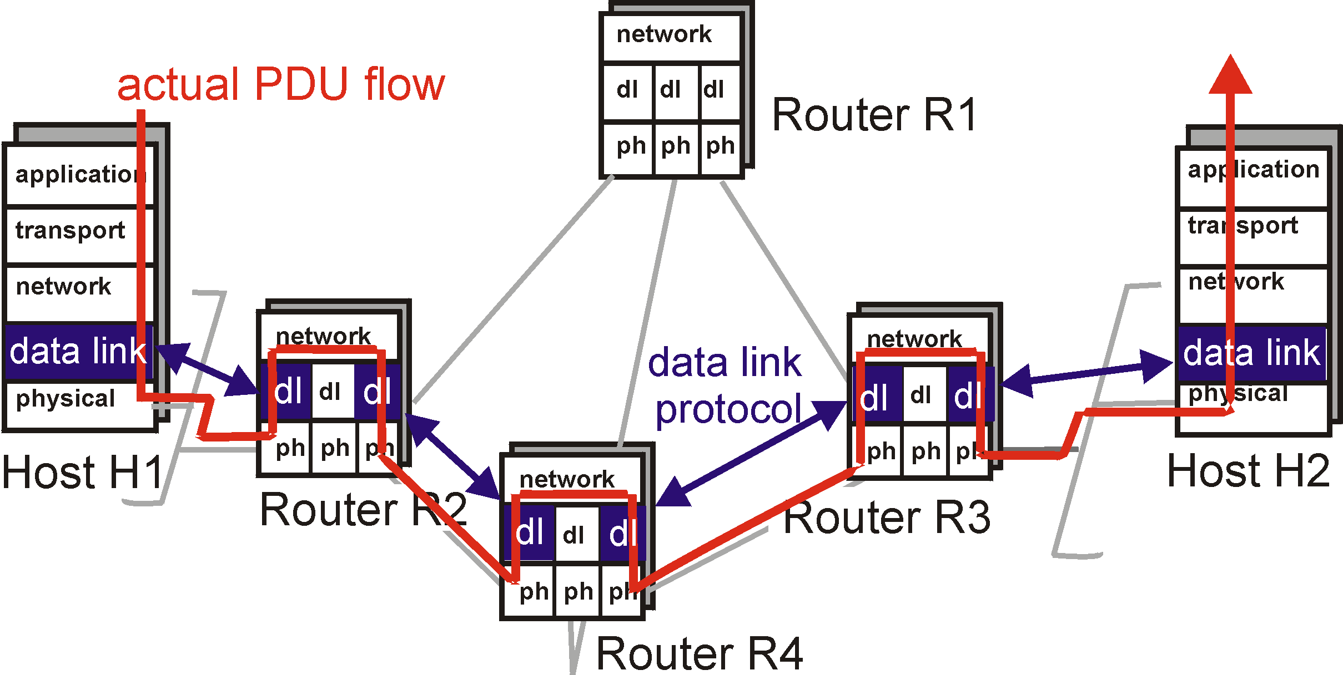
Link layer: context
Datagram transferred by different link protocols over different links:
  e.g., Ethernet on first link, frame relay on intermediate links, 802.11 on last link
Each link protocol provides different services
  e.g., may or may not provide rdt over link
transportation analogy
trip from Princeton to Lausanne
  limo: Princeton to JFK
  plane: JFK to Geneva
  train: Geneva to Lausanne
tourist = datagram
transport segment = communication link
transportation mode = link layer protocol
travel agent = routing algorithm

Slide 3
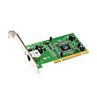
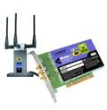

Where is the link layer implemented?
in each and every host
link layer implemented in “adapter” (aka network interface card NIC) or on a chip
  Ethernet card, 802.11 card; Ethernet chipset
  implements link, physical layer
attaches into host’s system buses
combination of hardware, software, firmware
application
transport
network
link
cpu
memory
link
physical
host
bus
(e.g., PCI)
controller
physical
transmission
network adapter
card

Slide 4
Adapters communicating
datagram
datagram
controller
controller
sending host
receiving host
datagram
frame
sending side:
  encapsulates datagram in frame
  adds error checking bits, rdt, flow control, etc.
receiving side
  looks for errors, rdt, flow control, etc
  extracts datagram, passes to upper layer at receiving side

Slide 5
Link layer services
framing, link access:
  encapsulate datagram into frame (header, trailer)
    Link-layer addresses in frame headers to identify source, dest
      different from IP address!
  channel access if shared medium
reliable delivery between adjacent nodes
  we learned how to do this already (chapter 3)!
    seldom used on low bit-error link (fiber, some twisted pair)
  wireless links: high error rates; error detection and correction applicable
error detection:
  receiver detect errors caused by signal attenuation, noise.
error correction:
  receiver identifies and corrects bit error(s) without resorting to retransmission
flow control:
  pacing between adjacent sending and receiving nodes

Slide 6

Link Layer
5.1 Introduction and services
5.3 Multiple access protocols
(5.2 Error detection and correction )
*grey items will be treated as complement, in subsequent lecture
LAN technology
5.5 Ethernet
5.6 Interconnection
5.4 Link-Layer Addressing
5.9 A day in the life of a web request
(5.7 PPP
5.8 Link Virtualization: ATM and MPLS)
Framing

Slide 7






access links, protocols
two types of “links”:
point-to-point
  PPP for dial-up access
  point-to-point link between Ethernet switch, host
broadcast (shared wire or medium), eg
  old-fashioned Ethernet
  802.11 wireless LAN
shared wire (e.g.,
cabled Ethernet)
shared RF
(e.g., 802.11 WiFi)
shared RF
(satellite)
humans at a
cocktail party
(shared air, acoustical)

Slide 8
i.e. (Multiple access)
single shared broadcast channel
two or more simultaneous transmissions by nodes: interference
  collision if node receives two or more signals at the same time
multiple access protocol
distributed algorithm that determines how nodes share channel, i.e., determine when node can transmit
communication about channel sharing must use channel itself!
  no out-of-band channel for coordination

Slide 9
An ideal multiple access protocol
given: broadcast channel of rate R bps
desiderata:
  1. when one node wants to transmit, it can send at rate R.
  2. when M nodes want to transmit, each can send at average rate R/M
  3. fully decentralized:
    no special node to coordinate transmissions
    no synchronization of clocks, slots
  4. simple

Slide 10
MAC protocols: taxonomy
three broad classes:
channel partitioning
  divide channel into smaller “pieces” (time slots, frequency, code)
  allocate piece to node for exclusive use
random access
  channel not divided, allow collisions
  “recover” from collisions
“taking turns”
  nodes take turns, but nodes with more to send can take longer turns

Slide 11

Channel Partitioning MAC protocols:
TDMA, FDMA
TDMA: time division multiple access
access to channel in "rounds"
each station gets fixed length slot (length = pkt trans time) in each round
unused slots go idle
  example: 6-station LAN, 1,3,4 have pkt, slots 2,5,6 idle
FDMA: frequency division multiple access
each station assigned fixed frequency band
unused transmission time in frequency bands goes idle
  example: 6-station LAN, 1,3,4 have pkt, frequency bands 2,5,6 idle
frequency bands

Slide 12
Channel Partitioning CDMA
CDMA: Code Division Multiple Access
allows each station to transmit over the entire frequency spectrum all the time.
simultaneous transmissions are separated using coding theory.
used mostly in wireless broadcast channels (cellular, satellite, etc) – we will study it in the wireless context
has been ”traditionally” used in the military
Observe:
MUX = speak person-to-person in designated space
CDMA = ”shout” using different languages: the ones who know the language will get what you say

Slide 13
MAC protocols: taxonomy
three broad classes:
channel partitioning
  divide channel into smaller “pieces” (time slots, frequency, code)
  allocate piece to node for exclusive use
random access
  channel not divided, allow collisions
  “recover” from collisions
“taking turns”
  nodes take turns, but nodes with more to send can take longer turns

Slide 14
Random access protocols
when node has packet to send
  transmit at full channel data rate R.
  no a priori coordination among nodes
random access MAC protocol specifies:
  how to detect collisions
  how to recover from collisions (e.g., via delayed retransmissions)
examples of random access MAC protocols:
  slotted ALOHA
  ALOHA
  CSMA, CSMA/CD, CSMA/CA

Slide 15
Slotted ALOHA
assumptions:
all frames same size
time divided into equal size slots (time to transmit 1 frame)
nodes start to transmit only at slot beginning
nodes are synchronized
if 2 or more nodes transmit in slot, all nodes detect collision
operation:
when node obtains fresh frame (from upper layer protocol), it transmits in next slot
  if no collision: ok
  if collision: node retransmits frame in each subsequent slot with prob. p until success

Slide 16
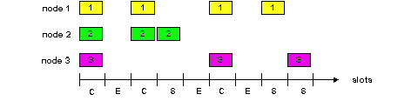
Slotted ALOHA
Pros
single active node can continuously transmit at full rate of channel
highly decentralized: only slots in nodes need to be in sync
simple
Cons
collisions, wasting slots
idle slots
clock synchronization

Slide 17
Slotted Aloha efficiency
Efficiency : long-run
fraction of successful slots
(many nodes, all with many frames to send)
Q: max fraction of
successful transmissions?
A: Suppose N stations, each transmits in slot with probability p
  prob. successful transmission is:
  P[specific node succeeds]= p (1-p)^{(N-1)}
  P[any of N nodes succeeds]
= N p (1-p)^{(N-1)}

Slide 18
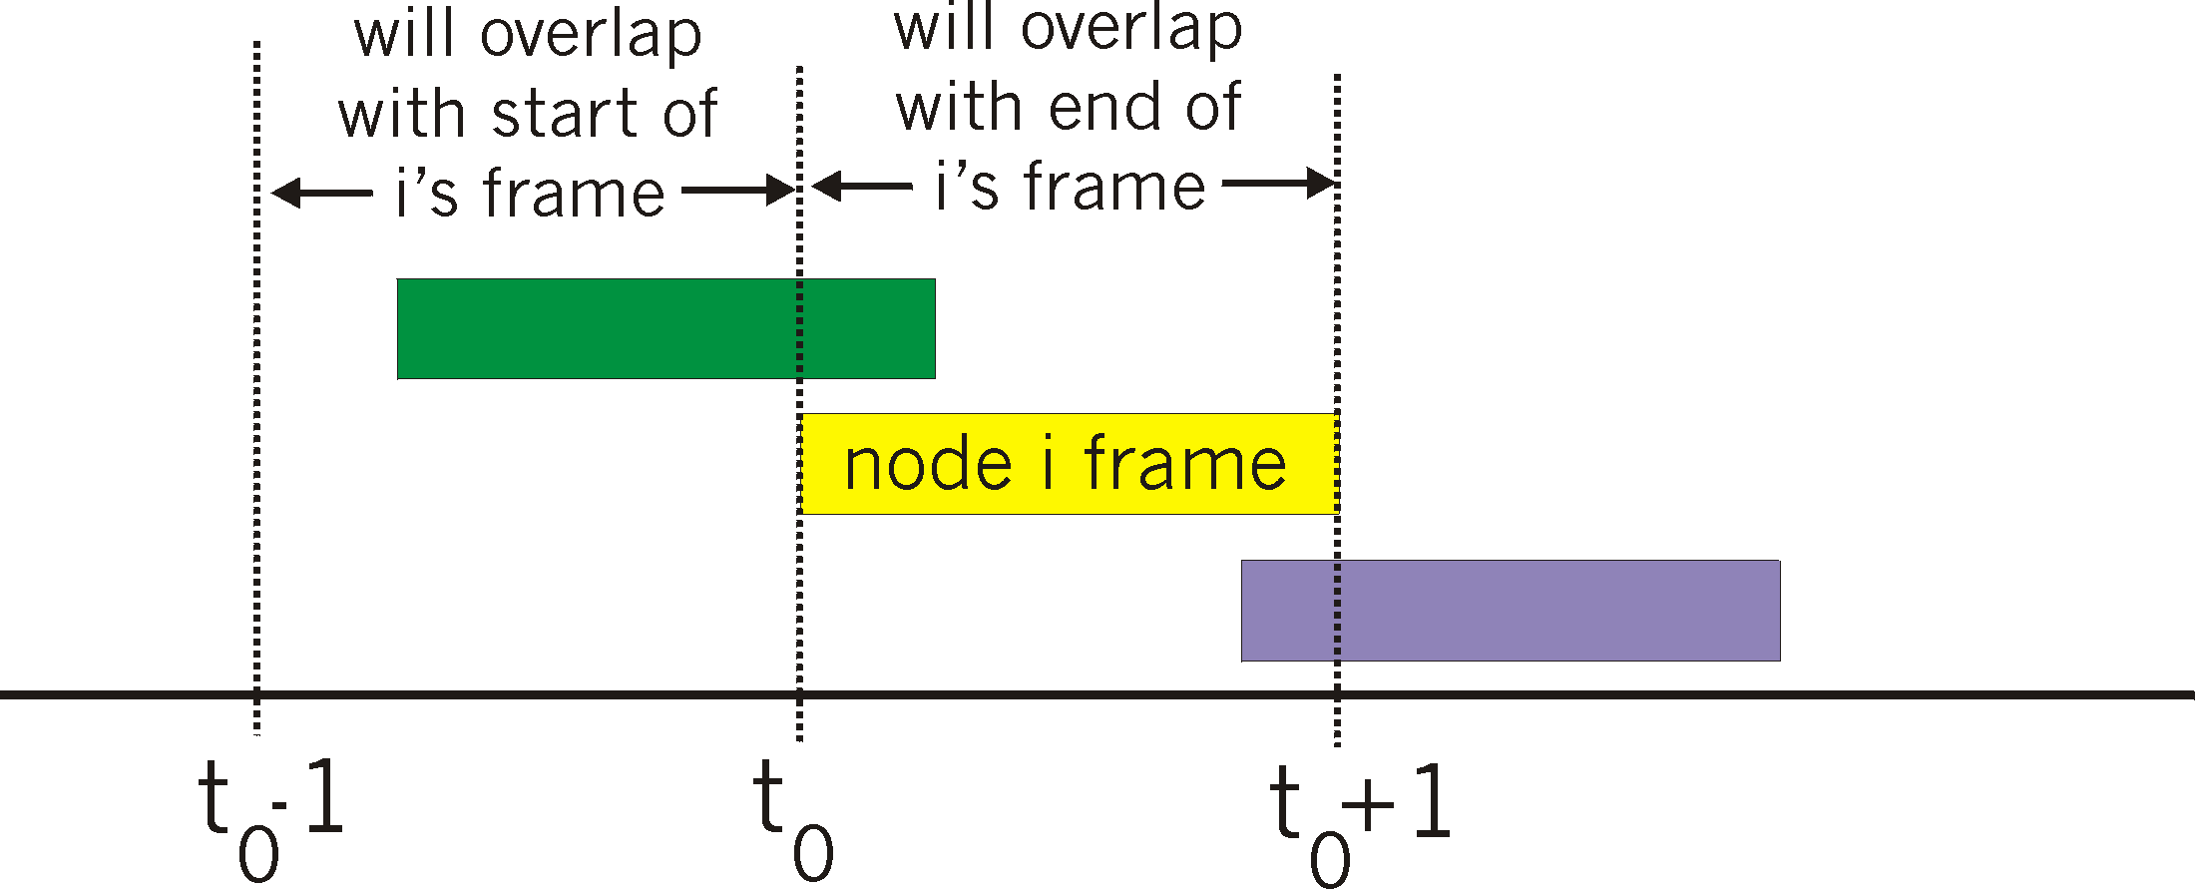
Pure Aloha vs slotted Aloha
P(success by any of N nodes) = N p . (1-p)^{2N =}
i.e. N p P(no other node transmits in [p0-1,p0] .
P(no other node transmits in [p0,p0+1]
^{=(as n -> infty …)}
^{1/(2e) = .18}
0.4
0.3
S = throughput = “goodput”
(success rate)
Slotted Aloha
0.2
0.1
Pure Aloha
0.5
1.0
1.5
2.0
G = offered load = #frames per frame-time

Slide 19
CSMA: Carrier Sense Multiple Access
CSMA: listen before transmit:
If channel sensed busy, defer transmission
  back-off, random interval
If/when channel sensed idle:
  p-persistent CSMA: transmit immediately with probability p; with probablility 1-p retry after random interval
  non-persistent CSMA: transmit after random interval
human analogy: don’t interrupt others!

Slide 20
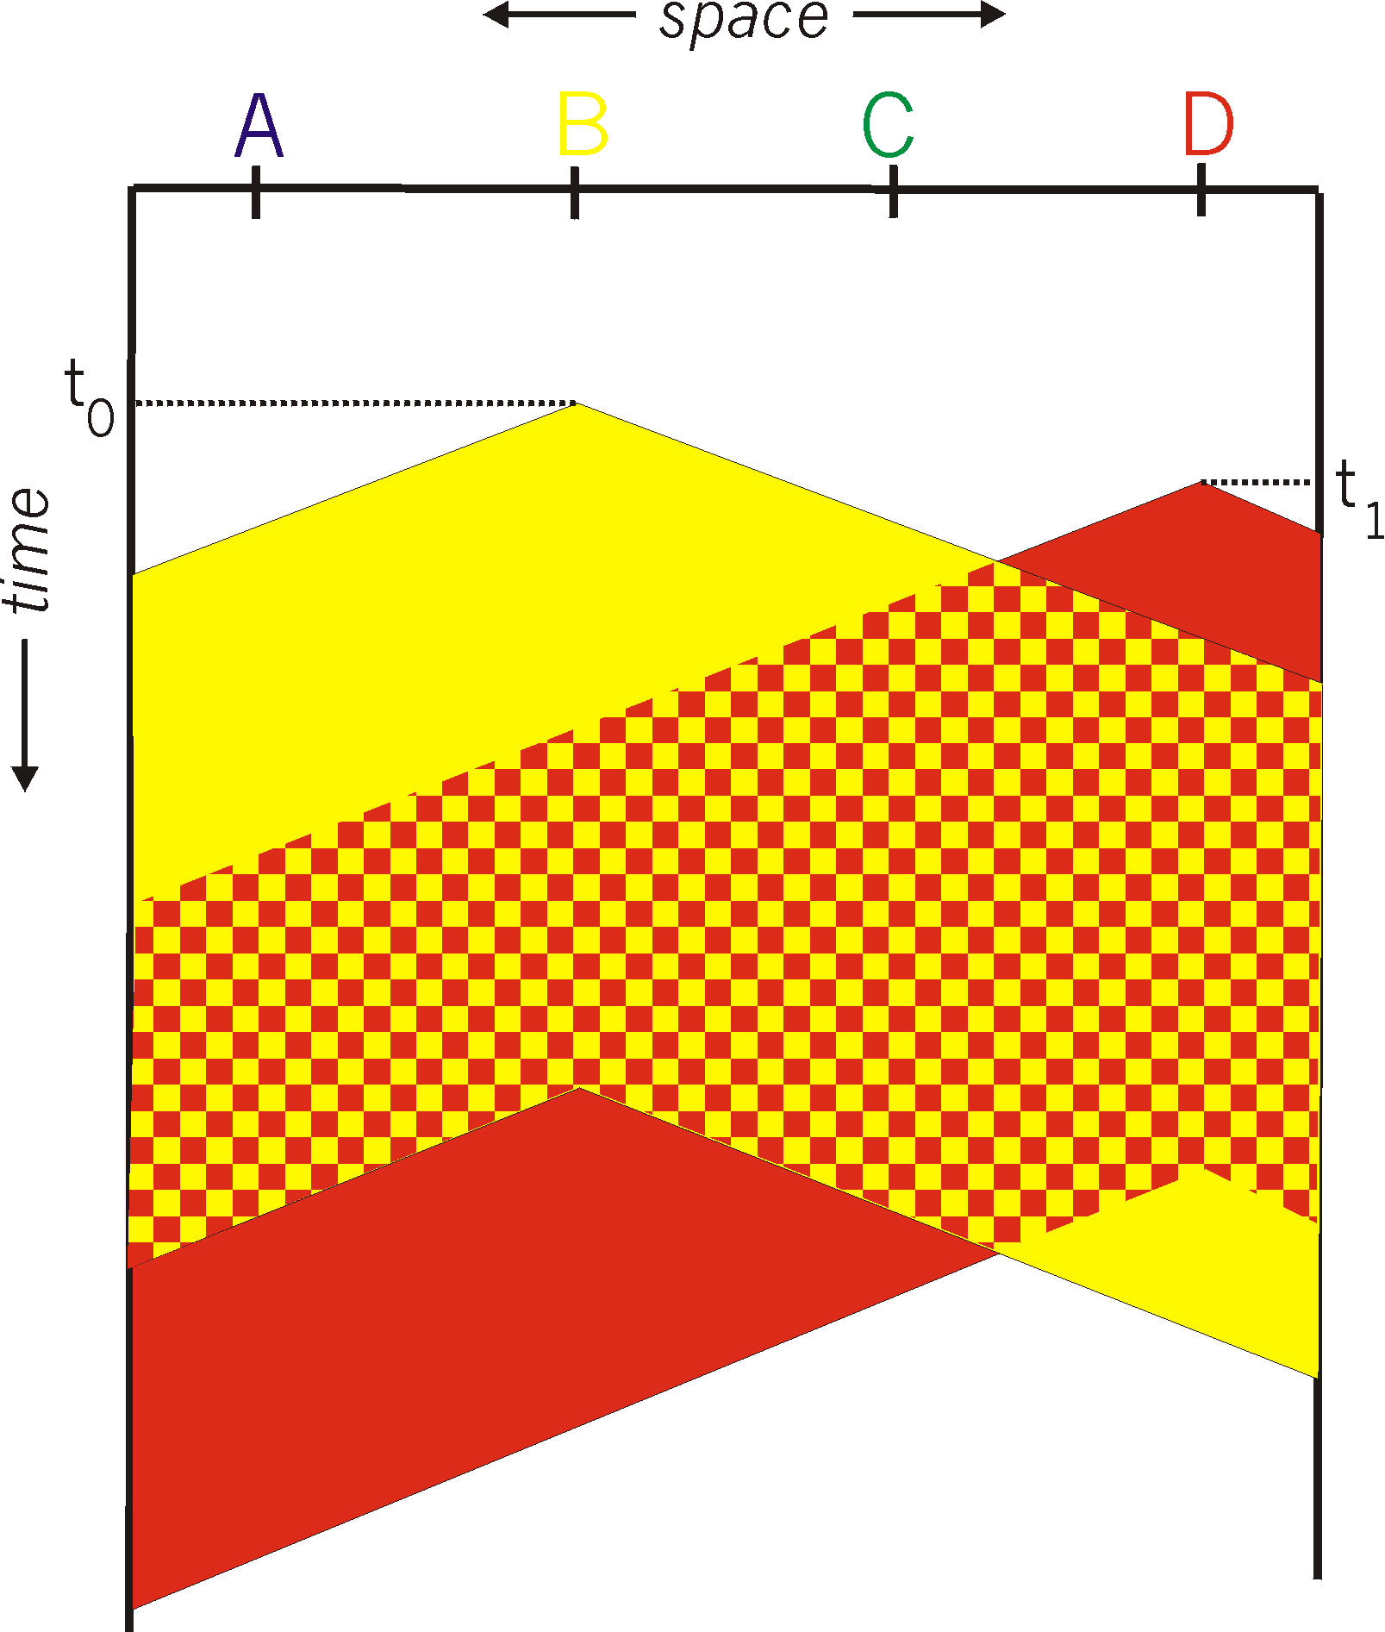
CSMA collisions
spatial layout of nodes along ethernet
collisions can occur:
Due to propagation delay, two nodes may not hear each other’s transmission
collision:
entire packet transmission
time wasted
note:
role of distance and propagation delay (d)in determining collision
(collision-detection delay <= 2d)

Slide 21
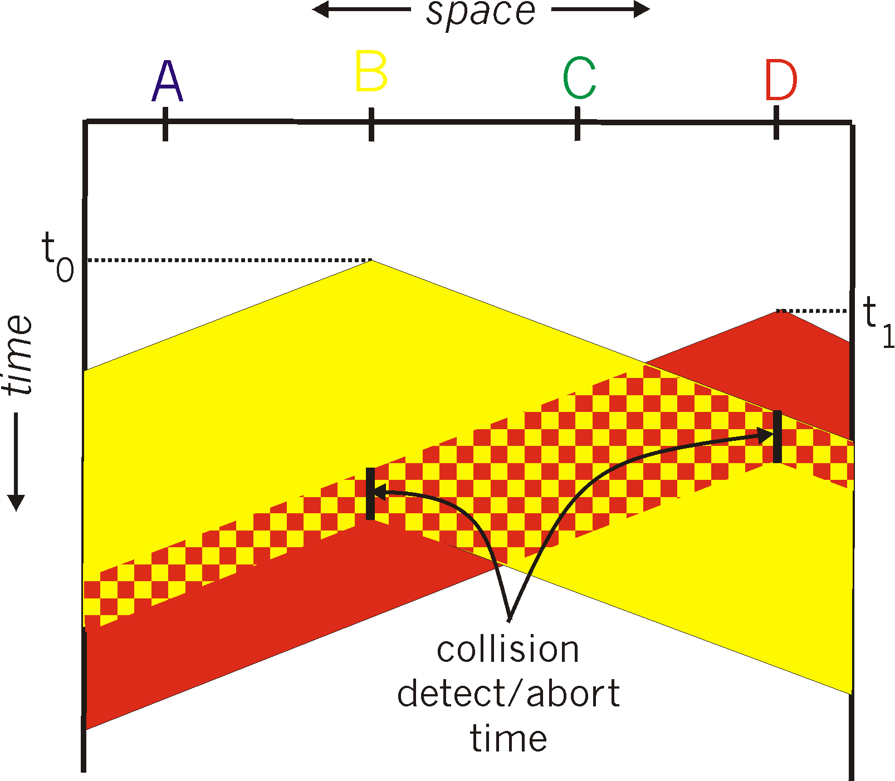
CSMA/CD (Collision Detection)
CSMA/CD: carrier sensing, deferral as in CSMA
colliding transmissions aborted, reducing channel wastage
persistent or non-persistent retransmission
collision detection:
easy in wired LANs: measure signal
  strengths, compare transmitted,
  received signals
different in wireless LANs:
  transmitter/receiver not “on”
  simultaneously; collision at the
  receiver matters, not the sender
human analogy: the polite
conversationalist

Slide 22
MAC protocols: taxonomy
three broad classes:
channel partitioning
  divide channel into smaller “pieces” (time slots, frequency, code)
  allocate piece to node for exclusive use
random access
  channel not divided, allow collisions
  “recover” from collisions
“taking turns”
  nodes take turns, but nodes with more to send can take longer turns

Slide 23
Trade-off in MAC:
channel partitioning MAC protocols:
  share channel efficiently and fairly at high load
  inefficient at low load: delay in channel access, bandwidth allocated even if only 1 active node!
Random access MAC protocols
  efficient at low load: single node can fully utilize channel
  high load: collision overhead
“taking turns” protocols
  look for best of both worlds!

Slide 24
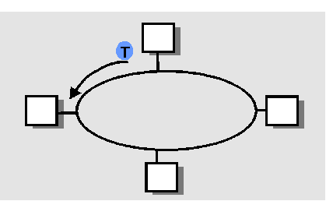
“Taking Turns” MAC protocols
Token passing:
control token-frame passed from one node to next sequentially.
not pure broadcast
concerns:
  token overhead
  latency
  single point of failure (token)
other: token bus, take-turns + reservation; see extra slides @ end of lecture

Slide 25
Summary of MAC protocols
What do you do with a shared media?
  Channel Partitioning, by time, frequency or code
    Time Division, Frequency Division
  Random partitioning (dynamic),
    ALOHA, S-ALOHA, CSMA, CSMA/CD
    carrier sensing: easy in some technologies (wire), hard in others (wireless)
    CSMA/CD used in Ethernet
    CSMA/CA used in 802.11 (to be studied in wireless)
  Taking Turns
    polling, token passing
    Bluetooth, FDDI, IBM Token Ring

Slide 26
Link Layer
5.1 Introduction and services
5.3Multiple access protocols
(5.2 Error detection and correction )
*grey items will be treated as complement, in subsequent lecture
LAN technology
5.5 Ethernet
5.6 Interconnection
5.4 Link-Layer Addressing
5.9 A day in the life of a web request
(5.7 PPP
5.8 Link Virtualization: ATM and MPLS)
Framing

Slide 27
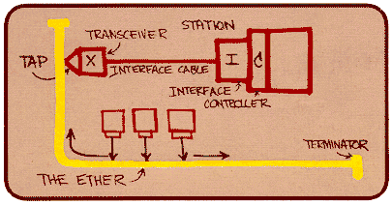
Ethernet
“dominant” wired LAN technology:
cheap $20 for 100Mbs!
first widely used LAN technology
Simpler, cheaper than token LANs and ATM
Kept up with speed race: 10 Mbps – 100 Gbps
Metcalfe’s Ethernet
sketch

Slide 28
Ethernet: uses CSMA/CD
A: sense channel, if idle
  then {
  transmit and monitor the channel;
      If detect another transmission
      then {
      abort and send jam signal;
        update # collisions;
        delay as required by exponential backoff algorithm;
        goto A
        }
      else {done with the frame; set collisions to zero}
    }
  else {wait until ongoing transmission is over and goto A}

Slide 29
Ethernet’s CSMA/CD (more)
Jam Signal: make sure all other transmitters are aware of collision; 48 bits;
Exponential Backoff:
Goal: adapt retransmission attempts to estimated current load
  heavy load: random wait will be longer
first collision: choose K from {0,1}
  (delay is K x frame-transmission time)
after m (<10) collisions: choose K from {0,…, 2^m}…
after ten or more collisions, choose K from {0,1,2,3,4,…,1023}

Slide 30
Ethernet (CSMA/CD) Limitation
Recall: collision detection interval = 2*Propagation delay along the LAN
This implies a minimum frame size and/or a maximum wire length
Critical factor:
  a = 2 * propagation_delay / frame_transmission_delay

Slide 31
Star topology
bus topology popular through mid 90s
  all nodes in same collision domain (can collide with each other)
today: star topology prevails (more bps, shorter distances)
  Hub or active switch in center
  (more in a while)
switch
bus: coaxial cable
star

Slide 32

Ethernet Frame Structure
Sending adapter encapsulates IP datagram (or other network layer protocol packet) in Ethernet frame
Preamble: 7 bytes with pattern 10101010 followed by one byte with pattern 10101011
  to synchronize receiver and sender clock rates
Addresses: 6 bytes, frame is received by all adapters on a LAN and dropped if address does not match
Type: indicates the higher layer protocol, mostly IP but others may be supported
CRC: checked at receiver, if error is detected, the frame is simply dropped

Slide 33
802.3 Ethernet Standards: Link & Physical Layers
many different Ethernet standards
  common MAC protocol and frame format
  different speeds: 2 Mbps, 10 Mbps, 100 Mbps, 1Gbps, 10G bps
  different physical layer media: fiber, cable
application
transport
network
link
physical
MAC protocol
and frame format
100BASE-TX
100BASE-T2
100BASE-FX
100BASE-T4
100BASE-SX
100BASE-BX
copper (twisted
pair) physical layer
fiber physical layer

Slide 34
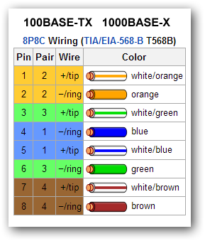
Ethernet: Unreliable, connectionless
connectionless: No handshaking between sending and receiving NICs
unreliable: receiving NIC doesn’t send acks or nacks to sending NIC
  stream of datagrams passed to network layer can have gaps (missing datagrams)
  gaps will be filled if app is using TCP
  otherwise, app will see gaps

Slide 35
Link Layer
5.1 Introduction and services
5.3Multiple access protocols
(5.2 Error detection and correction )
*grey items will be treated as complement, in subsequent lecture
LAN technology
5.5 Ethernet
5.6 Interconnection
5.4 Link-Layer Addressing
5.9 A day in the life of a web request
(5.7 PPP
5.8 Link Virtualization: ATM and MPLS)
Framing

Slide 36
Interconnecting with hubs
Hubs are essentially physical-layer repeaters:
  bits coming from one link go out all other links
  at the same rate (no frame buffering)
no CSMA/CD at hub: adapters detect collisions (one large collision domain)
provides net management functionality (monitoring, statistics)
Extends distance between nodes
Can’t interconnect different standards, e.g. 10BaseT & 100BaseT
hub
hub
hub
hub
http://www.youtube.com/watch?v=reXS_e3fTAk&feature=related (video link)

Slide 37


Switch: multiple simultaneous transmissions
switches buffer packets
Ethernet protocol used on each incoming link, but no collisions; full duplex
  each link is its own collision domain
switching: A-to-A’ and B-to-B’ can transmit simultaneously, without collisions
A
C’
B
6
1
2
5
4
3
B’
C
A’
forwarding: how to know LAN segment on which to forward frame?
  looks like a routing problem…
switch with six interfaces
(1,2,3,4,5,6)

Slide 38
Switch: self-learning
Source: A
Dest: A’
switch learns which hosts can be reached through which interfaces
  when frame received, switch “learns” location of sender: incoming LAN segment
  records sender/location pair in switch table
A
A A’
C’
B
6
1
2
5
4
3
B’
C
A’
MAC addr interface TTL
A
1
60
Switch table
(initially empty)

Slide 39
Switch: frame filtering/forwarding
when frame received at switch:
  1. record incoming link, MAC address of sending host
  2. index switch table using MAC destination address
  3. if entry found for destination
  then {
  if destination on segment from which frame arrived
  then drop frame
  else forward frame on interface indicated by entry
  }
  else flood /* forward on all interfaces except arriving interface */

Slide 40
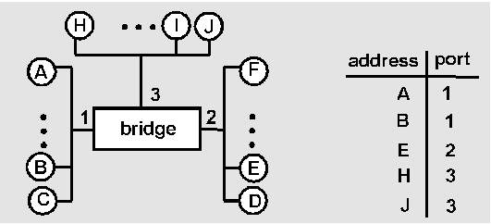
Switch Learning: example
Suppose C sends a frame to D and D replies with a frame to C
switch
C sends frame, switch has no info about D, so floods
  switch notes that C is on port 1
  frame ignored on upper LAN
  frame received by D
D generates reply to C, sends
  switch sees frame from D
  switch notes that D is on interface 2
  switch knows C on interface 1, so selectively forwards frame out via interface 1

Slide 41
Switch: traffic isolation
switch installation breaks subnet into LAN segments
switch filters packets:
  same-LAN-segment frames not usually forwarded onto other LAN segments
  segments become separate collision domains
switch
collision
domain
hub
hub
hub
collision domain
collision domain

Slide 42
Switches vs. routers
application
transport
network
link
physical
both are store-and-forward:
routers: network-layer devices (examine network-layer headers)
switches: link-layer devices (examine link-layer headers)
both have forwarding tables:
routers: compute tables using routing algorithms, IP addresses
switches: learn forwarding table using flooding, learning, MAC addresses
datagram
frame
link
physical
frame
switch
network
link
physical
datagram
frame
application
transport
network
link
physical

Slide 43
Summary comparison

Slide 44
Link Layer
5.1 Introduction and services
5.3Multiple access protocols
(5.2 Error detection and correction )
*grey items will be treated as complement, in subsequent lecture
LAN technology
5.5 Ethernet
5.6 Interconnection
5.4 Link-Layer Addressing
5.9 A day in the life of a web request
(5.7 PPP
5.8 Link Virtualization: ATM and MPLS)
Framing

Slide 45
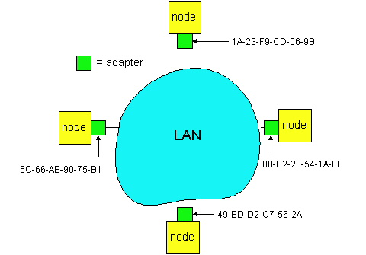
LAN Addresses
32-bit IP address:
network-layer address
used to get datagram to destination network (recall IP network definition)
LAN (or MAC or physical) address:
to get datagram from
  one interface to another
  physically-connected
  interface (same network)
48 bit MAC address
  (for most LANs)
  burned in NIC’s ROM
  (sometimes configurable)
Broadcast address =
FF-FF-FF-FF-FF-FF

Slide 46
LAN Address (more)
MAC address allocation administered by IEEE
manufacturer buys portion of MAC address space (to assure uniqueness)
Analogy:
(a) MAC address: like People’s Names or PersonalNum’s
(b) IP address: like postal address
MAC flat address => portability
  can move LAN card from one LAN to another
IP hierarchical address NOT portable
  depends on network to which one attaches

Slide 47
Recall earlier routing discussion
Starting at A, given IP datagram addressed to B:
look up net. address of B, find B on same net. as A
link layer sends datagram to B inside link-layer frame
A
223.1.1.1
223.1.2.1
223.1.1.2
223.1.1.4
223.1.2.9
B
223.1.2.2
E
223.1.1.3
223.1.3.27
223.1.3.1
223.1.3.2
frame source,
dest address
datagram source,
dest address
A’s MAC
addr
B’s MAC
addr
A’s IP
addr
B’s IP
addr
IP payload
datagram
frame

Slide 48
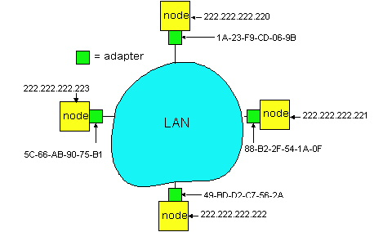
ARP: Address Resolution Protocol
Each IP node (Host, Router) on LAN has ARP table
  ARP Table: IP/MAC address mappings
    < IP address; MAC address; TTL>
  < ………………………….. >
    TTL (Time To Live): time to cache (typically 20 min); afterwards:
  A broadcasts ARP query pkt, containing B's IP address
  B receives ARP packet, replies to A with its (B's) physical layer address
  A caches (saves) IP-to-physical address pairs until they time out
    soft state: information that times out (goes away) unless refreshed
Question: how to determine
MAC address of B
given B’s IP address?
Broadcast address =
FF-FF-FF-FF-FF-FF

Slide 49
Addressing: routing to another LAN
walkthrough: send datagram from A to B via R
assume A knows B’s IP address
two ARP tables in router R, one for each IP network (LAN)
74-29-9C-E8-FF-55
88-B2-2F-54-1A-0F
A
E6-E9-00-17-BB-4B
222.222.222.221
111.111.111.111
1A-23-F9-CD-06-9B
222.222.222.220
222.222.222.222
111.111.111.110
B
111.111.111.112
R
49-BD-D2-C7-56-2A
CC-49-DE-D0-AB-7D

Slide 50
A creates IP datagram with source A, destination B
  Network layer finds out I should be forwarded to R
A uses ARP to get R’s MAC address for 111.111.111.110
A creates link-layer frame with R's MAC address as dest, frame contains A-to-B IP datagram
A’s NIC sends frame
R’s NIC receives frame
R removes IP datagram from Ethernet frame, sees its destined to B
R uses ARP to get B’s MAC address
R creates frame containing A-to-B IP datagram; sends to B
This is a really important
example – make sure you
understand!
74-29-9C-E8-FF-55
88-B2-2F-54-1A-0F
A
E6-E9-00-17-BB-4B
222.222.222.221
111.111.111.111
1A-23-F9-CD-06-9B
222.222.222.220
222.222.222.222
111.111.111.110
B
111.111.111.112
R
49-BD-D2-C7-56-2A
CC-49-DE-D0-AB-7D

Slide 51
Link Layer
5.1 Introduction and services
5.3Multiple access protocols
(5.2 Error detection and correction )
*grey items will be treated as complement, in subsequent lecture
LAN technology
5.5 Ethernet
5.6 Interconnection
5.4 Link-Layer Addressing
5.9 A day in the life of a web request
(5.7 PPP
5.8 Link Virtualization: ATM and MPLS)
Framing

Slide 52
Review questions for this part
  Why both link-level and end-end reliability?
Medium access methods: how they work, pros and cons
  Partitioning
  Random access
  Reservation
Aloha vs CSMA/CD
Ethernet: protocol, management of collisions, connections
Switches vs routers
Addressing in link layer

Slide 53
Extra slides/topics

Slide 54
IEEE 802.4 Standard
(General Motors Token Bus)
(not in must-study material)
Contention systems limitation: worst-case delay until successful transmission is unlimited => not suitable for real-time traffic
Solution: token-passing, round robin
token = special control frame; only the holding station can transmit; then it passes it to another station, i.e. for token bus, the next in the logical ring
4 priority classes of traffic, using timers
Logical ring-maintenance: distributed strategy
  Robust, somehow complicated though

Slide 55
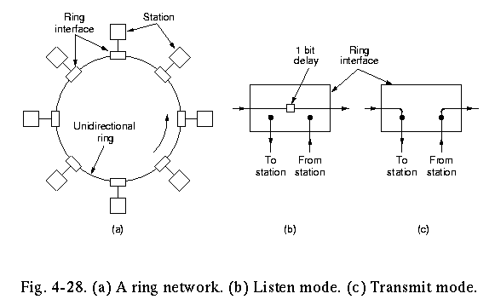
IEEE Standard 802.5 (Token Ring)
(not in must-study material)
Motivation: instead of complicated token-bus, have a physical ring
Principle: Each bit arriving at an interface is copied into a 1-bit buffer (inspected and/or modified); then copied out to the ring again.
  copying step introduces a 1-bit delay at each interface.

Slide 56
Token Ring operation
to transmit a frame, a station is required to seize the token and remove it from the ring before transmitting.
bits that have propagated around the ring are removed from the ring by the sender (the receiver in FDDI).
After a station has finished transmitting the last bit of its frame, it must regenerate the token.

Slide 57
IEEE 802.5 Ring: Maintenance
(not in must-study material)
Centralised: a “monitor” station oversees the ring:
generates token when lost
cleans the ring when garbled/orphan frames appear
If the monitor goes away, a convention protocol ensures that another station is elected as a monitor (e.g. the one with highest identity)
If the monitor gets ”mad”, though…..

Slide 58
IEEE 802.5 Ring: Priority Algorithm
(not in must-study material)
Station S
upon arrival of frame f:
  set prior(f) := max{prior(f), prior(S)}
  forward(f)
upon arrival of T
  if prior(T)>prior(S) then forward(T)
  else send own frame f with prior(f):=0
    wait until f comes back
    prior(T):=prior(f)
    forward(T)

Slide 59
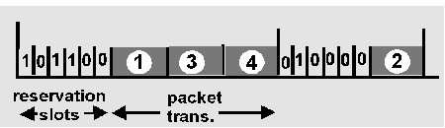
Reservation-based protocols
Distributed Polling – Bit-map protocol:
time divided into slots
begins with N short reservation slots
  station with message to send posts reservation during its slot
  reservation seen by all stations
  reservation slot time equal to channel end-end propagation delay (why?)
after reservation slots, message transmissions ordered by known priority

Slide 60
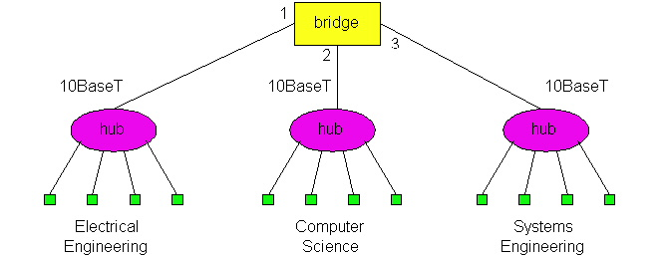
Switches (bridges): cont.
Link Layer devices: operate on frames, examining header and selectively forwarding frame based on its destination
  filtering: same-LAN-segment frames not forwarded to other seg’s
Advantages:
  Isolates collision domains:
    higher total max throughput
    no limit on number of nodes nor distances
  Can connect different net-types (translational, …)
  Transparent: no need for any change to hosts LAN adapters
forwarding: how to know LAN segment on which to forward frame?
  looks like a routing problem…
switch

