Slide 1

Chapter I: Introduction
Course on Computer Communication and Networks, EDA343/DIT 420, CTH/GU
The slides are based on adaptations of the slides available by the authors of the course’s main textbook, further edited by the instructor(s):
Computer Networking: A Top Down Approach,
Jim Kurose, Keith Ross, Addison-Wesley.
Slides with darker background contain topics discussed in less detail in class

Slide 2


Chapter I: Introduction
Overview:
what’s the Internet
types of service
ways of information transfer, routing, performance, delays, loss
--------------------------------------------
access net, physical media
protocol layers, service models
backbones, NAPs, ISPs
Security prelude

Slide 3


the Internet: “nuts and bolts” view
PC
millions of connected computing devices: hosts = end systems
  running network apps
Mobile network
server
Global ISP
wireless
laptop
cellular
handheld
Home network
communication links
  fiber, copper, radio, satellite
  transmission rate = bandwidth
Regional ISP
access
points
Institutional network
wired
links
routers: forward packets (chunks of data)
router

Slide 4

the Internet: “nuts and bolts” view
protocols control sending, receiving of msgs
  e.g., TCP, IP, HTTP, Skype, Ethernet
Internet: “network of networks”
  loosely hierarchical
  public Internet versus private intranet
Internet standards
  RFC: Request for comments
  IETF: Internet Engineering Task Force
Mobile network
Global ISP
Home network
Regional ISP
Institutional network

Slide 5

the Internet: a service view
communication infrastructure enables distributed applications:
  Web, VoIP, email, games, e-commerce, file sharing
communication services provided to apps:
  reliable data delivery from source to destination
  “best effort” (unreliable) data delivery

Slide 6

Internet standards
RFC: Request for comments
IETF: Internet Engineering Task Force

Slide 7

A closer look at (any big) network’s structure:
network edge: applications and hosts
access networks, physical media: wired, wireless communication links
network core:
  interconnected routers
  network of networks

Slide 8

The network edge

Slide 9

The network edge:
end systems (hosts):
run application programs e.g. in Internet Web, email, …
… based on network services available at the edge
peer-peer
client/server
types of service offered by the network to applications:
  connection-oriented: deliver data in the order they are sent
  connectionless: delivery of data in arbitrary order

Slide 10
Network Core

Slide 11
The Network Core
mesh of interconnected routers
fundamental question: how is data transferred through net?
  packet-switching: data sent thru net in discrete “chunks”
    Study latency issues ++
    We will contrast with circuit switching: dedicated circuit per call: “classic”phone net

Slide 12
Network Core: Packet Switching
10 Mbs
Ethernet
A
C
statistical multiplexing
1.5 Mbs
B
queue of packets
waiting for output
link
45 Mbs
D
E

Slide 13
Network Core: Packet Switching
each end-end data stream divided into packets
packets share network resources
resources used as needed
store and forward:
packets move one hop at a time
  transmit over link
  wait turn at next link
http://www.youtube.com/watch?v=O7CuFlM4V54
  nice animation; note some of the terms in narration are not accurate (wrt protocol specifications)
Notes:
From 0:22 – 1:00
1: 20 Until 7.35 (afterwards firewalls)

Slide 14
Delay in packet-switched networks
packets experience delay on end-to-end path
1. nodal processing:
  check bit errors
  determine output link
2. queuing
  time waiting at output link for transmission
  depends on congestion level of router
transmission
A
propagation
http://www.youtube.com/watch?v=O7CuFlM4V54
  Nice animation; disregard the terms used in narration; they do not follow exact protocol specifications
B
nodal
processing
queueing

Slide 15
Delay in packet-switched networks
3. Transmission delay:
R=link bandwidth (bps)
L=packet length (bits)
time to send bits into link = L/R
4. Propagation delay:
d = length of physical link
s = propagation speed in medium (~2x10⁸ m/sec)
propagation delay = d/s
Note: s and R are very different quantities!
transmission
A
propagation
B
nodal
processing
queuing

Slide 16
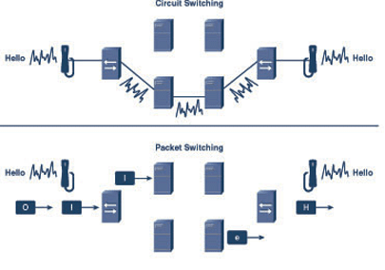
Network Core: Circuit Switching
End-end resources reserved/dedicated for “call”
link bandwidth, switch capacity
dedicated resources: no sharing
circuit-like (guaranteed) performance
call setup required

Slide 17
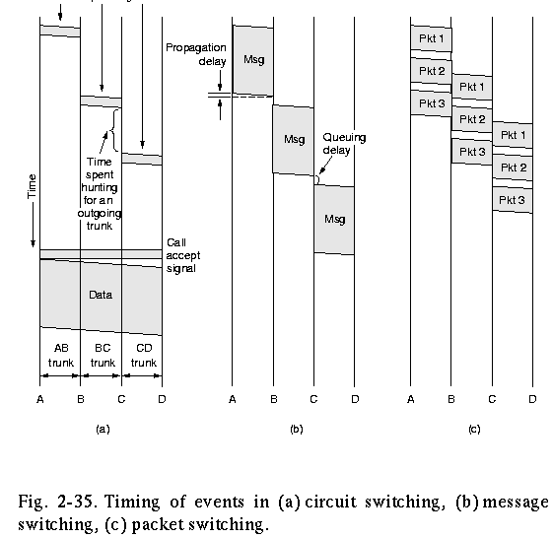
Visualize deleys: Circuit, message, packet switching
store and forward behavior + other delays’ visualization (fig. from “Computer Networks” by A. Tanenbaum,)

Slide 18
Packet switching versus classical circuit switching
Packet switching allows more users to use the network!
1 Mbit link
each user:
  100Kbps when “active”
  active 10% of time (bursty behaviour)
circuit-switching:
  10 users
packet switching:
  with 35 users, probability > 10 active less than 0.0004 (⇒ almost all of the time same queuing behaviour as circuit switching)
N users
1 Mbps link

Slide 19
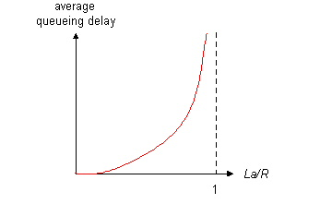
Queueing delay (revisited) …
R=link bandwidth (bps)
L=packet length (bits)
a=average packet arrival rate
traffic intensity = La/R
La/R ~ 0: average queueing delay small
La/R -> 1: delays become large
La/R > 1: more “work” arriving than can be serviced, average delay infinite! Queues may grow unlimited, packets can be lost

Slide 20
… “Real” Internet delays and routes (1)…
What do “real” Internet delay & loss look like?
Traceroute program: provides delay measurement from source to router along end-end Internet path towards destination. For all i:
  sends three packets that will reach router i on path towards destination
  router i will return packets to sender
  sender times interval between transmission and reply.
3 probes
3 probes
3 probes

Slide 21
…“Real” Internet delays and routes (2)…
traceroute: gaia.cs.umass.edu to www.eurecom.fr
Three delay measurements from
gaia.cs.umass.edu to cs-gw.cs.umass.edu
1 cs-gw (128.119.240.254) 1 ms 1 ms 2 ms
2 border1-rt-fa5-1-0.gw.umass.edu (128.119.3.145) 1 ms 1 ms 2 ms
3 cht-vbns.gw.umass.edu (128.119.3.130) 6 ms 5 ms 5 ms
4 jn1-at1-0-0-19.wor.vbns.net (204.147.132.129) 16 ms 11 ms 13 ms
5 jn1-so7-0-0-0.wae.vbns.net (204.147.136.136) 21 ms 18 ms 18 ms
6 abilene-vbns.abilene.ucaid.edu (198.32.11.9) 22 ms 18 ms 22 ms
7 nycm-wash.abilene.ucaid.edu (198.32.8.46) 22 ms 22 ms 22 ms
8 62.40.103.253 (62.40.103.253) 104 ms 109 ms 106 ms
9 de2-1.de1.de.geant.net (62.40.96.129) 109 ms 102 ms 104 ms
10 de.fr1.fr.geant.net (62.40.96.50) 113 ms 121 ms 114 ms
11 renater-gw.fr1.fr.geant.net (62.40.103.54) 112 ms 114 ms 112 ms
12 nio-n2.cssi.renater.fr (193.51.206.13) 111 ms 114 ms 116 ms
13 nice.cssi.renater.fr (195.220.98.102) 123 ms 125 ms 124 ms
14 r3t2-nice.cssi.renater.fr (195.220.98.110) 126 ms 126 ms 124 ms
15 eurecom-valbonne.r3t2.ft.net (193.48.50.54) 135 ms 128 ms 133 ms
16 194.214.211.25 (194.214.211.25) 126 ms 128 ms 126 ms
17 * * *
18 * * *
19 fantasia.eurecom.fr (193.55.113.142) 132 ms 128 ms 136 ms
trans-oceanic
link
* means no reponse (probe lost, router not replying)

Slide 22

Packet switching properties
PS: Good: Great for bursty data
  resource sharing
  no call setup
PS: Not so good? Excessive congestion: packet delay and loss
  protocols needed for reliable data transfer, congestion control
http://www.youtube.com/watch?v=Dq1zpiDN9k4&feature=related
Q: How to provide circuit-like behavior?
  bandwidth guarantees are needed for some apps
  Some routing policies can help (cf next slide)

Slide 23
Packet-switched networks: routing
What is routing’s goal? find routes from source to destination
  (Challenge 1) path selection algorithms
How does routing relate with the switching question and the bandwidth guarantees?
  (Challenge2) Important design issue:
    datagram network:
      destination address determines next hop
      routes may change during session
    virtual circuit network:
      each packet carries tag (virtual circuit ID), tag determines next hop
      fixed path determined at call setup time, remains fixed thru call
      routers maintain per-call state

Slide 24

Virtual circuits:
“source-to-dest path behaves almost like a physical circuit”
call setup, teardown for each call before data can flow
  signaling protocols to setup, maintain, teardown VC
every router maintains “state” for each passing connection
resources (bandwidth, buffers) may be allocated to VC
application
transport
network
data link
physical
5. Data flow begins
6. Receive data
application
transport
network
data link
physical
4. Call connected
3. Accept call
1. Initiate call
2. incoming call

Slide 25

Network Taxonomy
Telecommunication
networks
Circuit-switched
networks
Packet-switched
networks
Networks
with VCs
Datagram
Networks
Datagram network (eg Internet) cannot be characterized either connection-oriented or connectionless.
  Internet provides both connection-oriented (TCP) and
connectionless services (UDP), at the network edge, to apps.

Slide 26
Related with delays…
- packet loss
- throughput

Slide 27
Packet loss
queue (aka buffer) preceding link has finite capacity
packet arriving to full queue dropped (aka lost)
lost packet may be retransmitted by previous node, by source end system, or not at all
buffer
(waiting area)
packet being transmitted
A
B
packet arriving to
full buffer is lost

Slide 28
Throughput
throughput: rate (bits/time unit) at which bits transferred between sender/receiver
  instantaneous: rate at given point in time
  average: rate over longer period of time
link capacity
R_{s} bits/sec
link capacity
R_{c} bits/sec
server, with
file of F bits
to send to client
pipe that can carry
fluid at rate
R_{s} bits/sec)
pipe that can carry
fluid at rate
R_{c} bits/sec)
server sends bits
(fluid) into pipe

Slide 29
Throughput (more)
R_{s} < R_{c} What is average end-end throughput?
R_{s} bits/sec
R_{c} bits/sec
R_{s} > R_{c} What is average end-end throughput?
R_{s} bits/sec
R_{c} bits/sec
bottleneck link
link on end-end path that constrains end-end throughput

Slide 30
Throughput: Internet scenario
R_{s}
per-connection end-end throughput: min(R_{c},R_{s},R/10 (if fair))
in practice: R_{c} or R_{s} is often bottleneck
R_{s}
R_{s}
R
R_{c}
R_{c}
R_{c}
10 connections (fairly) share backbone bottleneck link R bits/sec

Slide 31
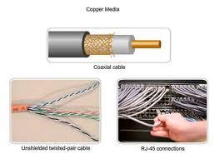
Access networks and physical media

Slide 32
Access networks and physical media
Q: How to connect end systems to edge router?
residential access nets
institutional access networks (school, company)
mobile access networks
Keep in mind:
bandwidth (bits per second) of access network?
shared or dedicated?

Slide 33
Dial-up Modem
central
office
telephone
network
Internet
home
PC
home
dial-up
modem
ISP
modem
(e.g., AOL)
Uses existing telephony infrastructure
  Home is connected to central office
up to 56Kbps direct access to router (often less)
Can’t surf and phone at same time: not “always on”

Slide 34
Digital Subscriber Line (DSL)
Internet
home
phone
Existing phone line:
DSLAM
telephone
network
splitter
DSL
modem
Central Office:
multiplexer
home
PC
  Also uses existing telephone infrastructure
  Commonly up to 2.5 Mbps upstream (more typically < 1 Mbps)
  Commonly up to 24 Mbps downstream (more typically < 10 Mbps)
  dedicated physical line to telephone central office

Slide 35




Access net: cable network
cable headend
…
cable
modem
splitter
CMTS
cable modem
termination system
data, TV transmitted at different
frequencies over shared cable
distribution network
ISP
HFC: hybrid fiber coax
  asymmetric: up to 30Mbps downstream transmission rate, 2 Mbps upstream transmission rate
network of cable, fiber attaches homes to ISP router
  homes share access network to cable headend
  unlike DSL, which has dedicated access to central office

Slide 36
Institutional access: local area networks
local area network (LAN) connects end system to edge router
E.g. Ethernet:
  10 Mbs, 100Mbps, Gigabit Ethernet
deployment: institutions, home LANs

Slide 37
Wireless access networks
shared wireless access network connects end system to router
  via base station aka “access point”, or “adhoc”
wireless LANs:
  802.11b/g (WiFi): 11 or 54 Mbps
wider-area wireless access
  provided by telco operator
  ~1Mbps over cellular system
  WiMAX (10’s Mbps) over wide area
router
base
station
mobile
hosts

Slide 38
Home networks
Typical home network components:
DSL or cable modem
router/firewall/NAT
Ethernet
wireless access
point
wireless
devices
to/from
cable
headend
Cable or DSL
modem
router/
Firewall
NAT
wireless
access
Point (54 Mbps)
Ethernet

Slide 39
Physical Media
physical link: transmitted data bit propagates across link
  guided media:
    signals propagate in solid media: copper, fiber
  unguided media:
    signals propagate freely e.g., radio

Slide 40
Physical media: wireless
signal carried in electromagnetic spectrum
Omnidirectional: signal spreads, can be received by many antennas
Directional: antennas communicate with focused el-magnetic beams and must be aligned (requires higher frequency ranges)
propagation environment effects:
  reflection
  obstruction by objects
  interference

Slide 41
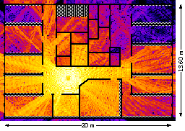
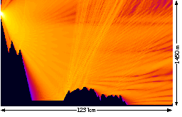
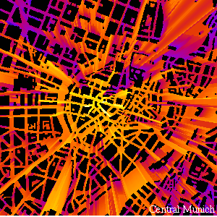
Properties: Attenuation, Multipath propagation
Signal can fade with distance, can get obstructed, can take many different paths between sender and receiver due to reflection, scattering, diffraction
signal at sender
signal at receiver

Slide 42
Physical Media: Twisted pair
Twisted Pair (TP)
two insulated copper wires
  Category 3: traditional phone wires, 10 Mbps Ethernet
  Category 5 TP: more twists, higher insulation: 100Mbps Ethernet

Slide 43


Physical Media: coax, fiber
Coaxial cable:
wire (signal carrier) within a wire (shield)
  baseband: single channel on cable (common use in 10Mbs Ethernet)
  broadband: multiple channels on cable (FDM; commonly used for cable TV)
Fiber optic cable:
glass fiber carrying light pulses
low attenuation
high-speed operation:
  100Mbps Ethernet
  high-speed point-to-point transmission (e.g., 5 Gps)
low error rate

Slide 44
Back to Layers-discussion

Slide 45
Protocol “Layers”
Networks are complex!
many “pieces”:
  hosts
  routers
  links of various media
  applications
  protocols
  hardware, software
Question:
Is there any hope of organizing structure of network?
Or at least our discussion of networks

Slide 46
Why layering?
Dealing with complex systems:
explicit structure allows identification, relationship of complex system’s pieces
  layered reference model for discussion
modularization eases maintenance/es
  change of implementation of layer’s service transparent to rest of system
  e.g., change in gate procedure doesn’t affect rest of system

Slide 47
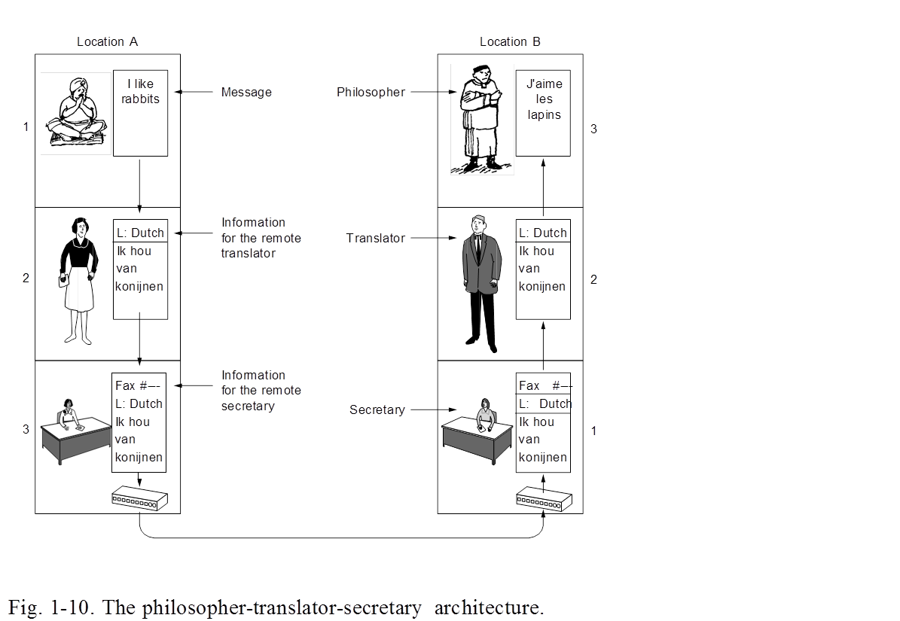
Terminology: Protocols, Interfaces
Each layer offers services to the upper layers (shielding from the implementation details)
  service interface: across layers in same host
Layer n on a host carries a conversation with layer n on another host
  PROTOCOL, host-to-host interface: defines messages exchanged with peer entity
Network architecture (set of layers, interfaces) vs protocol stack (protocol implementation)

Slide 48



What’s a protocol?
a human protocol and a computer network protocol:
Hi
TCP connection
req.
Hi
TCP connection
reply.
Got the
time?
time
Get http://gaia.cs.umass.edu/index.htm
2:00
<file>
host-to-host interface: defines messages exchanged with peer entity: format, order of msgs sent and received
among network entities and actions taken on msg
transmission, receipt

Slide 49
The OSI Reference Model
ISO (International Standards Organization) defines the OSI (Open Systems Inerconnect) model to help vendors create interoperable network implementation
Reduce the problem into smaller and more manageable problems: 7 layers
  a layer should be created where a different level of abstraction is needed; each layer should perform a well defined function)
  The function of each layer should be chosen with an eye toward defining internationally standardized protocols
``X dot" series (X.25, X. 400, X.500) OSI model implementation (protocol stack)

Slide 50
Internet protocol stack
application: ftp, smtp, http, etc
transport: tcp, udp, …
network: routing of datagrams from source to destination
  ip, routing protocols
link: data transfer between neighboring network elements
  ppp, ethernet
physical: bits “on the wire”
application
transport
network
link
physical

Slide 51
Internet protocol stack
Architecture simple but not as good as OSI‘s
  no clear distinction between interface-design and implementations;
  hard to re-implement certain layers
Successful protocol suite (de-facto standard)
  was there when needed (OSI implementations were too complicated)
  freely distributed with UNIX

Slide 52
Layering: logical communication
Each layer:
distributed
“entities” implement layer functions at each node
entities perform actions, exchange messages with peers
application
transport
network
link
physical
network
link
physical
application
transport
network
link
physical
application
transport
network
link
physical
application
transport
network
link
physical

Slide 53
Layering: logical communication
data
E.g.: transport
take data from app
add addressing, form “datagram”
send datagram to peer
(possibly wait for peer to ack receipt)
application
transport
network
link
physical
transport
ack
network
link
physical
application
transport
network
link
physical
data
data
application
transport
network
link
physical
application
transport
network
link
physical
transport

Slide 54
Layering: physical communication
data
application
transport
network
link
physical
network
link
physical
application
transport
network
link
physical
data
application
transport
network
link
physical
application
transport
network
link
physical

Slide 55
Protocol layering and data
Each layer takes data from above
adds header information to create new data unit
passes new data unit to layer below
source
destination
M
application
transport
network
link
physical
application
transport
network
link
physical
M
message
H
M
H
t
M
segment
t
H
H
H
H
M
datagram
n
t
M
n
t
H
H
H
H
H
H
M
frame
l
n
t
M
l
n
t

Slide 56
Internet structure: network of networks
roughly hierarchical
national/international backbone providers (NBPs)- tier 1 providers
  e.g. BBN/GTE, Sprint, AT&T, IBM, UUNet/Verizon, TeliaSonera
  interconnect (peer) with each other privately, or at public Network Access Point (NAPs: routers or NWs of routers)
regional ISPs, tier 2 providers
  connect into NBPs; e.g. Tele2
local ISP, company
  connect into regional ISPs
local
ISP
regional ISP
NBP B
NAP
NAP
NBP A
regional ISP
local
ISP

Slide 57
Internet structure: network of networks
“Tier-2” ISPs: smaller (often regional) ISPs
  Connect to one or more tier-1 ISPs, possibly other tier-2 ISPs
Tier-2 ISPs also peer privately with each other.
Tier-2 ISP pays tier-1 ISP for connectivity to rest of Internet
tier-2 ISP is customer of
tier-1 provider
Tier-2 ISP
Tier-2 ISP
Tier 1 ISP
Tier 1 ISP
Tier 1 ISP
Tier-2 ISP
Tier-2 ISP
Tier-2 ISP

Slide 58
Internet structure: network of networks
“Tier-3” ISPs and local ISPs
  last hop (“access”) network (closest to end systems)
local
ISP
Tier 3
ISP
local
ISP
local
ISP
local
ISP
Local and tier- 3 ISPs are customers of
higher tier ISPs
connecting them to rest of Internet
Tier-2 ISP
Tier-2 ISP
Tier 1 ISP
Tier 1 ISP
Tier 1 ISP
Tier-2 ISP
Tier-2 ISP
Tier-2 ISP
local
ISP
local
ISP
local
ISP
local
ISP

Slide 59
Internet structure: network of networks
a packet passes through many networks
local
ISP
Tier 3
ISP
local
ISP
local
ISP
local
ISP
Tier-2 ISP
Tier-2 ISP
Tier 1 ISP
Tier 1 ISP
Tier 1 ISP
Tier-2 ISP
Tier-2 ISP
Tier-2 ISP
local
ISP
local
ISP
local
ISP
local
ISP

Slide 60
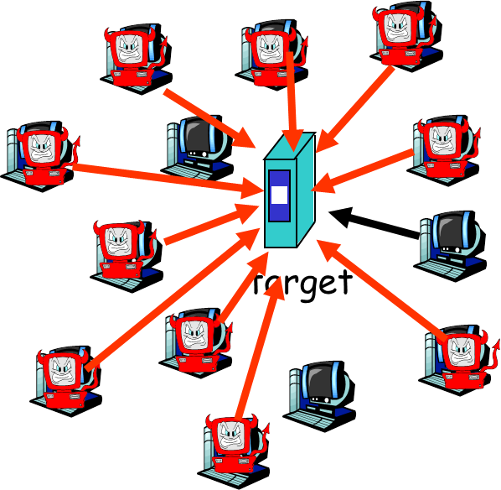
Security prelude

Slide 61
Network Security
The field of network security is about:
  how adversaries can attack computer networks
  how we can defend networks against attacks
  how to design architectures that are immune to attacks
Internet not originally designed with (much) security in mind
  original vision: “a group of mutually trusting users attached to a transparent network” ☺
  Internet protocol designers playing “catch-up”
  Security considerations in all layers!

Slide 62
Bad guys can put malware into hosts via Internet
Malware can get in host from a virus, worm, or trojan horse.
Spyware malware can record keystrokes, web sites visited, upload info to collection site.
Infected host can be enrolled in a botnet, used for spam and DDoS attacks.
Malware is often self-replicating: from an infected host, seeks entry into other hosts

Slide 63
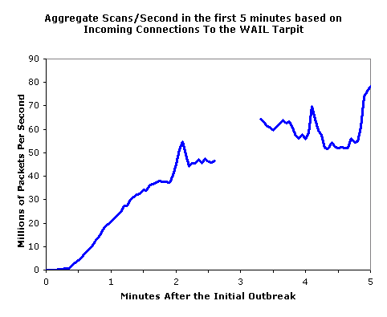
Example types of malware
Trojan horse
  Hidden part of some otherwise useful software
  Today often on a Web page (Active-X, plugin)
Virus
  infection by receiving object (e.g., e-mail attachment), actively executing
  self-replicating: propagate itself to other hosts, users
Worm:
  infection by passively receiving object that gets itself executed
  self- replicating: propagates to other hosts, users
Sapphire Worm: aggregate scans/sec
in first 5 minutes of outbreak (CAIDA, UWisc data)

Slide 64
Bad guys can attack servers and network infrastructure
Denial of service (DoS): attackers make resources (server, bandwidth) unavailable to legitimate traffic by overwhelming resource with bogus traffic
select target
break into hosts around the network (see botnet)
send packets toward target from compromised hosts
target

Slide 65
The bad guys can sniff packets
Packet sniffing:
  broadcast media (shared Ethernet, wireless)
  promiscuous network interface reads/records all packets (e.g., including passwords!) passing by
A
C
src:B dest:A payload
B
  Wireshark software used for end-of-chapter labs is a (free) packet-sniffer

Slide 66
The bad guys can use false source addresses
IP spoofing: send packet with false source address
A
C
src:B dest:A payload
B

Slide 67
The bad guys can record and playback
record-and-playback: sniff sensitive info (e.g., password), and use later
  password holder is that user from system point of view
C
A
src:B dest:A user: B; password: foo
B

Slide 68
Chapter 1: Summary
Covered a “ton” of material!
what’s the Internet
what’s a protocol?
network edge (types of service)
network core (ways of transfer, routing, performance, delays, loss)
access net, physical media
protocol layers, service models
backbones, NAPs, ISPs
(history)
Security concerns
quick look into ATM networks (historical and service/resource-related perspective)
You now hopefully have:
context, overview, “feel” of networking
more depth, detail later in course

Slide 69
Reading instructions
1. Kurose Ross book
Careful | Quick
4/e,5/e,6/e: 1.3, 1.4, 1.5 | 4/e,5/e,6/e: the rest
Extra Reading (optional)
Computer and Network Organization: An Introduction,
by Maarten van Steen and Henk Sips, Prentice Hall
(very good introductory book for non-CSE students

Slide 70
Review questions
Review questions from Kurose-Ross book, chapter 1 (for basic study)
R11, R12, R13, R16, 17, R18, R19, R20, R21, R22, R23, R24, R25, R28.
Extra questions, for further study: delay analysis in packet switched networks:
http://www.comm.utoronto.ca/~jorg/teaching/ece466/material/466-SimpleAnalysis.pdf

