Slide 1
Computer Communications
DIT 420 EDA343
Summary

Slide 2
Important for the exam
When/where:Friday Dec 20, 14.00-18.00, H
You may have with you:
English-X dictionary
no calculators, PDAs, etc (if/where numbers matter, do rounding)
Grading
30-40, 41-50, 51-60 (out of 60)= 3, 4, 5 (CTH)
30-50, 51-60 (out of 60) = G, VG (GU)
To think during last, summary-study
Overview; critical eye; explain: why is this so? / How does it work?

Slide 3
Flashback

Slide 4
Principles, Organisation
Network Problems (in the order faced in the 1st intro):
producer-consumer problems, flow and error control,
manage access to shared (broadcast) transmission media ,
routing,
congestion,
connecting transparently different networks,
serving different types of traffic,
performance,
mobility
security
Layering : principle, why

Slide 5
Highlights
application-layer networking
network security issues
TCP/IP, LAN protocol stack
delays performance
routing, also with mobility
multiple access protocols (wired, wireless)
reliable data transfer
datagram vs VC/congestion control

Slide 6
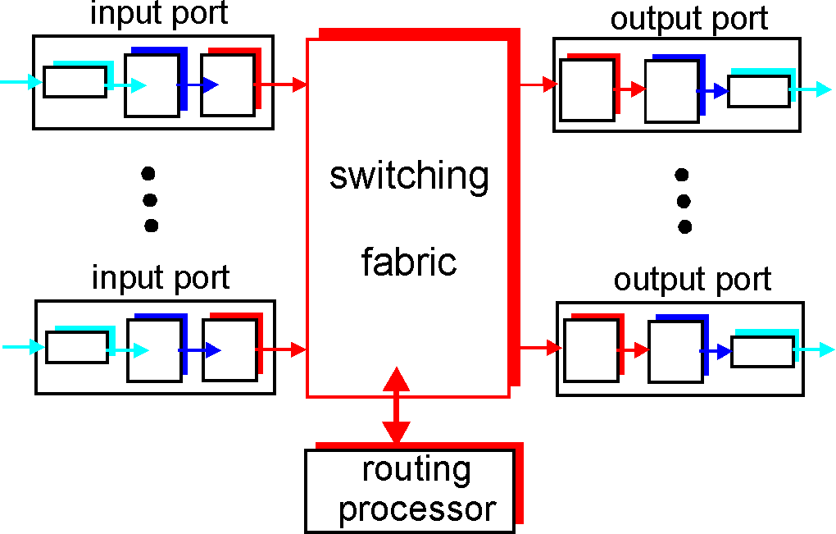
Types of delay; performance
Propagation, transmission, queueing, processing
Throughput (effective bandwidth)
Utilization (efficiency)
Packet-switching: impact of store&forward
TCP’s slow start
Sliding windows performance
transmission
A
propagation
B
nodal
processing
queuing

Slide 7
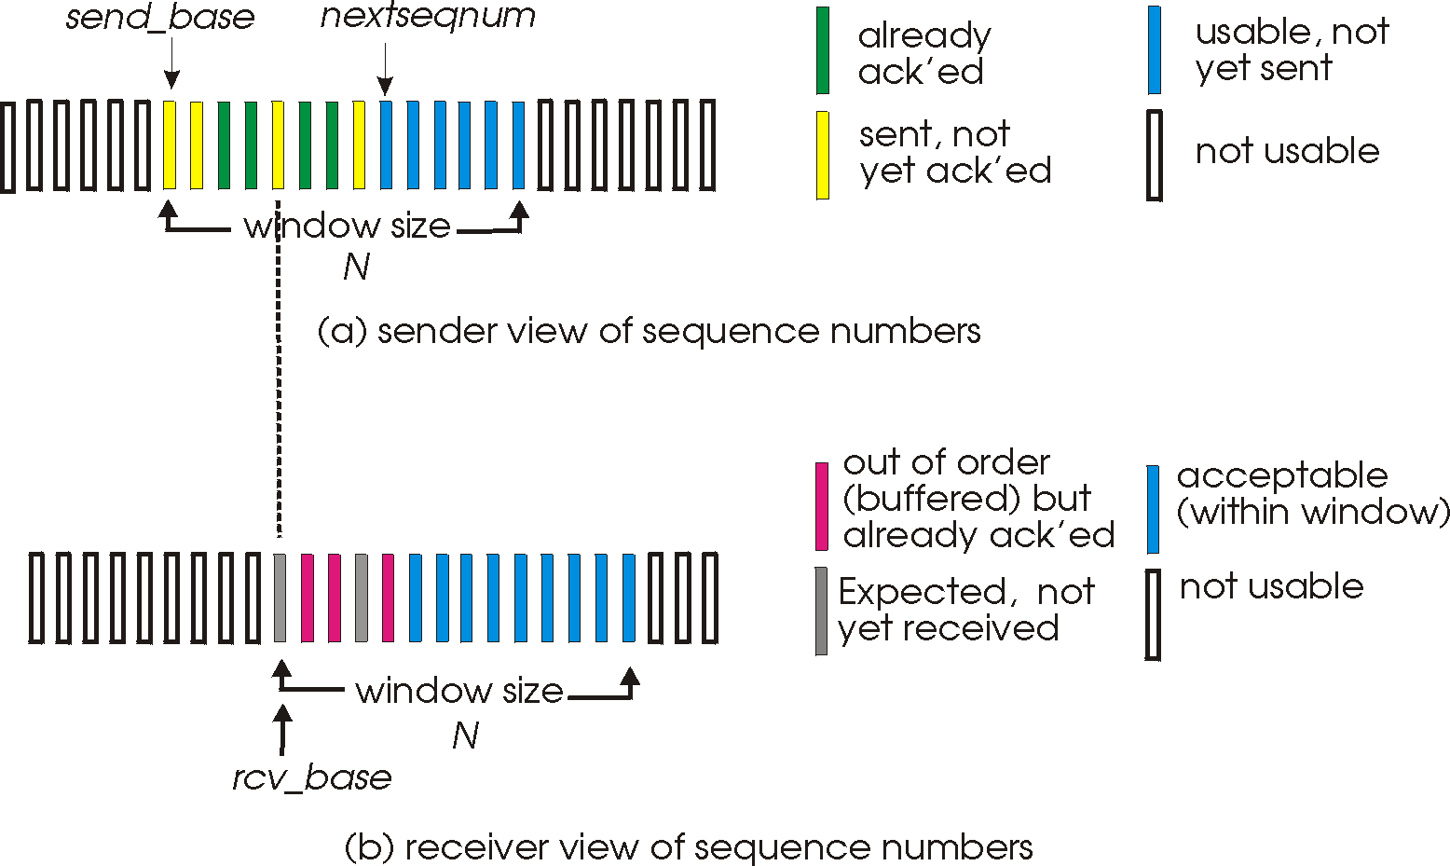
Reliable data transfer
Guaranteed, in-order, correct delivery:
Flow control:
  stop&wait
  sliding windows
  sequence numbers
  window sizes
  dynamic windows (TCP)
  performance
Error detection: checksums, CRC
Error control: go-back-n, selective repeat, FEC methods

Slide 8
Datagram vs VC end-to-end comm.
Congestion
Control
RT traffic

Slide 9
Datagram vs VC end-to-end communication
Conceptual differences
Decisions, comparison, why

Slide 10
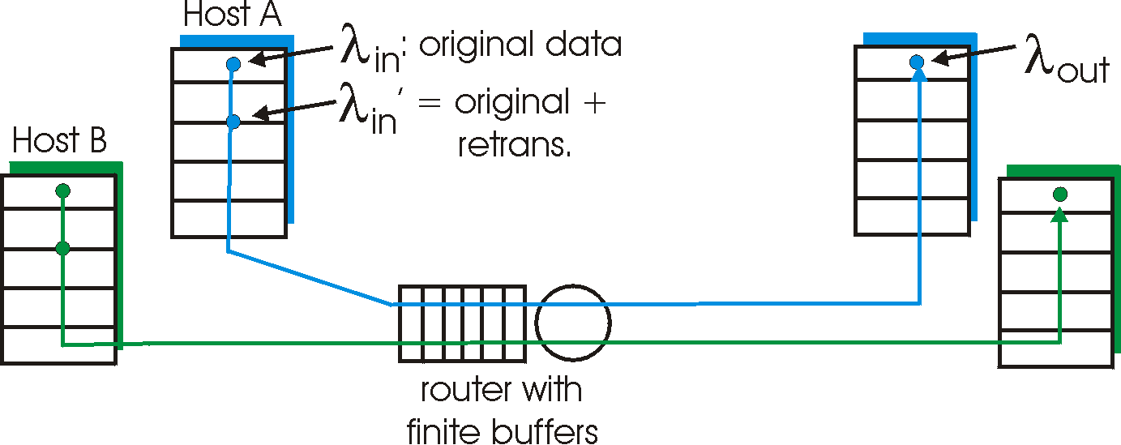
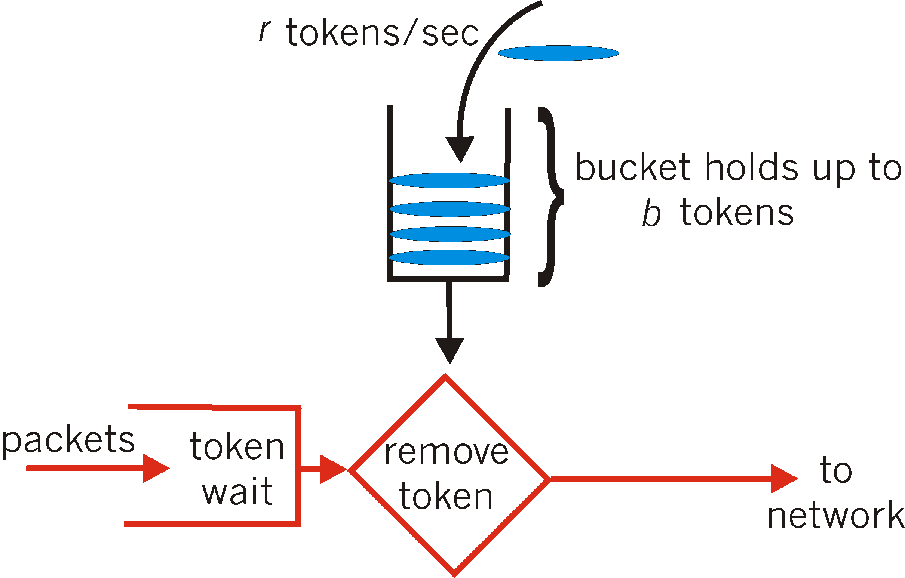
Congestion control (CC)
why, how congestion occurs
CC in TCP and performance; implied weaknesses
CC in other ways, e.g. VC-based networks
  RT-traffic resource reservation:
    traffic shaping and policing
  rate-based

Slide 11
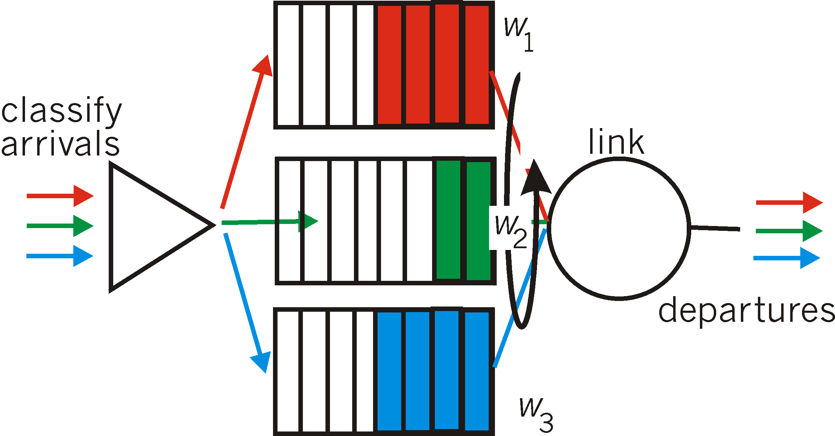
RT/streaming traffic
Conceptual needs:
packet/flow marking
Admission control
Traffic shaping & policing
Packet scheduling (switches)
Internet context
Application-level solutions (FEC, playout delay, caching-CDN)
Intserv, Diffserv

Slide 12

Routing, also with mobility
Routing algorithms
Forwarding
Resource, policy issues
Addressing mobility, tunneling
5
B
3
C
2
5
A
2
1
F
3
1
2
D
E
1
Mobile
Switching
Center
Public telephone
network, and
Internet
Complementary video links
- IP addresses and subnets http://www.youtube.com/watch?v=ZTJIkjgyuZE&list=PLE9F3F05C381ED8E8&feature=plcp
- How does BGP choose its routes http://www.youtube.com/watch?v=RGe0qt9Wz4U&feature=plcp
Mobile
Switching
Center

Slide 13
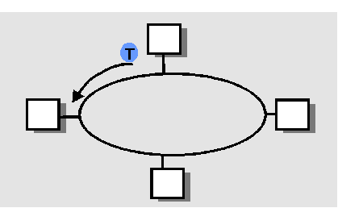
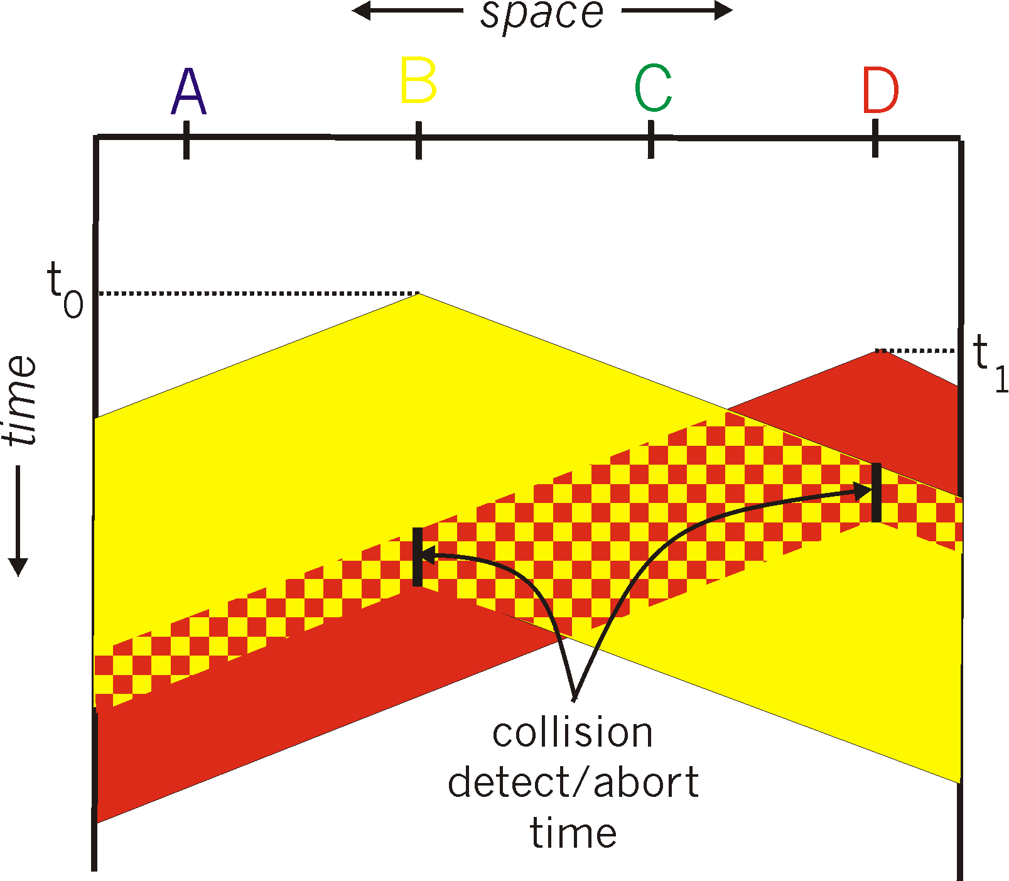

Medium access: multiple access methods
Strategies: (functionality, appropriateness)
Contention-based (random access), wired/wireless:
  Aloha, CSMA(CD/CA) (collision-delay trade-off)
Collision-free:
  Channel partitioning: TDMA, FDMA, CDMA
  Taking turns: token-passing, reservation-based
A
B
C
A’s signal
strength
C’s signal
strength
space

Slide 14
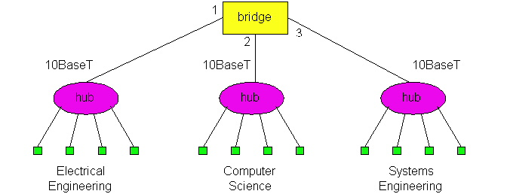
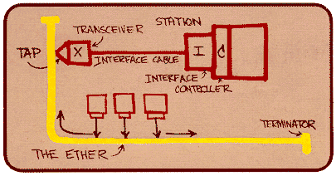
LANs & related link technologies
Protocol Examples: wired, wireless
  Ethernet, 802.11 (+ 802.16 wimax), GSM:
    Functionality, performance under low/high load
Connecting devices;
  functionalities and differences (Hubs, switches)
  Algorithms for switch-”routing”: learning& forwarding of packets
ARP
switch

Slide 15
TCP/IP protocol stack (also applications), evolution
Instantiation of network-
solutions (Routing, Congestion
Control, Flow & error control, applications, link layer technologies)
Limitations, advantages, updates
Application-layer networking
(P2P applications, overlays, CDNs, multimedia/streaming application issues)
application
transport
network
link
physical

Slide 16
Application-layer networking
P2P applications
Overlays
multimedia/streaming applications
… complement the networking infrastructure at application-layer (taking advantage of the network resources at the edge of the network)

Slide 17



Security issues
C, I, A and methods to achieve them
Instantiation in Internet: RSA, email PGP, authentication
Firewalls and packet filtering
Alice
Bob
channel
data, control messages
secure
sender
s
data
secure
receiver
data
Trudy

Slide 18
Synthesis: a day in the life of a web request
putting-it-all-together: synthesis!
  goal: identify, review protocols (at all layers) involved in seemingly simple scenario: requesting www page
  scenario: student attaches laptop to campus network, requests/receives www.google.com

Slide 19


A day in the life: scenario
browser
DNS server
Comcast network
68.80.0.0/13
school network
68.80.2.0/24
web page
web server
Google’s network
64.233.160.0/19
64.233.169.105

Slide 20
A day in the life… connecting to the Internet
DHCP
DHCP
UDP
IP
Eth
Phy
connecting laptop needs to get its own IP address: use DHCP
DHCP
DHCP
DHCP
DHCP
DHCP request encapsulated in UDP, encapsulated in IP, encapsulated in Ethernet
DHCP
DHCP
UDP
IP
Eth
Phy
DHCP
DHCP
DHCP
DHCP
router
(runs DHCP)
Ethernet frame broadcast (dest: FFFFFFFFFFFF) on LAN, received at router running DHCP server
Ethernet demux’ed to IP demux’ed to UDP demux’ed to DHCP

Slide 21
A day in the life… connecting to the Internet
DHCP
DHCP
UDP
IP
Eth
Phy
DHCP server formulates DHCP ACK containing client’s IP address (and also IP address of first-hop router for client, name & IP address of DNS server)
DHCP
DHCP
DHCP
frame forwarded (switch learning) through LAN, demultiplexing at client
DHCP
DHCP
UDP
IP
Eth
Phy
DHCP
DHCP
DHCP
router
(runs DHCP)
DHCP client receives DHCP ACK reply
DHCP
Client now has IP address, knows name & addr of DNS
server, IP address of its first-hop router

Slide 22
A day in the life… ARP (before DNS, before HTTP)
DNS
UDP
IP
Eth
Phy
before sending HTTP request, need IP address of www.google.com: DNS
DNS
DNS
DNS
ARP
ARP query
DNS query created, encapsulated in UDP, encapsulated in IP, encasulated in Eth. In order to send frame to router, need MAC address of router interface: ARP
ARP
ARP reply
Eth
Phy
ARP query broadcast, received by router, which replies with ARP reply giving MAC address of router interface
client now knows MAC address of first hop router, so can now send frame containing DNS query

Slide 23
A day in the life… using DNS
DNS
UDP
IP
Eth
Phy
DNS
DNS server
DNS
UDP
IP
Eth
Phy
DNS
DNS
DNS
DNS
DNS
DNS
DNS
DNS
Comcast network
68.80.0.0/13
IP datagram forwarded from campus network to destination (DNS-server) network, routed (tables created by RIP, OSPF and BGP routing protocols) to DNS server
IP datagram containing DNS query forwarded via LAN switch from client to 1st hop router
demux’ed to DNS server
DNS server replies to client with IP address of www.google.com

Slide 24
A day in the life… TCP connection carrying HTTP
HTTP
HTTP
TCP
IP
Eth
Phy
SYNACK
SYN
SYNACK
SYN
SYNACK
SYN
SYN
to send HTTP request, client first opens TCP socket to web server
TCP SYN segment (step 1 in 3-way handshake) inter-domain routed to web server
TCP
IP
Eth
Phy
SYNACK
SYN
SYNACK
SYN
SYNACK
SYNACK
SYN
web server responds with TCP SYNACK
web server
64.233.169.105
TCP connection established!

Slide 25
A day in the life… HTTP request/reply
web page finally (!!!) displayed
HTTP
HTTP
TCP
IP
Eth
Phy
HTTP
HTTP
HTTP
HTTP
HTTP
HTTP
HTTP
HTTP
HTTP request sent into TCP socket
IP datagram containing HTTP request routed to www.google.com
HTTP
HTTP
TCP
IP
Eth
Phy
HTTP
HTTP
HTTP
web server responds with HTTP reply (containing web page)
HTTP
web server
64.233.169.105
IP datgram containing HTTP reply routed back to client

Slide 26
Synthesis cont.

Slide 27
Internet structure: network of networks
Question: given millions of access ISPs, how to connect them together?
…
…
access
net
access
net
access
net
access
net
access
net
access
net
access
net
…
…
access
net
access
net
access
net
access
net
access
net
access
net
…
access
net
access
net
…
access
net

Slide 28
Internet structure: network of networks
Option: connect each access ISP to every other access ISP?
…
…
access
net
access
net
access
net
access
net
access
net
…
…
access
net
access
net
…
connecting each access ISP to each other directly doesn’t scale: O(N²) connections.
…
…
access
net
access
net
…
access
net
access
net
access
net
…
access
net
…
access
net
access
net
…
access
net

Slide 29
Internet structure: network of networks
Option: connect each access ISP to a global transit (imaginary) ISP? Customer and provider ISPs have economic agreement.
…
…
access
net
access
net
access
net
access
net
access
net
access
net
access
net
…
…
global
ISP
access
net
access
net
access
net
access
net
access
net
access
net
…
access
net
access
net
…
access
net

Slide 30
Internet structure: network of networks
But if one global ISP is viable business, there will be competitors ….
…
…
access
net
access
net
access
net
access
net
access
net
access
net
access
net
ISP A
…
…
access
net
ISP B
access
net
ISP C
access
net
access
net
access
net
access
net
…
access
net
access
net
…
access
net

Slide 31
Internet structure: network of networks
But if one global ISP is viable business, there will be competitors …. which must be interconnected
Internet exchange point
(ca 300 in the world;
multiple ISPs peering/switching;
3rd company)
…
…
access
net
access
net
access
net
access
net
access
net
access
net
access
net
ISP A
…
…
IXP
access
net
access
net
ISP B
ISP C
access
net
access
net
peering link
(no payment to each-other)
access
net
access
net
…
access
net
access
net
…
access
net

Slide 32
Internet structure: network of networks
… and regional networks may arise to connect access nets to ISPS
…
…
access
net
access
net
access
net
access
net
access
net
access
net
access
net
ISP A
…
…
IXP
access
net
access
net
ISP B
ISP C
access
net
access
net
access
net
regional net
access
net
…
access
net
access
net
…
access
net

Slide 33
Internet structure: network of networks
… and content provider networks (e.g., Google, Microsoft, Akamai ) may run their own network, to bring services, content close to end users
…
…
access
net
access
net
access
net
access
net
access
net
access
net
access
net
ISP A
…
…
Content provider network
IXP
access
net
access
net
ISP B
ISP B
access
net
access
net
access
net
regional net
access
net
…
access
net
access
net
…
access
net

Slide 34
Internet structure: network of networks
Tier 1 ISP
Tier 1 ISP
Google
IXP
IXP
IXP
Regional ISP
Regional ISP
access
ISP
access
ISP
access
ISP
access
ISP
access
ISP
access
ISP
access
ISP
access
ISP
at center: small # of well-connected large networks
  “tier-1” commercial ISPs (e.g., Level 3, Sprint, AT&T, NTT), national & international coverage
  A new form of content provider network (e.g, Google): private network that connects it data centers to Internet, often bypassing tier-1, regional ISPs

Slide 35
Thank you
Reminder exam info:
  When/where:Friday Dec 20, 14.00-18.00 , H
  You may have with you:
  English-X dictionary
  no calculators, PDAs, etc (if/where numbers matter, do rounding)
  Grading
  30-40, 41-50, 51-60 (out of 60)= 3, 4, 5 (CTH)
  30-50, 51-60 (out of 60) = G, VG (GU)
  To think during last, summary-study
  Overview; critical eye; explain: why is this so? / How does it work?
Good luck with all your efforts! & Happy holiday season!

