Slide 1
Data networking technologies in Smart Grids
10/12/2013
Giorgos Georgiadis

Slide 2
Introduction
1
“Here be SCADA”
 | SONET - Synchronous Optical Network WDM - Wavelength Division Multiplexing Satellite/VSAT IP Radio | Twisted pair / Fiber optics BPL - Broadband over Power Lines WiMax - Worldwide Interoperability for Microwave Access GPRS
 | Ethernet rules~ | Ethernet rules! (IEC 61850) | Ethernet rules? Hint: not always
?
Communication
technologies
?
Communication
protocols

Slide 3
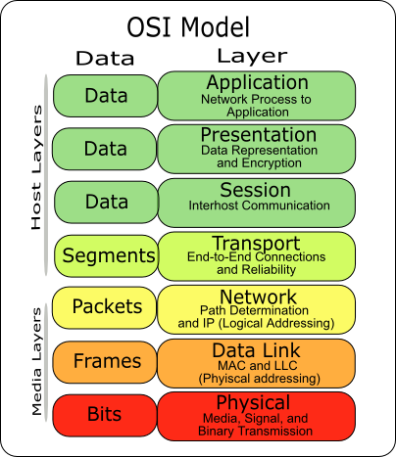
Overview
2
Protocols @ Distribution’s last mile
OpenADR REST-based (i.e. CoAP) |  | ZigBee | 6LoWPAN | HomePlug
XMPP BACNet LonWorks Modbus | WiFi
Proprietary | Ethernet / Gigabit Ethernet | IEEE 802.15.4 |  | Proprietary, part 2: HomePlug

Slide 4
PHY/DataLink protocols
3
Ethernet
Not much to say
HomePlug
Honorable mention: popular home automation protocol
Powerline based
Speed: ~200mbps
Otherwise, vanilla protocol:
i.e. using TDMA,
Two kinds of nodes,
…
OpenADR REST-based (i.e. CoAP) |  | ZigBee | 6LowPAN | HomePlug
XMPP BACNet LonWorks Modbus | WiFi
Proprietary | Ethernet / Gigabit Ethernet | IEEE 802.15.4 |  | Proprietary, part 2: HomePlug

Slide 5
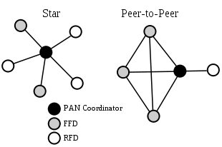
PHY/DataLink protocols
4
IEEE 802.15.4
Radio based, usually 2.4GHz
Small packets (<=127bytes)
Medium speed (~250kbps)
Originally DSSS
Topologies supported:
Star
Peer-to-peer
Roles supported:
Full-function device
Reduced-function device
OpenADR REST-based (i.e. CoAP) |  | ZigBee | 6LowPAN | HomePlug
XMPP BACNet LonWorks Modbus | WiFi
Proprietary | Ethernet / Gigabit Ethernet | IEEE 802.15.4 |  | Proprietary, part 2: HomePlug

Slide 6
Higher protocols
5
6LoWPAN
“IPv6 over LoW Power wireless Area Networks”
Builds on 802.15.4, IPv6
Aimed at low power devices (sensors, controllers)
Topologies
Star, peer-to-peer + Mesh
Many Challenges:
IP packets >=1280bytes (!)
128bit IP addresses
…
OpenADR REST-based (i.e. CoAP) |  | ZigBee | 6LoWPAN | HomePlug
XMPP BACNet LonWorks Modbus | WiFi
Proprietary | Ethernet / Gigabit Ethernet | IEEE 802.15.4 |  | Proprietary, part 2: HomePlug

Slide 7
Higher protocols
6
ZigBee
Builds on 802.15.4, but not IP
Aimed at low power devices too (sensors, controllers)
Speed 250kbps
Packet 127bytes
Battery powered devices (supports sleep)
Topologies supported
Mesh (jump to: example)
Roles supported
Coordinator, router, end node
Different profiles exist:
ZigBee Home Automation
Zigbee Smart Energy
Zigbee IP, ...
OpenADR REST-based (i.e. CoAP) |  | ZigBee | 6LoWPAN | HomePlug
XMPP BACNet LonWorks Modbus | WiFi
Proprietary | Ethernet / Gigabit Ethernet | IEEE 802.15.4 |  | Proprietary, part 2: HomePlug

Slide 8
Higher protocols
8
More protocols, same story:
XMPP, BACNet, LonWorks, Modbus, …
Wired
Proprietary, build around specific companies (BACNet, LonWorks) or legacy protocols (Modbus)
Today gateway devices to “break out” to Ethernet are in use
Simple topologies (i.e bus), same roles as before
But what is the connecting thread over all?
Open standards!
Internet! (of Things?)
OpenADR REST-based (i.e. CoAP) |  | ZigBee | 6LoWPAN | HomePlug
XMPP BACNet LonWorks Modbus | WiFi
Proprietary | Ethernet / Gigabit Ethernet | IEEE 802.15.4 |  | Proprietary, part 2: HomePlug

Slide 9
Towards interoperability
9
OpenADR
ADR: Advanced Metering Response
Trying to ‘unify’ different solutions in a high level protocol
Formalizing:
Roles
Messages
Device detection
Simple topologies (i.e bus), same roles as before
REST-based APIs
I.e. Costrained Application Protocol
Ultimately, HTTP-based
Verb oriented: GET, PUT, DELETE, …
OpenADR REST-based (i.e. CoAP) |  | ZigBee | 6LoWPAN | HomePlug
XMPP BACNet LonWorks Modbus | WiFi
Proprietary | Ethernet / Gigabit Ethernet | IEEE 802.15.4 |  | Proprietary, part 2: HomePlug

Slide 10
Towards interoperability
10
Ethernet/IP-based integration
Remember:
Radio band: 2.4GHz (WiFI, ZigBee, 6LoWPAN)
Similar topologies, roles
Made for low energy devices, but flops/watt/kr increase!
Ethernet gateways commonly used
Solution: make them (formally) interoperable
ZigBee Smart Energy v2.0
ZigBee, WiFi, HomePlug on board
6LoWPAN coming soon
OpenADR REST-based (i.e. CoAP) |  | ZigBee | 6LoWPAN | HomePlug
XMPP BACNet LonWorks Modbus | WiFi
Proprietary | Ethernet / Gigabit Ethernet | IEEE 802.15.4 |  | Proprietary, part 2: HomePlug

Slide 11
Conclusion
11
Ethernet + misc communication technologies
Ethernet vs non-ethernet
Why?
Design for low energy devices (smaller packets, lower comm speed)
Peer to peer, mesh topologies
Now + Future?
Devices’ specs catching up
Importance of being connected (to the Internet?)
Topologies still important (i.e. reliability)
Will probably remain radio-based

Slide 12
Thank you!
Questions/comments?

