Slide 1
Computer Communications
Peer to Peer networking
Ack: Many of the slides are adaptations of slides by authors in the bibliography section.

Slide 2
p2p
Quickly grown in popularity
  numerous sharing applications
  many million people worldwide use P2P networks
But what is P2P in the Internet?
  Computers “Peering”?
  Take advantage of resources at the edges of the network
    End-host resources have increased dramatically
    Broadband connectivity now common

Slide 3
Lecture outline
Evolution of p2p networking
  seen through file-sharing applications
Other applications

Slide 4
P2P Networks: file sharing
Common Primitives:
  Join: how do I begin participating?
  Publish: how do I advertise my file?
  Search: how to I find a file/service?
  Fetch: how to I retrieve a file/use service?

Slide 5
First generation in p2p file sharing/lookup
Centralized Database: single directory
  Napster
Query Flooding
  Gnutella
Hierarchical Query Flooding
  KaZaA
(Further unstructured Overlay Routing
  Freenet, …)
Structured Overlays
  …

Slide 6


P2P: centralized directory
original “Napster” design (1999, S. Fanning)
1) when peer connects, it informs central server:
  IP address, content
2) Alice queries directory server for “Boulevard of Broken Dreams”
3) Alice requests file from Bob
Bob
centralized
directory server
1
peers
1
1
3
2
1
Alice

Slide 7


Napster: Publish
insert(X,
123.2.21.23)
...
Publish
I have X, Y, and Z!
123.2.21.23

Slide 8
Napster: Search
123.2.0.18
search(A)
-->
123.2.0.18
Fetch
Query
Reply
Where is file A?

Slide 9
First generation in p2p file sharing/lookup
Centralized Database
  Napster
Query Flooding: no directory
  Gnutella
Hierarchical Query Flooding
  KaZaA
(Further unstructured Overlay Routing
  Freenet)
Structured Overlays
  …

Slide 10
Gnutella: Overview
Query Flooding:
  Join: on startup, client contacts a few other nodes (learn from bootstrap-node); these become its “neighbors”
  Publish: no need
  Search: ask “neighbors”, who ask their neighbors, and so on... when/if found, reply to sender.
  Fetch: get the file directly from peer

Slide 11
Gnutella: Search
I have file A.
I have file A.
Reply
Query
Where is file A?

Slide 12
Gnutella: protocol
Query message
sent over existing TCP
connections
peers forward
Query message
QueryHit
sent over
reverse
path
File transfer:
HTTP
Query
QueryHit
Query
Query
QueryHit
Query
QueryHit
Scalability:
limited scope
flooding
Query

Slide 13
Discussion +, -?
Napster
Pros:
  Simple
  Search scope is O(1)
Cons:
  Server maintains O(N) State
  Server performance bottleneck
  Single point of failure
Gnutella:
Pros:
  Simple
  Fully de-centralized
  Search cost distributed
Cons:
  Search scope is O(N)
  Search time is O(???)

Slide 14
Gnutella
Interesting concept in practice: overlay network:
active gnutella peers and edges form an overlay
A network on top of another network:
  Edge is not a physical link (what is it?)

Slide 15
First generation in p2p file sharing/lookup
Centralized Database
  Napster
Query Flooding
  Gnutella
Hierarchical Query Flooding: some directories
  KaZaA
Further unstructured Overlay Routing
  Freenet
…

Slide 16
KaZaA: Overview
“Smart” Query Flooding:
  Join: on startup, client contacts a “supernode” ... may at some point become one itself
  Publish: send list of files to supernode
  Search: send query to supernode, supernodes flood query amongst themselves.
  Fetch: get the file directly from peer(s); can fetch simultaneously from multiple peers

Slide 17
KaZaA: File Insert
“Super Nodes”
insert(X,
123.2.21.23)
...
Publish
I have X!
123.2.21.23

Slide 18
KaZaA: File Search
search(A)
-->
123.2.22.50
“Super Nodes”
search(A)
-->
123.2.0.18
123.2.22.50
Query
Replies
Where is file A?
123.2.0.18

Slide 19
KaZaA: Discussion
Pros:
  Tries to balance between search overhead and space needs
  Tries to take into account node heterogeneity:
    Bandwidth
    Host Computational Resources
Cons:
  Still no real guarantees on search scope or search time
P2P architecture used by Skype, Joost (communication, video distribution p2p systems)

Slide 20
First steps in p2p file sharing/lookup
Centralized Database
  Napster
Query Flooding
  Gnutella
Hierarchical Query Flooding
  KaZaA
Further unstructured Overlay Routing
  Freenet: some directory, cache-like, based on recently seen targets; see literature pointers for more
Structured Overlay Organization and Routing
  Distributed Hash Tables
  Combine database+distributed system expertise

Slide 21
Problem from this perspective
How to find data in a distributed file sharing system?
(Routing to the data)
N₂
N₃
Publisher
N₁
Key=“LetItBe”
Value=MP3 data
Internet
N₅
?
N₄
Client
Lookup(“LetItBe”)
How to do Lookup?

Slide 22
Centralized Solution
Central server (Napster)
N₂
N₃
Publisher
N₁
Key=“LetItBe”
Value=MP3 data
Internet
DB
N₅
N₄
Client
Lookup(“LetItBe”)
O(M) state at server, O(1) at client
O(1) search communication overhead
Single point of failure

Slide 23
Distributed Solution
Flooding (Gnutella, etc.)
N₂
N₃
Publisher
N₁
Key=“LetItBe”
Value=MP3 data
Internet
N₅
N₄
Client
Lookup(“LetItBe”)
O(1) state per node
Worst case O(E) messages per lookup

Slide 24
Distributed Solution
(some more structure? In-between the two?)
Publisher
balance the update/lookup complexity..
Abstraction: a distributed “hash-table” (DHT) data structure:
  put(id, item);item = get(id);
Key=“LetItBe”
Value=MP3 data
N₂
N₃
N₁
Internet
  Implementation: nodes form an overlay (a distributed data structure)
    eg. Ring, Tree, Hypercube, SkipList, Butterfly.
Hash function maps entries to nodes; using the node structure, find the node responsible for item; that one knows where the item is
N₅
N₄
Client
Lookup(“LetItBe”)
- >

Slide 25
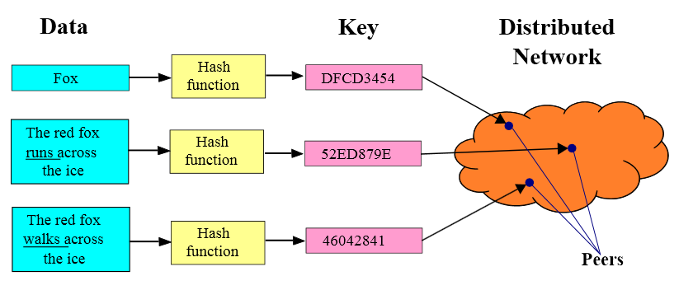
Hash function maps entries to nodes; using the node structure
Lookup: find the node responsible for item; that one knows where the item is
I do not know DFCD3454
but can ask a
neighbour in the DHT
Challenges:
  Keep the hop count (asking chain) small
  Keep the routing tables (#neighbours) “right size”
  Stay robust despite rapid changes in membership
figure source: wikipedia

Slide 26
DHT: Comments/observations?
  think about structure maintenance/benefits

Slide 27


Next generation in p2p netwoking
Swarming
  BitTorrent, Avalanche, …
…

Slide 28
BitTorrent: Next generation fetching
In 2002, B. Cohen debuted BitTorrent
Key Motivation:
  Popularity exhibits temporal locality (Flash Crowds)
Focused on Efficient Fetching, not Searching:
  Distribute the same file to groups of peers
  Single publisher, multiple downloaders
Used by publishers to distribute software, other large files
http://vimeo.com/15228767

Slide 29
BitTorrent: Overview
Swarming:
  Join: contact centralized “tracker” server, get a list of peers.
  Publish: can run a tracker server.
  Search: Out-of-band. E.g., use Google, some DHT, etc to find a tracker for the file you want. Get list of peers to contact for assembling the file in chunks
  Fetch: Download chunks of the file from your peers. Upload chunks you have to them.

Slide 30
File distribution: BitTorrent
P2P file distribution
tracker: tracks peers
participating in torrent
torrent: group of
peers exchanging
chunks of a file
obtain list
of peers
trading
chunks
peer

Slide 31
BitTorrent (1)
file divided into chunks.
peer joining torrent:
  has no chunks, but will accumulate them over time
  registers with tracker to get list of peers, connects to subset of peers (“neighbors”)
while downloading, peer uploads chunks to other peers.
peers may come and go
once peer has entire file, it may (selfishly) leave or (altruistically) remain

Slide 32
BitTorrent: Tit-for-tat
(1) Alice “optimistically unchokes” Bob
(2) Alice becomes one of Bob’s top-four providers; Bob reciprocates
(3) Bob becomes one of Alice’s top-four providers
  Works reasonably well in practice
  Gives peers incentive to share resources; tries to avoid freeloaders
With higher upload rate,
can find better trading
partners & get file faster!

Slide 33
Lecture outline
Evolution of p2p networking
  seen through file-sharing applications
Other applications

Slide 34
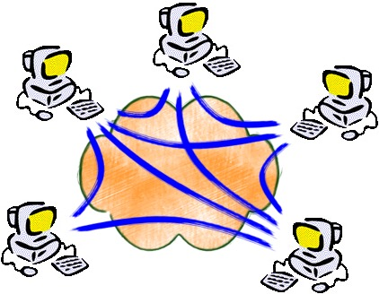
P2P – not only sharing files
Overlays useful in other ways, too:
Content delivery, software publication
Streaming media applications
Distributed computations (volunteer computing)
Portal systems
Distributed search engines
Collaborative platforms
Communication networks
Social applications
Other overlay-related applications....
Overlay: a network implemented on top of a network
  E.g. Peer-to-peer networks, ”backbones” in adhoc networks, transportaiton network overlays, electricity grid overlays ...

Slide 35
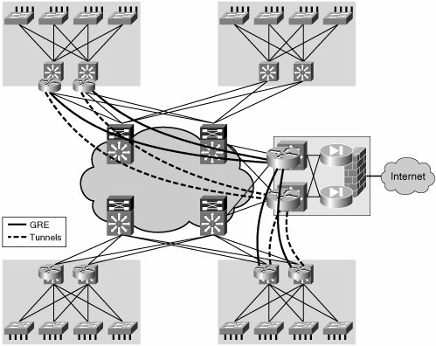
Router Overlays for e.g. protection/mitigation of flooding attacks

Slide 36
Reading list
Kurose, Ross: Computer Networking, a top-down approach, chapter on applications, sections peer-to-peer, streaming and multimedia; AdisonWesley
for Further Study
Aberer’s coursenotes and references therein
  http://lsirwww.epfl.ch/courses/dis/2007ws/lecture/week%208%20P2P%20systems-general.pdf
  http://lsirwww.epfl.ch/courses/dis/2007ws/lecture/week%209%20Structured%20Overlay%20Networks.pdf
Incentives build Robustness in BitTorrent, Bram Cohen. Workshop on Economics of Peer-to-Peer Systems, 2003.
Do incentives build robustness in BitTorrent? Michael Piatek, Tomas Isdal, Thomas Anderson, Arvind Krishnamurthy and Arun Venkataramani, NSDI 2007
J. Mundinger, R. R. Weber and G. Weiss. Optimal Scheduling of Peer-to-Peer File Dissemination. Journal of Scheduling, Volume 11, Issue 2, 2008. [arXiv] [JoS]
Christos Gkantsidis and Pablo Rodriguez, Network Coding for Large Scale Content Distribution, in IEEE INFOCOM, March 2005 (avalanche swarming: combining p2p + streming)

Slide 37
Extra slides/notes

Slide 38

More examples: a story in progress...

Slide 39
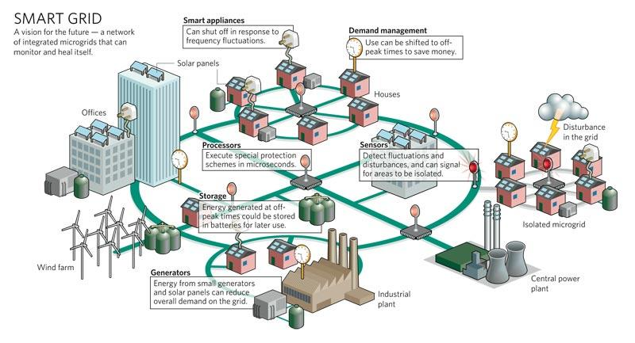
New power grids: be adaptive!
Bidirectional power and information flow
  – Micro-producers or “prosumers”, can share resources
  – Distributed energy resources
Communication + resource-administration (distributed system) layer
  – aka “smart” grid
Notes:
Bidirectional power flow
Communications layer
= From “water pipes” model to “traffic network” model

Slide 40
From ”broadcasting” to ”routing” -and more
SmartGrid: From ”broadcasting” to
”routing” of power and non-centralized coordination
Data-, communication- and distributed computing-enabled functionality
From | To
Central generation and control | Distributed and central generation and control
Flow by Kirchhoff’s law | Flow control (routing) by power electronics
Power generation according to demand | Fluctuating generation and demand; need for equilibrium/storage
Manual trouble response | Automatic response/islanding, predictive avoidance; advanced monitoring, situational awareness
Security /Robustness needs in the power system | security needs in the information system

Slide 41

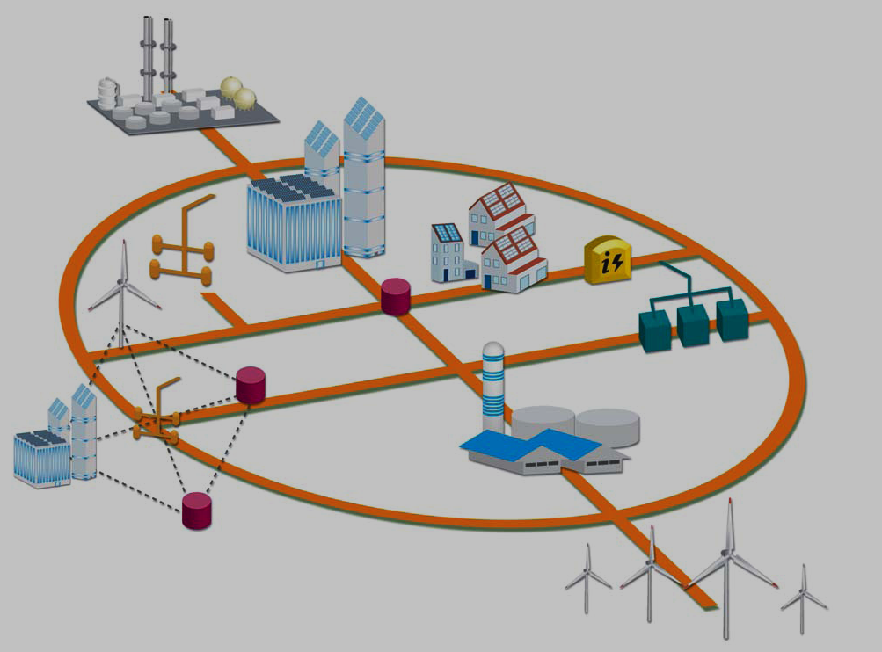


El-networks as distributed cyber-physical systems
Overlay network
El- link and/or communication link
Computing+ communicating device
Cyber system
Why adding “complexity” in the infrastructure?
Motivation: enable renewables, better use of el-power
Physical system
An analogy: layering in computing systems and networks
Notes:
Info-centered ElNet: information overlay on the energy distribution system

Slide 42
Course/Masterclass:
ICT Support for Adaptiveness and Security in the Smart Grid (DAT300, LP4)
Goals
  students (from computer science and other disciplines) get introduced to advanced interdisciplinary concepts related to the smart grid, thus
  building an understanding of essential notions in the individual disciplines, and
  investigating a domain-specific problem relevant to the smart grid that need an understanding beyond the traditional ICT field.

Slide 43
Environment
Based on both the present and future design of the smart grid.
  How can techniques from networks/distributed systems be applied to large, heterogeneous systems where a
  massive amount of data will be collected?
  How can such a system, containing legacy components with no security primitives, be made
  secure when the communication is added by interconnecting the systems?
The students will have access to a hands-on lab, where they can run and test their design and code.

Slide 44
Course Setup
The course is given on an advanced master’s level, resulting in 7.5 points.
Study Period 4
  Can also define individual, “research internship courses”, 7.5, 15p or MS thesis, starting earlier
The course structure
  lectures to introduce the two disciplines (“crash course-like”); invited talks by industry and other collaborators
  second part: seminar-style where research papers from both disciplines are actively discussed and presented.
  At the end of the course the students are also expected to present their respective project.
Notes:
Different lectures are given by teachers with different competences (will have teachers from power systems)

Slide 45
From ”broadcasting” to ”routing” -and more
SmartGrid: From ”broadcasting” to
”routing” of power and non-centralized coordination
Information processing and data networking are enablers for this infrastructure
The course team runs a number of research and education projects/collaborations on the topic
Feel free to speak with us for projects or register for the course
From | To
Central generation and control | Distributed and central generation and control
Flow by Kirchhoff’s law | Flow control (routing) by power electronics
Power generation according to demand | Fluctuating generation and demand; need for equilibrium/storage
Manual trouble response | Automatic response/islanding, predictive avoidance; advanced monitoring, situational awareness
Security /Robustness needs in the power system | New security needs in the information system: operation & administration domains, ”openness” (e.g. malicious/misleading sources; trust)

Slide 46
Besides,
A range of projects and possibilities of ”internship courses” with the supporting team (faculty and PhD/postdocs)
  M. Almgren, O. Landsiedel, M. Papatriantafilou
  Z. Fu, G. Georgiadis, V. Gulisano

Slide 47
Example MS/research-internship projects up-to-dateinfo is/becomes available through http://www.cse.chalmers.se/research/group/dcs/exjobbs.html

Slide 48
Briefly on the team’s research + education area http://www.cse.chalmers.se/research/group/dcs/
Application domains: energy systems, vehicular systems, communication systems and networks
International masters program on Computer Systems and Networks
  Among the top 5 at CTH (out of ~50)
distributed problems over network-based systems
(e.g. overlays, distributed, locality-based resource management)
Security, reliability, adaptiveness
Survive failures, detect & mitigate attacks, secure self-organization, …
Parallel processing
For efficiecy, data&computation-intensive systems, programming new systems(e.g. multicores)

Slide 49
Notes p2p

Slide 50

P2P Case study: Skype
Skype clients (SC)
inherently P2P: pairs of users communicate.
proprietary application-layer protocol (inferred via reverse engineering)
hierarchical overlay with SNs
Index maps usernames to IP addresses; distributed over SNs
Skype
login server
Supernode
(SN)

Slide 51
Peers as relays
Problem when both Alice and Bob are behind “NATs”.
  NAT prevents an outside peer from initiating a call to insider peer
Solution:
  Using Alice’s and Bob’s SNs, Relay is chosen
  Each peer initiates session with relay.
  Peers can now communicate through NATs via relay

Slide 52

DHT: Overview
Structured Overlay Routing:
  Join: On startup, contact a “bootstrap” node and integrate yourself into the distributed data structure; get a node id
  Publish: Route publication for file id toward an appropriate node id along the data structure
    Need to think of updates when a node leaves
  Search: Route a query for file id toward a close node id. Data structure guarantees that query will meet the publication.
  Fetch: Two options:
    Publication contains actual file => fetch from where query stops
    Publication says “I have file X” => query tells you 128.2.1.3 has X, use http or similar (i.e. rely on IP routing) to get X from 128.2.1.3

Slide 53


BitTorrent – joining a torrent
metadata file
website
new leecher
1
2
join
peer list
3
data
request
seed/leecher
tracker
4
Peers divided into:
seeds: have the entire file
leechers: still downloading
1. obtain the metadata file
2. contact the tracker
3. obtain a peer list (contains seeds & leechers)
4. contact peers from that list for data

Slide 54


BitTorrent – exchanging data
leecher B
leecher A
I have
!
seed
leecher C
● Verify pieces using hashes
● Download sub-pieces in parallel
● Advertise received pieces to the entire peer list
● Look for the rarest pieces

Slide 55
BitTorrent - unchoking
leecher B
leecher A
seed
leecher C
leecher D
● Periodically calculate data-receiving rates
● Upload to (unchoke) the fastest downloaders
● Optimistic unchoking
▪ periodically select a peer at random and upload to it
▪ continuously look for the fastest partners

Slide 56
BitTorrent (2)
Pulling Chunks
at any given time, different peers have different subsets of file chunks
periodically, a peer (Alice) asks each neighbor for list of chunks that they have.
Alice sends requests for her missing chunks
  rarest first
Sending Chunks: tit-for-tat
Alice sends chunks to (4) neighbors currently sending her chunks at the highest rate
  re-evaluate top 4 every 10 secs
every 30 secs: randomly select another peer, starts sending chunks
  newly chosen peer may join top 4
  “optimistically unchoke”

Slide 57
An exercise:
Efficiency/scalability through peering (collaboration)

Slide 58
File Distribution: Server-Client vs P2P
Question : How much time to distribute file from one server to N peers?
u_{s}: server upload bandwidth
Server
u_{i}: peer i upload bandwidth
u₁
d₁
u₂
u_{s}
d₂
d_{i}: peer i download bandwidth
File, size F
d_{N}
Network (with
abundant bandwidth)
u_{N}

Slide 59
File distribution time: server-client
Server
server sequentially sends N copies:
  NF/u_{s} time
client i takes F/d_{i} time to download
F
u₁
d₁
u₂
u_{s}
d₂
d_{N}
Network (with
abundant bandwidth)
u_{N}
Time to distribute F
to N clients using
client/server approach
= d_{cs} depends on
max { NF/u_{s}, F/min(d_{i}) }
i
increases linearly in N
(for large N)

Slide 60
File distribution time: P2P
Server
server must send one copy: F/u_{s} time
client i takes F/d_{i} time to download
NF bits must be downloaded (aggregate)
F
u₁
d₁
u₂
u_{s}
d₂
d_{N}
Network (with
abundant bandwidth)
u_{N}
aggregated upload rate: u_{s} + Σu_{i}
d_{P2P} depends on max { F/u_{s}, F/min(d_{i}) , NF/(u_{s} + Σu_{i}) }
i

Slide 61
Server-client vs. P2P: example
Client upload rate = u, F/u = 1 hour, u_{s} = 10u, d_{min} ≥ u_{s}

