Slide 1
Course on Computer Communication and Networks Lecture 4 Chapter 3; Transport Layer, Part A
EDA344/DIT 420, CTH/GU

Slide 2
Transport services and protocols
provide logical communication to app processes
transport protocols run in end systems
send side: breaks app messages into segments, passes to network layer
rcv side: reassembles segments into messages, passes to app layer
transport protocols available to apps
Internet: TCP and UDP
application
transport
network
data link
physical
logical end-end transport
application
transport
network
data link
physical

Slide 3
Internet transport-layer protocols
reliable, in-order delivery: TCP; also provides
flow control
congestion control
connection setup
application
transport
network
data link
physical
Recall: best-effort datagram service
network
data link
physical
network
data link
physical
network
data link
physical
logical end-end transport
network
data link
physical
unreliable, unordered delivery: UDP
no-frills extension of “best-effort” IP
network
data link
physical
network
data link
physical
network
data link
physical
application
transport
network
data link
physical

Slide 4
Transport Layer: Learning goals:
understand principles behind transport layer services:
Addressing, multiplexing/demultiplexing
reliable data transfer
flow control
congestion control (no;t strictly Transport layer issue --some study now; more in connection with RealTime traffic)
instantiation and implementation in the Internet

Slide 5
Roadmap
Transport layer services in Internet
Addressing, multiplexing/demultiplexing
Connectionless, unreliable transport: UDP
principles of reliable data transfer
Next lecture: connection-oriented transport: TCP
reliable transfer
flow control
connection management
TCP congestion control

Slide 6
Addressing: Multiplexing/demultiplexing
Demultiplexing at rcv host:
Multiplexing at send host:
delivering received segments
to correct socket
gathering data, enveloping data
with header (later used for
demultiplexing)
= socket
= process
application
application
application
P4
P3
P1
P2
P1
transport
transport
transport
network
network
network
link
link
link
physical
physical
physical
host 1
host 2
host 3
Recall: segment - unit of data exchanged between transport layer entities
aka TPDU: transport protocol data unit

Slide 7
Addressing
Host receives IP datagrams
datagram has source IP address, destination IP address
datagram carries transport-layer segment
segment has source, destination port number
Host uses IP addresses & port numbers to direct segment to appropriate socket
32 bits
source port #
dest port #
other header fields
application
data
(payload)
TCP/UDP segment format

Slide 8
UDP addressing - demultiplexing
when creating datagram to send, must specify:
destination IP address
destination port #
created socket has host-local port #, eg:
DatagramSocket mySocket1 = new DatagramSocket(12534);
when host receives UDP datagram:
checks destination port # in datagram
directs UDP datagram to socket with that port #
IP datagrams with same dest. port #, but different source IP addresses and/or source port numbers will be directed to the same socket

Slide 9
UDP : example
DatagramSocket serverSocket = new DatagramSocket
(6428);
DatagramSocket mySocket2 = new DatagramSocket
(9157);
DatagramSocket mySocket1 = new DatagramSocket (5775);
application
application
P1
application
P3
P4
transport
transport
network
transport
network
link
network
link
physical
link
physical
physical
source port: 6428
dest port: 9157
source port: ?
dest port: ?
source port: 9157
dest port: 6428
source port: ?
dest port: ?

Slide 10
Connection-oriented (TCP) addressing/demux
server host may support many simultaneous TCP sockets:
one socket per connection
each socket identified by its own 4-tuple
web servers have different sockets for each connecting client
non-persistent HTTP will even have different sockets for each request
TCP socket identified by 4-tuple:
source IP address
source port number
dest IP address
dest port number
demux: receiver uses all four values to direct segment to appropriate socket

Slide 11
TCP: example
application
application
P4
P5
P6
application
P3
P2
P3
transport
transport
network
transport
network
link
network
link
physical
link
physical
server: IP address B
physical
host: IP address A
source IP,port: B,80
dest IP,port: A,9157
host: IP address C
source IP,port: C,5775
dest IP,port: B,80
source IP,port: A,9157
dest IP, port: B,80
source IP,port: C,9157
dest IP,port: B,80
three segments, all destined to IP address: B,
dest port: 80 are demultiplexed to different sockets

Slide 12
TCP demux: Threaded web server
threaded server
application
application
P4
application
P3
P2
P3
transport
transport
network
transport
network
link
network
link
physical
link
physical
server: IP address B
physical
host: IP address A
source IP,port: B,80
dest IP,port: A,9157
host: IP address C
source IP,port: C,5775
dest IP,port: B,80
source IP,port: A,9157
dest IP, port: B,80
source IP,port: C,9157
dest IP,port: B,80

Slide 13
Roadmap
Transport layer services
Addressing, multiplexing/demultiplexing
Connectionless, unreliable transport: UDP
principles of reliable data transfer
Next lecture: connection-oriented transport: TCP
reliable transfer
flow control
connection management
TCP congestion control

Slide 14
UDP: User Datagram Protocol [RFC 768]
“best effort” service, UDP segments may be:
lost
delivered out-of-order
connectionless:
no handshaking between UDP sender, receiver
each UDP segment handled independently of others

Slide 15
UDP: segment header
UDP use:
DNS
SNMP
More discussion later…
length, in bytes of UDP datagram, including header
32 bits
source port #
dest port #
length
checksum
why is there a UDP?
Must do the addressing job
no connection establishment (which could add delay)
simple: no connection state at sender, receiver
small header size
no congestion control: UDP can blast away as fast as desired
application
data
(payload)
UDP datagram format

Slide 16
UDP Checksum[RFC 1071]: check bit flips
Sender:
treat segment contents as sequence of 16-bit integers
checksum: addition (1’s complement sum) of segment contents
sender puts checksum value into UDP checksum field
Receiver:
compute checksum of received segment
check if computed checksum equals checksum field value:
NO - error detected (report error to app or discard)
YES - no error detected.
But maybe (rarely) errors nonethless? More later ….
1 1 1 1 0 0 1 1 0 0 1 1 0 0 1 1 0
1 1 1 0 1 0 1 0 1 0 1 0 1 0 1 0 1
1 1 0 1 1 1 0 1 1 1 0 1 1 1 0 1 1
1 1 0 1 1 1 0 1 1 1 0 1 1 1 1 0 0
1 0 1 0 0 0 1 0 0 0 1 0 0 0 0 1 1
Wraparound:
Add to final
sum
checksum
Notes:
Kurose and Ross forgot to say anything about wrapping the carry and adding it to low order bit

Slide 17
Roadmap
Transport layer services
Addressing, multiplexing/demultiplexing
Connectionless, unreliable transport: UDP
principles of reliable data transfer
Next lecture: connection-oriented transport: TCP
reliable transfer
flow control
connection management
TCP congestion control

Slide 18
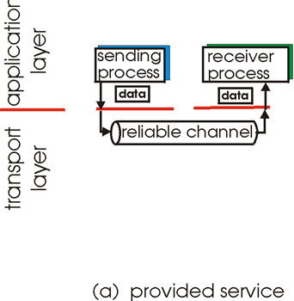
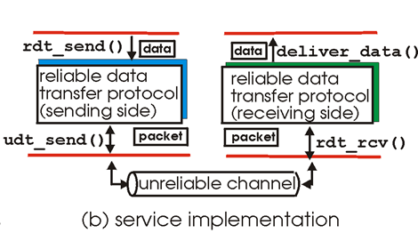
Principles of reliable data transfer
top-10 list of important networking topics!
characteristics of unreliable channel will determine complexity of reliable data transfer protocol (rdt)

Slide 19
Is it possible to have reliable transfer over UDP?
http://poll.fm/54om5

Slide 20
reliable transfer over UDP?
add reliability at application layer
application-specific error recovery
But best to: not “reinvent “TCP on top of UDP
If you need TCP, use TCP

Slide 21
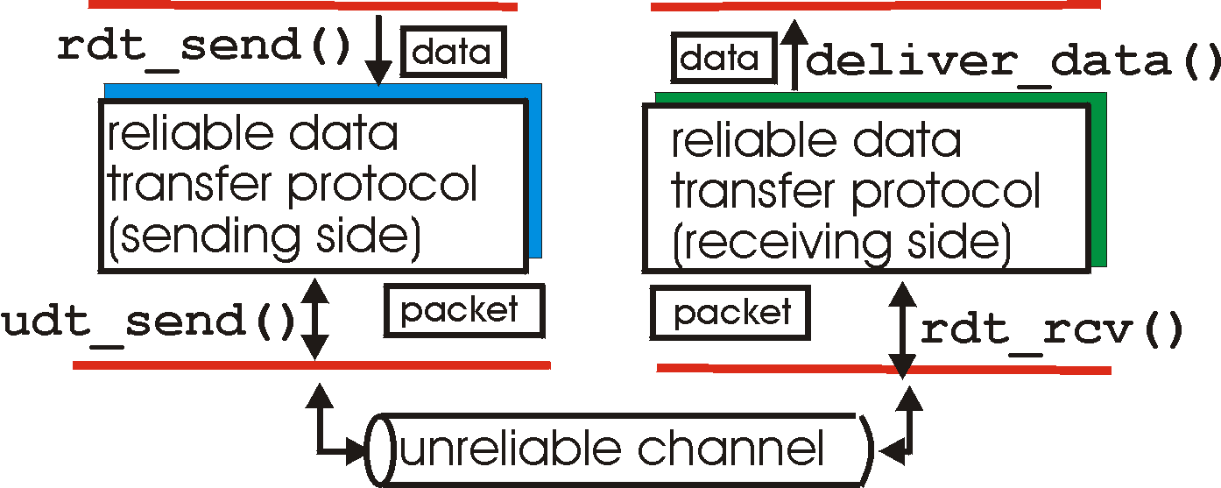
Reliable data transfer (RDT): getting started
rdt_send(): called from above, (e.g., by app.). Passed data to
deliver to receiver upper layer
deliver_data(): called by rdt to deliver data to upper
send
side
receive
side
udt_send(): called by rdt,
to transfer packet over
unreliable channel to receiver
rdt_rcv(): called when packet arrives on rcv-side of channel

Slide 22
RDT:
S application: Author
Writes and Sends pages
R application: publisher
Receives & publishes written pages
S transport: secretary Alice
Must fax pages on behalf of author
S transport: secretary Bob
Receives faxed pages;
Must pass on to publisher in-order
Birirectional Fax connection
A sends one page at a time;
How do A & B do their job if fax connection…
…is reliable?
…might introduce errors?
…might lose fax-messages?

Slide 23
Reliable data transfer: getting started
we’ll:
incrementally develop sender, receiver sides of reliable data transfer protocol (rdt)
consider only unidirectional data transfer
but control info will flow on both directions!
use finite state machines (FSM) to specify sender, receiver
event causing state transition
actions taken on state transition
state: when in this “state” next state uniquely determined by next event
state
1
state
2
event
actions

Slide 24
rdt1.0: reliable transfer & reliable channel
underlying channel perfectly reliable
no bit errors
no loss of packets
separate FSMs for sender, receiver:
sender sends data into underlying channel
receiver reads data from underlying channel
Wait for call from above
rdt_send(data)
Wait for call from below
rdt_rcv(packet)
extract (packet,data)
deliver_data(data)
packet = make_pkt(data)
udt_send(packet)
sender
receiver

Slide 25
rdt2.0: channel with bit errors
underlying channel may flip bits in packet
checksum to detect bit errors
the question: how to recover from errors:
acknowledgements (ACKs): receiver explicitly tells sender that pkt received OK
negative acknowledgements (NAKs): receiver explicitly tells sender that pkt had errors
sender retransmits pkt on receipt of NAK
new mechanisms in rdt2.0 (beyond rdt1.0):
error detection
feedback: control msgs (ACK,NAK) from receiver to sender

Slide 26
rdt2.0: FSM specification
rdt_send(data)
sndpkt = make_pkt(data, checksum)
udt_send(sndpkt)
receiver
rdt_rcv(rcvpkt) &&
isNAK(rcvpkt)
Wait for call from above
Wait for ACK or NAK
rdt_rcv(rcvpkt) &&
corrupt(rcvpkt)
udt_send(sndpkt)
udt_send(NAK)
rdt_rcv(rcvpkt) && isACK(rcvpkt)
Λ
Wait for call from below
sender
rdt_rcv(rcvpkt) &&
notcorrupt(rcvpkt)
extract(rcvpkt,data)
deliver_data(data)
udt_send(ACK)

Slide 27
rdt2.0: operation with no errors
rdt_send(data)
snkpkt = make_pkt(data, checksum)
udt_send(sndpkt)
rdt_rcv(rcvpkt) &&
isNAK(rcvpkt)
Wait for call from above
Wait for ACK or NAK
rdt_rcv(rcvpkt) &&
corrupt(rcvpkt)
udt_send(sndpkt)
udt_send(NAK)
rdt_rcv(rcvpkt) && isACK(rcvpkt)
Wait for call from below
Λ
rdt_rcv(rcvpkt) &&
notcorrupt(rcvpkt)
extract(rcvpkt,data)
deliver_data(data)
udt_send(ACK)

Slide 28
rdt2.0: error scenario
rdt_send(data)
snkpkt = make_pkt(data, checksum)
udt_send(sndpkt)
rdt_rcv(rcvpkt) &&
isNAK(rcvpkt)
Wait for call from above
Wait for ACK or NAK
rdt_rcv(rcvpkt) &&
corrupt(rcvpkt)
udt_send(sndpkt)
udt_send(NAK)
rdt_rcv(rcvpkt) && isACK(rcvpkt)
Wait for call from below
Λ
rdt_rcv(rcvpkt) &&
notcorrupt(rcvpkt)
extract(rcvpkt,data)
deliver_data(data)
udt_send(ACK)

Slide 29
rdt2.0 has an issue ….
what happens if ACK/NAK corrupted?
sender uncertain what happened at receiver!
Can retransmit : BUT WATCH: possible duplicates!
handling duplicates:
sender retransmits current pkt if hears nothing
sender adds sequence number to each pkt
receiver discards (doesn’t deliver up) duplicate pkt
stop and wait
sender sends one packet,
then waits for receiver
response

Slide 30
rdt2.1: sender, handles garbled ACK/NAKs
rdt_send(data)
sndpkt = make_pkt(0, data, checksum)
udt_send(sndpkt)
rdt_rcv(rcvpkt) &&
( corrupt(rcvpkt) ||
isNAK(rcvpkt) )
Wait for call 0 from above
Wait for ACK or NAK 0
udt_send(sndpkt)
rdt_rcv(rcvpkt)
&& notcorrupt(rcvpkt)
&& isACK(rcvpkt)
rdt_rcv(rcvpkt)
&& notcorrupt(rcvpkt)
&& isACK(rcvpkt)
Λ
Λ
Wait for ACK or NAK 1
Wait for
call 1 from above
rdt_rcv(rcvpkt) &&
( corrupt(rcvpkt) ||
isNAK(rcvpkt) )
rdt_send(data)
udt_send(sndpkt)
sndpkt = make_pkt(1, data, checksum)
udt_send(sndpkt)

Slide 31
rdt2.1: receiver, handles garbled ACK/NAKs
rdt_rcv(rcvpkt) && notcorrupt(rcvpkt)
&& has_seq0(rcvpkt)
extract(rcvpkt,data)
deliver_data(data)
sndpkt = make_pkt(ACK, chksum)
udt_send(sndpkt)
rdt_rcv(rcvpkt) && (corrupt(rcvpkt)
rdt_rcv(rcvpkt) && (corrupt(rcvpkt)
sndpkt = make_pkt(NAK, chksum)
udt_send(sndpkt)
sndpkt = make_pkt(NAK, chksum)
udt_send(sndpkt)
Wait for
0 from below
Wait for
1 from below
rdt_rcv(rcvpkt) &&
not corrupt(rcvpkt) &&
has_seq1(rcvpkt)
rdt_rcv(rcvpkt) &&
not corrupt(rcvpkt) &&
has_seq0(rcvpkt)
sndpkt = make_pkt(ACK, chksum)
udt_send(sndpkt)
sndpkt = make_pkt(ACK, chksum)
udt_send(sndpkt)
rdt_rcv(rcvpkt) && notcorrupt(rcvpkt)
&& has_seq1(rcvpkt)
extract(rcvpkt,data)
deliver_data(data)
sndpkt = make_pkt(ACK, chksum)
udt_send(sndpkt)

Slide 32
rdt2.1: discussion
sender:
seq # added to pkt
two seq. #’s (0,1) will suffice. Why?
must check if received ACK/NAK corrupted
twice as many states
state must “remember” whether “expected” pkt should have seq # 0 or 1
receiver:
must check if received packet is duplicate
state indicates whether 0 or 1 is expected pkt seq #
note: receiver can not know if its last ACK/NAK received OK at sender

Slide 33
rdt2.2: a NAK-free protocol
same functionality as rdt2.1, using ACKs only
instead of NAK, receiver sends ACK for last pkt received OK
receiver must explicitly include seq # of pkt being ACKed
duplicate ACK at sender results in same action as NAK: retransmit current pkt

Slide 34
rdt3.0: channels with errors and loss
new assumption: underlying channel can also lose packets (data, ACKs)
handling duplicates:
sender adds sequence number to each pkt
receiver discards (doesn’t deliver up) duplicate pkt
approach: sender waits “reasonable” amount of time for ACK
retransmits if no ACK received in this time
requires countdown timer
if pkt (or ACK) just delayed (not lost):
Must handle duplicates ->

Slide 35
rdt3.0 sender
rdt_send(data)
rdt_rcv(rcvpkt) &&
( corrupt(rcvpkt) ||
isACK(rcvpkt,1) )
sndpkt = make_pkt(0, data, checksum)
udt_send(sndpkt)
start_timer
rdt_rcv(rcvpkt)
Λ
Λ
Wait for
call 0from above
Wait for ACK0
timeout
udt_send(sndpkt)
start_timer
rdt_rcv(rcvpkt)
&& notcorrupt(rcvpkt)
&& isACK(rcvpkt,1)
rdt_rcv(rcvpkt)
&& notcorrupt(rcvpkt)
&& isACK(rcvpkt,0)
stop_timer
stop_timer
Wait for ACK1
Wait for
call 1 from above
timeout
udt_send(sndpkt)
start_timer
rdt_rcv(rcvpkt)
rdt_send(data)
Λ
rdt_rcv(rcvpkt) &&
( corrupt(rcvpkt) ||
isACK(rcvpkt,0) )
sndpkt = make_pkt(1, data, checksum)
udt_send(sndpkt)
start_timer
Λ

Slide 36
rdt3.0 in action
sender
receiver
sender
receiver
send pkt0
pkt0
send pkt0
pkt0
rcv pkt0
rcv pkt0
ack0
send ack0
ack0
send ack0
rcv ack0
rcv ack0
send pkt1
pkt1
send pkt1
pkt1
rcv pkt1
X
ack1
send ack1
loss
rcv ack1
send pkt0
pkt0
rcv pkt0
timeout
resend pkt1
ack0
send ack0
pkt1
rcv pkt1
ack1
send ack1
rcv ack1
send pkt0
pkt0
(a) no loss
rcv pkt0
ack0
send ack0
(b) packet loss

Slide 37
rdt3.0 in action
sender
receiver
sender
receiver
send pkt0
pkt0
send pkt0
pkt0
rcv pkt0
rcv pkt0
ack0
send ack0
send ack0
rcv ack0
ack0
send pkt1
pkt1
rcv ack0
rcv pkt1
send pkt1
pkt1
send ack1
rcv pkt1
ack1
send ack1
ack1
X
loss
timeout
resend pkt1
pkt1
rcv pkt1
timeout
resend pkt1
rcv ack1
pkt1
rcv pkt1
pkt0
(detect duplicate)
send pkt0
send ack1
ack1
(detect duplicate)
ack1
rcv pkt0
rcv ack1
send ack1
rcv ack1
ack0
send ack0
pkt0
send pkt0
pkt0
send pkt0
rcv pkt0
rcv pkt0
ack0
(detect duplicate)
ack0
send ack0
send ack0
(c) ACK loss
(d) premature timeout/ delayed ACK

Slide 38
Performance of rdt3.0
rdt3.0 is correct, but performance stinks
e.g.: 1 Gbps link, 15 ms prop. delay, 8000 bit packet:
L
8000 bits
D_{trans} =
=
=
8 microsecs
R
10⁹ bits/sec
Utilization (fraction of time sender busy sending):
if RTT=30 msec, 1KB pkt every 30 msec: → we get 330 kbps throughput over a 1 Gbps link
network protocol limits use of physical resources!

Slide 39
rdt3.0: stop-and-wait operation
sender
receiver
first packet bit transmitted, t = 0
last packet bit transmitted, t = L / R
first packet bit arrives
RTT
last packet bit arrives, send ACK
ACK arrives, send next
packet, t = RTT + L / R

Slide 40
Is RDT necessarily that slow/inefficient?

Slide 41
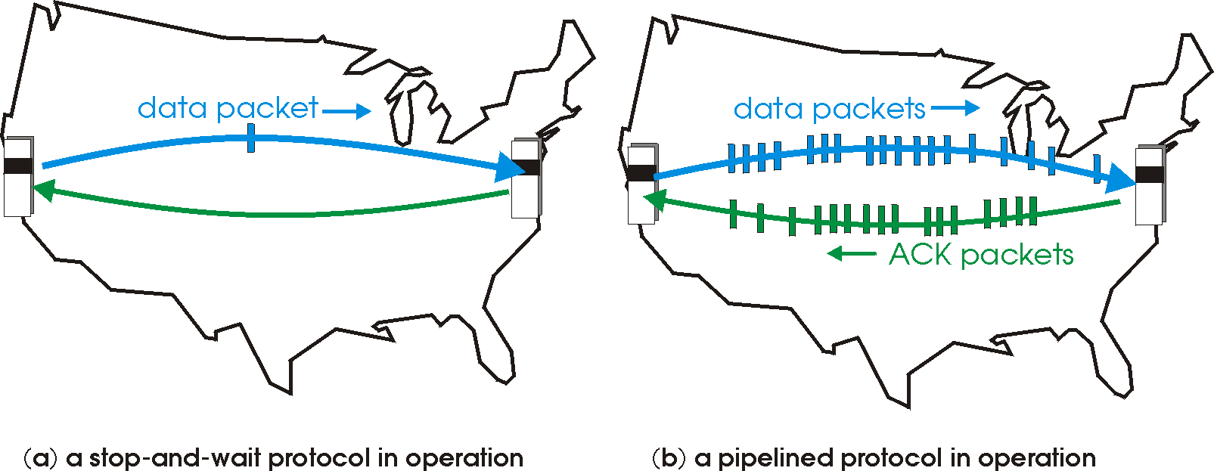
Pipelined protocols
pipelining: sender allows multiple, “in-flight”, yet-to-be-acknowledged pkts
range of sequence numbers must be increased
buffering at sender and/or receiver

Slide 42
Pipelining: increased utilization
sender
receiver
first packet bit transmitted, t = 0
last bit transmitted, t = L / R
first packet bit arrives
RTT
last packet bit arrives, send ACK
last bit of 2nd packet arrives, send ACK
last bit of 3rd packet arrives, send ACK
ACK arrives, send next
packet, t = RTT + L / R
3-packet pipelining increases
utilization by a factor of 3!

Slide 43
Pipelined protocols: ack-based error control
if data is lost, two generic forms of pipelined protocols: go-Back-N, selective repeat

Slide 44
Go-Back-n: sender
“window” of up to N, consecutive unack’ed pkts allowed
ACK(n): ACKs all pkts up to, including seq # n - “cumulative ACK”
may receive duplicate ACKs (see receiver)
timer for oldest in-flight pkt
timeout(n): retransmit packet n and all higher seq # pkts in window

Slide 45
GBn in action
sender window (N=4)
sender
receiver
0 1 2 3 4 5 6 7 8
send pkt0
send pkt1
send pkt2
send pkt3
(wait)
0 1 2 3 4 5 6 7 8
receive pkt0, send ack0
receive pkt1, send ack1
receive pkt3, discard,
(re)send ack1
0 1 2 3 4 5 6 7 8
X
0 1 2 3 4 5 6 7 8
loss
0 1 2 3 4 5 6 7 8
rcv ack0, send pkt4
rcv ack1, send pkt5
0 1 2 3 4 5 6 7 8
receive pkt4, discard,
(re)send ack1
ignore duplicate ACK
receive pkt5, discard,
(re)send ack1
pkt 2 timeout
0 1 2 3 4 5 6 7 8
send pkt2
send pkt3
send pkt4
send pkt5
0 1 2 3 4 5 6 7 8
0 1 2 3 4 5 6 7 8
rcv pkt2, deliver, send ack2
rcv pkt3, deliver, send ack3
rcv pkt4, deliver, send ack4
rcv pkt5, deliver, send ack5
0 1 2 3 4 5 6 7 8
http://media.pearsoncmg.com/aw/aw_kurose_network_4/applets/go-back-n/index.html

Slide 46
Selective repeat
receiver individually acknowledges all correctly received pkts
buffers pkts, as needed, for eventual in-order delivery to upper layer
sender only resends pkts for which ACK not received
sender timer for each unACKed pkt
sender window
N consecutive seq #’s
limits seq #s of sent, unACKed pkts

Slide 47
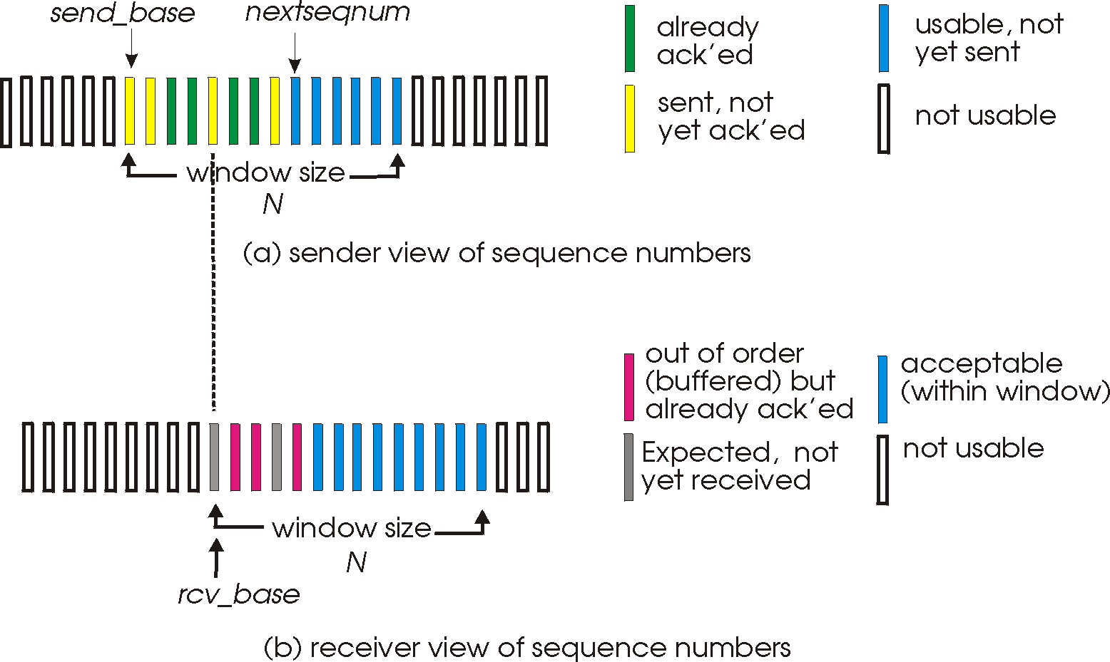
Selective repeat: sender, receiver windows

Slide 48
Selective repeat
sender
receiver
pkt n in [rcvbase, rcvbase+N-1]
send ACK(n)
out-of-order: buffer
in-order: deliver (also deliver buffered, in-order pkts), advance window to next not-yet-received pkt
pkt n in [rcvbase-N,rcvbase-1]
ACK(n)
otherwise:
ignore
data from above:
if next available seq # in window, send pkt
timeout(n):
resend pkt n, restart timer
ACK(n) in [sendbase,sendbase+N]:
mark pkt n as received
if n smallest unACKed pkt, advance window base to next unACKed seq #

Slide 49
Selective repeat in action
sender window (N=4)
sender
receiver
0 1 2 3 4 5 6 7 8
send pkt0
send pkt1
send pkt2
send pkt3
(wait)
0 1 2 3 4 5 6 7 8
receive pkt0, send ack0
receive pkt1, send ack1
receive pkt3, buffer,
send ack3
0 1 2 3 4 5 6 7 8
X
0 1 2 3 4 5 6 7 8
loss
0 1 2 3 4 5 6 7 8
rcv ack0, send pkt4
rcv ack1, send pkt5
0 1 2 3 4 5 6 7 8
receive pkt4, buffer,
send ack4
0 1 2 3 4 5 6 7 8
record ack3 arrived
receive pkt5, buffer,
send ack5
pkt 2 timeout
send pkt2
0 1 2 3 4 5 6 7 8
record ack4 arrived
rcv pkt2; deliver pkt2,
pkt3, pkt4, pkt5; send ack2
0 1 2 3 4 5 6 7 8
record ack5 arrived
0 1 2 3 4 5 6 7 8
Q: what happens when ack2 arrives?

Slide 50
Sequence numbers
sender window
(after receipt)
receiver window
(after receipt)
0 1 2 3 0 1 2
pkt0
example:
seq #’s: 0, 1, 2, 3
window size=3
0 1 2 3 0 1 2
pkt1
0 1 2 3 0 1 2
0 1 2 3 0 1 2
pkt2
0 1 2 3 0 1 2
0 1 2 3 0 1 2
0 1 2 3 0 1 2
pkt3
X
0 1 2 3 0 1 2
pkt0
will accept packet
with seq number 0
receiver sees no difference in two scenarios!
duplicate data accepted as new in (b)
Q: what relationship between seq # size and window size to avoid problem in (b)?
(a) no problem
receiver can’t see sender side.
receiver behavior identical in both cases!
something’s (very) wrong!
0 1 2 3 0 1 2
pkt0
0 1 2 3 0 1 2
pkt1
0 1 2 3 0 1 2
0 1 2 3 0 1 2
pkt2
0 1 2 3 0 1 2
X
0 1 2 3 0 1 2
X
timeout
retransmit pkt0
X
0 1 2 3 0 1 2
pkt0
will accept packet
with seq number 0
(b) oops!

Slide 51
Pipelining: increased utilization Ack-based => flow control at the same time!!!
sender
receiver
first packet bit transmitted, t = 0
last bit transmitted, t = L / R
first packet bit arrives
RTT
last packet bit arrives, send ACK
last bit of 2nd packet arrives, send ACK
last bit of 3rd packet arrives, send ACK
ACK arrives, send next
packet, t = RTT + L / R
Flow control: Sender/receiver problem; S cares to not overwhelm R

Slide 52
Roadmap
Transport layer services
Addressing, multiplexing/demultiplexing
Connectionless, unreliable transport: UDP
principles of reliable data transfer
Next lecture: connection-oriented transport: TCP
reliable transfer
flow control
connection management
TCP congestion control

Slide 53
Reading instructions chapter 3
KuroseRoss book
Other resources (further, optional study)
Lakshman, T. V., Upamanyu Madhow, and Bernhard Suter. "Window-based error recovery and flow control with a slow acknowledgement channel: a study of TCP/IP performance." INFOCOM'97. Sixteenth Annual Joint Conference of the IEEE Computer and Communications Societies. Proceedings IEEE. Vol. 3. IEEE, 1997.
Rizzo, Luigi. "Effective erasure codes for reliable computer communication protocols." ACM SIGCOMM Computer Communication Review 27.2 (1997): 24-36.
A. Agarwal and M. Charikar, “On the advantage of network coding for improving network throughput,” in Proceedings of the IEEE Information Theory Workshop, Oct. 2004
Harvey, N. J., Kleinberg, R., & Lehman, A. R. (2006). On the capacity of information networks. IEEE/ACM Transactions on Networking (TON), 14(SI), 2345-2364.
Careful | Quick
3.1, 3.2, 3.4-3.7 | 3.3

Slide 54
Some review questions on this part
Why do we need an extra protocol, i.e. UDP, to deliver the datagram service of Internets IP to the applications?
Draw space-time diagrams without errors and with errors, for the following, for a pair of sender-receive S-R: (assume only 1 link between them)
Stop-and-wait: transmission delay < propagation delay and transmission delay > propagation delay
Sliding window aka pipeleined protocol, with window’s transmission delay < propagation delay and window’s transmission delay > propagation delay; illustrate both go-back-n and selective repeat when there are errors
Show how to compute the effective throughput between S-R in the above cases, whene there are no errors

Slide 55
Review questions cont.
What are the goals of reliable data transfer?
Reliable data transfer: show why we need sequence numbers when the sender may retransmit due to timeouts.
Show how there can be wraparound in a reliable data transfer session if the sequence-numbers range is not large enough.
Describe the go-back-N and selective repeat methods for reliable data transfer

Slide 56
Extra slides, for further study

Slide 57
Bounding sequence numbers for stop-and-wait…
… s.t. no wraparound, i.e. we do not run out of numbers: binary value suffices for stop-and-wait:
Prf: assume towards a contradiction that there is wraparound when we use binary seq. nums.
R expects segment #f, receives segment #(f+2):
R rec. f+2 => S sent f+2 => S rec. ack for f+1
=> R ack f+1=> R ack f => contradiction
R expects f+2, receives f:
R exp. f+2 => R ack f+1 => S sent f+1
=> S rec. ack for f => contradiction

