Slide 1
Course on Computer Communication and Networks Lecture 13 Chapter 7: Multimedia networking Chapter 3-5: VC-type congestion control
EDA344/DIT 420, CTH/GU

Slide 2
multimedia applications: network audio and video
(“continuous media”)

Slide 3
Multimedia: audio
analog audio signal sampled at constant rate
telephone: 8,000 samples/sec
CD music: 44,100 samples/sec
example: 8,000 samples/sec, 256 quantized values: 64,000 bps
receiver converts bits back to analog signal:
some quality reduction
example rates
CD: 1.411 Mbps
MP3: 96, 128, 160 kbps
Internet telephony: 5.3 kbps and up
quantization error
quantized value of
analog value
analog
signal
audio signal amplitude
time
sampling rate
(N sample/sec)

Slide 4
Multimedia: video
spatial coding example: instead of sending N values of same color (all purple), send only two values: color value (purple) and number of repeated values (N)
video: sequence of images (arrays of pixels) displayed at constant rate
e.g. 24 images/sec
CBR: (constant bit rate): video encoding rate fixed
VBR: (variable bit rate): video encoding rate changes as amount of spatial, temporal coding changes
examples:
MPEG 1 (CD-ROM) 1.5 Mbps
MPEG2 (DVD) 3-6 Mbps
MPEG4 (often used in Internet, < 1 Mbps)
……………………...…
……………………...…
frame i
temporal coding example: instead of sending complete frame at i+1, send only differences from frame i
frame i+1

Slide 5
Multimedia networking: application types
streaming, stored audio, video
streaming: can begin play before downloading entire file
stored (at server): can transmit faster than audio/video will be rendered (implies storing/buffering at client)
e.g., YouTube, Netflix,
streaming live audio, video
e.g., live sporting event, …
conversational voice/video
interactive nature of human-to-human conversation limits delay tolerance; e.g., Skype
Fundamental characteristics:
typically delay sensitive
end-to-end delay
delay jitter
loss tolerant: infrequent losses cause minor glitches
antithesis with data, which are loss intolerant but delay tolerant.
Jitter is the variability of packet delays within the same packet stream

Slide 6
Multimedia Over Today’s Internet
best-effort service, no guarantees on delay, loss
?
?
?
?
?
?
?
But you said multimedia apps require
Delay/jitter (ie bandwidth) guarantees to be
effective!
?
?
?
?
Today’s Internet multimedia applications
use application-level techniques to mitigate
(as best possible) effects of delay, loss

Slide 7
Solution Approaches in Internet
To mitigate impact of “best-effort” protocols:
Several applications use UDP to avoid TCP’s ack-based progress (and slow start)…
Buffer content at client and control playback to remedy jitter
Different error control methods (no ack)
Exhaust all uses of caching, proxys, etc
Adapt compression level to available bandwidth
add more bandwidth

Slide 8
Roadmap
Application Classes, challenges
Today’s representative technology
recovery from jitter and loss
Streaming protocols
(Overlays) CDN: content distribution networks
Improving timing guarantees in Networks (also related with congestion-control)
Packet scheduling and policing
Two generally different approaches
The VC (ATM) approach (incl. material from Ch 3, 4, 5)
Internet approaches in discussion: Int-serv + RSVP, Diff-serv

Slide 9
Streaming: recovery from jitter
playout delay small => higher loss rate
constant bit
rate video
transmission
client video
reception
constant bit
rate video
playout at client
Cumulative data
variable
network
delay
buffered
video
client playout
delay
time
client-side buffering and playout delay: compensate for network-added delay, delay jitter

Slide 10
Client-side buffering, playout
buffer fill level, Q(t)
variable fill
rate, x(t)
playout rate,
e.g., CBR r
video server
client application
buffer, size B
client
1. Initial fill of buffer until playout begins at t_{p}
2. playout begins at t_{p,}
3. buffer fill level varies over time as fill rate x(t) varies and playout rate r is constant

Slide 11
Client-side buffering, playout
buffer fill level, Q(t)
variable fill
rate, x(t)
playout rate,
e.g., CBR r
video server
client application
buffer, size B
playout buffering: average fill rate (x), playout rate (r):
x < r: buffer eventually empties (causing freezing of video playout until buffer again fills)
x > r: buffer will not empty, provided initial playout delay is large enough to absorb variability in x(t)
initial playout delay tradeoff: buffer starvation less likely with larger delay, but larger delay until user begins watching

Slide 12
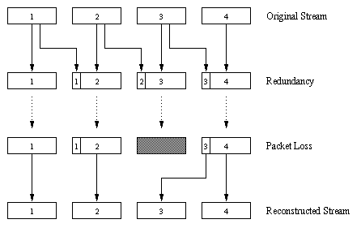
Recovery From Packet Loss Forward Error Correction
Eg. through piggybacking Lower Quality Stream

Slide 13
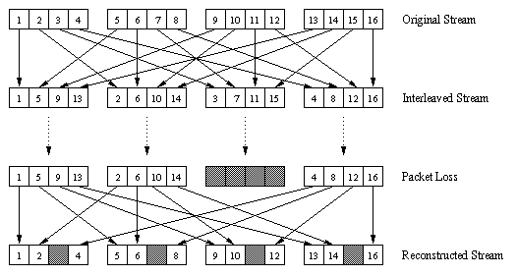
Recovery From Packet Loss/FEC (cont)
Interleaving: no redundancy, but can cause delay in playout beyond Real Time requirements
Upon loss, have a set of partially filled chunks
playout time must adapt to receipt of group

Slide 14
Roadmap
Application Classes, challenges
Today’s representative technology
recovery from jitter and loss
Streaming protocols
(Overlays) CDN: content distribution networks
Improving timing guarantees in Networks (also related with congestion-control)
Packet scheduling and policing
Two generally different approaches
The VC (ATM) approach (incl. material from Ch 3, 4, 5)
Internet approaches in discussion: Int-serv + RSVP, Diff-serv

Slide 15
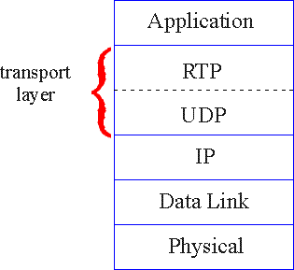
Real-Time Protocol (RTP) RFC 3550
RTP specifies packet structure for carrying audio, video data
payload type (encoding)
sequence numbering
time stamping
RTP does not provide any mechanism to ensure timely data delivery or other guarantees
RTP encapsulation only seen at end systems
RTP packets encapsulated in UDP segments
interoperability: if two Internet phone applications run RTP, then they may be able to work together

Slide 16
Streaming multimedia: UDP
server sends at rate appropriate for client
often: send rate = encoding rate = constant rate
transmission rate can be oblivious to congestion levels
short playout delay to remove network jitter
BUT: UDP may not go through firewalls

Slide 17
Streaming multimedia: HTTP
multimedia file retrieved via HTTP GET
send at maximum possible rate under TCP
fill rate fluctuates due to TCP congestion control, retransmissions (in-order delivery)
larger playout delay: smooth TCP delivery rate
HTTP/TCP passes easier through firewalls
variable rate, x(t)
video
file
TCP send buffer
TCP receive buffer
application playout buffer
server
client

Slide 18
Streaming multimedia: DASH: Dynamic, Adaptive Streaming over HTTP
1.5 Mbps encoding
28.8 Kbps encoding
server:
divides video file into multiple chunks
each chunk stored, encoded at different rates
manifest file: provides URLs for different chunks
client:
periodically measures server-to-client bandwidth
consulting manifest, requests one chunk at a time, at appropriate coding rate
can choose different coding rates at different points in time (depending on available bandwidth at time)

Slide 19
Roadmap
Application Classes, challenges
Today’s representative technology
recovery from jitter and loss
Streaming protocols
(Overlays) CDN: content distribution networks
Improving timing guarantees in Networks (also related with congestion-control)
Packet scheduling and policing
Two generally different approaches
The VC (ATM) approach (incl. material from Ch 3, 4, 5)
Internet approaches in discussion: Int-serv + RSVP, Diff-serv

Slide 20
Content distribution networks(CDNs)
Content replication
It does not scale to stream large files from single origin server in real time to hundreds of 1000 or more end hosts
A solution: replicate content at several/many servers
content downloaded to CDN servers ahead of time
content “close” to user avoids impairments (loss, delay) of sending content over long paths
CDN server typically in edge/access network
Resembles overlay networks in P2P applications
origin server
CDN distribution node
CDN server
in S. America
CDN server
in Asia
CDN server
in Europe
Video link: http://vimeo.com/26469929

Slide 21
CDN: “simple” content access scenario
Bob (client) requests video http://netcinema.com/6Y7B23V
video stored in CDN at http://KingCDN.com/NetC6y&B23V
1. Bob gets URL for for video http://netcinema.com/6Y7B23V
from netcinema.com
web page
2. resolve http://netcinema.com/6Y7B23V
via Bob’s local DNS
1
2
6. request video from
KINGCDN server,
streamed via HTTP
5
4&5. Resolve
http://KingCDN.com/NetC6y&B23
via KingCDN’s authoritative DNS, which returns IP address of KIingCDN
server with video
netcinema.com
3. netcinema’s DNS returns URL
http://KingCDN.com/NetC6y&B23V
4
3
netcinema’s
authorative DNS
KingCDN.com
KingCDN
authoritative DNS

Slide 22
Case study: Netflix
upload copies of multiple versions of video to CDNs
Amazon cloud
Akamai CDN
Netflix registration,
accounting servers
3. Manifest file
returned for
requested video
2. Bob browses
Netflix video
Limelight CDN
2
3
1
1. Bob manages Netflix account
Level-3 CDN
4. DASH streaming
Netflix uploads studio master to 3rd party cloud
create multiple version of movie (different encodings) in cloud
upload versions from cloud to 3rd party CDNs; user downloads the suitable encoding from them

Slide 23
Summary Internet Multimedia: bag of tricks
use UDP to avoid TCP congestion control (delays) for time-sensitive traffic; or multiple TCP connections (DASH)
Buffering and client-side adaptive playout delay: to compensate for delay
error recovery (on top of UDP)
FEC, interleaving, error concealment
CDN: bring content closer to clients
server side matches stream bandwidth to available client-to-server path bandwidth
chose among pre-encoded stream rates
dynamic server encoding rate

Slide 24
Roadmap
Application Classes, challenges
Today’s representative technology
recovery from jitter and loss
Streaming protocols
(Overlays) CDN: content distribution networks
Improving timing guarantees in Networks (also related with congestion-control)
Packet scheduling and policing
Two generally different approaches
The VC (ATM) approach (incl. material from Ch 3, 4, 5)
Internet approaches in discussion: Int-serv + RSVP, Diff-serv

Slide 25
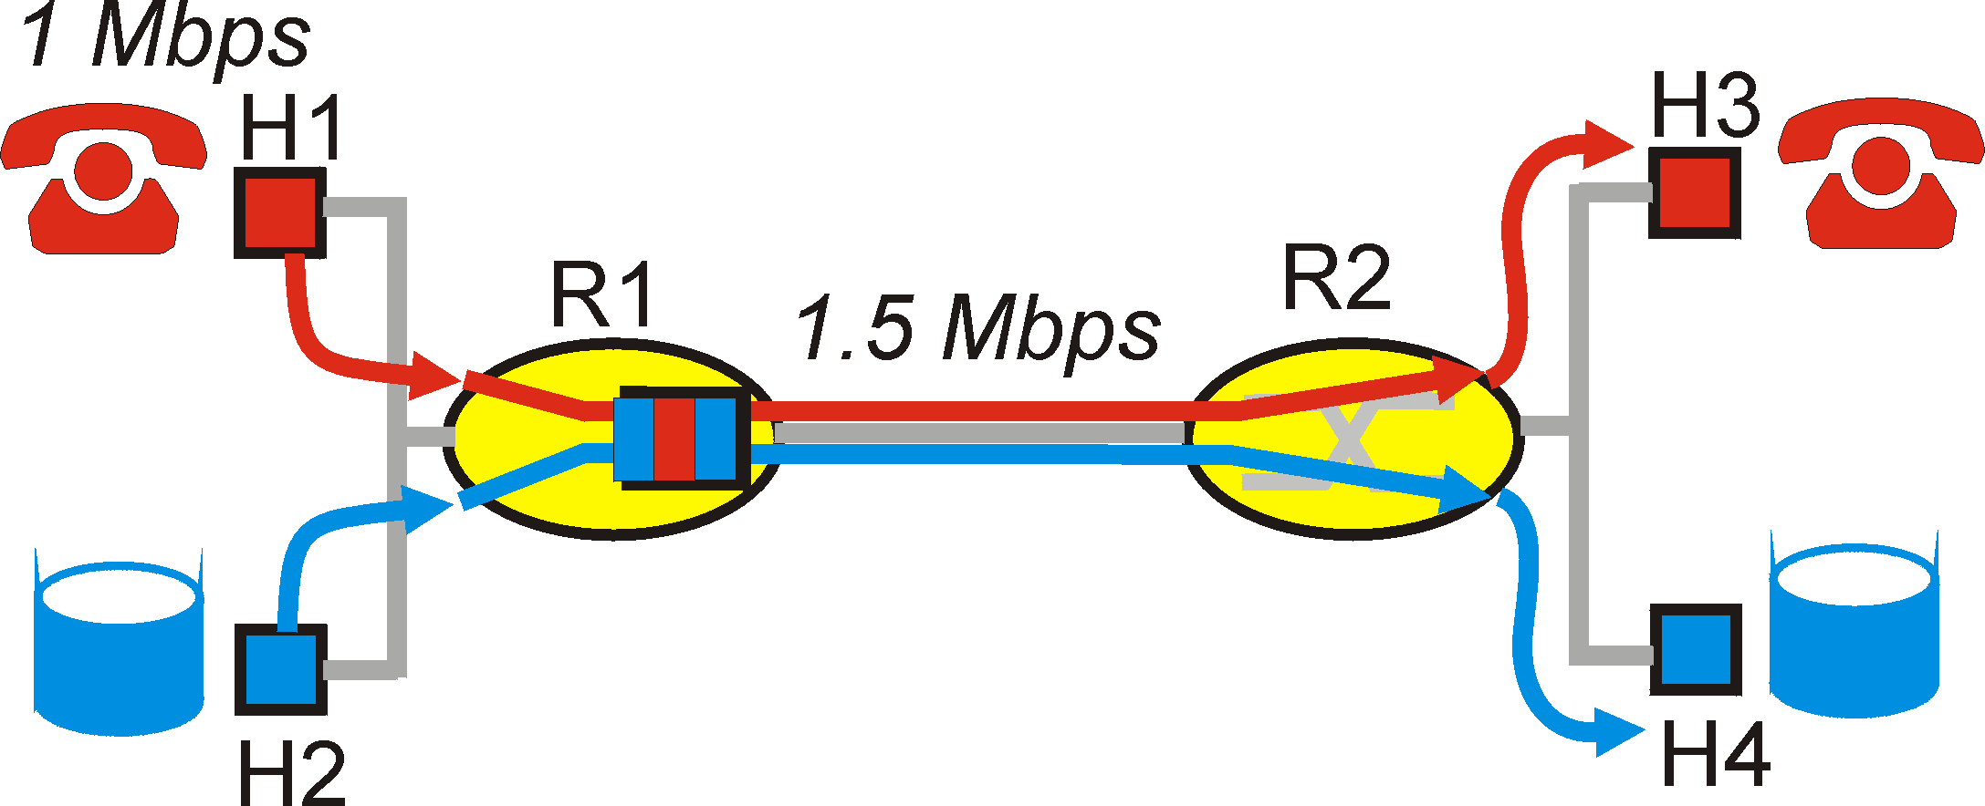
Improving timing/bandwidth guarantees in Networks
aka Quality of Service (QoS): agreement on
Traffic characteristics (packet rate, sizes, …)
Network service guarantees (delay, jitter, loss rate, …)
model for resource sharing and congestion studies: questions/principles for QoS
Distinguish traffic?
Control offered load? (isolate different ”streams”?)
Resources? (utilization)
Control acceptance of new sessions?
Packet classification & scheduling (bandwidth allocation)n control
Traffic shaping/policing (enforce contract terms)
Admission control will not study methods here)

Slide 26
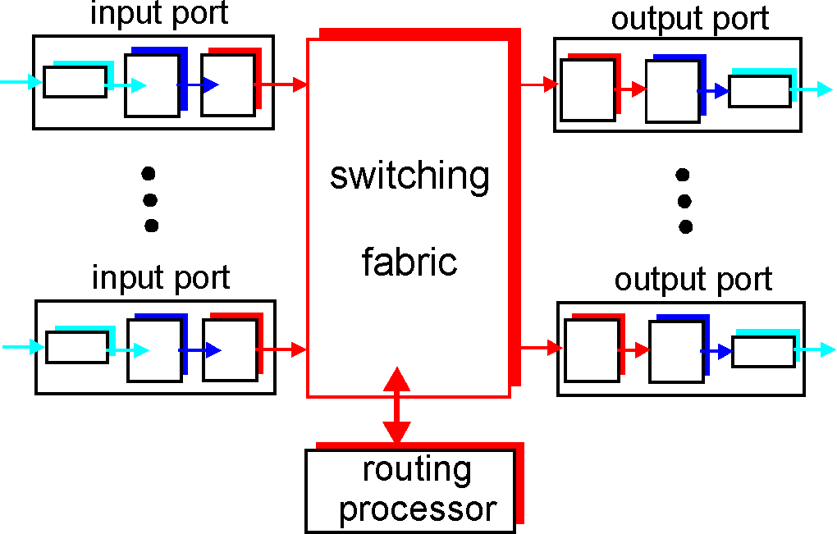
Where does this go in?
Scheduling = choosing the next packet for transmission on a link (= allocate bandwidth)

Slide 27
Packet Scheduling Policies: FIFO
FIFO: in order of arrival to the queue
if buffer full: a discard policy determines which packet to discard among the arrival and those already queued

Slide 28
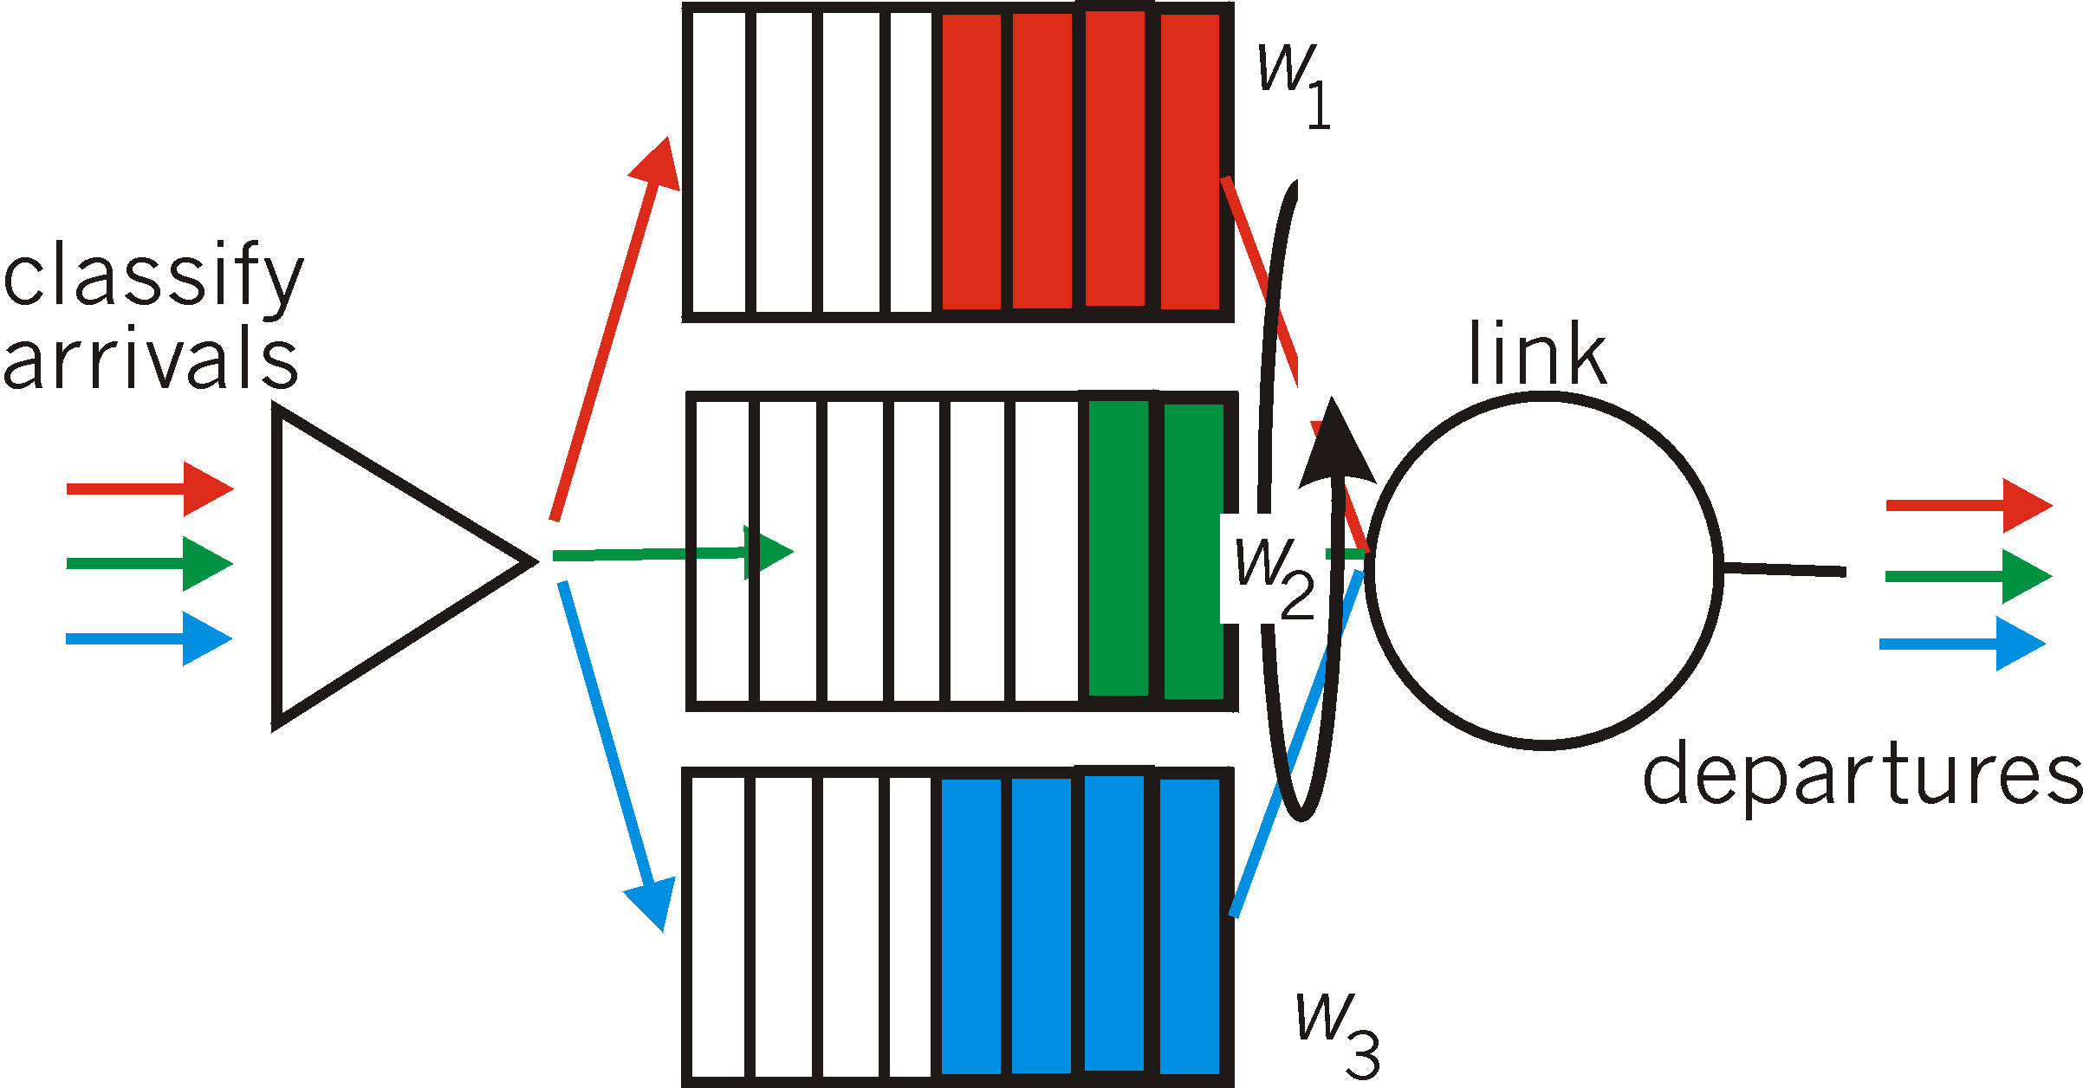
Scheduling Policies: Weighted Fair Queueing
Weighted Fair Queuing: generalized Round Robin, including priorities (weights)
provide each class with a differentiated amount of service
class i receives a fraction of service w_{i}/∑(w_{j})
ore on packet scheduling: work-conserving policies, delays, …

Slide 29
Policing Mechanisms
Idea: shape the packet traffic (the network provider does traffic policing, ie monitors/enforces the ”shape” agreed).
Traffic shaping, to limit transmission rates:
(Long term) Average Rate (e.g.100 pkts/sec or 6000 packets per min), crucial aspect is the interval length
Peak Rate: e.g.1500 pkts/sec peak
(Max.) Burst Size: Max. number of packets sent consecutively, ie over a very short period of time

Slide 30
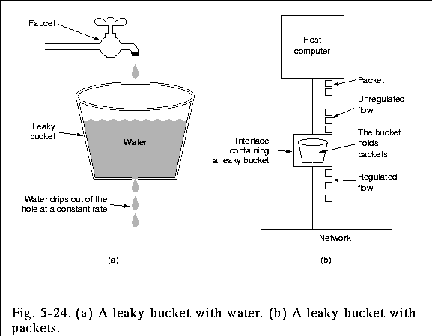
Policing Mechanisms: Pure Leaky Bucket
Idea: eliminates bursts completely; may cause unnecessary packet losses

Slide 31
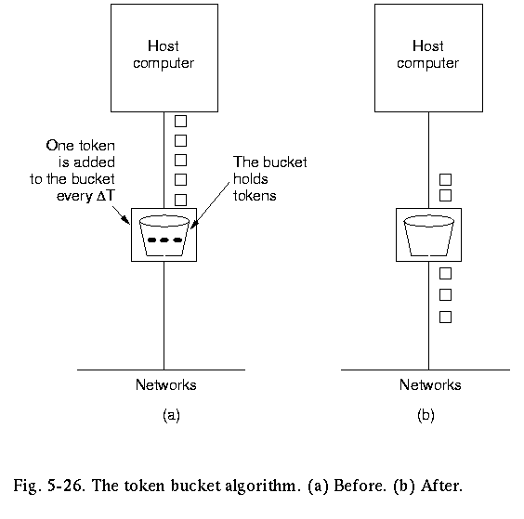
Policing Mechanisms:LeakyToken Bucket
Idea: packets sent by consuming tokens produced at constant rate r
limit input to specified Burst Size (b= bucket capacity) and Average Rate (max admitted #packets over time period t is b+rt).
to avoid still much burstiness, put a leaky bucket -with higher rate; why?- after the token bucket)

Slide 32
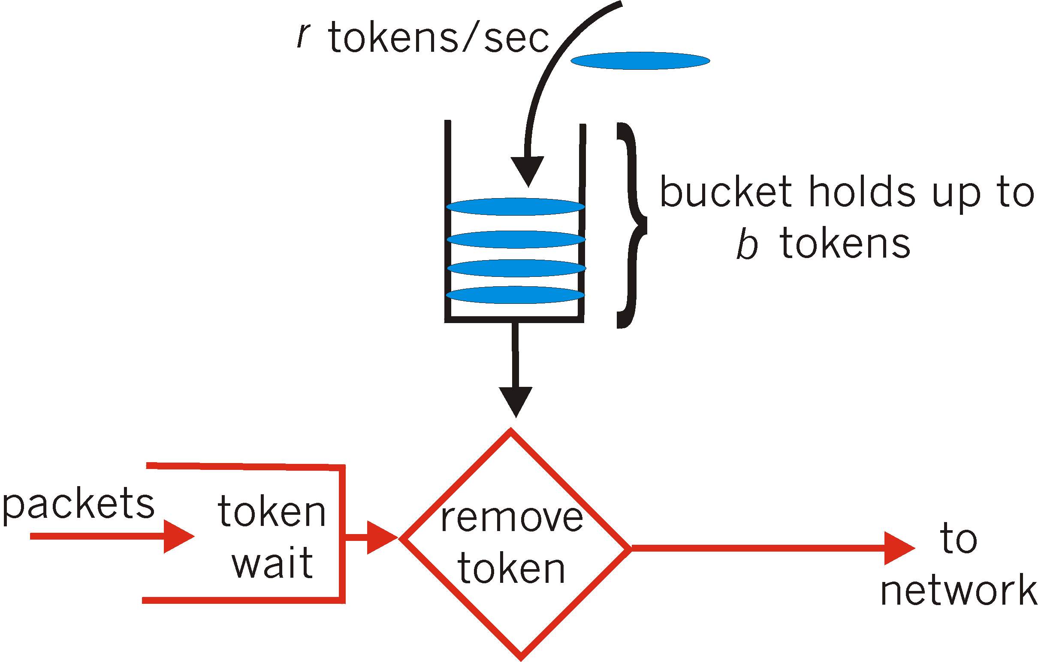
Policing Mechanisms: token bucket
Another way to illustrate token buckets:

Slide 33
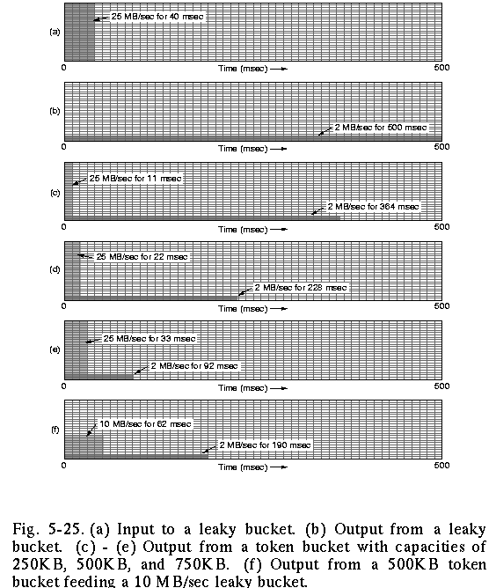
Policing: the effect of buckets
input
output pure leaky bucket, 2MBps
output token bucket 250KB, 2MBps
output token bucket 500KB, 2MBps
output token bucket 750KB, 2MBps
output 500KB, 2MBps token bucket feeding 10MBps leaky bucket

Slide 34
Roadmap
Application Classes, challenges
Today’s representative technology
recovery from jitter and loss
Streaming protocols
(Overlays) CDN: content distribution networks
Improving timing guarantees in Networks (also related with congestion-control)
Packet scheduling and policing
Two generally different approaches
The VC (ATM) approach (incl. material from Ch 3, 4, 5)
Internet approaches in discussion: Int-serv + RSVP, Diff-serv

Slide 35
(Virtual Circuit example) ATM: Asynchronous Transfer Mode nets
Internet:
today’s de facto standard for global data networking
1980’s:
telco’s develop ATM: competing network standard for carrying high-speed voice/data
ATM principles:
virtual-circuit networks: switches maintain state for each “call”
small (48 byte payload, 5 byte header) fixed length cells (like packets)
fast switching
small size good for voice
Assume low error-rates, do not perform error control (enhance speed)
well-defined interface between “network” and “user” (think of classic telecom)
?

Slide 36
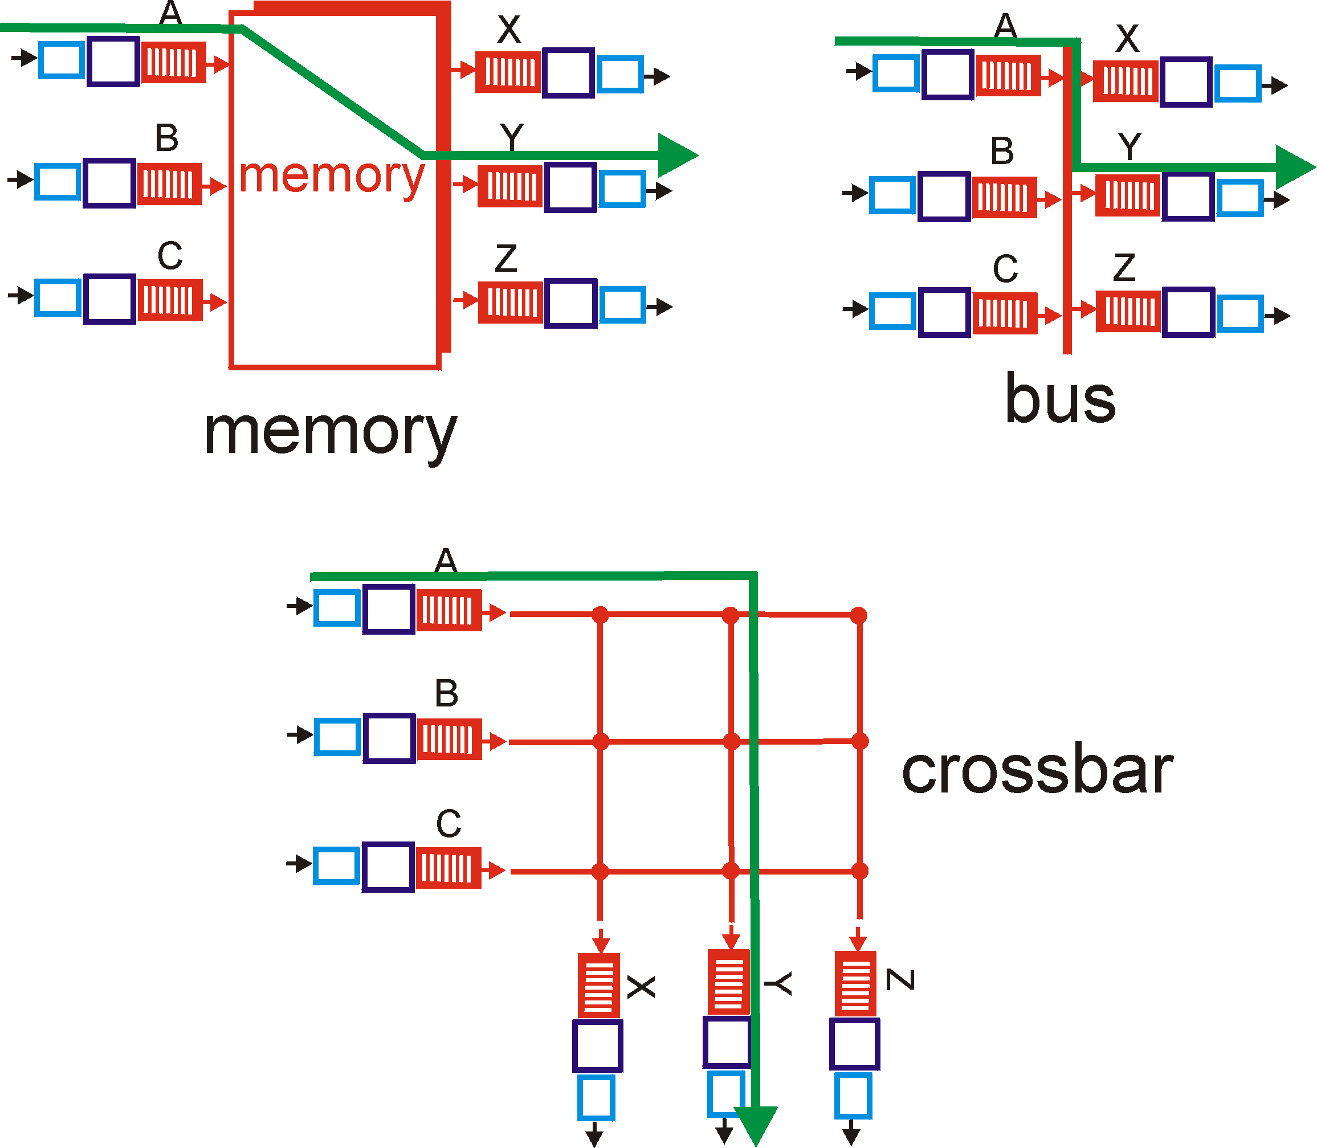
Recall: switching fabrics
ATM switches: VC technology
Virtual channels, virtual circuits
Based on Banyan crossbar switches
ATM routing: as train travelling (hence no state for each ”stream/passenger”, but for each ”train”)

Slide 37
ATM cell (small packet)
48-byte payload
Why?: small payload -> short cell-creation delay for digitized voice
halfway between 32 and 64 (compromise!)
Header: 5bytes
VCI: virtual channel ID
PT: Payload type (e.g. Resource Management cell versus data cell)
CLP: Cell Loss Priority bit
CLP = 1 implies low priority cell, can be discarded if congestion
HEC: Header Error Checksum
Cell header
Cell format

Slide 38
Example VC technology ATM Network service models:
Service
Model
Constant Bit Rate
VariableBR
(RT/nRT)
Available BR
UndefinedBR
Guarantees ?
Example
voice
Video/
“streaming”
www-browsing
Background file transfer
Congestion
feedback
no
congestion
no
congestion
yes
no
Bandwidth
constant
rate
guaranteed
rate
guaranteed
minimum
none
Loss
yes
yes
no
no
Order
yes
yes
yes
yes
Timing
yes
yes
no
no
With ABR you can get min guaranteed capacity and better, if possible; with UBR you can get better, but you may be thrown out in the middle ☹

Slide 39
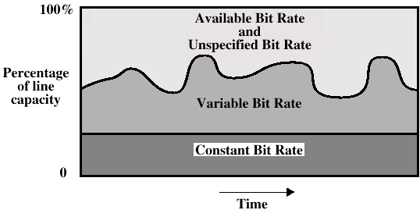
ATM Bit Rate Services

Slide 40
ATM Congestion Control
Several different strategies:
Admission control and resource reservation: reserve resources when opening a VC; traffic shaping and policing (use bucket-like methods)
Rate-based congestion control: (especially for ABR traffic)
idea = give feedback to the sender and intermediate stations on the min. available (= max. acceptable) rate on the VC.
similar to choke packets (option also provided in IP (ICMP) also, but not really used in implementations);

Slide 41
Multiprotocol label switching (MPLS) in IP networks: ATM-inspired
initial goal: speed up IP forwarding by using fixed length label (instead of IP address) to do forwarding
borrowing ideas from Virtual Circuit (VC) approach but IP datagram still keeps IP address
label-switched router
forwards packets to outgoing interface based only on label value (don’t inspect IP address)
MPLS forwarding table distinct from IP forwarding tables
PPP or Ethernet
header
IP header
remainder of link-layer frame
MPLS header
MPLS router must co-exist
with IP-only routers
(cf overlays,
software-defined networking)
label
Exp
S
TTL
20
3
1
5

Slide 42
Roadmap
Application Classes, challenges
Today’s representative technology
recovery from jitter and loss
Streaming protocols
(Overlays) CDN: content distribution networks
Improving timing guarantees in Networks (also related with congestion-control)
Packet scheduling and policing
Two generally different approaches
The VC (ATM) approach (incl. material from Ch 3, 4, 5)
Internet approaches in discussion: Int-serv + RSVP, Diff-serv

Slide 43
Intserv: QoS guarantee scenario
Resource reservation per individual application session
call setup, signaling (RSVP)
Maintains state a la VC (but soft state, ie times out)
responsibility at the client to renew reservations
traffic, QoS declaration
per-element admission control
request/
reply
QoS-sensitive scheduling (e.g., WFQ)

Slide 44
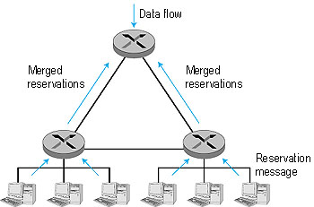
RSVP: resource reservation protocol
RSVP: a leading candidate for signaling protocol
allows reservations for bandwidth in multicast trees
is receiver-oriented (the receiver of a
data flow initiates and maintains the
resource reservation for the flow).
Maintains soft-state
receivers renew interest regularly
does not specify how the network
provides the reserved bandwidth, only
allows the applications to reserve it.
is not a routing protocol; it depends on
an underlying routing protocol to
determine the routes for the flows; when a route changes,
RSVP re-reserves resources.
does not define the admission test, but it assumes that the routers perform such a test and that RSVP can interact with the test.

Slide 45
Back to Internet bandwidth guarantee support: alternatively?
Concerns with Intserv:
Scalability: signaling, maintaining per-flow router state difficult with large number of flows
Diffserv approach:
Don’t define service classes, provide functional components to build service classes
Network core: stateless, simple
Combine flows into aggregated flows
Classification, shaping, admission at the network edge

Slide 46
Diffserv Architecture
Edge router:
per-flow traffic management
marks packets as in-profile and out-profile
marking
r
scheduling
.
b
.
.
Core router:
per class traffic management
buffering and scheduling based on marking at edge
preference given to in-profile packets

Slide 47
Edge-router Packet Marking
profile: pre-negotiated rate A, bucket size B
packet marking at edge based on per-flow profile
Rate A
B
User packets
Possible usage of marking:
class-based marking: packets of different classes marked differently
intra-class marking: conforming portion of flow marked differently than non-conforming one
Packet is marked in the Type of Service (TOS) in IPv4, and Traffic Class in IPv6

Slide 48
DiffServ Core Functions
Forwarding: according to “Per-Hop-Behavior” (PHB) specified for the particular packet class; PHB is strictly based on classification marking
PHB does not specify what mechanisms to use to ensure required PHB performance behavior
Examples:
Class A gets x% of outgoing link bandwidth over time intervals of a specified length
Class A packets leave before packets from class B
Advantage:
No state info to be maintained by routers

Slide 49
Roadmap - Summary
Application Classes, challenges
Today’s representative technology
recovery from jitter and loss
Streaming protocols
(Overlays) CDN: content distribution networks
Improving timing guarantees in Networks (also related with congestion-control)
Packet scheduling and policing
Two generally different approaches
The VC (ATM) approach (incl. material from Ch 3, 4, 5)
Internet approaches in discussion: Int-serv + RSVP, Diff-serv
Internet core and transport protocols do not provide guarantees for multimedia streaming traffic
Applications take matters into own hands
Bag of tricks and interesting evolving methods
Another type of service at the core (VC-like) would imply a different situation
But then the Internet core would be different

Slide 50
Reading list, review questions, further study
Upkar Varshney, Andy Snow, Matt McGivern, and Christi Howard. 2002. Voice over IP. Commun. ACM 45, 1 (January 2002), 89-96. DOI=10.1145/502269.502271
Jussi Kangasharju, James Roberts, Keith W. Ross, Object replication strategies in content distribution networks, Computer Communications, Volume 25, Issue 4, 1 March 2002, Pages 376-383, ISSN 0140-3664, http://dx.doi.org/10.1016/S0140-3664(01)00409-1.
K.L Johnson, J.F Carr, M.S Day, M.F Kaashoek, The measured performance of content distribution networks, Computer Communications, Volume 24, Issue 2, 1 February 2001, Pages 202-206, ISSN 0140-3664, http://dx.doi.org/10.1016/S0140-3664(00)00315-7.
Eddie Kohler, Mark Handley, and Sally Floyd. 2006. Designing DCCP: congestion control without reliability. SIGCOMM Comput. Commun. Rev. 36, 4 (August 2006), 27-38. DOI=10.1145/1151659.1159918 http://doi.acm.org/10.1145/1151659.1159918
Chapter 7
3.6.2
5.5.1
R7: 5, 6, 7, 8, 12, 14, 17

Slide 51
Extra slides/notes

Slide 52
Adaptive Playout Delay (1)
Goal: minimize playout delay, keeping late loss rate low
Approach: adaptive playout delay adjustment:
estimate network delay, adjust playout delay at beginning of each talk spurt.
silent periods compressed and elongated.
chunks still played out every 20 msec during talk spurt.
dynamic estimate of average delay at receiver:
where u is a fixed constant (e.g., u = .01).

Slide 53
Adaptive playout delay (2)
also useful to estimate average deviation of delay, v_{i} :
estimates d_{i} , v_{i} calculated for every received packet
(but used only at start of talk spurt
for first packet in talk spurt, playout time is:
where K is positive constant
remaining packets in talkspurt are played out periodically

Slide 55
Real-Time Protocol (RTP) & RT Control Protocol (RTCP)
standard packet format for real-time application
Payload Type: 7 bits: 128 possible types of encoding; eg PCM, MPEG2 video, GSM, etc. (sender can change in the middle of session)
Sequence Number: to detect packet loss
Timestamp: sampling instant of first byte in packet; to remove jitter introduced by the network
Synchronization Source identifier (SSRC): id for the source of a stream; assigned randomly by the source
Real-Time Control Protocol (RTCP): specifies report packets exchanged between sources and destinations, with statistics (# packets sent/lost, inter-arrival jitter
Can be used to modify sender transmission rates

Slide 57
SIP Service Initiation Protocol
SIP long-term vision
All phone/video conference calls take place over the Internet
People are identified by names or e-mail addresses, rather than by phone numbers.
You can reach the callee, no matter where the callee roams, no matter what IP device the callee is currently using.
What does it do:
Determine current IP address of callee.
Maps mnemonic identifier to current IP address
Setting up/ending a call
Provides also mechanisms so that caller and callee can agree on media type and encoding.
Call management
Add new media streams during call
Change encoding during call
Invite others
Transfer and hold calls

Slide 58
Setting up a call to known IP address
Alice’s SIP invite message indicates her port number & IP address+encoding
Bob’s 200 OK message (could also reject, say “busy”, etc) indicates his port number, IP address & preferred encoding (GSM)
SIP messages can be sent over TCP or UDP; here over RTP/UDP.
HTTP message syntax (but SIP maintains state)
Default SIP port number: 5060.

Slide 59
Example name translation, user location
Caller jim@umass.edu places a
call to keith@upenn.edu
Jim sends INVITE to umass SIPproxy.
(2) Proxy forwards request to upenn registrar server.
(3) upenn server returns redirect response, indicating that it should try keith@eurecom.fr
(4) umass proxy sends INVITE to eurecom registrar.
(5) eurecom registrar forwards INVITE to 197.87.54.21, which is running keith’s SIP client.
(6-8) SIP response sent back
(9) media sent directly between clients.
(follows pretty much the DNS inquiry structure)

Slide 60
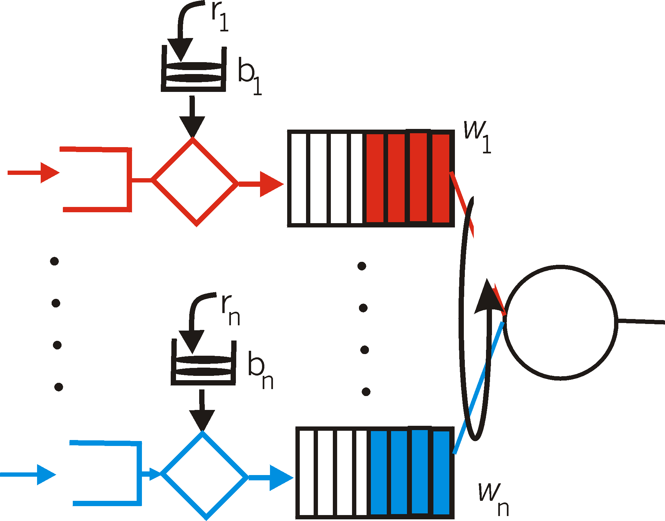
Token bucket + WFQ…
…can be combined to provide upper bound on packet delay in queue:
b_{i} packets in queue, packets are serviced at a rate of at least R · w_{i}/∑ (wj) packets per second, then the time until the last packet is transmitted is at most
b_{i} /(R · w_{i}/∑ (wj))

Slide 62
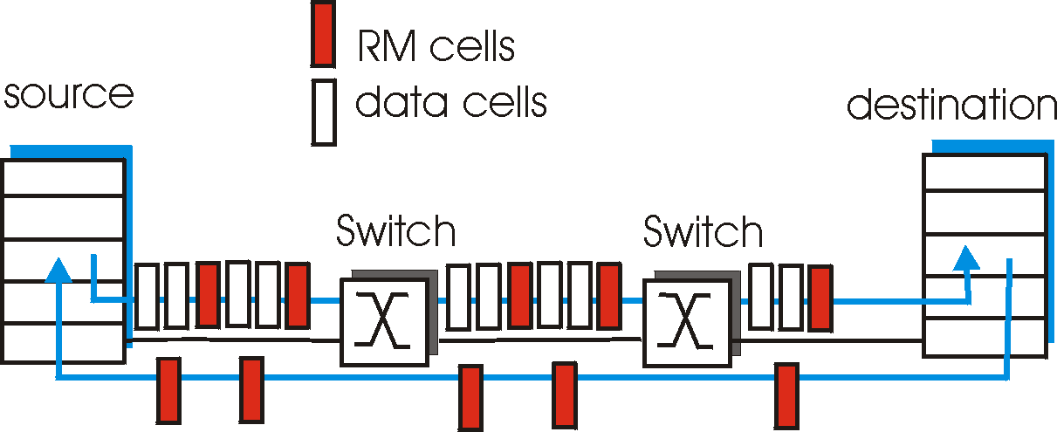
ATM ABR congestion control
ABR: available bit rate:
“elastic service”
if path “underloaded”:
sender should use available bandwidth
if path congested:
sender throttled to minimum guaranteed rate
RM (resource management) cells:
interspersed with data cells
bits in RM cell set by switches (“network-assisted”)
NI bit: no increase in rate (mild congestion)
CI bit: congestion indication two-byte ER (explicit rate) field in RM cell
congested switch may lower ER value in cell
sender’ send rate thus minimum supportable rate on path

Slide 63
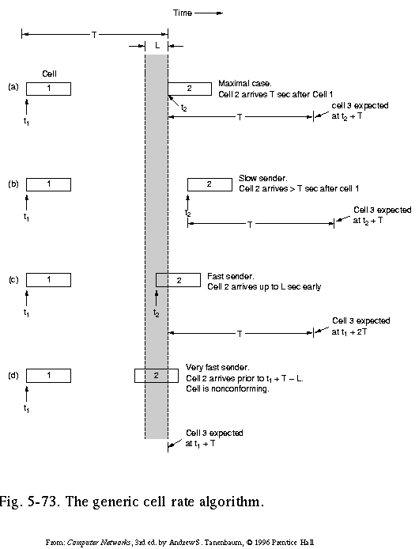
Traffic Shaping and Policing in ATM
Enforce the QoS parameters: check if Peak Cell Rate (PCR) and Cell Delay Variation (CDVT) are within the negotiated limits:
Generic Cell Rate Algo: introduce:
expected next time for a successive cell, based on T = 1/PCR
border time L ( = CDVT) < T in which next transmission may start (but never before T-L)
A nonconforming cell may be discarded, or its Cell Loss Priority bit be set, so it may be discarded in case of congestion

Slide 64
ATM Adaptation (Transport) Layer: AAL
Basic idea: cell-based VCs need to be ”complemented ”to be supportive for applications.
Several ATM Adaptation Layer (AALx) protocols defined, suitable for different classes of applications
AAL1: for CBR (Constant Bit Rate) services, e.g. circuit emulation
AAL2: for VBR (Variable Bit Rate) services, e.g., MPEG video
.....
”suitability” has not been very successful
computer science community introduced AAL5, (simple, elementary protocol), to make the whole ATM stack usable as switching technology for data communication under IP!

Slide 65
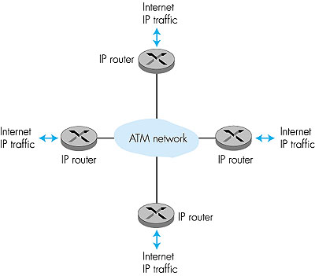
ATM: network or link layer?
Vision: end-to-end transport: “ATM from desktop to desktop”
ATM is a network technology
Reality: used to connect IP backbone routers
“IP over ATM”
ATM as switched link layer, connecting IP routers

Slide 66
e.g. IP-Over-ATM
IP over ATM
replace “network” (e.g., LAN segment) with ATM network
ATM addresses (as MAC addresses), IP addresses
“Classic” IP over eg Ethernet
3 “networks” (e.g., LAN segments)
MAC (eg802.3) and IP addresses
ATM
network
Ethernet
LANs
Ethernet
LANs

Slide 67
IP-Over-ATM
app
transport
IP
AAL
ATM
phy
app
transport
IP
Eth
phy
IP
AAL
ATM
phy
Eth
ATM
phy
phy
ATM
phy
AAL: ATM adaptation layer intended for transport layer functionality (with AAL1-4 services: cons/var/avail/undefined bit-rate traffic) but implementations did not allow such use; AAL5 made for use under IP….

Slide 68
The Internet: virtualizing networks
1974: multiple unconnected nets
ARPAnet
data-over-cable networks
packet satellite network (Aloha)
packet radio network
… differing in:
addressing conventions
packet formats
error recovery
routing
ARPAnet
satellite net
"A Protocol for Packet Network Intercommunication",
V. Cerf, R. Kahn, IEEE Transactions on Communications,
May, 1974, pp. 637-648.

Slide 69
The Internet: virtualizing networks
Internetwork layer (IP):
addressing: internetwork appears as single, uniform entity, despite underlying local network heterogeneity
network of networks
Gateway:
“embed internetwork packets in local packet format”
route (at internetwork level) to next gateway
gateway
ARPAnet
satellite net

Slide 70
Cerf & Kahn’s Internetwork Architecture
What is virtualized?
two layers of addressing: internetwork and local network
new layer (IP) makes everything homogeneous at internetwork layer
underlying local network technology
Cable, satellite, 56K telephone modem
Ethernet, other LAN
ATM/ MPLS (Multiprotocol Label Switching Protocol)
… “invisible” at internetwork layer. Looks like a link layer technology to IP

Slide 72
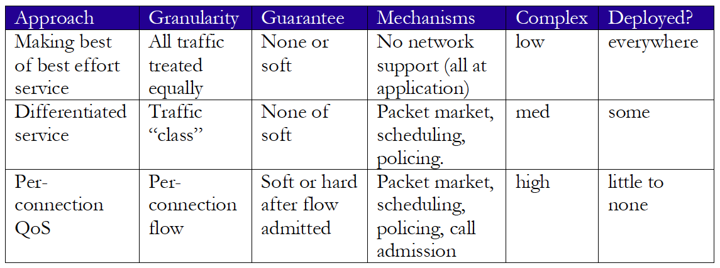
Network support for multimedia

