Slide 1
An Introduction to Software-Defined Networking (SDN)
Zhang Fu

Slide 2
Roadmap
Reviewing traditional networking
Examples for motivating SDN
Enabling networking as developing softwares
SDN architecture
SDN components
Use cases
Challenges and research problems
Little bite of Openflow

Slide 3
Reviewing traditional networking
Network layers
Application layer
Application layer
transport layer
transport layer
network layer
network layer
Data-link layer
Data-link layer
physical layer
physical layer
source
destination
Why layers? Good abstraction, transparency…

Slide 4
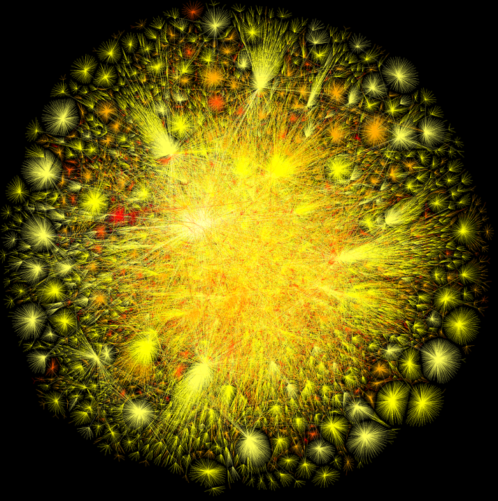
Reviewing traditional networking
Design principles of Internet
  Simple
  Intelligent end-points
  Distributed control
Resulting in huge complex network and hard to manage
Billions of computers
Tens of thousands of ASes
Great business for selling routers

Slide 5
Reviewing traditional networking
Complex routers
Router
Million of lines
of source code
Hard to extend
Software
Tens of billions of transistors
10Gbytes RAM
Power Hungry
Hardware
Vertically integration with many complex functions: OSPF, BGP, multicast, QoS, Traffic Engineering, NAT, firewalls, MPLS…

Slide 6
Roadmap
Reviewing traditional networking
Examples for motivating SDN
Enabling networking as developing softwares
SDN architecture
SDN components
Use cases
Challenges and research problems
Little bite of Openflow

Slide 7
Example: oscillation problem
Link cost equals the amount of carried traffic
A
A
A
A
1
1+e
2+e
0
0
2+e
2+e
0
D
B
D
B
D
B
D
B
0
0
1+e
1
0
0
1+e
1
0
C
e
0
0
1
0
0
1
C
C
1+e
C
1
e
initially
given these costs,
find new routing….
resulting in new costs
given these costs,
find new routing….
resulting in new costs
given these costs,
find new routing….
resulting in new costs
How to achieve optimal routing dynamically?

Slide 8


Example: mitigating attacks
Checking the validity of packets by middle boxes
Internet
How to route the packets through a series of middle boxes?

Slide 9
Roadmap
Reviewing traditional networking
Examples for motivating SDN
Enabling networking as developing softwares
SDN architecture
SDN components
Use cases
Challenges and research problems
Little bite of Openflow

Slide 10
Software development VS Network diagnosing
Software Specification
Networking Specification
Coding
Testing
Coding ?
Testing ?
Various tools for code analysis, verification, debugging
Diagnosing tools? Ping, traceroute, SNMP
The life cycle for network protocols is much longer than that for software
Timely research does not find its way into practice

Slide 11
Network substrate
We want to mimic the success in software industry
  Has simple common substrate
  Building OS on top the hardware, which enables easy deployment of networking applications
SDN
A network in which the control plane is physically separate from the data plane.
A single control plane controls several forwarding devices.

Slide 12
Separate data and control plane
software
software
hardware
hardware
software
software
hardware
hardware

Slide 13
Separate data and control plane
Control plane
software
software
hardware
hardware
software
software
hardware
hardware

Slide 14
Separate data and control plane
Control plane
hardware
hardware
hardware
hardware

Slide 15
Roadmap
Reviewing traditional networking
Examples for motivating SDN
Enabling networking as developing softwares
SDN architecture
SDN components
Use cases
Challenges and research problems
Little bite of Openflow

Slide 16
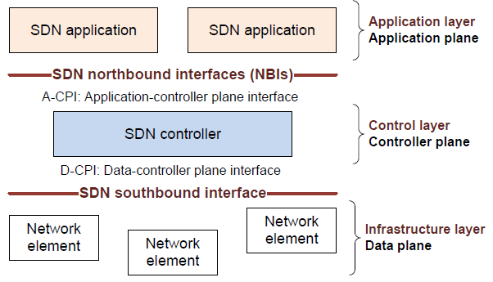
SDN architecture

Slide 17
SDN architecture
The data plane consists of network elements, which expose their capabilities to the control plane via southbound interface
The SDN applications are in the application plane and communicate their network requirements toward the control plane via northbound interface
The control plane sits in the middle
  translate the applications’ requirements and exerts low-level control over the network elements
  Provide network information to the applications
  Orchestrate different applications

Slide 18
Roadmap
Reviewing traditional networking
Examples for motivating SDN
Enabling networking as developing softwares
SDN architecture
SDN components
Use cases
Challenges and research problems
Little bite of Openflow

Slide 19
Data-plane
Data sources and sinks
Traffic forwarding/processing engine
  May have the ability to handle some types of protocols
Provide interfaces communicating to the control plane
  Programmatic control of all functions offered by the network element
  Capability advertisement
  Event notification

Slide 20
Control-plane
Logically centralized
Core functionality
  Topology and network state information
  Device discovery
  Path computation
  Security mechanism
Coordination among different controllers
Interfaces to the application plane

Slide 21
Application-plane
Applications specify the resources and behaviors required from the network, with the context of business and policy agreement
It may need to orchestrate multiple-controllers to achieve the objectives
Programming languages help developing applications, e.g. Pyretic, FatTire,etc.

Slide 22
Roadmap
Reviewing traditional networking
Examples for motivating SDN
Enabling networking as developing softwares
SDN architecture
SDN components
Use cases
Challenges and research problems
Little bite of Openflow

Slide 23
Use cases
Traffic engineering
Mobility and wireless
Security
Data center networking

Slide 24
Example: routing
Controller:
Find path <a,b>,
set QoS requirements,
Commands to devices
Devices:
Configure hardware,
Installing forwarding rules
App: build path
<a,b,QoS>
Internet

Slide 25
Roadmap
Reviewing traditional networking
Examples for motivating SDN
Enabling networking as developing softwares
SDN architecture
SDN components
Use cases
Challenges and research problems
Little bite of Openflow

Slide 26
Challenges and research problems
Switch design
  Find common abstraction
  Flow table capacity
  Throughput
Controller platform
  Distributed vs centralized
  Flexibility
Dependability and security
  Attack to data plane
  Attack to control plane
  Trust, privacy issues

Slide 27
Roadmap
Reviewing traditional networking
Examples for motivating SDN
Enabling networking as developing softwares
SDN architecture
SDN components
Use cases
Challenges and research problems
Little bite of Openflow

Slide 28
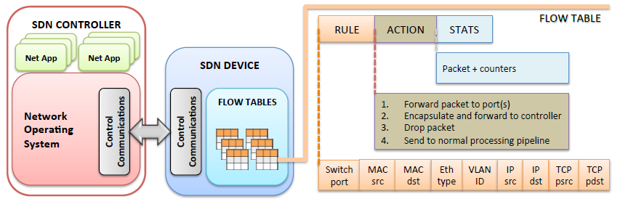
Openflow
An southbound standard:
Provide specification to implement Openflow-enabled forwarding devices
Communication channel between data and control plane

Slide 29
Mininet
Provide tools to create virtualized network with OVS
CLI for manipulating network dynamically
Virtualized hosts
CONTROLLER
Openflow traffic
App
h
Virtual
Switch
Virtual
Switch
h
h
h

Slide 30
References
"The road to SDN" http://queue.acm.org/detail.cfm?ref=rss&id=2560327
Kreutz, D., Ramos, F. M., Verissimo, P. E., Rothenberg, C. E., Azodolmolky, S., & Uhlig, S. (2015). Software-defined networking: A comprehensive survey.proceedings of the IEEE, 103(1), 14-76.
“SDN Architecture 1.0 - Open Networking Foundation”, https://www.opennetworking.org/images/stories/downloads/sdn-resources/technical-reports/TR_SDN_ARCH_1.0_06062014.pdf
Openflow specification v1.0, https://www.opennetworking.org/images/stories/downloads/sdn-resources/onf-specifications/openflow/openflow-spec-v1.0.0.pdf
Mininet, mininet.org
POX controller, http://www.noxrepo.org/

