Slide 1
Welcome this Monday to …
an afternoon with a lecture and workshop on scientific reading, writing and reviewing
Before the first language lecture on Sept, 8th, please read the three survey examples that can be found on the course homepage!
You do not have to read them in detail. Rather, get acquainted with them, browse them and pay attention to how they are structured. They will be discussed and further analysed in class.

Slide 2
Three diverse texts
All examples of survey papers
Model-Based Evaluation: From Dependability to Security by Nicol et al Prudent Practices for Designing Malware Experiments: Status Quo and Outlook by Rossow et al Little words can make a big difference for text classification by Riloff
Introducing scientific writing, function, structure and organization of survey papers
How to work with reviewing strategies

Slide 3
Analyses of
Text structure, logic, text building, general to specific, topic sentences
Definitions and explanations
Problem, process, and solution, argumentation
Data commentary
Style and language
In-text referencing
Summary writing strategies, paraphrasing
Notes:
In the workshop, analyses of text parts
The information flow and logic in the text
Based on Feak and Swales - analyses through a set of examples from Nicol et al, to get an in-depth understanding of the text

Slide 4
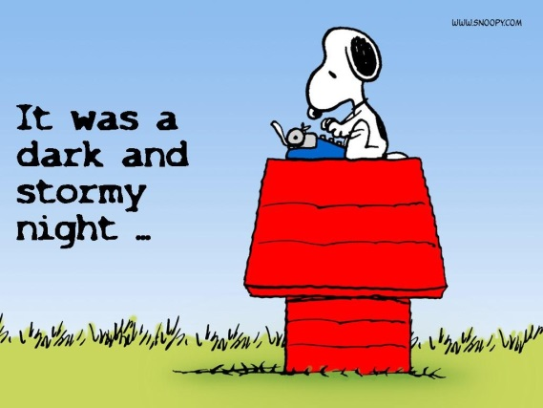
Finally….
In this course a large number of teachers and TAs are involved. We are all here to help you improve your writing, reading and reviewing skills, something that is of value in a much wider context than computer science.
Do take advantage of this opportunity!
Looking forward seeing you Monday 8 Sept in EB!

