Slide 1
Introduction to Programming in Haskell
Chalmers & GU
Emil Axelsson and John Hughes
(with thanks to Koen Lindström Claessen)
Notes:
Welcome to the functional programming course – very exciting subject at the heart of CS.
Many have never programmed before: in for a treat, learning how to make the computer do what you say
Many have already done some programming: much use for knowledge, but will learn to program in a completely new way.
All will learn a great deal from this course.

Slide 2
Programming
Exciting subject at the heart of computing
Never programmed?
  Learn to make the computer obey you!
Programmed before?
  Lucky you! Your knowledge will help a lot...
  ...as you learn a completely new way to program
Everyone will learn a great deal from this course!

Slide 3
Goal of the Course
Start from the basics, after Datorintroduktion
Learn to write small-to-medium sized programs in Haskell
Introduce basic concepts of computer science

Slide 4
The Flow
Do not break the flow!
You prepare
in advance
I explain
in lecture
Tuesdays,Fridays
You learn
with exercises
Mondays
You put to practice
with lab assignments
Submit end of each week

Slide 5
Exercise Sessions
Mondays
  Group rooms
Come prepared
Work on exercises together
Discuss and get help from tutor
  Personal help
Make sure you understand this week’s things before you leave

Slide 6
Lab Assignments
Work in pairs
  (Almost) no exceptions!
Lab supervision
  Book a time in advance
  One time at a time!
Start working on lab when you have understood the matter
Submit end of each week
Feedback
  Return: The tutor has something to tell you; fix and submit again
  OK: You are done
bring pen and paper
even this week!

Slide 7
Getting Help
Weekly group sessions
  personal help to understand material
Lab supervision
  specific questions about programming assignment at hand
Discussion forum
  general questions, worries, discussions

Slide 8
Assessment
Written exam (4.5 credits)
  Consists of small programming problems to solve on paper
  You need Haskell ”in your fingers”
Course work (3 credits)
  Complete all labs successfully

Slide 9
A Risk
7 weeks is a short time to learn programming
So the course is fast paced
  Each week we learn a lot
  Catching up again is hard
So do keep up!
  Read the lecture notes each week
  Make sure you can solve the problems
  Go to the weekly exercise sessions
  From the beginning

Slide 10
Course Homepage
The course homepage will have ALL up-to-date information relevant for the course
  Schedule
  Lab assignments
  Exercises
  Last-minute changes
  (etc.)
Or go via the student portal
http://www.cse.chalmers.se/edu/course/TDA555/

Slide 11
Software
Software = Programs + Data

Slide 12
Data
Data is any kind of storable information. Examples:
Numbers
Letters
Email messages
Songs on a CD
Maps
Video clips
Mouse clicks
Programs

Slide 13
Programs
Programs compute new data from old data.
Example: Starcraft II computes a sequence of screen images and sounds from a sequence of mouse clicks.

Slide 14
Building Software Systems
A large system may contain many millions of lines of code.
Software systems are among the most complex artefacts ever made.
Systems are built by combining existing components as far as possible.
Volvo buys engines from Mitsubishi.
Facebook buys video player from Adobe

Slide 15
Programming Languages
Programs are written in programming languages.
There are hundreds of different programming languages, each with their strengths and weaknesses.
A large system will often contain components in many different languages.

Slide 16
Programming Languages
which language should we teach?
Scheme
C
Lisp
BASIC
C++
Haskell
Java
C#
ML
Python
JavaScript
Curry
csh
O’CaML
Perl
bash
Erlang
Ruby
Prolog
Lustre
Mercury
PostScript
VHDL
Esterel
PDF
SQL
Verilog
Notes:
16

Slide 17
Programming Language Features
dynamically typed
pure functions
higher-order functions
statically typed
type inference
immutable datastructures
real-time
polymorphism
overloading
concurrency
high performance
parameterized types
lazy
distribution
virtual machine
Java
reflection
type classes
object oriented
compiler
interpreter
meta-programming
Haskell
unification
backtracking
C
Notes:
17

Slide 18
Teaching Programming
Give you a broad basis
  Easy to learn more programming languages
  Easy to adapt to new programming languages
    Haskell is defining state-of-the-art in programming language development
  Appreciate differences between languages
  Become a better programmer!

Slide 19
”Functional Programming”
Functions are the basic building blocks of programs
Functions are used to compose these building blocks into larger programs
A (pure) function computes results from arguments – consistently the same

Slide 20
Industrial Uses of Functional Languages
Intel (microprocessor verification)
Hewlett Packard (telecom event correlation)
Ericsson (telecommunications)
Jeppesen (air-crew scheduling)
Facebook (chat engine)
Credit Suisse (finance)
Barclays Capital (finance)
Hafnium (automatic transformation tools)
Shop.com (e-commerce)
Motorola (test generation)
Thompson (radar tracking)
Microsoft (F#)
Jasper (hardware verification)
And many more!

Slide 21
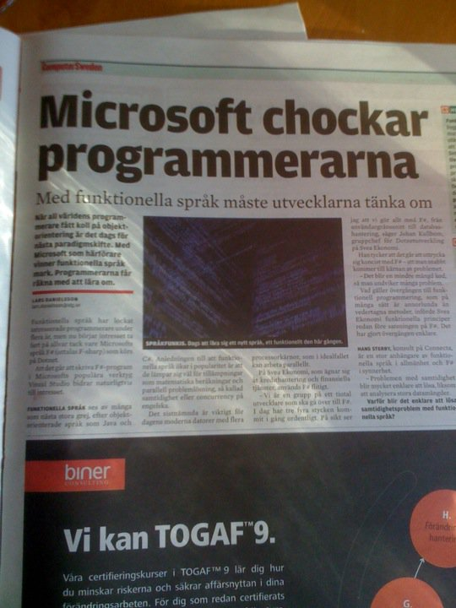
Computer Sweden, 2010

Slide 22



Keynotes at Developer Conferences
Don Syme
Eclipse Summit Europé 2009
  Taking Functional Programming into the Mainstream
YOW! 2011, Australia
  Escape From the Ivory Tower: The Haskell Journey
Qcon 2012, San Francisco
  Testing the Hard Stuff and Staying Sane
Simon Peyton Jones
John Hughes

Slide 23
Why Haskell?
Haskell is a very high-level language (many details taken care of automatically).
Haskell is expressive and concise (can achieve a lot with a little effort).
Haskell is good at handling complex data and combining components.
Haskell is not a particularly high-performance language (prioritise programmer-time over computer-time).

Slide 24
Cases and Recursion

Slide 25
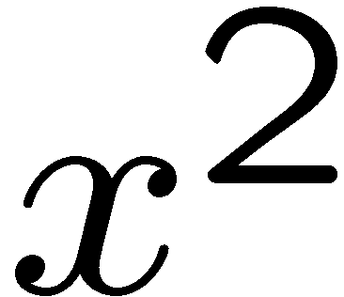
Example: The squaring function
Example: a function to compute
-- sq x returns the square of x
sq :: Integer -> Integer
sq x = x * x
Notes:
25

Slide 26
Evaluating Functions
To evaluate sq 5:
  Use the definition—substitute 5 for x throughout
    sq 5 = 5 * 5
  Continue evaluating expressions
    sq 5 = 25
Just like working out mathematics on paper
sq x = x * x
Notes:
26

Slide 27
Example: Absolute Value
Find the absolute value of a number
-- absolute x returns the absolute value of x
absolute :: Integer -> Integer
absolute x = undefined
Notes:
27

Slide 28
Example: Absolute Value
Find the absolute value of a number
Two cases!
  If x is positive, result is x
  If x is negative, result is -x
Programs must often choose between alternatives
-- absolute x returns the absolute value of x
absolute :: Integer -> Integer
absolute x | x > 0 = undefined
absolute x | x < 0 = undefined
Think of the cases! These are guards
Notes:
28

Slide 29
Example: Absolute Value
Find the absolute value of a number
Two cases!
  If x is positive, result is x
  If x is negative, result is -x
-- absolute x returns the absolute value of x
absolute :: Integer -> Integer
absolute x | x > 0 = x
absolute x | x < 0 = -x
Fill in the result in each case
Notes:
29

Slide 30
Example: Absolute Value
Find the absolute value of a number
Correct the code
-- absolute x returns the absolute value of x
absolute :: Integer -> Integer
absolute x | x >= 0 = x
absolute x | x < 0 = -x
>= is greater than or equal, ¸
Notes:
30

Slide 31
Evaluating Guards
Evaluate absolute (-5)
  We have two equations to use!
  Substitute
    absolute (-5) | -5 >= 0 = -5
    absolute (-5) | -5 < 0 = -(-5)
absolute x | x >= 0 = x
absolute x | x < 0 = -x
Notes:
31

Slide 32
Evaluating Guards
Evaluate absolute (-5)
  We have two equations to use!
  Evaluate the guards
    absolute (-5) | False = -5
    absolute (-5) | True = -(-5)
Discard this equation
Keep this one
absolute x | x >= 0 = x
absolute x | x < 0 = -x
Notes:
32

Slide 33
Evaluating Guards
Evaluate absolute (-5)
  We have two equations to use!
  Erase the True guard
    absolute (-5) = -(-5)
absolute x | x >= 0 = x
absolute x | x < 0 = -x
Notes:
33

Slide 34
Evaluating Guards
Evaluate absolute (-5)
  We have two equations to use!
  Compute the result
    absolute (-5) = 5
absolute x | x >= 0 = x
absolute x | x < 0 = -x
Notes:
34

Slide 35
Notation
We can abbreviate repeated left hand sides
Haskell also has if then else
absolute x | x >= 0 = x
absolute x | x < 0 = -x
absolute x | x >= 0 = x
| x < 0 = -x
absolute x = if x >= 0 then x else -x
Notes:
35

Slide 36
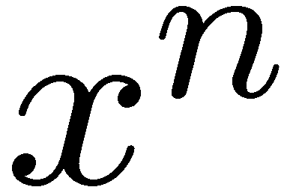
Example: Computing Powers
Compute (without using built-in x^n)
Notes:
36

Slide 37
Example: Computing Powers
Compute (without using built-in x^n)
Name the function
power
Notes:
37

Slide 38
Example: Computing Powers
Compute (without using built-in x^n)
Name the inputs
power x n = undefined
Notes:
38

Slide 39
Example: Computing Powers
Compute (without using built-in x^n)
Write a comment
-- power x n returns x to the power n
power x n = undefined
Notes:
39

Slide 40
Example: Computing Powers
Compute (without using built-in x^n)
Write a type signature
-- power x n returns x to the power n
power :: Integer -> Integer -> Integer
power x n = undefined
Notes:
40

Slide 41
How to Compute power?
We cannot write
  power x n = x * … * x
n times
Notes:
41

Slide 42
A Table of Powers
Each row is x* the previous one
Define power x n to compute the nth row
n
power x n
0
1
1
x
2
x*x
3
x*x*x
Notes:
42

Slide 43
A Definition?
power x n = x * power x (n-1)
Testing:
  Main> power 2 2
  ERROR - stack overflow
Why?
Notes:
43

Slide 44
A Definition?
Testing:
  Main> power 2 2
  Program error: pattern match failure: power 2 0
power x n | n > 0 = x * power x (n-1)
Notes:
44

Slide 45
A Definition?
First row of the table
Testing:
  Main> power 2 2
  4
power x 0 = 1
power x n | n > 0 = x * power x (n-1)
The BASE CASE
Notes:
45

Slide 46
Recursion
First example of a recursive function
  Defined in terms of itself!
Why does it work? Calculate:
  power 2 2 = 2 * power 2 1
  power 2 1 = 2 * power 2 0
  power 2 0 = 1
power x 0 = 1
power x n | n > 0 = x * power x (n-1)
Notes:
46

Slide 47
Recursion
First example of a recursive function
  Defined in terms of itself!
Why does it work? Calculate:
  power 2 2 = 2 * power 2 1
  power 2 1 = 2 * 1
  power 2 0 = 1
power x 0 = 1
power x n | n > 0 = x * power x (n-1)
Notes:
47

Slide 48
Recursion
First example of a recursive function
  Defined in terms of itself!
Why does it work? Calculate:
  power 2 2 = 2 * 2
  power 2 1 = 2 * 1
  power 2 0 = 1
power x 0 = 1
power x n | n > 0 = x * power x (n-1)
No circularity!
Notes:
48

Slide 49
Recursion
First example of a recursive function
  Defined in terms of itself!
Why does it work? Calculate:
  power 2 2 = 2 * power 2 1
  power 2 1 = 2 * power 2 0
  power 2 0 = 1
power x 0 = 1
power x n | n > 0 = x * power x (n-1)
The STACK
Notes:
49

Slide 50
Recursion
Reduce a problem (e.g. power x n) to a smaller problem of the same kind
So that we eventually reach a ”smallest” base case
Solve base case separately
Build up solutions from smaller solutions
Powerful problem solving strategy
in any programming language!
Notes:
50

Slide 51
Replication
Replicate a given word n times
repli :: Integer -> String -> String
repli ...
GHCi> repli 3 “apa”
“apaapaapa”

Slide 52
An Answer
repli :: Integer -> String -> String
repli 1 s = s
repli n s | n > 1 = s ++ repli (n-1) s
repli :: Integer -> String -> String
repli 1 s = s
repli n s | n > 1 = s ++ repli (n-1) s
repli :: Integer -> String -> String
repli 0 s = “”
repli n s | n > 0 = s ++ repli (n-1) s
make base case as simple as possible!

Slide 53
Counting the regions
n lines. How many regions?
remove one line ...
problem is easier!
when do we stop?

Slide 54
A Solution
Don't forget a base case
regions :: Integer -> Integer
regions 1 = 2
regions n | n > 1 = regions (n-1) + n

Slide 55
A Better Solution
Always pick the base case as simple as possible!
regions :: Integer -> Integer
regions 0 = 1
regions n | n > 0 = regions (n-1) + n

Slide 56
Group
Divide up a string into groups of length n
group :: ...
group n s = ...
LIVE CODING!!!

Slide 57
Types
What are the types of repli and group?
repli :: Integer -> String -> String
group :: Integer -> String -> [String]
repli :: Integer -> [a] -> [a]
group :: Integer -> [a] -> [[a]]

Slide 58
How many ways are there to choose k of n elements?
e.g.
2 of 4?
6!
LIVE CODING!!!

Slide 59
There is no book!
If you want a book anyway, try:
The Craft of Functional Programming, by Simon Thompson. Available at Cremona.

Slide 60
Course Web Pages
Updated almost daily!
URL:
http://www.cse.chalmers.se/edu/course/TDA555/
These slides
Schedule
Practical information
Assignments
Discussion board

