Slide 1
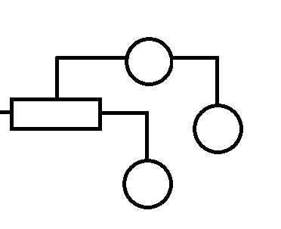
Mining High-Speed Data Streams
Hoeffding Trees and Very Fast Decision Trees
By: Mikael Weckstén

Slide 2
Introduktion
What is a decision tree
Given n training examples
(x, y) where x is a vector
i.e (x1, x2, x3... xi, y)
Produce a model
y = f(x)

Slide 3
Introduktion cont.
How is it structured
Each node tests a attribute
Each branch is the outcome of that test
Each leaf holds a class label

Slide 4
Decision trees
ID3
C4.5
CART
SLIQ SPRINT
Needs to look at each value several times
Holds all examples in memory Writes to disk Reads several times
Notes:
ID3 – Simultant i minnet, limited by number of examples
SLIQ – Stored on disk, learn by repeatedly reading them in sequentially (once per level in the tree)

Slide 5
Resources
What resources does this take
Time
Memory
Sample Size

Slide 6
Resources
What resources does this take
Time
Reading several times
Memory
Sample Size

Slide 7
Resources
What resources does this take
Time
Memory
Storing all examples
Sample Size

Slide 8
Resources
What resources does this take
Time
Memory
Sample Size
Not enough samples
Often not a problem today, especially not with data streams

Slide 9
Hoeffding trees resources
Resources
Read once
Total memory is:
O(ldvc)

Slide 10
Hoeffding trees resources
Resources
Read once
Total memory is:
O(ldvc)
Where:
l: number of leaves
d: number of attributes
v: max no. values per attribute
c: number of classes

Slide 11
Hoeffding tree algorithm
Start with a root node
for all x in X:
sort x to leaf l
increase seen x in leaf l
set l to majority x seen
if l is not all same class
compute G(x_{i})
x_{a} = best result
x_{b} = second best result
compute ε
if ΔG > ε
split on x_{a}and replace l with node
add leaves and initilize them

Slide 12
Hoeffding trees
Building a tree:
Comparing for split
G(x) = heuristic messaure
After n examples, G(X_{a}) is the highest observed G, G(X_{b}) is the second-best attribute
ΔG = G(X_{a}) - G(X_{b})
ΔG ≥ 0
Notes:
Heuristic measure = information gain, gini index
I(f) = sum, i=1 to m, f(i)*log2*f(i)

Slide 13
Hoeffding trees
Building a tree:
Comparing for split
If ΔG > ε

Slide 14
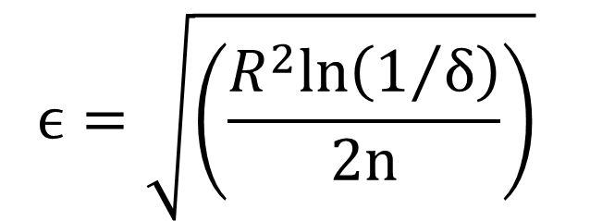
Hoeffding bound
Hoeffding bound:
Is computed on r, which is a real-valued random variable.
We have seen r n independent times and computer their mean r
“Hoeffding bound states that, with probability 1- δ, the true mean of the variable is at least r – ε”
ε is as we know
$$ϵ=\sqrt{\left(\frac{R^{2}ln\left(1/δ\right)}{2n}\right)}$$

Slide 15

Hoeffding bound continued
$$ϵ=\sqrt{\left(\frac{R^{2}ln\left(1/δ\right)}{2n}\right)}$$
R is the range of r
n is the number of independent observations of the variable

Slide 16
Hoeffding trees
Building a tree:
Comparing for split
If ΔG > ε
The Hoeffding bound guarantees that:
ΔG ≥ ΔG > 0
With the probability:
1-δ
Notes:
This means that Xa is the best attribute with the same probability.
This also means in other words that the node needs to accumulate enough examples from the stream until epsilon becomes smaller then the observed delta G
So when delta G is greater then epsilon we split the node using the current best attribute (Xa) and the examples that come after will be passed down to the new leaves.

Slide 17
Comparing DT and HT
Quickly
At most δ/p disagrement
Where:
p = leaf probability
Basically:
More examples are needed the less leafs we have.
If p = 0.01% we can get a disagrement of only 1 % with 725 ex. per node

Slide 18
VFDT improvments
Ties
Very similar attributes can take a long time to be decided among
Set a threshold τ
ΔG < ε < τ
Notes:
Even if the difference is not greater then epsilon we will split as long as epsilon is smaller then the threshold

Slide 19
VFDT improvments
Memory
Deactivate least promising leaf
The leaf with the lowest plel
Where:
el is observed error rate
pl is probability that a arbirtary example will fall into leaf l
Notes:
Freed memory, save a number to keep track of deactivated leaf, can switch out active leaves with deactivated if they are more promising by scanning at regular intervals

Slide 20
VFDT improvments
Poor attributes
When a attributes G and the best one becomes greater than ε we can drop it

Slide 21
VFDT improvments
Initilization
Initilize the VFDT tree with a tree created by conventional RAM-based learner
Less examples are needed to reach the same accuracies

Slide 22
VFDT improvments
Rescans
Re-use examples if there is time or there is there is very few examples

Slide 23
VFDT improvments
G computation
Stop recomputing G for every new example
Set threshold of number of new examples before G is recalculated
This will affect δ, so we need to choose a corresponding larger δ than the target

Slide 24
Emperical study

Slide 25
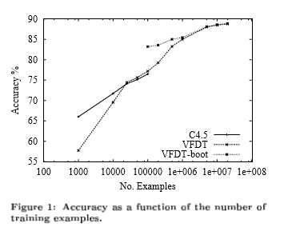

Slide 26
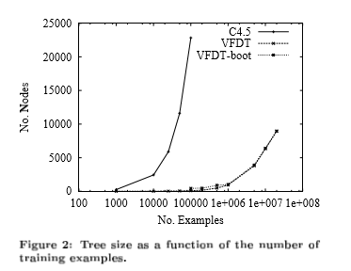

Slide 27
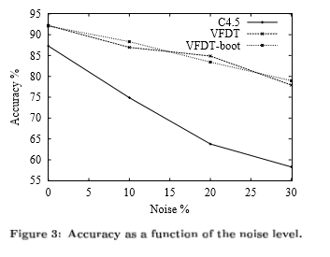

Slide 28
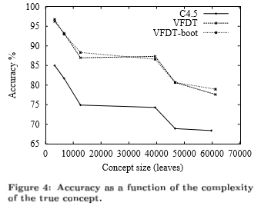

Slide 29
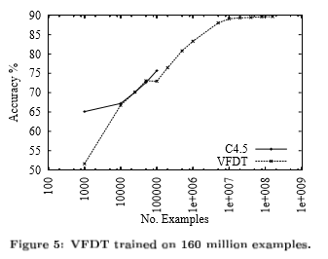

Slide 30
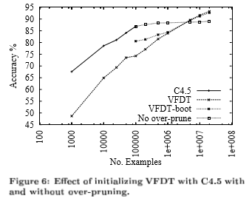

Slide 31
