Slide 1
Stream-Based Electricity Load Forecast
Authors:
Joao Gama
Pedro Pereira Rodrigues
Presented by:
Viktor Botev

Slide 2
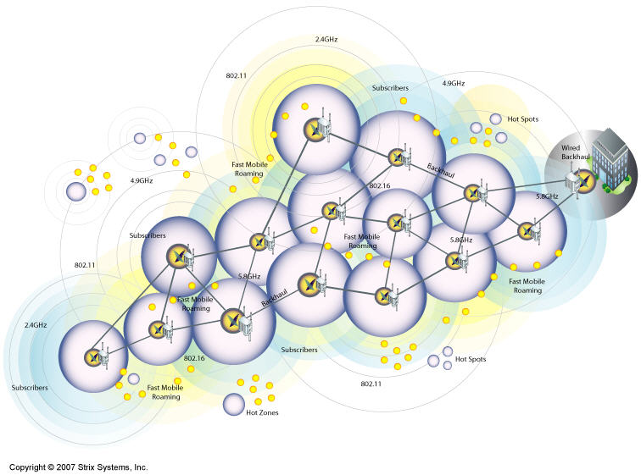
Problem area
Sensor data received at high speed
Dynamic and non-stationary environment
Companies buy and cell energy based on load profiles and forecasts
Load forecast in SCADA/DMS system help find critical points

Slide 3
Existing methods
Forecasting using Adaptive neural networks (ANN)
Static iteration training for ANN is not applicable for high speed data
Predictive systems over thousands of sensor

Slide 4
Solution presented
Incremental Clustering (Variable Clustering)
Incremental Learning of ANN
Other techniques for preprocessing and postprocessing
Data aggregation engine
Kalman Filter

Slide 5
Technical goal
Incremental system to continuously predict in real time the electricity load demand
At time t:
receive data from all sensors
predict the sensor value of each sensor for time t+k
back propagate the measurement corresponding to the prediction at t-k

Slide 6
Preprocessing
Server based approach for:
Gathering data from sensors
Aggregation
Synchronization
< date, time, sensor,measure, value >

Slide 7
Clustering of Data Streams
Using ODAC algorithm (Online Divisive-Agglomerative Clustering)
based on dissimilarities between streams
Similarity equation
Pearson’s correlation coeﬃcient
Guarantees
Hoeﬀding bounds

Slide 8
Clustering of Data Streams
Building a clustering hierarchy
Measures taken for relax the assumption that
” In a hierarchical structure of clusters, considering that the data streams are produced by a stable concept, the intra-cluster dissimilarity should decrease with each split”

Slide 9
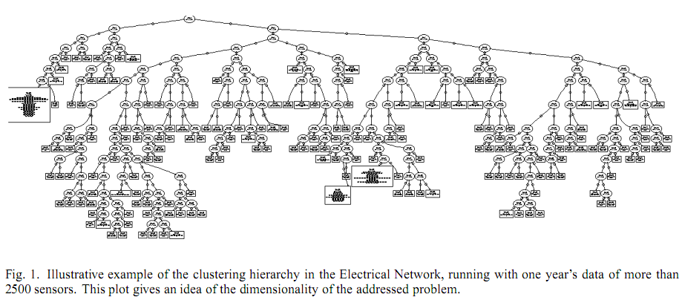
Clustering of Data Streams

Slide 10
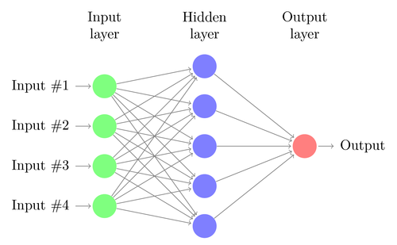
MLP ANN predictive model
Time horizons
1 hour
24 hours
168 hours
Muti-layered perceptron
10 input neurons
4 hidden neurons
1 linear output
Input vector
{1, 2, 3, 4}
{7, 14}
4 cyclic variables (sin + cos)

Slide 11
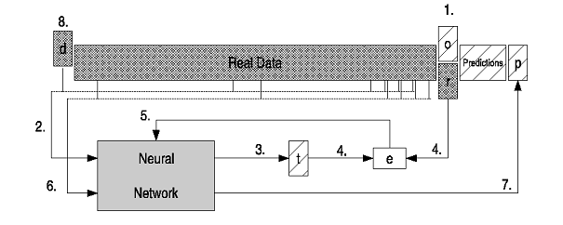
MLP ANN predictive model How it works?
Read Buffer (size is defined by experts)
Structure – input into buffer, real value and old prediction comparison, input the ANN, store predictions, delete from buffer

Slide 12
MLP ANN problems and solutions
Slow learning rate
Propagating an example only once
Overfitting
Dual perturb and combine algorithm
Processing one example several times
Adding noise to the examples
Avaraging all the predictions produced
(Pesonal opinion is that the main reason for dealing with overfitting is convincing the companies)

Slide 13
Improving predictions
Kalman Filter
Simple one dimensional Kalman Filter
Using for combining inexact measurement with inexact predictions
Common technique is when at time t to predict value at time t-k

Slide 14
Online learning and preprocessing
Missing data
Accomodate homologue technique
Problems
When sensors do not send data for a long time
Consequences
Overfitting
Concept damaging

Slide 15
Evaluation and results
Test setup
2500 sensors
565 High Tension
1629 Mean Tension
299 Power Transformers
Measure of interest
Current intensity
Data
Gathered data for 3 years in an hourly bases
Quality measures of the forecasts
MAPE (Mean Absolute Percentage Error)
MEDAPE (Median Absolute Percentage Error)
Windows used
Weekly
Monthly

Slide 16
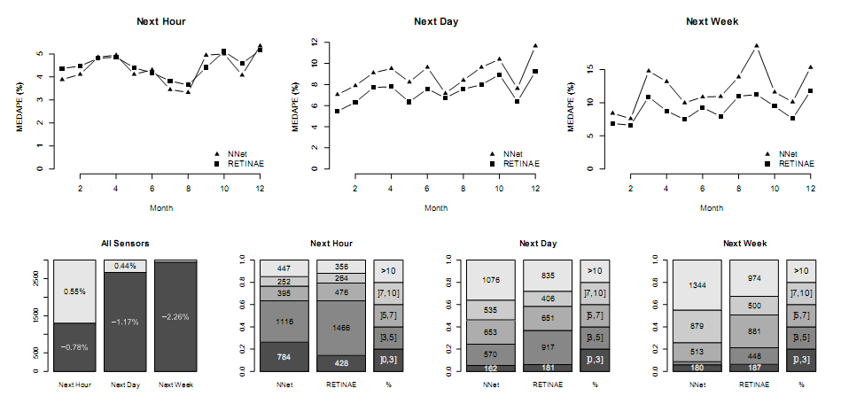
Evaluation and results

Slide 17
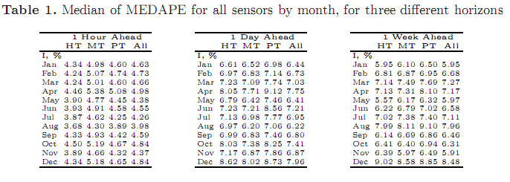
Evaluation and results

Slide 18
Summary
We have discussed a system that can deal with large number of sensor data and predict their values within a given time horizon
The predictive model discussed eliminates the need for batch clustering and periodic ANN training
Future work could be adding more information in the model as temperature, holiday, and special events.

Slide 19
Thank you

