Slide 1


An overview of Data Streaming
ICT Support for Adaptiveness and (Cyber)Security
in the Smart Grid DAT285B
Vincenzo Gulisano
vinmas@chalmers.se (room 5107)
Chalmers University
of technology

Slide 2
Agenda
Introduction
Motivation and System Model
Sample Data Streaming application
Evolution of Stream Processing Engines
Challenges in the context of Smart Grids

Slide 3
Agenda
Introduction
Motivation and System Model
Sample Data Streaming application
Evolution of Stream Processing Engines
Challenges in the context of Smart Grids

Slide 4
Database vs. Data Streaming
Problem:
  James travels by car from A to B
  His grandmother is worried, she wants to know if he exceeds the speed limit
How will the “database” and the “data streaming” grandmothers do this?

Slide 5
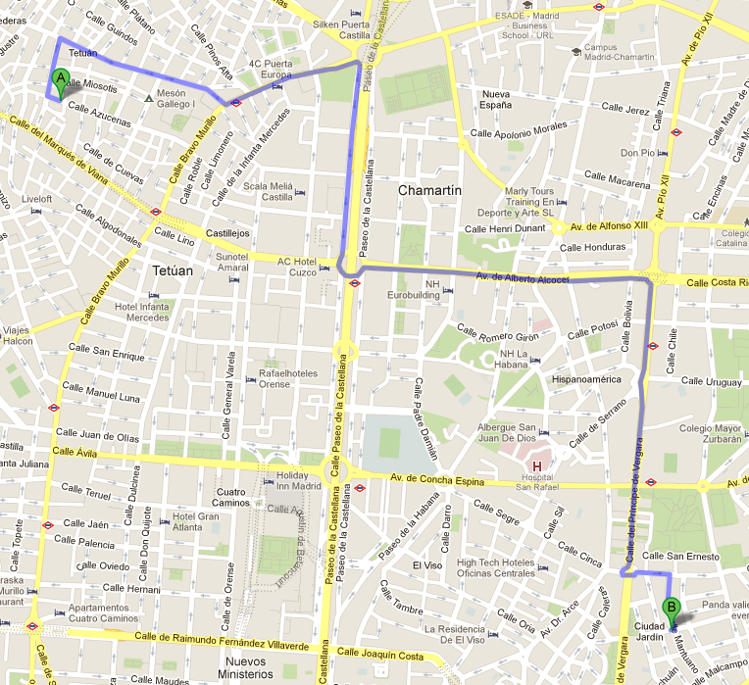

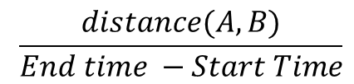
Database vs. Data Streaming
Start time
Position A
End time
Position B
$$\frac{distance(A,B)}{End time −Start Time}$$
Database
grandmother

Slide 6
Database vs. Data Streaming
First the data, then the query
Precise result
Need to store information
Database
grandmother

Slide 7
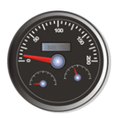
Database vs. Data Streaming
First the query, then the data
“Continuous” result
No need to store information
Data streaming
grandmother

Slide 8
Agenda
Introduction
Motivation and System Model
Sample Data Streaming application
Evolution of Stream Processing Engines
Challenges in the context of Smart Grids

Slide 9
Motivation
    Applications such as:
      Sensor networks
      Network Traffic Analysis
      Financial tickers
      Transaction Log Analysis
      Fraud Detection
    Require:
      Continuous processing of data streams
      Real Time Fashion

Slide 10
Motivation
    Store and process is not feasible
      high-speed networks, nanoseconds to handle a packet
      ISP router: gigabytes of headers every hour,…
    Data Streaming:
      In memory
      Bounded resources
      Efficient one-pass analysis

Slide 11
Motivation
DBMS vs. DSMS
2 Query
3 Query
results
Query Processing
Query Processing
1 Data
Main Memory
Main Memory
Query
results
Data
Continuous
Query
Disk

Slide 12
System Model
Data Stream: unbounded sequence of tuples
  Example: Call Description Record (CDR)
Field | Field
Caller | text
Callee | text
Time (secs) | int
Price (€) | double
A | B | 8:00 | 3
C | D | 8:20 | 7
A | E | 8:35 | 6
time

Slide 13
System Model
Operators:
OP
    Stateless
    1 input tuple
    1 output tuple
OP
    Stateful
    1+ input tuple(s)
    1 output tuple

Slide 14
System Model
Stateless Operators
Map: transform tuples schema
Example: convert price € → $
Filter: discard / route tuples
Example: route depending on price
Union: merge multiple streams
(sharing the same schema)
Example: merge CDRs from
different sources
Map
Filter
…
Union
…

Slide 15
System Model
Stateful Operators
Aggregate: compute aggregate
functions (group-by)
Example: compute avg. call duration
Equijoin: match tuples from 2 streams
(equality predicate)
Example: match CDRs with same price
Cartesian Product: merge tuples from
2 streams (arbitrary predicate)
Example: match CDRs with prices in the
same range
Aggregate
Equijoin
2
Cartesian Product
2

Slide 16
System Model
Infinite sequence of tuples / bounded memory
  → windows
Example: 1 hour windows
time
[8:00,9:00)
[8:20,9:20)
[8:40,9:40)

Slide 17
System Model
Infinite sequence of tuples / bounded memory
  → windows
Example: count tuples - 1 hour windows
8:05
8:15
8:22
8:45
9:05
time
[8:00,9:00)
[8:20,9:20)
Output: 4

Slide 18
Agenda
Introduction
Motivation and System Model
Sample Data Streaming application
Evolution of Stream Processing Engines
Challenges in the context of Smart Grids

Slide 19
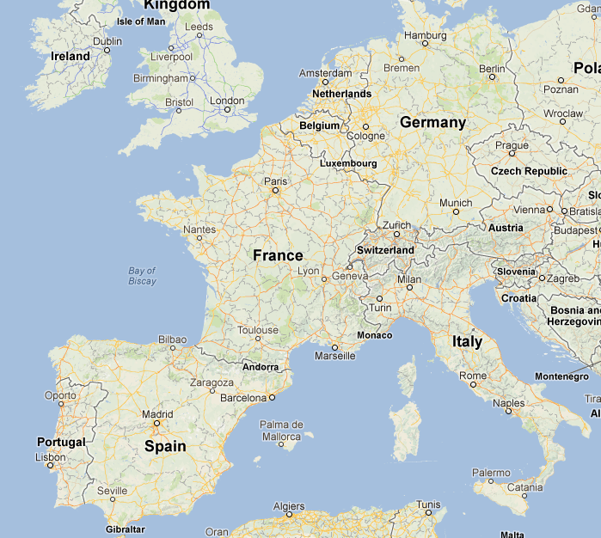

Continuous Query Example
Fraud detection, High Mobility
  Spot mobile phone whose space and time distance between two consecutive calls is suspicious
Phone X
at 12:03
CLONED NUMBER !
Phone X
at 12:00

Slide 20
High Mobility Continuous Query (1/2)
Field
Caller
Callee
Time
Duration
Price
Caller_Position
Callee_Position
Field
Caller
Callee
Time
Duration
Caller_Position
Callee_Position
Field
Phone number
Start time
End time
Position
Field
Phone number
Start time
End time
Position
Map
Map
Create separate
tuple for caller
Field
Phone number
Start time
End time
Position
Union
Input Stream
Map
Remove fields
that are not needed
Merge tuples
Create separate
tuple for callee

Slide 21
High Mobility Continuous Query (2/2)
Field
Phone number
Start time
End time
Position
Field
Phone number
Time
Speed
Field
Phone number
Time
Speed
Union
Aggregate
Filter
…
Merge tuples
For each consecutive pair of calls
referring to the same number
compute speed
Forward tuples with speed
exceeding a given threshold
Window type: tuple based
Window size: 2
Window Advance: 1

Slide 22
Agenda
Introduction
Motivation and System Model
Sample Data Streaming application
Evolution of Stream Processing Engines
Challenges in the context of Smart Grids

Slide 23
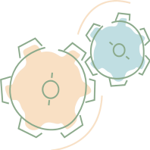

Centralized SPEs

Slide 24
Distributed SPEs
Inter-operator parallelism

Slide 25
Parallel SPEs
Intra-operator parallelism
…
…
Over-provisioning or under-provisioning?

Slide 26
Elastic SPEs
Scale up
…
…
+
+

Slide 27
Elastic SPEs
Scale down
…
…
-
-

Slide 28
Agenda
Introduction
Motivation and System Model
Sample Data Streaming application
Evolution of Stream Processing Engines
Challenges in the context of Smart Grids

Slide 29
Challenges in the context of Smart Grids
Process energy consumption data
  Build profiles and spot deviations
  Predictions / forecasts about consumption

Slide 30
Challenges in the context of Smart Grids
Process control events
  Spot possible threats
  Monitor the devices status

Slide 31
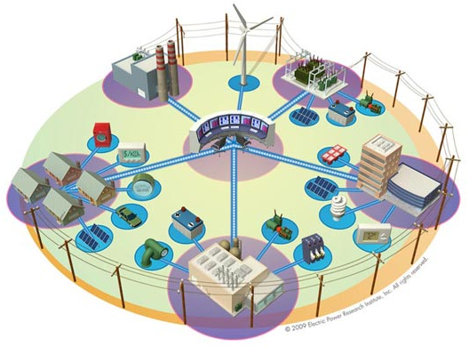
Challenges in the context of Smart Grids
How to process
the information?
Centralized

Slide 32
Challenges in the context of Smart Grids
How to process
the information?
Distributed
(In-network aggregation)

Slide 33

Challenges in the context of Smart Grids
How to deal with
constrained/limited
resources?
What if this device
is running out of
battery?

Slide 34
An overview of Data Streaming
Questions?

Slide 35
Bibliography
  Brian Babcock, Shivnath Babu, Mayur Datar, Rajeev Motwani, and Jennifer Widom. Models and issues in data stream systems. In Proceedings of the twenty-first ACM SIGMOD-SIGACT-SIGART symposium on Principles of database systems, PODS ’02, New York, NY, USA, 2002. ACM.
  Brian Babcock, Shivnath Babu, Mayur Datar, Rajeev Motwani, and Jennifer Widom. Models and issues in data stream systems. In Proceedings of the twenty-first ACM SIGMOD-SIGACT-SIGART symposium on Principles of database systems, PODS ’02, New York, NY, USA, 2002. ACM.
  Michael Stonebraker, Uˇgur Çetintemel, and Stan Zdonik. The 8 requirements of realtime stream processing. SIGMOD Rec., 34(4), December 2005.
  Nesime Tatbul. QoS-Driven load shedding on data streams. In Proceedings of the Worshops XMLDM, MDDE, and YRWS on XML-Based Data Management and Multimedia Engineering-Revised Papers, EDBT ’02, London, UK, UK, 2002. Springer-Verlag.
  Arvind Arasu, Shivnath Babu, and Jennifer Widom. The CQL continuous query language: semantic foundations and query execution. The VLDB Journal, 15(2), June 2006.
  Daniel J. Abadi, Don Carney, Ugur Cetintemel, Mitch Cherniack, Christian Convey, Sangdon Lee, Michael Stonebraker, Nesime Tatbul, and Stan Zdonik. Aurora: a new model and architecture for data stream management. The VLDB Journal, 12(2), August 2003.
  Arvind Arasu, Shivnath Babu, and Jennifer Widom. The CQL continuous query language: semantic foundations and query execution. The VLDB Journal, 15(2), June 2006.
  Daniel J. Abadi, Don Carney, Ugur Cetintemel, Mitch Cherniack, Christian Convey, Sangdon Lee, Michael Stonebraker, Nesime Tatbul, and Stan Zdonik. Aurora: a new model and architecture for data stream management. The VLDB Journal, 12(2), August 2003.

Slide 36
Bibliography
  Vincenzo Gulisano, Ricardo Jiménez-Peris, Marta Patiño-Martínez, and Patrick Valduriez. Streamcloud: A large scale data streaming system. In ICDCS 2010: International Conference on Distributed Computing Systems, pages 126–137, June 2010.
  Mehul Shah Joseph, Joseph M. Hellerstein, Sirish Ch, and Michael J. Franklin. Flux: An adaptive partitioning operator for continuous query systems. In In ICDE, 2002.
  Vincenzo Gulisano, Ricardo Jimenez-Peris, Marta Patino-Martinez, Claudio Soriente, and Patrick Valduriez. Streamcloud: An elastic and scalable data streaming system. IEEE Transactions on Parallel and Distributed Systems, 99(PrePrints), 2012.
  Thomas Heinze. Elastic complex event processing. In Proceedings of the 8th Middleware Doctoral Symposium, MDS ’11, New York, NY, USA, 2011. ACM.

