Slide 1
Control and Optimization Meet the Smart Power Grid: Scheduling of Power Demands for Optimal Energy Management
Authors:
Iordanis Koutsopoulos
Leandros Tassiulas
Presentation by:
Sanjana Hangal

Slide 2
Introduction
Consider a scenario with real-time communication between the operator and consumers.
The grid operator controller receives requests for power demands from consumers.
Each request has different power requirement, duration, and a deadline by which it is to be completed.

Slide 3
Introduction Cntd..
The operational cost is a convex function of instantaneous total power consumption
This reflects the fact that each additional unit of power needed to serve demands is more expensive as the demand load increases
Thus our aim is to reduce the operational cost of the instantaneous power consumption for each task

Slide 4
Aim
The supply profile shaping depends highly on demand profile, the latter constitutes the primary foundation on which control should be exercised by the operator
The basic objective therefore is,
“to alleviate peak load by transferring non-emergency power demands at off-peak-load time intervals”.
Load management aids in smoothing the power demand profile of the system across time by avoiding power overload periods

Slide 5
Benefits
From the system operator’s perspective, effective demand load management reduces the cost of operating the grid
From the consumer’s perspective, it lowers real time electricity prices

Slide 6
Approaches
off-line version of the demand scheduling problem
  elastic demands (preemptive task scheduling) and
  inelastic demands (non-preemptive task scheduling)
online dynamic scheduling problem
  Default Policy: No scheduling
  A Universal Lower Bound
  An Asymptotically Optimal Policy: Controlled Release
  Optimal Threshold Based Control Policies

Slide 7
THE MODEL
Each power demand task n, n = 1, 2, . . . has,
  a time of generation a_{n},
  a time duration s_{n} time units, and
  an instantaneous power requirement p_{n} (in Watts) when the corresponding task is activated and consumes power
  Each task is characterized by delay tolerance in being activated, this is the deadline d_{n} , where d_{n}≥ a_{n} by which it needs to be completed

Slide 8
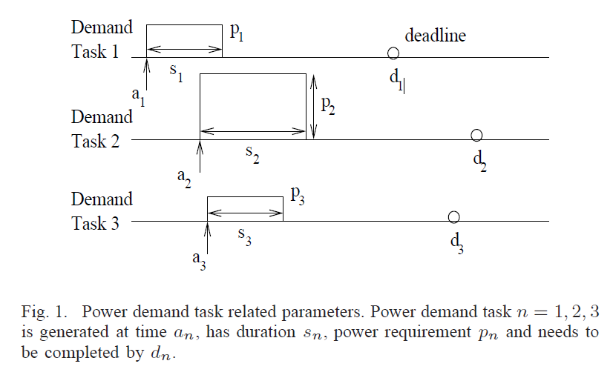

Slide 9
Cost Model
At each time t, let P(t) denote the total instantaneous consumed power in the system
Then we denote instantaneous cost associated with power consumption P(t) at time t as C(P(t))
Convexity of C(・) reflects the fact that the differential cost of power consumption for the electric utility operator increases as the demand increases
The cost may be a piecewise linear function of the form:
C(x) = max _{i=1,...,L} {k_{i}x + b_{i}}
with k₁ ≤ . . . ≤ k_{L}, accounting for L different classes of power
consumption, where each additional Watt consumed costs more
when at class ℓ than at class (ℓ − 1)

Slide 10
OFF-LINE DEMAND SCHEDULING PROBLEM
For each task n = 1, . . . ,N, the attributes a_{n}, p_{n}, s_{n} and d_{n} are deterministic quantities which are known to the controller before time t = 0
Consider a finite time horizon T
The offline demand scheduling can be done in 2 ways,
  Preemptive scheduling of tasks
  Non-preemptive scheduling of tasks

Slide 11
Preemptive scheduling of tasks
The demands here are elastic in nature. Each task can be interrupted and continued later such that it is active at nonconsecutive time intervals
The tasks have deadline d_{n} fixed power requirement p_{n} when it is active.
For each task n and time t we define the function x_{n}(t),
x_{n}(t) = 1, if job n is active at time t, t ∈ [0, T ], and
x_{n}(t) = 0 otherwise.
A scheduling policy is a collection of functions X = {x₁(t), . . . , x_{N}(t)}, defined on interval [0, T ]

Slide 12


Preemptive scheduling of tasks
Design
  The controller needs to find the scheduling policy that minimizes the total cost in horizon [0, T ]
  The optimization problem faced by the controller is:
Subject to:

Slide 13

Continuous-valued problem
Consider a bipartite graph U ∪ V.
There exist |U| = N nodes on one side of the graph, one node for each task.
|V| nodes, where each node k corresponds to the infinitesimal time interval [(k − 1) dt, k dt] of length dt.
Let denote the power load at time t
The optimal cost problem is,
The solution is load balancing across different locations

Slide 14
Non-preemptive scheduling of tasks
The demands here are inelastic in nature. Once a task is scheduled to start, the task should be served until it is completion
For each task, a_{n} = 0 and d_{n} = D, this is common for all tasks.
We also assume that power requirements are the same, i.e. p_{n} = p for all n
Fix a positive integer m, the scheduling problem:
“Does there exist a schedule for the N tasks such that the maximum instantaneous consumed power is mp?”

Slide 15
Bin Packing problem
Bin Packing problem - ”objects of different volumes must be packed into a finite number of bins or containers each of volume V in a way that minimizes the number of bins used”.
Partition the set of N items (tasks) into the smallest possible number m of disjoint subsets (bins) U₁, . . . ,U_{m} such that the sum of the sizes (s_{n})of items in each subset (bin) is D or less.
Therefore the instantaneous power consumption is ‘mp’
This is equivalent to the problem of finding a schedule of power demand tasks that minimizes the maximum power consumption over the time horizon T .

Slide 16
Online dynamic scheduling problem
Default Policy: No scheduling
A Universal Lower Bound
An Asymptotically Optimal Policy: Controlled Release
Optimal Threshold Based Control Policies
  Bi-modal control space
  Enhanced control space

Slide 17
Threshold based Control Policies
Bi-modal control space
This approach has two modes in which the tasks are scheduled, thus the control space is U_{b}[0, D_{n}]
Each demand n is either scheduled immediately upon arrival, or it is postponed to the end based on the threshold
If the power consumption of task, P(t) > P_{b} then the task is queued to be activated at the deadline otherwise the task is activated immediately
We call this policy, the Threshold Postponement (TP) policy.

Slide 18
Threshold based Control Policies
Enhanced control space
In this approach each demand n is either scheduled immediately upon arrival, or it is postponed to the end based on the threshold
Additionally we can schedule a demand after it is generated and before its deadline is expired
The control space is, U_{e} = {[a_{n},D_{n}] for n = 1, 2, . . .}
Whenever the deadline of the demand expires, the task is activated

Slide 19
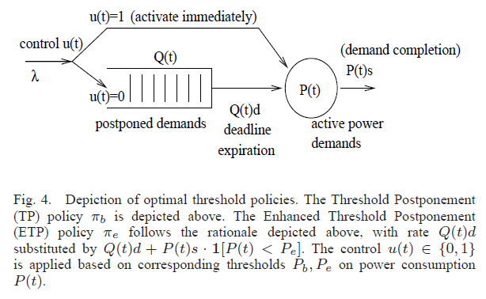
System State

Slide 20
Summary
We have discussed the fundamental problem of smoothing the power demand profile so as to minimize the grid operational cost over some time horizon
Various algorithms have been discussed to promote efficient energy management
Each of the algorithm is suitable for different scenarios
The factors that affect load management are various the most important being the cost to the operator and consumer

Slide 21
Thank you

