Slide 1
Computer Communications
Summary

Slide 2
Important for the exam
When/where:Thursday Dec 16, 14.00-18.00 M
You may have with you:
English-X dictionary
no calculators, PDAs, etc (if/where numbers matter, do rounding)
Grading
30,40,48 (out of 60)= 3, 4, 5 (CTH)
30-48 (out of 60) = G, VG (GU)
To think during last, summary-study
Overview; critical eye; explain: why is this so? / How does it work?

Slide 3
Principles, Organisation
Network Problems (in the order faced in the 1st intro):
managing communication links (& connections)
manage access to shared (broadcast) transmission media ,
transmission errors,
producer-consumer problems, flow and error control,
routing,
congestion,
connecting transparently different networks,
performance,
serving different types of traffic,
mobility
security
Layering : principle, why

Slide 4
Highlights
types of delay; performance
reliable data transfer (flow, error control)
datagram vs VC end-to-end communication, congestion control, quality-of-service and RT traffic
routing, also with mobility
multiple access protocols (wired, wireless)
LANs and related technologies
network security issues covered
TCP/IP protocol stack (also applications), evolution (p2p applications, overlays, NAT, streaming apps)

Slide 5
Types of delay; performance

Slide 6
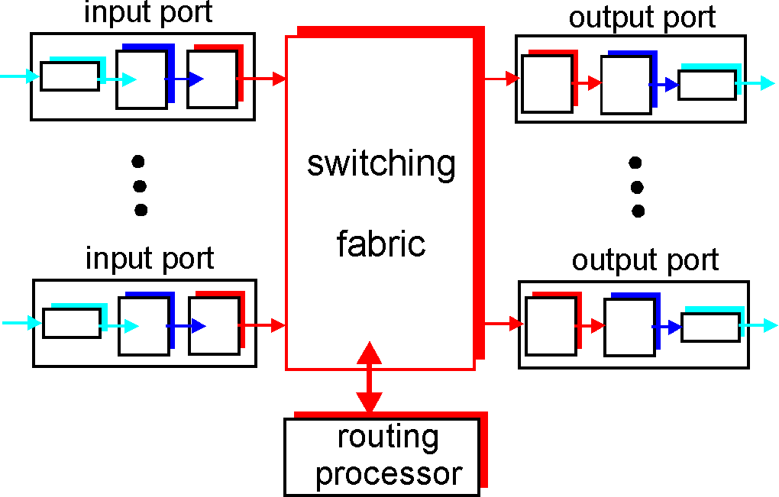
Types of delay; performance
Propagation, transmission, queueing, processing
Throughput (effective bandwidth)
Utilization (efficiency)
Packet-switching: impact of store&forward
TCP’s slow start
Sliding windows performance
transmission
A
propagation
B
nodal
processing
queuing

Slide 7
Reliable data transfer

Slide 8
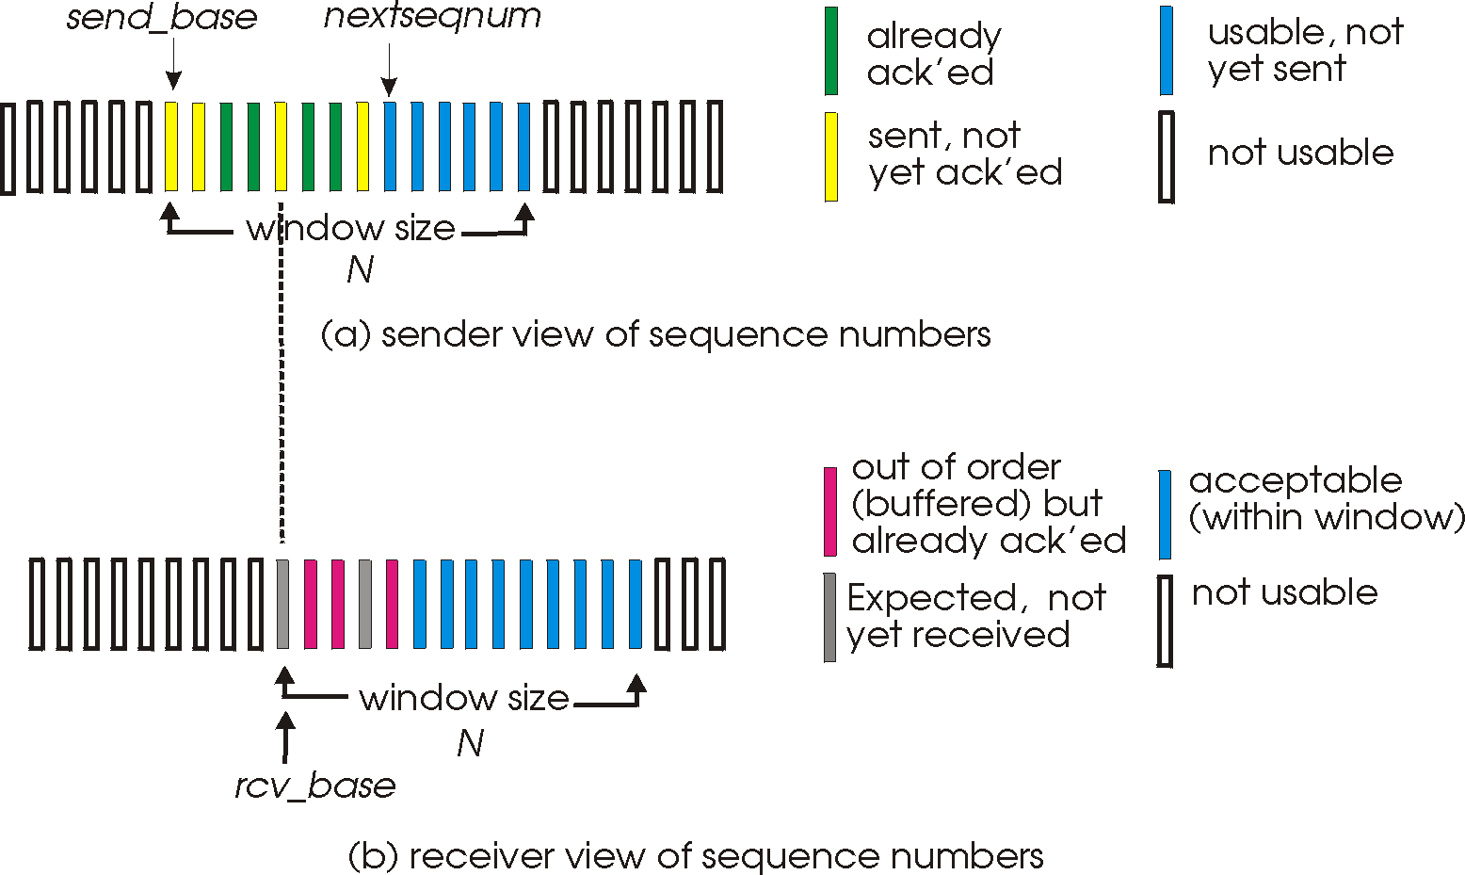
Reliable data transfer
Guaranteed, in-order, correct delivery:
Flow control:
  stop&wait
  sliding windows
  sequence numbers
  window sizes
  dynamic windows (TCP)
  performance
Error detection: checksums, CRC
Error control: go-back-n, selective repeat, FEC methods

Slide 9
Datagram vs VC end-to-end comm.
Congestion
Control
Quality-of-service and RT traffic

Slide 10
Datagram vs VC end-to-end communication
Conceptual differences
Example technologies
Decisions, comparison, why
Redundancy in current networks (internet; eg IP over ATM, MPLS)
ATM
Network/
MPLS
Ethernet
LANs

Slide 11
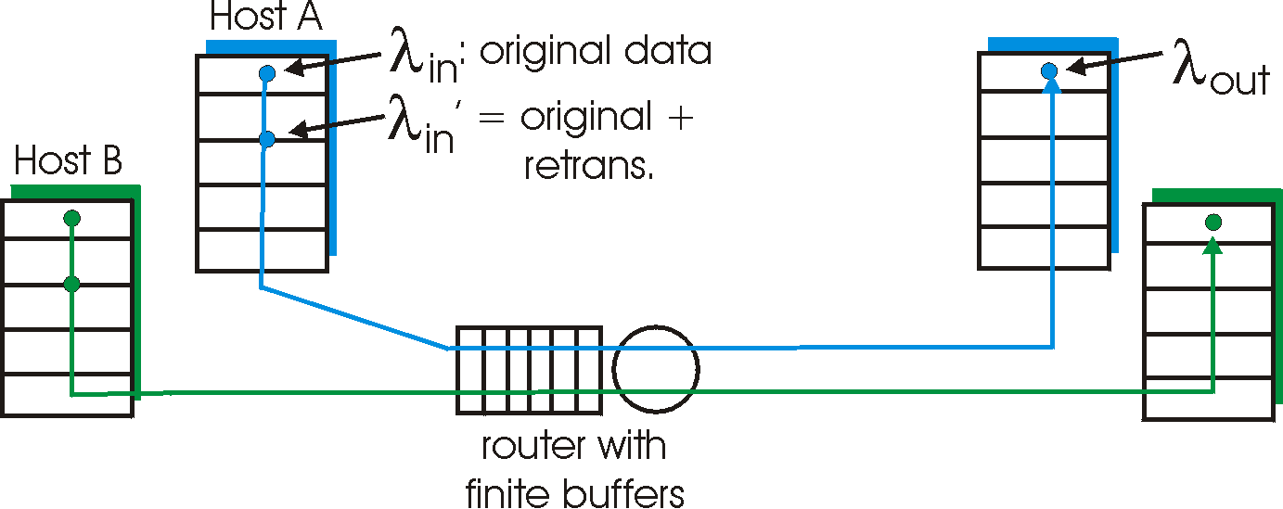
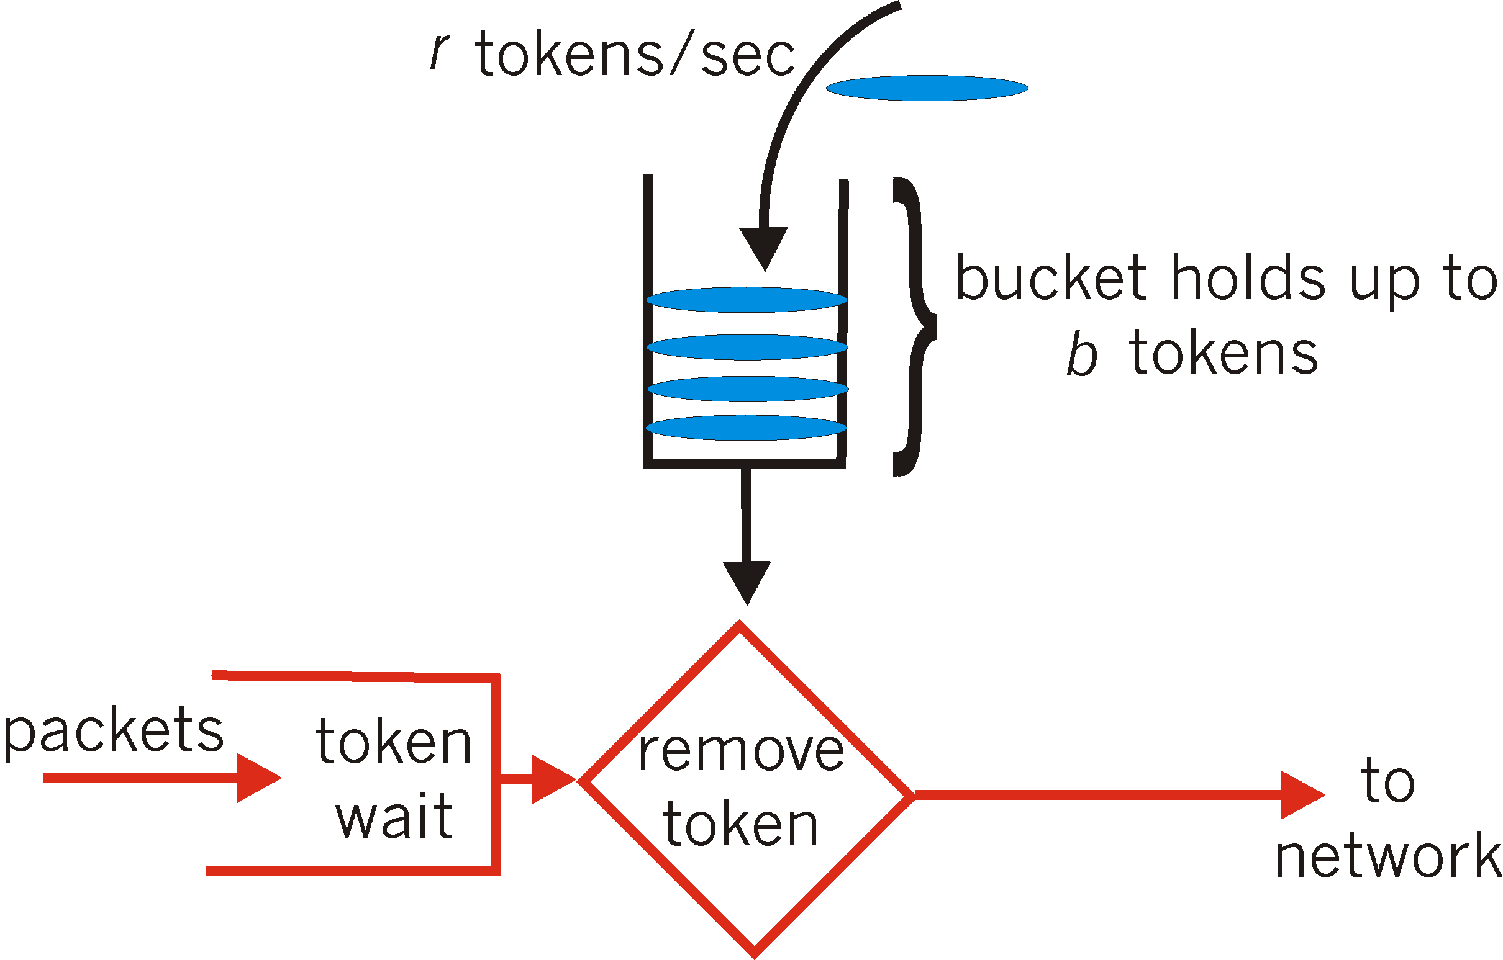
Congestion control (CC)
why, how congestion occurs
CC in TCP and performance; implied weaknesses
CC in other ways, e.g. VC-based networks
  RT-traffic resource reservation:
    traffic shaping and policing
  rate-based

Slide 12
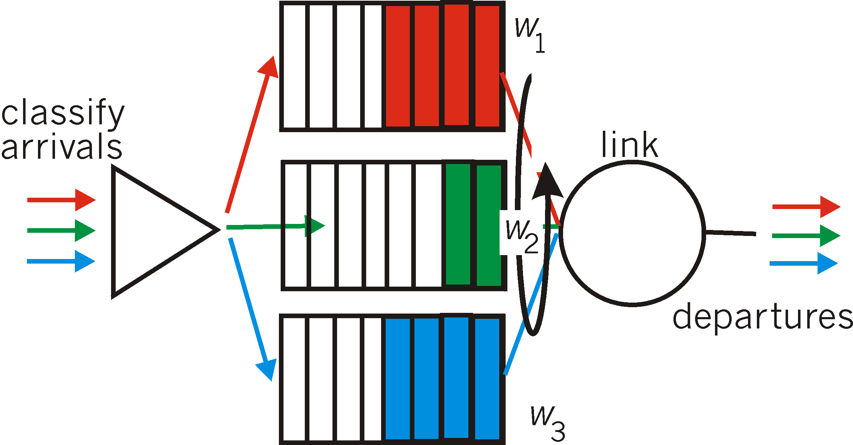
Quality-of-service and RT traffic
Conceptual needs:
packet/flow marking
Admission control
Traffic shaping & policing
Packet scheduling (switches)
Internet context
Application-level solutions (FEC, playout delay, caching-CDN)
Intserv, Diffserv

Slide 13
Routing, also with mobility

Slide 14

Routing, also with mobility
Routing algorithms
Forwarding
Resource, policy issues
Addressing mobility, tunneling
5
B
3
C
2
5
A
2
1
F
3
1
2
D
E
1
Mobile
Switching
Center
Public telephone
network, and
Internet
Mobile
Switching
Center

Slide 15
Multiple access algorithms

Slide 16
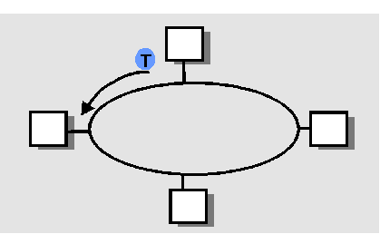
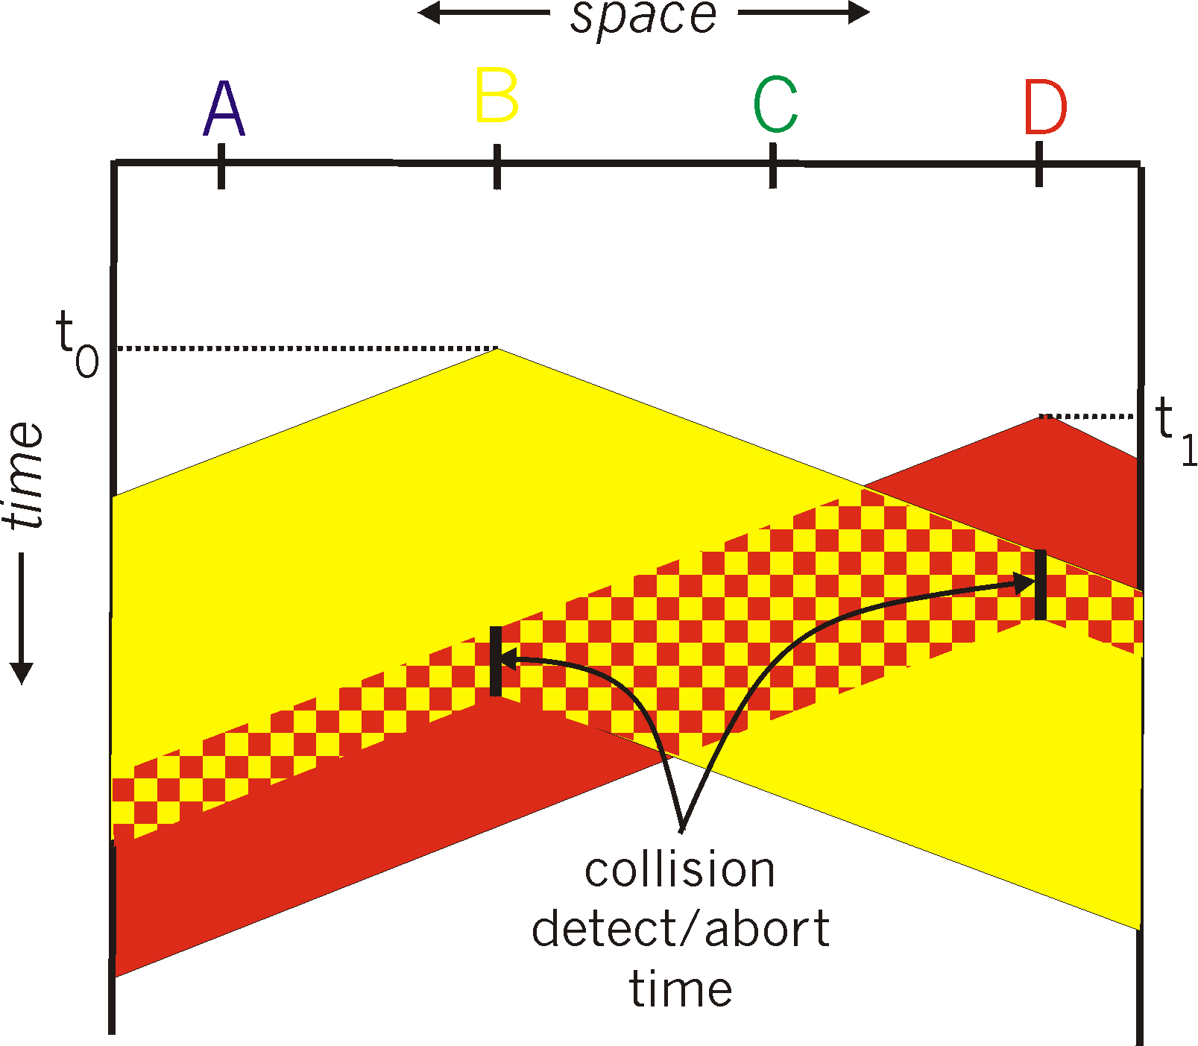

Medium access: multiple access methods
Strategies: (functionality, appropriateness)
Contention-based (random access), wired/wireless:
  Aloha, CSMA(CD/CA) (collision-delay trade-off)
Collision-free:
  Channel partitioning: TDMA, FDMA, CDMA
  Taking turns: token-passing, reservation-based
A
B
C
A’s signal
strength
C’s signal
strength
space

Slide 17
LANs & related technologies

Slide 18
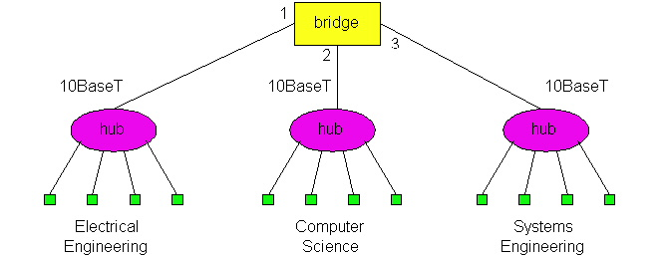
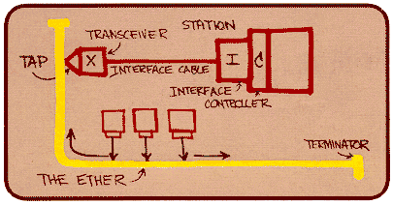
LANs & related link technologies
Protocol Examples
  Ethernet, 802.11 (+ 802.16 wimax), GSM:
    Functionality, performance under low/high load
Connecting devices;
  functionalities and differences (Hubs, switches)
  Algorithms for switch-”routing”: learning& forwarding of packets
ARP
switch

Slide 19
Security issues

Slide 20
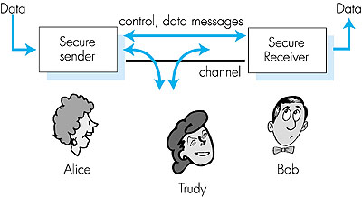
Security issues
C, I, A and methods to achieve them
Instantiation in Internet: PGP, IPsec, SSL
Firewalls and packet filtering

Slide 21
TCP/IP protocol stack (also applications), evolution

Slide 22
TCP/IP protocol stack (also applications), evolution
Instantiation of network-
solutions (Routing, Congestion
Control, Flow & error control, applications, link layer technologies)
Limitations, advantages, updates
Application-layer networking
(P2P applications, overlays, multimedia-
application protocols)
application
transport
network
link
physical

