Slide 1
Peer-to-Peer Networking
Marina Papatriantafilou
CSE Department, Distributed Computing and Systems group
Ack: Many of the slides are adaptation of slides by authors in the bibliography section and by the authors of the course’s main textbook, J.F Kurose and K.W. Ross, All Rights Reserved 1996-2009

Slide 2
Intro
Quickly grown in popularity
  Dozens or hundreds of file sharing applications
  many million people worldwide use P2P networks
  Audio/Video transfer now dominates traffic on the Internet
But what is P2P?
  Searching or location?
  Computers “Peering”?
  Take advantage of resources at the edges of the network
    End-host resources have increased dramatically
    Broadband connectivity now common

Slide 3

Pure P2P architecture
no always-on server
arbitrary end systems directly communicate
peers are intermittently connected and change IP addresses
Three topics:
  Searching for information
  File distribution
  Case Study: Skype
peer-peer

Slide 4
First steps in p2p file sharing/lookup
Centralized Database
  Napster
Query Flooding
  Gnutella
Hierarchical Query Flooding
  KaZaA
…

Slide 5


P2P: centralized directory
original “Napster” design (1999, S. Fanning)
1) when peer connects, it informs central server:
  IP address, content
2) Alice queries directory server for “Boulevard of Broken Dreams”
3) Alice requests file from Bob
Bob
centralized
directory server
1
peers
1
1
3
2
1
Problems?
Single point of failure
Performance bottleneck
Copyright infringement
Alice

Slide 6


Napster: Publish
insert(X,
123.2.21.23)
...
Publish
I have X, Y, and Z!
123.2.21.23

Slide 7
Napster: Search
123.2.0.18
search(A)
-->
123.2.0.18
Fetch
Query
Reply
Where is file A?

Slide 8
Napster: Discussion +, - ?
+:
  Simple
  Search scope is O(1)
-:
  Server maintains O(N) State
  Server does all processing
  Single point of failure

Slide 9
First steps in p2p file sharing/lookup
Centralized Database
  Napster
Query Flooding
  Gnutella
Hierarchical Query Flooding
  KaZaA
…

Slide 10
Gnutella: Overview
Query Flooding:
  Join: on startup, client contacts a few other nodes; these become its “neighbors”
  Publish: no need
  Search: ask neighbors, who ask their neighbors, and so on... when/if found, reply to sender.
  Fetch: get the file directly from peer

Slide 11
Gnutella: Search
I have file A.
I have file A.
Reply
Query
Where is file A?

Slide 12
Gnutella: protocol
Query message
sent over existing TCP
connections
peers forward
Query message
QueryHit
sent over
reverse
path
File transfer:
HTTP
Query
QueryHit
Query
Query
QueryHit
Query
QueryHit
Scalability:
limited scope
flooding
Query

Slide 13
Query flooding: Gnutella
Pros:
  Fully de-centralized
  Search cost distributed
Cons:
  Search scope is O(N)
  Search time is O(???)
    But can limit to some distance
  Sensitive to churn
overlay network:
edge between peer X and Y if there’s a TCP connection
all active peers and edges is overlay net
Edge is not a physical link
Given peer will typically be connected with < 10 overlay neighbors
What is routing in p2p info-sharing networks?

Slide 14
First steps in p2p file sharing/lookup
Centralized Database
  Napster
Query Flooding
  Gnutella
Hierarchical Query Flooding
  KaZaA
…

Slide 15
KaZaA: Overview
“Smart” Query Flooding:
  Join: on startup, client contacts a “supernode” ... may at some point become one itself
  Publish: send list of files to supernode
  Search: send query to supernode, supernodes flood query amongst themselves.
  Fetch: get the file directly from peer(s); can fetch simultaneously from multiple peers

Slide 16
KaZaA: Network Design
“Super Nodes”

Slide 17
KaZaA: File Insert
insert(X,
123.2.21.23)
...
Publish
I have X!
123.2.21.23

Slide 18
KaZaA: File Search
search(A)
-->
123.2.22.50
search(A)
-->
123.2.0.18
123.2.22.50
Query
Replies
Where is file A?
123.2.0.18

Slide 19
KaZaA: Discussion
Pros:
  Tries to take into account node heterogeneity:
    Bandwidth
    Host Computational Resources
    Host Availability (?)
  Rumored to take into account network locality
Cons:
  Still no real guarantees on search scope or search time
P2P architecture used by Skype, Joost (communication, video distribution p2p systems)

Slide 20
Next steps in p2p networking
Centralized Database
  Napster
Query Flooding
  Gnutella
Hierarchical Query Flooding
  KaZaA
…
Academia: “we can show how to do this better” :)
  Motivation:
    Frustrated by popularity of all these “half-baked” P2P apps :)
    Guaranteed lookup success for files in system
    Provable bounds on search time
    Provable scalability to millions of node
  Hot Topic in networking ever since

Slide 21
Next steps in p2p netwoking
Structured Overlay Organization and Routing
  Distributed Hash Tables
Swarming
  BitTorrent
…

Slide 22
Distributed Hash Table (DHT)
DHT = distributed P2P database
Database has (key, value) pairs;
  key: ss number; value: human name
  key: content type; value: IP address
Peers query DB with key
  DB returns values that match the key
Peers can also insert (key, value) peers

Slide 23
DHT Identifiers: e.g:
Assign integer identifier to each peer in range [0,2^{n}-1].
  Each identifier can be represented by n bits.
Require each key to be an integer in same range.
To get integer keys, hash original key.
  eg, key = h(“Led Zeppelin IV”)
  This is why they call it a distributed “hash” table

Slide 24
How to assign keys to peers? E.g.
Central issue:
  Assigning (key, value) pairs to peers.
Rule: assign key to the peer that has the closest ID.
Convention in lecture: closest is the immediate successor of the key.
Ex: n=4; peers: 1,3,4,5,8,10,12,14;
  key = 13, then successor peer = 14
  key = 15, then successor peer = 1

Slide 25
Circular DHT (1)
1
3
15
4
12
5
10
8
Each peer only aware of immediate successor and predecessor.
“Overlay network”

Slide 26
Circle DHT (2)
O(N) messages
on avg to resolve
query, when there
are N peers
0001
Who’s resp
for key 1110 ?
I am
0011
1111
1110
1110
0100
1110
1100
1110
0101
1110
Define closest
as closest
successor
1110
1010
1000

Slide 27
Circular DHT with Shortcuts
1
Who’s resp
for key 1110?
3
15
4
12
5
10
8
Each peer keeps track of IP addresses of predecessor, successor, + shortcuts.
Possible to design shortcuts so O(log N) neighbors, O(log N) messages in query:
  Query simulates binary search (divide and conquer)
  Reduced from 6 to 2 messages.

Slide 28
Peer Churn
1
To handle peer churn, require
each peer to know the IP address
of its two successors.
Each peer periodically pings its
two successors to see if they
are still alive.
3
15
4
12
5
10
8
Peer 5 abruptly leaves
Peer 4 detects; makes 8 its immediate successor; asks 8 who its immediate successor is; makes 8’s immediate successor its second successor.
What if peer 13 wants to join?

Slide 29
Common DHT structures for P2P overlays/searching
Chord: ring with ”chords” (i.e. Shortcuts), works as binary tree
Content-Addressable Network (CAN) topological routing (k-dimensional grid)
Tapestry, Pastry, DKS: ring organization as Chord, other measure of key closeness, k-ary search instead of binary search paradigm
Kademlia: tree-based overlay
Viceroy: butterfly-type overlay network
....

Slide 30
Next steps in p2p netwoking
Structured Overlay Organization and Routing
  Distributed Hash Tables
Swarming
  BitTorrent
…

Slide 31
All Peers Equal?
1.5Mbps DSL
1.5Mbps DSL
56kbps Modem
1.5Mbps DSL
10Mbps LAN
1.5Mbps DSL
56kbps Modem
56kbps Modem

Slide 32
BitTorrent: Overview
Swarming:
  Join: contact centralized “tracker” server, get a list of peers.
  Publish: can run a tracker server.
  Search: Out-of-band. E.g., use Google, some DHT, etc to find a tracker for the file you want. Get list of peers to contact for assembling the file in chunks
  Fetch: (FOCUS)Download chunks of the file from your peers. Upload chunks you have to them.

Slide 33
File distribution: BitTorrent
P2P file distribution
tracker: tracks peers
participating in torrent
torrent: group of
peers exchanging
chunks of a file
obtain list
of peers
trading
chunks
peer

Slide 34
BitTorrent: Tit-for-tat
(1) Alice “optimistically unchokes” Bob
(2) Alice becomes one of Bob’s top-four providers; Bob reciprocates
(3) Bob becomes one of Alice’s top-four providers
With higher upload rate,
can find better trading
partners & get file faster!

Slide 35
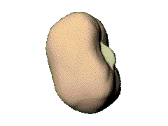

BitTorrent – joining a torrent
metadata file
website
new leecher
1
2
join
peer list
3
data
request
seed/leecher
tracker
4
Peers divided into:
seeds: have the entire file
leechers: still downloading
1. obtain the metadata file
2. contact the tracker
3. obtain a peer list (contains seeds & leechers)
4. contact peers from that list for data

Slide 36


BitTorrent – exchanging data
leecher B
leecher A
I have
!
seed
leecher C
● Verify pieces using hashes
● Download sub-pieces in parallel
● Advertise received pieces to the entire peer list
● Look for the rarest pieces

Slide 37
BitTorrent - unchoking
leecher B
leecher A
seed
leecher C
leecher D
● Periodically calculate data-receiving rates
● Upload to (unchoke) the fastest downloaders
● Optimistic unchoking
▪ periodically select a peer at random and upload to it
▪ continuously look for the fastest partners

Slide 38
BitTorrent (1)
file divided into 256KB chunks.
peer joining torrent:
  has no chunks, but will accumulate them over time
  registers with tracker to get list of peers, connects to subset of peers (“neighbors”)
while downloading, peer uploads chunks to other peers.
peers may come and go
once peer has entire file, it may (selfishly) leave or (altruistically) remain

Slide 39
BitTorrent (2)
Pulling Chunks
at any given time, different peers have different subsets of file chunks
periodically, a peer (Alice) asks each neighbor for list of chunks that they have.
Alice sends requests for her missing chunks
  rarest first
Sending Chunks: tit-for-tat
Alice sends chunks to (4) neighbors currently sending her chunks at the highest rate
  re-evaluate top 4 every 10 secs
every 30 secs: randomly select another peer, starts sending chunks
  newly chosen peer may join top 4
  “optimistically unchoke”

Slide 40
BitTorrent: Sharing Strategy
“Tit-for-tat” sharing strategy
  “I’ll share with you if you share with me”
  Be optimistic: occasionally let freeloaders download
    Otherwise no one would ever start!
    Also allows you to discover better peers to download from when they reciprocate
Approximates Pareto Efficiency
  Game Theory: “No change can make anyone better off without making others worse off”

Slide 41
BitTorrent: Discussion
Pros:
  Works reasonably well in practice
  Gives peers incentive to share resources; avoids freeloaders to some extend
Cons:
  Central tracker server needed to bootstrap swarm

Slide 42
Discussion bittorrent, gaming, fairness, etc
Gaming Incentives, tuning of behaviour
Other issues: sybil attacks
Literature, evolution: includes currency, economic games (but brings problems with inflation, etc like in real economics systems)
Evolving literature, including economic and social sciences
Related issue: information dissemination?

Slide 43
File Distribution: Server-Client vs P2P
Question : How much time to distribute file from one server to N peers?
u_{s}: server upload bandwidth
Server
u_{i}: peer i upload bandwidth
u₁
d₁
u₂
u_{s}
d₂
d_{i}: peer i download bandwidth
File, size F
d_{N}
Network (with
abundant bandwidth)
u_{N}

Slide 44
File distribution time: server-client
Server
server sequentially sends N copies:
  NF/u_{s} time
client i takes F/d_{i} time to download
F
u₁
d₁
u₂
u_{s}
d₂
d_{N}
Network (with
abundant bandwidth)
u_{N}
Time to distribute F
to N clients using
client/server approach
= d_{cs} depends on
max { NF/u_{s}, F/min(d_{i}) }
i
increases linearly in N
(for large N)

Slide 45
File distribution time: P2P
Server
server must send one copy: F/u_{s} time
client i takes F/d_{i} time to download
NF bits must be downloaded (aggregate)
F
u₁
d₁
u₂
u_{s}
d₂
d_{N}
Network (with
abundant bandwidth)
u_{N}
fastest possible upload rate: u_{s} + Σu_{i}
d_{P2P} depends on max { F/u_{s}, F/min(d_{i}) , NF/(u_{s} + Σu_{i}) }
i

Slide 46
Server-client vs. P2P: example
Client upload rate = u, F/u = 1 hour, u_{s} = 10u, d_{min} ≥ u_{s}

Slide 47
Overview
First steps in p2p, file sharing
Next steps: structure, performance (DHTs, bit-torrent)
NEXT ? …
Observe: Application-layer networking

Slide 48
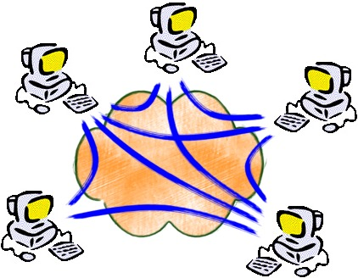
P2P – not only sharing files…
Content delivery, software publication
Streaming media applications
Distributed computations (volunteer computing)
Portal systems
Distributed search engines
Collaborative platforms
Communication networks
Social applications
Other overlay-related applications....
Overlay: a network implemented on top of a network
  E.g. Peer-to-peer networks, ”backbones” in adhoc networks, transportaiton network overlays, ...

Slide 49

P2P Case study: Skype
Skype clients (SC)
inherently P2P: pairs of users communicate.
proprietary application-layer protocol (inferred via reverse engineering)
hierarchical overlay with SNs
Index maps usernames to IP addresses; distributed over SNs
Skype
login server
Supernode
(SN)

Slide 50
Peers as relays
Problem when both Alice and Bob are behind “NATs”.
  NAT prevents an outside peer from initiating a call to insider peer
Solution:
  Using Alice’s and Bob’s SNs, Relay is chosen
  Each peer initiates session with relay.
  Peers can now communicate through NATs via relay

Slide 51
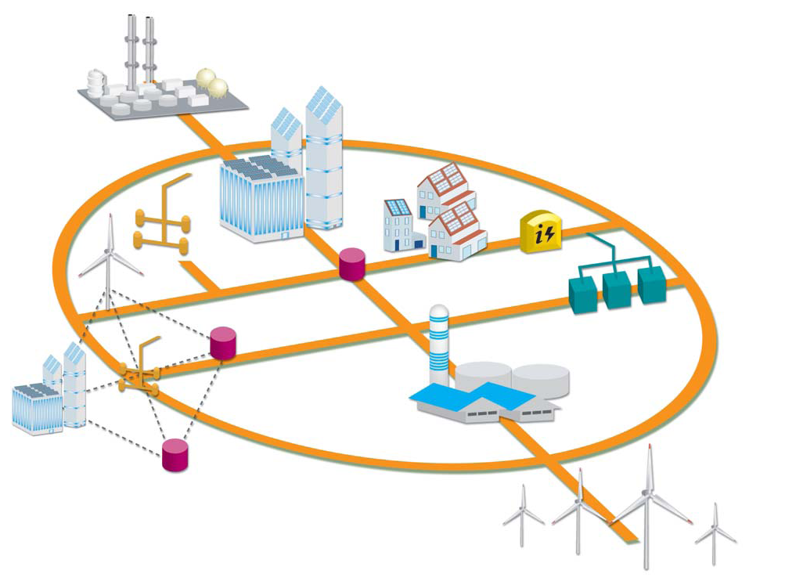

More on examples : New power grids
Natural overlays

Slide 52
Bibliography (arbitrary order)
Do Incentives build Robustness in BitTorrent?, Michael Piatek, Tomas Isdal, Thomas Anderson, Arvind Krishnamurthy and Arun Venkataramani, NSDI 2007.
Law and Economics: The Prisoners’ Dilemma
mason.gmu.edu/~fbuckley/documents/PrisonersDilemma.ppt
Exploiting BitTorrent For Fun (But Not Profit)
iptps06.cs.ucsb.edu/talks/Liogkas_BitTorrent.ppt
Aberer’s coursenotes
  http://lsirwww.epfl.ch/courses/dis/2007ws/lecture/week%208%20P2P%20systems-general.pdf
  http://lsirwww.epfl.ch/courses/dis/2007ws/lecture/week%209%20Structured%20Overlay%20Networks.pdf
Chord presentation by Cristine Kiefer, MPII Saarbruecken
  www.mpi-inf.mpg.de/departments/d5/teaching/ws03_04/p2p-data/11-18-writeup1.pdf
  www.mpi-inf.mpg.de/departments/d5/teaching/ws03_04/p2p-data/11-18-paper1.ppt
Kurose, Ross: Computer Networking, a top-down approach, AdisonWesley 2009

Slide 53
Bibliography (cont)
Kademlia: A Peer to peer information system Based on the XOR Metric. Petar Maymounkov and David Mazières , 1st International Workshop on Peer-to-peer Systems, 2002.
Pastry: Scalable, distributed object location and routing for large-scale peer-to-peer systems, A. Rowstron and P. Druschel, IFIP/ACM International Conference on Distributed Systems Platforms (Middleware), November 2001.
Chord: A Scalable Peer-to-peer Lookup Service for Internet Applications, Ion Stoica, Robert Morris, David Karger, M. Frans Kaashoek, and Hari Balakrishnan. ACM SIGCOMM 2001, San Deigo, CA, August 2001, pp. 149-160.
A Scalable Content-Addressable Network, S. Ratnasamy, P. Francis, M. Handley, R. Karp, and S. Shenker, Sigcomm 2001, San Diego, CA, USA, August, 2001.
Incentives build Robustness in BitTorrent, Bram Cohen. Workshop on Economics of Peer-to-Peer Systems, 2003.
Ian Clarke, Oskar Sandberg, Brandon Wiley, and Theodore W. Hong. Freenet: A Distributed Anonymous Information Storage and Retrieval System. Int’l Workshop on Design Issues in Anonymity and Unobservability. LLNCS 2009. Springer Verlag 2001.
Viceroy: A Scalable and Dynamic Emulation of the Butterfly. By D. Malkhi, M. Naor and D. Ratajczak. In Proceedings of the 21st ACM Symposium on Principles of Distributed Computing (PODC '02), August 2002. Postscript.

Slide 54
Bibliography cont.
http://en.wikipedia.org/wiki/Chord_(DHT)
http://en.wikipedia.org/wiki/Tapestry_(DHT)
http://en.wikipedia.org/wiki/Pastry_(DHT)
http://en.wikipedia.org/wiki/Kademlia
http://en.wikipedia.org/wiki/Content_addressable_network
http://en.wikipedia.org/wiki/Comparison_of_file_sharing_applications

