Slide 1
Chapter 7 + ATM/VC networks (3, 4, 5):
Multimedia networking, QoS, Congestion control
Course on Computer Communication and Networks, CTH/GU
The slides are adaptation of the slides made available by the authors of the course’s main textbook

Slide 2


Multimedia and Quality of Service: What is it?
multimedia applications: network audio and video
(“continuous media”)
QoS
network provides application with level of performance needed for application to function.
i.e. Contract between network user & provider
Agree on
  Traffic characteristics (packet rate, sizes, …)
  Network service guarantees (delay, jitter, loss rate, …)

Slide 3
MM Networking Applications
Classes of MM applications:
1) stored streaming
2) live streaming
3) interactive, real-time
Fundamental characteristics:
typically delay sensitive
  end-to-end delay
  delay jitter
loss tolerant: infrequent losses cause minor glitches
antithesis with data, which are loss intolerant but delay tolerant.
  Jitter is the variability
  of packet delays within
  the same packet stream

Slide 4

Streaming Stored Multimedia
Stored streaming:
media stored at source
transmitted to client
streaming: client playout begins before all data has arrived
timing constraint for still-to-be transmitted data: in time for playout
VCR-like functionality: client can pause, rewind, FF, push slider bar
  10 sec initial delay OK
  1-2 sec until command effect OK

Slide 5
Streaming Live Multimedia
Examples:
Internet radio talk show
live sporting event
Streaming (as with streaming stored multimedia)
playback buffer (to be explained soon)
Interactivity
fast forward impossible
rewind, pause possible!

Slide 6
Real-Time Interactive Multimedia
applications: IP telephony, video conference, distributed interactive worlds
end-end delay requirements:
  audio: < 150 msec good, < 400 msec OK
    includes application-level (packetization) and network delays
    higher delays noticeable, impair interactivity
session initialization

Slide 7
Multimedia Over Today’s Internet
“best-effort service”
no guarantees on delay, loss
?
?
?
?
?
?
But you said multimedia apps requires
QoS and level of performance to be
effective!
?
?
?
?
?
Today’s Internet multimedia applications
use application-level techniques to mitigate
(as best possible) effects of delay, loss

Slide 8
Solution Approaches in IP Networks
To mitigate impact of “best-effort” protocols:
  Use UDP to avoid TCP’s slow-start phase…
  Buffer content at client and control playback to remedy jitter
  Adapt compression level to available bandwidth
  Exhaust all uses of caching, proxys, etc
add more bandwidth
Scalability? May need major change of the protocols (?):
… to consider resource reservation, traffic classes, service level agreements, … (more on this in a short while...)

Slide 9
Chapter 7: goals
Principles
classify multimedia applications
identify network services applications need
making the best of best-effort service
Protocols and Architectures
specific protocols for best-effort
mechanisms for providing QoS
architectures for QoS

Slide 10
Multimedia Applications, Services, Needs, …
Application Classes
  QoS
  challenges
Today’s representative technology
  Phone over IP
    recovery from jitter and loss
  Streaming
  (Overlays) CDN: content distribution networks
  SIP
Improving QoS in Networks (also related with congestion-control)
  Qos Principles
  Packet scheduling and policing
Two generally different approaches
  The VC (ATM) approach (incl. material from Ch 3, 4, 5)
  Internet approach: Int-serv + RSVP, Diff-serv

Slide 11
Real-Time (Phone) Over IP’s Best-Effort
Delay jitter is handled by using timestamps, sequence numbers, and delaying playout at receivers either a fixed or a variable amount
Forward Error Control: to fix errors, make up losses

Slide 12
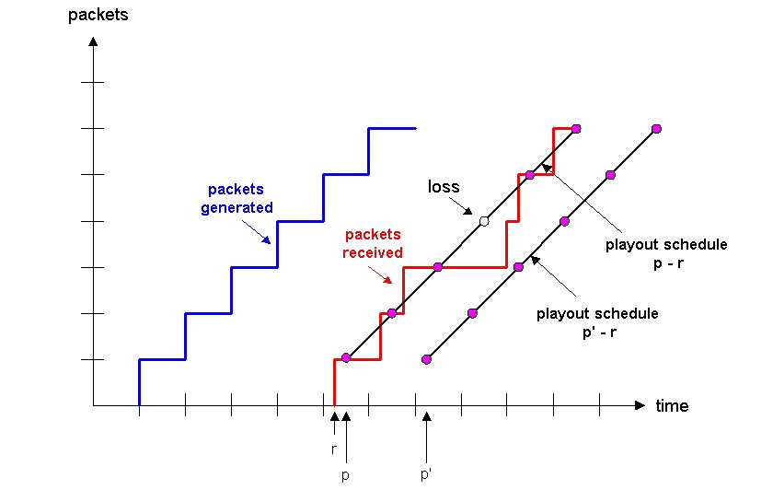
Internet Phone’s Playout Delay
Fixed: chunk timestamped t is played out (at the receiver) at time t + q (assuming it arrived)
Observe: delay-loss trade-off
  large q: less packet loss
  small q: better interactive experience
Dynamic:
estimate network delay +variance (as in TCP) ;
adjust playout-delay at the beginning of each talkspurt
will cause silent periods to be compressed and elongated by a small amount; not noticeable in speech

Slide 13
Adaptive Playout Delay (1)
Goal: minimize playout delay, keeping late loss rate low
Approach: adaptive playout delay adjustment:
  estimate network delay, adjust playout delay at beginning of each talk spurt.
  silent periods compressed and elongated.
  chunks still played out every 20 msec during talk spurt.
dynamic estimate of average delay at receiver:
where u is a fixed constant (e.g., u = .01).

Slide 14
Adaptive playout delay (2)
also useful to estimate average deviation of delay, v_{i} :
estimates d_{i} , v_{i} calculated for every received packet
(but used only at start of talk spurt
for first packet in talk spurt, playout time is:
where K is positive constant
remaining packets in talkspurt are played out periodically

Slide 15
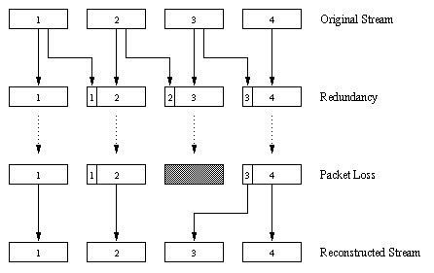
Recovery From Packet Loss (FEC)
Redundant chunk (XOR of n chunks); can reconstruct one lost chunk; playout time must adapt to receipt of group
Piggybacking Lower Quality Stream

Slide 16
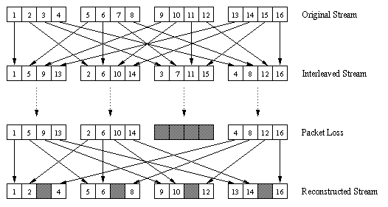
Recovery From Packet Loss/FEC (cont)
3. Interleaving: no redundancy, but can cause delay in playout beyond Real Time requirements
  Divide 20 msec of audio data into smaller units of 5 msec each and interleave
  Upon loss, have a set of partially filled chunks

Slide 17
Multimedia Applications, Services, Needs, …
Application Classes
  QoS
  challenges
Today’s representative technology
  Phone over IP
    recovery from jitter and loss
  Streaming
  (Overlays) CDN: content distribution networks
  Protocols for interactive RT applications (RTP, RTCP, SIP)
(TOP 10): Improving QoS in Networks (also related with congestion-control)
  Qos Principles
  Packet scheduling and policing
Two generally different approaches
  The VC (ATM) approach (incl. material from Ch 3, 4, 5)
  Internet approach: Int-serv + RSVP, Diff-serv

Slide 18
Streaming
Audio/Video file is segmented and sent over TCP or UDP;
User interactive control provided, e.g. Real Time Streaming Protocol (RTSP)
Helper Application: displays content, (typically requested via a Web browser); e.g. RealPlayer; typical functions:
  Decompression
  Jitter removal
  Error correction: use redundant packets to be used for reconstruction of original stream
  GUI for user control

Slide 19
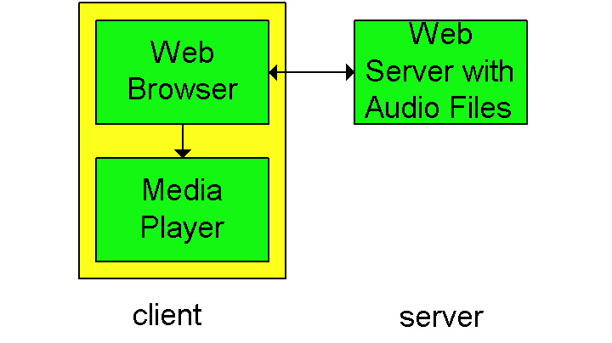
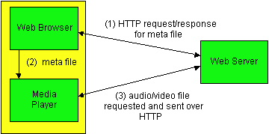
Streaming From Web Servers
Audio (in file), Video (interleaved audio+images in 1 file, or 2 separate files + client synchronizes display) sent as HTTP-object
A simple architecture:
  Browser requests the object(s);
  after reception pass them to the player (no pipelining)
Alternative:
  browser requests and receives a Meta File
  Browser launches the appropriate Player and passes it the Meta File;
  Player sets up a TCP connection with Web Server and downloads the file

Slide 20
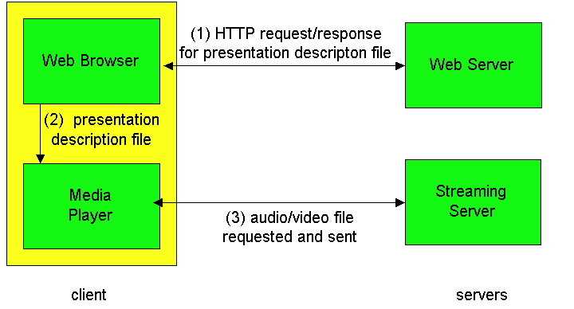
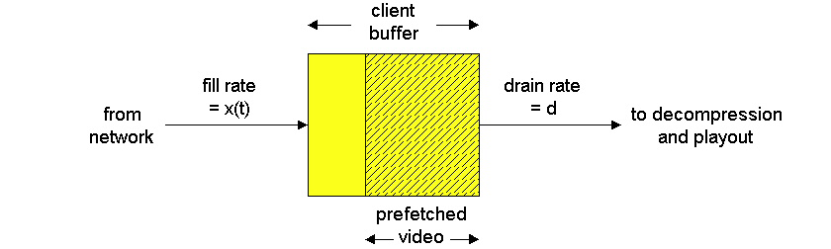
Using a Streaming Server
gets around HTTP = allows a choice of UDP vs. TCP
Player can be better tailored to Streaming:
  UDP: Server sends at rate appropriate for client; to reduce jitter, player buffers initially (2-5 sec), then starts display
  TCP: sender sends at max possible rate (+retransmit when error); player uses larger buffer to smooth delivery rate of TCP

Slide 21
Streaming Multimedia: UDP or TCP?
UDP
server sends at rate appropriate for client (oblivious to network congestion !)
  often send rate = encoding rate = constant rate
  then, fill rate = constant rate - packet loss
short playout delay (2-5 seconds) to remove network jitter
error recover: time permitting
TCP
send at maximum possible rate under TCP
fill rate fluctuates due to TCP congestion control
larger playout delay: smooth TCP delivery rate
HTTP/TCP passes more easily through firewalls

Slide 22
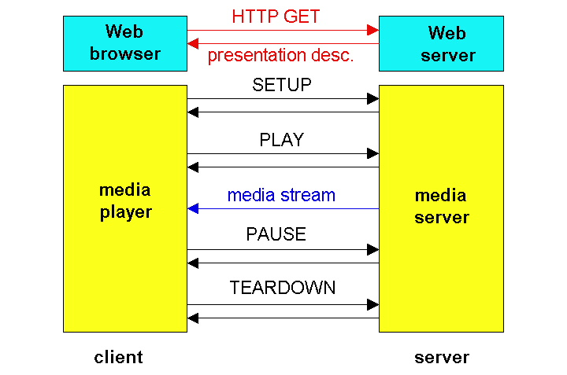
Real Time Streaming Protocol (RTSP)
… replaces http, adds control:
For user to control display: rewind, fast forward, pause, resume, etc…
Out-of-band protocol (uses two connections, one for control messages (Port 554) and for media stream)
RFC 2326 permits use of either TCP or UDP for the control messages connection, sometimes called the RTSP Channel

Slide 23
Streaming Multimedia: client rate(s)
1.5 Mbps encoding
28.8 Kbps encoding
Q: how to handle different client receive rate capabilities?
  28.8 Kbps dialup
  100Mbps Ethernet
A: server stores, transmits multiple copies of video, encoded at different rates

Slide 24
Metafile Example
<title>Twister</title>
<session>
<group language=en lipsync>
<switch>
<track type=audio
e="PCMU/8000/1"
src = "rtsp://audio.example.com/twister/audio.en/lofi">
<track type=audio
e="DVI4/16000/2" pt="90 DVI4/8000/1"
src="rtsp://audio.example.com/twister/audio.en/hifi">
</switch>
<track type="video/jpeg"
src="rtsp://video.example.com/twister/video">
</group>
</session>

Slide 25
RTSP Exchange Example
C: SETUP rtsp://audio.example.com/twister/audio RTSP/1.0
Transport: rtp/udp; compression; port=3056; mode=PLAY
S: RTSP/1.0 200 1 OK
Session 4231
C: PLAY rtsp://audio.example.com/twister/audio.en/lofi RTSP/1.0
Session: 4231
Range: npt=0-
C: PAUSE rtsp://audio.example.com/twister/audio.en/lofi RTSP/1.0
Session: 4231
Range: npt=37
C: TEARDOWN rtsp://audio.example.com/twister/audio.en/lofi RTSP/1.0
Session: 4231
S: 200 3 OK

Slide 26
Real-Time Protocol (RTP)
RTP specifies packet structure for packets carrying audio, video data
RFC 3550
RTP packet provides
  payload type identification
  packet sequence numbering
  time stamping
RTP runs in end systems
RTP packets encapsulated in UDP segments
interoperability: if two Internet phone applications run RTP, then they may be able to work together

Slide 27
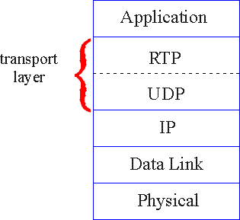
RTP runs on top of UDP
RTP libraries provide transport-layer interface
that extends UDP:
  port numbers, IP addresses
  payload type identification
  packet sequence numbering
  time-stamping

Slide 28

Real-Time Protocol (RTP) & RT Control Protocol (RTCP)
standard packet format for real-time application
  Payload Type: 7 bits: 128 possible types of encoding; eg PCM, MPEG2 video, GSM, etc. (sender can change in the middle of session)
  Sequence Number: to detect packet loss
  Timestamp: sampling instant of first byte in packet; to remove jitter introduced by the network
  Synchronization Source identifier (SSRC): id for the source of a stream; assigned randomly by the source
Real-Time Control Protocol (RTCP): specifies report packets exchanged between sources and destinations, with statistics (# packets sent/lost, inter-arrival jitter
  Can be used to modify sender transmission rates

Slide 29
Multimedia Applications, Services, Needs, …
Application Classes
  QoS
  challenges
Today’s representative technology
  Phone over IP
    recovery from jitter and loss
  Streaming
  (Overlays) CDN: content distribution networks
  SIP
(TOP 10): Improving QoS in Networks (also related with congestion-control)
  Qos Principles
  Packet scheduling and policing
Two generally different approaches
  The VC (ATM) approach (incl. material from Ch 3, 4, 5)
  Internet approach: Int-serv + RSVP, Diff-serv

Slide 30
Content distribution networks(CDNs)
Content replication
Challenging to stream large files (e.g., video) from single origin server in real time
Solution: replicate content at several/many servers in Internet
  content downloaded to CDN servers ahead of time
  content “close” to user avoids impairments (loss, delay) of sending content over long paths
  CDN server typically in edge/access network
  Resembles overlay networks in P2P applications
origin server
in North America
CDN distribution node
CDN server
in S. America
CDN server
in Asia
CDN server
in Europe

Slide 31
CDN example
HTTP request for
www.foo.com/sports/sports.html
Content replication
CDN (e.g., Akamai) customer is the content provider (e.g., CNN)
CDN replicates customers’ content in CDN servers. When provider updates content, CDN updates servers
1
Origin server
2
DNS query for www.cdn.com
CDNs authoritative
DNS server
3
HTTP request for
www.cdn.com/www.foo.com/sports/ruth.gif
Nearby
CDN server
origin server (www.foo.com)
distributes HTML
replaces:
http://www.foo.com/sports.ruth.gif
with http://www.cdn.com/www.foo.com/sports/ruth.gif
CDN company (cdn.com)
uses its authoritative DNS server (always involved) to redirect requests
  “map” to determine closest CDN server to requesting ISP

Slide 32
Multimedia Applications, Services, Needs, …
Application Classes
  QoS
  challenges
Today’s representative technology
  Phone over IP
    recovery from jitter and loss
  Streaming
  (Overlays) CDN: content distribution networks
  SIP
Improving QoS in Networks (also related with congestion-control)
  Qos Principles
  Packet scheduling and policing
Two generally different approaches
  The VC (ATM) approach (incl. material from Ch 3, 4, 5)
  Internet approach: Int-serv + RSVP, Diff-serv

Slide 33
SIP Service Initiation Protocol
SIP long-term vision
All phone/video conference calls take place over the Internet
People are identified by names or e-mail addresses, rather than by phone numbers.
You can reach the callee, no matter where the callee roams, no matter what IP device the callee is currently using.
What does it do:
Determine current IP address of callee.
  Maps mnemonic identifier to current IP address
Setting up/ending a call
  Provides also mechanisms so that caller and callee can agree on media type and encoding.
Call management
  Add new media streams during call
  Change encoding during call
  Invite others
  Transfer and hold calls

Slide 34
Setting up a call to known IP address
Alice’s SIP invite message indicates her port number & IP address+encoding
Bob’s 200 OK message (could also reject, say “busy”, etc) indicates his port number, IP address & preferred encoding (GSM)
SIP messages can be sent over TCP or UDP; here over RTP/UDP.
HTTP message syntax (but SIP maintains state)
Default SIP port number: 5060.

Slide 35
Example name translation, user location
Caller jim@umass.edu
places a
call to keith@upenn.edu
Jim sends INVITE
to umass SIPproxy.
(2) Proxy forwards
request to upenn
registrar server.
(3) upenn server returns
redirect response,
indicating that it should
try keith@eurecom.fr
(4) umass proxy sends INVITE to eurecom registrar.
(5) eurecom registrar forwards INVITE to 197.87.54.21, which is running keith’s SIP client.
(6-8) SIP response sent back
(9) media sent directly between clients.
(follows pretty much the DNS inquiry structure)

Slide 36
Summary: Internet Multimedia: bag of tricks
use UDP to avoid TCP congestion control (delays) for time-sensitive traffic
client-side adaptive playout delay: to compensate for delay
server side matches stream bandwidth to available client-to-server path bandwidth
  chose among pre-encoded stream rates
  dynamic server encoding rate
error recovery (on top of UDP)
  FEC, interleaving, error concealment
  Retransmissions only time-permitting
CDN: bring content closer to clients

Slide 37
Multimedia Applications, Services, Needs, …
Application Classes
  QoS
  challenges
Today’s representative technology
  Phone over IP
    recovery from jitter and loss
  Streaming
  (Overlays) CDN: content distribution networks
  SIP
Improving QoS in Networks (also related with congestion-control)
  Qos Principles
  Packet scheduling and policing
Two generally different approaches
  The VC (ATM) approach (incl. material from Ch 3, 4, 5)
  Internet approach: Int-serv + RSVP, Diff-serv

Slide 38
QoS parameters: recall ….
Contract between
  network user
  network provider
Agree on
  Traffic characteristics (packet rate, sizes, …)
  Network service guarantees (delay, jitter, loss rate, …)

Slide 39
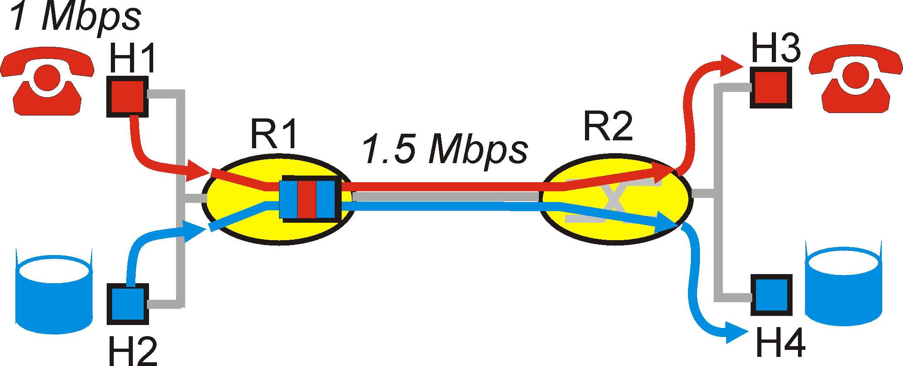
Improving QOS in IP Networks
IETF groups are working on proposals to provide better QOS control in IP networks, i.e., going beyond best effort
Simple model for sharing and congestion studies:
Questions
  Distinguish traffic?
  Control offered load? (isolate different ”streams”?)
  Resources? (utilization)
  Control acceptance of new sessions?

Slide 40
Principles for QoS for networked applications
  Packet classification
  Traffic shaping/policing
  Packet scheduling (resource=bandwidth allocation)
  Admission control

Slide 41
Multimedia Applications, Services, Needs, …
Application Classes
  QoS
  challenges
Today’s representative technology
  Phone over IP
    recovery from jitter and loss
  Streaming
  (Overlays) CDN: content distribution networks
  SIP
Improving QoS in Networks (also related with congestion-control)
  Qos Principles
  Packet scheduling and policing
Two generally different approaches
  The VC (ATM) approach (incl. material from Ch 3, 4, 5)
  Internet approach: Int-serv + RSVP, Diff-serv

Slide 42
Where does this fit in?

Slide 43
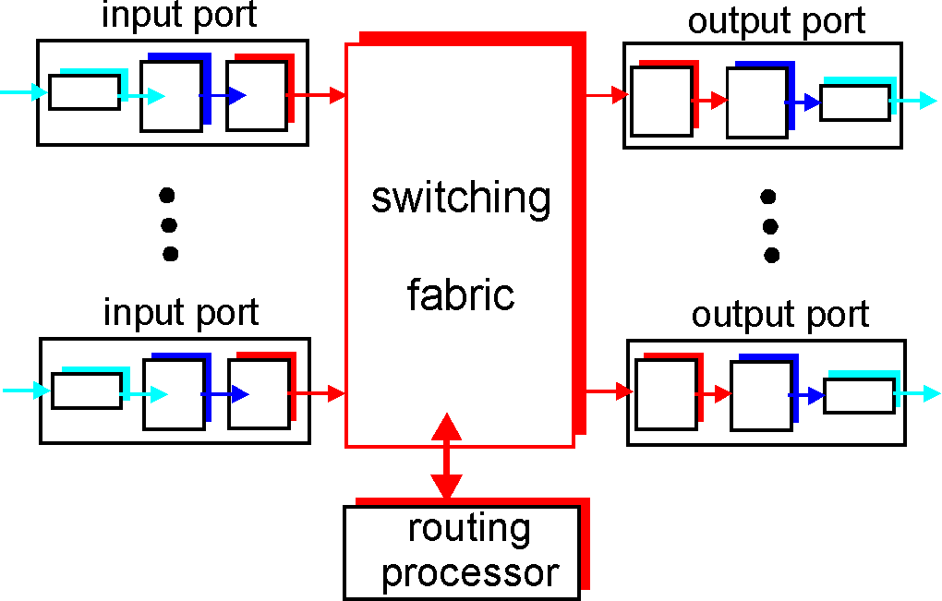
Where does this fit in?
Scheduling = choosing the next packet for transmission on a link (= allocate bandwidth)

Slide 44
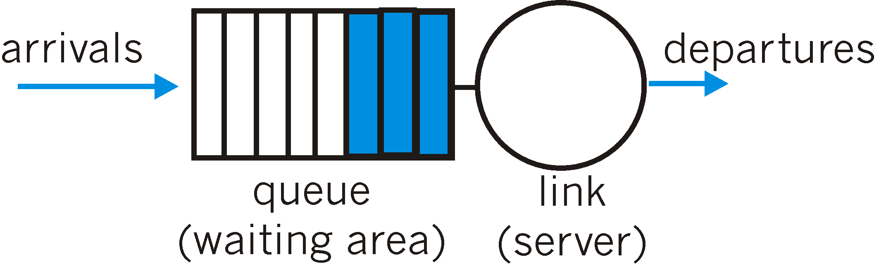
Packet Scheduling Policies: FIFO
FIFO: in order of arrival to the queue
  if buffer full: a discard policy determines which packet to discard among the arrival and those already queued

Slide 45
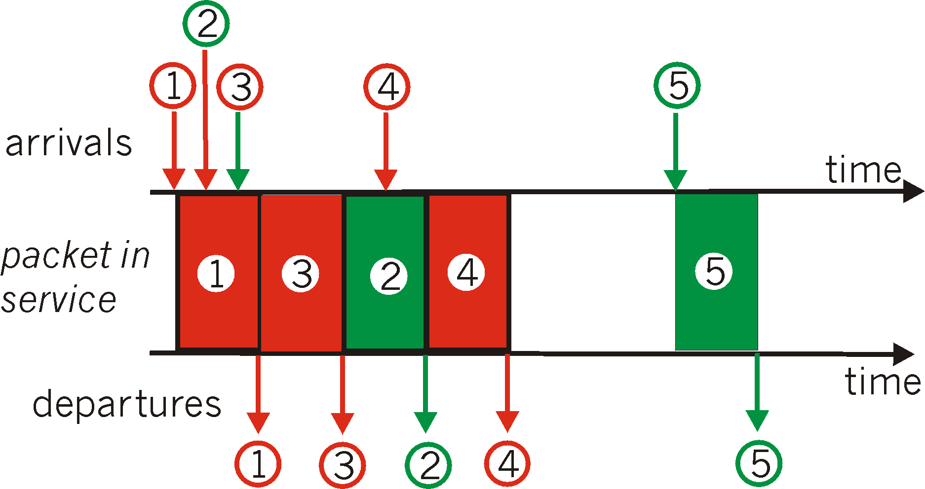
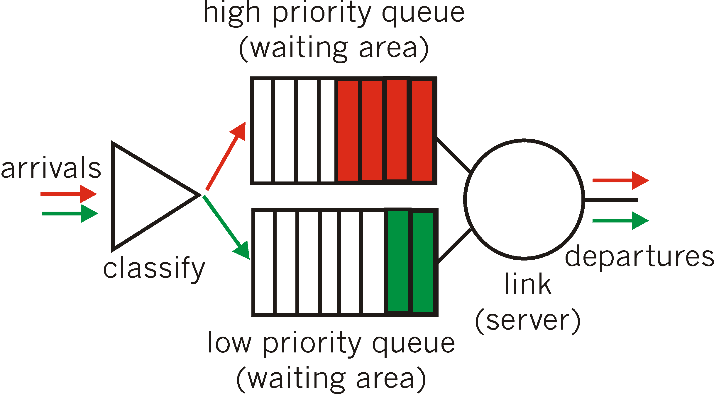
Packet Scheduling Policies: Priority queueing
Priority Queuing: classes have different priorities; priority may depend on explicit marking or other header info, eg IP source or destination, type of packet, etc.
  Transmit a packet from the highest priority class with a non-empty queue

Slide 46
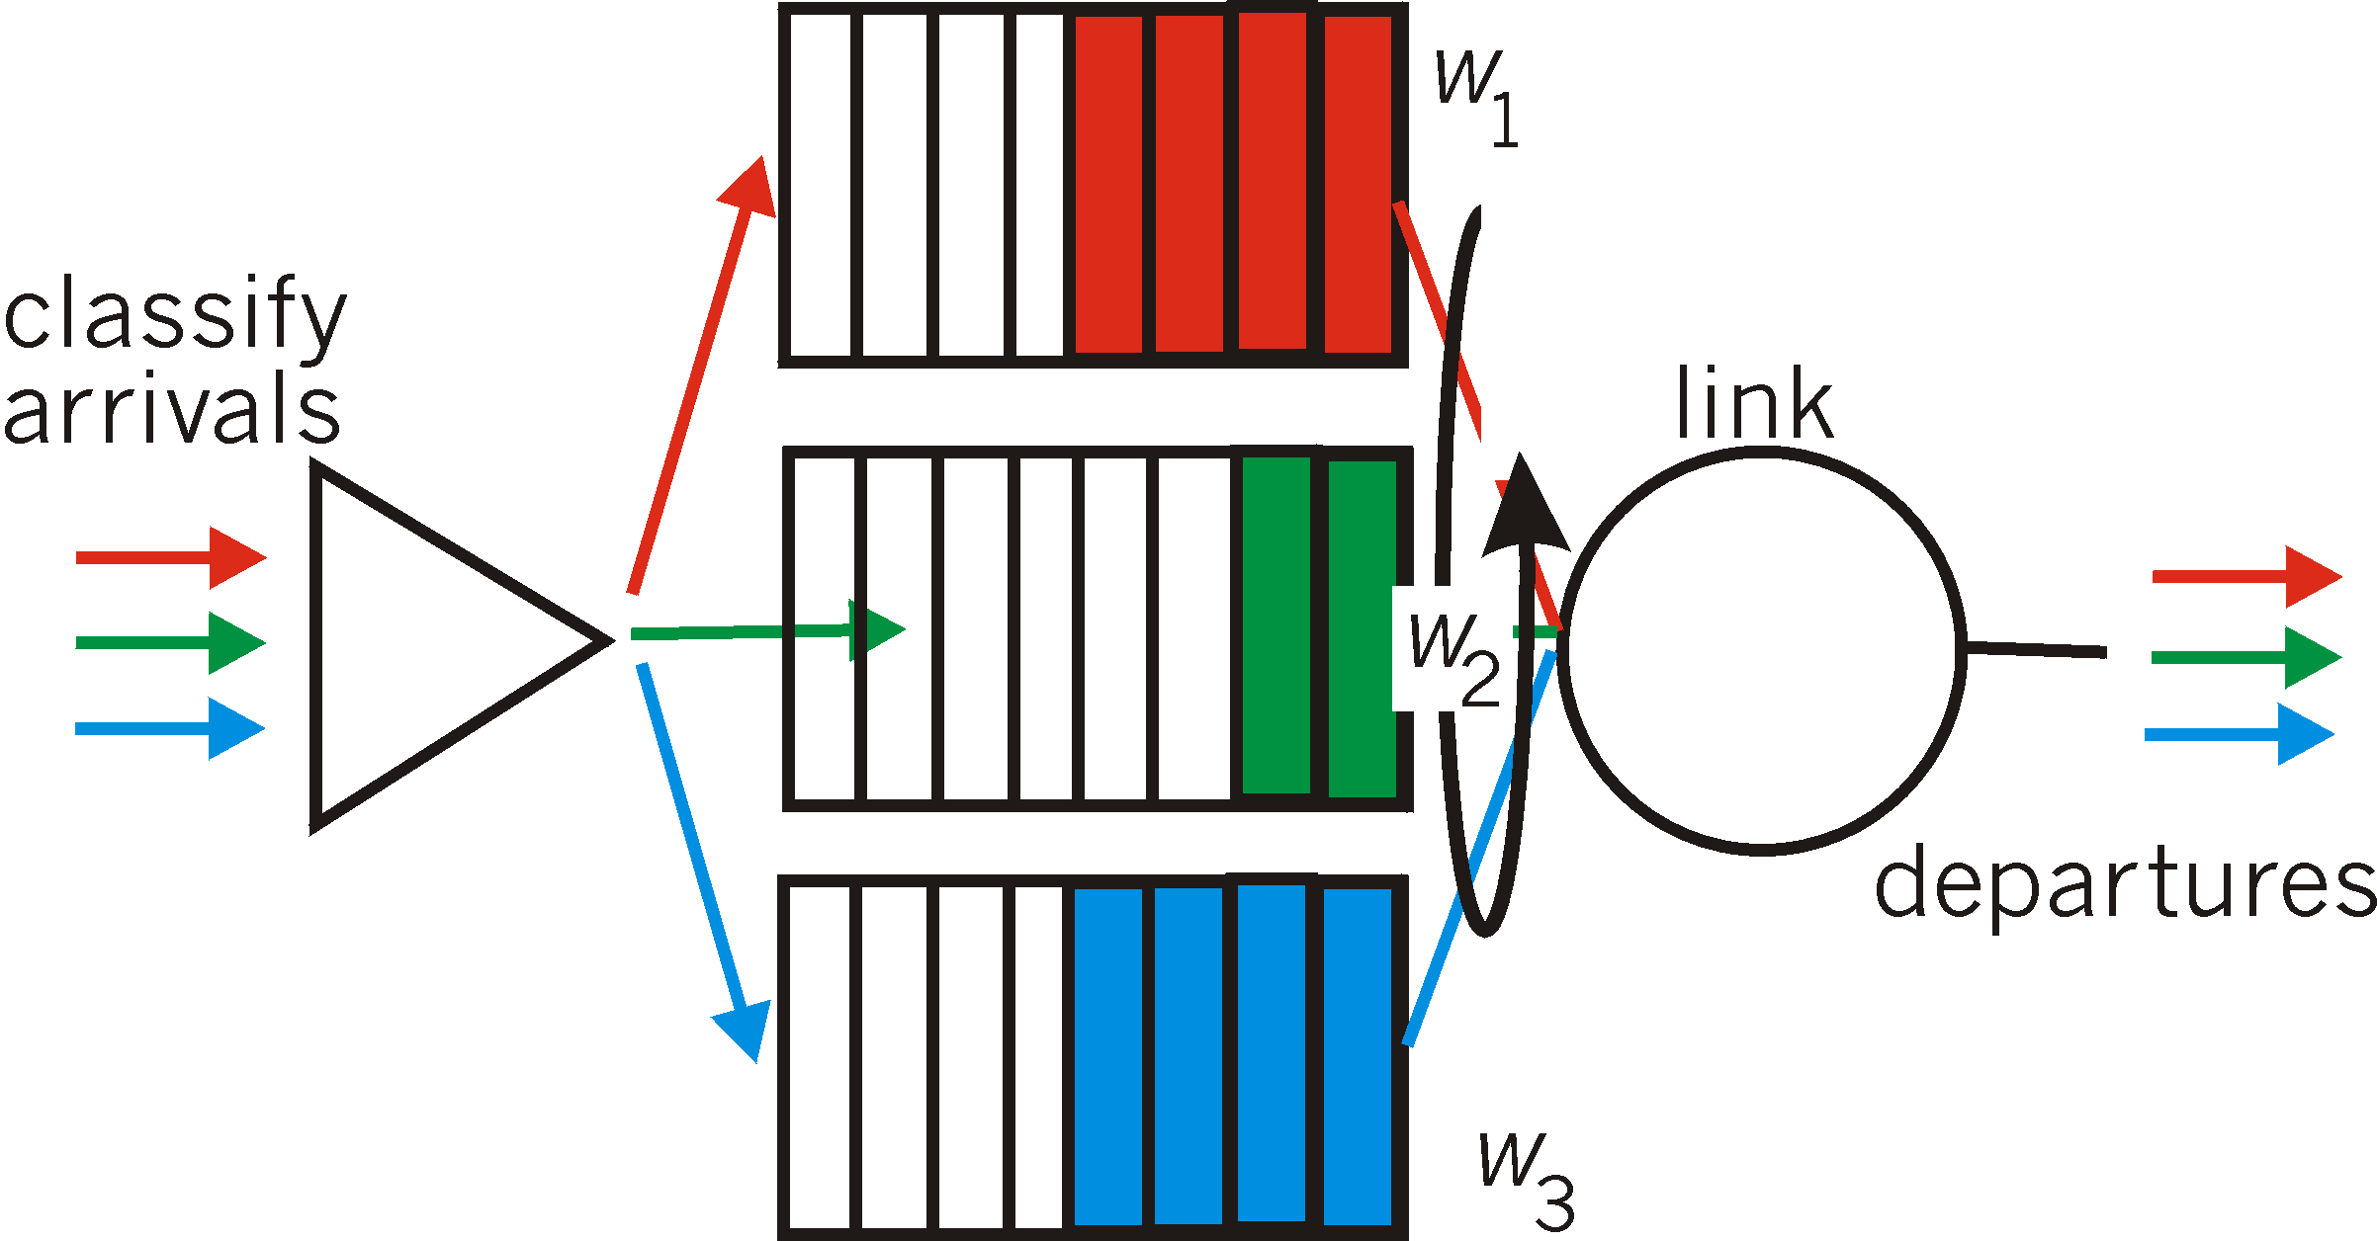
Scheduling Policies: Weighted Fair Queueing
Weighted Fair Queuing: generalized Round Robin, including priorities (weights)
  provide each class with a differentiated amount of service
  class i receives a fraction of service w_{i}/∑(w_{j})
More on packet scheduling: work-conserving policies, delays, …

Slide 47
Policing Mechanisms
Idea: shape the packet traffic (the network provider does traffic policing, ie monitors/enforces the ”shape” agreed).
Traffic shaping, to limit transmission rates:
  (Long term) Average Rate (100 packets per sec or 6000 packets per min), crucial aspect is the interval length
  Peak Rate: e.g., 6000 p p minute Avg and 1500 p p sec Peak
  (Max.) Burst Size: Max. number of packets sent consecutively, ie over a very short period of time

Slide 48
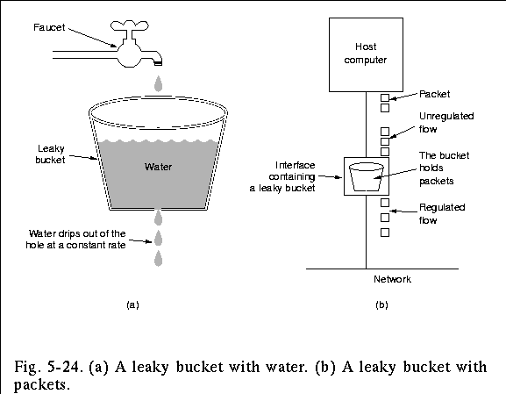
Policing Mechanisms: Pure Leaky Bucket
Idea: eliminates bursts completely; may cause unnecessary packet losses

Slide 49
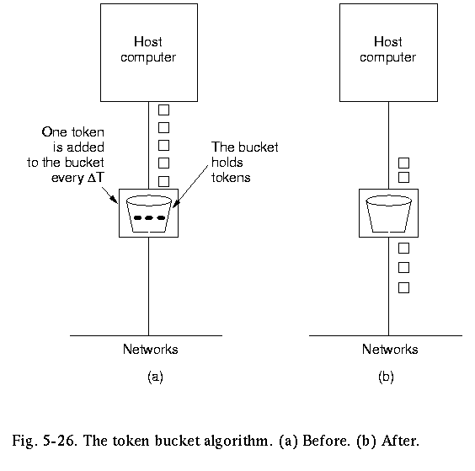
Policing Mechanisms:LeakyToken Bucket
Idea: packets sent by consuming tokens produced at constant rate r
  a means for limiting input to specified Burst Size (b= bucket capacity) and Average Rate (max admitted #packets over time period t is b+rt).
  to avoid still much burstiness, put a leaky bucket -with higher rate; why?- after the token bucket)

Slide 50
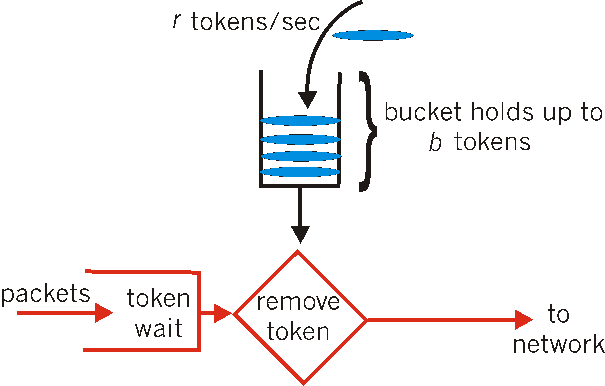
Policing Mechanisms: token bucket
Another way to illustrate token buckets:

Slide 51
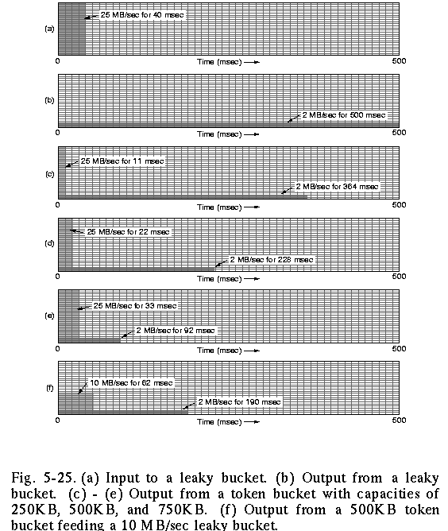
Policing: the effect of buckets
input
output pure leaky bucket, 2MBps
output token bucket 250KB, 2MBps
output token bucket 500KB, 2MBps
output token bucket 750KB, 2MBps
output 500KB, 2MBps token bucket feeding 10MBps leaky bucket

Slide 52
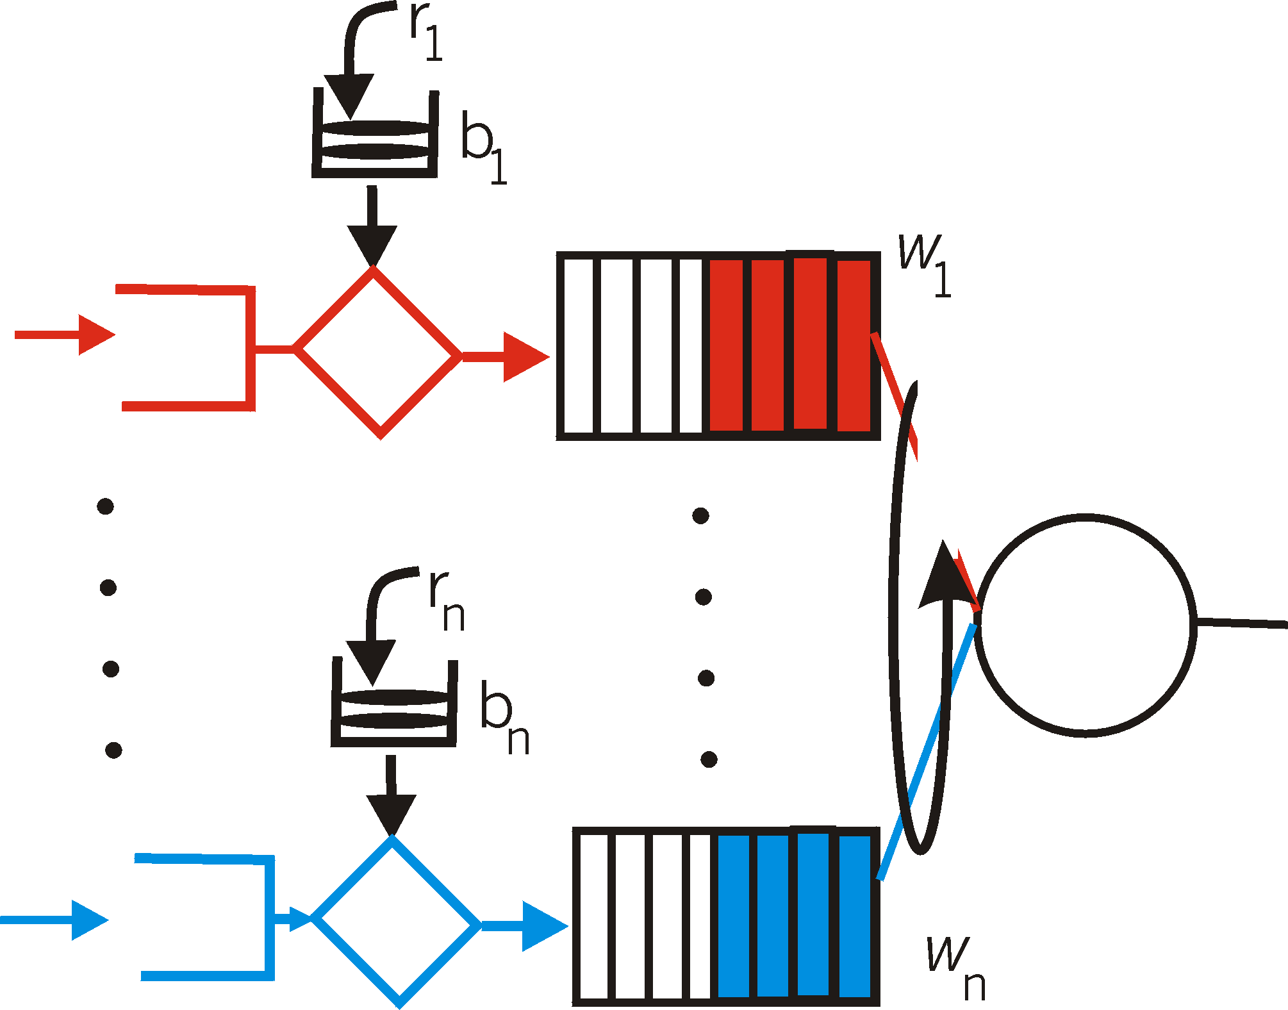
Token bucket + WFQ…
…can be combined to provide upper bound on packet delay in queue:
b_{i} packets in queue, packets are serviced at a rate of at least R · w_{i}/∑ (wj) packets per second, then the time until the last packet is transmitted is at most
b_{i} /(R · w_{i}/∑ (wj))

Slide 53
Multimedia Applications, Services, Needs, …
Application Classes
  QoS
  challenges
Today’s representative technology
  Phone over IP
    recovery from jitter and loss
  Streaming
  (Overlays) CDN: content distribution networks
  SIP
Improving QoS in Networks (also related with congestion-control)
  Qos Principles
  Packet scheduling and policing
Two generally different approaches
  The VC (ATM) approach (incl. material from Ch 3, 4, 5)
  Internet approach: Int-serv + RSVP, Diff-serv

Slide 54
ATM networks …
… the past’s vision of future networks …
… envisioning to servicing all –- incl. multimedia-- applications

Slide 55
VC (ATM) networks for Qos, classes, etc...
Recall about ATM…

Slide 56
ATM: Asynchronous Transfer Mode nets
Internet:
today’s de facto standard for global data networking
1980’s:
telco’s develop ATM: competing network standard for carrying high-speed voice/data
ATM principles:
virtual-circuit networks: switches maintain state for each “call”
small (48 byte payload, 5 byte header) fixed length cells (like packets)
  fast switching
  small size good for voice
Assume low error-rates, do not perform error control (enhance speed)
well-defined interface between “network” and “user” (think of telephone company)

Slide 57
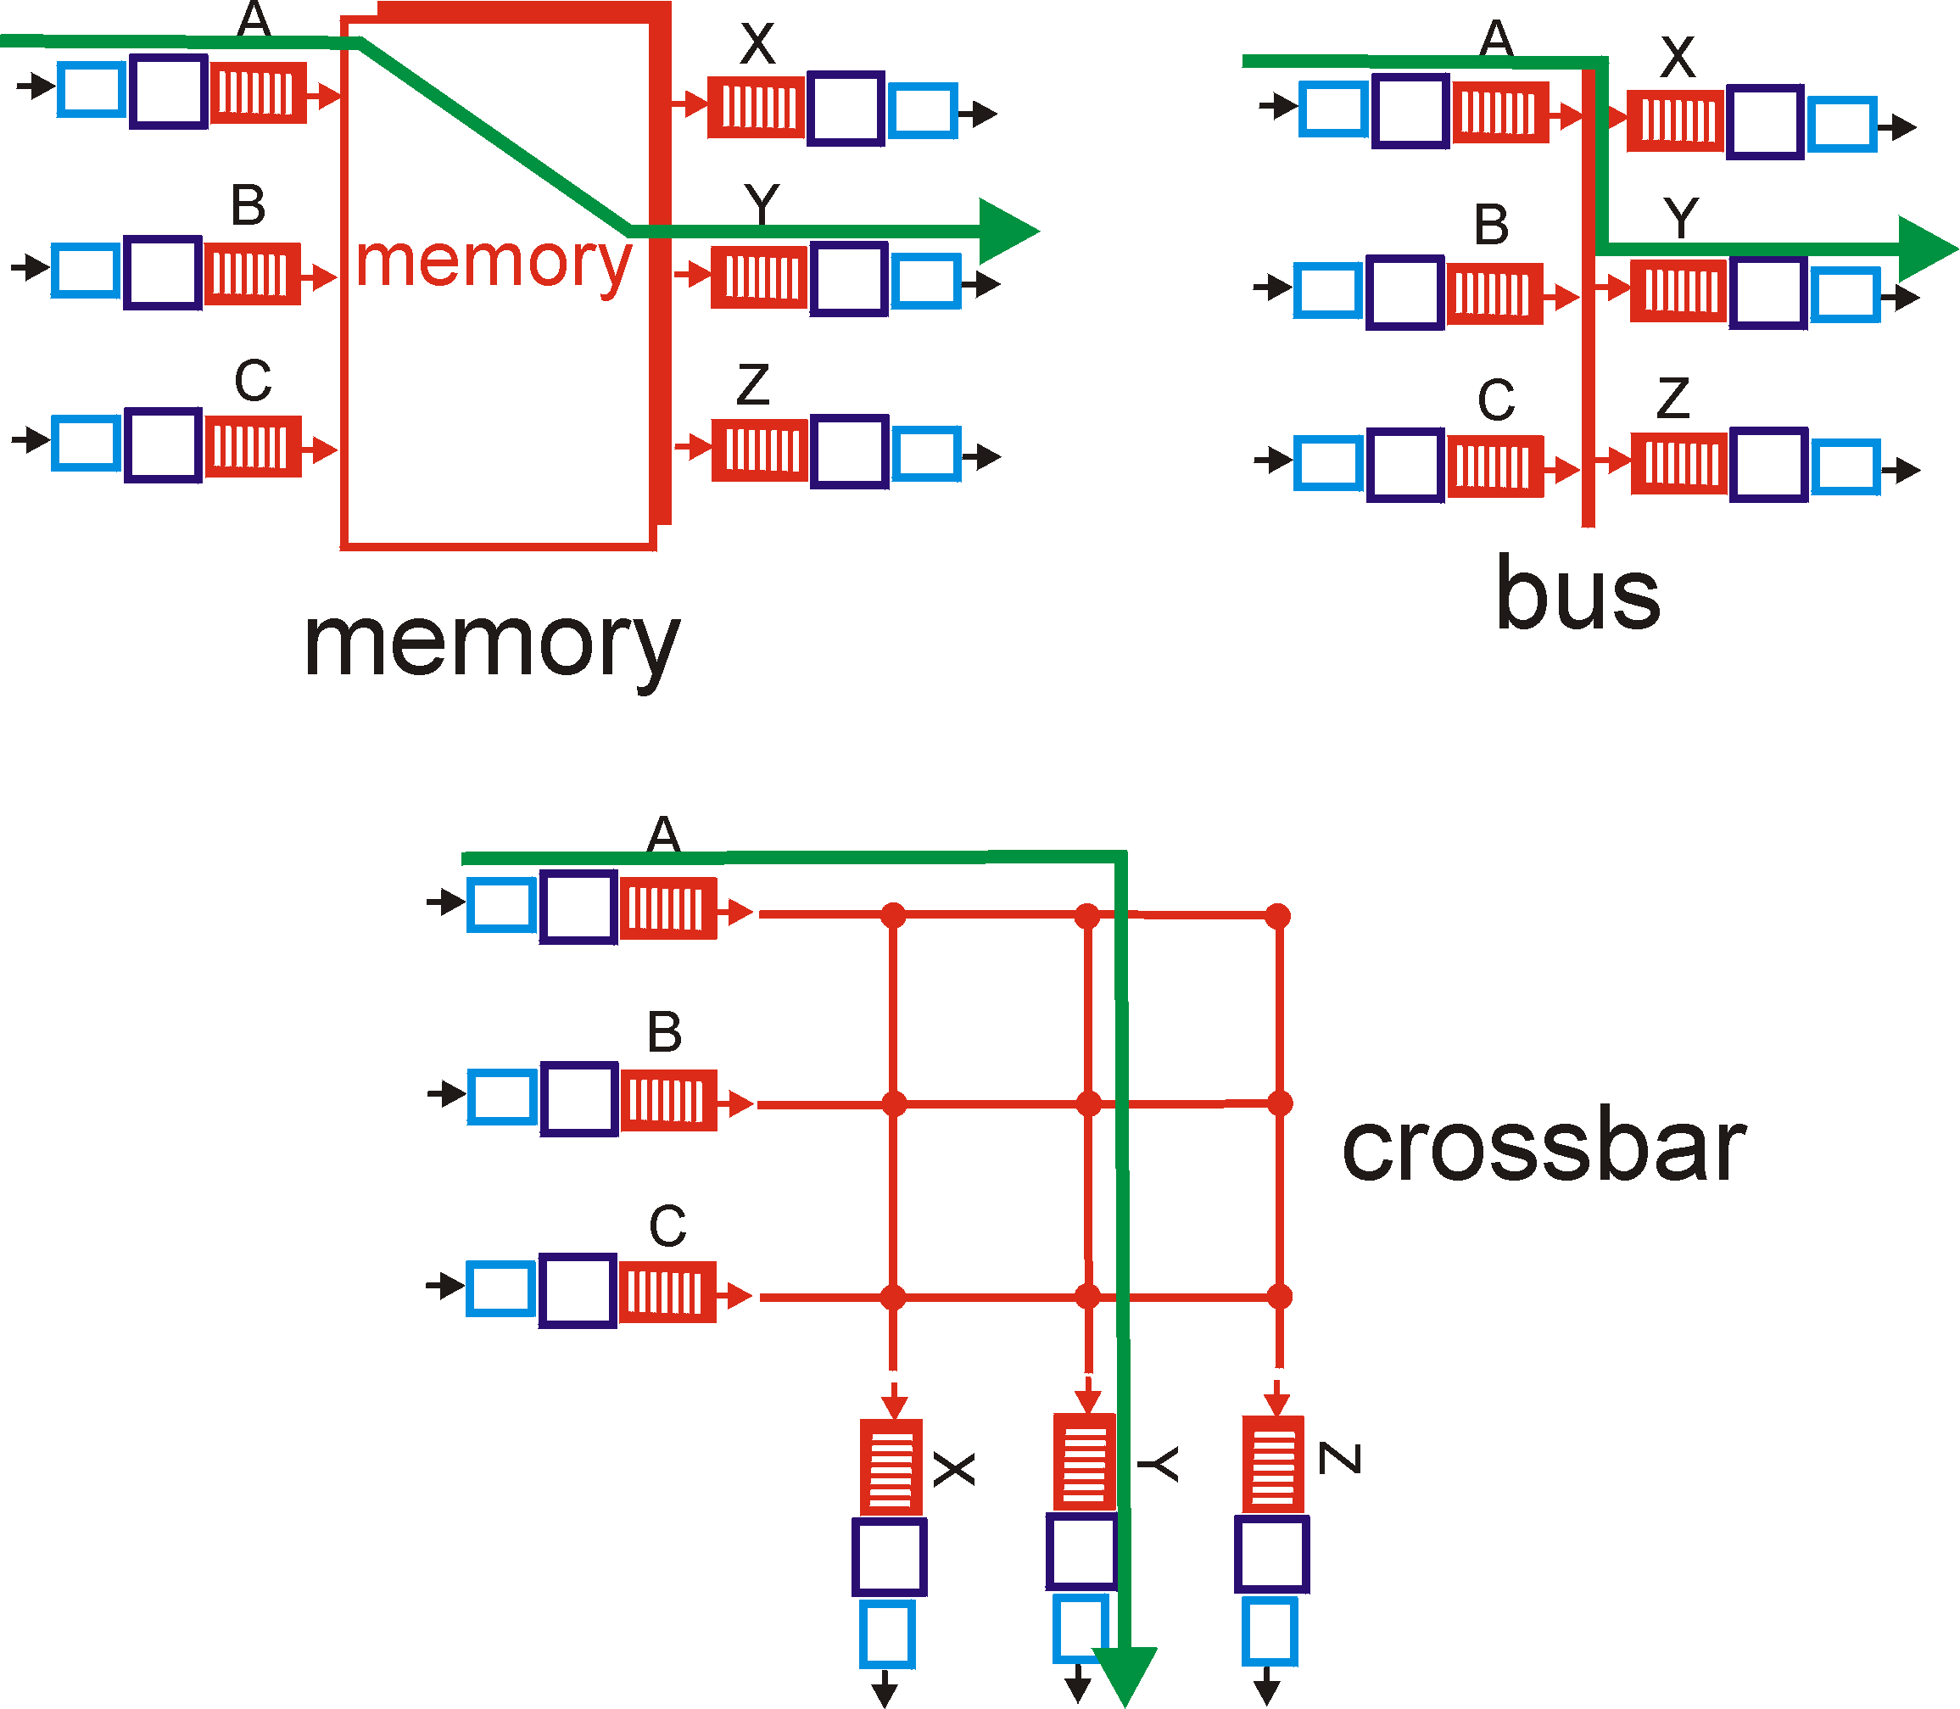
Recall: switching fabrics
ATM switches: VC technology
  Virtual channels, virtual circuits
    Based on Banyan crossbar switches
ATM routing: as train travelling (hence no state for each ”stream”, but for each ”train”)

Slide 58

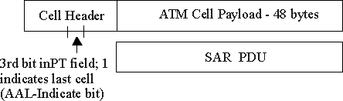
ATM Layer: ATM cell
48-byte payload
  Why?: small payload -> short cell-creation delay for digitized voice
  halfway between 32 and 64 (compromise!)
Header: 5bytes
  VCI: virtual channel ID
  PT: Payload type (e.g. Resource Management cell versus data cell)
  CLP: Cell Loss Priority bit
    CLP = 1 implies low priority cell, can be discarded if congestion
  HEC: Header Error Checksum
    cyclic redundancy check
Cell header
Cell format

Slide 59
Example VC technology
ATM Network service models:
Service
Model
Constant Bit Rate
VariableBR
(RT/nRT)
Available BR
UndefinedBR
Guarantees ?
Example
voice
Video/
“streaming”
www-browsing
Background file transfer
Congestion
feedback
no
congestion
no
congestion
yes
no
Bandwidth
constant
rate
guaranteed
rate
guaranteed
minimum
none
Loss
yes
yes
no
no
Order
yes
yes
yes
yes
Timing
yes
yes
no
no
With ABR you can get min guaranteed capacity and better, if possible; with UBR you can get better, but you may be thrown out in the middle ☹

Slide 60
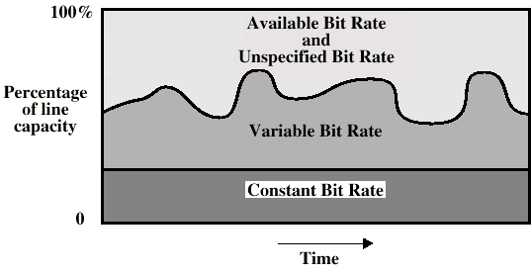
ATM Bit Rate Services

Slide 61
ATM Congestion Control
Several different strategies are used:
Admission control and resource reservation: reserve resources when opening a VC; traffic shaping and policing
Rate-based congestion control: similar to choke packets (method provided in IP (ICMP) also, but not really used in implementations); (especially for ABR traffic)
  idea = give feedback to the sender and intermediate stations on the min. available (= max. acceptable) rate on the VC.

Slide 62
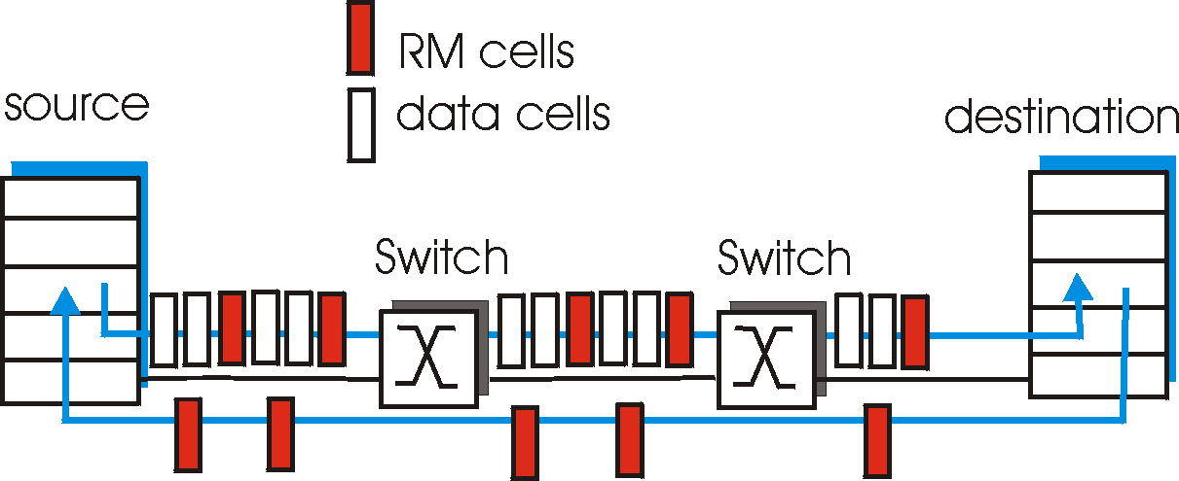
ATM ABR congestion control
ABR: available bit rate:
“elastic service”
if path “underloaded”:
  sender should use available bandwidth
if path congested:
  sender throttled to minimum guaranteed rate
RM (resource management) cells:
interspersed with data cells
bits in RM cell set by switches (“network-assisted”)
  NI bit: no increase in rate (mild congestion)
  CI bit: congestion indication two-byte ER (explicit rate) field in RM cell
  congested switch may lower ER value in cell
  sender’ send rate thus minimum supportable rate on path

Slide 63
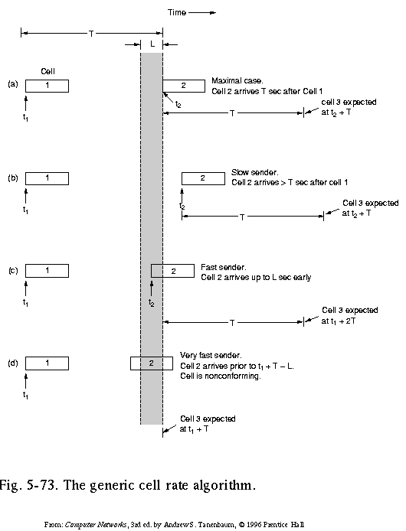
Traffic Shaping and Policing in ATM
Enforce the QoS parameters: check if Peak Cell Rate (PCR) and Cell Delay Variation (CDVT) are within the negotiated limits:
Generic Cell Rate Algo: introduce:
expected next time for a successive cell, based on T = 1/PCR
border time L ( = CDVT) < T in which next transmission may start (but never before T-L)
A nonconforming cell may be discarded, or its Cell Loss Priority bit be set, so it may be discarded in case of congestion

Slide 64
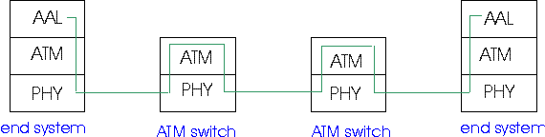
ATM Adaptation (Transport) Layer: AAL
Basic idea: cell-based VCs need to be ”complemented ”to be supportive for applications.
Several ATM Adaptation Layer (AALx) protocols defined, suitable for different classes of applications
  AAL1: for CBR (Constant Bit Rate) services, e.g. circuit emulation
  AAL2: for VBR (Variable Bit Rate) services, e.g., MPEG video
  .....
”suitability” has not been very successful
computer science community introduced AAL5, (simple, elementary protocol), to make the whole ATM stack usable as switching technology for data communication under IP!

Slide 65
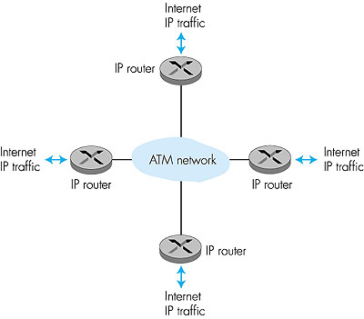
ATM: network or link layer?
Vision: end-to-end transport: “ATM from desktop to desktop”
  ATM is a network technology
Reality: used to connect IP backbone routers
  “IP over ATM”
  ATM as switched link layer, connecting IP routers

Slide 66
IP-Over-ATM
IP over ATM
replace “network” (e.g., LAN segment) with ATM network
ATM addresses, IP addresses
Classic IP only
3 “networks” (e.g., LAN segments)
MAC (802.3) and IP addresses
ATM
network
Ethernet
LANs
Ethernet
LANs
To be continued...

Slide 67
Multimedia Applications, Services, Needs, …
Application Classes
  QoS
  challenges
Today’s representative technology
  Phone over IP
    recovery from jitter and loss
  Streaming
  (Overlays) CDN: content distribution networks
  SIP
Improving QoS in Networks (also related with congestion-control)
  Qos Principles
  Packet scheduling and policing
Two generally different approaches
  The VC (ATM) approach (incl. material from Ch 3, 4, 5)
  Internet approach: Int-serv + RSVP, Diff-serv

Slide 68
Recall:
Solution Approaches in IP Networks
To mitigate impact of “best-effort” protocols:
  Use UDP to avoid TCP’s slow-start phase…
  Buffer content at client and control playback to remedy jitter
  Adapt compression level to available bandwidth
  Exhaust all uses of caching, proxys, etc
add more bandwidth
Scalability? May need major change of the protocols (?):
Incorporate resource reservation (bandwidth, processing, buffering), and new scheduling policies
Use traffic classes for packets and differentiate service accordingly
Set up service level agreements with applications, monitor and enforce the agreements, charge accordingly

Slide 69


Intserv: QoS guarantee scenario
Resource reservation per individual application session
  call setup, signaling (RSVP)
  traffic, QoS declaration
  per-element admission control
  maintain state a la VC
request/
reply
  QoS-sensitive scheduling (e.g., WFQ)

Slide 70
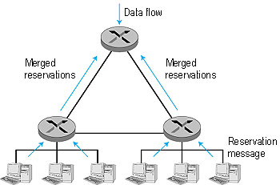
RSVP: resource reservation protocol
RSVP: a leading candidate for signaling protocol
  allows reservations for bandwidth in multicast trees
  is receiver-oriented (the receiver of a
    data flow initiates and maintains the
    resource reservation for the flow).
  Maintains soft-state
    receivers renew interest regularly
  does not specify how the network
    provides the reserved bandwidth, only
    allows the applications to reserve it.
  is not a routing protocol; it depends on
    an underlying routing protocol to
    determine the routes for the flows; when a route changes,
    RSVP re-reserves resources.
  does not define the admission test, but it assumes that the routers perform such a test and that RSVP can interact with the test.

Slide 71
Back to Internet QoS support:alternatively?
Concerns with Intserv:
Scalability: signaling, maintaining per-flow router state difficult with large number of flows
Diffserv approach:
Don’t define service classes, provide functional components to build service classes
  Network core: stateless, simple
  Combine flows into aggregated flows
  Classification, shaping, admission at the network edge

Slide 72

Diffserv Architecture
Edge router:
per-flow traffic management
marks packets as in-profile and out-profile
marking
r
scheduling
.
b
.
.
Core router:
per class traffic management
buffering and scheduling based on marking at edge
preference given to in-profile packets

Slide 73
Edge-router Packet Marking
profile: pre-negotiated rate A, bucket size B
packet marking at edge based on per-flow profile
Rate A
B
User packets
Possible usage of marking:
class-based marking: packets of different classes marked differently
intra-class marking: conforming portion of flow marked differently than non-conforming one
Packet is marked in the Type of Service (TOS) in IPv4, and Traffic Class in IPv6

Slide 74
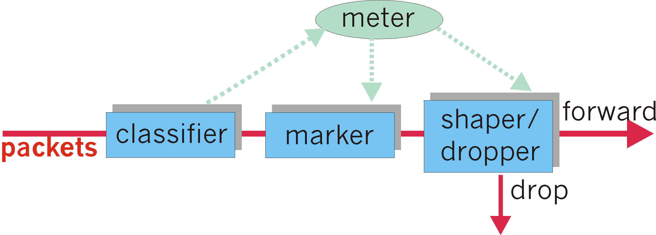
Classification and Conditioning
may be desirable to limit traffic injection rate of some class:
user declares traffic profile (e.g., rate, burst size)
traffic metered, shaped if non-conforming

Slide 75
DiffServ Core Functions
Forwarding: according to “Per-Hop-Behavior” (PHB) specified for the particular packet class; PHB is strictly based on classification marking (no other header fields can be used to influence PHB)
  PHB results in a different observable (measurable) forwarding performance behavior
  PHB does not specify what mechanisms to use to ensure required PHB performance behavior
  Examples:
    Class A gets x% of outgoing link bandwidth over time intervals of a specified length
    Class A packets leave before packets from class B
BIG ADVANTAGE:
No state info to be maintained by routers!

Slide 76
A parallel story: Evolution from ATM/VC related approach: Multiprotocol label switching (MPLS)
initial goal: speed up IP forwarding by using fixed length label (instead of IP address) to do forwarding
  borrowing ideas from Virtual Circuit (VC) approach
  but IP datagram still keeps IP address!
PPP or Ethernet
header
IP header
remainder of link-layer frame
MPLS header
label
Exp
S
TTL
20
3
1
5

Slide 77
MPLS capable routers
a.k.a. label-switched router
forwards packets to outgoing interface based only on label value (don’t inspect IP address)
  MPLS forwarding table distinct from IP forwarding tables
signaling protocol needed to set up forwarding
  RSVP-TE (extension for “traffic-engineering”, use MPLS)
  forwarding possible along paths that IP alone would not allow (e.g., source-specific routing) !!
must co-exist with IP-only routers

Slide 78
Summary: How should the Internet evolve to better support multimedia?
Integrated services philosophy:
Fundamental changes in Internet so that apps can reserve end-to-end bandwidth
Requires new, complex software in hosts & routers
Laissez-faire
no major changes
more bandwidth when needed
Let application layer solve the problems
  content distribution, application-layer multicast, etc
Differentiated services philosophy:
Fewer changes to Internet infrastructure, yet provide variable class service.
What’s your opinion?

