Slide 1
Chapter 4: Network Layer
Chapter goals:
understand principles behind network layer services:
  how a router works
  routing (path selection)
  dealing with scale
instantiation and implementation in the Internet (incl. advanced topics: IPv6, multicast)
Overview:
network layer services
  VC, datagram
what’s inside a router?
Addressing, forwarding, IP
routing principle: path selection
  hierarchical routing
  Internet routing protocols
(multicast routing)

Slide 2

Network layer
transport packet from sending to receiving hosts
network layer protocols in every host, router
important functions
path determination: route taken by packets from source to dest. Routing algorithms
switching: move packets from router’s input to appropriate router output
call setup: (in some some network architectures) along path before data flows
congestion control (in some network architectures)
application
transport
network
data link
physical
network
data link
physical
network
data link
physical
network
data link
physical
network
data link
physical
network
data link
physical
network
data link
physical
network
data link
physical
network
data link
physical
network
data link
physical
application
transport
network
data link
physical
network
data link
physical
network
data link
physical

Slide 3
Interplay between routing and forwarding
routing: process of planning trip from source to dest
forwarding: process of getting through single interchange
routing algorithm
local forwarding table
header value
output link
0100
0101
0111
1001
3
2
2
1
value in arriving
packet’s header
0111
1
3
2

Slide 4
Network service model
Q: What service model for “channel” transporting packets from sender to receiver?
guaranteed bandwidth?
preservation of inter-packet timing (no jitter)?
loss-free delivery?
in-order delivery?
congestion feedback to sender?
The most important
abstraction provided
by network layer:
?
?
virtual circuit
or
datagram?
?
service abstraction

Slide 5
Virtual circuits:
“source-to-dest path behaves almost like telephone circuit”
call setup, teardown for each call before data can flow
  signaling protocols to setup, maintain teardown VC (ATM, frame-relay, X.25; not in IP)
each packet carries VC identifier (not destination host)
every router maintains “state” for each passing connection
resources (bandwidth, buffers) may be allocated to VC
application
transport
network
data link
physical
5. Data flow begins
6. Receive data
application
transport
network
data link
physical
4. Call connected
3. Accept call
1. Initiate call
2. incoming call

Slide 6
Forwarding table in a VC network
VC number
12
22
32
1
3
2
Forwarding table in
northwest router:
interface
number
Incoming interface Incoming VC # Outgoing interface Outgoing VC #
1 12 3 22
2 63 1 18
3 7 2 17
1 97 3 87
… … … …
Routers maintain connection state information!

Slide 7
Datagram networks: the Internet model
no call setup at network layer
routers: no state about end-to-end connections
  no network-level concept of “connection”
packets typically routed using destination host ID
  packets between same source-dest pair may take different paths
application
transport
network
data link
physical
application
transport
network
data link
physical
1. Send data
2. Receive data

Slide 8
Forwarding table in a datagram network
4 billion
possible entries
Destination Address Range Link Interface
11001000 00010111 00010000 00000000
through 0
11001000 00010111 00010111 11111111
11001000 00010111 00011000 00000000
through 1
11001000 00010111 00011000 11111111
11001000 00010111 00011001 00000000
through 2
11001000 00010111 00011111 11111111
otherwise 3

Slide 9
Forwarding table in datagram NWs: in practice by masking: Longest prefix matching
Prefix Match Link Interface
11001000 00010111 00010 0
11001000 00010111 00011000 1
11001000 00010111 00011 2
otherwise 3
Examples
DA: 11001000 00010111 00010110 10100001
Which interface?
DA: 11001000 00010111 00011000 10101010
Which interface?

Slide 10
Datagram or VC network: why?
e.g. Internet
data exchange among computers
  “elastic” service, no strict timing req.
“smart” end systems (computers)
  can adapt, perform control, error recovery
  simple inside network, complexity at “edge”
But: many traffic types
  different characteristics
  uniform service difficult
e.g. ATM
evolved from telephony
human conversation-like paradigm:
  strict timing, reliability requirements
  need for guaranteed service
“dumb” end systems
  Like (classic) telephones
“clever”, fast routers: to efficiently pipeline receiving/forwarding, eliminating store&forward delays

Slide 11
Network layer service models:
Network
Architecture
Internet
ATM
ATM
ATM
ATM
Service
Model
best effort
CBR
VBR
ABR
UBR
Guarantees ?
Congestion
feedback
no (inferred
via loss)
no
congestion
no
congestion
yes
no
Bandwidth
none
constant
rate
guaranteed
rate
guaranteed
minimum
none
Loss
no
yes
yes
no
no
Order
no
yes
yes
yes
yes
Timing
no
yes
yes
no
no
Internet model being extented: Intserv, Diffserv
(will study these later on)

Slide 12
Router Architecture Overview

Slide 13
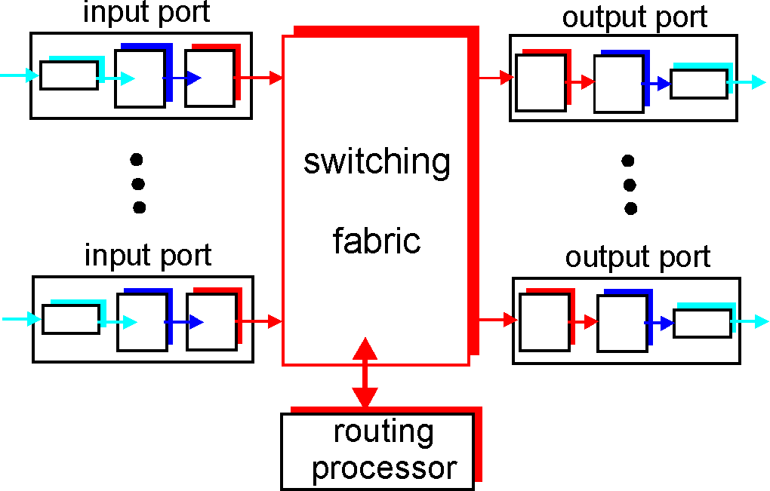
Router Architecture Overview
Two key router functions:
run routing algorithms/protocol
switching packets from incoming to outgoing link

Slide 14
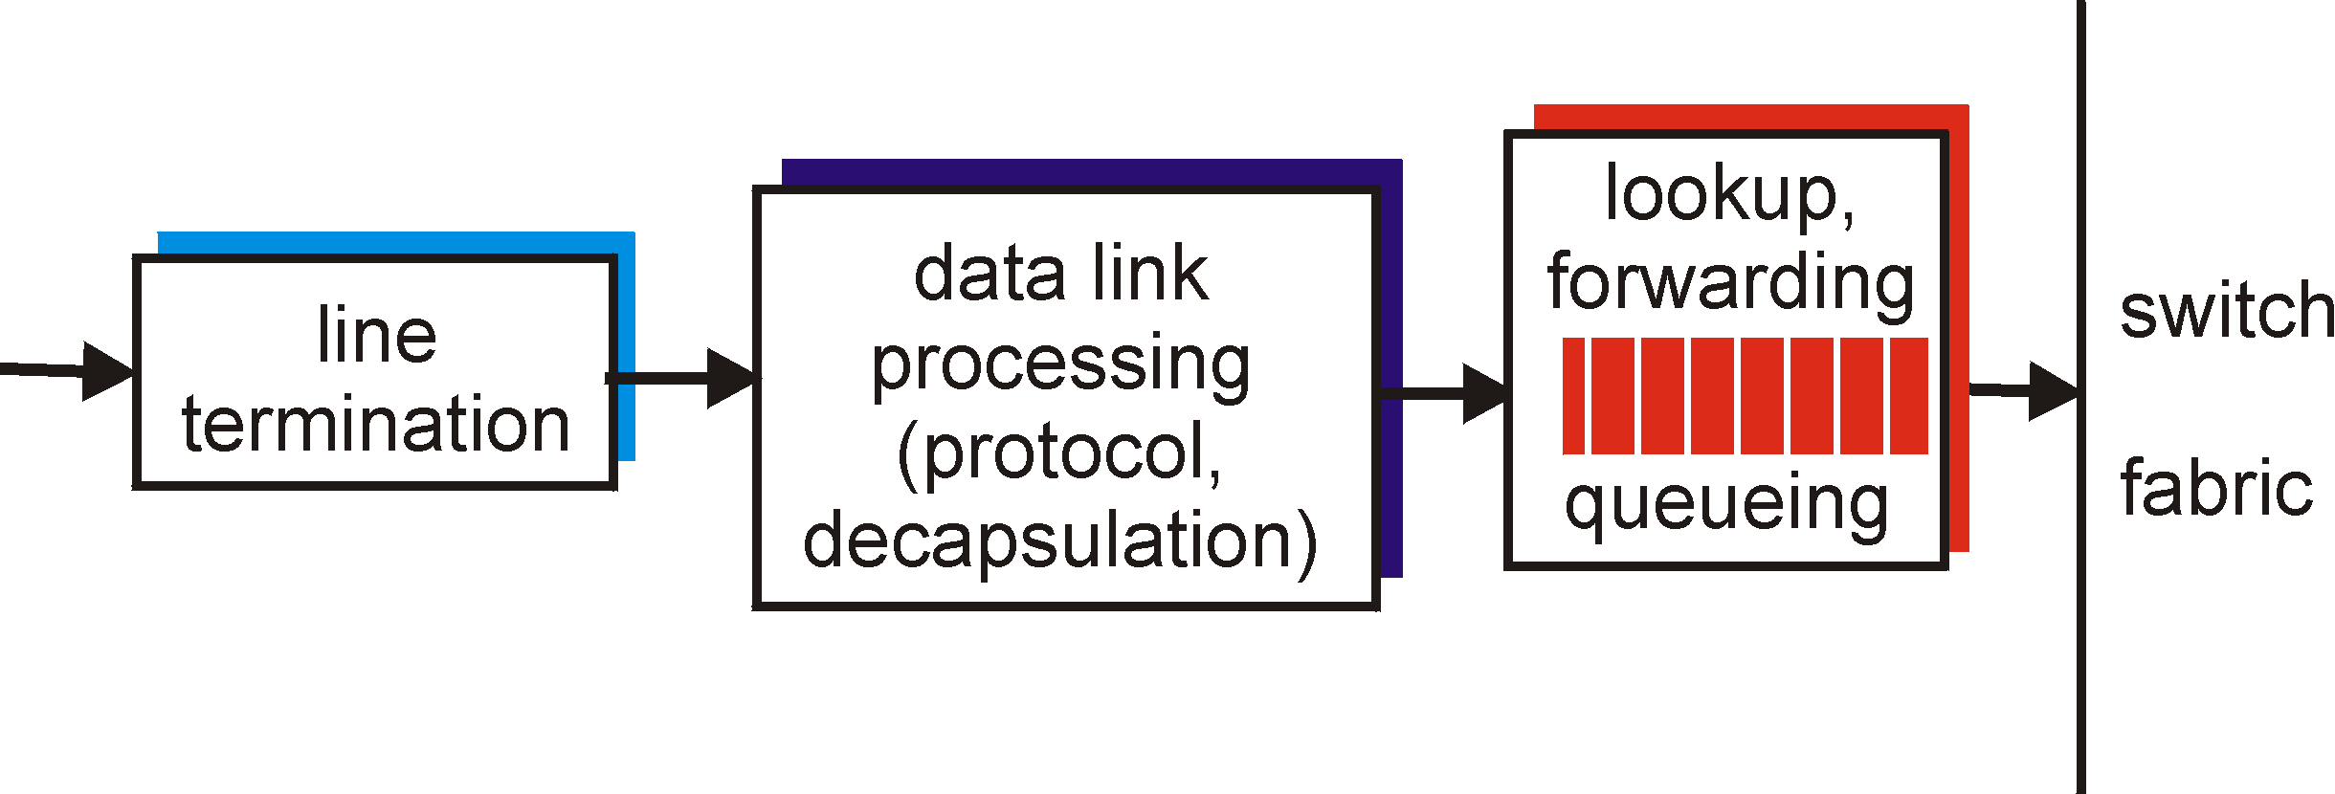
Input Port Functions
Physical layer:
bit-level reception
Data link layer:
e.g., Ethernet
see chapter 5
Decentralized switching:
given datagram dest., lookup output port using routing table in input port memory
goal: complete input port processing at ‘line speed’
queuing: if datagrams arrive faster than forwarding rate into switch fabric

Slide 15
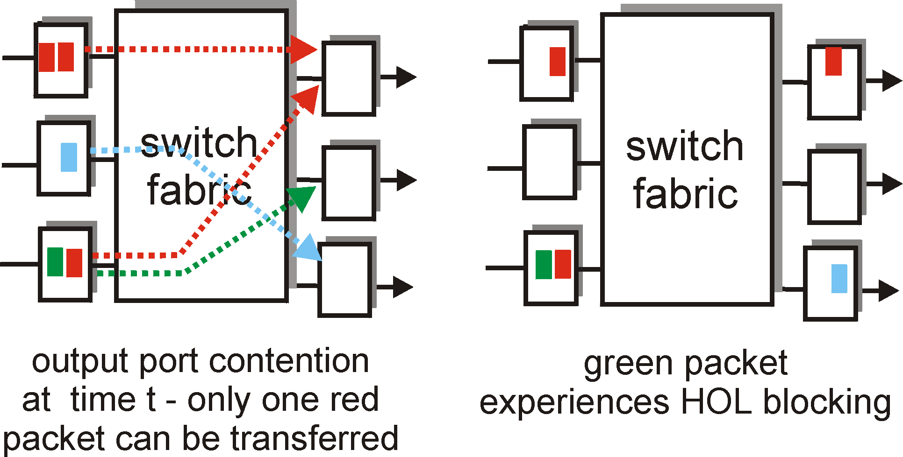
Input Port Queuing
Fabric slower that input ports combined -> queueing may occur at input queues
Head-of-the-Line blocking: queued datagram at front of queue prevents others in queue from moving forward
queueing delay and loss due to input buffer overflow!

Slide 16
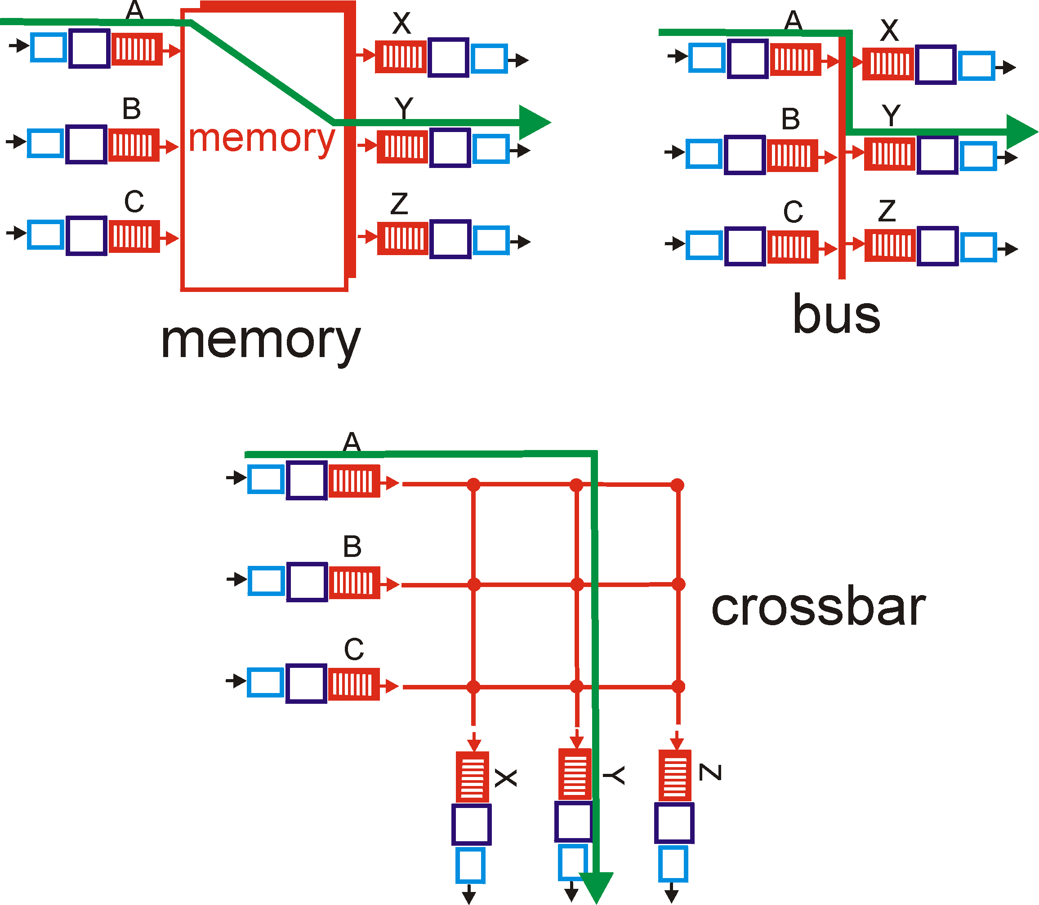
Three types of switching fabrics

Slide 17
Switching Via Memory
First generation routers:
packet copied by system’s (single) CPU
speed limited by memory bandwidth (2 bus crossings per datagram)
Input
Port
Memory
Output
Port
System Bus
Modern routers:
input port processor performs lookup, copy into memory
Cisco Catalyst 8500

Slide 18
Switching Via Bus
datagram from input port memory
to output port memory via a shared bus
bus contention: switching speed limited by bus bandwidth
1 Gbps bus, Cisco 1900: sufficient speed for access and enterprise routers (not regional or backbone)

Slide 19
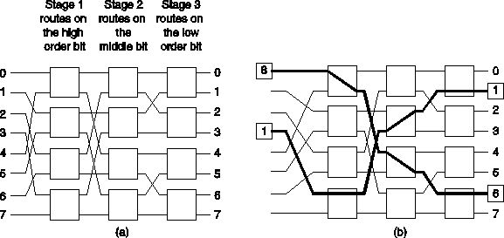
Switching Via An Interconnection Network
Overcome bus bandwidth limitations
Banyan networks, other interconnection nets (also used in processors-memory interconnects in multiprocessors), see eg
Advanced design: fragmenting datagram into fixed length cells, switch cells through the fabric (ATM-network principle).
Cisco 12000: switches 60 Gbps through the interconnection network

Slide 20
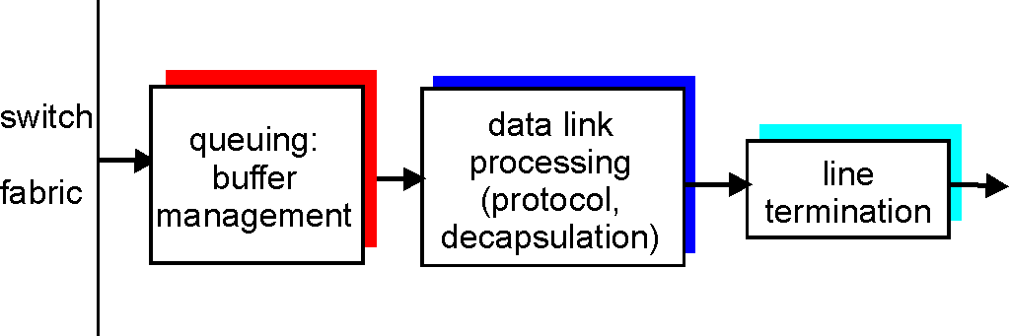
Output Ports
Buffering required when datagrams arrive from fabric faster than the transmission rate
Scheduling discipline chooses among queued datagrams for transmission (cf. QoS guarantees, to be discussed in multimedia context)

Slide 21
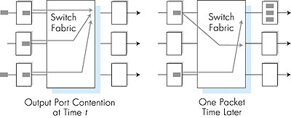
Output port queueing
buffering when arrival rate via switch exceeeds ouput line speed
queueing (delay) and loss due to output port buffer overflow!

Slide 22
Roadmap
Chapter goals:
understand principles behind network layer services:
  how a router works
  routing (path selection)
  dealing with scale
instantiation and implementation in the Internet (incl. IPv6, multicast)
Overview:
network layer services
  VC, datagram
what’s inside a router?
Addressing, forwarding, IP
routing principle: path selection
  hierarchical routing
  Internet routing protocols
(multicast routing)

Slide 23
The Internet Network layer
Host, router network layer functions:
Transport layer: TCP, UDP
Routing protocols
path selection
RIP, OSPF, BGP
IP protocol
addressing conventions
datagram format
packet handling conventions
Network
layer
Forwarding
table
routing
table
ICMP protocol
error reporting
router “signaling”
Link layer
physical layer

Slide 24
IPv4 datagram format
IP protocol version
number
32 bits
total datagram
length (bytes)
header length
(bytes)
head.
len
type of
service
ver
length
for
fragmentation/
reassembly
“type” of data
flgs
fragment
offset
16-bit identifier
max number
remaining hops
(decremented at
each router)
time to
live
upper
layer
Internet
checksum
Why?
32 bit source IP address
upper layer protocol
to deliver payload to
(www.iana.org: dynamic
DB for numbers,
constants, etc)
32 bit destination IP address
Options (if any)
E.g. timestamp,
record route
taken, specify
list of routers
to visit.
data
(variable length,
typically a TCP
or UDP segment)

Slide 25
IP Addressing: introduction
IP address: 32-bit identifier for host, router interface
interface: connection between host/router and physical link
  routers typically have multiple interfaces
  host typically has one interface
  IP addresses associated with each interface
223.1.1.1
223.1.2.1
223.1.1.2
223.1.1.4
223.1.2.9
223.1.2.2
223.1.1.3
223.1.3.27
223.1.3.1
223.1.3.2
223.1.1.1 = 11011111 00000001 00000001 00000001
223
1
1
1

Slide 26
Subnets
IP address:
  subnet part (high order bits)
  host part (low order bits)
What’s a subnet ?
  device interfaces with same subnet-part in their IP addresses
  can physically reach each other without intervening router
223.1.1.1
223.1.2.1
223.1.1.2
223.1.1.4
223.1.2.9
223.1.1.3
223.1.2.2
223.1.3.27
subnet
223.1.3.1
223.1.3.2
network consisting of 3 subnets

Slide 27
Subnets
223.1.1.0/24
223.1.2.0/24
Recipe
To determine the subnets, detach each interface from its host or router, creating islands of isolated networks. Each isolated network is called a subnet.
223.1.3.0/24
Subnet mask: /24

Slide 28
IP addressing: CIDR
CIDR: Classless InterDomain Routing
  subnet portion of address of arbitrary length
  address format: a.b.c.d/x, where x is # bits in subnet portion of address
subnet
part
host
part
11001000 00010111 00010000 00000000
200.23.16.0/23

Slide 29
Internet hierarchical routing
Inter-AS
routing
between
A and B
C.b
B.a
A.a
Host
h2
b
A.c
c
a
C
a
b
a
B
Host
h1
d
c
Intra-AS routing
within AS B
A
b
Intra-AS routing
within AS A
scale: with 50 million destinations:
can’t store all dest’s in routing tables!
routing table exchange would swamp links!
We’ll examine Internet routing algorithms and protocols shortly

Slide 30
IP addresses: how to get one?
Host portion:
hard-coded by system admin in a file; or
DHCP: Dynamic Host Configuration Protocol: dynamically get address:
  host broadcasts “DHCP discover” msg
  DHCP server responds with “DHCP offer” msg
  host requests IP address: “DHCP request” msg
  DHCP server sends address: “DHCP ack” msg

Slide 31
IP addresses: how to get one?
Network portion:
get allocated portion of ISP’s address space:
ISP's block 11001000 00010111 00010000 00000000 200.23.16.0/20
Organization 0 11001000 00010111 00010000 00000000 200.23.16.0/23
Organization 1 11001000 00010111 00010010 00000000 200.23.18.0/23
Organization 2 11001000 00010111 00010100 00000000 200.23.20.0/23
... ….. …. ….
Organization 7 11001000 00010111 00011110 00000000 200.23.30.0/23

Slide 32
IP addressing: the last word...
Q: How does an ISP get block of addresses?
A: ICANN: Internet Corporation for Assigned
Names and Numbers
  allocates addresses
  manages DNS
  assigns domain names, resolves disputes

Slide 33
Well, it was not really the last word…
NAT: Network Address Translation
rest of
Internet
local network
(e.g., home network)
10.0.0/24
10.0.0.1
10.0.0.4
10.0.0.2
138.76.29.7
10.0.0.3
All datagrams leaving local
network have same single source NAT IP address: 138.76.29.7,
different source port numbers
Datagrams with source or
destination in this network
have 10.0.0/24 address for
source, destination (as usual)

Slide 34
NAT: Network Address Translation
Motivation: local network uses just one IP address as far as outside world is concerned:
  range of addresses not needed from ISP: just one IP address for all devices
  can change addresses of devices in local network without notifying outside world
  can change ISP without changing addresses of devices in local network
  devices inside local net not explicitly addressable, visible by outside world (a security plus).

Slide 35
NAT: Network Address Translation
Implementation: NAT router must:
  outgoing datagrams: replace (source IP address, port #) of every outgoing datagram to (NAT IP address, new port #)
    . . . remote clients/servers will respond using (NAT IP address, new port #) as destination addr.
  remember (in NAT translation table) every (source IP address, port #) to (NAT IP address, new port #) translation pair
  incoming datagrams: replace (NAT IP address, new port #) in dest fields of every incoming datagram with corresponding (source IP address, port #) stored in NAT table

Slide 36
NAT: Network Address Translation
NAT translation table
WAN side addr LAN side addr
1: host 10.0.0.1
sends datagram to
128.119.40.186, 80
2: NAT router
changes datagram
source addr from
10.0.0.1, 3345 to
138.76.29.7, 5001,
updates table
138.76.29.7, 5001 10.0.0.1, 3345
…… ……
S: 10.0.0.1, 3345
D: 128.119.40.186, 80
10.0.0.1
1
2
S: 138.76.29.7, 5001
D: 128.119.40.186, 80
10.0.0.4
10.0.0.2
138.76.29.7
S: 128.119.40.186, 80
D: 10.0.0.1, 3345
4
S: 128.119.40.186, 80
D: 138.76.29.7, 5001
3
10.0.0.3
4: NAT router
changes datagram
dest addr from
138.76.29.7, 5001 to 10.0.0.1, 3345
3: Reply arrives
dest. address:
138.76.29.7, 5001

Slide 37
NAT: Network Address Translation
16-bit port-number field:
  60,000 simultaneous connections with a single LAN-side address!
NAT is controversial:
  routers should only process up to layer 3
  violates end-to-end argument
    NAT possibility must be taken into account by app designers, eg, P2P applications
  address shortage should instead be solved by IPv6

Slide 38
NAT traversal problem
client want to connect to server with address 10.0.0.1
  server address 10.0.0.1 local to LAN (client can’t use it as destination addr)
  only one externally visible NATted address: 138.76.29.7
solution 1 (manual): statically configure NAT to forward incoming connection requests at given port to server
  e.g., (123.76.29.7, port 2500) always forwarded to 10.0.0.1 port 2500
10.0.0.1
Client
?
10.0.0.4
138.76.29.7
NAT
router

Slide 39
NAT traversal problem
solution 2 (protocol) : Universal Plug and Play (UPnP) Internet Gateway Device (IGD) Protocol. Allows NATted host to:
  learn public IP address (138.76.29.7)
  enumerate existing port mappings
  add/remove port mappings (with lease times)
  i.e., automate static NAT port map configuration
10.0.0.1
IGD
10.0.0.4
138.76.29.7
NAT
router

Slide 40


NAT traversal problem
solution 3 (application): relaying (used in Skype)
  NATed server establishes connection to relay
  External client connects to relay
  relay bridges packets between two connections
2. connection to
relay initiated
by client
1. connection to
relay initiated
by NATted host
10.0.0.1
3. relaying
established
Client
138.76.29.7
NAT
router

Slide 41
Getting a datagram from source to dest.
forwarding table in A
Dest. Net. next router Nhops
223.1.1 1
223.1.2 223.1.1.4 2
IP datagram:
223.1.3 223.1.1.4 2
misc
fields
source
IP addr
dest
IP addr
data
A
223.1.1.1
datagram remains unchanged, as it travels source to destination
addr fields of interest here
223.1.2.1
223.1.1.2
223.1.1.4
223.1.2.9
B
223.1.2.2
E
223.1.1.3
223.1.3.27
223.1.3.1
223.1.3.2

Slide 42
Getting a datagram from source to dest.
misc
fields
Dest. Net. next router Nhops
223.1.1.1
223.1.1.3
data
223.1.1 1
Starting at A, given IP datagram addressed to B:
look up net. address of B
find B is on same net. as A (B and A are directly connected)
link layer will send datagram directly to B (inside link-layer frame)
223.1.2 223.1.1.4 2
223.1.3 223.1.1.4 2
A
223.1.1.1
223.1.2.1
223.1.1.2
223.1.1.4
223.1.2.9
B
223.1.2.2
E
223.1.1.3
223.1.3.27
223.1.3.1
223.1.3.2

Slide 43
Getting a datagram from source to dest.
misc
fields
Dest. Net. next router Nhops
223.1.1.1
223.1.2.3
data
223.1.1 1
Starting at A, dest. E:
look up network address of E
E on different network
routing table: next hop router to E is 223.1.1.4
link layer is asked to send datagram to router 223.1.1.4 (inside link-layer frame)
datagram arrives at 223.1.1.4
continued…..
223.1.2 223.1.1.4 2
223.1.3 223.1.1.4 2
A
223.1.1.1
223.1.2.1
223.1.1.2
223.1.1.4
223.1.2.9
B
223.1.2.2
E
223.1.1.3
223.1.3.27
223.1.3.1
223.1.3.2

Slide 44
Getting a datagram from source to dest.
Dest. next
misc
fields
network router Nhops interface
223.1.1.1
223.1.2.3
data
223.1.1 - 1 223.1.1.4
Arriving at 223.1.4, destined for 223.1.2.2
look up network address of E
E on same network as router’s interface 223.1.2.9
  router, E directly attached
link layer sends datagram to 223.1.2.2 (inside link-layer frame) via interface 223.1.2.9
datagram arrives at 223.1.2.2!!! (hooray!)
223.1.2 - 1 223.1.2.9
223.1.3 - 1 223.1.3.27
A
223.1.1.1
223.1.2.1
223.1.1.2
223.1.1.4
223.1.2.9
B
223.1.2.2
E
223.1.1.3
223.1.3.27
223.1.3.1
223.1.3.2

Slide 45
IP Fragmentation & Reassembly
network links have MTU (max.transfer size) - largest possible link-level frame.
  different link types, different MTUs
large IP datagram divided (“fragmented”) within net
  one datagram becomes several datagrams
  “reassembled” only at final destination
  IP header bits used to identify, order related fragments
fragmentation:
in: one large datagram
out: 3 smaller datagrams
reassembly

Slide 46
IP Fragmentation and Reassembly
length
=4000
ID
=x
fragflag
=0
offset
=0
One large datagram becomes
several smaller datagrams
length
=1500
ID
=x
fragflag
=1
offset
=0
length
=1500
ID
=x
fragflag
=1
offset
=1500
length
=1000
ID
=x
fragflag
=0
offset
=3000

Slide 47
IPv6
Initial motivation: prediction: 32-bit address space completely allocated by approx. 2008.
Additional motivation:
  header format helps speed processing/forwarding
  header changes to facilitate provisioning of services that could guarantee timing, bandwidth
  new “anycast” address: route to “best” of several replicated servers
IPv6 datagram format (to speed-up pkt-processing):
  fixed-length 40 byte header
  no (intermediate) fragmentation allowed
  no checksum

Slide 48
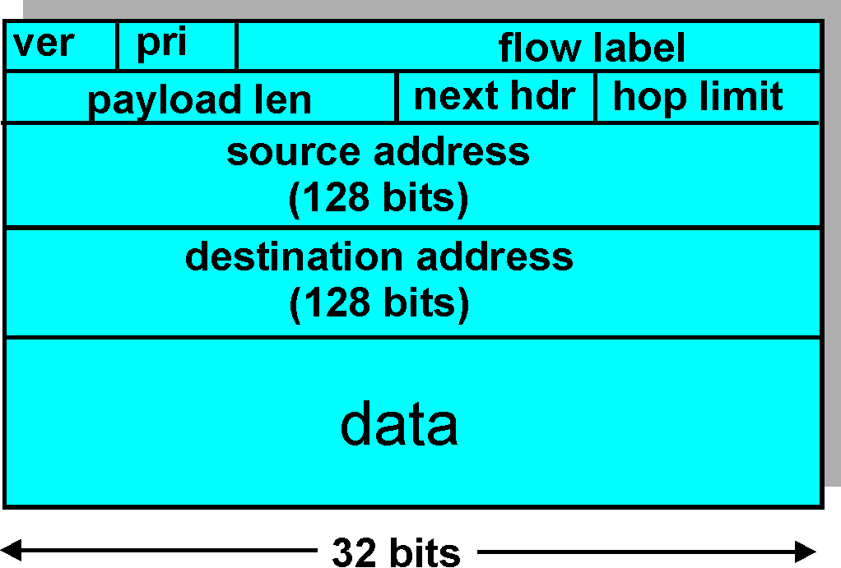
IPv6 Header (Cont)
Priority: identify priority among datagrams in flow
Flow Label: identify datagrams in same “flow.”
(concept of“flow” not well defined).
Next header: (e.g. extend header with info such as
identify upper layer protocol for data)

Slide 49
Transition From IPv4 To IPv6
Not all routers can be upgraded simultaneous
  no “flag days”
  How will the network operate with mixed IPv4 and IPv6 routers?
Two proposed approaches:
  Dual Stack: some routers with dual stack (v6, v4) can “translate” between formats
  Tunneling: IPv6 carried as payload n IPv4 datagram among IPv4 routers

Slide 50
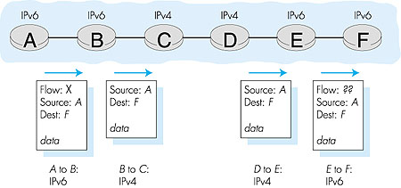
Dual Stack Approach

Slide 51
Tunneling
A
B
E
F
Logical view:
tunnel
IPv6
IPv6
IPv6
IPv6
A
B
E
F
Physical view:
IPv6
IPv6
IPv4
IPv4
IPv6
IPv6

Slide 52
Tunneling
A
B
E
F
Logical view:
tunnel
IPv6
IPv6
IPv6
IPv6
A
B
C
D
E
F
Physical view:
IPv6
IPv6
IPv4
IPv4
IPv6
IPv6
Flow: X
Src: A
Dest: F
data
Src:B
Dest: E
Src:B
Dest: E
Flow: X
Src: A
Dest: F
data
Flow: X
Src: A
Dest: F
data
Flow: X
Src: A
Dest: F
data
A-to-B:
IPv6
B-to-C:
IPv6 inside
IPv4
D-to-E:
IPv6 inside
IPv4
E-to-F:
IPv6

Slide 53
ICMP: Internet Control Message Protocol
used by hosts, routers, gateways to communicate network-level information:
  error reporting:
  control: echo request/reply (used by ping), cong. Control (tentative)
ICMP message: type, code plus first 8 bytes of IP datagram causing error
network-layer-protocol “above” IP:
  ICMP msgs carried in IP datagrams
What if an ICMP message gets lost?
Type Code description
0 0 echo reply (ping)
3 0 dest. network unreachable
3 1 dest host unreachable
3 2 dest protocol unreachable
3 3 dest port unreachable
3 6 dest network unknown
3 7 dest host unknown
4 0 source quench (congestion
control - not used)
8 0 echo request (ping)
9 0 route advertisement
10 0 router discovery
11 0 TTL expired
12 0 bad IP header

Slide 54
Roadmap
Chapter goals:
understand principles behind network layer services:
  how a router works
  routing (path selection)
  dealing with scale
instantiation and implementation in the Internet (incl. IPv6, multicast)
Overview:
network layer services
  VC, datagram
what’s inside a router?
Addressing, forwarding, IP
NEXT: routing principle: path selection
  hierarchical routing
  Internet routing protocols
(multicast routing)

