Slide 1
Chapter 3: Transport Layer
Part B
Course on Computer Communication and Networks, CTH/GU
The slides are adaptation of the slides made available by the authors of the course’s main textbook

Slide 2
Pipelining: increased utilization
Ack-based => flowcontrol
sender
receiver
first packet bit transmitted, t = 0
last bit transmitted, t = L / R
first packet bit arrives
RTT
last packet bit arrives, send ACK
last bit of 2nd packet arrives, send ACK
last bit of 3rd packet arrives, send ACK
ACK arrives, send next
packet, t = RTT + L / R
Increase utilization
by a factor of 3!

Slide 3
TCP: Overview RFCs: 793, 1122, 1323, 2018, 2581
full duplex data:
  bi-directional data flow in same connection
point-to-point:
  one sender, one receiver
flow controlled:
  sender will not overwhelm receiver
connection-oriented:
  handshaking (exchange of control msgs) init’s sender, receiver state before data exchange, MSS (maximum segment size)
reliable, in-order byte steam:
  no “message boundaries”
pipelined:
  TCP congestion and flow control set window size
send & receive buffers

Slide 4
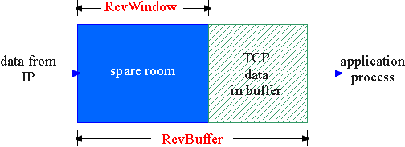
TCP Flow Control:
Dynamic sliding windows
flow control
receiver: explicitly informs sender of (dynamically changing) amount of free buffer space
  RcvWindow field in TCP segment
sender: keeps the amount of transmitted, unACKed data less than most recently received RcvWindow
sender won’t overrun
receiver’s buffers by
transmitting too much,
too fast
RcvBuffer = size or TCP Receive Buffer
RcvWindow = amount of spare room in Buffer
receiver buffering

Slide 5
TCP Round Trip Time and Timeout
Q: how to set TCP timeout value?
longer than RTT
  note: RTT will vary
too short: premature timeout
  unnecessary retransmissions
too long: slow reaction to segment loss
Q: how to estimate RTT?
SampleRTT: measured time from segment transmission until ACK receipt
  ignore retransmissions, cumulatively ACKed segments
SampleRTT will vary, want estimated RTT “smoother”
  use several recent measurements, not just current SampleRTT

Slide 6
TCP Round Trip Time and Timeout
EstimatedRTT = (1-x)*EstimatedRTT + x*SampleRTT
Exponential weighted average: influence of given sample decreases exponentially fast
typical value of x: 0.1
Setting the timeout
EstimtedRTT plus “safety margin”
large variation in EstimatedRTT -> larger safety margin
Timeout = EstimatedRTT + 4*Deviation
Deviation = (1-x)*Deviation +
x*|SampleRTT-EstimatedRTT|

Slide 7
Example RTT estimation:

Slide 8
TCP seq. #’s and ACKs
Seq. #’s: byte stream “number” of first byte in segment’s data
  initially random (to min. probability of conflict, with “historical” segments, buffered in the network)
  recycling sequence numbers?
ACKs: seq # of next byte expected from other side
  cumulative ACK
Host A
Host B
User
types
‘C’
Seq=42, ACK=79, data = ‘C’
host ACKs
receipt of
‘C’, echoes
back ‘C’
Seq=79, ACK=43, data = ‘C’
host ACKs
receipt
of echoed
‘C’
Seq=43, ACK=80
time
simple telnet scenario

Slide 9
TCP ACK generation [RFC 1122, RFC 2581]
Event
in-order segment arrival,
no gaps,
everything else already ACKed
in-order segment arrival,
no gaps,
one delayed ACK pending
out-of-order segment arrival
higher-than-expect seq. #
gap detected
arrival of segment that
partially or completely fills gap
TCP Receiver action
delayed ACK. Wait up to 500ms
for next segment. If no next segment,
send ACK
immediately send single
cumulative ACK
send duplicate ACK, indicating seq. #
of next expected byte
immediate ACK if segment starts
at lower end of gap

Slide 10
TCP: retransmission scenaria
Host A
Host B
Host A
Host B
Seq=92, 8 bytes data
Seq=92, 8 bytes data
Seq=100, 20 bytes data
timeout
ACK=100
Seq=92 timeout
X
ACK=100
Seq=100 timeout
ACK=120
loss
Seq=92, 8 bytes data
Seq=92, 8 bytes data
ACK=120
ACK=100
time
time
premature timeout,
cumulative ACKs
lost ACK scenario

Slide 11
Fast Retransmit
Time-out period often relatively long:
  long delay before resending lost packet
Detect lost segments via duplicate ACKs.
  Sender often sends many segments back-to-back
  If segment is lost, there will likely be many duplicate ACKs.
If sender receives 3 ACKs for the same data, it supposes that segment after ACKed data was lost:
  fast retransmit: resend segment before timer expires

Slide 12
TCP Connection Management
Recall: TCP sender, receiver establish “connection” before exchanging data segments -to initialize TCP variables
client: connection initiator
Socket clientSocket = new Socket("hostname","port number");
server: contacted by client
Socket connectionSocket = welcomeSocket.accept();
Note: connection is between processes (socket end-points); underlying network may be connectionless

Slide 13
TCP Connection Management: Establishing a connection
Three way handshake:
Step 1: client end system sends TCP SYN control segment to server
  specifies initial seq #
Step 2: server end system receives SYN:
  allocates buffers
  specifies server-> client initial seq. #
  ACKs received SYN (SYNACK control segment)
  Negotiate MSS
Step 3: client receives SYNACK-segm:
  allocates buffers
  ACKs the SYNACK (segment may contain payload)
client
server
open
SYN
SYNACK
ACK SYNACK (may incl. Payload)

Slide 14
TCP Connection Management: Closing a connection
Requires distributed agreement (cf. also Byzantine generals problem)
client closes socket: clientSocket.close();
Step 1: client end system sends TCP FIN control segment to server
Step 2: server receives FIN, replies with ACK. (Possibly has more data to send; then closes connection, sends FIN.
Step 3: client receives FIN, replies with ACK. Enters “timed wait” (needed to be able to respond with ACK to received FINs, if first ACK was lost)
Step 4: server, receives ACK. Connection closed.
client
server
close
FIN
ACK
data
ACK
close
FIN
ACK
timed wait
closed

Slide 15
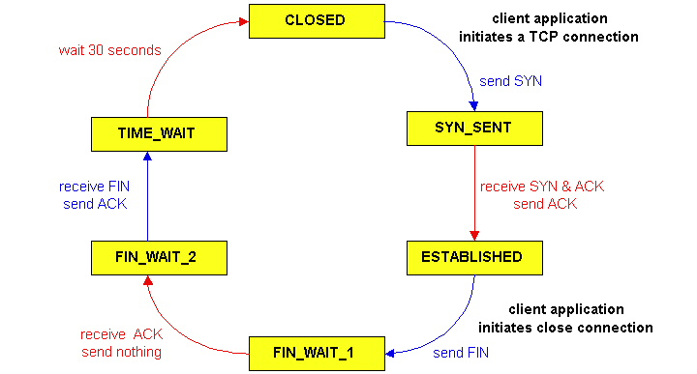
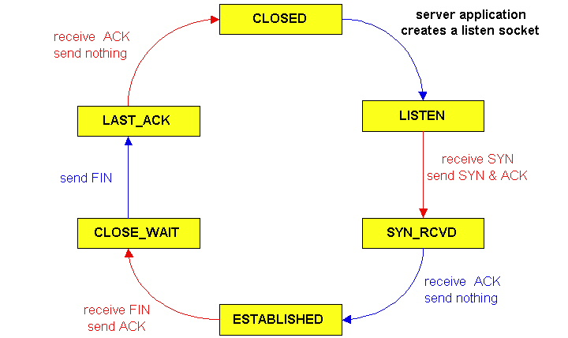
TCP Connection Management (cont)
TCP server
lifecycle
TCP client
lifecycle

Slide 16
TCP segment structure
32 bits
URG: urgent data
(limited use)
counting
by bytes
of data
(not segments!)
source port #
dest port #
sequence number
ACK: ACK #
valid
acknowledgement number
head
len
not
used
U
rcvr window size
A
P
R
S
PSH: push data now
(ltd use)
F
# bytes
rcvr willing
to accept
checksum
ptr urgent data
RST, SYN, FIN:
connection estab
(setup, teardown
commands)
Options (variable length)
application
data
(variable length)
Internet
checksum
(as in UDP)

Slide 17
Principles of Congestion Control
Congestion: a top-10 problem!
informally: “too many sources sending too much data too fast for network to handle”
different from flow control!
manifestations:
  lost packets (buffer overflow at routers)
  long delays (queueing in router buffers)

Slide 18
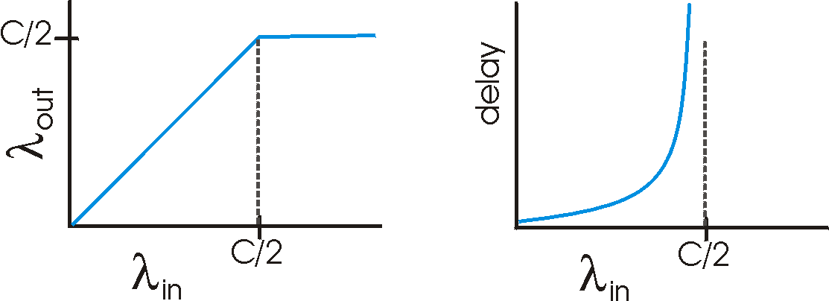
Causes/costs of congestion: scenario 1
two senders, two receivers
one router, infinite buffers
no retransmission
Host A
λ_{in} : original data
λ_{out}
Host B
unlimited shared output link buffers
large delays when congested
maximum achievable throughput

Slide 19
Causes/costs of congestion: scenario 2
one router, finite buffers
sender retransmits lost packets
Host A
λ_{in} : original data
λ_{out}
λ'_{in} : original data, plus retransmitted data
Host B
finite shared output link buffers

Slide 20
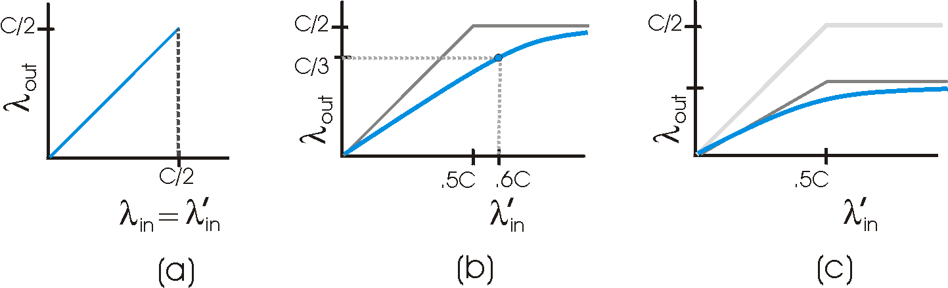
Causes/costs of congestion: scenario 2
λ
=
λ
always: (goodput)
“perfect” retransmission only when loss:
retransmission of delayed (not lost) packet makes larger (than perfect case) for same
in
out
λ
>
λ
in
out
λ
λ
in
out
“costs” of congestion: (more congestion ☹)
more work (retrans) for given “goodput”
unneeded retransmissions: link carries multiple copies of pkt

Slide 21
Causes/costs of congestion: scenario 3
λ
four senders
multihop paths
timeout/retransmit
Q: what happens as and increase ?
λ
in
in
Host A
λ_{in} : original data
λ_{out}
λ'_{in} : original data, plus retransmitted data
finite shared output link buffers
Host B

Slide 22
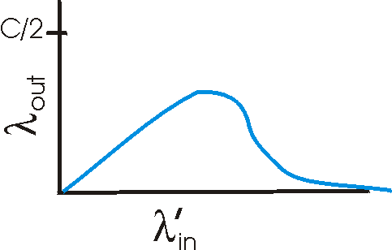
Causes/costs of congestion: scenario 3
Host A
λ_{out}
Host B
Another “cost” of congestion:
when packet dropped, any “upstream transmission capacity used for that packet was wasted!

Slide 23
Summary causes of Congestion:
Bad network design (bottlenecks)
Bad use of network : feed with more than can go through
… congestion ☺ (bad congestion-control policies e.g. dropping the wrong packets, etc)

Slide 24
Two broad approaches towards congestion control
End-end congestion control:
no explicit feedback from network
congestion inferred from end-system observed loss, delay
approach taken by TCP (focus here)
Network-assisted congestion control:
routers provide feedback to end systems
  single bit indicating congestion (SNA, DECbit, TCP/IP ECN, ATM)
  explicit rate sender should send at
routers may serve flows with parameters, may also apply admission control on connection-request
(see later, in assoc. with N/W layer, ATM policies, multimedia apps & QoS, match of traffic needs with use of the N/W)

Slide 25
TCP Congestion Control
end-end control (no network assistance)
sender limits transmission:
LastByteSent-LastByteAcked ≤ CongWin
Roughly,
CongWin is dynamic, function of perceived network congestion (NOTE: different than receiver’s window!)
How does sender perceive congestion?
loss event = timeout or 3 duplicate acks
TCP sender reduces rate (CongWin) after loss event
Q: any problem with this?
three mechanisms:
  AIMD
  slow start
  conservative after timeout events
CongWin
rate =
Bytes/sec
RTT
cwnd
bytes
RTT
RTT
ACK(s)

Slide 26
TCP Slowstart
Slowstart algorithm
Host A
Host B
initialize: Congwin = 1
for (each segment ACKed)
Congwin = 2 * Congwin
until (loss event OR
CongWin > threshold)
one segment
RTT
two segments
four segments
exponential increase (per RTT) in window size (not so slow !?)
loss event = timeout (Tahoe TCP) and/or three duplicate ACKs (Reno TCP)
time

Slide 27
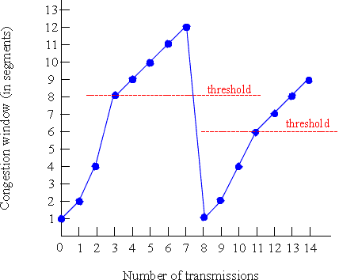
TCP Congestion Avoidance
Congestion avoidance
/* slowstart is over */
/* Congwin > threshold */
Until (loss event) {
every w segments ACKed:
Congwin++
}
threshold = Congwin/2
Congwin = 1
perform slowstart

Slide 28
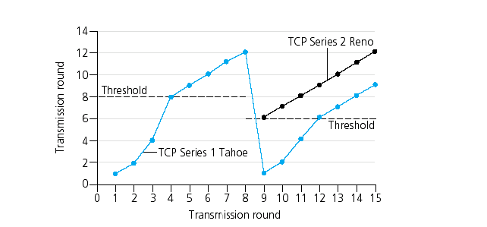
Refinement (Reno)
Avoid slow starts!
Go to linear increase after 3rd duplicate ack, starting from window of size (1/2 window before change)

Slide 29
TCP AIMD
multiplicative decrease: cut CongWin in half after loss event
additive increase: increase CongWin by 1 MSS every RTT in the absence of loss events
Long-lived TCP connection

Slide 30
Summary: TCP Congestion Control
When CongWin is below Threshold, sender in slow-start phase, window grows exponentially.
When CongWin is above Threshold, sender is in congestion-avoidance phase, window grows linearly.
When a triple duplicate ACK occurs, Threshold set to CongWin/2 and CongWin set to Threshold.
When timeout occurs, Threshold set to CongWin/2 and CongWin is set to 1 MSS.

Slide 31
TCP sender congestion control
Event | State | TCP Sender Action | Commentary
ACK receipt for previously unacked data | Slow Start (SS) | CongWin = CongWin + MSS, If (CongWin > Threshold) set state to “Congestion Avoidance” | Resulting in a doubling of CongWin every RTT
ACK receipt for previously unacked data | Congestion Avoidance (CA) | CongWin = CongWin+MSS * (MSS/CongWin) | Additive increase, resulting in increase of CongWin by 1 MSS every RTT
Loss event detected by triple duplicate ACK | SS or CA | Threshold = CongWin/2, CongWin = Threshold, Set state to “Congestion Avoidance” | Fast recovery, implementing multiplicative decrease. CongWin will not drop below 1 MSS.
Timeout | SS or CA | Threshold = CongWin/2, CongWin = 1 MSS, Set state to “Slow Start” | Enter slow start
Duplicate ACK | SS or CA | Increment duplicate ACK count for segment being acked | CongWin and Threshold not changed

Slide 32
TCP Fairness
TCP’s congestion avoidance effect: AIMD: additive increase, multiplicative decrease
  increase window by 1 per RTT
  decrease window by factor of 2 on loss event
Fairness goal: if N TCP sessions share same bottleneck link, each should get 1/N of link capacity
TCP connection 1
TCP
connection 2
bottleneck
router
capacity R

Slide 33
Why is TCP fair?
Two competing sessions:
Additive increase gives slope of 1, as throughout increases
multiplicative decrease decreases throughput proportionally
R
equal bandwidth share
loss: decrease window by factor of 2
congestion avoidance: additive increase
Connection 2 throughput
loss: decrease window by factor of 2
congestion avoidance: additive increase
Connection 1 throughput
R

Slide 34
Fairness (more)
Fairness and UDP
Multimedia apps often do not use TCP
  do not want rate throttled by congestion control
Instead use UDP:
  pump audio/video at constant rate, tolerate packet loss
Research area: TCP friendly
Fairness and parallel TCP connections
nothing prevents app from opening parallel cnctions between 2 hosts.
Web browsers do this ….

Slide 35
TCP delay modeling
Q: How long does it take to receive an object from a Web server after sending a request?
TCP connection establishment
data transfer delay
Notation, assumptions:
Assume one link between client and server of rate R
Assume: fixed congestion window, W segments
S: MSS (bits)
O: object size (bits)
no retransmissions (no loss, no corruption)

Slide 36
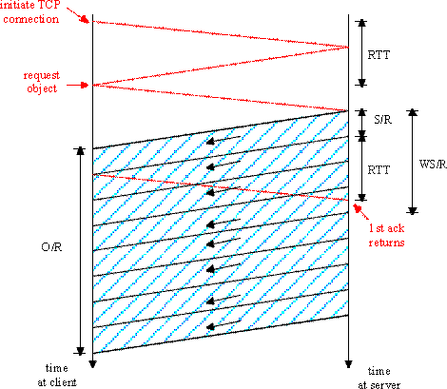
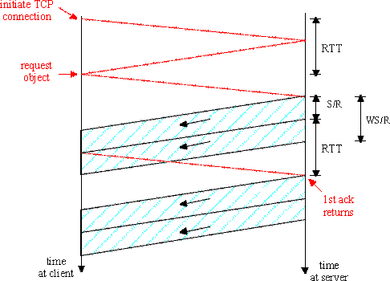
TCP delay Modeling: Fixed window
K:= O/WS
Case 1: WS/R > RTT + S/R:
ACK for first segment in window returns before window’s worth of data sent
latency = 2RTT + O/R
Case 2: WS/R < RTT + S/R:
wait for ACK after sending window’s worth of data sent
latency = 2RTT + O/R
+ (K-1)[S/R + RTT - WS/R]

Slide 37
TCP Latency Modeling: Slow Start
Now suppose window grows according to slow start.
Will show that the latency of one object of size O is:
where P is the number of times TCP stalls at server:
where
Q = number of times the server would stall until cong. window grows larger than a “full-utilization” window (if the object were of unbounded size).
- K = number of (incremental-sized) congestion-windows that “cover” the object.

Slide 38
TCP Delay Modeling: Slow Start (2)
Delay components:
2 RTT for connection estab and request
O/R to transmit object
time server idles due to slow start
Server idles:
P = min{K-1,Q} times
Example:
O/S = 15 segments
K = 4 windows
Q = 2
P = min{K-1,Q} = 2
Server idles P=2 times

Slide 39
TCP Delay Modeling (3)

Slide 40
TCP Delay Modeling (4)
Recall K = number of windows that cover object
How do we calculate K ?
Calculation of Q, number of idles for infinite-size object,
is similar.

Slide 41
Wireless TCP
Problem: higher data error-rate destroys congestion control principle (assumption)
Possible solutions:
Non-transparent (indirect): manage congestion-control in 2 sub-connections (one wired, one wireless). But … the semantics of a connection changes: ack at the sender means that base-station, (not the receiver) received the segment
Transpartent: use extra rules at the base-station (network layer retransmissions...) to ”hide” the errors of the wireless part from the sender. But … the sender may still timeout in the meanwhile and think that there is congestion ...
Vegas algorithm: observe RTT estimation and reduce transmission rate when in danger of loss

Slide 42
Chapter 3: Summary
principles behind transport layer services:
  multiplexing/demultiplexing
  reliable data transfer
  flow control
  congestion control
instantiation and implementation in the Internet
  UDP
  TCP
Next:
leaving the network “edge” (application transport layer)
into the network “core”

