Slide 1
Chapter 3: Transport Layer
Part A
Course on Computer Communication and Networks, CTH/GU
The slides are adaptation of the slides made available by the authors of the course’s main textbook

Slide 2
Chapter 3: Transport Layer
Chapter goals:
understand principles behind transport layer services:
  multiplexing/demultiplexing
  reliable data transfer
  flow control
  congestion control (some now; more in connection with RT applications)
instantiation and implementation in the Internet
Chapter Overview:
transport layer services
multiplexing/demultiplexing
connectionless transport: UDP
principles of reliable data transfer
connection-oriented transport: TCP
  reliable transfer
  flow control
  connection management
  TCP congestion control

Slide 3
Transport services and protocols
provide logical communication between app’ processes running on different hosts
transport protocols run in end systems
transport vs network layer services:
  network layer: data transfer between end systems
  transport layer: data transfer between processes
    uses and enhances, network layer services
application
transport
network
data link
physical
network
data link
physical
network
data link
physical
network
data link
physical
logical end-end transport
network
data link
physical
network
data link
physical
application
transport
network
data link
physical

Slide 4
Transport-layer protocols
Internet transport services:
reliable, in-order unicast delivery (TCP)
  congestion
  flow control
  connection setup
unreliable (“best-effort”), unordered unicast or multicast delivery: UDP
services not available:
  real-time
  bandwidth guarantees
  reliable multicast
application
transport
network
data link
physical
network
data link
physical
network
data link
physical
network
data link
physical
logical end-end transport
network
data link
physical
network
data link
physical
application
transport
network
data link
physical

Slide 5
Multiplexing/demultiplexing
Demultiplexing at rcv host:
Multiplexing at send host:
delivering received segments
to correct socket
gathering data, enveloping data
with header (later used for
demultiplexing)
= socket
= process
application
application
application
P4
P3
P1
P2
P1
transport
transport
transport
network
network
network
link
link
link
physical
physical
physical
host 1
host 2
host 3
Recall: segment - unit of data exchanged between transport layer entities
  aka TPDU: transport protocol data unit

Slide 6
How demultiplexing works
host receives IP datagrams
  each datagram has source IP address, destination IP address
  each datagram carries 1 transport-layer segment
  each segment has source, destination port number
  (recall: well-known port numbers for specific applications)
host uses IP addresses & port numbers to direct segment to appropriate receiver
32 bits
source port #
dest port #
other header fields
application
data
(message)
TCP/UDP segment format

Slide 7
Connectionless demultiplexing
When host receives UDP segment:
  checks destination port number in segment
  directs UDP segment to socket with that port number
IP datagrams with different source IP addresses and/or source port numbers directed to same socket
Create sockets with port numbers:
DatagramSocket mySocket1 = new DatagramSocket(99111);
DatagramSocket mySocket2 = new DatagramSocket(99222);
UDP socket identified by two-tuple:
(dest IP address, dest port number)

Slide 8
Connectionless demux (cont)
DatagramSocket serverSocket = new DatagramSocket(6428);
P2
P1
P3
P1
SP: 6428
SP: 6428
DP: 9157
DP: 5775
SP: 9157
SP: 5775
client
IP: A
DP: 6428
server
IP: C
DP: 6428
Client
IP:B
SP provides “return address”

Slide 9
Connection-oriented demux
TCP socket identified by 4-tuple:
  source IP address
  source port number
  dest IP address
  dest port number
recv host uses all four values to direct segment to appropriate socket
Server host may support many simultaneous TCP sockets:
  each socket identified by its own 4-tuple
Web servers have different sockets for each connecting client
  non-persistent HTTP will have different socket for each request

Slide 10
Connection-oriented demux (cont)
P1
P4
P5
P6
P2
P1
P3
SP: 5775
DP: 80
S-IP: B
D-IP:C
SP: 9157
SP: 9157
client
IP: A
DP: 80
server
IP: C
DP: 80
Client
IP:B
S-IP: A
S-IP: B
D-IP:C
D-IP:C

Slide 11
Connection-oriented demux: Threaded Web Server
P1
P4
P2
P1
P3
SP: 5775
DP: 80
S-IP: B
D-IP:C
SP: 9157
SP: 9157
client
IP: A
DP: 80
server
IP: C
DP: 80
Client
IP:B
S-IP: A
S-IP: B
D-IP:C
D-IP:C

Slide 12
UDP: User Datagram Protocol [RFC 768]
“best effort” service, UDP segments may be:
  lost
  delivered out of order to app
connectionless:
  no handshaking between UDP sender, receiver
  each UDP segment handled independently of others; subsequent UDP segments can arrive in wrong order
Is UDP any good?
no connection establishment (i.e. no added delay)
simple: no connection state at sender, receiver
small segment header
no congestion control: UDP can blast away as fast as desired

Slide 13
UDP: more
often used for streaming multimedia apps
  loss tolerant
  rate sensitive
other UDP users (why?):
  DNS
  SNMP
reliable transfer over UDP: add reliability at application layer
  application-specific error recovery!
32 bits
Length, in
bytes of UDP
segment,
including
header
source port #
dest port #
length
checksum
Application
data
(message)
UDP segment format

Slide 14
UDP Checksum: check bit flips
Sender:
treat segment contents as sequence of 16-bit integers
checksum: addition (1’s complement sum) of segment contents
sender puts checksum value into UDP checksum field
Receiver:
compute checksum of received segment
check if computed checksum equals checksum field value:
  NO - error detected (report error to app or discard)
  YES - no error detected.
    But maybe (very rarely) errors nonethless? More later ….
1 1 1 1 0 0 1 1 0 0 1 1 0 0 1 1 0
1 1 1 0 1 0 1 0 1 0 1 0 1 0 1 0 1
1 1 0 1 1 1 0 1 1 1 0 1 1 1 0 1 1
1 1 0 1 1 1 0 1 1 1 0 1 1 1 1 0 0
1 0 1 0 0 0 1 0 0 0 1 0 0 0 0 1 1
Wraparound:
Add to final
sum
checksum
Notes:
Kurose and Ross forgot to say anything about wrapping the carry and adding it to low order bit

Slide 15
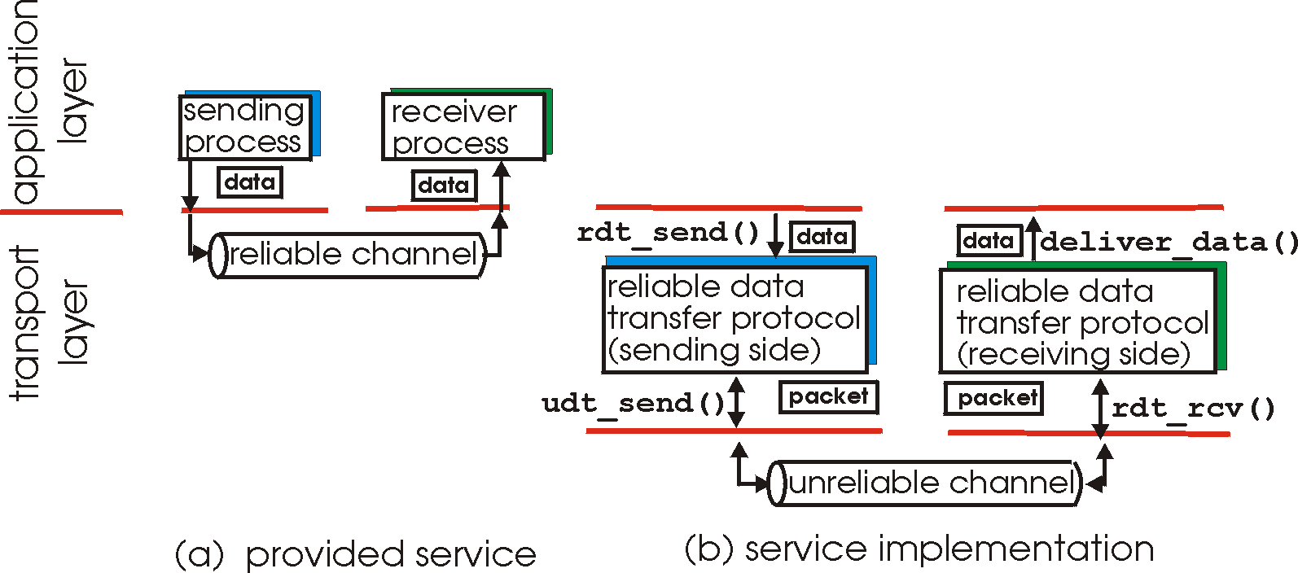
Principles of Reliable data transfer
important in (app.,) transport, link layers
in top-10 list of important networking topics!
characteristics of unreliable channel will determine complexity of reliable data transfer protocol (rdt)

Slide 16
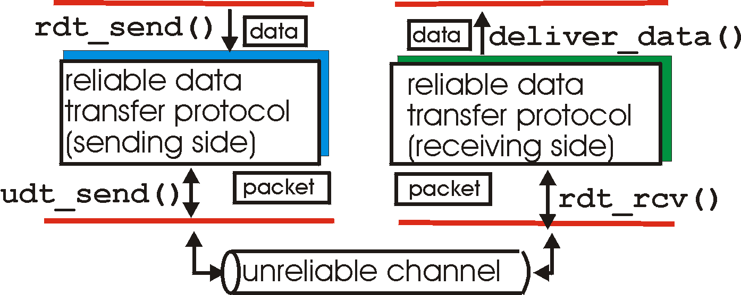
Reliable data transfer: getting started
rdt_send(): called from above, (e.g., by app.). Passed data to
deliver to receiver upper layer
deliver_data(): called by rdt to deliver data to upper
send
side
receive
side
udt_send(): called by rdt,
to transfer packet over
unreliable channel to receiver
rdt_rcv(): called when packet arrives on rcv-side of channel

Slide 17
Reliable data transfer: getting started
We’ll:
incrementally develop sender, receiver sides of reliable data transfer protocol (rdt)
consider only unidirectional data transfer
  but control info will flow on both directions!
use finite state machines (FSM) to specify sender, receiver
event causing state transition
actions taken on state transition
state: when in this “state” next state uniquely determined by next event
state
1
state
2
event
actions

Slide 18
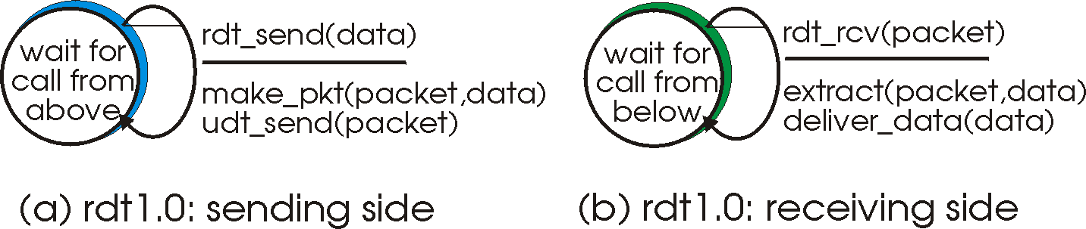
Rdt1.0: reliable transfer over a reliable channel
underlying channel perfectly reliable
  no bit erros
  no loss of packets
separate FSMs for sender, receiver:
  sender sends data into underlying channel
  receiver read data from underlying channel

Slide 19
Rdt2.0: channel with bit errors
underlying channel may flip bits in packet
  recall: UDP checksum to detect bit errors
the question: how to recover from errors:
  acknowledgements (ACKs): receiver explicitly tells sender that pkt received OK
  negative acknowledgements (NAKs): receiver explicitly tells sender that pkt had errors
  sender retransmits pkt on receipt of NAK
  human scenarios using ACKs, NAKs?
new mechanisms in rdt2.0 (beyond rdt1.0):
  error detection
  receiver feedback: control msgs (ACK,NAK) rcvr->sender

Slide 20
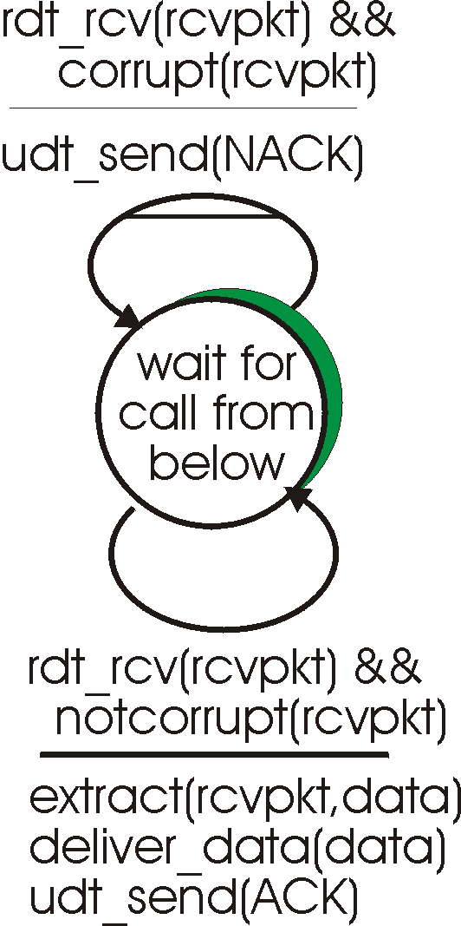
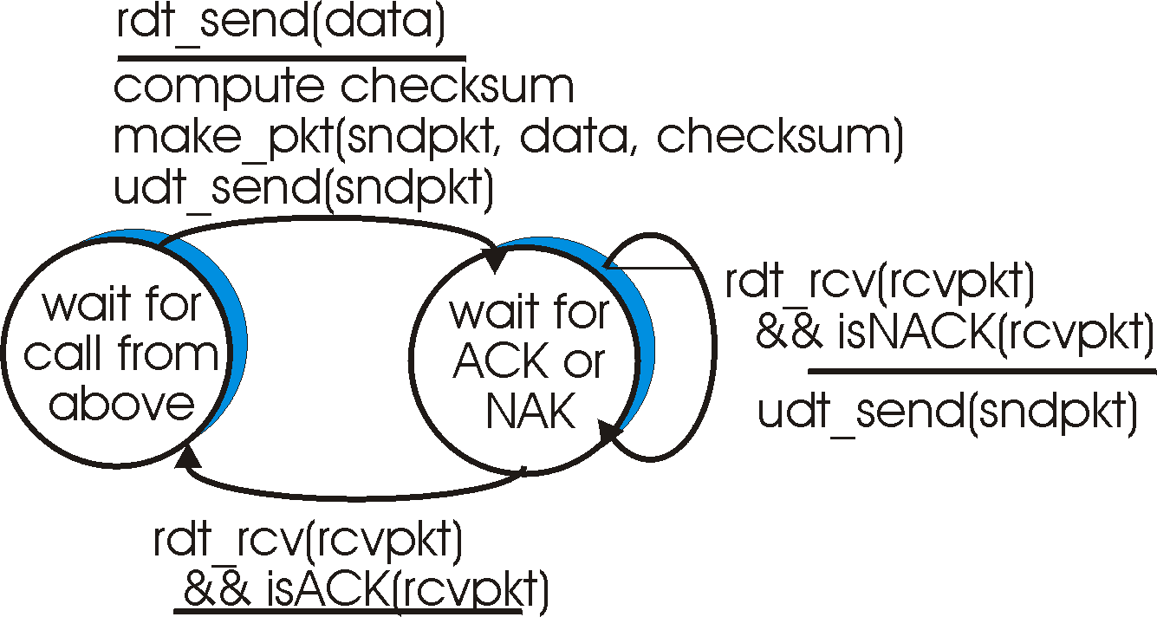
rdt2.0: FSM specification
sender FSM
receiver FSM

Slide 21
rdt2.0: in action (no errors)
sender FSM
receiver FSM

Slide 22
rdt2.0: in action (error scenario)
sender FSM
receiver FSM

Slide 23
rdt2.0 has an issue:
What happens if ACK/NAK corrupted?
sender doesn’t know what happened at receiver!
What to do?
sender ACKs/NAKs receiver’s ACK/NAK? What if sender ACK/NAK lost?
retransmit, but this might cause retransmission of correctly received pkt!
Handling duplicates:
sender adds sequence number to each pkt
sender retransmits current pkt if ACK/NAK garbled
receiver discards (doesn’t deliver up) duplicate pkt
stop and wait
Sender sends one packet,
then waits for receiver
response

Slide 24
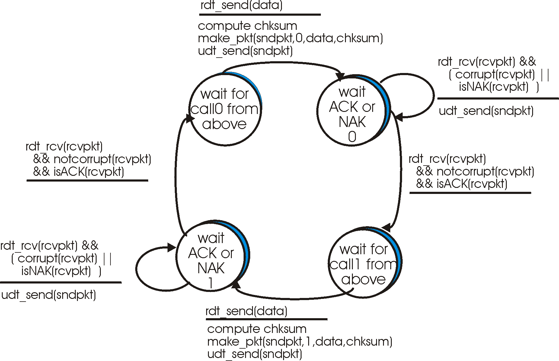
rdt2.1: sender, handles garbled ACK/NAKs

Slide 25
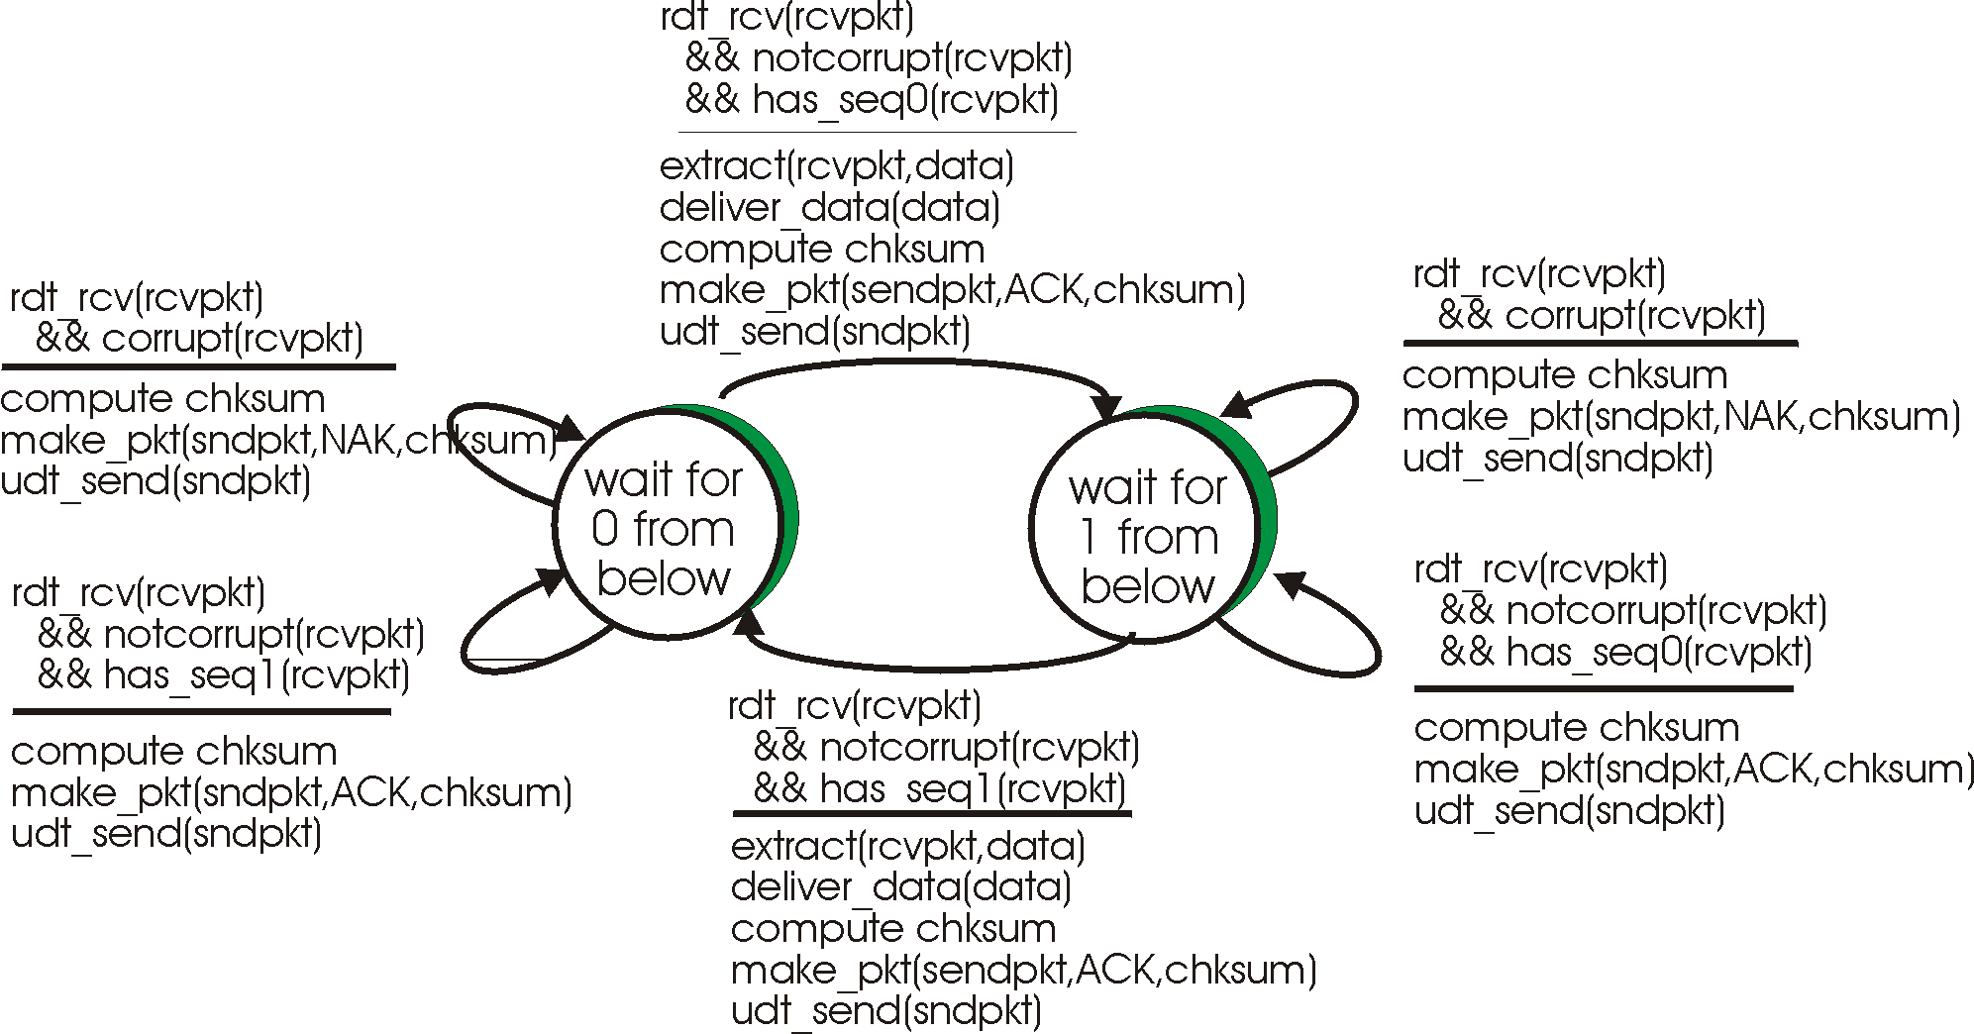
rdt2.1: receiver, handles garbled ACK/NAKs

Slide 26
rdt2.1: discussion
Sender:
seq # added to pkt
two seq. #’s (0,1) will suffice. Why?
must check if received ACK/NAK corrupted
twice as many states
  state must “remember” whether “current” pkt has 0 or 1 seq. #
Receiver:
must check if received packet is duplicate
  state indicates whether 0 or 1 is expected pkt seq #
note: receiver can not know if its last ACK/NAK received OK at sender

Slide 27
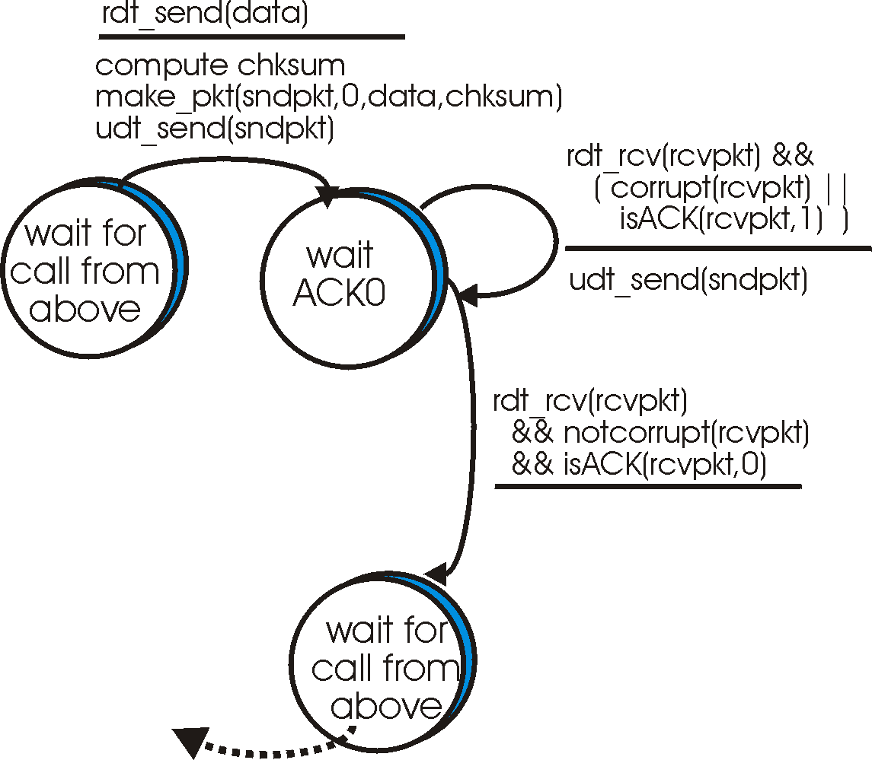
rdt2.2: a NAK-free protocol
sender
FSM
same functionality as rdt2.1, using ACKs only:
  instead of NAK, receiver sends ACK for last pkt received OK
    receiver must explicitly include seq # of pkt being ACKed
  duplicate ACK at sender results in same action as NAK: retransmit current pkt
!

Slide 28
rdt3.0: channels with errors and loss
New assumption: underlying channel can also lose packets (data or ACKs)
  checksum, seq. #, ACKs, retransmissions will be of help, but not enough
Q: how to deal with loss?
Approach: sender waits “reasonable” amount of time for ACK
retransmits if no ACK received in this time
if pkt (or ACK) just delayed (not lost):
  retransmission will be duplicate, but use of seq. #’s already handles this
  receiver must specify seq # of pkt being ACKed
requires countdown timer

Slide 29
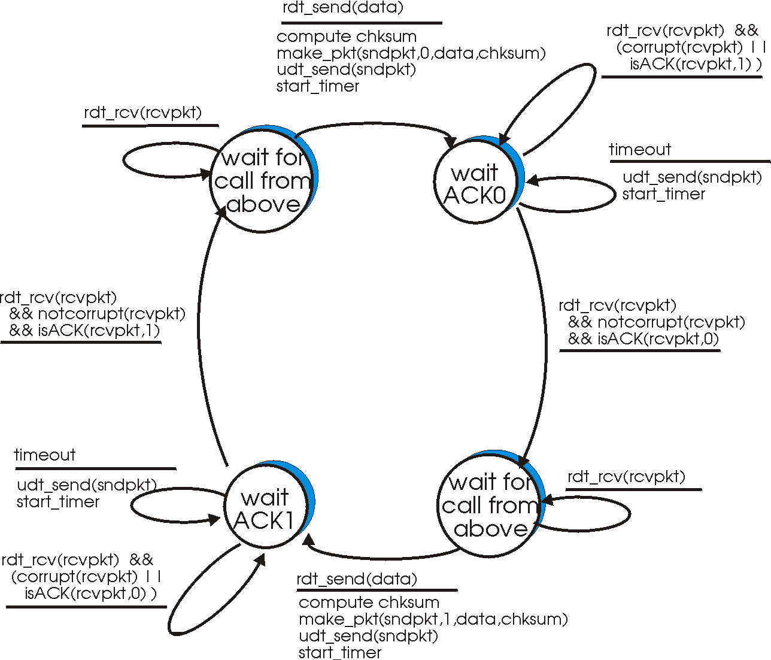
rdt3.0 sender

Slide 30
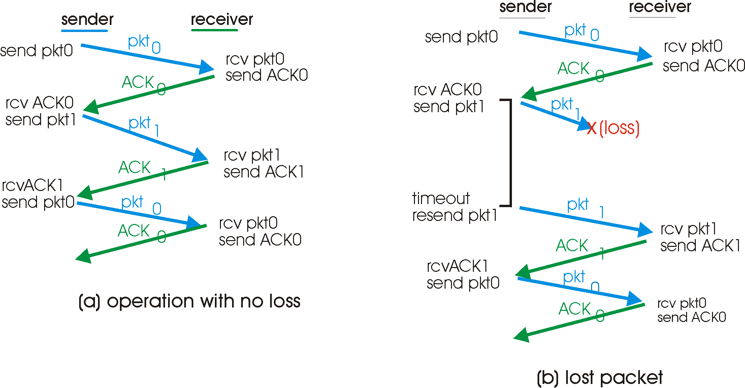
rdt3.0 in action

Slide 31
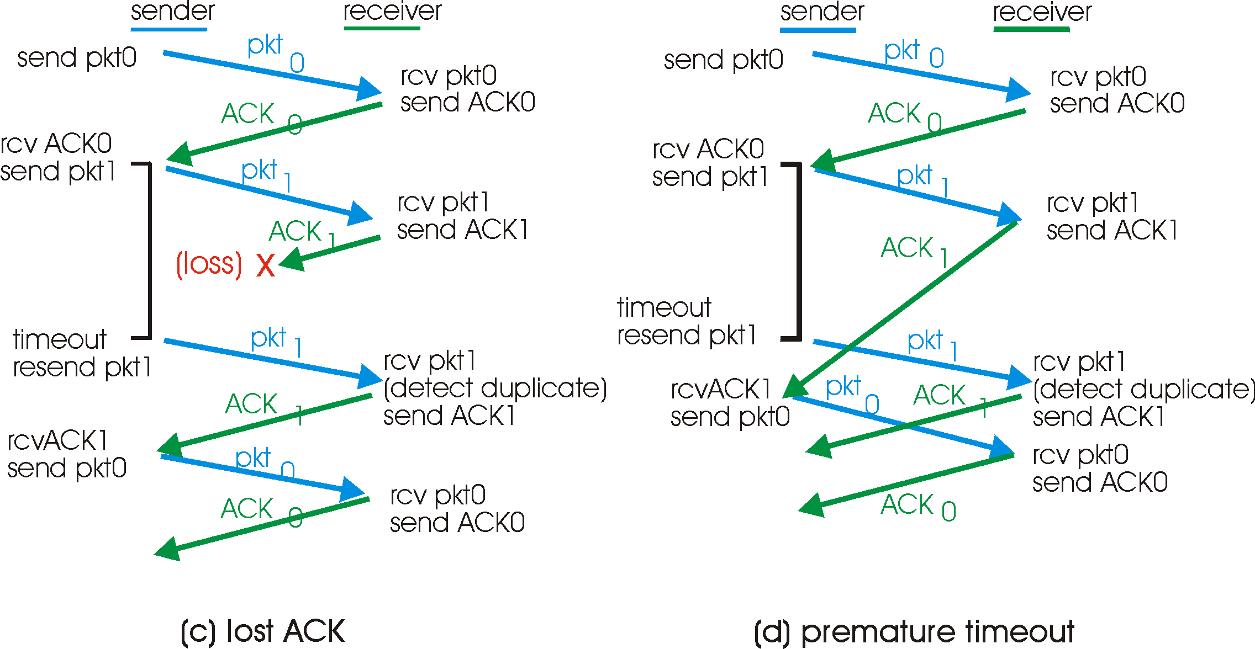
rdt3.0 in action

Slide 32
Bounding sequence numbers…
… s.t. no wraparound, i.e. we do not run out of numbers: binary value suffices for stop-and-wait:
Prf: assume towards a contradiction that there is wraparound when we use binary seq. nums.
  R expects segment #f, receives segment #(f+2):
    R rec. f+2 => S sent f+2 => S rec. ack for f+1
    => R ack f+1=> R ack f => contradiction
  R expects f+2, receives f:
    R exp. f+2 => R ack f+1 => S sent f+1
    => S rec. ack for f => contradiction

Slide 33
rdt3.0: stop-and-wait operation
sender
receiver
first packet bit transmitted, t = 0
last packet bit transmitted, t = L / R
first packet bit arrives
RTT
last packet bit arrives, send ACK
ACK arrives, send next
packet, t = RTT + L / R

Slide 34
Performance of rdt3.0
rdt3.0 works, but performance stinks
Example: 50 Kbps, 500-msec round-trip propagation delay (satellite connection), transmit 1000-bit segments
1000b
T
=
= 20 msec
transmit
50 Kb/sec
fraction of time
sender busy sending
20 msec
Utilization = U =
=
= 0.04
520 msec
  1 segment every 520 msec -> 2 Kbps thruput (effective bit-rate) over 50 Kbps link
  network protocol limits use of physical resources!

Slide 35
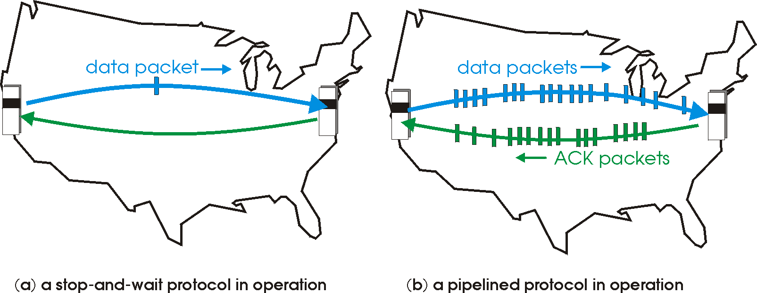
Pipelined protocols
Pipelining: Solution to the problem of low utilization of stop-and-wait: sender allows multiple, up to N, “in-flight”, yet-to-be-acknowledged pkts.
  Choice of N: optimally, it should allow the sender to continously transmit during the round-trip transit time
  range of sequence numbers must be increased
  buffering at sender and/or receiver
Two generic forms of pipelined protocols: go-Back-N, selective repeat (check also corresponding on-line material in book’s site)

Slide 36
Pipelining: increased utilization
sender
receiver
first packet bit transmitted, t = 0
last bit transmitted, t = L / R
first packet bit arrives
RTT
last packet bit arrives, send ACK
last bit of 2nd packet arrives, send ACK
last bit of 3rd packet arrives, send ACK
ACK arrives, send next
packet, t = RTT + L / R
Increase utilization
by a factor of 3!

Slide 37
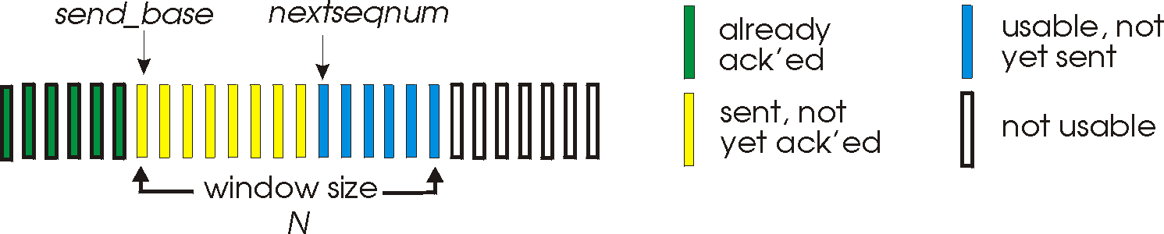
Go-Back-N
Sender:
k-bit seq # in pkt header
“window” of up to N, consecutive unack’ed pkts allowed
ACK(n): ACKs all pkts up to, including seq # n - “cumulative ACK”
  may receive duplicate ACKs (see receiver)
timer for each in-flight pkt
timeout(n): retransmit pkt n and all higher seq # pkts in window

Slide 38
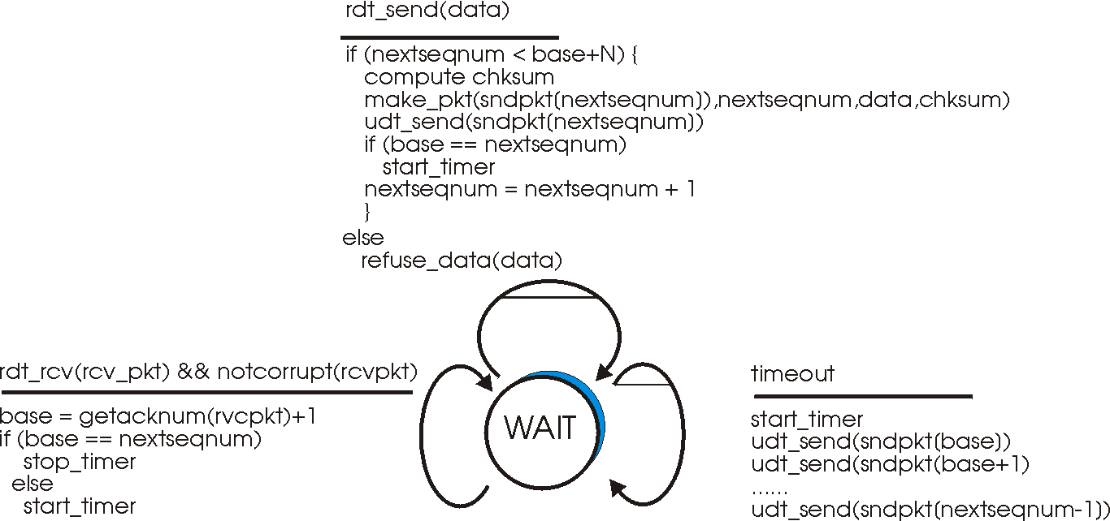
GBN: sender extended FSM

Slide 39
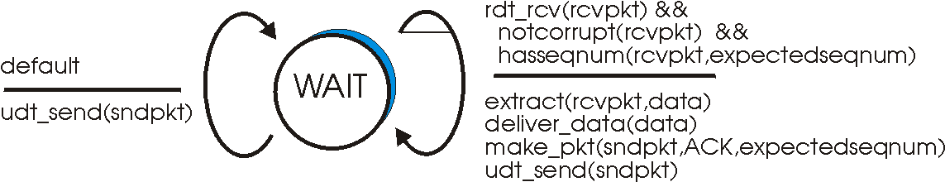
GBN: receiver extended FSM
receiver simple:
ACK-only: always send ACK for correctly-received pkt with highest in-order seq #
  may generate duplicate ACKs
  need only remember expectedseqnum
out-of-order pkt:
  discard (don’t buffer) -> no receiver buffering!
  ACK pkt with highest in-order seq #

Slide 40
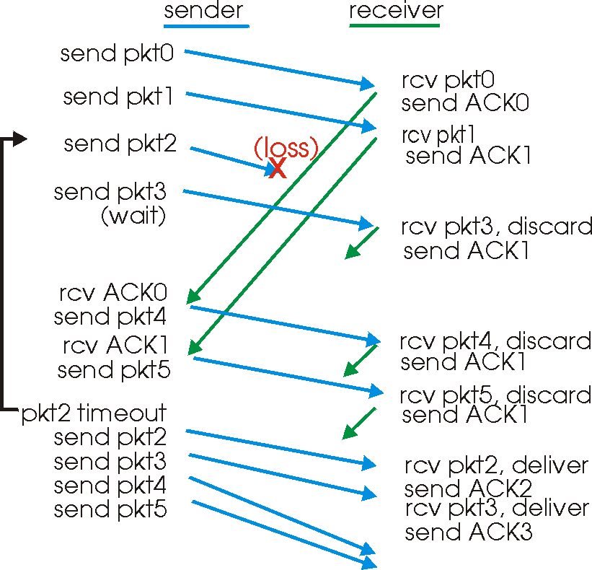
GBN in action

Slide 41
Selective Repeat
receiver individually acknowledges all correctly received pkts
  buffers pkts, as needed, for eventual in-order delivery to upper layer
sender only resends pkts for which ACK not received
  sender timer for each unACKed pkt
sender window
  N consecutive seq #’s
  again limits seq #s of sent, unACKed pkts

Slide 42
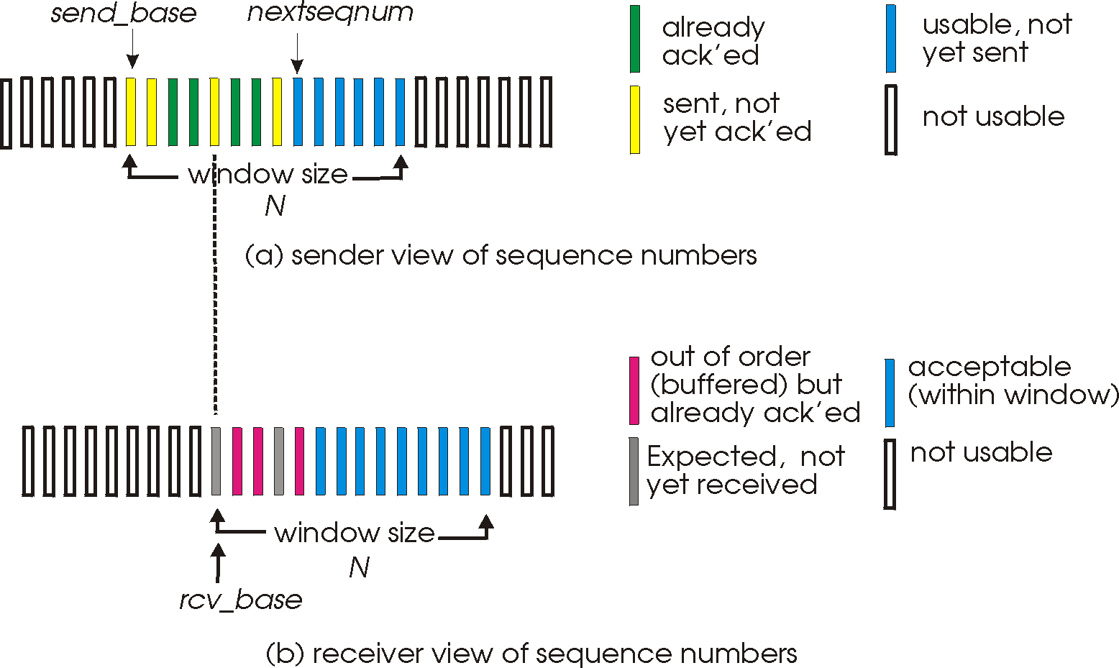
Selective repeat: sender, receiver windows

Slide 43
Selective repeat
sender
receiver
data from above :
if next available seq # in window, send pkt
timeout(n):
resend pkt n, restart timer
ACK(n) in [sendbase,sendbase+N]:
mark pkt n as received
if n smallest unACKed pkt, advance window base to next unACKed seq #
pkt n in [rcvbase, rcvbase+N-1]
send ACK(n)
out-of-order: buffer
in-order: deliver (also deliver buffered, in-order pkts), advance window to next not-yet-received pkt
pkt n in [rcvbase-N,rcvbase-1]
ACK(n)
otherwise:
ignore

Slide 44
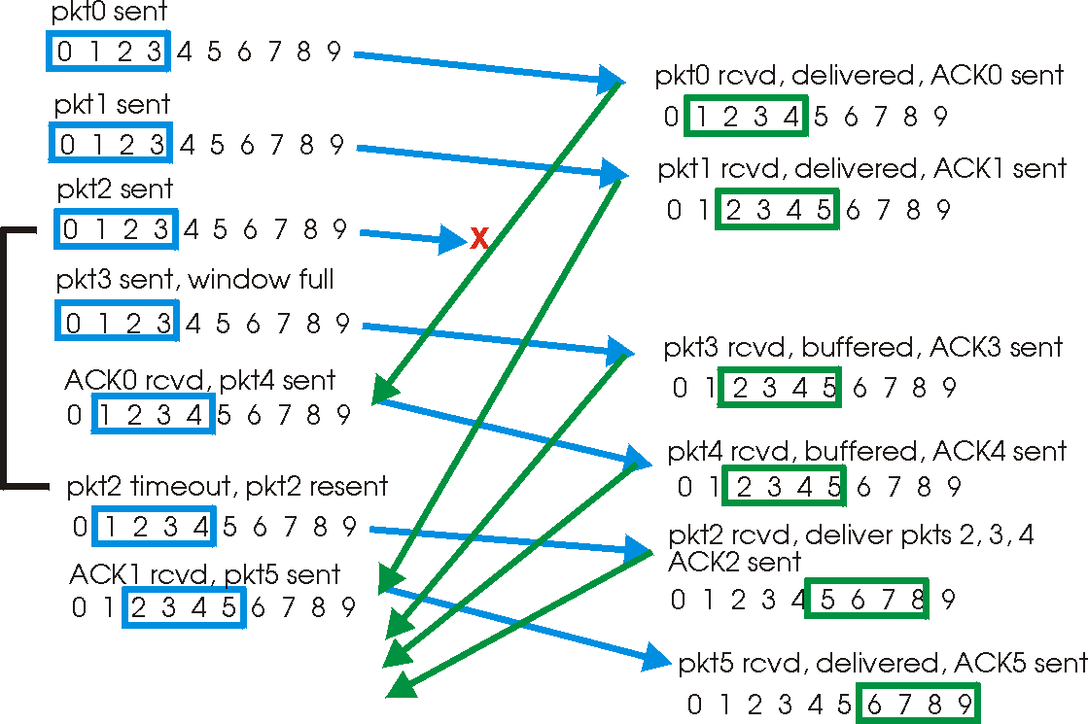
Selective repeat in action

Slide 45
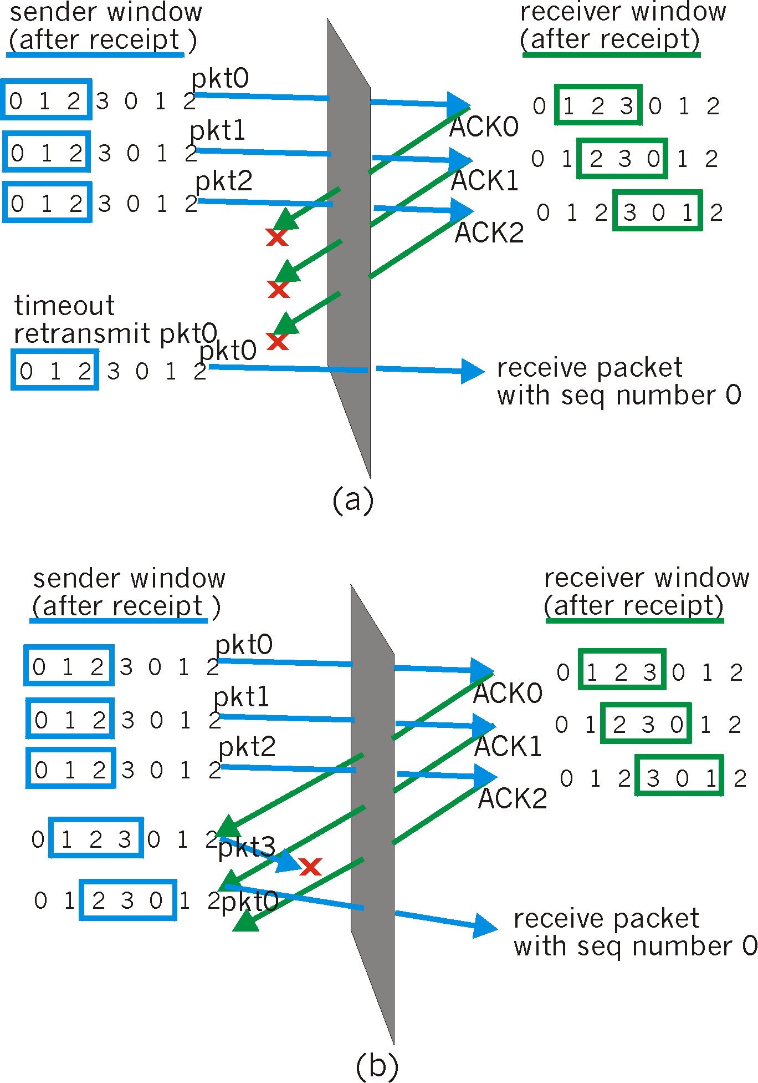
Selective repeat: sequence number range and wraparound
Example:
seq #’s: 0, 1, 2, 3
window size=3
receiver sees no difference in two scenarios!
incorrectly passes duplicate data as new in (a)
Q: what relationship between seq # size and window size?

