Slide 1
Chapter 4: Network Layer, partb
The slides are adaptations of the slides available by the main textbook authors, Kurose&Ross

Slide 2
Chapter 4: Network Layer
4. 1 Introduction
4.2 Virtual circuit and datagram networks
4.3 What’s inside a router
4.4 IP: Internet Protocol
  Datagram format
  IPv4 addressing
  ICMP
  IPv6
4.5 Routing algorithms
  Link state
  Distance Vector
  Hierarchical routing
4.6 Routing in the Internet
  RIP
  OSPF
  BGP
4.7 Broadcast and multicast routing

Slide 3
Interplay between routing, forwarding
routing algorithm
local forwarding table
header value
output link
0100
0101
0111
1001
3
2
2
1
value in arriving
packet’s header
0111
1
3
2

Slide 4
Graph abstraction
5
v
3
w
Graph: G = (N,E)
N = set of routers = { u, v, w, x, y, z }
E = set of links ={ (u,v), (u,x), (v,x), (v,w), (x,w), (x,y), (w,y), (w,z), (y,z) }
2
5
u
2
1
z
3
1
x
2
y
1
c(x,x’) = cost of link (x,x’)
- e.g., c(w,z) = 5
cost could always be 1, or inversely related to bandwidth, or inversely related to congestion or something else
Cost of path (x₁, x₂, x₃,…, x_{p}) = c(x₁,x₂) + c(x₂,x₃) + … + c(x_{p-1},x_{p})
Question: What’s the least-cost path between u and z ?
Routing algorithm: algorithm that finds least-cost path

Slide 5
Routing Algorithm classification
Global or decentralized information?
Global:
all routers have complete topology, link cost info
“link state” algorithms
Decentralized:
router knows physically-connected neighbors, link costs to neighbors
iterative process of computation, exchange of info with neighbors
“distance vector” algorithms
Static or dynamic?
Static:
routes don’t change (or do soslowly over time)
Dynamic:
routes change
  periodic update
  in response to link cost changes

Slide 6
Chapter 4: Network Layer
4. 1 Introduction
4.2 Virtual circuit and datagram networks
4.3 What’s inside a router
4.4 IP: Internet Protocol
  Datagram format
  IPv4 addressing
  ICMP
  IPv6
4.5 Routing algorithms
  Link state
  Distance Vector
  Hierarchical routing
4.6 Routing in the Internet
  RIP
  OSPF
  BGP
4.7 Broadcast and multicast routing

Slide 7
A Link-State Routing Algorithm
Dijkstra’s algorithm
net topology, link costs known to all nodes
  accomplished via “link state broadcast”
  all nodes have same info
computes least cost paths from one node (‘source”) to all other nodes
  gives forwarding table for that node
iterative: after k iterations, know least cost path to k dest.’s
Notation:
c(x,y): link cost from node x to y; = ∞ if not direct neighbors
D(v): current value of cost of path from source to dest. v
p(v): predecessor node along path from source to v
N': set of nodes whose least cost path definitively known

Slide 8
Dijsktra’s Algorithm
1 Initialization:
2 N' = {u}
3 for all nodes v
4 if v adjacent to u
5 then D(v) = c(u,v)
6 else D(v) = ∞
7
8 Loop
9 find w not in N' such that D(w) is a minimum
10 add w to N'
11 update D(v) for all v adjacent to w and not in N' :
12 D(v) = min( D(v), D(w) + c(w,v) )
13 /* new cost to v is either old cost to v or known
14 shortest path cost to w plus cost from w to v */
15 until all nodes in N'

Slide 9
Dijkstra’s algorithm: example
Step
0
1
2
3
4
5
N'
u
ux
uxy
uxyv
uxyvw
uxyvwz
D(v),p(v)
2,u
2,u
2,u
D(w),p(w)
5,u
4,x
3,y
3,y
D(x),p(x)
1,u
D(y),p(y)
∞
2,x
D(z),p(z)
∞
∞
4,y
4,y
4,y
5
v
3
w
2
5
u
2
1
z
3
1
2
x
y
1

Slide 10
Dijkstra’s algorithm: example (2)
Resulting shortest-path tree from u:
v
w
u
z
x
y
Resulting forwarding table in u:
destination
link
v
(u,v)
x
(u,x)
y
(u,x)
w
(u,x)
z
(u,x)

Slide 11
Dijkstra’s algorithm, discussion
Algorithm complexity: n nodes
each iteration: need to check all nodes, w, not in N
n(n+1)/2 comparisons: O(n²)
more efficient implementations possible: O(nlogn)
Oscillations possible:
e.g., link cost = amount of carried traffic
1
A
A
A
A
1+e
2+e
0
0
2+e
2+e
0
D
0
0
B
D
B
D
B
D
B
1+e
1
0
0
1+e
1
0
e
0
0
1
1+e
0
e
C
C
C
C
1
1
e
… recompute
routing
… recompute
… recompute
initially

Slide 12
Chapter 4: Network Layer
4. 1 Introduction
4.2 Virtual circuit and datagram networks
4.3 What’s inside a router
4.4 IP: Internet Protocol
  Datagram format
  IPv4 addressing
  ICMP
  IPv6
4.5 Routing algorithms
  Link state
  Distance Vector
  Hierarchical routing
4.6 Routing in the Internet
  RIP
  OSPF
  BGP
4.7 Broadcast and multicast routing

Slide 13
Distance Vector Algorithm
Bellman-Ford Equation
Define
d_{x}(y) := cost of least-cost path from x to y
Then
d_{x}(y) = min {c(x,v) + d_{v}(y) }
where min is taken over all neighbors v of x
v

Slide 14
Bellman-Ford example
5
Clearly, d_{v}(z) = 5, d_{x}(z) = 3, d_{w}(z) = 3
v
3
w
2
5
u
z
B-F equation says:
2
1
3
1
2
d_{u}(z) = min { c(u,v) + d_{v}(z),
c(u,x) + d_{x}(z),
c(u,w) + d_{w}(z) }
= min {2 + 5,
1 + 3,
5 + 3} = 4
x
y
1
Node that achieves minimum is next
hop in shortest path ➜ forwarding table

Slide 15
Distance Vector Algorithm
D_{x}(y) = estimate of least cost from x to y
Node x knows cost to each neighbor v: c(x,v)
Node x maintains distance vector D_{x} = [D_{x}(y): y є N ]
Node x also needs to know its neighbors’ distance vectors
  For each neighbor v, x knows
  D_{v} = [D_{v}(y): y є N ]

Slide 16
Distance vector algorithm (4)
Basic idea:
From time-to-time, each node sends its own distance vector estimate to neighbors
Asynchronous
When a node x receives new DV estimate from neighbor, it updates its own DV using B-F equation:
D_{x}(y) ← min_{v}{c(x,v) + D_{v}(y)} for each node y ∊ N
Under minor, natural conditions, the estimate D_{x}(y) converges to the actual least cost d_{x}(y)

Slide 17
Distance Vector Algorithm (5)
Iterative, asynchronous: each local iteration caused by:
local link cost change
DV update message from neighbor
Distributed:
each node notifies neighbors only when its DV changes
  neighbors then notify their neighbors if necessary
Each node:
wait for (change in local link cost or msg from neighbor)
recompute estimates
if DV to any dest has changed, notify neighbors

Slide 18
D_{x}(y) = min{c(x,y) + D_{y}(y), c(x,z) + D_{z}(y)}
= min{2+0 , 7+1} = 2
D_{x}(z) = min{c(x,y) +
D_{y}(z), c(x,z) + D_{z}(z)}
= min{2+1 , 7+0} = 3
node x table
cost to
cost to
x y z
x y z
x
0 2 7
x
0
2
3
y
y
from
∞
∞
∞
from
2 0 1
z
∞
∞
∞
z
7 1 0
node y table
cost to
x y z
y
2
1
x
∞
∞
z
∞
2 0 1
x
y
7
from
z
∞
∞
∞
node z table
cost to
x y z
x
∞ ∞ ∞
y
from
∞
∞
∞
z
7
1
0
time

Slide 19
D_{x}(y) = min{c(x,y) + D_{y}(y), c(x,z) + D_{z}(y)}
= min{2+0 , 7+1} = 2
D_{x}(z) = min{c(x,y) +
D_{y}(z), c(x,z) + D_{z}(z)}
= min{2+1 , 7+0} = 3
node x table
cost to
cost to
cost to
x y z
x y z
x y z
x
0 2 7
x
0 2 3
x
0 2 3
y
y
from
∞
∞
∞
from
2 0 1
y
from
2 0 1
z
∞
∞
∞
z
7 1 0
z
3 1 0
node y table
cost to
cost to
cost to
x y z
x y z
x y z
y
2
1
x
∞
∞
x
0 2 7
z
∞
2 0 1
x
0 2 3
x
y
y
7
from
from
2 0 1
y
from
2 0 1
z
∞
∞
∞
z
7 1 0
z
3 1 0
node z table
cost to
cost to
cost to
x y z
x y z
x y z
x
∞ ∞ ∞
x
0 2 7
x
0 2 3
y
y
2 0 1
y
from
2 0 1
from
from
∞
∞
∞
z
z
3 1 0
z
3 1 0
7
1
0
time

Slide 20
Distance Vector: link cost changes
Link cost changes:
node detects local link cost change
updates routing info, recalculates
distance vector
if DV changes, notify neighbors
1
y
4
1
x
z
50
At time t₀, y detects the link-cost change, updates its DV,
and informs its neighbors.
“good
news
travels
fast”
At time t₁, z receives the update from y and updates its table.
It computes a new least cost to x and sends its neighbors its DV.
At time t₂, y receives z’s update and updates its distance table.
y’s least costs do not change and hence y does not send any
message to z.

Slide 21
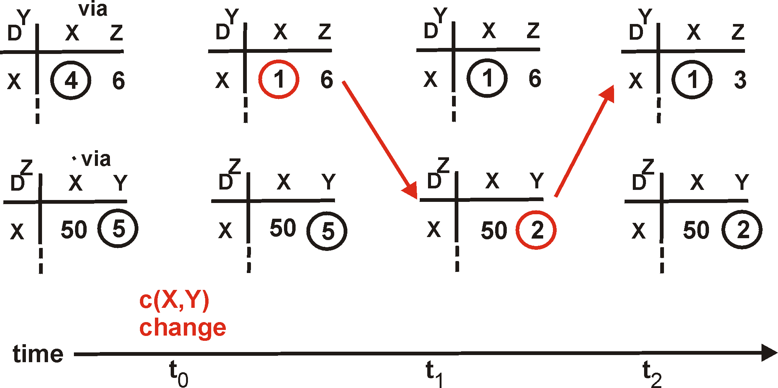
Distance Vector: link cost changes
Link cost changes:
node detects local link cost change
updates distance table
if cost change in least cost path, notify neighbors
1
Y
4
1
X
Z
50
y to x
y to x, via
y to x, via
y to x via
algorithm
terminates
“good
news
travels
fast”
z to x
z to x , via
z to x, via
z to x, via

Slide 22
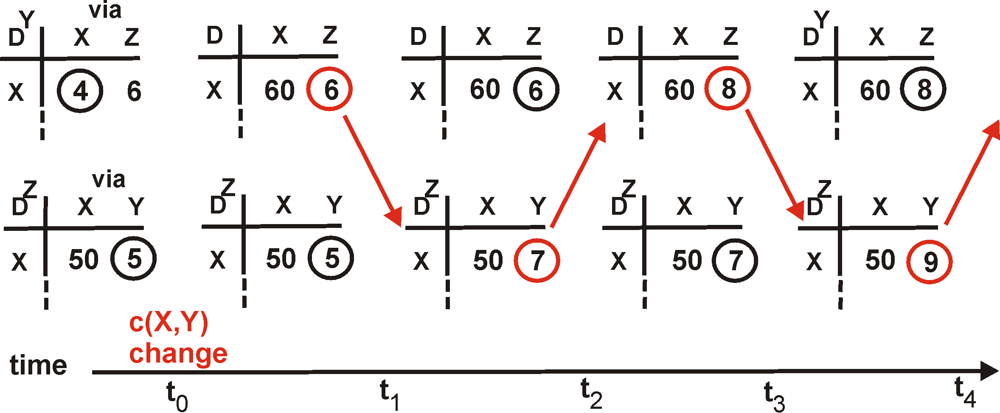
Distance Vector: link cost changes
Link cost changes:
good news travels fast
bad news travels slow (watch: loops!) - “count to infinity” problem!
60
Y
4
1
X
Z
50
Y to x, via
Y to x, via
Y to x, via
Y to x, via
Y to x, via
algorithm
continues
on!
z to x , via
z to x , via
z to x , via
z to x , via
z to x , via

Slide 23
Distance Vector:count to infinity problem: way out?
Poisoned reverse:
If Z routes through Y to get to X :
  Z tells Y its (Z’s) distance to X is infinite (so Y won’t route to X via Z)
60
y
4
1
x
z
50

Slide 24
Comparison of LS and DV algorithms
Message complexity
LS: with n nodes, E links, O(nE) msgs sent
DV: exchange between neighbors only
Speed of Convergence
LS: O(n²) algorithm
  may have oscillations
DV: convergence time varies
  may be routing loops
  count-to-infinity problem
Robustness: what happens if router malfunctions?
LS:
  node can advertise incorrect link cost
  each node computes only its own table
DV:
  DV node can advertise incorrect path cost
  each node’s table used by others
    error propagates thru network

Slide 25
Chapter 4: Network Layer
4. 1 Introduction
4.2 Virtual circuit and datagram networks
4.3 What’s inside a router
4.4 IP: Internet Protocol
  Datagram format
  IPv4 addressing
  ICMP
  IPv6
4.5 Routing algorithms
  Link state
  Distance Vector
  Hierarchical routing
4.6 Routing in the Internet
  RIP
  OSPF
  BGP
4.7 Broadcast and multicast routing

Slide 26
Hierarchical Routing
Recall:
all routers identical
network “flat”
… not true in practice
scale: with 200 million destinations:
can’t store all dest’s in routing tables!
routing table exchange would swamp links!
administrative autonomy
internet = network of networks
each network admin may want to control routing in its own network

Slide 27
Hierarchical Routing: Interconnected ASes
Gateway router
Direct link to router in another AS
3c
3a
2c
3b
2a
AS3
2b
1c
AS2
1a
1b
1d
AS1
forwarding table configured by both intra- and inter-AS routing algorithm
  intra-AS sets entries for internal dests
  inter-AS & intra-As sets entries for external dests
aggregate routers into regions, “autonomous systems” (AS)
routers in same AS run same routing protocol
  “intra-AS” routing protocol
  routers in different AS can run different intra-AS routing protocol
Intra-AS
Routing
algorithm
Inter-AS
Routing
algorithm
Forwarding
table

Slide 28
Inter-AS tasks
AS1 must:
learn which dests are reachable through AS2, which through AS3
propagate this reachability info to all routers in AS1
Job of inter-AS routing!
suppose router in AS1 receives datagram destined outside of AS1:
  router should forward packet to gateway router, but which one?
3c
3a
2c
3b
2a
AS3
2b
1c
AS2
1a
1b
1d
AS1

Slide 29
Example 1: Setting forwarding table in router 1d
suppose AS1 learns (via inter-AS protocol) that subnet x reachable via AS3 (gateway 1c) but not via AS2.
inter-AS protocol propagates reachability info to all internal routers.
router 1d determines from intra-AS routing info that its interface I is on the least cost path to 1c.
  installs forwarding table entry (x,I)
…
x
3c
3a
2c
3b
2a
AS3
2b
1c
AS2
1a
1b
1d
AS1

Slide 30
Example 2: Choosing among multiple ASes
now suppose AS1 learns from inter-AS protocol that subnet x is reachable from AS3 and from AS2.
to configure forwarding table, router 1d must determine towards which gateway it should forward packets for dest x.
  this is also job of inter-AS routing protocol!
…
…
x
3c
3a
2c
3b
2a
AS3
2b
1c
AS2
1a
1b
1d
AS1

Slide 31
Example 2: Choosing among multiple ASes
now suppose AS1 learns from inter-AS protocol that subnet x is reachable from AS3 and from AS2.
to configure forwarding table, router 1d must determine towards which gateway it should forward packets for dest x.
  this is also job of inter-AS routing protocol!
hot potato routing: send packet towards closest of two routers.
Use routing info
from intra-AS
protocol to determine
costs of least-cost
paths to each
of the gateways
Determine from
forwarding table the
interface I that leads
to least-cost gateway.
Enter (x,I) in
forwarding table
Learn from inter-AS
protocol that subnet
x is reachable via
multiple gateways
Hot potato routing:
Choose the gateway
that has the
smallest least cost

Slide 32
Chapter 4: Network Layer
4. 1 Introduction
4.2 Virtual circuit and datagram networks
4.3 What’s inside a router
4.4 IP: Internet Protocol
  Datagram format
  IPv4 addressing
  ICMP
  IPv6
4.5 Routing algorithms
  Link state
  Distance Vector
  Hierarchical routing
4.6 Routing in the Internet
  RIP
  OSPF
  BGP
4.7 Broadcast and multicast routing

Slide 33
Intra-AS Routing
also known as Interior Gateway Protocols (IGP)
most common Intra-AS routing protocols:
  RIP: Routing Information Protocol
  OSPF: Open Shortest Path First
  IGRP: Interior Gateway Routing Protocol (Cisco proprietary)

Slide 34
Chapter 4: Network Layer
4. 1 Introduction
4.2 Virtual circuit and datagram networks
4.3 What’s inside a router
4.4 IP: Internet Protocol
  Datagram format
  IPv4 addressing
  ICMP
  IPv6
4.5 Routing algorithms
  Link state
  Distance Vector
  Hierarchical routing
4.6 Routing in the Internet
  RIP
  OSPF
  BGP
4.7 Broadcast and multicast routing

Slide 35
RIP (Routing Information Protocol)
Distance vector algorithm, with poisoned-reverse
  Distance metric: # of hops
    max = 15 hops (16 = infinity)
  Distance vectors: advertised every 30 sec (no advertisement heard after 180 sec --> neighbor/link declared dead)
z
w
x
y
A
D
B
C
Destination Network Next Router Num. of hops to dest.
w A 2
y B 2
z B 7
x -- 1
…. …. ....
Routing table in D

Slide 36
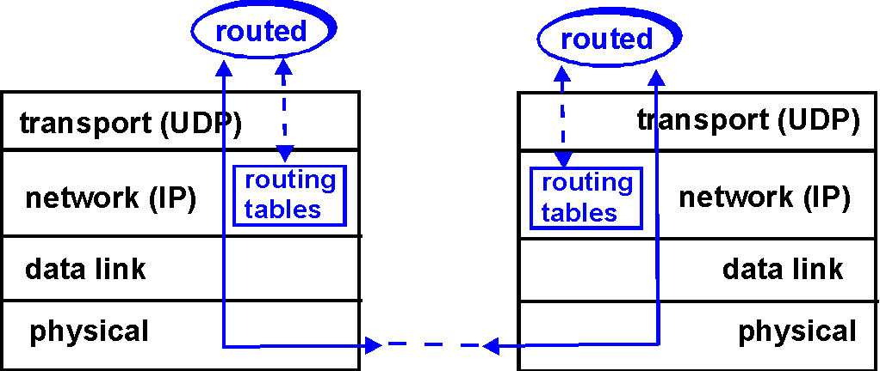
RIP Table processing
RIP routing tables managed by application-level process called route-d (daemon)
advertisements sent in UDP packets, periodically repeated

Slide 37
Chapter 4: Network Layer
4. 1 Introduction
4.2 Virtual circuit and datagram networks
4.3 What’s inside a router
4.4 IP: Internet Protocol
  Datagram format
  IPv4 addressing
  ICMP
  IPv6
4.5 Routing algorithms
  Link state
  Distance Vector
  Hierarchical routing
4.6 Routing in the Internet
  RIP
  OSPF
  BGP
4.7 Broadcast and multicast routing

Slide 38
OSPF (Open Shortest Path First)
“open”: publicly available
Uses Link State algorithm (configurable edge-costs)
  Advertisements disseminated to entire AS (via flooding), via IP packets (unlike RIP)
OSPF “advanced” features (Note: features of the standardized protocol, not the algorithm) -not in RIP
  Security: all OSPF messages authenticated (to prevent malicious intrusion)
  Multiple same-cost paths allowed (only one path in RIP)
  multiple cost metrics for different TypeOfService (eg, satellite link cost “low” for best effort; high for real time)
  Integrated uni- and multicast support:
    Multicast OSPF (MOSPF) uses same topology data base as OSPF
  Hierarchical OSPF in large domains.

Slide 39
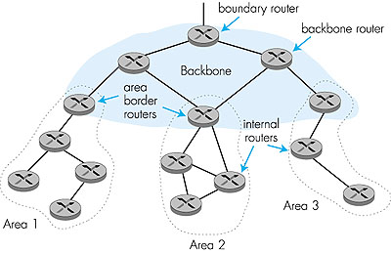
Hierarchical OSPF

Slide 40
Hierarchical OSPF
Two-level hierarchy: local area, backbone.
  Link-state advertisements only in area
  each node has detailed area topology; only know direction (shortest path) to nets in other areas.
Area border routers: “summarize” distances to nets in own area, advertise to other Area Border routers.
Backbone routers: run OSPF routing limited to backbone.
Boundary routers: connect to other ASs.

Slide 41
Chapter 4: Network Layer
4. 1 Introduction
4.2 Virtual circuit and datagram networks
4.3 What’s inside a router
4.4 IP: Internet Protocol
  Datagram format
  IPv4 addressing
  ICMP
  IPv6
4.5 Routing algorithms
  Link state
  Distance Vector
  Hierarchical routing
4.6 Routing in the Internet
  RIP
  OSPF
  BGP
4.7 Broadcast and multicast routing

Slide 42
Internet inter-AS routing: BGP
BGP (Border Gateway Protocol): the de facto standard
BGP provides each AS a means to:
  Obtain subnet reachability information from neighboring ASs.
  Propagate reachability information to all AS-internal routers.
  Determine “good” routes to subnets based on reachability information and policy.
allows subnet to advertise its existence to rest of Internet: “I am here”

Slide 43
BGP basics
pairs of routers (BGP peers) exchange routing info over semi-permanent TCP connections: BGP sessions
  External, internal: eBGP, iBGP
  BGP sessions need not correspond to physical links.
when AS2 advertises a prefix (e.g. subnet) to AS1:
  AS2 promises it will forward datagrams towards that prefix.
  AS2 can aggregate prefixes in its advertisement
eBGP session
3c
iBGP session
2c
3a
3b
2a
AS3
2b
1c
AS2
1a
1b
AS1
1d

Slide 44
Distributing reachability info
using eBGP session between 3a and 1c, AS3 sends prefix reachability info to AS1.
  1c can then use iBGP do distribute new prefix info to all routers in AS1
  1b can then re-advertise new reachability info to AS2 over 1b-to-2a eBGP session
when router learns of new prefix, it creates entry for prefix in its forwarding table.
eBGP session
3c
iBGP session
2c
3a
3b
2a
AS3
2b
1c
AS2
1a
1b
AS1
1d

Slide 45
BGP: routing
Path Vector protocol (similar to Distance Vector): each Border Gateway advertises entire path (I.e, sequence of ASs) to destination
  Suppose: gateway X send its path to peer gateway W
  W may or may not select path offered by X
    cost, policy (don’t route via competitor’s AS), loop prevention reasons.
  If W selects path advertised by X, then:
  Path (W,Z) = w, Path (X,Z)
  Note: X can control incoming traffic by controling its route advertisements to peers:
    e.g., don’t want to route traffic to Z -> don’t advertise any routes to Z

Slide 46
Path attributes & BGP routes
advertised prefix includes BGP attributes.
  prefix + attributes = “route”
two important attributes:
  AS-PATH: contains ASs through which prefix advertisement has passed: e.g, AS 67, AS 17
  NEXT-HOP: indicates specific internal-AS router to next-hop AS. (may be multiple links from current AS to next-hop-AS)
when gateway router receives route advertisement, uses import policy to accept/decline.

Slide 47
BGP route selection
router may learn about more than 1 route to some prefix. Router must select route.
elimination rules:
  local preference value attribute: policy decision
  shortest AS-PATH
  closest NEXT-HOP router: hot potato routing
  additional criteria

Slide 48
BGP messages
BGP messages exchanged using TCP.
BGP messages:
  OPEN: opens TCP connection to peer and authenticates sender
  UPDATE: advertises new path (or withdraws old)
  KEEPALIVE keeps connection alive in absence of UPDATES; also ACKs OPEN request
  NOTIFICATION: reports errors in previous msg; also used to close connection

Slide 49
BGP routing policy: example
legend:
provider
B
network
X
W
A
customer
C
network:
Y
A,B,C are provider networks
X,W,Y are customer (of provider networks)
X is dual-homed: attached to two networks
  X does not want to route from B via X to C
  .. so X will not advertise to B a route to C

Slide 50
BGP routing policy: example (cont)
legend:
provider
B
network
X
W
A
customer
C
network:
Y
A advertises path AW to B
B advertises path BAW to X
Should B advertise path BAW to C?
  No way! B gets no “revenue” for routing CBAW since neither W nor C are B’s customers
  B wants to force C to route to w via A
  B wants to route only to/from its customers!

Slide 51
Why different Intra- and Inter-AS routing ?
Policy:
Inter-AS: admin wants control over how its traffic routed, who routes through its net.
Intra-AS: single admin, so no policy decisions needed
Scale:
hierarchical routing saves table size, reduced update traffic
Performance:
Intra-AS: can focus on performance
Inter-AS: policy may dominate over performance

Slide 52
Chapter 4: Network Layer
4. 1 Introduction
4.2 Virtual circuit and datagram networks
4.3 What’s inside a router
4.4 IP: Internet Protocol
  Datagram format
  IPv4 addressing
  ICMP
  IPv6
4.5 Routing algorithms
  Link state
  Distance Vector
  Hierarchical routing
4.6 Routing in the Internet
  RIP
  OSPF
  BGP
4.7 Broadcast and multicast routing (next)

