Slide 1

Distributed systems II
Replication Cnt.
Prof Philippas Tsigas
Distributed Computing and Systems Research Group

Slide 2
Executing Operations
invocation
response
P₁
P₂
P₃

Slide 3
Interleaving Operations
Concurrent execution

Slide 4
Interleaving Operations
(External) behavior

Slide 5
Interleaving Operations, or Not
Sequential execution

Slide 6
Interleaving Operations, or Not
Sequential behavior: invocations & response alternate and match (on process & object)
Sequential specification: All the legal sequential behaviors, satisfying the semantics of the ADT
  E.g., for a (LIFO) stack: pop returns the last item pushed

Slide 7
Correctness: Sequential consistency
[Lamport, 1979]
For every concurrent execution there is a sequential execution that
  Contains the same operations
  Is legal (obeys the sequential specification)
  Preserves the order of operations by the same process

Slide 8
Sequential Consistency: Examples
Concurrent (LIFO) stack
✓
push(4)
push(7)
pop():4
Last In
First Out
✓
push(4)
push(7)
pop():4

Slide 9
Sequential Consistency: Examples
Concurrent (LIFO) stack
✓
push(4)
push(7)
pop():7
Last In
First Out

Slide 10
Sequential Consistency is not Composable
enq(Q_{1,}X)
enq(Q₂,Y)
enq(Q_{2,}X)
enq(Q₁,Y)
Deq (Q_{1,}Y)
deq(Q₂,X)
The execution is not sequentially consistent
enq(Q₁,Y) ->enq(Q_{1,}X) =>
enq(Q₂,Y)->enq(Q₂,X)

Slide 11
Sequential Consistency is not Composable
enq(Q_{1,}X)
enq(Q₂,Y)
enq(Q_{2,}X)
enq(Q₁,Y)
deq(Q_{1,}Y)
deq(Q₂,X)
The execution projected on each object is
sequentially consistent

Slide 12
Safety: Linearizability
  Sequential specification defines legal sequential executions
  Concurrent operations allowed to be interleaved
  For every concurrent execution there is a sequential execution that
    Contains the same operations
    Is legal (obeys the sequential specification)
    Preserves the real-time order of all operations
push(4)
push(4)
concurrent
LIFO stack
T₁
push(7)
push(7)
pop():4
pop():4
time
T₂
Last In
First Out

Slide 13
Safety: Linearizability
  Sequential specification defines legal sequential executions
  Concurrent operations allowed to be interleaved
  Operations appear to execute atomically
    External observer gets the illusion that each operation takes effect instantaneously at some point between its invocation and its response
push(4)
push(4)
concurrent
LIFO stack
T₁
push(7)
push(7)
pop():4
pop():4
time
T₂
Last In
First Out

Slide 14
Sequential consistency (p567)
it is not linearizable because client2’s getBalance is after client 1’s setBalance in real time.
the following is sequentially consistent but not linearizable
Client 1: | Client 2:
setBalance_{B}(x,1)
 | getBalance_{A}(y) →0
 | getBalance_{A}(x) →0
setBalance_{A}(y,2)
this is possible under a naive replication strategy, even if neither A or B fails -
the update at B has not yet been propagated to A when client 2 reads it
but the following interleaving satisfies both criteria for sequential consistency :
getBalance_{A}(y) → 0; getBalance_{A}(x ) → 0; setBalance_{B}(x,1); setBalance_{A}(y,2)
•
Notes:
possible under naive replication strategy, even if neither A or B fails
update at B not yet propagated to A when client 2 reads it
it is not linearizable because client2’s getBalance is after client 1’s set balance in real time.
but the following interleaving: getBalanceA_{A}(y)-> 0 getBalanceA_{A}(x) -> 0 setBalanceB_{A}(x,1) setBalanceA_{A}(x,1)
satisfies both criteria for sequential consistency are satisfied

Slide 15
Active replication for fault tolerance: State Machine Approach
the RMs are state machines all playing the same role and organised as a group.
  all start in the same state and perform the same operations in the same order so that their state remains identical
If an RM crashes it has no effect on performance of the service because the others continue as normal
It can tolerate byzantine failures because the FE can collect and compare the replies it receives
the RMs process each request identically and reply
a FE multicasts each request to the group of RMs (and FE’s)
RM
C
FE
RM
FE
C
Requires totally ordered reliable multicast so that all RMs perfrom the same operations in the same order
RM
Figure 14.5
•

Slide 16
Active replication - five phases in performing a client request
Request
  FE attaches a unique id and uses totally ordered reliable multicast to send request to RMs. FE can at worst, crash. It does not issue requests in parallel
Coordination
  the multicast delivers requests to all the RMs in the same (total) order.
Execution
  every RM executes the request. They are state machines and receive requests in the same order, so the effects are identical. The id is put in the response
Agreement
  no agreement is required because all RMs execute the same operations in the same order, due to the properties of the totally ordered multicast.
Response
  FEs collect responses from RMs. FE may just use one or more responses. If it is only trying to tolerate crash failures, it gives the client the first response.
•

Slide 17
Replication for Highly available services: The gossip approach
we discuss the application of replication techniques to make services highly available.
  we aim to give clients access to the service with:
    reasonable response times for as much of the time as possible
    even if some results do not conform to sequential consistency
    e.g. a disconnected user may accept temporarily inconsistent results if they can continue to work and fix inconsistencies later
eager versus lazy updates
  fault-tolerant systems send updates to RMs in an ‘eager’ fashion (as soon as possible) and reach agreement before replying to the client
  for high availability, clients should:
    only need to contact a minimum number of RMs and
    be tied up for a minimum time while RMs coordinate their actions
  weaker consistency generally requires less agreement and makes data more available. Updates are propagated 'lazily'.
•

Slide 18
14.4.1 The gossip architecture
the gossip architecture is a framework for implementing highly available services
  data is replicated close to the location of clients
  RMs periodically exchange ‘gossip’ messages containing updates
gossip service provides two types of operations
  queries - read only operations
  updates - modify (but do not read) the state
FE sends queries and updates to any chosen RM
  one that is available and gives reasonable response times
Two guarantees (even if RMs are temporarily unable to communicate
  each client gets a consistent service over time ( i.e. data reflects the updates seen by client, even if the use different RMs). Vector timestamps are used – with one entry per RM.
  relaxed consistency between replicas. All RMs eventually receive all updates. RMs use ordering guarantees to suit the needs of the application (generally causal ordering). Client may observe stale data.
•

Slide 19
Query and update operations in a gossip service
The service consists of a collection of RMs that exchange gossip messages
Queries and updates are sent by a client via an FE to an RM
prev is a vector timestamp for the latest version seen by the FE (and client)
Service
new is the vector timestamp of the resulting value, val
RM
Gossip
RM
RM
Query,
prev
Val,
new
Update,
prev
Update id
FE
FE
Query
update id is the vector timestamp of the update
Val
Update
Clients
Figure 14.6
Causal ordering
•

Slide 20
Gossip processing of queries and updates
Causal ordering
The five phases in performing a client request are:
  request
    FEs normally use the same RM and may be blocked on queries
    update operations return to the client as soon as the operation is passed to the FE
  update response - the RM replies as soon as it has seen the update
  coordination
    the RM waits to apply the request until the ordering constraints apply.
    this may involve receiving updates from other RMs in gossip messages
  execution - the RM executes the request
  query response - if the request is a query the RM now replies:
  agreement
    RMs update one another by exchanging gossip messages (lazily)
      e.g. when several updates have been collected
      or when an RM discovers it is missing an update
•
Notes:
queries, FE may need to contact another RM
update ops - for higher reliability, block client until update given to f+1 RMs
query response - will have waited until ordering constraints apply

Slide 21
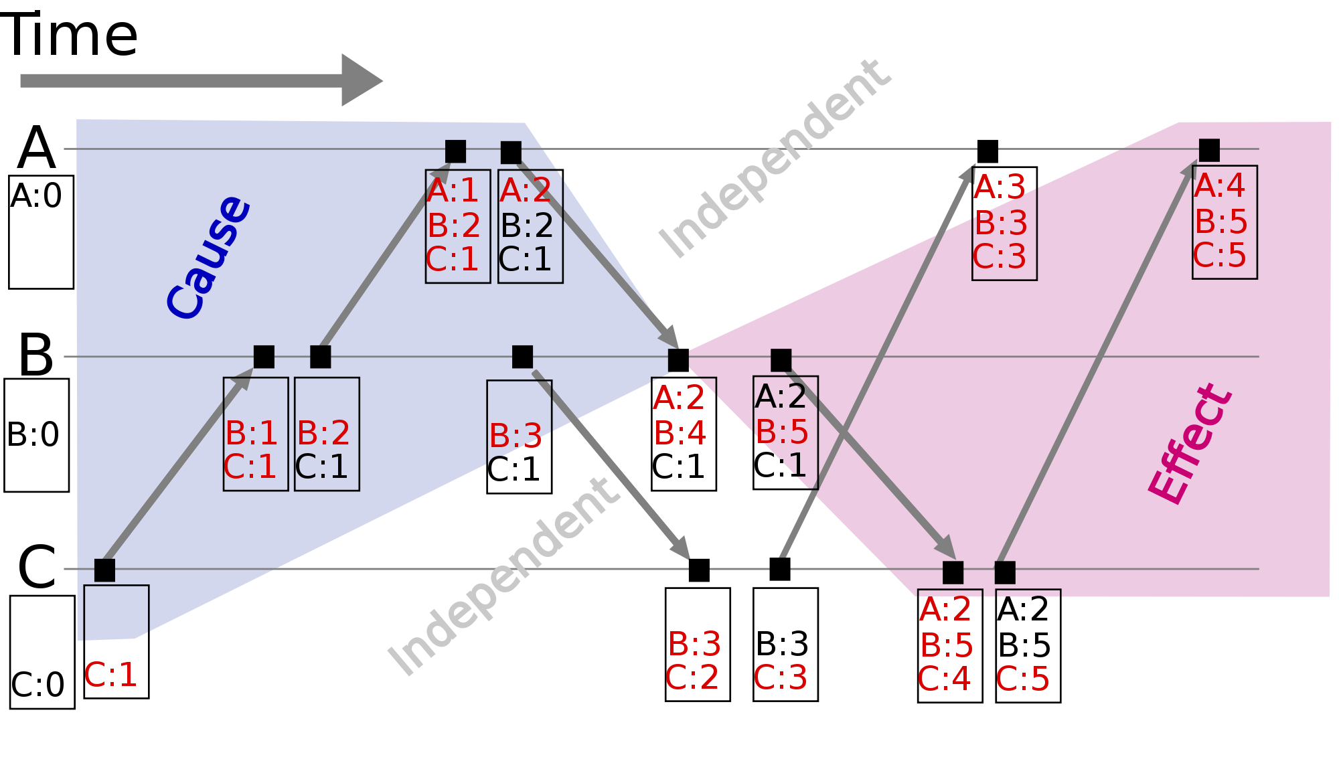

Slide 22
Front ends propagate their timestamps whenever clients communicate directly
each FE keeps a vector timestamp of the latest value seen (prev)
  which it sends in every request
  clients communicate with one another via FEs which pass vector timestamps
Service
client-to-client communication can lead to causal relationships between operations.
RM
RM
gossip
RM
FE
Vector
FE
timestamps
Figure 14.7
Clients
•
Notes:
client-to-client communication can lead to causal relationships between operations, it also occurs via front ends.

Slide 23
A gossip replica manager, showing its main state components
Other replica
managers
timestamp table -a collection of vector timestamps received from other RMs in gossip messages. It is used to know when RMs have received updates
Replica
Replica log
value - application state (each RM is a state machine) we are only talking about one value here
timestamp
Gossip
messages
executed operation table - prevents an operation being applied twice e.g. if received from other RMs as well as FE
Replica manager
Timestamp table
Replica timestamp
Value
timestamp
Stable
Update log
Value
updates
value timestamp (updated each time an update is applied to the value)
Executed operation table
Figure 14.8
update log - held-back until ordering allows it to be applied (when it becomes stable) also held until updates have been received by all other RMs
Updates
OperationID
Update
Prev
FE
FE
replica timestamp - indicates updates accepted by RM in log (different from value’s timestamp if some updates are not yet stable)
•
Notes:
value - application state (each RM is a state machine) - only talking about one value here
value timestamp (updated each time an update is applied to the value)
update log - held-back until ordering allows it to be applied (when it becomes stable) also held until updates have been received by all other RMs
replica timestamp - indicates updates accepted by RM in log (different from value’s timestamp if some updates are not yet stable)
executed operation table - prevents an operation being applied twice e.g. if received from other RMs as well as FE
timestamp table - collection of vector timestamps received from other RMs in gossip messages. Used to know when RMs have received updates

Slide 24
Processing of query and update operations
RMs are numbered 0, 1, 2,…
e.g. in a gossip system with 3 RMs a value of (2,4,5) at RM 0 means that the value there reflects the first 2 updates accepted from FEs at RM 0, the first 4 at RM 1 and the first 5 at RM 2.
Vector timestamp held by RM i consists of:
  ith element holds updates received from FEs by that RM
  jth element holds updates received by RM j and propagated to RM i
Query operations contain q.prev
  they can be applied if q.prev ≤ valueTS (value timestamp)
  failing this, the RM can wait for gossip message or initiate them
    e.g. if valueTS = (2,5,5) and q.prev = (2,4,6) - RM 0 has missed an update from RM 2
  Once the query can be applied, the RM returns valueTS (new) to the FE. The FE merges new with its vector timestamp
•
Notes:
example has 3 RMs. RMs are 0, 1, 2. RM 0 missed update from RM 2 as 6 is not <= 5
FE must have used RM 2 last time. Merge the FE had not seen the latest update at RM 1 ([prev had 4 and RM had 5)
More details of what is stored for updates on page 578.
They can implement total ordering by using a primary RM as a sequencer

Slide 25
Gossip update operations
Update operations are processed in causal order
  A FE sends update operation u.op, u.prev, u.id to RM i
    A FE can send a request to several RMs, using same id
  When RM i receives an update request, it checks whether it is new, by looking for the id in its executed ops table and its log
  if it is new, the RM
    increments by 1 the ith element of its replica timestamp,
    assigns a unique vector timestamp ts to the update
    and stores the update in its log
    logRecord = <i, ts, u.op, u.prev, u.id>
  The timestamp ts is calculated from u.prev by replacing its ith element by the ith element of the replica timestamp.
  The RM returns ts to the FE,which merges it with its vector timestamp
  For stability u.prev ≤ valueTS
  That is, the valueTS reflects all updates seen by the FE.
  When stable, the RM applies the operation u.op to the value,updates valueTS and adds u.id to the executed operation table.
•

Slide 26
Gossip messages
an RM uses entries in its timestamp table to estimate which updates another RM has not yet received
  The timestamp table contains a vector timestamp for each other replica, collected from gossip messages
an RM receiving gossip message m has the following main tasks
  merge the arriving log with its own (omit those with ts ≤ replicaTS)
  apply in causal order updates that are new and have become stable
  remove redundant entries from the log and executed operation table when it is known that they have been applied by all RMs
  merge its replica timestamp with m.ts, so that it corresponds to the additions in the log
•
Notes:
the timestamp table provides only an estimate - because the other RM may have received updates from elsewhere

Slide 27
Discussion of Gossip architecture
the gossip architecture is designed to provide a highly available service
clients with access to a single RM can work when other RMs are inaccessible
  but it is not suitable for data such as bank accounts
  it is inappropriate for updating replicas in real time (e.g. a conference)
scalability
  as the number of RMs grow, so does the number of gossip messages
  for R RMs, the number of messages per request (2 for the request and the rest for gossip) = 2 + (R-1)/G
    G is the number of updates per gossip message
    increase G and improve number of gossip messages, but make latency worse
    for applications where queries are more frequent than updates, use some read-only replicas, which are updated only by gossip messages
•

Slide 28
The Quorum consensus method for Replication
To prevent transactions in different partitions from producing inconsistent results
  make a rule that operations can be performed in only one of the partitions.
RMs in different partitions cannot communicate:
  each subgroup decides independently whether they can perform operations.
A quorum is a subgroup of RMs whose size gives it the right to perform operations.
  e.g. if having the majority of the RMs could be the criterion
in quorum consensus schemes
  update operations may be performed by a subset of the RMs
    and the other RMs have out-of-date copies
    version numbers or timestamps are used to determine which copies are up-to-date
    operations are applied only to copies with the current version number
•

Slide 29
Gifford’s quorum consensus file replication scheme
a number of ‘votes’ is assigned to each physical copy of a logical file at an RM
  a vote is a weighting giving the desirability of using a particular copy.
  each read operation must obtain a read quorum of R votes before it can read from any up-to-date copy
  each write operation must obtain a write quorum of W votes before it can do an update operation.
  R and W are set for a group of replica managers such that
    W > half the total votes
    R + W > total number of votes for the group
  ensuring that any pair contain common copies (i.e. a read quorum and a write quorum or two write quora)
  therefore in a partition it is not possible to perform conflicting operations on the same file, but in different partitions.
•

