Slide 1
Parallel Programming
Philippas Tsigas
Chalmers University of Technology
Computer Science and Engineering Department
© Philippas Tsigas

Slide 2
Why Parallel Programming Is Esssential in Distributed Systems and Networking
© Philippas Tsigas

Slide 3
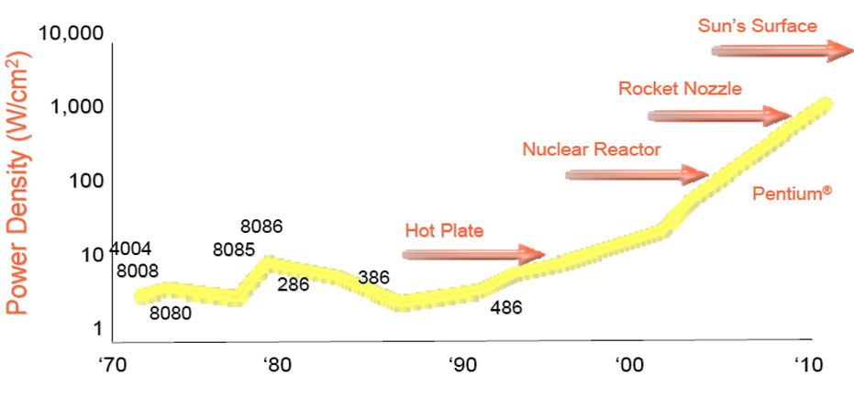
How did we reach there?
Picture from Pat Gelsinger, Intel
Developer Forum, Spring 2004 (Pentium at 90W)

Slide 4
Concurrent Software Becomes Essential
1 Core
1) Scalability becomes an issue for all software.
2) Modern software development relies on the ability to compose libraries into larger programs.
24GHz
12GHz
2 Cores
4 Cores
Our work is to help the programmer to develop efficient parallel programs but also survive the multicore transition.
6GHz
8 Cores
3GHz
3GHz
3GHz
3GHz
Notes:
The tera-scale research prototype
This test chip represents Intel’s first tera-scale research prototype silicon
ATI-FireSTREAM graphics cards with 48 processors directly programmable

Slide 5
Distributed APPLICATIONs
© Philippas Tsigas

Slide 6
Data Sharing:
Gameplay Simulation as an example
This is the hardest problem…
10,000’s of objects
Each one contains mutable state
Each one updated 30 times per second
Each update touches 5-10 other objects
Manual synchronization (shared state concurrency) is
hopelessly intractable here.
Solutions?
Slide:
Tim Sweeney
CEO Epic Games
POPL 2006
© Philippas Tsigas

Slide 7



Distributed Applications Demand
Quite High Level Data Sharing:
Commercial computing (media and information processing)
Control Computing (on board flight-control system)

Slide 8
NETWORKING
© Philippas Tsigas

Slide 9
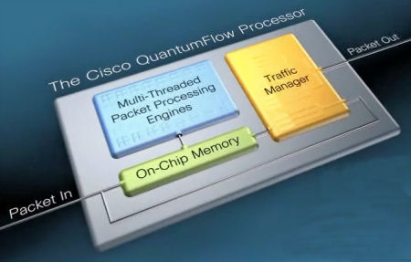
40 multithreaded packet-processing engines
http://www.cisco.com/assets/cdc_content_elements/embedded-video/routers/popup.html
On chip, there are 40 32-bit, 1.2-GHz packet-processing engines. Each engine works on a packet from birth to death within the Aggregation Services Router.
each multithreaded engine handles four threads (each thread handles one packet at a time) so each QuantumFlow Processor chip has the ability to work on 160 packets concurrently

Slide 10
DATA SHARING
© Philippas Tsigas

Slide 11
Blocking Data Sharing
A typical Counter Impl:
Thread1:
getNumber()
Thread2:
getNumber()
class Counter {
int next = 0;
synchronized int getNumber () {
int t;
t = next;
next = t + 1;
return t;
}
}
Lock acquired
t = 0
Lock released
next = 0
result=0
result=1
next = 1
next = 2

Slide 12
Do we need Synchronization?
What can go wrong here?
Thread1:
getNumber()
Thread2:
getNumber()
class Counter {
int next = 0;
int getNumber () {
int t;
t = next;
next = t + 1;
return t;
}
}
t = 0
t = 0
result=0
result=0
☹
next = 0
next = 1

Slide 13
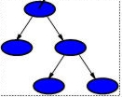
Blocking Synchronization =
Sequential Behavior
© Philippas Tsigas

Slide 14
BS ->Priority Inversion
A high priority task is delayed due to a low priority task holding a shared resource. The low priority task is delayed due to a medium priority task executing.
Solutions: Priority inheritance protocols
  Works ok for single processors, but for multiple processors …
Task H:
Task M:
Task L:

Slide 15
Critical Sections + Multiprocessors
Reduced Parallelism. Several tasks with overlapping critical sections will cause waiting processors to go idle.
Task 1:
Task 2:
Task 3:
Task 4:

Slide 16

The BIGEST Problem with Locks?
Blocking Locks are not composable
All code that accesses a piece of shared state must know and obey the locking convention, regardless of who wrote the code or where it resides.

Slide 17
Interprocess Synchronization = Data Sharing
Synchronization is required for concurrency
Mutual exclusion (Semaphores, mutexes, spin-locks, disabling interrupts: Protects critical sections)
  Locks limits concurrency
  Busy waiting – repeated checks to see if lock has been released or not
  Convoying – processes stack up before locks
  Blocking Locks are not composable
  All code that accesses a piece of shared state must know and obey the locking convention, regardless of who wrote the code or where it resides.
A better approach is to use data structures
that are …
Notes:
now to provide this concurrency they need to have some kind of synchronization, and the easiest way to
provide this to use a blocking approach by using a lock to get mutual exclusion. the problem with this
approach however is that you get low concurrency and problems such as busywaiting and convoying.
a better approach might be to use data structures that are lock-free.

Slide 18
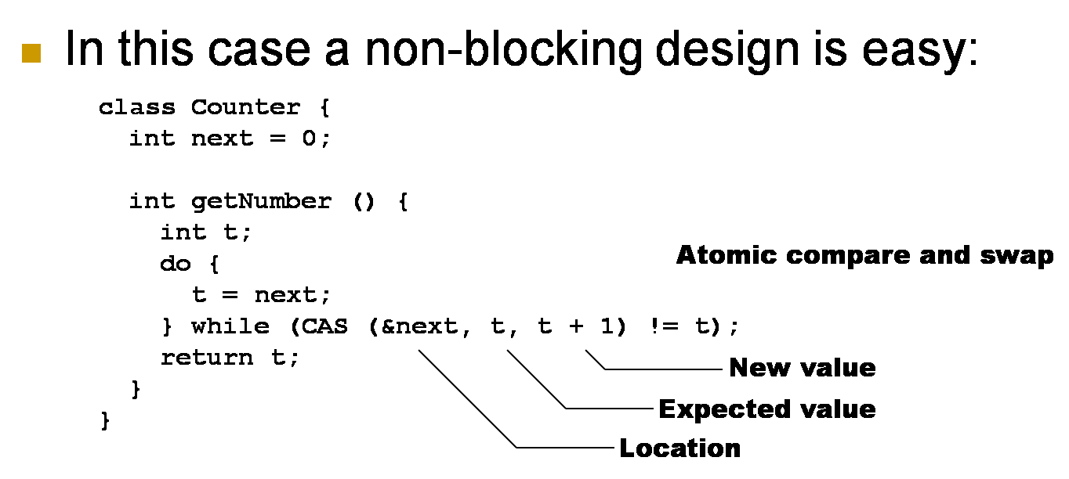
A Lock-free Implementation

Slide 19
LET US START FROM THE BEGINING
© Philippas Tsigas

Slide 20
Shared Memory
Data-structures
Object in shared memory
  Supports some set of operations (ADT)
  Concurrent access by many processes/threads
  Useful to e.g.
    Exchange data between threads
    Coordinate thread activities
Op B
Op A
P1
P2
Op B
Op B
Op B
Op A
P4
P3

Slide 21
Executing Operations
invocation
response
P₁
P₂
P₃

Slide 22
Interleaving Operations
Concurrent execution

Slide 23
Interleaving Operations
(External) behavior

Slide 24
Interleaving Operations, or Not
Sequential execution

Slide 25
Interleaving Operations, or Not
Sequential behavior: invocations & response alternate and match (on process & object)
Sequential specification: All the legal sequential behaviors, satisfying the semantics of the ADT
  E.g., for a (LIFO) stack: pop returns the last item pushed

Slide 26
Correctness: Sequential consistency
[Lamport, 1979]
For every concurrent execution there is a sequential execution that
  Contains the same operations
  Is legal (obeys the sequential specification)
  Preserves the order of operations by the same process

Slide 27
Sequential Consistency: Examples
Concurrent (LIFO) stack
✓
push(4)
push(7)
pop():4
Last In
First Out
✓
push(4)
push(7)
pop():4

Slide 28
Sequential Consistency: Examples
Concurrent (LIFO) stack
✓
push(4)
push(7)
pop():7
Last In
First Out

Slide 29
Safety: Linearizability
Linearizable data structure
  Sequential specification defines legal sequential executions
  Concurrent operations allowed to be interleaved
  Operations appear to execute atomically
    External observer gets the illusion that each operation takes effect instantaneously at some point between its invocation and its response
push(4)
push(4)
concurrent
LIFO stack
T₁
push(7)
push(7)
pop():4
pop():4
time
T₂
Last In
First Out

Slide 30
Safety II
An accessible node is never freed.
Notes:
In a lock-based dynamic object, when a thread removes
a node from the object, it can be guaranteed that
no other thread will subsequently access the contents of the
removed node while still assuming its retention of type and
content semantics. Consequently, it is safe for the removing
thread to free the memory occupied by the removed node
into the general memory pool for arbitrary future reuse.

Slide 31
Liveness
Non-blocking implementations
  Wait-free implementation of a DS [Lamport, 1977]
    Every operation finishes in a finite number of its own steps.
  Lock-free (≠ FREE of LOCKS) implementation of a DS [Lamport, 1977]
    At least one operation (from a set of concurrent operation) finishes in a finite number of steps (the data structure as a system always make progress)

Slide 32
Liveness II
every garbage node is eventually collected

Slide 33
Abstract Data Types (ADT)
data
Cover most concurrent applications
  At least encapsulate their data needs
  An object-oriented programming point of view
Abstract representation of data
& set of methods (operations)
for accessing it
  Signature
  Specification

Slide 34
Implementing High-Level ADT
Using lower-level ADTs
& procedures
data
------------------
-------------------
------------------
----------------
----------------
---------------
------------------
-------------------
data

Slide 35
Lower-Level Operations
High-level operations translate into primitives on base objects that are available on H/W
  Obvious: read, write
  Common: compare&swap (CAS), LL/SC, FAA

Slide 36

Our Research: Non-Blocking Synchronization for Accessing Shared Data
We are trying to design efficient non-blocking implementations of building blocks that are used in concurrent software design for data sharing.

