Slide 1
Distributed Systems II
TDA297(CTH), DIT290 (GU)
LP3 2012
7.5 hec
http://www.cse.chalmers.se/edu/course/TDA297

Slide 2
The Teachers
Instructor: Philippas Tsigas
  E-mail: tsigas@chalmers.se
  Phone: +46-31-772 5409
  Office: 5106
  Office hours: By appointment
Assistants:
  Farnaz Moradi – moradi@chalmers.se
  Ioannis Nikolakopoulos – ioaniko@chalmers.se
  Office hours: To be announced

Slide 3
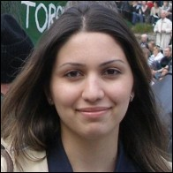

The Teachers
  Farnaz Moradi moradi@chalmers.sePhone: 772 1045
  Room: 5111
  Ioannis Nikolakopoulos ioaniko@chalmers.sePhone: 772 5720
  Room: 5107
  Office hours: To be announced

Slide 4
Course Representatives

Slide 5
Reading
4th Edition of the book: "Distributed Systems: Concepts and Design"
  written by: George Coulouris, Jean Dollimore and Tim Kindberg
  published by Addison-Wesley, ISBN 0-321-26354-5
Some extra material: Distributed Algorithms (Notes) + papers.

Slide 6
Description
Distributed systems are popular and powerful computing paradigms. Their importance increases as networked computers become more common than freestanding ones, especially since many different types of computers can be found in networks. In this course we will see the points of inherent difference and strength of distributed systems compared with sequential or strongly-coupled systems; consequently, we will also study the issues and problems that have to be addressed and solved efficiently for these differences to be taken advantage of, so that the system retains its strength and high potential.

Slide 7
Goals
1.Replication; The advantages and costs of replicating data:
  Potential improvement in response times and reliability
  Extra communication costs involved in keeping data consistent.
2.Fault-tolerant Agreement in Distributed Systems:
  (a very special and significant problem, since it is a key issue in most synchronisation and coordination problems in distributed systems)
  Study of the basic impossibility results and discuss their implications
  Proceed with solutions and protocols for systems with certain strengths and design structures.

Slide 8
Goals cont.
3. Resource Allocation.
4. Distributed algorithms: How to design and analyse distributed algorithms?
5. Sensor Networks.
6. Denial of Service Attacks.

Slide 9
This is an advanced course
No list of things to learn
  The book and assignments cover most exam material
Find out what you need
  Lectures
  The book
  Internet
Lectures and assignments in parallel
  Don’t wait for the lectures before you start with the assignments

Slide 10
Approximate Course Schedule
Week (Chalmers week/LV) | Monday | Wednesday | Friday
3 (1) (Jan 17-21) | Lecture 1: Introduction | Lecture 2: Broadcasting | Assignment Lecture 1: Introduction to Lab 1
4 (2) (Jan 24-Jan 28) | Lecture 3: Broadcasting & Replication | Lecture 4: Replication | Lecture 5: Replication & Quorum Consensus
5 (3) (Mar 31-Feb 4) | Assignment Lecture 2: Introduction to Lab 2 + Questions and answers for all labs. | No Lecture – Work on assignments | Lecture 6: Distributed denial of service attacks
6 (4) (Feb 7-11) | Lecture 7: Distributed Transactions & Concurrency Control in Distributed Transactions Deadline for lab 1 at 23:59 | CHARM – No Lecture | Assignment Lecture 3: Questions and answers for all labs.
7 (5) (Feb 14-18) | Lecture 8: Atomic Commit protocols & Byzantine General | Lecture 9: Distributed Algorithms | Assignment Lecture 4: Sensor Networks + Introduction to Lab 3 + Questions and answers for all labs.
8 (6) (Feb 21-25) | Lecture 10: Grouping and routing in sensor networks Deadline for lab 2 at 23:59 | Assignment Lecture 5: Questions and answers for all labs. | Lecture 11: Mutual Exclusion and Resource Allocation. Dining Philosophers
9 (7) (Feb 28-Mar 4) | Lecture 12: Generalization of the Dining Philosophers | Lecture 13: Drinking Philosophers and Efficient Resource Allocation | No Lecture Deadline for lab 3 at 23:59
10 (8) (Mar 7-11) | Assignment presentations: Presentations and Demos of the 3rd lab. | Lecture 14: Efficient Resource Allocation continued | Lecture 15: Closing
 | EXAM: Monday the 14th of March 2011 in the V building 14:00-18:00

Slide 11
Examination
1st Lab due: arround 10th of February
2nd Lab due: arround 17th of February
3rd Lab due: arround 1st of March
Final examination: 05th of March

Slide 12
Resources
Full support page for the Coulouris’ book:
http://www.cdk4.net/
http://www.cdk5.net/
Slides:
At homepage after lecture
Last years slides available, use them as a reference point before the lecture: http://www.cse.chalmers.se/edu/year/2010/course/TDA297/
1st Assignment:
Distributed bulletin board
http://www.cse.chalmers.se/edu/course/TDA297/labs/lab1.html

Slide 13
Resources cont.
1st Assignment:
Distributed bulletin board
http://www.cse.chalmers.se/edu/course/TDA297/labs/lab1.html

Slide 14
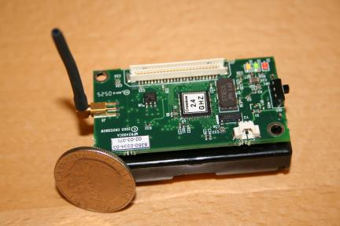
Resources cont(2).
2nd Assignment:
Reliable and ordered multicast
http://www.cse.chalmers.se/edu/course/TDA297/labs/lab2.html
3nd Assignment:
Routing in Sensor Networks
http://www.cse.chalmers.se/edu/course/TDA297/labs/lab3.html

Slide 15
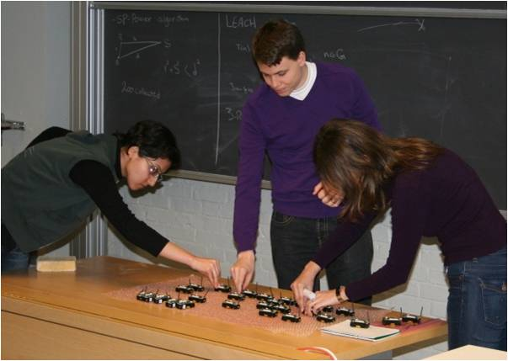

Slide 16
Why Distributed Systems?
Suggestions?

Slide 17
Because they are there
Distributed Applications
Automated Banking Systems
Tracking Roaming Cellular Telephones
Air-Traffic Control Systems
Fly-by-wire Systems
The World-Wide- Web

Slide 18
Because they have many +
Network vs. Centralised Systems
Cycles always available
Incremental growth
Independent failure
Heterogeneity
Increased Autonomy
  purchasing
  management
  software

Slide 19
Ingredients of D.S.
Multiple computers
Interconnections
Shared states

Slide 20
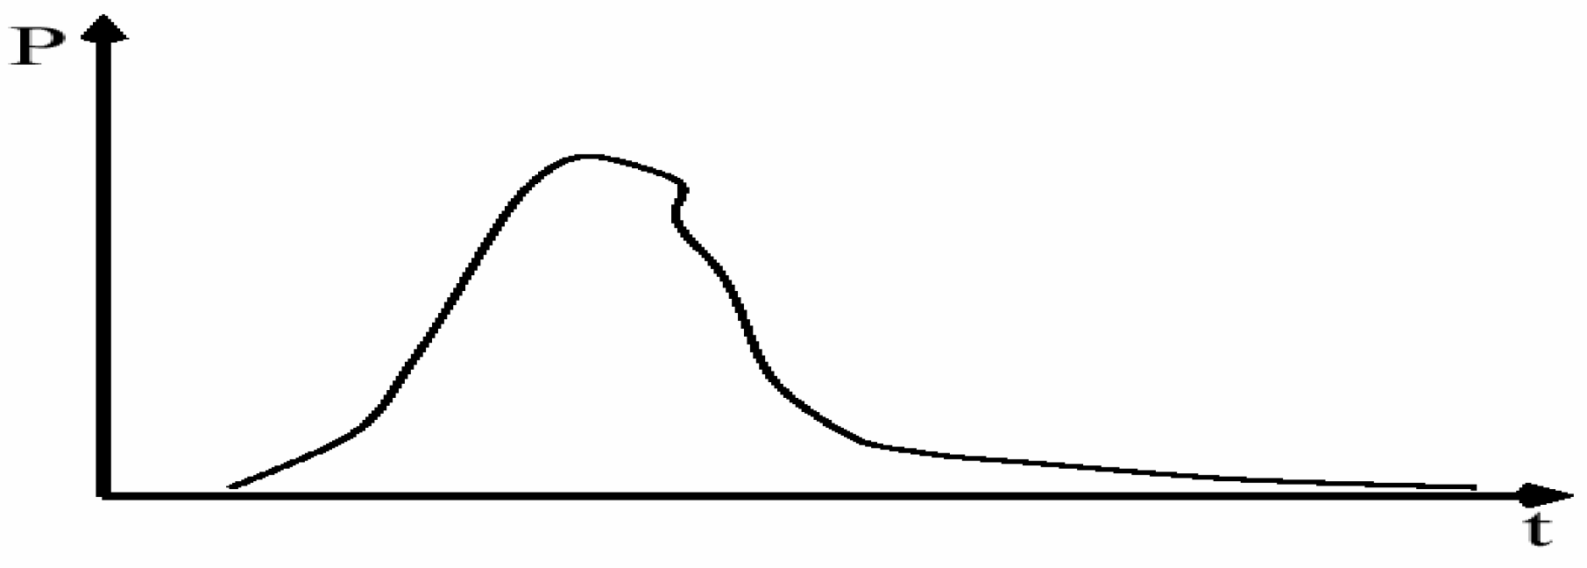
Asynchronous Systems
Communication is reliable but incurs potentially unbounded delays

Slide 21
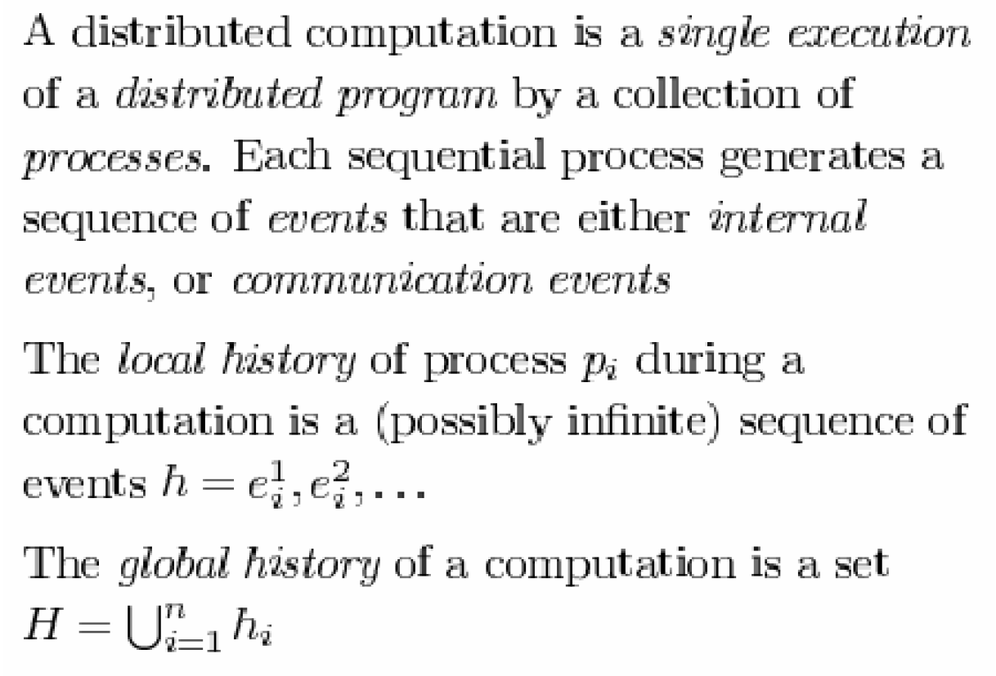
Distributed Computation

Slide 22
State of the computation
Imagine stopping a distributed computation by stopping all of its processes simultaneously.
The combined states of each of the processes, plus the contents of the messages in transit between processes will then tell us the exact global state of the computation.

Slide 23
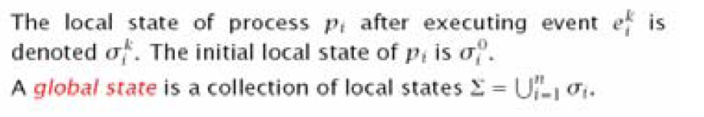
State of the computation
The problem with our asynchronous system is that there is no such thing as simultaneity.
The concept of a system state is still used in analysis

Slide 24
Cause and Effect
No simultaneity in an asynchronous system
  => we need something else in order to study the events in such a system.
We do have the notion of cause and effect, however.
If one event e_{i} caused another event e_{j} to happen, then e_{i} and e_{j} could never have happened simultaneously:
e_{i} happened before e_{j}

Slide 25
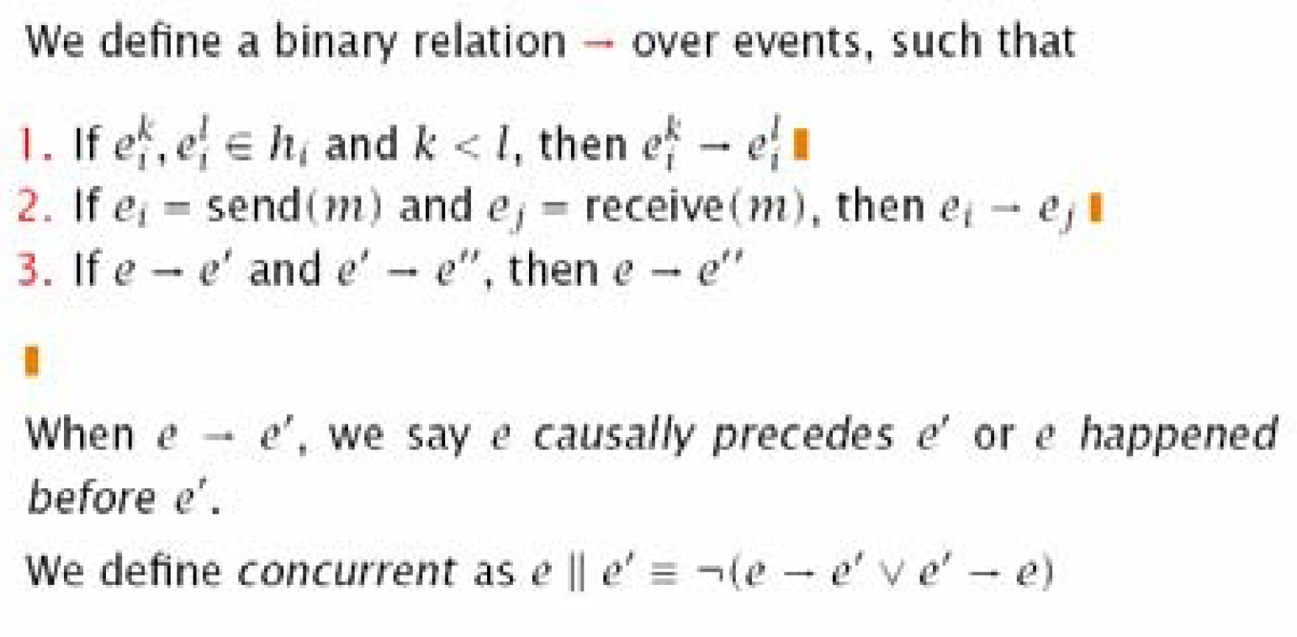
Causal Orders

Slide 26
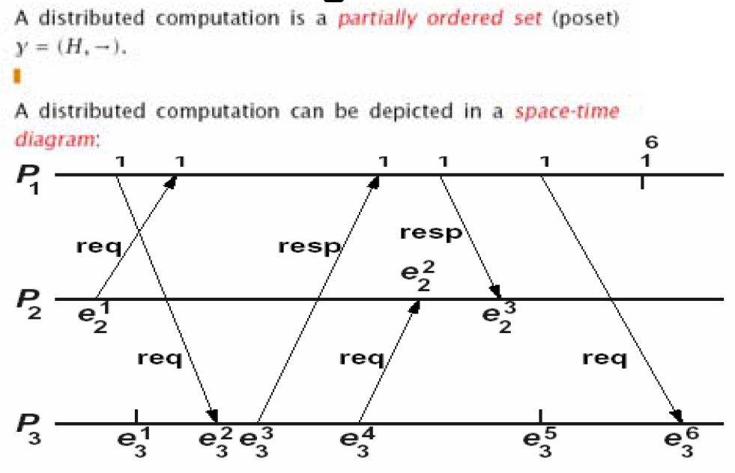
Space Time Diagram

