Slide 1
Highly available services
we discuss the application of replication techniques to make services highly available.
  we aim to give clients access to the service with:
    reasonable response times for as much of the time as possible
    even if some results do not conform to sequential consistency
    e.g. a disconnected user may accept temporarily inconsistent results if they can continue to work and fix inconsistencies later
eager versus lazy updates
  fault-tolerant systems send updates to RMs in an ‘eager’ fashion (as soon as possible) and reach agreement before replying to the client
  for high availability, clients should:
    only need to contact a minimum number of RMs and
    be tied up for a minimum time while RMs coordinate their actions
  weaker consistency generally requires less agreement and makes data more available. Updates are propagated 'lazily'.
•

Slide 2
14.4.1 The gossip architecture
the gossip architecture is a framework for implementing highly available services
  data is replicated close to the location of clients
  RMs periodically exchange ‘gossip’ messages containing updates
gossip service provides two types of operations
  queries - read only operations
  updates - modify (but do not read) the state
FE sends queries and updates to any chosen RM
  one that is available and gives reasonable response times
Two guarantees (even if RMs are temporarily unable to communicate
  each client gets a consistent service over time ( i.e. data reflects the updates seen by client, even if the use different RMs). Vector timestamps are used – with one entry per RM.
  relaxed consistency between replicas. All RMs eventually receive all updates. RMs use ordering guarantees to suit the needs of the application (generally causal ordering). Client may observe stale data.
•

Slide 3
Query and update operations in a gossip service
The service consists of a collection of RMs that exchange gossip messages
Queries and updates are sent by a client via an FE to an RM
prev is a vector timestamp for the latest version seen by the FE (and client)
Service
new is the vector timestamp of the resulting value, val
RM
Gossip
RM
RM
Query,
prev
Val,
new
Update,
prev
Update id
FE
FE
Query
update id is the vector timestamp of the update
Val
Update
Clients
Figure 14.6
Causal ordering
•

Slide 4
Gossip processing of queries and updates
Causal ordering
The five phases in performing a client request are:
  request
    FEs normally use the same RM and may be blocked on queries
    update operations return to the client as soon as the operation is passed to the FE
  update response - the RM replies as soon as it has seen the update
  coordination
    the RM waits to apply the request until the ordering constraints apply.
    this may involve receiving updates from other RMs in gossip messages
  execution - the RM executes the request
  query response - if the request is a query the RM now replies:
  agreement
    RMs update one another by exchanging gossip messages (lazily)
      e.g. when several updates have been collected
      or when an RM discovers it is missing an update
•
Notes:
queries, FE may need to contact another RM
update ops - for higher reliability, block client until update given to f+1 RMs
query response - will have waited until ordering constraints apply

Slide 5
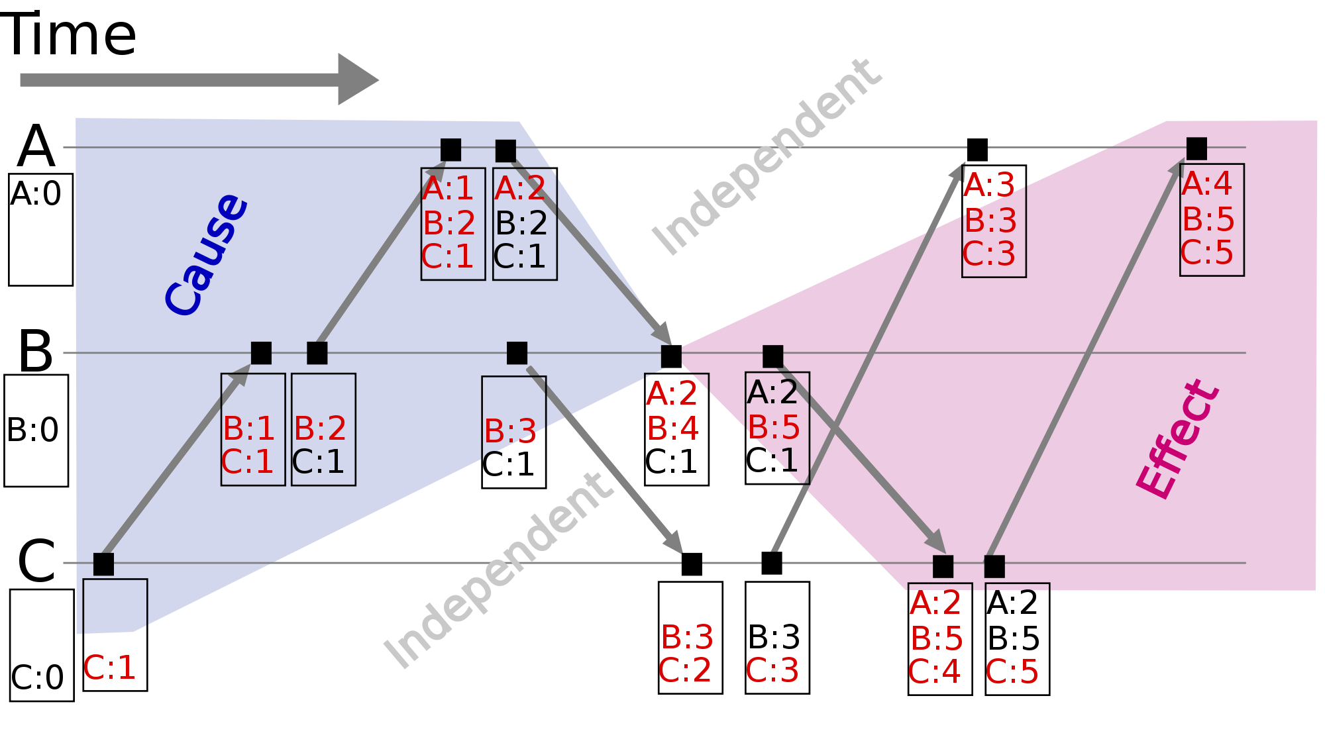

Slide 6
Front ends propagate their timestamps whenever clients communicate directly
each FE keeps a vector timestamp of the latest value seen (prev)
  which it sends in every request
  clients communicate with one another via FEs which pass vector timestamps
Service
client-to-client communication can lead to causal relationships between operations.
RM
RM
gossip
RM
FE
Vector
FE
timestamps
Figure 14.7
Clients
•
Notes:
client-to-client communication can lead to causal relationships between operations, it also occurs via front ends.

Slide 7
A gossip replica manager, showing its main state components
Other replica
managers
timestamp table -a collection of vector timestamps received from other RMs in gossip messages. It is used to know when RMs have received updates
Replica
Replica log
value - application state (each RM is a state machine) we are only talking about one value here
timestamp
Gossip
messages
executed operation table - prevents an operation being applied twice e.g. if received from other RMs as well as FE
Replica manager
Timestamp table
Replica timestamp
Value
timestamp
Stable
Update log
Value
updates
value timestamp (updated each time an update is applied to the value)
Executed operation table
Figure 14.8
update log - held-back until ordering allows it to be applied (when it becomes stable) also held until updates have been received by all other RMs
Updates
OperationID
Update
Prev
FE
FE
replica timestamp - indicates updates accepted by RM in log (different from value’s timestamp if some updates are not yet stable)
•
Notes:
value - application state (each RM is a state machine) - only talking about one value here
value timestamp (updated each time an update is applied to the value)
update log - held-back until ordering allows it to be applied (when it becomes stable) also held until updates have been received by all other RMs
replica timestamp - indicates updates accepted by RM in log (different from value’s timestamp if some updates are not yet stable)
executed operation table - prevents an operation being applied twice e.g. if received from other RMs as well as FE
timestamp table - collection of vector timestamps received from other RMs in gossip messages. Used to know when RMs have received updates

Slide 8
Processing of query and update operations
RMs are numbered 0, 1, 2,…
e.g. in a gossip system with 3 RMs a value of (2,4,5) at RM 0 means that the value there reflects the first 2 updates accepted from FEs at RM 0, the first 4 at RM 1 and the first 5 at RM 2.
Vector timestamp held by RM i consists of:
  ith element holds updates received from FEs by that RM
  jth element holds updates received by RM j and propagated to RM i
Query operations contain q.prev
  they can be applied if q.prev ≤ valueTS (value timestamp)
  failing this, the RM can wait for gossip message or initiate them
    e.g. if valueTS = (2,5,5) and q.prev = (2,4,6) - RM 0 has missed an update from RM 2
  Once the query can be applied, the RM returns valueTS (new) to the FE. The FE merges new with its vector timestamp
•
Notes:
example has 3 RMs. RMs are 0, 1, 2. RM 0 missed update from RM 2 as 6 is not <= 5
FE must have used RM 2 last time. Merge the FE had not seen the latest update at RM 1 ([prev had 4 and RM had 5)
More details of what is stored for updates on page 578.
They can implement total ordering by using a primary RM as a sequencer

Slide 9
Gossip update operations
Update operations are processed in causal order
  A FE sends update operation u.op, u.prev, u.id to RM i
    A FE can send a request to several RMs, using same id
  When RM i receives an update request, it checks whether it is new, by looking for the id in its executed ops table and its log
  if it is new, the RM
    increments by 1 the ith element of its replica timestamp,
    assigns a unique vector timestamp ts to the update
    and stores the update in its log
    logRecord = <i, ts, u.op, u.prev, u.id>
  The timestamp ts is calculated from u.prev by replacing its ith element by the ith element of the replica timestamp.
  The RM returns ts to the FE,which merges it with its vector timestamp
  For stability u.prev ≤ valueTS
  That is, the valueTS reflects all updates seen by the FE.
  When stable, the RM applies the operation u.op to the value,updates valueTS and adds u.id to the executed operation table.
•

Slide 10
Gossip messages
an RM uses entries in its timestamp table to estimate which updates another RM has not yet received
  The timestamp table contains a vector timestamp for each other replica, collected from gossip messages
gossip message, m contains log m.log and replica timestamp m.ts
an RM receiving gossip message m has the following main tasks
  merge the arriving log with its own (omit those with ts ≤ replicaTS)
  apply in causal order updates that are new and have become stable
  remove redundant entries from the log and executed operation table when it is known that they have been applied by all RMs
  merge its replica timestamp with m.ts, so that it corresponds to the additions in the log
•
Notes:
the timestamp table provides only an estimate - because the other RM may have received updates from elsewhere

Slide 11
Discussion of Gossip architecture
the gossip architecture is designed to provide a highly available service
clients with access to a single RM can work when other RMs are inaccessible
  but it is not suitable for data such as bank accounts
  it is inappropriate for updating replicas in real time (e.g. a conference)
scalability
  as the number of RMs grow, so does the number of gossip messages
  for R RMs, the number of messages per request (2 for the request and the rest for gossip) = 2 + (R-1)/G
    G is the number of updates per gossip message
    increase G and improve number of gossip messages, but make latency worse
    for applications where queries are more frequent than updates, use some read-only replicas, which are updated only by gossip messages
•

Slide 12
14.5.5 Quorum consensus methods
To prevent transactions in different partitions from producing inconsistent results
  make a rule that operations can be performed in only one of the partitions.
RMs in different partitions cannot communicate:
  each subgroup decides independently whether they can perform operations.
A quorum is a subgroup of RMs whose size gives it the right to perform operations.
  e.g. if having the majority of the RMs could be the criterion
in quorum consensus schemes
  update operations may be performed by a subset of the RMs
    and the other RMs have out-of-date copies
    version numbers or timestamps are used to determine which copies are up-to-date
    operations are applied only to copies with the current version number
•

Slide 13
Gifford’s quorum consensus file replication scheme
a number of ‘votes’ is assigned to each physical copy of a logical file at an RM
  a vote is a weighting giving the desirability of using a particular copy.
  each read operation must obtain a read quorum of R votes before it can read from any up-to-date copy
  each write operation must obtain a write quorum of W votes before it can do an update operation.
  R and W are set for a group of replica managers such that
    W > half the total votes
    R + W > total number of votes for the group
  ensuring that any pair contain common copies (i.e. a read quorum and a write quorum or two write quora)
  therefore in a partition it is not possible to perform conflicting operations on the same file, but in different partitions.
•

Slide 14
Gifford’s quorum consensus - performing read and write operations
before a read operation, a read quorum is collected
  by making version number enquiries at RMs to find a set of copies, the sum of whose votes is not less than R (not all of these copies need be up to date).
  as each read quorum overlaps with every write quorum, every read quorum is certain to include at least one current copy.
  the read operation may be applied to any up-to-date copy.
before a write operation, a write quorum is collected
  by making version number enquiries at RMs to find a set with up-to-date copies, the sum of whose votes is not less than W.
  if there are insufficient up-to-date copies, then an out-of-date file is replaced with a current one, to enable the quorum to be established.
  the write operation is then applied by each RM in the write quorum, the version number is incremented and completion is reported to the client.
  the files at the remaining available RMs are then updated in the background.
Two-phase read/write locking is used for concurrency control
  the version number enquiry sets read locks (read and write quora overlap)
•

Slide 15
Gifford’s quorum consensus: configurability of groups of replica managers
groups of RMs can be configured to give different performance or reliability characteristics
  once the R and W have been chosen for a set of RMs:
  the reliability and performance of write operations may be increased by decreasing W
  and similarly for reads by decreasing R
the performance of read operations is degraded by the need to collect a read consensus
examples from Gifford
  three examples show the range of properties that can be achieved by allocating weights to the various RMs in a group and assigning R and W appropriately
  weak representatives (on local disk) have zero votes, get a read quorum from RMs with votes and then read from the local copy
•

Slide 16
Gifford’s quorum consensus examples (1979)
Example 1
Example 2
Example 3
Latency
Replica 1
75
75
75
Derived performance
latency
blocking probability - probability that a quorum cannot be obtained, assuming probability of 0.01 that any single RM is unavailable
(milliseconds)
Replica 2
65
100
750
Replica 3
65
750
750
Voting
Replica 1
1
2
1
configuration
Replica 2
0
1
1
Replica 3
0
1
1
Quorum
R
1
2
1
sizes
W
1
3
3
Example 1 is configured for a file with high read to write ratio
with several weak representatives and a single RM.
Replication is used for performance, not reliability.
The RM can be accessed in 75 ms and the two clients can access their weak representatives in 65 ms, resulting in lower latency and less network traffic
Derived performance of file suite:
Example 2 is configured for a file with a moderate read to write ratio which is accessed mainly from one local network. Local RM has 2 votes and remote RMs 1 vote each.
Reads can be done at the local RM, but writes must access one local RM and one remote RM. If the local RM fails only reads are allowed
Read
Example 3 is configured for a file with a very high read to write ratio.
Reads can be done at any RM and the probability of the file being unavailable is small. But writes must access all RMs.
Latency
65
75
75
Blocking probability
0.01
0.0002
0.000001
Write
Latency
75
100
750
Blocking probability
0.01
0.0101
0.03
•
Notes:
availaility - Ex 1 reqd quorum .01, write quorum .01
Ex 2. read quorum 2, fails if either of 2+1 fails - i.e. 2*( .01*.01)
write quorum 3, fails if first missing (.01) or other two (.01*.01)
total = .0101
Ex 3. read quorum 1. prob all 3 failing = (.01*.01*.01)
write quorum 3. prob of one unavailable = 3*.01

Slide 17
Distributed Replicated FIFO Queue
State Machine Approach (One copy of the Queue on each replica)
Quorun Consensus
    Can we use the approach above?

Slide 18
Distributed Replicated FIFO Queue
State Machine Approach (One copy of the Queue on each replica)
Quorun Consensus:
  Propably representing a state machine does not help here. Instead represent the queue as a log of versioned entries:
    1.enq(x)
    2.enq(y)
    3.deq(x)

Slide 19
FIFO Queue
Can we use the log representation of the FIFO queue to build a distributed highly available queue based on quorum consensus?
Enter enq or deq:
Read queue version
Compute new version
Write new version
Make sure that all quorums intersect!

Slide 20
FIFO Queue
Here is a new replication protocol:
  Definition: To merge a log:
  Short entries in version order
  Discard Duplicates
  Merge logs from the initial read operation
  Reconstruct object’s state from log
  Apply operation and compute new entry
  Append new entry to log and write log to the the final quorum
  Each replica merges logs

Slide 23
Log Compaction
Here is a more compact queue representation:
  No deq records
  The event horizon: enq version of most recently dequed item
  The sequence of undequed enq entries
  To merge:
  take latest event horizon
  Discrad earlier enq entries
  Sort remaining enq entries, discard duplicates
  Replicas can send event horizons in ”gossip” messages. Page (21)

Slide 24
Log Compaction
Event horizons are type-specific, but many similar ideas can work
Garbage collection:
  Local: discard entries that can’t effect the future
  Non-local use background ”gossip” to discard entries.

Slide 25
Quorum Assignments
How are quorums chosen?
  deq needs to know about earlier enq operations
  deq needs to know about earlier deq operations
  enq does not need to know about other operations

Slide 26
Depends-On Relation
Let
  D be a relation on opertions
  h any operation sequence
  and p any operation
  A view of h to p is
  a sequence of g of h
  contains every q such that pDq
  If g contains q, then it contains any earlier r such that qDr
  Definition: D is a depends-on relation if whenever g.p is legal, so is h.p

Slide 27
Depends-On relation
Quorum consensus replication is correct if and only if the quorum intersection is a depends-on relation

