Slide 1
A polynomial local solution to Mutual Exclusion

Slide 2
Doorways
Doorway is a separation mechanism of two areas.
Processes which pass a doorway at time T prevent neighbour processes entering the same area at a greater time than T until exiting the doorway.

Slide 3


Asynchronous Dorway
Enry Code
Exit Code
m1 is the I am going in message

Slide 4
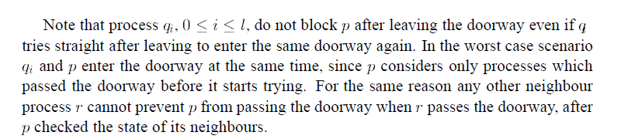
Behaviour

Slide 5
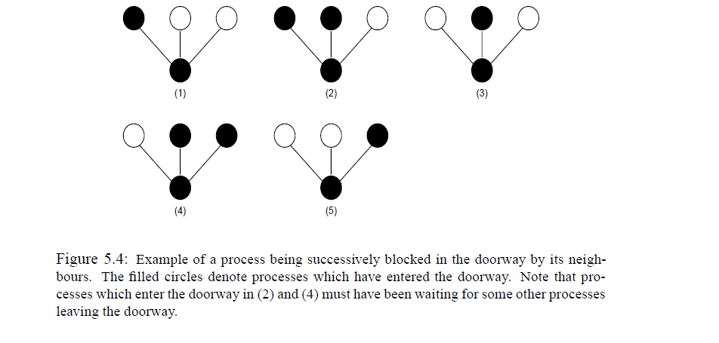
Problem with the Asynchronous
Doorway

Slide 6
Synchronous Doorway
A process which desires to enter a synchronous doorway is required to wait for a situation in which all its neighbours are outside the doorway. This is implemented by checking for a process the states of its neighbours before it enters the doorway.

Slide 7


Entry code:
Exit code:

Slide 8
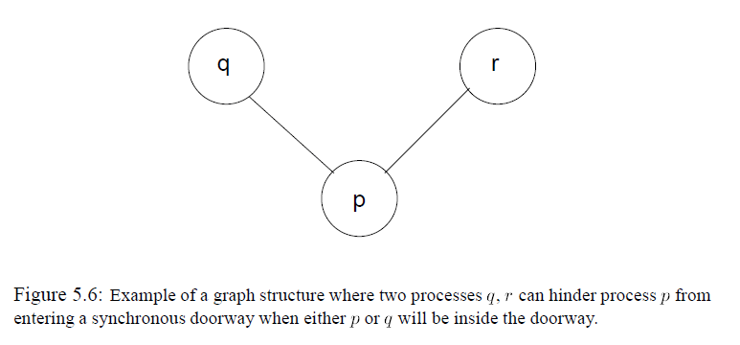
What Can Go Wrong?

Slide 9
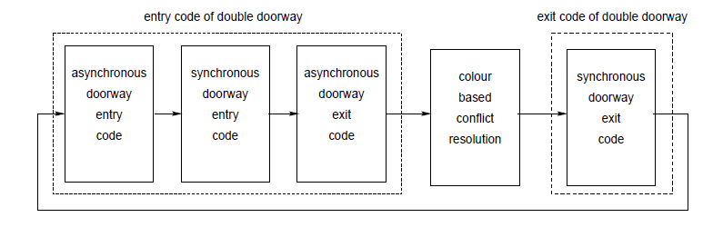
What if We Combine?

Slide 10
