Slide 1
Chapter 5: DataLink Layer
Course on Computer Communication and Networks, CTH/GU
The slides are adaptation of the slides made available by the authors of the course’s main textbook
Computer Networking: A Top Down Approach
5th edition.
Jim Kurose, Keith Ross
Addison-Wesley, 2009

Slide 2
Chapter 5: The Data Link Layer
data-link layer has responsibility of
transferring frames from one node
to adjacent node over a link
Our goals:
understand principles behind data link layer services:
  error detection, correction
  sharing a broadcast channel: multiple access
  link layer addressing
  reliable data transfer, flow control: done!
instantiation and implementation of various link layer technologies

Slide 3
Link Layer
5.1 Introduction and services
Framing
5.2 Error detection and correction
5.3Multiple access protocols
LAN technology
5.5 Ethernet
5.6 Interconnection
5.4 Link-Layer Addressing
5.7 PPP
5.9 A day in the life of a web request
(5.8 Link Virtualization: ATM and MPLS)

Slide 4
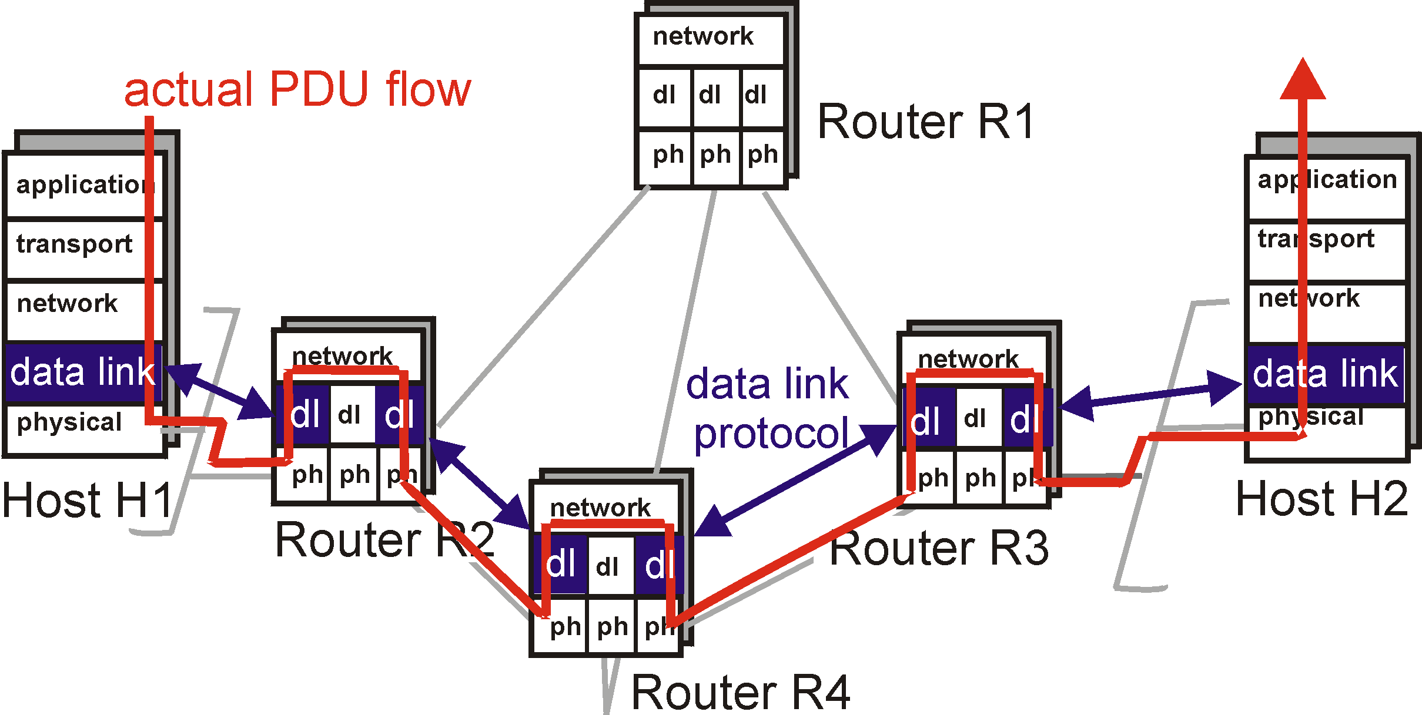
Link layer: context
Datagram transferred by different link protocols over different links:
  e.g., Ethernet on first link, frame relay on intermediate links, 802.11 on last link
Each link protocol provides different services
  e.g., may or may not provide rdt over link
transportation analogy
trip from Princeton to Lausanne
  limo: Princeton to JFK
  plane: JFK to Geneva
  train: Geneva to Lausanne
tourist = datagram
transport segment = communication link
transportation mode = link layer protocol
travel agent = routing algorithm

Slide 5
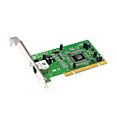
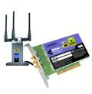
Where is the link layer implemented?
in each and every host
link layer implemented in “adaptor” (aka network interface card NIC)
  E.g. Ethernet card, 802.11 card
  implements link, physical layer
attaches into host’s system buses
combination of hardware, software, firmware
host schematic
application
transport
network
link
cpu
memory
link
physical
host
bus
(e.g., PCI)
controller
physical
transmission
network adapter
card

Slide 6
Adaptors Communicating
datagram
datagram
controller
controller
sending host
receiving host
datagram
frame
sending side:
  encapsulates datagram in frame
  adds error checking bits, rdt, flow control, etc.
receiving side
  looks for errors, rdt, flow control, etc
  extracts datagram, passes to upper layer at receiving side

Slide 7
Link Layer Services
Framing, link access:
  encapsulate datagram into frame, adding header, trailer
  channel access if shared medium
  “MAC” addresses used in frame headers to identify source, dest
    different from IP address!
Reliable delivery between adjacent nodes, flow ctrl
  Control when errors + pace between adjacent sending and receiving nodes
    we learned how to do this already (chapter 3)!
  seldom used on low bit error link (fiber, some twisted pair)
  wireless links: high error rates
  Q: why both link-level and end-end reliability?

Slide 8
Link Layer Services (more)
Error Detection:
  errors caused by signal attenuation, noise.
  receiver detects presence of errors:
    signals sender for retransmission or drops frame
Error Correction:
  receiver identifies and corrects bit error(s) without resorting to retransmission

Slide 9
Link Layer
5.1 Introduction and services
Framing
5.2 Error detection and correction
5.3Multiple access protocols
LAN technology
5.5 Ethernet
5.6 Interconnection
5.4 Link-Layer Addressing
5.7 PPP
5.9 A day in the life of a web request
(5.8 Link Virtualization: ATM and MPLS)

Slide 10
Framing
to detect possible bit stream errors in the physical layer, the data link layer groups bits from the network layer into discrete frames
the receiver must be able to detect the beginning and the end of the frame
Example methods:
Clock-based + Character count : physical-clock synchronization: much dependent on clock drifts + the counter could be garbled up during transmission

Slide 11
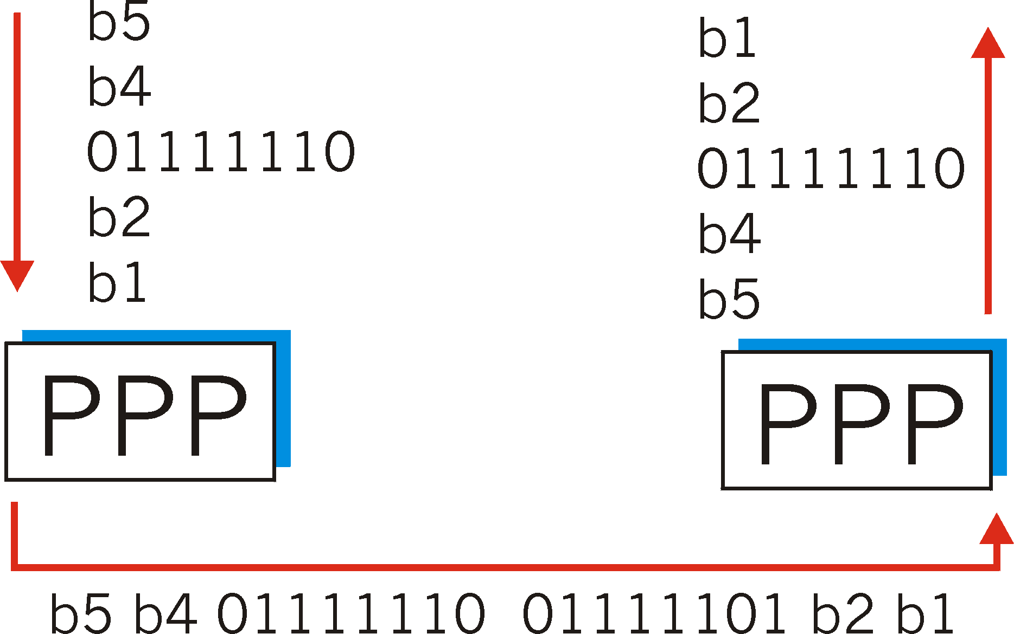
Byte Stuffing
flag byte
pattern
in data
to send
<01111110> delimits beginning, end of frame
“data transparency”: data field must be allowed to include <01111110>
  Q: is received <01111110> data or flag?
Sender: adds (“stuffs”) extra <01111110> byte after each <01111110> data byte
01 1 1 1 1 10
flag byte pattern plus
stuffed byte in transmitted data
Receiver:
  two 01111110 bytes in a row: discard first byte, continue data reception
  single 01111110: flag byte

Slide 12
Framing techniques: examples (cont)
...
Physical layer coding violation: exploits special encodings at the physical layer, e.g. Manchester encoding (see next …)

Slide 13
Encoding
Problem: Simple binary encoding (aka Non-Return to Zero, NRZ) introduces problems:
consecutive 0’s or 1’s can lead to a situation called baseline wander (hard to distinguish signal values)
hard to recover the clock
More robust encoding:
Manchester: XOR NRZ with clock

Slide 14
Link Layer
5.1 Introduction and services
Framing
5.2 Error detection and correction
5.3Multiple access protocols
LAN technology
5.5 Ethernet
5.6 Interconnection
5.4 Link-Layer Addressing
5.7 PPP
5.9 A day in the life of a web request
(5.8 Link Virtualization: ATM and MPLS)

Slide 15
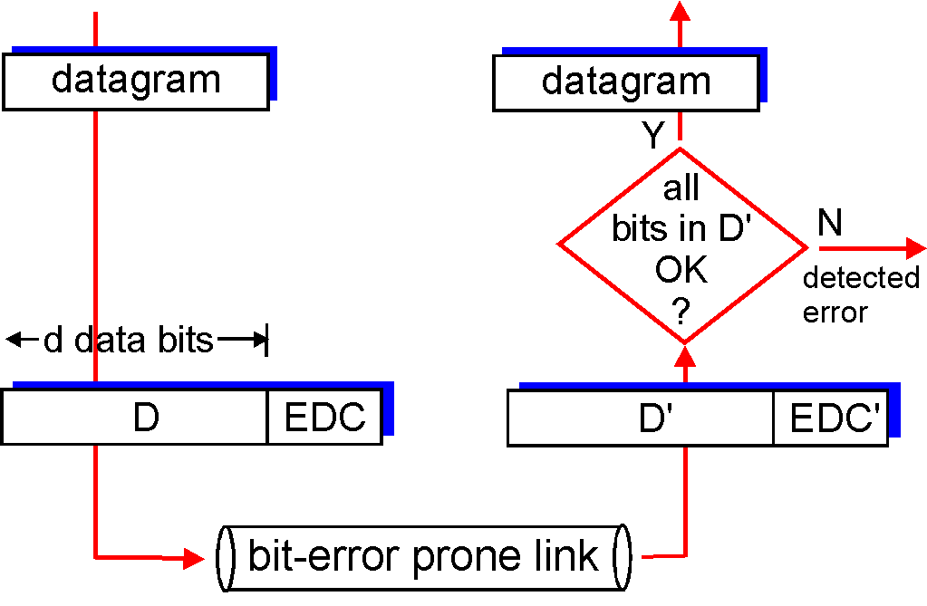
Error Detection
EDC= Error Detection and Correction bits (redundancy)
D = Data protected by error checking, may include header fields
Error detection not 100% reliable!
  protocol may miss some errors, but this should happen only rarely
  larger EDC field yields better detection and correction

Slide 16
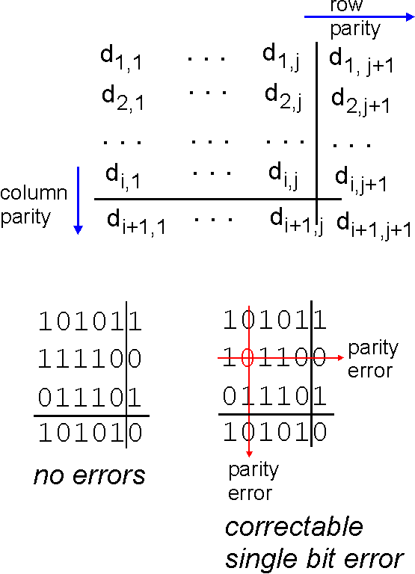
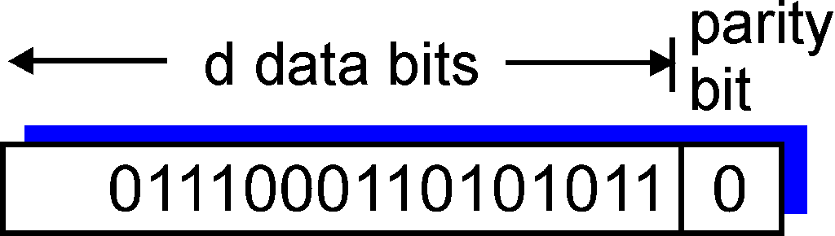
Parity Checking
Single Bit Parity:
Detect single bit errors
Two Dimensional Bit Parity:
Detect and correct single bit errors
0
0

Slide 17
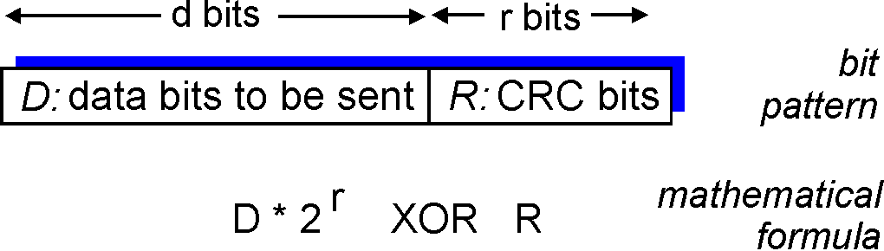
Internet checksums
TCP (UDP)’s checksum:
segment contents = sequence of 16-bit integers
checksum: addition (1’s complement sum) of segment contents
sender puts checksum value into UDP (TCP) checksum field
Cyclic redundancy check (CRC)
data bits, D = binary number
consider r+1 bit pattern (generator), G
goal: compute r CRC bits, R, such that
  <D,R> exactly divisible by G (modulo 2)
  receiver knows G, divides <D,R> by G. If non-zero remainder: error detected!
  can detect errors on less than r+1 bits
International standards for G (CRC polynomials)

Slide 18
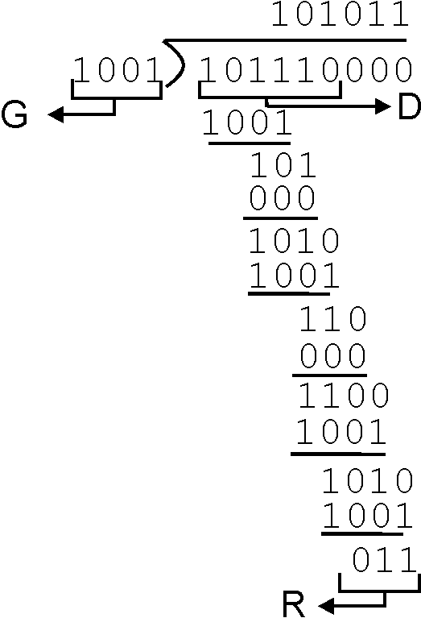
CRC Example
Recall we want:
  D.2^{r} XOR R = nG
equivalently:
  if we divide D.2^{r} by G, want remainder R
D.2^{r}
G
R = remainder[ ]

Slide 19
Link Layer
5.1 Introduction and services
Framing
5.2 Error detection and correction
5.3Multiple access protocols
LAN technology
5.5 Ethernet
5.6 Interconnection
5.4 Link-Layer Addressing
5.7 PPP
5.9 A day in the life of a web request
(5.8 Link Virtualization: ATM and MPLS)

Slide 20


Multiple Access Links and Protocols
Two types of “links”:
point-to-point
  PPP for dial-up access
  point-to-point link between Ethernet switch and host
broadcast (shared wire or medium)
  Ethernet
  upstream HFC
  802.11 wireless LAN
humans at a
cocktail party
(shared air, acoustical)
shared wire (e.g.,
cabled Ethernet)
shared RF
(e.g., 802.11 WiFi)
shared RF
(satellite)

Slide 21
Multiple Access protocols
single shared broadcast channel
two or more simultaneous transmissions by nodes: interference
  collision if node receives two or more signals at the same time
multiple access protocol
distributed algorithm that determines how nodes share channel, i.e., determine when node can transmit
  communication about channel sharing must use channel itself!
    no out-of-band channel for coordination

Slide 22
Ideal Mulitple Access Protocol
Broadcast channel of rate R bps
1. When one node wants to transmit, it can send at rate R.
2. When M nodes want to transmit, each can send at average rate R/M
3. Fully decentralized:
  no special node to coordinate transmissions
4. Simple

Slide 23
MAC Protocols: a taxonomy
Three broad classes:
Channel Partitioning
  divide channel into smaller “pieces” (time slots, frequency); allocate piece to node for exclusive use
Random Access
  allow collisions; “recover” from collisions
“Taking turns”
  tightly coordinate shared access to avoid collisions
Recall goal: efficient, fair, simple, decentralized

Slide 24

Channel Partitioning MAC protocols:
TDMA, FDMA
TDMA: time division multiple access
access to channel in "rounds"
each station gets fixed length slot (length = pkt trans time) in each round
unused slots go idle
  example: 6-station LAN, 1,3,4 have pkt, slots 2,5,6 idle
FDMA: frequency division multiple access
each station assigned fixed frequency band
unused transmission time in frequency bands goes idle
  example: 6-station LAN, 1,3,4 have pkt, frequency bands 2,5,6 idle
frequency bands

Slide 25
Channel Partitioning CDMA
CDMA: Code Division Multiple Access
allows each station to transmit over the entire frequency spectrum all the time.
simultaneous transmissions are separated using coding theory.
used mostly in wireless broadcast channels (cellular, satellite, etc) – we will study it in the wireless context
has been ”traditionally” used in the military
Observe:
MUX = speak person-to-person in designated space
CDMA = ”shout” using different languages: the ones who know the language will get what you say

Slide 26
Random Access Protocols
When node has packet to send
  transmit at full channel data rate R.
  no a priori coordination among nodes
two or more transmitting nodes ➜ “collision”,
random access MAC protocol specifies:
  how to detect collisions
  how to recover from collisions (e.g., via delayed retransmissions)
Examples of random access MAC protocols:
  slotted ALOHA
  ALOHA
  CSMA, CSMA/CD, CSMA/CA

Slide 27
Slotted ALOHA
Assumptions:
all frames same size
time divided into equal size slots (time to transmit 1 frame)
nodes start to transmit only at slot beginning
nodes are synchronized
if 2 or more nodes transmit in slot, all nodes detect collision
Operation:
when node obtains fresh frame, transmits in next slot
  if no collision: node can send new frame in next slot
  if collision: node retransmits frame in each subsequent slot with prob. p until success

Slide 28
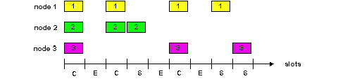
Slotted ALOHA
Pros
single active node can continuously transmit at full rate of channel
highly decentralized: only slots in nodes need to be in sync
simple
Cons
collisions, wasting slots
idle slots
nodes may be able to detect collision in less than time to transmit packet
clock synchronization

Slide 29
Slotted Aloha efficiency
Efficiency : long-run
fraction of successful slots
(many nodes, all with many frames to send)
Q: max fraction of
successful transmissions?
A: Suppose N stations, each transmits in slot with probability p
  prob. successful transmission is:
  P[specific node succeeds]= p (1-p)^{(N-1)}
  P[any of N nodes succeeds]
= N p (1-p)^{(N-1)}
^{Efficiency} = 1/e = .37 LARGE N
At best: channel
use for useful
transmissions 37%
of time!

Slide 30
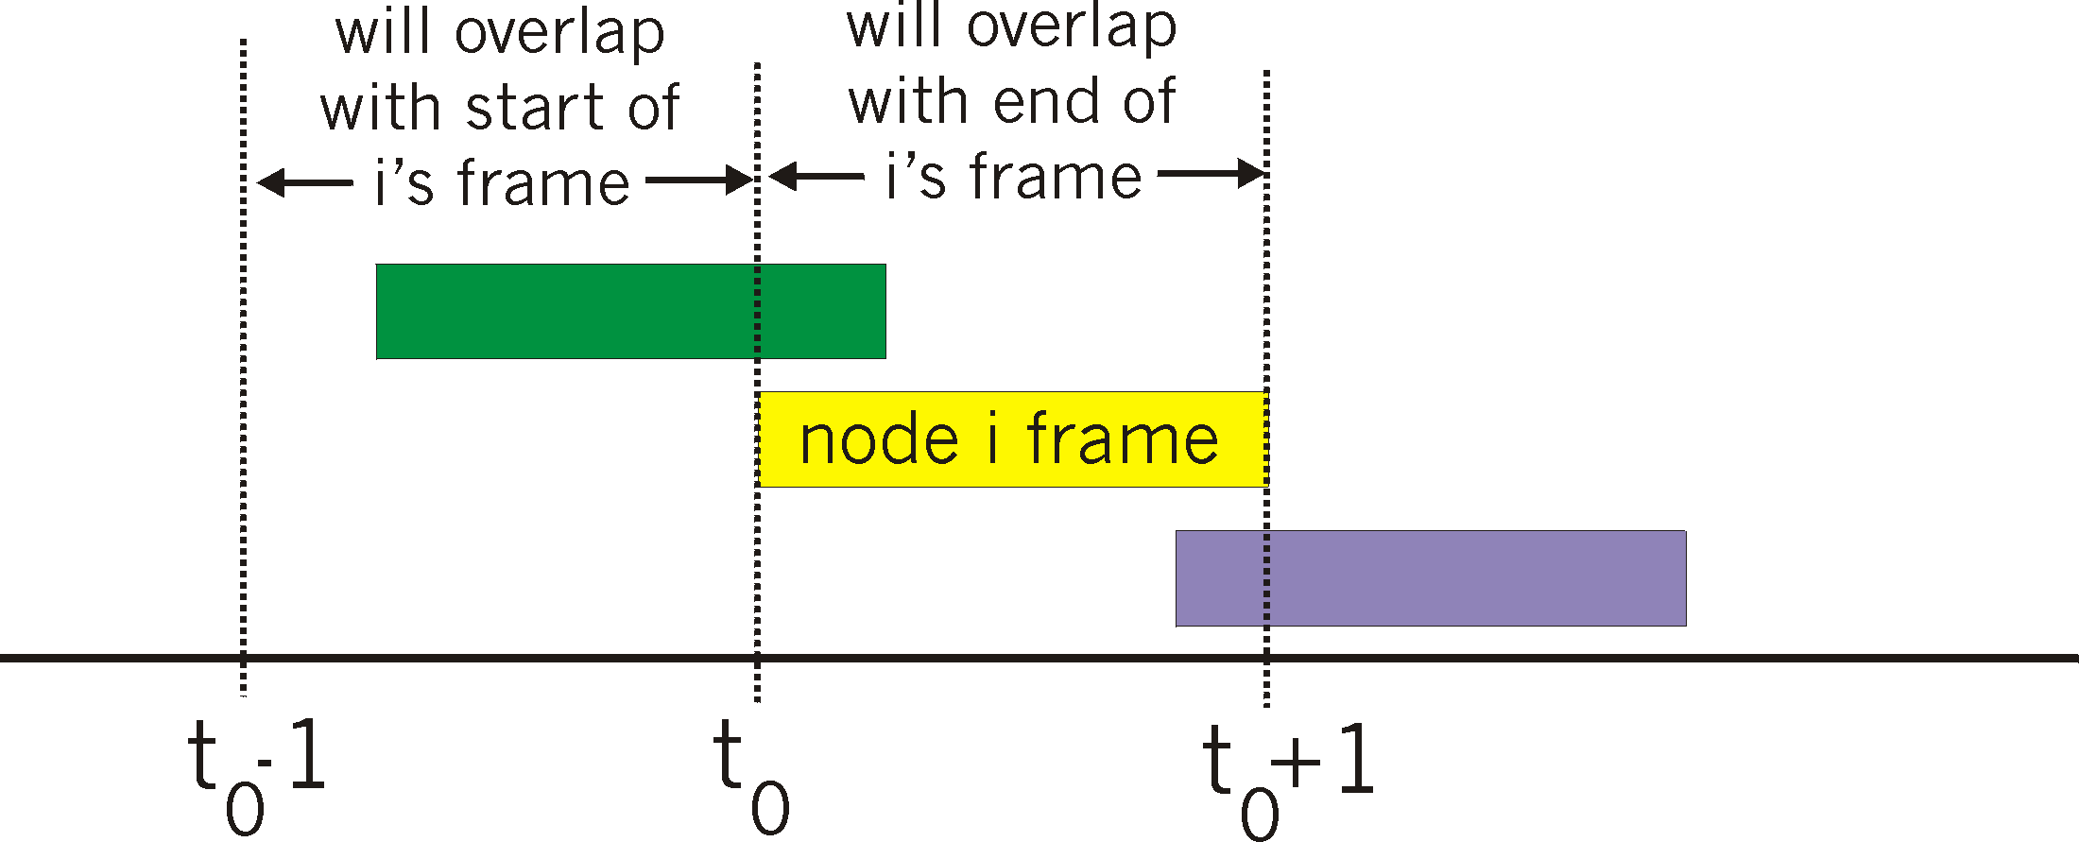
Pure (unslotted) ALOHA
unslotted Aloha: simpler, no synchronization
pkt needs transmission:
  send without awaiting for beginning of slot
collision probability increases:
  pkt sent at t₀ collide with other pkts sent in [t₀-1, t₀+1]

Slide 31
Pure Aloha (cont.)
P(success by any of N nodes) = N p . (1-p)^{2N =}
i.e. N p P(no other node transmits in [p0-1,p0] .
P(no other node transmits in [p0,p0+1]
^{=(as n -> infty …)}
^{1/(2e) = .18}
0.4
0.3
S = throughput = “goodput”
(success rate)
protocol constrains
effective channel
throughput!
Slotted Aloha
0.2
0.1
Pure Aloha
0.5
1.0
1.5
2.0
G = offered load = #frames per frame-time

Slide 32
CSMA: Carrier Sense Multiple Access
CSMA: listen before transmit:
If channel sensed busy, defer transmission
  back-off, random interval
If/when channel sensed idle:
  p-persistent CSMA: transmit immediately with probability p; with probablility 1-p retry after random interval
  non-persistent CSMA: transmit after random interval
human analogy: don’t interrupt others!

Slide 33
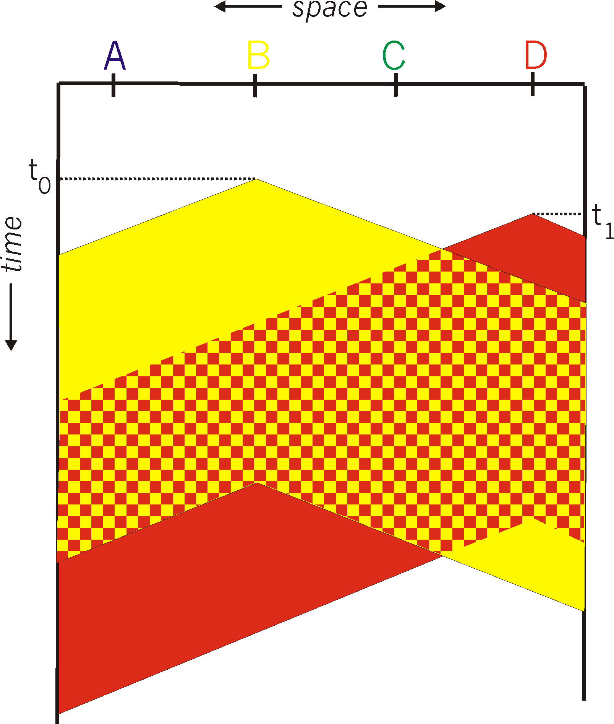
CSMA collisions
spatial layout of nodes along ethernet
collisions can occur:
Due to propagation delay, two nodes may not hear each other’s transmission
collision:
entire packet transmission
time wasted
note:
role of distance and propagation delay (d)in determining collision
(collision-detection delay = 2d)

Slide 34
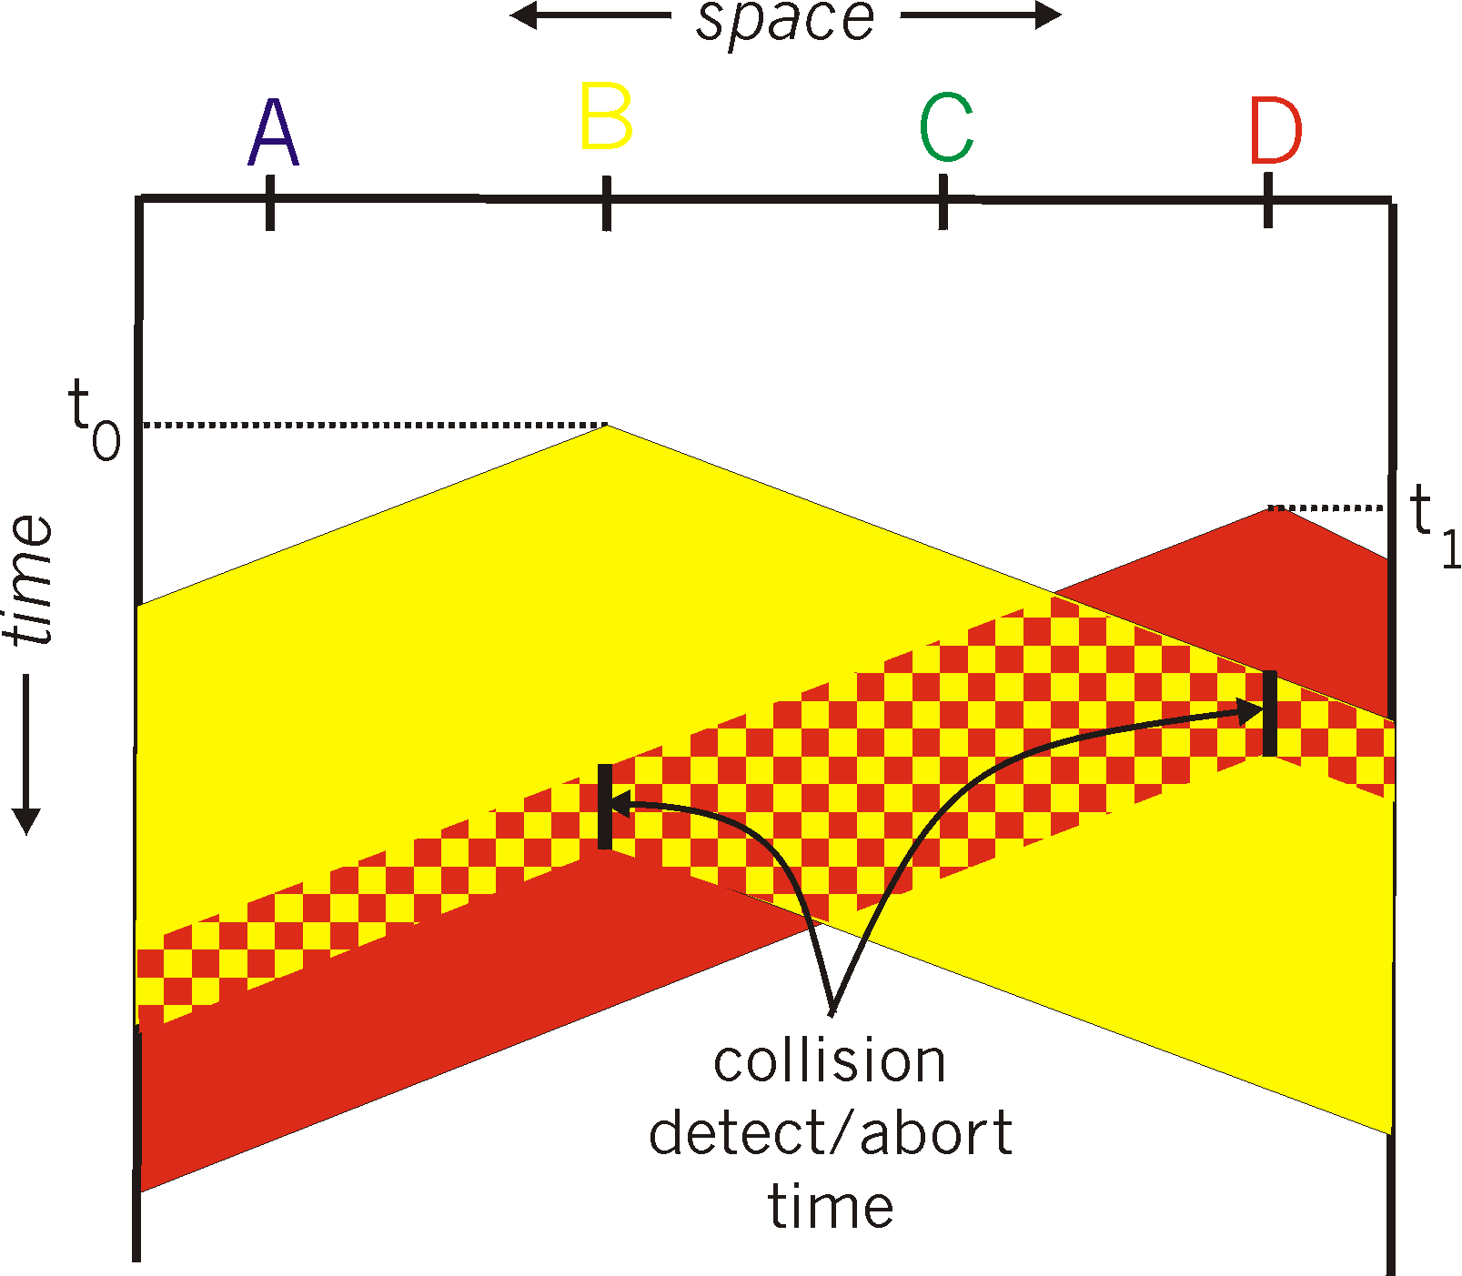
CSMA/CD (Collision Detection)
CSMA/CD: carrier sensing, deferral as in CSMA
colliding transmissions aborted, reducing channel wastage
persistent or non-persistent retransmission
collision detection:
easy in wired LANs: measure signal
  strengths, compare transmitted,
  received signals
different in wireless LANs:
  transmitter/receiver not “on”
  simultaneously; collision at the
  receiver matters, not the sender
human analogy: the polite
conversationalist

Slide 35
“Taking Turns” MAC protocols
channel partitioning MAC protocols:
  share channel efficiently and fairly at high load
  inefficient at low load: delay in channel access, 1/N bandwidth allocated even if only 1 active node!
Random access MAC protocols
  efficient at low load: single node can fully utilize channel
  high load: collision overhead
“taking turns” protocols
  look for best of both worlds!

Slide 36
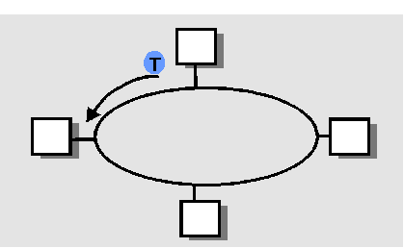
“Taking Turns” MAC protocols
Token passing:
control token-frame passed from one node to next sequentially.
not pure broadcast
concerns:
  token overhead
  latency
  single point of failure (token)

Slide 37
IEEE 802.4 Standard
(General Motors Token Bus)
(not in must-study material)
Contention systems limitation: worst-case delay until successful transmission is unlimited => not suitable for real-time traffic
Solution: token-passing, round robin
token = special control frame; only the holding station can transmit; then it passes it to another station, i.e. for token bus, the next in the logical ring
4 priority classes of traffic, using timers
Logical ring-maintenance: distributed strategy
  Robust, somehow complicated though

Slide 38
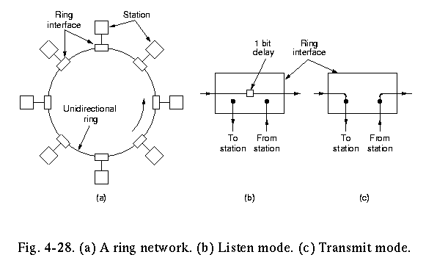
IEEE Standard 802.5 (Token Ring)
(not in must-study material)
Motivation: instead of complicated token-bus, have a physical ring
Principle: Each bit arriving at an interface is copied into a 1-bit buffer (inspected and/or modified); then copied out to the ring again.
  copying step introduces a 1-bit delay at each interface.

Slide 39
Token Ring operation
to transmit a frame, a station is required to seize the token and remove it from the ring before transmitting.
bits that have propagated around the ring are removed from the ring by the sender (the receiver in FDDI).
After a station has finished transmitting the last bit of its frame, it must regenerate the token.

Slide 40
IEEE 802.5 Ring: Maintenance
(not in must-study material)
Centralised: a “monitor” station oversees the ring:
generates token when lost
cleans the ring when garbled/orphan frames appear
If the monitor goes away, a convention protocol ensures that another station is elected as a monitor (e.g. the one with highest identity)
If the monitor gets ”mad”, though…..

Slide 41
IEEE 802.5 Ring: Priority Algorithm
(not in must-study material)
Station S
upon arrival of frame f:
  set prior(f) := max{prior(f), prior(S)}
  forward(f)
upon arrival of T
  if prior(T)>prior(S) then forward(T)
  else send own frame f with prior(f):=0
    wait until f comes back
    prior(T):=prior(f)
    forward(T)

Slide 42
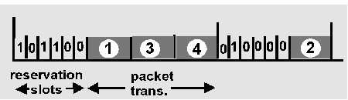
Reservation-based protocols
Distributed Polling – Bit-map protocol:
time divided into slots
begins with N short reservation slots
  station with message to send posts reservation during its slot
  reservation seen by all stations
  reservation slot time equal to channel end-end propagation delay (why?)
after reservation slots, message transmissions ordered by known priority

Slide 43
Summary of MAC protocols
What do you do with a shared media?
  Channel Partitioning, by time, frequency or code
    Time Division, Frequency Division
  Random partitioning (dynamic),
    ALOHA, S-ALOHA, CSMA, CSMA/CD
    carrier sensing: easy in some technologies (wire), hard in others (wireless)
    CSMA/CD used in Ethernet
    CSMA/CA used in 802.11
  Taking Turns
    polling, token passing
    Bluetooth, FDDI, IBM Token Ring

Slide 44
Link Layer
5.1 Introduction and services
Framing
5.2 Error detection and correction
5.3Multiple access protocols
LAN technology
5.5 Ethernet
5.6 Interconnection
5.4 Link-Layer Addressing
5.7 PPP
5.9 A day in the life of a web request
(5.8 Link Virtualization: ATM and MPLS)

Slide 45
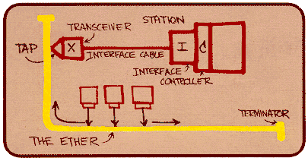
Ethernet
“dominant” wired LAN technology:
cheap $20 for 100Mbs!
first widely used LAN technology
Simpler, cheaper than token LANs and ATM
Kept up with speed race: 10 Mbps – 10 Gbps
Metcalfe’s Ethernet
sketch

Slide 46
Ethernet: uses CSMA/CD
A: sense channel, if idle
  then {
  transmit and monitor the channel;
      If detect another transmission
      then {
      abort and send jam signal;
        update # collisions;
        delay as required by exponential backoff algorithm;
        goto A
        }
      else {done with the frame; set collisions to zero}
    }
  else {wait until ongoing transmission is over and goto A}

Slide 47
Ethernet’s CSMA/CD (more)
Jam Signal: make sure all other transmitters are aware of collision; 48 bits;
Exponential Backoff:
Goal: adapt retransmission attempts to estimated current load
  heavy load: random wait will be longer
first collision: choose K from {0,1}
  (delay is K x frame-transmission time)
after m (<10) collisions: choose K from {0,…, 2^m}…
after ten or more collisions, choose K from {0,1,2,3,4,…,1023}

Slide 48
Ethernet (CSMA/CD) Limitation
Recall: collision detection interval = 2*Propagation delay along the LAN
This implies a minimum frame size and/or a maximum wire length
Critical factor:
  a = 2 * propagation_delay /frame_transmission_delay

Slide 49
Star topology
bus topology popular through mid 90s
  all nodes in same collision domain (can collide with each other)
today: star topology prevails (more bps, shorter distances)
  Hub or active switch in center
  (more in a while)
switch
bus: coaxial cable
star

Slide 50
CSMA/CD efficiency
T_{prop} = max prop between 2 nodes in LAN
t_{trans} = time to transmit max-size frame
Much better than ALOHA, but still decentralized, simple, and cheap

Slide 51

Ethernet Frame Structure
Sending adapter encapsulates IP datagram (or other network layer protocol packet) in Ethernet frame
Preamble: 7 bytes with pattern 10101010 followed by one byte with pattern 10101011
  to synchronize receiver, sender clock rates
Addresses: 6 bytes, frame is received by all adapters on a LAN and dropped if address does not match
Type: indicates the higher layer protocol, mostly IP but others may be supported (such as Novell IPX and AppleTalk)
CRC: checked at receiver, if error is detected, the frame is simply dropped

Slide 52
802.3 Ethernet Standards: Link & Physical Layers
many different Ethernet standards
  common MAC protocol and frame format
  different speeds: 2 Mbps, 10 Mbps, 100 Mbps, 1Gbps, 10G bps
  different physical layer media: fiber, cable
application
transport
network
link
physical
MAC protocol
and frame format
100BASE-TX
100BASE-T2
100BASE-FX
100BASE-T4
100BASE-SX
100BASE-BX
copper (twister
pair) physical layer
fiber physical layer

Slide 53
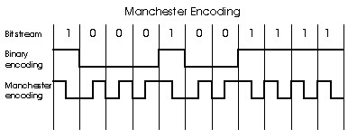
Manchester encoding
Used in 10BaseT
Each bit has a transition
Allows clocks in sending and receiving nodes to synchronize to each other
  no need for a centralized, global clock among nodes!
Hey, this is physical-layer stuff!

Slide 54
Ethernet: Unreliable, connectionless
connectionless: No handshaking between sending and receiving NICs
unreliable: receiving NIC doesn’t send acks or nacks to sending NIC
  stream of datagrams passed to network layer can have gaps (missing datagrams)
  gaps will be filled if app is using TCP
  otherwise, app will see gaps

Slide 55
Link Layer
5.1 Introduction and services
Framing
5.2 Error detection and correction
5.3Multiple access protocols
LAN technology
5.5 Ethernet
5.6 Interconnection
5.4 Link-Layer Addressing
5.7 PPP
5.9 A day in the life of a web request
(5.8 Link Virtualization: ATM and MPLS)

Slide 56
Interconnecting with hubs
Hubs are essentially physical-layer repeaters:
  bits coming from one link go out all other links
  at the same rate (no frame buffering)
no CSMA/CD at hub: adapters detect collisions (one large collision domain)
provides net management functionality (monitoring, statistics)
Extends distance between nodes
Can’t interconnect e.g. 10BaseT & 100BaseT
hub
hub
hub
hub

Slide 57
Switch: allows multiple simultaneous transmissions
A
hosts may have dedicated, direct connection to switch
switches buffer packets
Ethernet protocol used on each incoming link, but no collisions; full duplex
  each link is its own collision domain
switching: A-to-A’ and B-to-B’ simultaneously, without collisions
  not possible with dumb hub
C’
B
1
2
6
3
5
4
C
B’
A’
switch with six interfaces
(1,2,3,4,5,6)

Slide 58
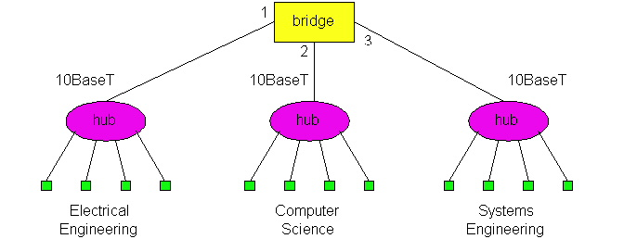
Switches (bridges): cont.
Link Layer devices: operate on frames, examining header and selectively forwarding frame based on its destination
  filtering: same-LAN-segment frames not forwarded to other seg’s
Advantages:
  Isolates collision domains:
    higher total max throughput
    no limit on number of nodes nor distances
  Can connect different net-types (translational, …)
  Transparent: no need for any change to hosts LAN adapters
forwarding: how to know LAN segment on which to forward frame?
  looks like a routing problem…
switch

Slide 59
Switch: self-learning
Source: A
Dest: A’
A
A A’
switch learns which hosts can be reached through which interfaces
  when frame received, switch “learns” location of sender: incoming LAN segment
  records sender/location pair in switch table
C’
B
1
2
6
3
5
4
C
B’
A’
MAC addr interface TTL
A
1
60
Switch table
(initially empty)

Slide 60
Switch: frame filtering/forwarding
When frame received:
1. record link associated with sending host
2. index switch table using MAC dest address
3. if entry found for destination
then {
if dest on segment from which frame arrived
then drop the frame
else forward the frame on interface indicated
}
else flood
forward on all but the interface
on which the frame arrived

Slide 61
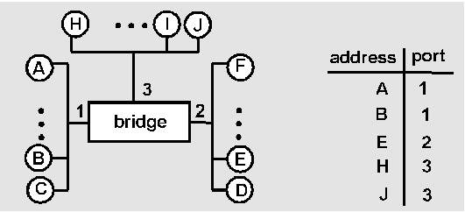
Switch Learning: example
Suppose C sends a frame to D and D replies with a frame to C
switch
C sends frame, switch has no info about D, so floods
  switch notes that C is on port 1
  frame ignored on upper LAN
  frame received by D
D generates reply to C, sends
  switch sees frame from D
  switch notes that D is on interface 2
  switch knows C on interface 1, so selectively forwards frame out via interface 1

Slide 62
Switch: traffic isolation
switch installation breaks subnet into LAN segments
switch filters packets:
  same-LAN-segment frames not usually forwarded onto other LAN segments
  segments become separate collision domains
switch
collision
domain
hub
hub
hub
collision domain
collision domain

Slide 63
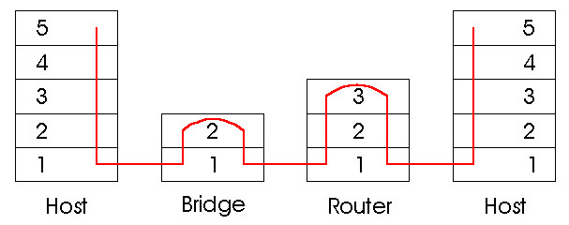
Switches vs. Routers
both store-and-forward devices
  routers: network layer devices (examine network layer headers)
  Switches (bridges) are Link Layer devices
routers maintain routing tables, implement routing algorithms
switches maintain filtering tables, implement filtering, learning (and spanning tree) algorithms
Switch

Slide 64
Routers vs. Bridges/Switches
Bridges/Switches
+ Bridge operation is simpler requiring less processing bandwidth
- Topologies are restricted with bridges (a spanning tree must be built to avoid cycle)
- Bridges do not offer protection from broadcast storms (endless broadcasting by a host will be forwarded by a bridge)
Routers
+ arbitrary topologies can be supported, cycling is limited by good routing protocols
+ provide firewall protection against broadcast storms
- require detailed configuration (not plug and play) and higher processing capacity
Bridges/switches do well in small (few hundred hosts) while
routers used in large networks (thousands of hosts)

Slide 65
Summary comparison

Slide 66
Institutional network
mail server
to external
network
router
web server
IP subnet

Slide 67
VLANs: motivation
What’s “wrong” with this picture?
What happens if:
CS user moves office to EE, but wants connect to CS switch?
What if single broadcast domain?
  all layer-2 broadcast traffic crosses entire LAN (security/privacy, efficiency issues)
each lowest level switch has only few ports in use
Computer
Science
Computer
Engineering
Electrical
Engineering

Slide 68

VLANs
Port-based VLAN: switch ports grouped (by switch management software) so that single physical switch ……
Virtual Local
Area Network
1
7
9
15
2
8
10
16
…
…
Switch(es) supporting VLAN capabilities can be configured to define multiple virtual LANS over single physical LAN infrastructure.
Electrical Engineering
(VLAN ports 1-8)
Computer Science
(VLAN ports 9-15)
… operates as multiple virtual switches
1
7
9
15
2
8
10
16
…
…
Electrical Engineering
(VLAN ports 1-8)
Computer Science
(VLAN ports 9-16)

Slide 69
Port-based VLAN:
router
traffic isolation: frames to/from ports 1-8 can only reach ports 1-8
  can also define VLAN based on MAC addresses of endpoints, rather than switch port
1
7
9
15
2
8
10
16
dynamic membership: ports can be dynamically (by the administrator) assigned among VLANs
…
…
Electrical Engineering
(VLAN ports 1-8)
Computer Science
(VLAN ports 9-15)
forwarding between VLANS: done via routing (just as with separate switches)
  in practice vendors sell combined switches plus routers

Slide 70
VLANS spanning multiple switches
1
7
9
15
1
3
5
7
2
8
10
16
2
4
6
8
…
…
Electrical Engineering
(VLAN ports 1-8)
Computer Science
(VLAN ports 9-15)
Ports 2,3,5 belong to EE VLAN
Ports 4,6,7,8 belong to CS VLAN
trunk port: carries frames between VLANS defined over multiple physical switches
  frames forwarded within VLAN between switches can’t be vanilla 802.1 frames (must carry VLAN ID info)
  802.1q protocol adds/removed additional header fields for frames forwarded between trunk ports

Slide 71


802.1Q VLAN frame format
Type
802.1 frame
802.1Q frame
2-byte Tag Protocol Identifier
(value: 81-00)
Recomputed
CRC
Tag Control Information (12 bit VLAN ID field,
3 bit priority field like IP TOS)

Slide 72
Link Layer
5.1 Introduction and services
Framing
5.2 Error detection and correction
5.3Multiple access protocols
LAN technology
5.5 Ethernet
5.6 Interconnection
5.4 Link-Layer Addressing
5.7 PPP
5.9 A day in the life of a web request
(5.8 Link Virtualization: ATM and MPLS)

Slide 73
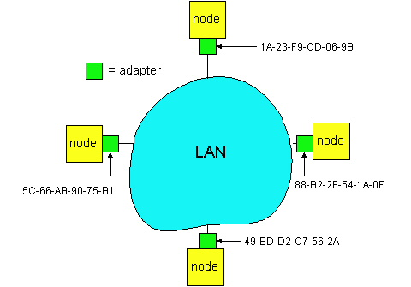
LAN Addresses
32-bit IP address:
network-layer address
used to get datagram to destination network (recall IP network definition)
LAN (or MAC or physical) address:
to get datagram from
  one interface to another
  physically-connected
  interface (same network)
48 bit MAC address
  (for most LANs)
  burned in NIC’s ROM
  (sometimes resettable)
Broadcast address =
FF-FF-FF-FF-FF-FF

Slide 74
LAN Address (more)
MAC address allocation administered by IEEE
manufacturer buys portion of MAC address space (to assure uniqueness)
Analogy:
(a) MAC address: like People’s Names or PersonalNum’s
(b) IP address: like postal address
MAC flat address => portability
  can move LAN card from one LAN to another
IP hierarchical address NOT portable
  depends on network to which one attaches

Slide 75
Recall earlier routing discussion
Starting at A, given IP datagram addressed to B:
look up net. address of B, find B on same net. as A
link layer send datagram to B inside link-layer frame
A
223.1.1.1
223.1.2.1
223.1.1.2
223.1.1.4
223.1.2.9
B
223.1.2.2
E
223.1.1.3
223.1.3.27
223.1.3.1
223.1.3.2
frame source,
dest address
datagram source,
dest address
A’s MAC
addr
B’s MAC
addr
A’s IP
addr
B’s IP
addr
IP payload
datagram
frame

Slide 76
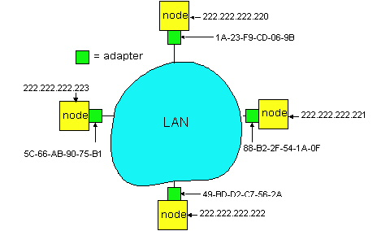
ARP: Address Resolution Protocol
Each IP node (Host, Router) on LAN has ARP module, table
  ARP Table: IP/MAC address mappings
    < IP address; MAC address; TTL>
  < ………………………….. >
    TTL (Time To Live): time to cache (typically 20 min); afterwards:
  A broadcasts ARP query pkt, containing B's IP address
  B receives ARP packet, replies to A with its (B's) physical layer address
  A caches (saves) IP-to-physical address pairs until they time out
    soft state: information that times out (goes away) unless refreshed
Question: how to determine
MAC address of B
given B’s IP address?
Broadcast address =
FF-FF-FF-FF-FF-FF

Slide 77
Addressing: routing to another LAN
walkthrough: send datagram from A to B via R
assume A knows B’s IP address
two ARP tables in router R, one for each IP network (LAN)
74-29-9C-E8-FF-55
88-B2-2F-54-1A-0F
A
E6-E9-00-17-BB-4B
222.222.222.221
111.111.111.111
1A-23-F9-CD-06-9B
222.222.222.220
222.222.222.222
111.111.111.110
B
111.111.111.112
R
49-BD-D2-C7-56-2A
CC-49-DE-D0-AB-7D

Slide 78
A creates IP datagram with source A, destination B
A uses ARP to get R’s MAC address for 111.111.111.110
A creates link-layer frame with R's MAC address as dest, frame contains A-to-B IP datagram
A’s NIC sends frame
R’s NIC receives frame
R removes IP datagram from Ethernet frame, sees its destined to B
R uses ARP to get B’s MAC address
R creates frame containing A-to-B IP datagram; sends to B
This is a really important
example – make sure you
understand!
74-29-9C-E8-FF-55
88-B2-2F-54-1A-0F
A
E6-E9-00-17-BB-4B
222.222.222.221
111.111.111.111
1A-23-F9-CD-06-9B
222.222.222.220
222.222.222.222
111.111.111.110
B
111.111.111.112
R
49-BD-D2-C7-56-2A
CC-49-DE-D0-AB-7D

Slide 79
Link Layer
5.1 Introduction and services
Framing
5.2 Error detection and correction
5.3Multiple access protocols
LAN technology
5.5 Ethernet
5.6 Interconnection
5.4 Link-Layer Addressing
5.7 PPP
5.9 A day in the life of a web request
(5.8 Link Virtualization: ATM and MPLS)

Slide 80
Point to Point Data Link Control
one sender, one receiver, one link: easier than broadcast link:
  no Media Access Control
  no need for explicit MAC addressing
  e.g., dialup link, ISDN line
popular point-to-point DLC protocols:
  PPP (point-to-point protocol)
  HDLC: High level data link control

Slide 81
PPP Design Requirements [RFC 1557]
packet framing: encapsulation of network-layer datagram in data link frame
carry network layer data of any network layer protocol (not just IP)
error detection (no correction)
connection liveness: detect, signal link failure to network layer
network layer address negotiation: endpoint can learn/configure each other’s network address

Slide 82
PPP non-requirements
no error correction/recovery
no flow control
“out of order” delivery OK
Error recovery, flow control, data re-ordering
all relegated to higher layers!

Slide 83
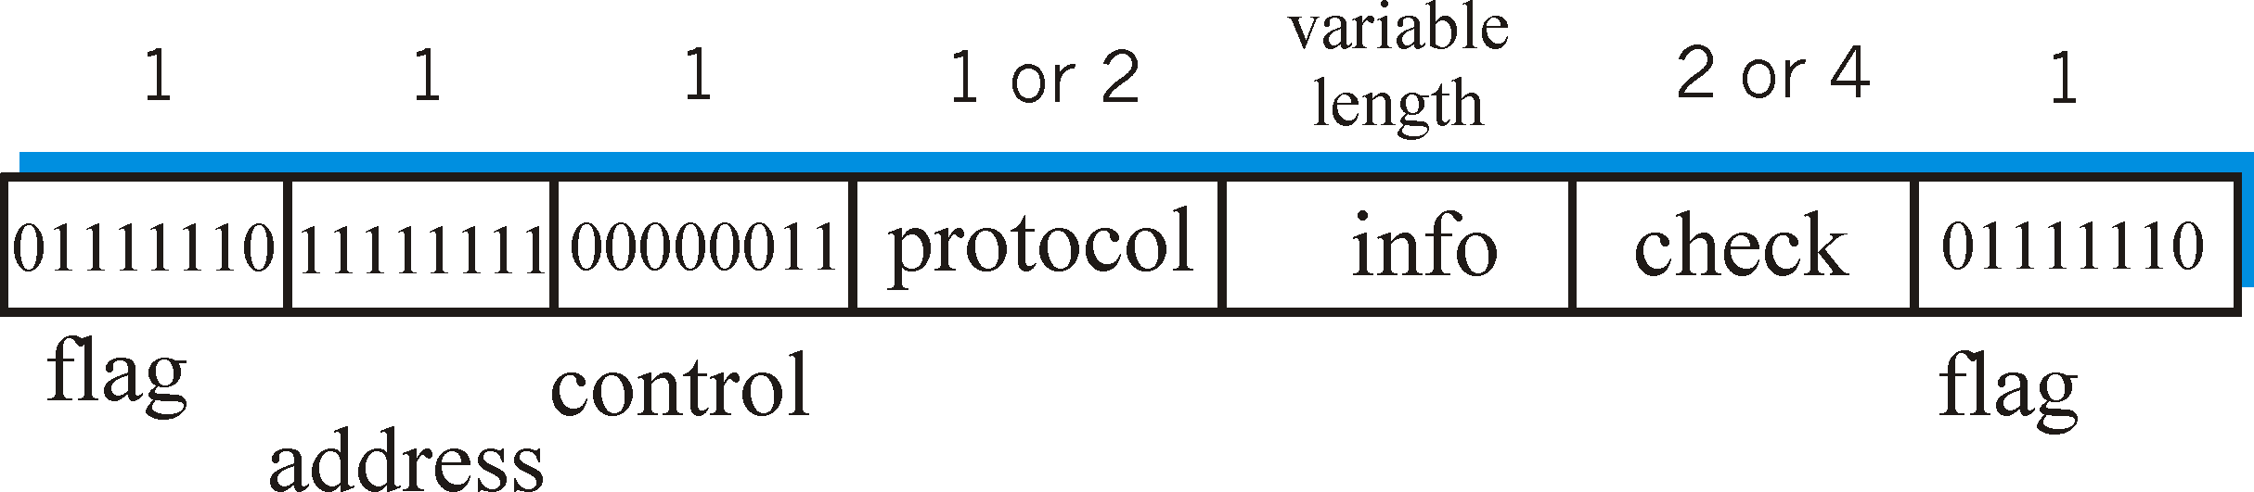
PPP Data Frame
Flag: delimiter (framing; hence “stuffing” in payload)
Address: does nothing (only one option)
Control: does nothing; in the future possible multiple control fields
Protocol: upper layer protocol to which frame delivered (eg, PPP-LCP, IP, IPCP, etc)
info: upper layer data being carried
check: cyclic redundancy check for error detection

Slide 84
Framing method: Byte Stuffing
“data transparency” requirement: data field must be allowed to include flag pattern <01111110>
  Q: is received <01111110> data or flag?
Sender: adds (“stuffs”) extra < 01111110> byte after each < 01111110> data byte
Receiver:
  two 01111110 bytes in a row: discard first byte, continue data reception
  single 01111110: flag byte

Slide 85
Byte Stuffing
flag byte
pattern
in data
to send
flag byte pattern plus
stuffed byte in transmitted data

Slide 86
Link Layer
5.1 Introduction and services
Framing
5.2 Error detection and correction
5.3Multiple access protocols
LAN technology
5.5 Ethernet
5.6 Interconnection
5.4 Link-Layer Addressing
5.7 PPP
5.9 A day in the life of a web request
(5.8 Link Virtualization: ATM and MPLS)

Slide 87
Synthesis: a day in the life of a web request
journey down protocol stack complete!
  application, transport, network, link
putting-it-all-together: synthesis!
  goal: identify, review, understand protocols (at all layers) involved in seemingly simple scenario: requesting www page
  scenario: student attaches laptop to campus network, requests/receives www.google.com

Slide 88

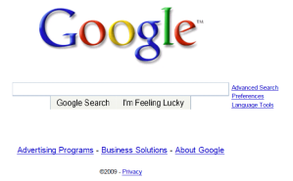
A day in the life: scenario
browser
DNS server
Comcast network
68.80.0.0/13
school network
68.80.2.0/24
web page
web server
Google’s network
64.233.160.0/19
64.233.169.105

Slide 89
A day in the life… connecting to the Internet
DHCP
DHCP
UDP
IP
Eth
Phy
connecting laptop needs to get its own IP address, addr of first-hop router, addr of DNS server: use DHCP
DHCP
DHCP
DHCP
DHCP
DHCP request encapsulated in UDP, encapsulated in IP, encapsulated in 802.1 Ethernet
DHCP
DHCP
UDP
IP
Eth
Phy
DHCP
DHCP
DHCP
DHCP
router
(runs DHCP)
Ethernet frame broadcast (dest: FFFFFFFFFFFF) on LAN, received at router running DHCP server
Ethernet demux’ed to IP demux’ed, UDP demux’ed to DHCP

Slide 90
A day in the life… connecting to the Internet
DHCP
DHCP
UDP
IP
Eth
Phy
DHCP server formulates DHCP ACK containing client’s IP address, IP address of first-hop router for client, name & IP address of DNS server
DHCP
DHCP
DHCP
encapsulation at DHCP server, frame forwarded (switch learning) through LAN, demultiplexing at client
DHCP
DHCP
UDP
IP
Eth
Phy
DHCP
DHCP
DHCP
router
(runs DHCP)
DHCP client receives DHCP ACK reply
DHCP
Client now has IP address, knows name & addr of DNS
server, IP address of its first-hop router

Slide 91
A day in the life… ARP (before DNS, before HTTP)
DNS
UDP
IP
Eth
Phy
before sending HTTP request, need IP address of www.google.com: DNS
DNS
DNS
DNS
ARP
ARP query
DNS query created, encapsulated in UDP, encapsulated in IP, encasulated in Eth. In order to send frame to router, need MAC address of router interface: ARP
ARP
ARP reply
Eth
Phy
ARP query broadcast, received by router, which replies with ARP reply giving MAC address of router interface
client now knows MAC address of first hop router, so can now send frame containing DNS query

Slide 92
A day in the life… using DNS
DNS
UDP
IP
Eth
Phy
DNS
DNS server
DNS
UDP
IP
Eth
Phy
DNS
DNS
DNS
DNS
DNS
DNS
DNS
DNS
Comcast network
68.80.0.0/13
IP datagram forwarded from campus network into comcast network, routed (tables created by RIP, OSPF and BGP routing protocols) to DNS server
IP datagram containing DNS query forwarded via LAN switch from client to 1st hop router
demux’ed to DNS server
DNS server replies to client with IP address of www.google.com

Slide 93
A day in the life… TCP connection carrying HTTP
HTTP
HTTP
TCP
IP
Eth
Phy
SYNACK
SYN
SYNACK
SYN
SYNACK
SYN
SYN
to send HTTP request, client first opens TCP socket to web server
TCP SYN segment (step 1 in 3-way handshake) inter-domain routed to web server
TCP
IP
Eth
Phy
SYNACK
SYN
SYNACK
SYN
SYNACK
SYNACK
SYN
web server responds with TCP SYNACK (step 2 in 3-way handshake)
web server
64.233.169.105
TCP connection established!

Slide 94
A day in the life… HTTP request/reply
web page finally (!!!) displayed
HTTP
HTTP
TCP
IP
Eth
Phy
HTTP
HTTP
HTTP
HTTP
HTTP
HTTP
HTTP
HTTP
HTTP request sent into TCP socket
IP datagram containing HTTP request routed to www.google.com
HTTP
HTTP
TCP
IP
Eth
Phy
HTTP
HTTP
HTTP
web server responds with HTTP reply (containing web page)
HTTP
web server
64.233.169.105
IP datgram containing HTTP reply routed back to client

Slide 95
Link Layer
5.1 Introduction and services
Framing
5.2 Error detection and correction
5.3Multiple access protocols
LAN technology
5.5 Ethernet
5.6 Interconnection
5.4 Link-Layer Addressing
5.7 PPP
5.9 A day in the life of a web request
(5.8 Link Virtualization: ATM and MPLS)

Slide 96
The Internet: virtualizing networks
1974: multiple unconnected nets
  ARPAnet
  data-over-cable networks
  packet satellite network (Aloha)
  packet radio network
… differing in:
  addressing conventions
  packet formats
  error recovery
  routing
ARPAnet
satellite net
"A Protocol for Packet Network Intercommunication",
V. Cerf, R. Kahn, IEEE Transactions on Communications,
May, 1974, pp. 637-648.

Slide 97
The Internet: virtualizing networks
Internetwork layer (IP):
addressing: internetwork appears as single, uniform entity, despite underlying local network heterogeneity
network of networks
Gateway:
“embed internetwork packets in local packet format or extract them”
route (at internetwork level) to next gateway
gateway
ARPAnet
satellite net

Slide 98
Cerf & Kahn’s Internetwork Architecture
What is virtualized?
two layers of addressing: internetwork and local network
new layer (IP) makes everything homogeneous at internetwork layer
underlying local network technology
  cable
  satellite
  56K telephone modem
  today: ATM, MPLS
… “invisible” at internetwork layer. Looks like a link layer technology to IP!

Slide 99
ATM and MPLS
ATM, MPLS separate networks in their own right
  different service models, addressing, routing from Internet
viewed by Internet as logical link connecting IP routers
  just like dialup link is really part of separate network (telephone network)
ATM, MPLS: of technical interest in their own right

Slide 100
On ATM: Asynchronous Transfer Mode nets
1980’s telco’s proposal for future networking
Smart core, simple terminals
small (48 byte payload, 5 byte header) fixed length cells (like packets)
  fast switching (pipelined/cut-through)
  small size good for voice
virtual-circuit network: switches maintain state for each “call”
well-defined interface between “network” and “user” (think of telephone company):
  several transport (Adaptation)-layer protocols, one per expected type of traffic

Slide 101
IP-Over-ATM
IP over ATM
replace “network” (e.g., LAN segment) with ATM network
ATM addresses, IP addresses
Classic IP only
3 “networks” (e.g., LAN segments)
MAC (802.3) and IP addresses
ATM
network
Ethernet
LANs
Ethernet
LANs

Slide 102
IP-Over-ATM
app
transport
IP
AAL
ATM
phy
app
transport
IP
Eth
phy
IP
AAL
ATM
phy
Eth
ATM
phy
phy
ATM
phy

Slide 103
Datagram Journey in IP-over-ATM Network
at Source Host:
  IP layer maps between IP, ATM dest address (using ARP)
  passes datagram to AAL5
  AAL5 encapsulates data, segments cells, passes to ATM layer
ATM network: moves cell along VC to destination
at Destination Host:
  AAL5 reassembles cells into original datagram
  if CRC OK, datagram is passed to IP

Slide 104
IP-Over-ATM
Issues:
IP datagrams into ATM AAL5 PDUs
from IP addresses to ATM addresses
  just like IP addresses to 802.3 MAC addresses!
ATM
network
Ethernet
LANs

Slide 105
Multiprotocol label switching (MPLS)
initial goal: speed up IP forwarding by using fixed length label (instead of IP address) to do forwarding
  borrowing ideas from Virtual Circuit (VC) approach
  but IP datagram still keeps IP address!
PPP or Ethernet
header
IP header
remainder of link-layer frame
MPLS header
label
Exp
S
TTL
20
3
1
5

Slide 106
MPLS capable routers
a.k.a. label-switched router
forwards packets to outgoing interface based only on label value (don’t inspect IP address)
  MPLS forwarding table distinct from IP forwarding tables
signaling protocol needed to set up forwarding
  RSVP-TE
  forwarding possible along paths that IP alone would not allow (e.g., source-specific routing) !!
  use MPLS for traffic engineering
must co-exist with IP-only routers

Slide 107
MPLS forwarding tables
in out out
label label dest interface
10 A 0
in out out
label label dest interface
12 D 0
8 A 1
10 6 A 1
12 9 D 0
R6
0
0
D
1
1
R4
R3
R5
0
0
A
R2
in out out
label label dest interface
R1
in out out
label label dest interface
6 - A 0
8 6 A 0

Slide 108
Chapter 5: Summary
principles behind data link layer services:
  error detection, correction
  sharing a broadcast channel: multiple access
  link layer addressing
instantiation and implementation of various link layer technologies
  Ethernet
  switched LANS
  PPP
  Link Virtualization: ATM and MPLS

