Slide 1
SaC – Functional Programming for HP³
Chalmers Tekniska Högskola
29.4.2016
Sven-Bodo Scholz

Slide 2
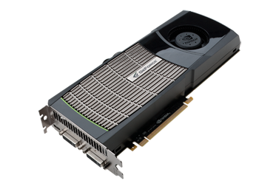
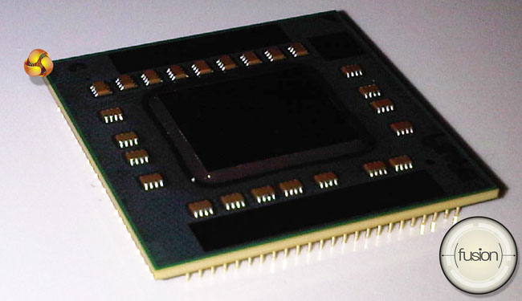
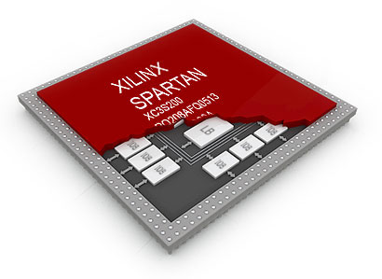
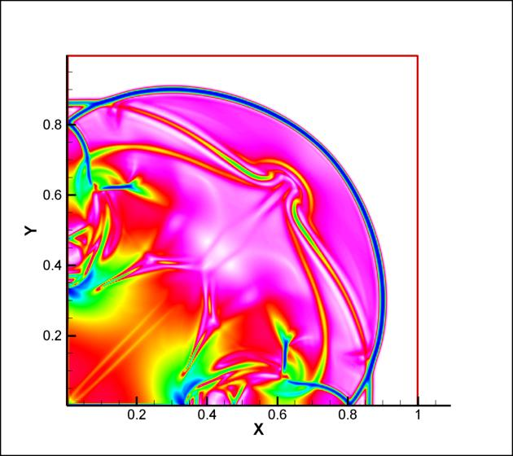

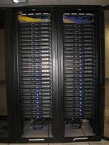
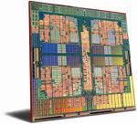
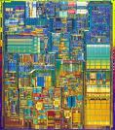
The Multicore Challenge
performance?
sustainability?
affordability?
High Performance
High Portability
High Productivity

Slide 3
Typical Scenario
☹
VHDL
μTC
OpenCL
MPI/
OpenMP
algorithm

Slide 4

Tomorrow’s Scenario
OpenCL
VHDL
μTC
algorithm
MPI/OpenMP

Slide 5
The HP³ Vision
☺
OpenCL
compiler
VHDL
μTC
algorithm
MPI/OpenMP

Slide 6
SaC: HP³ Driven Language Design
High-Productivity
easy to learn
  C-like look and feel
easy to program
  Matlab-like style
  OO-like power
  FP-like abstractions
easy to integrate
  light-weight C interface
High-Performance
no frills
  lean language core
performance focus
  strictly controlled side-effects
  implicit memory management
concurrency apt
  data-parallelism at core
&
High-Portability
no low-level facilities
  no notion of memory
  no explicit concurrency/ parallelism
  no notion of communication

Slide 7
What is Data-Parallelism?
Formulate algorithms in space rather than time!
prod = prod( iota( 10)+1)
prod = 1;
for( i=1; i<=10; i++) {
prod = prod*i;
}

Slide 8
Why is Space Better than Time?

Slide 9
Another Example: Fibonacci Numbers
if( n<=1)
return n;
} else {
return fib( n-1) + fib( n-2);
}

Slide 10
Another Example: Fibonacci Numbers
if( n<=1)
return n;
} else {
return fib( n-1) + fib( n-2);
}

Slide 11
Fibonacci Numbers – now linearised!
if( n== 0)
return fst;
else
return fib( snd, fst+snd, n-1)

Slide 12
Fibonacci Numbers – now data-parallel!
matprod( genarray( [n], [[1, 1], [1, 0]])) [0,0]

Slide 13
Everything is an Array
Think Arrays!
Vectors are arrays.
Matrices are arrays.
Tensors are arrays.
........ are arrays.

Slide 14
Everything is an Array
Think Arrays!
Vectors are arrays.
Matrices are arrays.
Tensors are arrays.
........ are arrays.
Even scalars are arrays.
Any operation maps arrays to arrays.
Even iteration spaces are arrays

Slide 15
Multi-Dimensional Arrays

Slide 16
Index-Free Combinator-Style Computations
sqrt( sum( square( A)))
L2 norm:
Convolution step:
Convergence test:
W1 * shift(-1, A) + W2 * A + W1 * shift( 1, A)
all( abs( A-B) < eps)

Slide 17
Shape-Invariant Programming
l2norm( [1,2,3,4] )
sqrt( sum( sqr( [1,2,3,4])))
sqrt( sum( [1,4,9,16]))
sqrt( 30)
5.4772

Slide 18
Shape-Invariant Programming
l2norm( [[1,2],[3,4]] )
sqrt( sum( sqr( [[1,2],[3,4]])))
sqrt( sum( [[1,4],[9,16]]))
sqrt( [5,25])
[2.2361, 5]

Slide 19
Where do these Operations Come from?
double l2norm( double[*] A)
{
return( sqrt( sum( square( A)));
}
double square( double A)
{
return( A*A);
}

Slide 20
Where do these Operations Come from?
double square( double A)
{
return( A*A);
}
double[+] square( double[+] A)
{
res = with {
(. <= iv <= .) : square( A[iv]);
} : modarray( A);
return( res);
}

Slide 21
With-Loops
with {
([0,0] <= iv < [3,4]) : square( iv[0]);
} : genarray( [3,4], 42);
[0,0] | [0,1] | [0,2] | [0,3]
[1,0] | [1,1] | [1,2] | [1,3]
[2,0] | [2,1] | [2,2] | [2,3]
0 | 0 | 0 | 0
1 | 1 | 1 | 1
4 | 4 | 4 | 4
indices
values

Slide 22
With-Loops
with {
([0,0] <= iv <= [1,1]) : square( iv[0]);
([0,2] <= iv <= [1,3]) : 42;
([2,0] <= iv <= [2,2]) : 0;
} : genarray( [3,4], 21);
[0,0] | [0,1] | [0,2] | [0,3]
[1,0] | [1,1] | [1,2] | [1,3]
[2,0] | [2,1] | [2,2] | [2,3]
0 | 0 | 42 | 42
1 | 1 | 42 | 42
0 | 0 | 0 | 21
indices
values

Slide 23
With-Loops
with {
([0,0] <= iv <= [1,1]) : square( iv[0]);
([0,2] <= iv <= [1,3]) : 42;
([2,0] <= iv <= [2,3]) : 0;
} : fold( +, 0);
[0,0] | [0,1] | [0,2] | [0,3]
[1,0] | [1,1] | [1,2] | [1,3]
[2,0] | [2,1] | [2,2] | [2,3]
map
0 | 0 | 42 | 42
1 | 1 | 42 | 42
0 | 0 | 0 | 0
reduce
170
indices
values

Slide 24
Set-Notation and With-Loops
{ iv -> a[iv] + 1}
with {
( 0*shape(a) <= iv < shape(a)) : a[iv] + 1;
} : genarray( shape( a), zero(a))

Slide 25
Observation
most operations boil down to With-loops
With-Loops are the source of concurrency

Slide 26
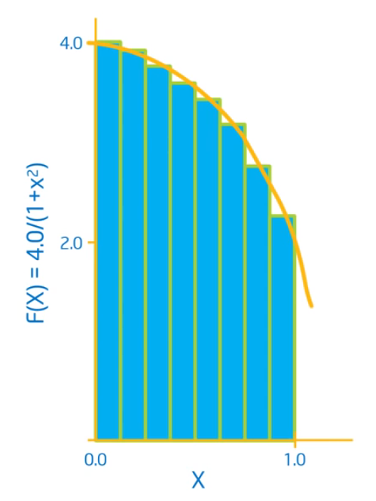
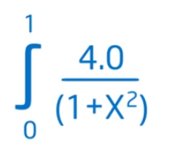
Computation of π

Slide 27
Computation of π
double f( double x)
{
return 4.0 / (1.0+x*x);
}
int main()
{
num_steps = 10000;
step_size = 1.0 / tod( num_steps);
x = (0.5 + tod( iota( num_steps))) * step_size;
y = { iv-> f( x[iv])};
pi = sum( step_size * y);
printf( " ...and pi is: %f\n", pi);
return(0);
}

Slide 28
Example: Matrix Multiply

Slide 29
Example: Relaxation
/ 8d

Slide 30
Programming in a Data-Parallel Style - Consequences
much less error-prone indexing!
combinator style
increased reuse
better maintenance
easier to optimise
huge exposure of concurrency!

Slide 31
What not How (1)
re-computation not considered harmful!
a = potential( firstDerivative(x));
a = kinetic( firstDerivative(x));

Slide 32
What not How (1)
re-computation not considered harmful!
a = potential( firstDerivative(x));
a = kinetic( firstDerivative(x));
compiler
tmp = firstDerivative(x);
a = potential( tmp);
a = kinetic( tmp);

Slide 33
What not How (2)
variable declaration not required!
int main()
{
istep = 0;
nstop = istep;
x, y = init_grid();
u = init_solv (x, y);
...

Slide 34
What not How (2)
variable declaration not required, ...
but sometimes useful!
int main()
{
double[ 256] x,y;
istep = 0;
nstop = istep;
x, y = init_grid();
u = init_solv (x, y);
...
acts like an assertion here!

Slide 35
What not How (3)
data structures do not imply memory layout
a = [1,2,3,4];
b = genarray( [1024], 0.0);
c = stencilOperation( a);
d = stencilOperation( b);

Slide 36
What not How (3)
data structures do not imply memory layout
could be implemented by:
int a0 = 1;
int a1 = 2;
int a2 = 3;
int a3 = 4;
a = [1,2,3,4];
b = genarray( [1024], 0.0);
c = stencilOperation( a);
d = stencilOperation( b);

Slide 37
What not How (3)
data structures do not imply memory layout
or by:
int a[4] = {1,2,3,4};
a = [1,2,3,4];
b = genarray( [1024], 0.0);
c = stencilOperation( a);
d = stencilOperation( b);

Slide 38
What not How (3)
data structures do not imply memory layout
or by:
adesc_t a = malloc(...)
a->data = malloc(...)
a->data[0] = 1;
a->desc[1] = 2;
a->desc[2] = 3;
a->desc[3] = 4;
a = [1,2,3,4];
b = genarray( [1024], 0.0);
c = stencilOperation( a);
d = stencilOperation( b);

Slide 39
What not How (4)
data modification does not imply in-place operation!
a = [1,2,3,4];
b = modarray( a, [0], 5);
c = modarray( a, [1], 6);
1 | 2 | 3 | 4
copy
copy or update
5 | 2 | 3 | 4
1 | 6 | 3 | 4

Slide 40
What not How (5)
truely implicit memory management
qpt = transpose( qp);
deriv = dfDxBoundary( qpt);
qp = transpose( deriv);
≡
qp = transpose( dfDxNoBoundary( transpose( qp), DX));

Slide 41
Challenge: Memory Management: What does the λ-calculus teach us?
conceptual copies
f( a, b , c)
f( a, b ,c )
{
... a..... a....b.....b....c...
}

Slide 42
How do we implement this? – the scalar case
conceptual copies
f( a, b , c)
f( a, b ,c )
{
... a..... a....b.....b....c...
}
operation | implementation
read | read from stack
funcall | push copy on stack

Slide 43
How do we implement this? – the non-scalar case naive approach
conceptual copies
f( a, b , c)
f( a, b ,c )
{
... a..... a....b.....b....c...
}
operation | non-delayed copy
read | O(1) + free
update | O(1)
reuse | O(1)
funcall | O(1) / O(n) + malloc

Slide 44
How do we implement this? – the non-scalar case widely adopted approach
conceptual copies
f( a, b , c)
f( a, b ,c )
{
... a..... a....b.....b....c...
}
GC
operation | delayed copy + delayed GC
read | O(1)
update | O(n) + malloc
reuse | malloc
funcall | O(1)

Slide 45
How do we implement this? – the non-scalar case reference counting approach
conceptual copies
f( a, b , c)
f( a, b ,c )
{
... a..... a....b.....b....c...
}
operation | delayed copy + non-delayed GC
read | O(1) + DEC_RC_FREE
update | O(1) / O(n) + malloc
reuse | O(1) / malloc
funcall | O(1) + INC_RC

Slide 46
How do we implement this? – the non-scalar case a comparison of approaches
operation | non-delayed copy | delayed copy + delayed GC | delayed copy + non-delayed GC
read | O(1) + free | O(1) | O(1) + DEC_RC_FREE
update | O(1) | O(n) + malloc | O(1) / O(n) + malloc
reuse | O(1) | malloc | O(1) / malloc
funcall | O(1) / O(n) + malloc | O(1) | O(1) + INC_RC

Slide 47
Avoiding Reference Counting Operations
a = [1,2,3,4];
b = a[1];
c = f( a, 1);
d= a[2];
e = f( a, 2);
clearly, we can avoid RC here!
we would like to avoid RC here!
and here!
BUT, we cannot avoid RC here!

Slide 48
NB: Why don’t we have
RC-world-domination?
1
1
2
3
3

Slide 49
Going Multi-Core
single-threaded
data-parallel
rc-op
rc-op
rc-op
rc-op
rc-op
rc-op
rc-op
rc-op
...
...
rc-op
rc-op
rc-op
rc-op
local variables do not escape!
relatively free variables can only benefit from reuse in 1/n cases!
☺
=> use thread-local heaps
=> inhibit rc-ops on rel-free vars

Slide 50
Bi-Modal RC:
fork
local
norc
join

Slide 51
SaC Tool Chain
sac2c – main compiler for generating executables; try
  sac2c –h
  sac2c –o hello_world hello_world.sac
  sac2c –t mt_pth
  sac2c –t cuda
sac4c – creates C and Fortran libraries from SaC libraries
sac2tex – creates TeX docu from SaC files

Slide 52
More Material
www.sac-home.org
  Compiler
  Tutorial
[GS06b] Clemens Grelck and Sven-Bodo Scholz. SAC: A functional array language for efficient multithreaded execution. International Journal of Parallel Programming, 34(4):383--427, 2006.
[WGH⁺12] V. Wieser, C. Grelck, P. Haslinger, J. Guo, F. Korzeniowski, R. Bernecky, B. Moser, and S.B. Scholz. Combining high productivity and high performance in image processing using Single Assignment C on multi-core CPUs and many-core GPUs. Journal of Electronic Imaging, 21(2), 2012.
[vSB⁺13] A. Šinkarovs, S.B. Scholz, R. Bernecky, R. Douma, and C. Grelck. SAC/C formulations of the all-pairs N-body problem and their performance on SMPs and GPGPUs Concurrency and Computation: Practice and Experience, 2013.

Slide 53
Outlook
There are still many challenges ahead, e.g.
  Non-array data structures
  Arrays on clusters
  Joining data and task parallelism
  Better memory management
  Application studies
  Novel Architectures
  … and many more ...
If you are interested in joining the team:
  talk to me ☺

